Slide 1
SELinux
It is all about the labels.

Slide 2

Who am I?
Open Source Advocate
Instructor
Consultant
Student, Tester, Volunteer
laubersm (twitter, freenode, fedoraproject)
sml@laubersolutions.com
https://github.com/laubersm/LauberSolutions

Slide 3







Where is SELinux

Slide 4


DAC vs MAC
My files, my rules!
POLICY RULES
$ chmod -R 777 $HOME
Security context

Slide 5
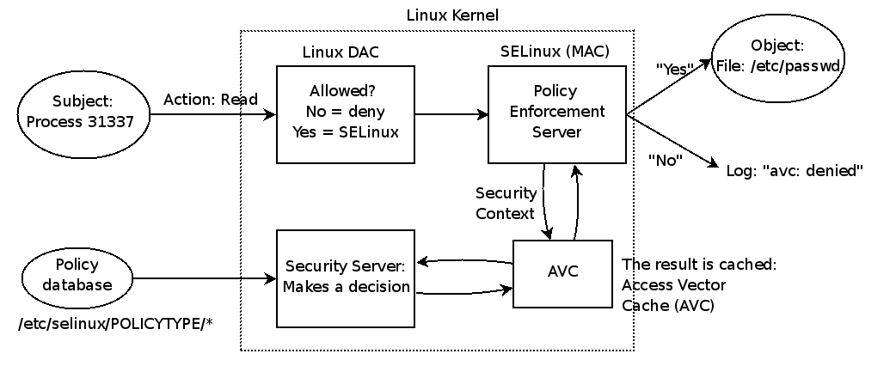
Both DAC and MAC
Source: docs.openstack.org

Slide 6
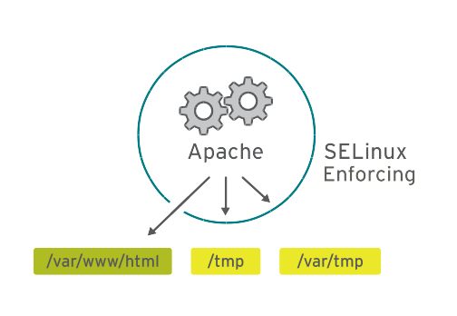
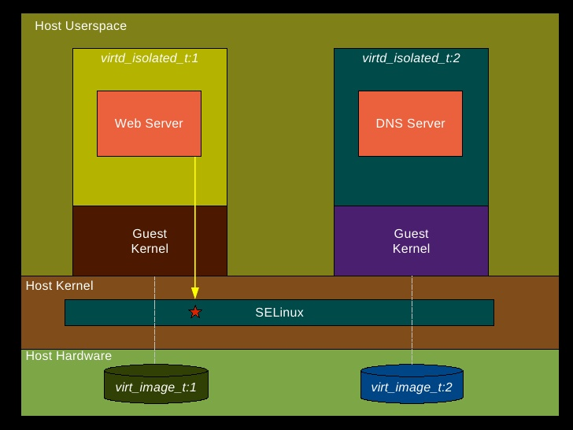



Not just “The Government”

Slide 7


Type Enforcement

Slide 8
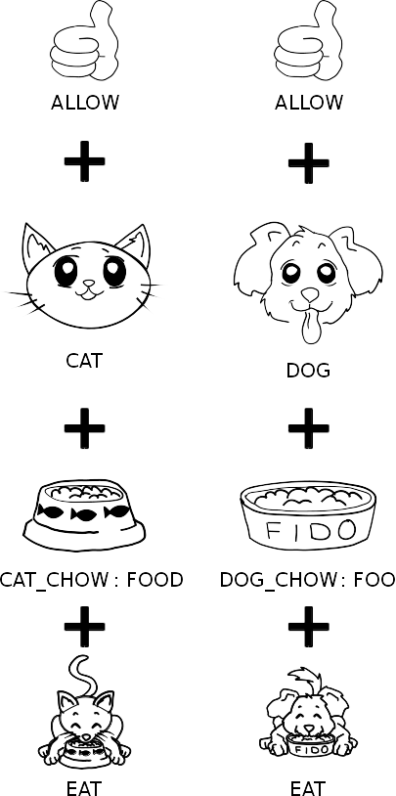

Slide 9
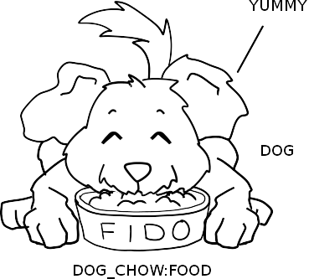
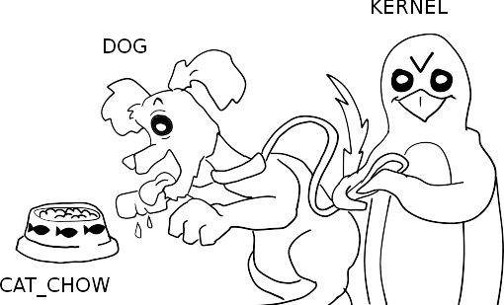
not allowed = DENIED

Slide 10
What does this look like on a system?
NOTE: These examples are from Fedora and Red Hat Enterprise Linux. Other distributions have different default policies.

Slide 11
$ sesearch --allow -s httpd_t -t httpd_sys_content_t
Found 15 semantic av rules:
allow httpd_t file_type : filesystem getattr ;
allow httpd_t file_type : dir { getattr search open } ;
allow daemon httpd_sys_content_t : dir { getattr search open } ;
allow httpd_t httpd_sys_content_t : file { ioctl read getattr lock open } ;
allow httpd_t httpd_sys_content_t : dir { ioctl read getattr lock search open } ;
allow httpd_t httpd_sys_content_t : lnk_file { read getattr } ;
allow httpd_t httpd_content_type : file { ioctl read getattr lock open } ;
allow httpd_t httpd_content_type : dir { getattr search open } ;
allow httpd_t httpd_sys_content_t : dir { ioctl read write getattr lock add_name remove_name search open } ;

Slide 12
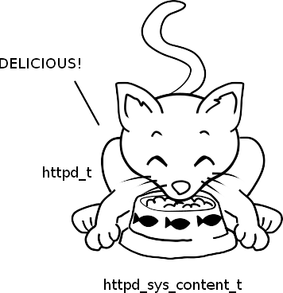
$ ps -ZU apache
LABEL PID TTY TIME CMD
system_u:system_r:httpd_t:s0 4876 ? 00:00:00 httpd
system_u:system_r:httpd_t:s0 4877 ? 00:00:00 httpd
$ ls -Z /var/www/html/
unconfined_u:object_r:httpd_sys_content_t:s0 /var/www/html/index.html

Slide 13
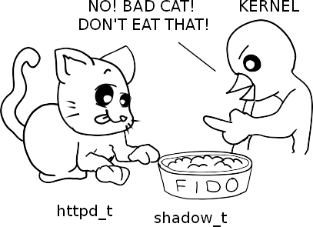
$ sesearch --allow -s httpd_t -t shadow_t
Found 2 semantic av rules:
allow httpd_t file_type : filesystem getattr ;
allow httpd_t file_type : dir { getattr search open } ;
$ ls -Z /var/www/html/
unconfined_u:object_r:httpd_sys_content_t:s0 /var/www/html/index.html
$ ls -Z /etc/shadow
system_u:object_r:shadow_t:s0 /etc/shadow

Slide 14
Wait! There's more.

Slide 15
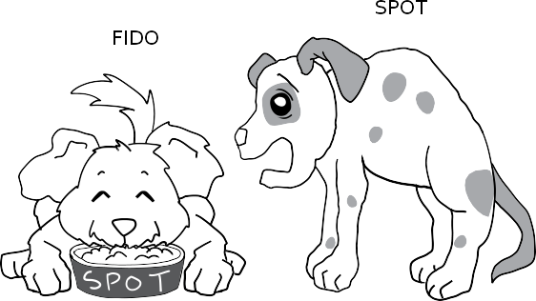
Multi Category Security (MCS)

Slide 16



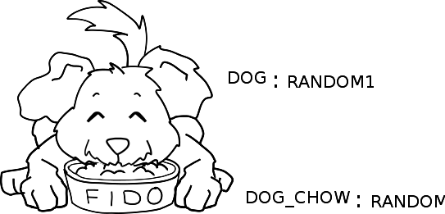

Slide 17
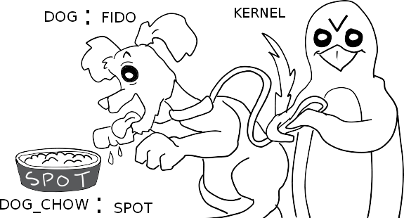

Slide 18


What does MCS look like on a system?
sandbox

Slide 19
A VM can only access its own disk
$ ps -ef -Z | grep qemu
system_u:system_r:svirt_t:s0:c189,c390 qemu 27671 1 99 17:36 ? 00:02:44 /usr/bin/qemu-system-x86_64 -machine accel=kvm -name AdminLocal … file=AdminLocal.raw ...
$ ls -Z AdminLocal.raw
system_u:object_r:svirt_image_t:s0:c189,c390 AdminLocal.raw
$ ls -Z RHcurr.img
system_u:object_r:svirt_image_t:s0:c290,c831 RHcurr.img

Slide 20
Network connections have context too!
$ ps -ef -Z | grep qemu
system_u:system_r:svirt_t:s0:c189,c390 qemu 27671 1 99 17:36 ? 00:02:44 /usr/bin/qemu-system-x86_64 -machine accel=kvm -name AdminLocal … file=AdminLocal.raw ...
# netstat -tZ | egrep '5901|5900'
tcp 0 0 127.0.0.1:5901 127.0.0.1:49865 ESTABLISHED 27671/qemu-system-x system_u:system_r:svirt_t:s0:c189,c390
tcp 0 0 127.0.0.1:5900 127.0.0.1:36699 ESTABLISHED 3672/qemu-system-x8 system_u:system_r:svirt_t:s0:c290,c831

Slide 21
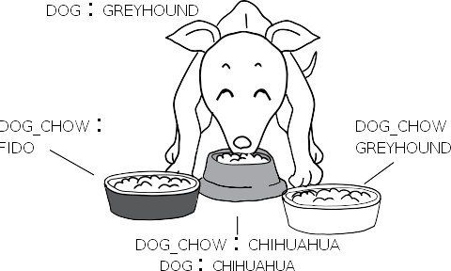

Multi Level Security (MLS)

Slide 22
Administration Scenario
Policy: default “targeted”
Content: custom location

Slide 23
Administration Scenario
Add file context for everything under /web
# semanage fcontext -a -t httpd_sys_content_t "/web(/.*)?"
# restorecon -R -v /web
OR match an existing file context.
# semanage fcontext -a -e /var/www /web
# restorecon -R -v /web
$ man semanage-fcontext

Slide 24
Administration Scenario
Policy: default “targeted”
Content: allow ftp dropbox

Slide 25
Administration Scenario
Add a read/write file-context for everything under /upload
# semanage fcontext -a -t public_content_rw_t "/upload(/.*)?"
# restorecon -R -v /upload
Enable allow rules with boolean
# semanage boolean -m --on ftpd_anon_write
$ man semanage-boolean

Slide 26
Administration Scenario
Policy: default “targeted”
Content: run service on custom port

Slide 27
Administration Scenario
Allow sshd to listen on tcp port 8991
# semanage port -a -t ssh_port_t -p tcp 8991
$ man semanage-port

Slide 28
Administration Scenario
Policy: default “targeted”
Place a particular module into permissive mode.

Slide 29
Administration Scenario
List all permissive modules
# semanage permissive -l
Make httpd_t (Web Server) a permissive domain
# semanage permissive -a httpd_t
$ man semanage-permissive

Slide 30
Logs, logs, logs (and a bit of troubleshooting)
# grep avc /var/log/audit/audit.log
type=AVC msg=audit(1439679445.509:7156): avc: denied { read } for pid=4878 comm="httpd" name="index.html" dev="dm-1" ino=57673974 scontext=system_u:system_r:httpd_t:s0 tcontext=unconfined_u:object_r:user_home_t:s0 tclass=file permissive=0

Slide 31
Got setroubleshoot?
/var/log/messages or journalctl will have a message similar to:
setroubleshoot[5564]: SELinux is preventing /usr/sbin/httpd from read access on the file index.html. For complete SELinux messages. run sealert -l ad4801f3-7f10-4191-a85f-b95d9de40ac1
python[5564]: SELinux is preventing /usr/sbin/httpd from read access on the file index.html.
***** Plugin catchall_boolean (89.3 confidence) suggests *********
If you want to allow httpd to read user content
Then you must tell SELinux about this by enabling the 'httpd_read_user_content' boolean.
Do
setsebool -P httpd_read_user_content 1

Slide 32
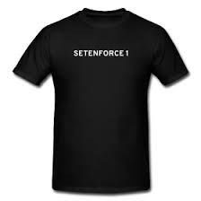
When all else fails...
# getenforce
# setenforce 0
# <test, test, test>
# setenforce 1
# man audit2allow

Slide 33



Does it really protect a system?

Slide 34
Shellshock
“SELinux does not block the exploit but it would prevent escalation of confined domains”
-Dan Walsh http://danwalsh.livejournal.com/71122.html
https://securityblog.redhat.com/2014/09/26/frequently-asked-questions-about-the-shellshock-bash-flaws/
http://cybermatters.info/2014/10/09/shellshock-selinux/ (interview with Dan)
https://blog.hqcodeshop.fi/archives/243-SElinux-and-Shellshock.html
CVE-2014-6271 and CVE-2014-7169 and CVE-2014-7186 and CVE-2014-7187

Slide 35
Vemon
“sVirt provides good anti-venom for this flaw”
-Dan Berrange (creater of libvirt)
http://danwalsh.livejournal.com/71489.html
https://securityblog.redhat.com/2015/05/13/venom-dont-get-bitten/
CVE-2015-3456

Slide 36
Svirt to the rescue is not new!
CVE-2011-1751 2011
http://danwalsh.livejournal.com/45194.html

Slide 37
PDFs, Browsers, and more
“Why we don't confine Firefox with SELinux”
By Dan Walsh http://danwalsh.livejournal.com/72697.html
CVE-2015-4495 Aug 2015
Consider sandbox tools to confine any application as needed.

Slide 38
More:
http://selinuxproject.org/page/NewUsers
https://www.nsa.gov/research/selinux/
http://oss.tresys.com/
https://github.com/TresysTechnology/refpolicy/wiki
https://github.com/TresysTechnology/setools3/wiki

Slide 39



Thanks!
Máirín Duffy
Dan Walsh
https://github.com/mairin/selinux-coloring-book
http://stopdisablingselinux.com

Slide 40
Slides available at:
http://github.com/laubersm/LauberSolutions
This work is licensed under a Creative Commons Attribution-ShareAlike 4.0 International License.
http://creativecommons.org/licenses/by-sa/4.0/

