Slide 1
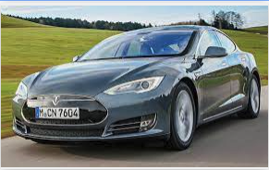

input image
is fed into
Car Classifier
produces
+ provides
information related to the car maker and links to video reviews
3 most likely car models

