Slide 1
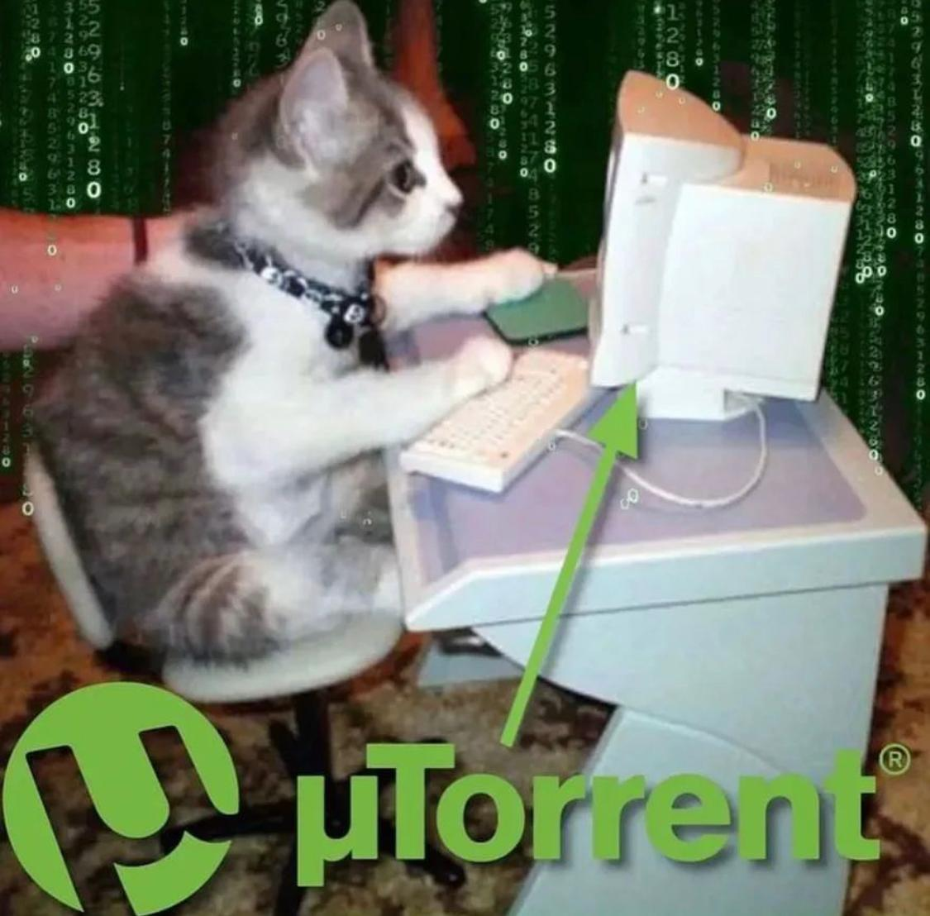
IPFS/CDN incentives
Claudia Richoux

Slide 2

hi i’m claudia from banyan and retrievals are broken
Notes:
I am the founder at Banyan where we are bringing data onto Filecoin
On the side, I do various research projects for fun
This was a project from August 2022 that I did on the side after work, and I decided it should probably be shared with the community when I found out that nobody knew about anyone working on this.
We all know incentivized retrievals are problematic on Filecoin and IPFS
you have to pay someone to give you data, how do you verify it within the protocol?
This talk is going to be a state of how things are right now (as far as I’m aware?), and my vision for how we could build decentralized retrievals that make sense.
I’m not going to go into any math, I’m mostly going to go into the state of how things are right now, and a vague toolkit/architecture for how we can make this thing better
There will be a lot of “yeah call blockscience they can probably model this with cadcad and get you some real equations”/”now draw the rest of the owl” in here
This is my first crypto conference talk and i am nervous! so please be nice but do call me out if i’m wrong or missing some exciting paper

Slide 3

Problem description

Slide 4
why do we care? / anatomy of a CDN
people want their data, and quickly! We need to get it to them
I talk to potential Filecoin users for my company.
*giant* objection is whether we can get speed that rivals AWS
data is distributed all over the planet and we need to get it to them both correctly and quickly
It gets to you quicker if it’s closer to you, but the origin could be anywhere!
durability under attempted censorship by dishonest nodes: a serious concern!
People are willing to pass it around, maybe
I did art to show you how this works

Slide 5




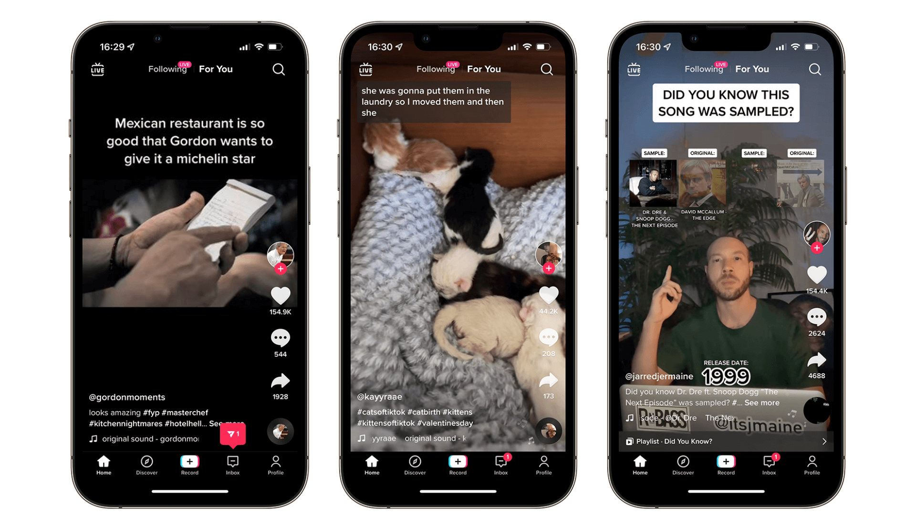

Bobs (holding data) (may be decentralized)
Swarm of Charlies (the internet) (message passers) (may warehouse data to serve it repeatedly)
More alices (tiktok stars) (edge uploaders)
Alices (tiktok user) (edge downloaders)
Notes:
data is coming from and going to sources that hold onto lots of data. they are untrusted (we’ll call them Bob: the guy with the data on his server)
data passes through a lot of intermediate Charlies (routers) between Bob and Alice, and there are tons of Charlie options for Bob and Alice
it may even be expedient for a “local” Charlie to warehouse the data to serve it up repeatedly
data may be censored or edited at any point before alice! we should assume bob and alice and charlie are greedy, and bob and charlie can be assumed to have been hijacked by evil government censors.
Everyone here is a rational actor! This means if they can save money they will, but they’re willing to spend money to get their desires met or have a believable probability that they’ll make more money.
angels mean that the user honestly just wants their untouched data to get to the other side. They have a real desire and will pay money to make that desire happen. They will, however, cheap out whenever possible in getting those desires met.
demons means some people in that class don’t care about untouched data getting to the other side, may actually want to corrupt or block the data… at least some of them are down to pass/store/serve the correct data to alice for a buck, though.

Slide 6
…unlike anything we’ve seen before…
leslie lamport’s byzantine generals (coordination/communication with dishonest or faulty actors)
(no incentives)
…which leads into bitcoin
(a bit of incentive for the last mile, nothing in between, public)
centralized CDNs
(legal and reputational incentives)
IPFS
(volunteer)
Filecoins/Sias/Arweaves
(rudimentary / bad decentralized distribution incentives, mostly storage incentives)
Notes:
Byzantine generals:
assume you know nothing globally except what’s broadcasted
messages just get passed/broadcasted magically and we try not to think about how
no incentives at all, no global knowledge except for shared between honest parties
Bitcoin
extremely global state because we all need to trust the soundness of the money
Same assumptions as byzantine generals- message passing is just assumed!
Alice is bribing the miner (a Bob) to transmit my message on chain using gas fees/transaction fees, but nobody in between
Cloudflare and ISPs
Bobs run a website and just sign a legal contract with these centralized Charlies to get the data to Alices
If my Alices (or my friends’ Alices) say “hey it’s loading slow” i switch my CDN to a different one to fill the charlie role
CDNs/intermediaries can drop Bobs, Alices are simply out of luck (kiwifarms, 8chan)
They can also drop Alices (has your ISP ever sent you a DMCA notice for torrenting?)
IPFS
It gets gossipped around (hopefully) (thank you kind stranger(???))
Maybe Charlies/Bobs run a gateway service as an expensive public good (oof)
Maybe they have cloudflare-style SLAs (see pinata- a centralized-incentivized IPFS Bob!)
filecoins/sias/arweaves
We check Bob has Alice’s data
When alice wants it she call you(???) And writes a check(???) And bob gets it to her by someone paying a charlie directly(???) And we just hope everything goes alright in the middle?
Arweave actually makes a really shoddy attempt at this, they call it “PIIA”, where they basically go “yeah the miners are just going to enforce each other on retrievals as a network good. Hugs all around” and slap an equation on it. Not covering it in detail bc i’m embarrassed for them.

Slide 7
Tension!
incentivizing CDN-speed trustless retrievals suffers from a tension between private information and public information
any friction in the process (publication/verification) destroys the valuable good
having a third party, or multiple third parties, validate post facto… not just utterly infeasible at scale, but also, *i can just lie to them*.
Notes:
Blockchain point: the soundness/validity of digital money depends on eventually publishing one’s conformance to invariants for enforcement (i.e.: i did not mint 4 bitcoins to send my friend, i had them beforehand, they are legitimate bitcoins!)
CDN transmission is actually one of the primitives you assume you just *have* when you build a blockchain. It’s not something the blockchain was intended to prove!
Next point
validation must happen nearly as quickly as sending because i am impatient for my data
waiting for outside transmission and confirmation is a non-starter for CDN users
Outside confirmation is too little too late anyway
…but we do distributed systems! I thought the entire POINT is doing a massive and slow global computation to agree on stuff!
You have to publish the accounting information because we assume we are using a blockchain to settle money trustlessly.
but CDN transmission is the act of accurate transmission between only two parties- initially not blockchain-friendly at all!
we are validating an act (speedy correct transmissions from Bob/Charlie to Alice). There are two definite witnesses (Bob, Alice), and a bunch of maybe-witnesses (Charlie). Both Bob and Alice are incentivized to lie, and Charlies must in practice process enough throughput that they can’t really do accounting.

Slide 8

Prior work: incremental verification, p2p privacy

Slide 9
Prior work: incremental verification + p2p privacy
Bao: blake3 verified streaming (Rudiger’s talk from Saturday!)
Bake a merkle inclusion proof into content as you send it
6-7% bandwidth overhead, as you transmit data, to prove it’s properly formed as part of a CID
Fast! Really fast!
Win: can ensure each packet is well-formed as a tiny piece of a known piece of content.
Wireguard / noise-QUIC / BTC lightning transport
Peer-to-peer VPN/tunnel technology
Verifies and encrypts packets from a PKI-identified peer (natural decentralization/P2P)
Fast! Well-supported! Already in the Linux kernel!
Ripe for adding a well-designed payment channel- periodic setup and teardown of a communication channel in a thread, with fast communications in the middle.
Wins: ensure nobody tampers with the content along the way. Safe P2P encryption. Timer system is perfect for periodically open/closing and renewing payment channels.

Slide 10
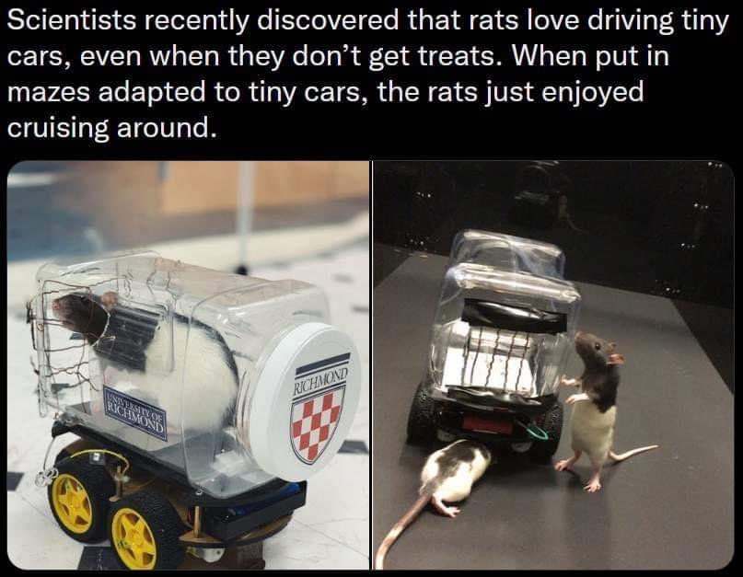
Prior work: Retrieval pinning

Slide 11
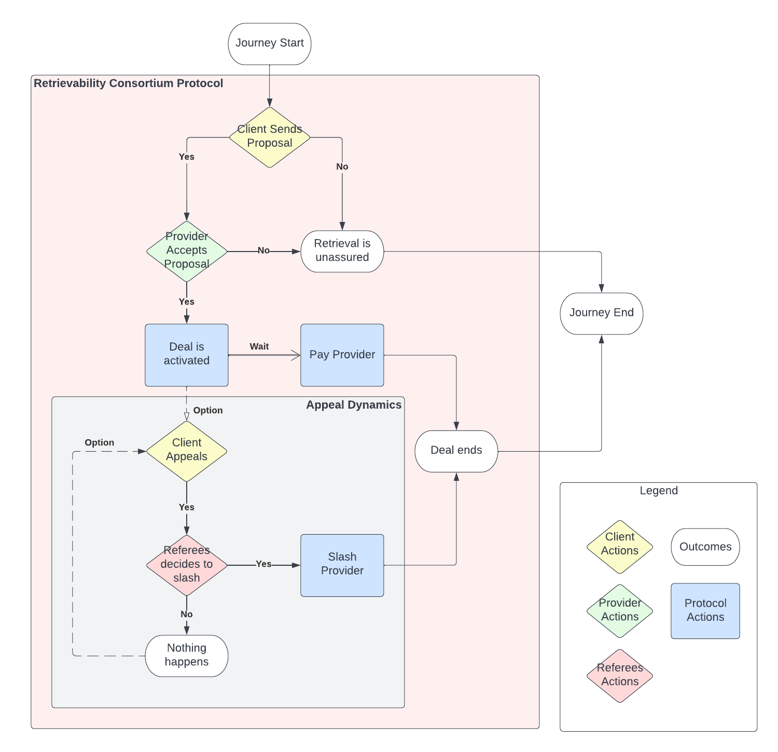
Retriev protocol/retrieval pinning
Retriev protocol/retrieval pinning (I think of it as CDN police!)
By cryptonetlab- nicola and irene
Alice pays a group of “referees” to “referee” that Bob sends her her file when she wants it. Bob agrees to submit to being refereed.
All you need to remember is:
if Bob is fooling around and not sending the file,
Alice petitions referees,
who obtain the file from Bob (or slash him),
validate it,
and forward it to Alice.
Check out: https://github.com/cryptonetlab/retriev/blob/main/PAPER.md
Notes:
Very cool protocol (go take a look!) but don’t worry about the details… just look at these bullet points

Slide 12
Problems with retriev…
Slow! Need to send to a middleman and then forward to alice
Have to pass file around between middlemen to validate
(*this part could probably be cleaned up with succinct-er proofs depending on security model)
Bob needs to collateralize
(nobody wants to collateralize… as we see in Filecoin, doesn’t scale)
OBSCENELY high collateral multipliers from simulation…
“Time value of money was not taken into consideration. Eg, all decisions can be understood as being immediate.” 😬😬😬
Alice has to pay middlemen, who have to run servers… ugh.
There are other problems too…
Elegantish but probably impractical?

Slide 13

Prior work: Payment Drips/tit-for-tat
Notes:
This class is what I call it when “I do a little work, you do a little payment”, over and over again.
This is very local knowledge applied into the market where it needs to go, minimal outside shared authority, minimal friction, minimal communication needs. So I put a little picture of Hayek for you economic theory enjoyers.

Slide 14
More good prior work: Skynet in-band incentivization
Skynet incentivization is in-band incentives over a payment channel
They have a little payment channel. You bump the amount of money in it with every sector you download and validate.
You pay the host directly.
Why isn’t this great?
Charlies unpaid!
One elliptic curve signature per sector (oof) (slow!)
Not programmable, not transferable, not protocol-layer
A few relevant snippets to orient u (from a pretty big amount of code) https://gitlab.com/SkynetLabs/skyd/-/blob/master/skymodules/renter/proto/downloader.go#L39
https://gitlab.com/SkynetLabs/skyd/-/blob/master/skymodules/gouging/gouging.go
Notes:
… talk about the solution …
I independently came up with this and added some stuff and future research directions, which is the core of the talk, I guess?
The benefits of this class of solution are basically: I don’t have to trust you very much or for very long. I give you a tiny little payment and you give me a little data. We repeat this. If I stop paying, you give me maybe a few extra packets, and then you stop giving me traffic- very little loss. Same if you stop giving me traffic or slow down unacceptably- I stop paying and go hunt down another server. Nobody needs to be involved or know except the two of us.
The core of the problem where you have

Slide 15

things i did
Notes:
Ok now we’re in the realm of stuff i did

Slide 16
Concept: improve skynet with state channel protocol
Set up state channel between client + server- one elliptic curve signature
Init with client posting hashes of random data (or keyed RNG output)
On receipts, with client ACKs, add the preimage of a hash to pay a little
Hash reveals are quick “monopoly money” to pay server for a packet
To claim, server proves tickets are correct preimages :)…
Notes:
- State channels Magmo is already building these on FEVM
BTC lightning payment channels already integrate with noise, btw :)

Slide 17
Concept: ramp-up / delegation on this?
Can ramp up to “more packets -> bigger denominations and a longer wait”
Building trust over time with server
*Economic future work- what’s the right rate of payment? Iterated prisoner’s dilemma
*Can reduce overhead for UDP-based protocols. Doesn’t matter for TCP.

Slide 18
Weird new topologies of skynet incentives
Caching Charlies: Charlies can cache and then serve the data, if they’re seeing a lot of requests for it and want to compete/share in profits.
How do you pay non-caching Charlies who are message-passing?
Prepay/pay for others’ bandwidth (Netflix giving clients bandwidth for movies)
Give “download coupons” for a specific server and piece of content
Notes:
Paying charlie:
Vague idea: onion routing where those who touch the message can “claim” a hash at each hop? Like blockchains’ fees, but for forwarding one hop.
Unclear… this idea has some fuzzy implications for the state channel… future work :)
Prepaid bandwidth
-Make the state channel 3-way: content owner, server, client
Allows a content owner to give the client “download coupons” specifically for a certain server (and piece of content, although this is not cryptographically provable)
Have owner give download coupons (+ a JWT for permissioning) on connection initiation, then hand off to a CDN POP (Charlie).
*Protocol-layer future work- gameable without more mechanism work

Slide 19
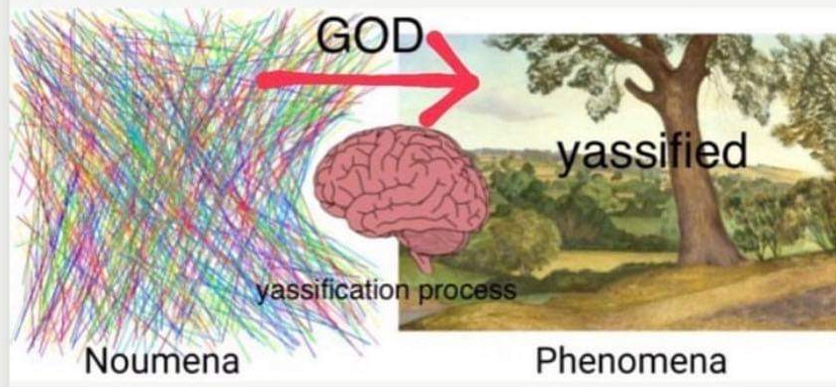
Modeling!

Slide 20
Game theory of in-band incentives
For both parties: generalized multi-armed bandit mixes with iterated prisoner’s dilemma mixes with LOTS of competition on both sides
Server/Bob
has its pick of clients/connections to serve data to with fixed bandwidth for maximal payoff
switching clients has a warm-up cost in terms of discovery, building trust, establishing connection
can stop serving (“betray trust”) at any point
Client/Alice
has its pick of servers to get its data from, within the set of servers that have its data, within reasonable RTT
Switching servers has the same warm-up cost as switching clients
can stop serving to “betray trust” at any point
Market naturally incentivizes sharing and replication for high-demand data
if I’m seeing a lot of cache misses on a given CID, I want to pay Bob once to download a copy, and then I will be his competitor (and profit from this CID)

Slide 21
Game theoretic failure modes
Alices are unlikely to start a “cartel” where they collectively refuse to pay for their requested data, seeing as they all want their data, and
Bob has many profit opportunities, so Alice lacks leverage.
However, if Bob is insufficiently decentralized…
No competition for prices- data hostage situation!
We can fix this…
Notes:
-Bob raises the rent to infinity on Alice’s data- refuses to serve to Alice or to a POP/Charlie that wants to make a replica.
Bob can do this in the Skynet + Filecoin paradigm, but not if you glue one more thing on… remember retriev?

Slide 22
Putting it all together
Filecoin-style storage incentives with collateral slashing
retriev-style “you must make this retrievable” slashing incentives
In-band skynet-style “you should make it retrievable with competitive QoS” incentives across all Saturn SPs
= the file is kept at multiple collateralized locations (no loss)
It is always accessible, or SOME collateralized SP is slashed
It is accessible quickly, because ALL SPs are competing for client bandwidth payments. market incentivizes new, geolocalized replications.
= YAY! Decentralized CDN POPs.

Slide 23
Tl;dr: you need a backstop, plus competition as gasoline
You need to eliminate situations where *nobody* will store or serve the data (censorship, data hostage, simple loss), using a game theoretic “stick”.
This has to be ensured by imposing slashing on individual responsible SPs for failing to meet minimum QoS.
Filecoin, Sia, Retrieval pinning all do this.
You need to create incentives for the data to be replicated, served rapidly, and generally “kept hot” to meet demand, using a game theoretic “carrot”.
This is done by creating a market and forcing SPs to compete on latency and replications to adaptively meet customer demand in the moment.
Skynet incentives do this.
Layering incentives across potentially-overlapping sets of SPs allows for strong performance in all cases.

Slide 24
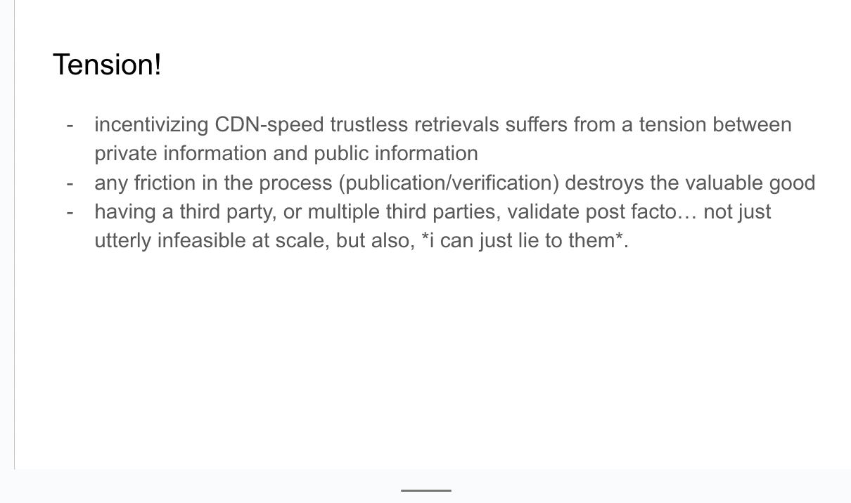
Resolves the tension from the first slide :)
You get both in-band fast local knowledge for fine-tuning (hayek)
And you get “The Government” on the side to make sure nothing catastrophic happens if things get unworkable internally
win!

Slide 25
Bonus: Upload is free in this paradigm!
Out-of-band stick: backstopping bob for minimal QoS
Alice makes sure bob posts a filecoin deal / retriev deal / other commitment
This enforces that he’ll start publicly proving deal receipt or get slashed.
In-band carrot: this is the same as download!
bob pays alice(+charlie?) to get his file over the normal skynet-style protocol. Price may be low or free.
Replications can be incentivized by simply repeating part 1 across multiple Bobs.

Slide 26
nice. some cool thoughts. what now?

Slide 27
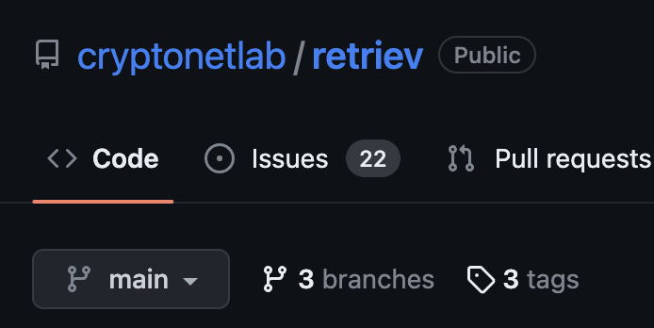



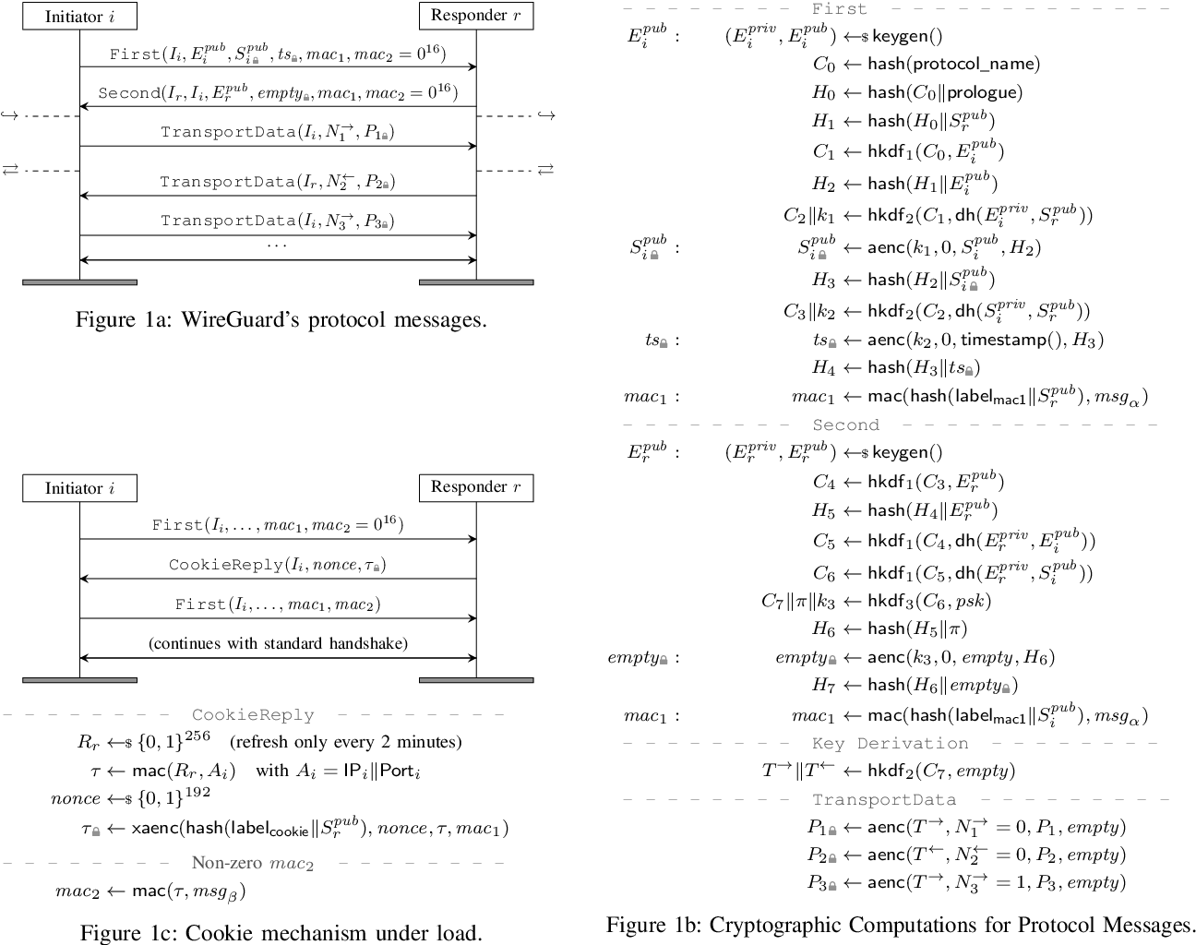
homework assignments!
Notes:
Obviously a lot is extremely lacking here, see the owl…
I think two really great starting points for work on this would be:
Modelling the tit-for-tat incentive layer with CADCAD, strapped onto nikola’s retriev protocol, using realistic bandwidth costs/replication costs/costs of capital. See what prices start looking like.
Adding the hash-based monopoly-money state channel to existing Wireguard or nQUIC implementations and seeing how fast you can get this thing going would be smart. Wireguard has a nice “timers” system for transport channel renegotiation, and a pre-implemented extra thread for handling expensive elliptic curve ops, so I suspect might be ripe for adding this payment channel for in-band micropayments that don’t bog down the networking
These would be great summer research internship projects, theoretically, for a couple of bright older undergrads or grad students in distributed systems and mechanism design.

Slide 28

Questions!
(*Thanks to dig, b5, david vorick from skynet, marten seeman, & nicola for letting me bounce ideas off of them… you all rock :D)

