Slide 1

A simple slides template
by Philosophy Of Computing Organizing Staff

Slide 2
Hi there!
This is a simple presentation template aligned with our brand guidelines that you can use to style your presentation for our conference.
The template is already embedded into this file, so you can just copy it to your drive (or download it) and start dropping your content here. This template is compatible with Google Slides and Microsoft Powerpoint.

Slide 3
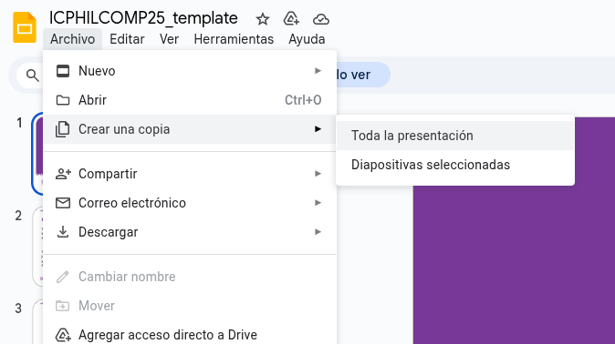
If you are using Google Slides, just go to file > create a copy > All of presentation to get a fresh copy into your drive to start working.

Slide 4
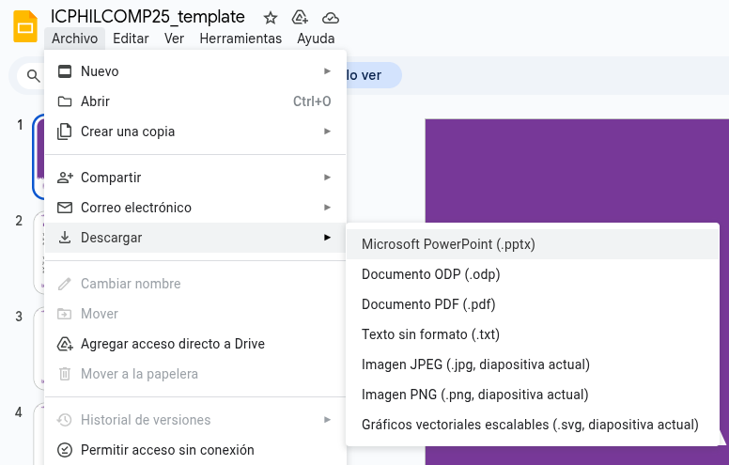
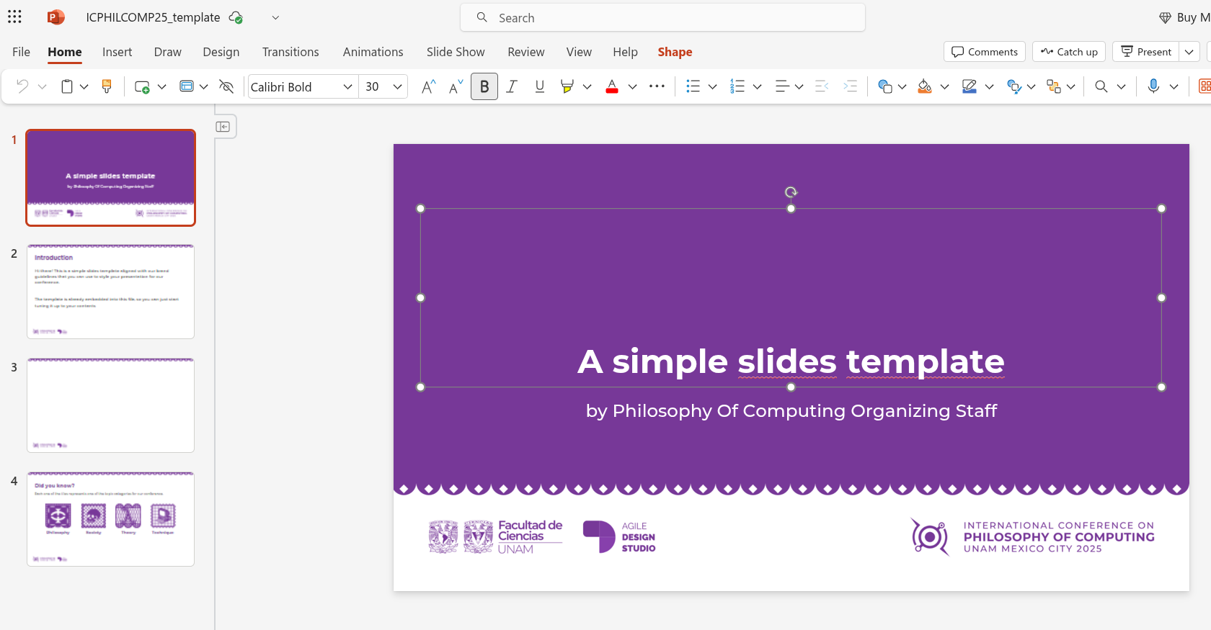
If you want to edit it locally, download the PPTX file from file > download > Microsoft Powerpoint (.pptx) and open it using Microsoft PowerPoint or any other slides application you like.

Slide 5
Montserrat
Crafted by Julieta Ulanovsky, Sol Matas, Juan Pablo del Peral and Jacques Le Bailly in Buenos Aires, Argentina, Montserrat is the default font for all of our materials.
It is already set up into this presentation if you use Google Slides, but in case you are using Microsoft Powerpoint into your local machine, you may have to install it first. Montserrat is completely free and available in Google Fonts.

Slide 6




Did you know?
This year visual line is inspired in Día de Muertos and the paper mats typically used during this time of the year in Mexico.
Each one of the tiles represents one of the topic categories for our conference:
Philosophy
Society
Theory
Technique

Slide 7
Colors
Morado
#773898
Deep purple
#291F3A
In addition to black and white, these are the allowed colors for our materials during this conference.
Fuschia
#BC5FD3
Lila
#CC97E2

Slide 8
Some tips for an awesome presentation
Don’t use a font size less than 18, it will render unreadable to the back of the room
Keep it brief and simple, don’t put more than 80 words in a single slide.
Bear in mind that you will have at most 30 minutes to deliver your speech, and people usually spend two or three minutes per slide. Our time is limited and the host will warn and interrupt you immediately when the time comes.

Slide 9
That’s all for now, see you soon at CDMX!

