Slide 1
Vendor Specialization Claims at 4B:
A Controlled Comparison of MedGemma and Gemma-3
on MIMIC-III MICU Nursing Tasks
Scott Laue | University of Texas at Austin
Graduate Seminar: AI in Healthcare | 2026
Notes:
Good [morning/afternoon]. My name is Scott Laue and I am presenting my project for the AI in Healthcare graduate seminar. The title is Vendor Specialization Claims at 4B: a controlled comparison of MedGemma and Gemma-3 on MIMIC-III MICU nursing tasks.
The short version: I tested whether a model marketed as clinically pre-trained actually outperforms a general model of identical size on clinical NLP tasks. The answer, across 637 independent patient records and 13 metrics, is no — and in some cases the clinical model is substantially worse. Let me walk you through how I got there.

Slide 2
Introduction
The vendor specialization claim
The marketing assumption
"Models pre-trained on clinical corpora outperform general models on clinical NLP."
Why it matters
• Health systems use vendor model cards as credibility signals when selecting LLMs for documentation support
• A clinically-labelled checkpoint at 4B parameters is the deployment-realistic choice for resource-constrained ICUs
• If the claim fails at this scale, procurement decisions based on it are unsupported
This paper
• Tests the claim directly for one checkpoint pair at identical size and architecture
• MedGemma-4B-IT (Google, clinically pre-trained) vs. Gemma-3-4B-IT (general instruction-tuned)
• Three MICU nursing tasks from MIMIC-III | n = 637 independent admission records | 13 metrics
Key caveat
The two checkpoints differ in pre-training corpus and alignment recipe — we falsify the vendor claim
for this pair without identifying pre-training corpus as the sole causal driver.
Laue | AI in Healthcare | UT Austin 2026
Notes:
The motivation for this project starts with a credibility signal that health systems routinely encounter: a model card that says 'pre-trained on clinical corpora.' The intuition is appealing. A model trained on medical notes should know more medicine than a generalist. But intuition is not evidence, and health systems are making real procurement decisions based on this framing.
The model I am testing this claim against is MedGemma-4B-IT, released by Google in 2025 and explicitly marketed as clinically pre-trained. I compare it to Gemma-3-4B-IT, a general instruction-tuned model at identical size and architecture from the same model family. The only experimental variable is pre-training corpus and alignment recipe.
One important caveat I want to flag upfront: the two checkpoints differ not just in pre-training corpus but also in their instruction-tuning and alignment recipe. So if MedGemma loses, I can say the vendor's specialization claim fails for this pair, but I cannot say the pre-training corpus alone caused it. I'll come back to this.

Slide 3
Three Nursing Tasks
MIMIC-III MICU | n = 637 independent admissions (one per hadm_id)
Sub-task 1
Sub-task 2
Sub-task 3
Structured Note Generation
Generate an MICU nursing progress note in AARP format (Assessment / Action / Response / Plan, one block per active problem) from 12 hours of structured EHR context.
Metrics:
ROUGE-L, Clinical Entity F1 (aggregate, drugs, vitals), AARP Section Score
Abnormal Value Identification
Given the most recent reading per vital sign, list every abnormal value with its clinical significance. Ground truth from hardcoded ICU reference ranges.
Metrics:
Precision, Recall, F1
Admission Summary Generation
Generate a free-form Hospital Course narrative from the same FHIR-lite context. Reference: extracted discharge summary hospital course section.
Metrics:
ROUGE-L, BERTScore F1, Problem Coverage, Out-of-Range Mention Rate, Medication Mention Rate
Laue | AI in Healthcare | UT Austin 2026
Notes:
I designed three tasks that represent the core documentation workload of an MICU nurse.
Sub-task 1 is structured note generation. The model receives 12 hours of structured EHR context — vital signs, labs, medications, active problems — and must produce a nursing progress note in AARP format: Assessment, Action, Response, Plan, one block per active problem. This is the closest analogue to actual nursing documentation.
Sub-task 2 is abnormal value identification. I give the model only the most recent reading per vital sign and ask it to flag anything outside normal ICU ranges. I hardcode nine reference ranges — things like Heart Rate 60 to 100, SpO2 at or above 95% — and use those same ranges to generate ground truth labels. This tests whether the model can do basic clinical alarm triage.
Sub-task 3 is admission summary generation. The model writes a free-form hospital course narrative from the same FHIR-lite context. The reference is the actual hospital course section extracted from the discharge summary.
Across all three tasks I ran 637 independent admission records — one per unique hospital admission — to satisfy the paired independence assumption for the Wilcoxon test.

Slide 4
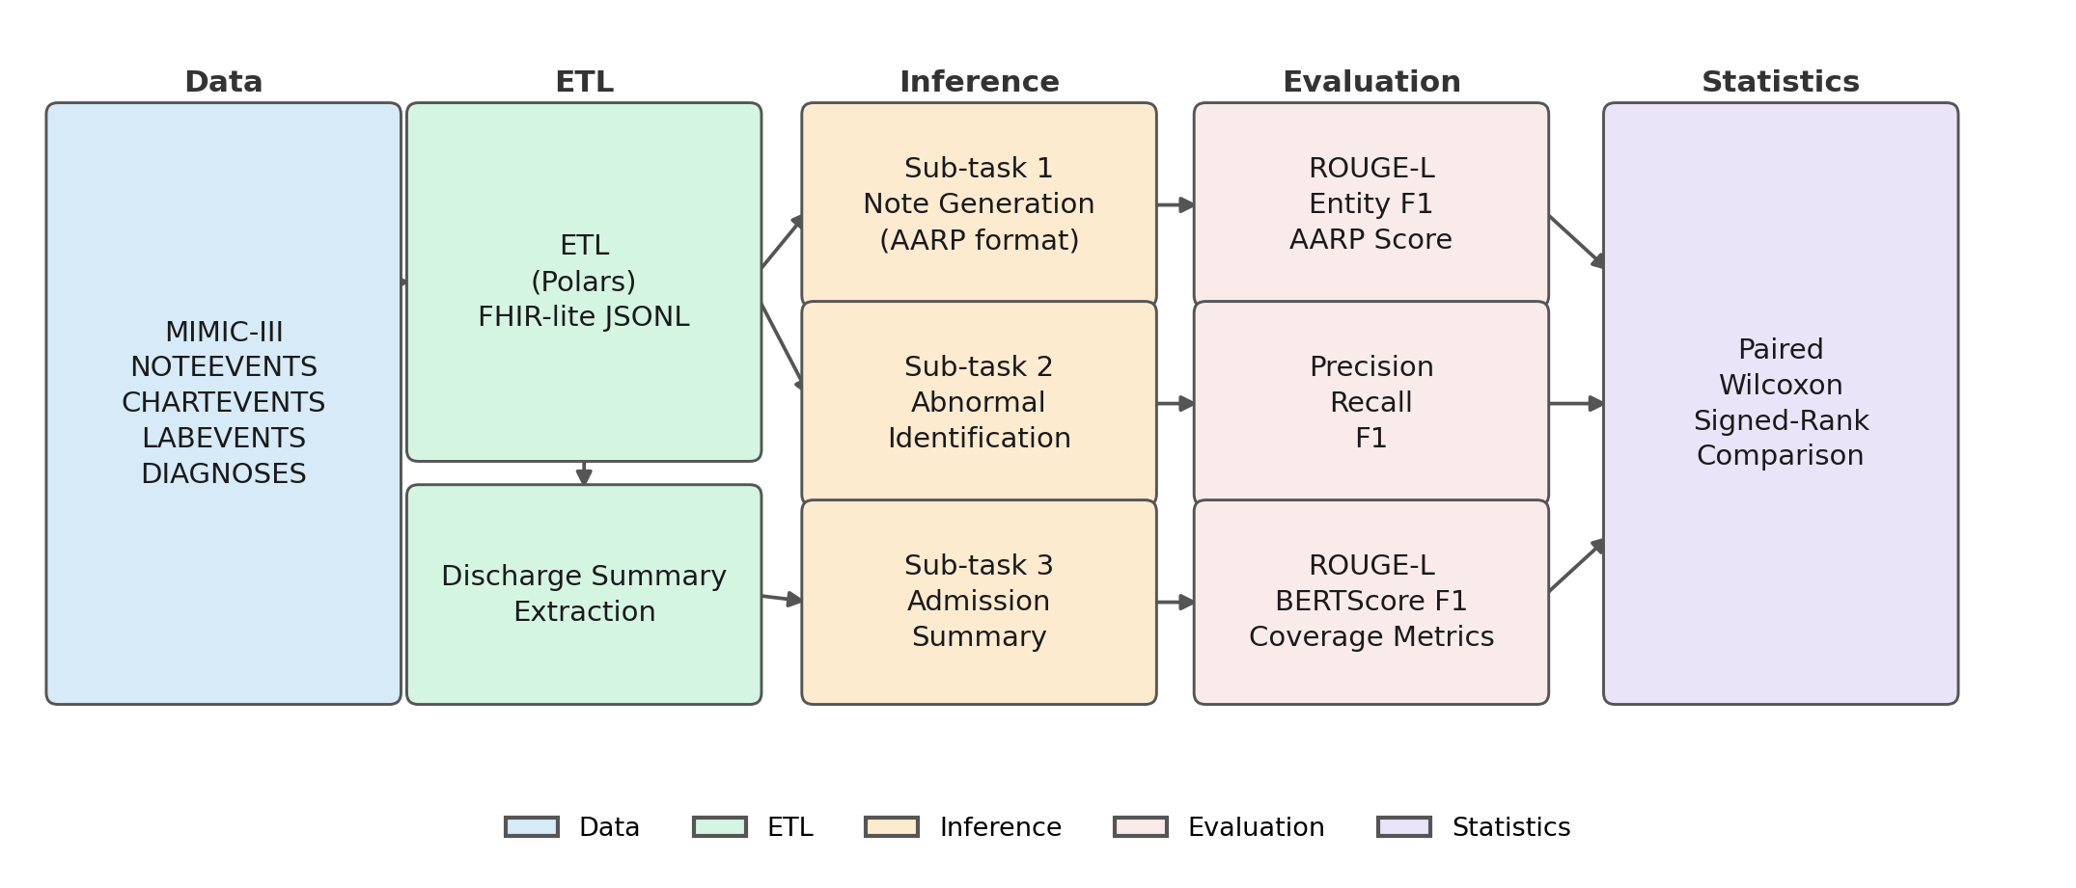
End-to-End Pipeline
Laue | AI in Healthcare | UT Austin 2026
Notes:
This figure shows the full pipeline. On the left is the raw MIMIC-III data: NOTEEVENTS, CHARTEVENTS, LABEVENTS, and DIAGNOSES CSVs.
Phase 1 is ETL. I use Polars in lazy mode to avoid loading multi-gigabyte CSVs into RAM. The output is a FHIR-lite JSONL file: each record contains a structured patient context window — observations, labs, medications, active problems — plus the ground-truth nursing note and, for Sub-task 3, the extracted hospital course text.
Phase 2 is inference. Both models run through vLLM on a single RTX 3090. I use identical sampling parameters for both, including a repetition penalty of 1.15 that I had to add because MedGemma degenerated into looping without it.
Phase 3 is evaluation. Task-specific metrics are computed per record, then aggregated to corpus-level means. The comparison step runs a paired Wilcoxon signed-rank test on the matched pairs, reporting the rank-biserial r as a direction-consistency measure.

Slide 5
Data & Methods
Dataset
• MIMIC-III MICU nursing notes (category = "Nursing")
• 103,442 records across train / val / test splits
• Evaluation: validation split, 1 record per hadm_id → n = 637
ETL (Polars lazy API)
• ITEMID harmonisation via MIMIC-Extract variable map
• 12-hour temporal window; ISO 8601 relative offsets (T-10h)
• FHIR-lite JSONL: obs (cap 1,100) + labs (150) + meds (250)
• Density gate: |obs| + |labs| + |meds| ≥ 5
• 99.1% of admissions within all three caps
Inference
• vLLM on single NVIDIA RTX 3090 (24 GB)
• tensor_parallel_size = 1; identical sampling for both models
• Temperature 0.30 | top-p 0.90 | rep. penalty 1.15
• Max tokens: 1,024 (Sub-tasks 1 & 3); 512 (Sub-task 2)
Evaluation
• ROUGE-L (stemmed F-measure)
• scispaCy en_core_sci_sm → Clinical Entity F1
• BERTScore F1 (distilbert-base-uncased)
• Paired Wilcoxon signed-rank + rank-biserial r
• α = 0.05, uncorrected across 13 metrics
Laue | AI in Healthcare | UT Austin 2026
Notes:
A few details about the data and methods worth calling out.
On the data side: MIMIC-III covers 58,976 admissions at Beth Israel Deaconess. I filter to MICU nursing notes, giving about 103,000 records total. I sample one record per unique hospital admission for evaluation to eliminate within-admission correlation — the same patient might have 20 nursing notes, and I do not want those inflating my sample size for the Wilcoxon test.
The ETL builds a 12-hour context window before each note's chart time. I use relative ISO 8601 offsets like T-minus-10-hours rather than real timestamps, which masks the MIMIC date-shifting artefact. Context sections are capped at 1,100 observation entries, 150 labs, and 250 medications. 99.1% of admissions fit within all three caps, so truncation is not a practical concern.
On inference: both models run at identical settings — temperature 0.3, top-p 0.9, repetition penalty 1.15. I want to flag that I did not sweep the penalty per model. I found that MedGemma looped without it; Gemma-3 was mostly fine. Applying the same penalty to both is the fairest comparison I could make, but it means I do not know each model's ceiling at its own optimal configuration.
For evaluation I use ROUGE-L, scispaCy clinical entity F1, BERTScore, and paired Wilcoxon with rank-biserial r. I report uncorrected p-values across 13 metrics and I will flag where that matters.

Slide 6
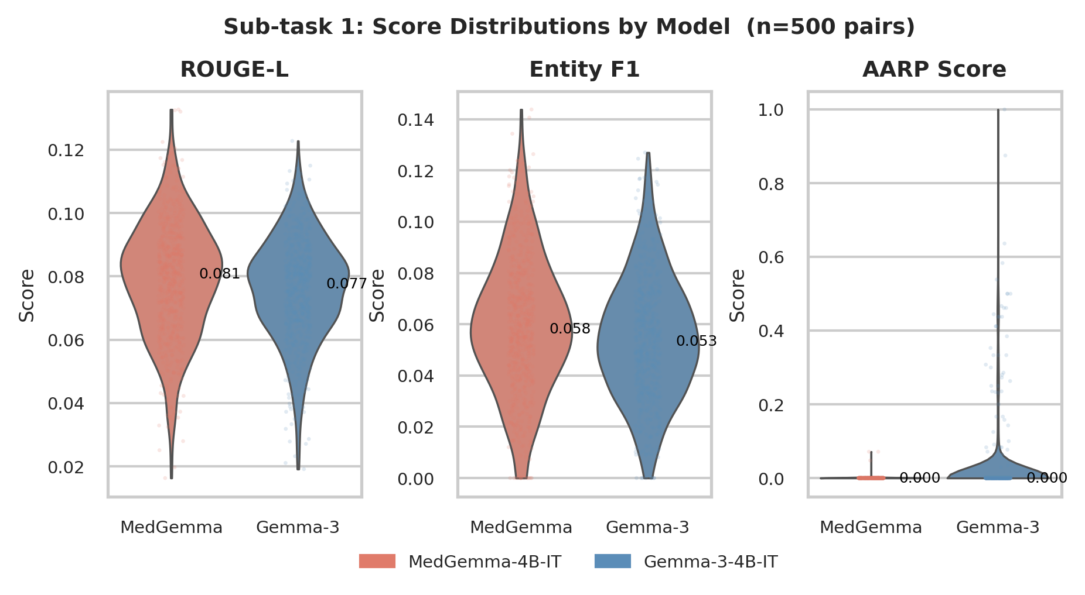
Results — Sub-task 1: Structured Note Generation
n = 637 pairs | Δ = MedGemma minus Gemma-3
Metric | MedGemma | Gemma-3 | Δ | p | r | Verdict
ROUGE-L | 0.079 | 0.076 | +0.003 | < 0.001 | 0.638 | draw
Entity F1 | 0.059 | 0.054 | +0.005 | < 0.001 | 0.610 | draw
Entity F1 (drugs) | 0.022 | 0.025 | −0.003 | 0.430 | 0.994 | n.s.
Entity F1 (vitals) | 0.058 | 0.074 | −0.016 | 0.017 | 0.975 | Gemma-3 ✓
AARP Score | 0.000 | 0.025 | −0.024 | < 0.001 | 0.999 | Gemma-3 ✓†
Key takeaways
• ROUGE-L and Entity F1 are near-floor (~0.06–0.08) — treated as draws
• Ground-truth notes contain bedside observations absent from EHR context
• Gemma-3 wins AARP structure and vital entity recognition
† AARP confound: MedGemma required rep. penalty 1.15 to avoid looping;
AARP result holds only at that configuration
Laue | AI in Healthcare | UT Austin 2026
Notes:
Sub-task 1 is where I expected MedGemma to have the clearest advantage: structured clinical note generation from EHR data. The results are largely a draw or a loss for MedGemma.
ROUGE-L and aggregate Entity F1 both reach statistical significance but the absolute differences are tiny — 0.003 and 0.005 respectively, on a near-floor scale of around 0.06 to 0.08. I classify these as draws. Part of the reason scores are so low is that ground-truth nursing notes contain bedside observations and patient-reported symptoms that simply are not in the structured EHR context. No model can recover that information.
The clinically meaningful results both favour Gemma-3. Entity F1 for vital signs is 0.074 versus 0.058 for MedGemma, significant at p equals 0.017 with an r of 0.975 — meaning Gemma-3 wins on nearly every individual paired comparison.
The AARP score is the most striking result: MedGemma scores essentially zero. It produced almost no complete Assessment-Action-Response-Plan blocks across 637 records. Gemma-3 achieved a mean of 0.025, small in absolute terms but orders of magnitude better. The violin plots on the right show the distributional picture clearly.
I have to be careful here though. This result carries the dagger footnote: it holds only at the repetition penalty of 1.15 that I found was needed to stop MedGemma looping. I cannot rule out that MedGemma can produce AARP output at a different configuration.

Slide 7
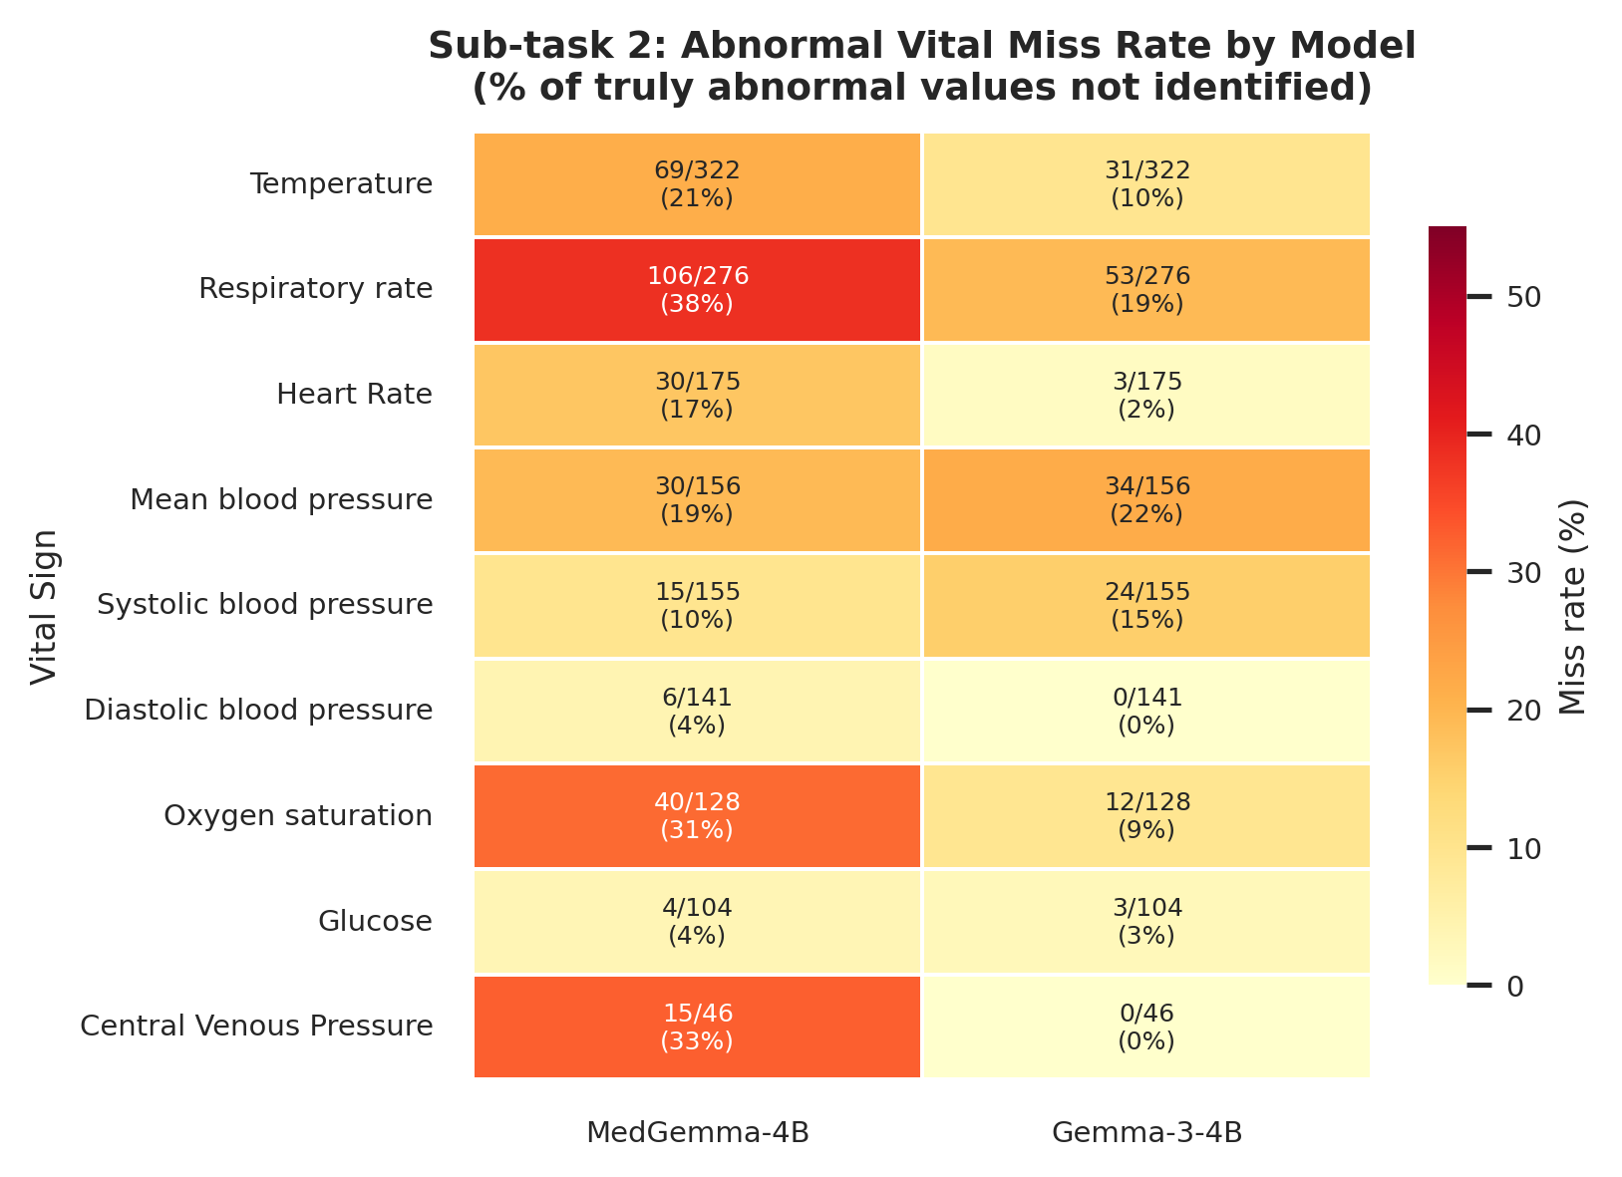
Results — Sub-task 2: Abnormal Value Identification
n = 637 pairs | Δ = MedGemma minus Gemma-3
Metric | MedGemma | Gemma-3 | Δ | p | r
Precision | 0.370 | 0.400 | −0.029 | < 0.001 | 0.805
Recall | 0.692 | 0.811 | −0.119 | < 0.001 | 0.972
F1 | 0.453 | 0.509 | −0.056 | < 0.001 | 0.828
Key takeaways
• Gemma-3 wins all three metrics at p < 0.001
• Recall gap is large: Gemma-3 identifies 81% vs MedGemma 69%
• Caveat: metric counts label mention, not explicit high/low flagging
• More verbose model can inflate recall — cannot rule out verbosity effect
Laue | AI in Healthcare | UT Austin 2026
Notes:
Sub-task 2 is the clearest result in the paper. Gemma-3 wins all three metrics at p less than 0.001, and the recall gap is large: 81% versus 69% for MedGemma. The rank-biserial r for recall is 0.972, which means Gemma-3 outperforms MedGemma on 97% of individual paired comparisons. That is not a marginal result.
The heatmap on the right breaks this down by vital sign. MedGemma misses Heart Rate at a 17% rate; Gemma-3 misses it at only 2%. For Respiratory Rate the gap is 38% versus 19%. Oxygen saturation: 31% versus 9%. These are consistently large advantages for Gemma-3 on the vitals that matter most in an ICU.
MAP — mean arterial pressure — is the interesting exception. Both models struggle with it at around 19 to 22%, and there is no meaningful difference between them. MAP is a derived value and may not appear as a direct item ID in the CareVue data, so both models seem to miss it for the same structural reason.
One caveat: my metric counts a vital sign as identified if its label appears anywhere in the generated text. It does not require the model to explicitly say the value is high or low. A more verbose model that mentions more vital signs in a preamble can inflate its recall without actually performing the abnormal-flagging task. I cannot fully rule out that part of Gemma-3's advantage reflects greater verbosity.

Slide 8
Results — Sub-task 3: Admission Summary Generation
n = 637 pairs | Δ = MedGemma minus Gemma-3
Metric | MedGemma | Gemma-3 | Δ | p | r
ROUGE-L | 0.110 | 0.101 | +0.009 | < 0.001 | 0.743
BERTScore F1 | 0.739 | 0.732 | +0.007 | < 0.001 | 0.808
Problem Coverage | 0.068 | 0.069 | −0.001 | 0.672 | 0.935
Out-of-Range Mention Rate | 0.235 | 0.314 | −0.079 | < 0.001 | 0.964
Medication Mention Rate | 0.452 | 0.481 | −0.029 | 0.003 | 0.800
Key takeaways
• MedGemma wins stylistic similarity (ROUGE-L, BERTScore) — clinical pre-training
matches prose style of discharge summaries
• Gemma-3 names more out-of-range metrics and medications from structured input
• Problem Coverage near-floor for both (~7%, n.s.) — ICD-9 verbatim matching too strict
• Mention-rate metrics measure vocabulary overlap, not numerical fidelity
Laue | AI in Healthcare | UT Austin 2026
Notes:
Sub-task 3 is the one place where MedGemma shows a genuine advantage, and it is instructive to look carefully at which metrics it wins and which it loses.
MedGemma achieves higher ROUGE-L — 0.110 versus 0.101 — and higher BERTScore F1 — 0.739 versus 0.732. Both are significant at p less than 0.001. This is consistent with the vendor claim: MedGemma was reportedly pre-trained on clinical notes and discharge summaries, and it has learned to generate prose that is lexically and semantically closer to discharge summary style. That is a real difference.
But then look at what Gemma-3 does better. Out-of-Range Term Mention Rate: 0.314 versus 0.235 for MedGemma, a delta of 0.079 at p less than 0.001. Medication Mention Rate: 0.481 versus 0.452, p equals 0.003. Gemma-3 names more of the specific out-of-range metrics and medications from the structured input than MedGemma does. So MedGemma writes more discharge-summary-like prose, but Gemma-3 is more grounded in the actual patient data it was given.
Problem Coverage is near-floor for both — around 7% — with no significant difference. That is a metric design problem, not a model problem: verbatim ICD-9 description matching is too strict. UMLS normalisation would be more appropriate.
I want to be clear that my mention-rate metrics measure substring presence, not numerical fidelity or clinical correctness. They reward vocabulary alignment with the input. But in a clinical safety context, at least naming the relevant out-of-range metric is a necessary first step toward grounded documentation.

Slide 9
Cross-Task Summary
13 metrics across 3 sub-tasks
Sub-task | Metric | Winner | Δ | r
1 — Notes | ROUGE-L | draw | +0.003 | 0.638
1 — Notes | Entity F1 | draw | +0.005 | 0.610
1 — Notes | Entity F1 (drugs) | n.s. | −0.003 | 0.994
1 — Notes | Entity F1 (vitals) | Gemma-3 | −0.016 | 0.975
1 — Notes | AARP Score | Gemma-3 † | −0.024 | 0.999
2 — Abnormal | Precision | Gemma-3 | −0.029 | 0.805
2 — Abnormal | Recall | Gemma-3 | −0.119 | 0.972
2 — Abnormal | F1 | Gemma-3 | −0.056 | 0.828
3 — Summary | ROUGE-L | MedGemma | +0.009 | 0.743
3 — Summary | BERTScore F1 | MedGemma | +0.007 | 0.808
3 — Summary | Problem Coverage | n.s. | −0.001 | 0.935
3 — Summary | Out-of-Range Mention Rate | Gemma-3 | −0.079 | 0.964
3 — Summary | Medication Mention Rate | Gemma-3 | −0.029 | 0.800
Final tally
Gemma-3 wins 7 metrics
MedGemma wins 2 metrics
Draws / n.s. 4 metrics
† AARP: config confound
Interpretation
Clinical pre-training at 4B provides
no consistent advantage.
Instruction-following quality
dominates domain vocabulary at this scale.
Laue | AI in Healthcare | UT Austin 2026
Notes:
Let me pull the three sub-tasks together. Across 13 metrics, the final tally is: Gemma-3 wins 7, MedGemma wins 2, and 4 are draws or not significant.
The two MedGemma wins are both on Sub-task 3 stylistic similarity metrics — ROUGE-L and BERTScore. These are real differences but they are modest in absolute terms, and they measure how much the generated text resembles the discharge summary prose style, not whether the clinical content is accurate or grounded.
The seven Gemma-3 wins span all three tasks: vital entity recognition and AARP compliance in Sub-task 1; precision, recall, and F1 in Sub-task 2; out-of-range mention rate and medication mention rate in Sub-task 3. These are not marginal — the recall gap in Sub-task 2 is 12 percentage points, the AARP gap is essentially MedGemma producing no structured output at all.
My interpretation is that at 4B parameters, the tasks I designed are primarily capability requirements — structured output compliance, instruction following, precise numerical grounding — not knowledge retrieval requirements. The clinical pre-training corpus may have conditioned MedGemma on unstructured clinical narratives in a way that actually hurts its ability to follow rigid structural templates. Instruction-following quality, which is shaped by alignment training rather than pre-training corpus, appears to be the more important variable here.

Slide 10
Future Directions & Lessons Learned
What I'd do differently
• Sweep repetition penalty per model separately
— MedGemma AARP failure may be configuration-dependent, not capability-limited
• Stricter Sub-task 2 scoring
— Require explicit "high" / "low" flag, not just label mention
— Eliminates the verbosity-inflates-recall confound
• Clinical encoder for BERTScore
— Bio_ClinicalBERT instead of distilbert-base-uncased
— May change relative Sub-task 3 rankings
• UMLS-normalised problem coverage
— Verbatim ICD-9 string match is too strict; concept matching would be informative
Future directions
• Scale up: MedGemma-27B vs. Gemma-3-27B
— Test whether relative ordering is stable across parameter scales
• Human evaluation
— ICU nurses rate clinical accuracy and usability of generated notes
— Automated metrics cannot capture grounding or safety-critical errors
• Broader checkpoint coverage
— Meditron-7B vs. Llama-2-7B; BioMistral vs. Mistral-7B
— Generalise null-to-negative finding beyond one checkpoint pair
• Other ICU types and institutions
— MICU at one Boston centre; CSICU, NICU, different EHR systems
Laue | AI in Healthcare | UT Austin 2026
Notes:
If I were redoing this project, there are four things I would change.
First, I would sweep the repetition penalty separately for each model before locking in inference parameters. The AARP result is scientifically interesting but I cannot fully stand behind it as a capability claim because I only tested MedGemma at the one configuration that produced non-looping output.
Second, I would tighten the Sub-task 2 scoring to require explicit high or low flagging, not just label mention. This would eliminate the verbosity confound and give a cleaner signal on actual abnormal-value reasoning.
Third, I would use a clinical encoder — Bio_ClinicalBERT — for BERTScore rather than the general distilbert. A clinical encoder may penalise MedGemma's stylistic similarity advantage if that advantage comes from fluency rather than clinical specificity.
Fourth, I would replace verbatim ICD-9 description matching for Problem Coverage with UMLS concept normalisation. The current metric is too strict and the near-floor result tells us nothing useful about either model.
On future directions: the most important follow-up is simply to run this at 27B parameters. My hypothesis is that instruction-following quality dominates domain vocabulary at 4B, but both models' instruction following improves with scale, so the relative ordering may or may not be stable. MedGemma-27B versus Gemma-3-27B would test that directly.
The other future direction I care about is human evaluation. Automated metrics cannot tell you whether a nurse would trust the generated note or whether it would be safe to use in a real clinical workflow. That requires ICU nurses in the loop.

Slide 11
Demo — Code Overview
github.com/lauesa/ai-healthcare-52680
Repository structure
src/etl/pipeline.py
Polars lazy ETL → FHIR-lite JSONL
12-hour temporal window, ISO 8601 offsets
src/inference/engine.py
vLLM PromptBuilder for all 3 sub-tasks
Hardcoded ICU reference ranges for Sub-task 2
Streaming JSONL output with gt_flags
src/evaluation/metrics.py
score_record / score_abnormal_record / score_summary_record
compute_corpus_summary + wilcoxon_compare
tools/visualise.py
7 figures (fig0–fig6), fully data-driven
Key design choices
• All stats derived at runtime from JSONL files
— No hardcoded p-values or means in figure code
• One record per hadm_id enforced in ETL
— Eliminates within-admission correlation for Wilcoxon
• Pydantic v2 throughout inference pipeline
— Typed FHIRLiteRecord, PromptResult, EvalRecord
• Reproducible via --seed in sample_jsonl.py
CLI entry points
python -m src.evaluation.metrics score \
--inference data/processed/inference_notes_*.jsonl \
--reference data/processed/fhir_lite_val.jsonl
python tools/visualise.py → figures/{academic,presentation}/
Laue | AI in Healthcare | UT Austin 2026
Notes:
I will keep this brief since the code is on GitHub. The repository is structured in four modules mirroring the four phases of the study.
The ETL pipeline uses Polars in lazy mode with chunked joins to handle the multi-gigabyte MIMIC CSV files without overflowing RAM. The output is a FHIR-lite JSONL file that every downstream phase reads from.
The inference engine uses vLLM's LLM class and builds prompts with a PromptBuilder that handles all three sub-task formats. Sub-task 2 has hardcoded ICU reference ranges in the engine that define both the ground-truth labels and the prompt context.
The evaluation module has separate scoring functions for each sub-task and a Wilcoxon comparison function that matches records by note ID. You can run it from the command line with a score subcommand for a single model or a compare subcommand to compare two eval files.
The visualise tool produces all seven figures from the processed data files, outputting both PDF for the LaTeX paper and 300 DPI PNG for presentations.
If you want to reproduce any of the results, the only thing you need beyond the code is a PhysioNet credentialed account to download MIMIC-III.

Slide 12
Conclusion
At 4B parameters, a clinically pre-trained model provides no consistent advantage
over a general instruction-tuned model on MICU nursing tasks.
Instruction-following quality likely dominates domain vocabulary at this scale.
Scott Laue | slaue@utexas.edu
github.com/lauesa/ai-healthcare-52680
Notes:
To summarise: I set out to test a vendor specialization claim for one specific 4-billion-parameter checkpoint pair. The clinically pre-trained model does not provide a consistent performance advantage on MICU nursing tasks. Gemma-3 wins seven of thirteen metrics, MedGemma wins two, and four are draws or not significant.
The practical implication for resource-constrained healthcare settings is that the evidence does not justify a preference for MedGemma on the basis of the vendor's specialization claim — at least not for this task profile and this parameter scale.
My hypothesis is that instruction-following quality, shaped by alignment training, is the dominant variable at 4B parameters, not pre-training corpus composition. But I want to be clear that this is a hypothesis, not a conclusion my design can prove. The two checkpoints differ in both corpus and alignment recipe, so I cannot isolate which is causal.
Thank you. I am happy to take questions.

