Slide 1
Survive in Database
--For New Developers
Simon Liao

Slide 2
Agenda
Welcome to ETOWN family
DBA team recommend
Release team suggest
SQL Server likes
Q & A

Slide 3


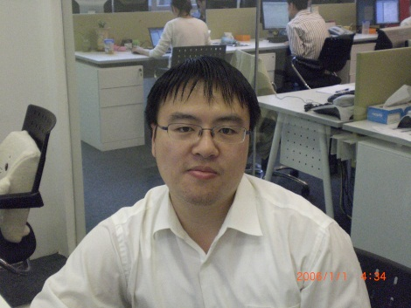
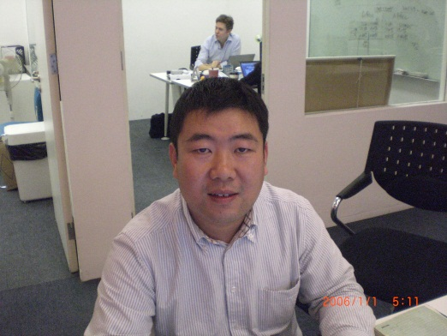
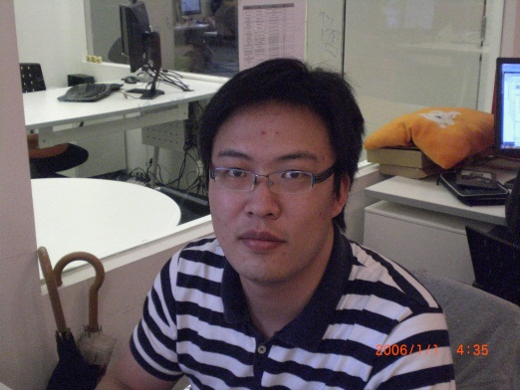
DBA team
Release team

Slide 4


SQL Server
SQL 2005 SP2
(9.0.3042)
SQL 2008 R2
(10.50.1600)

Slide 5
DBA Recommend (1)
SP Create
  [TableName]_[Action]_p
  use <dbName>
  dbo prefix
  set nocount on
  go
  permission grant to db base role
SP Alter
  No drop/create
  V2 when parameter number changes
CodeSpewWizard tool
  $/Builds/_Builds/Tools/CodeSpewingWizard
Notes:
$/Builds/_Builds/Tools/CodeSpewingWizard

Slide 6
DBA Recommend (2)
Table Create
  Singular form
  CapitalCasing
  _lkp, _lnk, w*
  PK, FK, UQ
  Collate SQL_Latin1_General_CP1_CI_AI
  InsertDate/UpdateDate
Table Drop
  _RemoveMeAfter20101201_ByXXX
  No _new, _1, _2, _bak

Slide 7
DBA Recommend (3)
Data Update
  Select before update with the same where clause
Use usb-etowndevts to access U.S.-based db servers
Add yourself in EnglishtownDevelopersShanghai group
Add your Chinese name in your Skype
Notes:
select * from sys.master_files
where file_id=2

Slide 8
Release Team Suggest
AutoBuild tool
  Run it before you request DB review
Release Request (RR) submit
  Don’t forget click ‘Request Review’
  Email/DropBy me for emergency release
  Take care the New/Update action
  Take care the US/CN/Both environment flags
Read-only data release
  Just get it ready in QA db server
  No need db script
Notes:
http://autobuild.englishtown.com/

Slide 9
SQL Server Likes (1)
WITH (NOLOCK)
  Specially for large table and live servers
No transaction
  We never use it except few scenarios
No ‘Select *’
  No covering index except table scan
  Additional disk IO and network bandwidth
SELECT TOP 10
Order By PK column

Slide 10
SQL Server Likes (2)
Sequential inserting to avoid page split
  Identity column
  LastID
Execute queries in VS3 instead of VS1
  Avoid additional workload for VS1
  VS3 has more indexes and much lighter workload
Cancel any query running longer than 2 minutes
Try stricter Where clause at first, then less
Filter the data based on famous index columns
  ET_Main..Members: MemberId, UserName, Email, PartnerSite
  ET_Payment..PaymentRequest: MemberId, Email
  VisitTracking: VisitDate
  PageVisit: VisitDate

Slide 11
Q & A

Slide 12
谢谢您
Thank You

