Slide 1


LVL2 Cosmics studies
Jamie Boyd, Takanori Kono (CERN - ATR)
Laura Gonzalez Silva (Buenos Aires)
Gaston Romeo (Buenos Aires)
31 Oct 2006
Outline:
Inner detector studies
Muon system studies
Combined slice
Future plans

Slide 2
LVL2 Cosmics / Muon & ID
General strategy
Find Muon hits (in RPCs and then in the MDTs)
Find TrigInDetTracks with slightly modified physics LVL2 tracking algorithms (IDScan and SiTrack)
Combine the TrigInDetTracks to form 1 track
Combine the ID track with the muon hits

Slide 3
Simulation issues
There are problems with SCT digitization for timing of simulated cosmics
  Recently given a fix for this but still doesn’t work (maybe reconstruction problem now?)
Studies with just muon systems simulation ok for cosmics
For ID studies getting round problem at the moment by simulating single muons. Current setup one of:
y=1m, x=0, z=0, eta & phi such that track inside barrel SCT first layer
y=7m, x=0, z=0, eta & phi such that track inside barrel SCT first layer

Slide 4
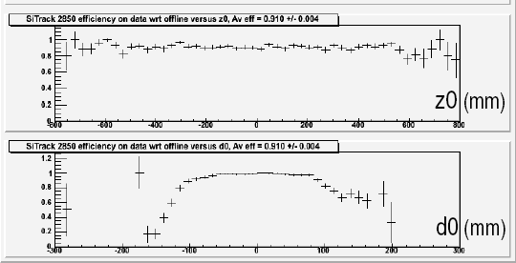
ID studies
Using physics LVL2 tracking algorithms (IDScan and SiTrack)
IDScan modified to use shifted space points (such as they look like they come from the IP)
SiTrack uses special LUT for tracks not coming from the IP
These were both tested on MC and real data from the ID barrel commissioning in SR1
Now concentrating on MC of the full detector in the pit
Example eff versus z0, d0 for SiTrack from SR1 MC

Slide 5
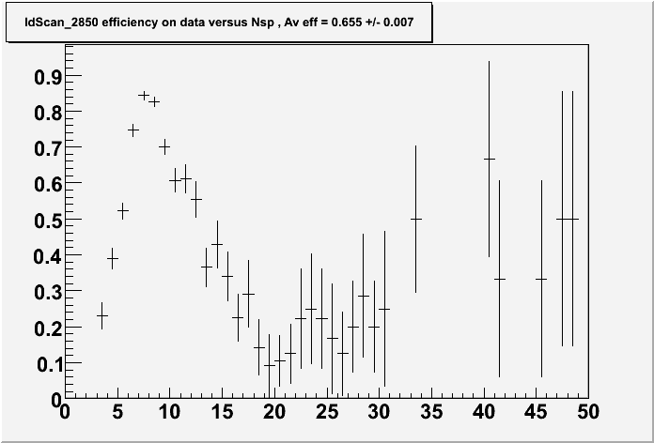
IDScan - shift
Shift done by simple line fit to all space points (remove hits that have high chi^2 contribution)
This shift wasn’t very effective when there are many space points in the event (plot) -> low IDScan efficiency
Mark Sutton wrote a new shifting routine
  Looks at pairs of hits in inner and outer layers
  Counts how many space points are in a thin straight line road between the pair
  Chooses the pair which have the most hits on the road and uses this to calculate shift
  Should be more robust with more noise space points
Unfortunately there is an occasional crash in the code that implements this, so not easy to run on lots of events
Have studied the 2 shifting algorithms on ~200 MC events (next slide)
Nspacepoints

Slide 6
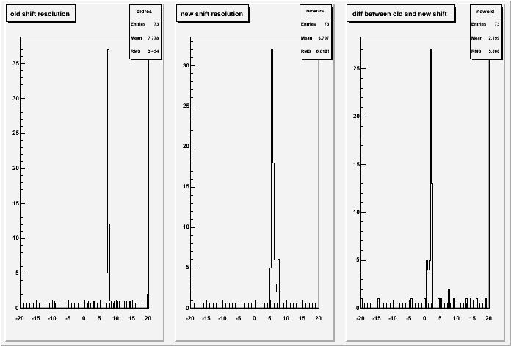
IDScan – new shift
Nevts
with MUROI
141
Old shift
Nevts with >0 IDScan tracks
111
Old shift
Nevts with >0 IDScan tracks
128
improvement
15%
Old shift – true shift
New shift – true shift
New shift distribution has less outliers
Improves the efficiency by ~15%
Distribution not centred at 0 as true shift doesn’t take into account the Field

Slide 7
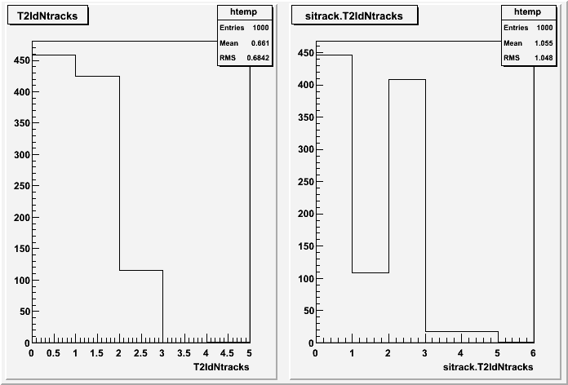
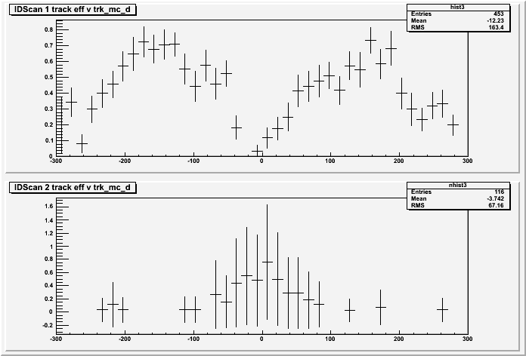
IDScan – 2 trks efficiency
IDScan
SiTrack
Seems IDScan doesn’t often find 2 tracks in these events (where SiTrack does)
IDScan shift OK and Z vertex OK
Problem is in finding the groups in the HitFilter
Problem is for large d0
Experts are looking into this…
IDScan 1 track efficiency versus d0
IDScan 2 track efficiency versus d0

Slide 8
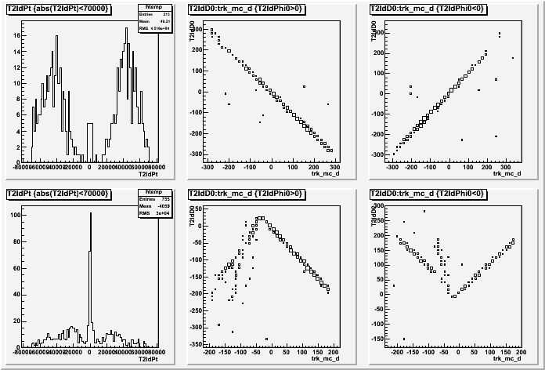
SiTrack – problems with d0 & Pt
SiTrack has good efficiency but seems to have problems
  D0 sign convention is bad
  Pt values for track come out badly
  Experts have been consulted
L2 track d0 versus MC truth d0
(left for tracks going up, right
for tracks going down)
IDScan
SiTrack

Slide 9
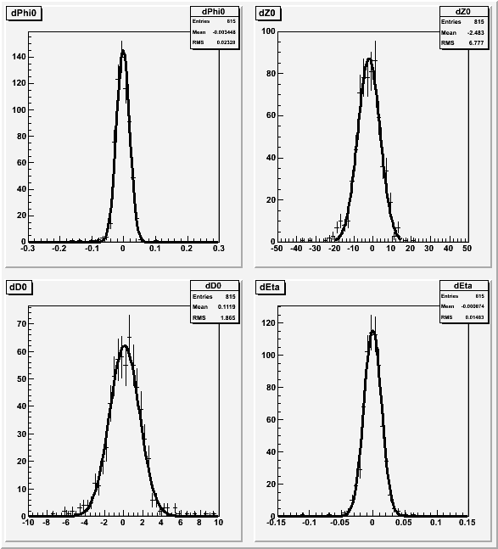
Combining 2 SiTrack Tracks
Laura Gonzalez Silva
Joining together the top and bottom tracks found by SiTrack
Then make a new track with average track parameters for joining to Muon
Resolns:
  phi ~0.02 rad
  z0 ~ 7mm
  d0 ~ 1.9mm
  eta ~0.015
Only shown for mc_d0>0

Slide 10
Muon algorithm
Takanori Kono
New Muon algorithm written specifically for cosmics
Reminder of the simple algorithm used
  Use RPC station 2 as seed
  Make simple straight line fit to RPC hits
  Look at MDT hits around the RPC track
  In each of the 3 MDT stations make MDT track segment out of the MDT hits around RPC track
  Look at angle between MDT track segments and RPC tracks
Algorithm efficiency ~70% and ~flat in d0,z0,eta,phi
RPC track
Used as
a seed
MDT track segment
MDT hit
RPC hit

Slide 11
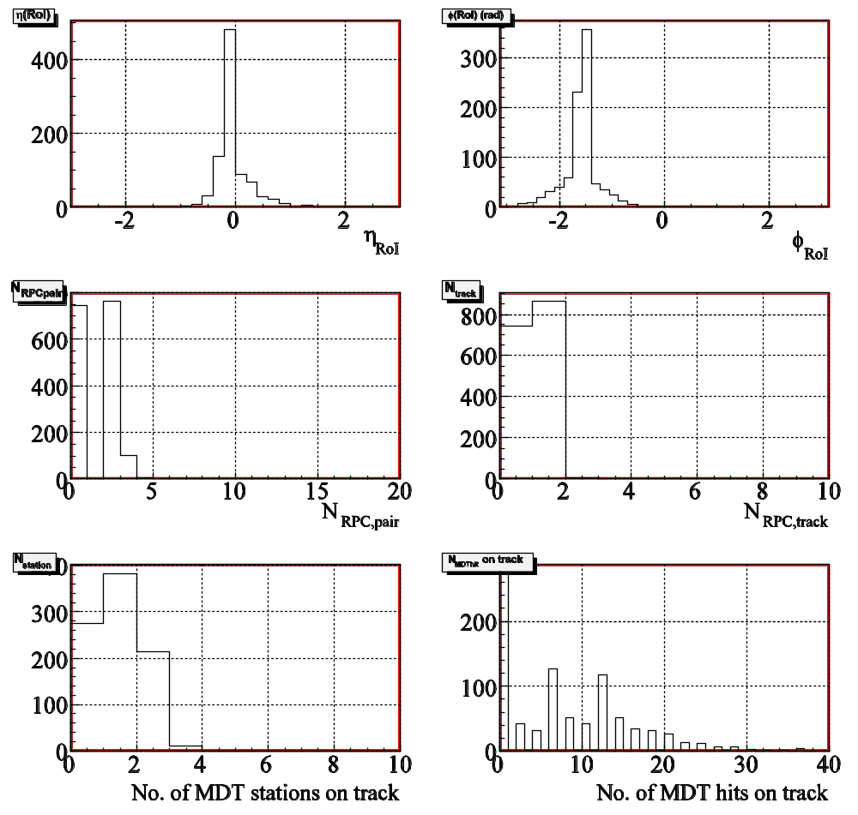
Muon algorithm on real data
Takanori Kono
Running the muon algorithm offline over the sector 13 cosmic data
Data contains MDT, RPC, MUCPTI, CPT
Many technical difficulties
  Non standard readout format (RPC and MDT)
  No ROI builder (had to run RoIBuilder simulation)
However data looks good
Awaiting data taking to try running online

Slide 12
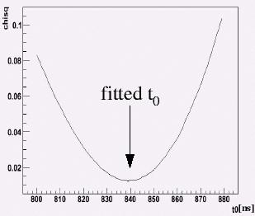
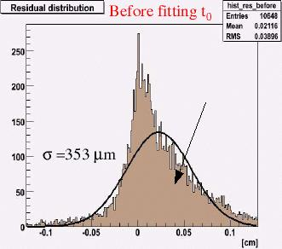
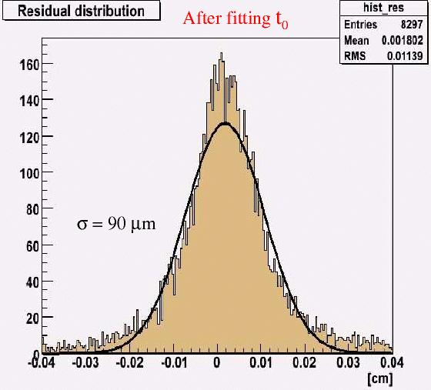
Muon algorithm – further work
Gaston Romeo
Using MDT info to estimate the t0 of the event
Step through possible t0 values and fit the MDT track using the MDT drift circles
  Choose the value of t0 which gives the lowest fit chi^2
This gives improved track residual from 353um to 90 um
Full details can be seen at:
http://indico.cern.ch/getFile.py/access?contribId=4&amp;resId=0&amp;materialId=slides&amp;confId=5142

Slide 13
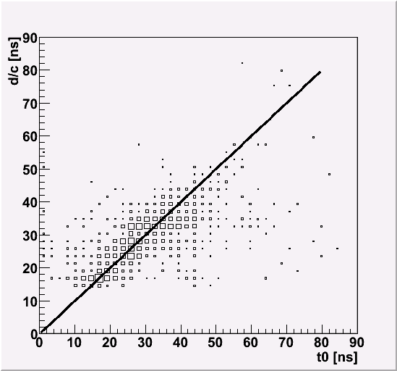
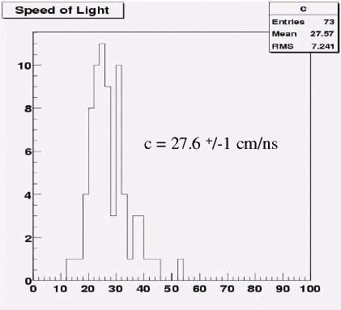
Muon – timing
Gaston Romeo
Can look at the difference in t0 from different MDT stations => gives us the speed of the Muon
Some funny effect in the simulation where timing seems to be wrong for cosmics – under investigation
Algorithm has been speeded up so as can run online
  Timing improved ~30ms / evt -> ~10ms /evt

Slide 14
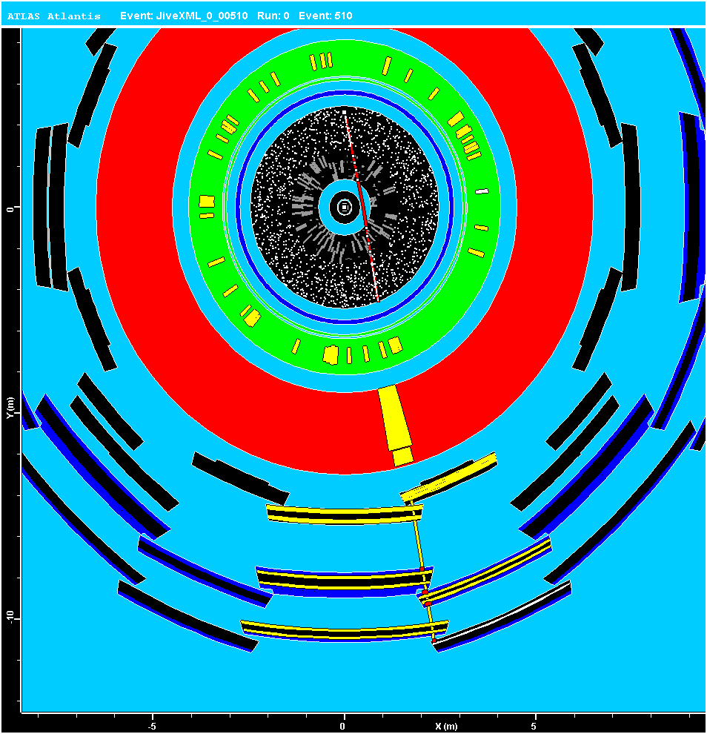
Combining ID and muon info
Simulation of single muons with displaced vertex
Run both ID and muon algorithms on the data
Look at combining the Muon and ID information

Slide 15
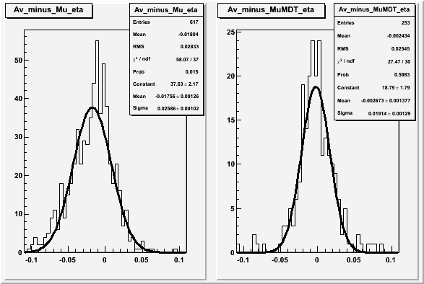
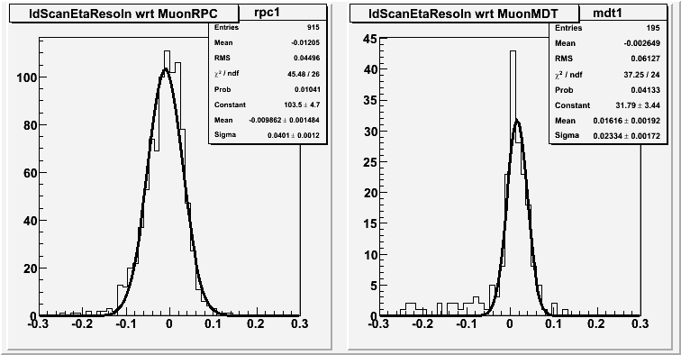
Combining ID and Muon system info
Laura Gonzalez Silva
Comparing the eta from the average of the top and bottom SiTrack tracks and the eta from the muon system.
Both from RPC and MDT
RPC eta
MDT eta
Comparing the eta from IdScan tracks and the eta from the muon system
Both RPC and MDT
Expect MDT better resoln than RPC – and will improve when we use the new t0 estimate
RPC eta
MDT eta

Slide 16
Example of a cosmic slice
We want to produce a full LVL2 cosmic slice
Will be very useful for testing the full HLT chain
  ROI mechanism
  LVL2 configuration
  LVL2 steering
  LVL2 -> EF (if we put in an EF slice)
  Offline software to understand the LVL2
Will also provide a sample of well reconstructed cosmics for other systems to use
Muon RoI
Muon RoI
TrigL2CosmicMuon
TrigL2CosmicMuon
IDSCAN/SiTrack
IDSCAN/SiTrack
Two back-to-back tracks
1track Hypo
2track Hypo

Slide 17
Conclusions
LVL2 cosmic algorithms progressing well
ID
  Some problems with both algorithms to be understood but still see reasonable efficiency, resolutions
  Need to work on getting the cosmic simulation to work for ID
Muon system
  Using the timing of the MDT to fit for t0 giving improved resolution
Started putting this into new HLTAlgorithms
Then need to work on combining the algorithms and testing in online slice (athenaMT)
On track for slice to be in place for when cosmic data taking starts
Work to start on an EF cosmic slice

Slide 18
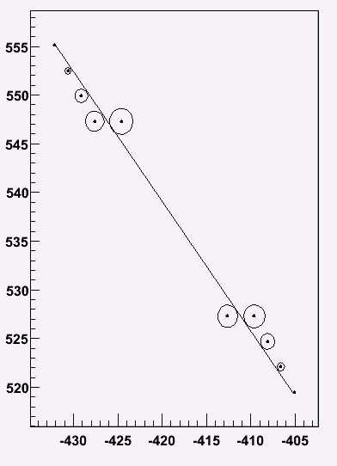

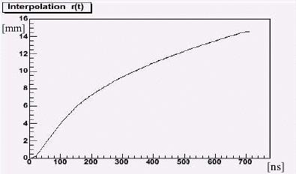
Backup - MDT t0
Choose a value of t0 and then calculate:
z, r is co-ordinate of wire
b, theta parameters of the straight line
Sum is over the MDT hits in 1 station
A t0 gives us a MDT drift time which can be used to give a drift circle
Fit the combined drift circles for that t0.
Repeat with a many t0 value and choose t0 which
gives the best chi^2.

Slide 19
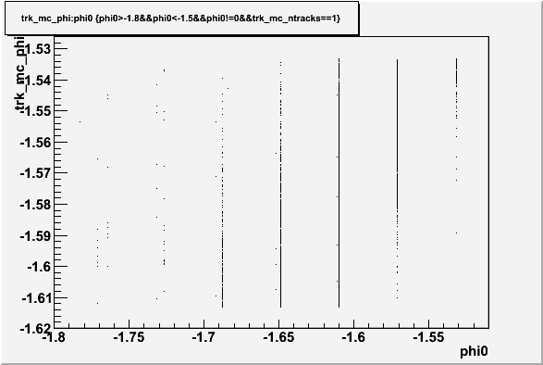
RPC resolutions
Phi value from RPC is quantised.
3mm x granularity separated by 1m.
See this when matching LVL2 track to RPC muon

