Slide 1


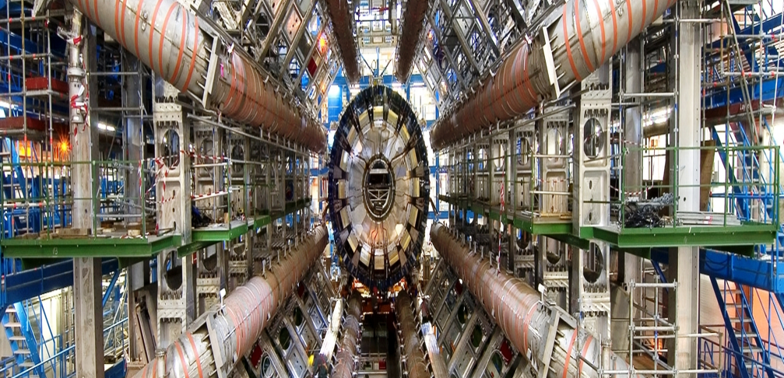
Identificación de jets con hadrones b producidos por desdoblamiento de gluones con el detector ATLAS
Tesis de doctorado en Cs. Físicas por Lic. M.Laura González Silva
Director: Dr. Ricardo Piegaia
Dep. Física, FCEyN, UBA
Marzo 2013

Slide 2

Esquema de la charla:
Introducción
Producción de jets b en QCD
El detector ATLAS en el LHC
Reconstrucción de jets y b-tagging con el detector ATLAS
Propiedades de jets con hadrones b
El identificador de jets con 2 hadrones b
Medición de la composición de b-jets en QCD
Conclusiones
Notes:
In particular, they tag jets containing a bb pair, with no net heavy
flavour, which do not correspond to the intuitive picture of a b-jet as a jet containing a single b-quark or
antiquark.
We will henceforth call “merged” b-jets the b-tagged jets containing two b-hadrons and single
b-jet the jets containing only one b-hadron, as depicted in Fig
There are two possible strategies to attempt to identify b-jets containing two b-hadrons. One of
them relies on the direct reconstruction of the two b-decay secondary vertices [4]. This allows the mea-
surement of the angular separation between the b-hadrons, but suffers from the low efficiency of a double
b-tag requirement plus additional reconstruction inefficiencies at small angular separation between the
two b-hadrons. In this paper we develop an alternative method that does not rely on explicit vertex find-
ing, but exploits the substructure differences between single and merged b-jets, combining them in a
multivariate analysis.
Tagging merged b-jets provides a handle to reduce background in different lines of analysis. where signal is known to produce single b-hadron jets.

Slide 3
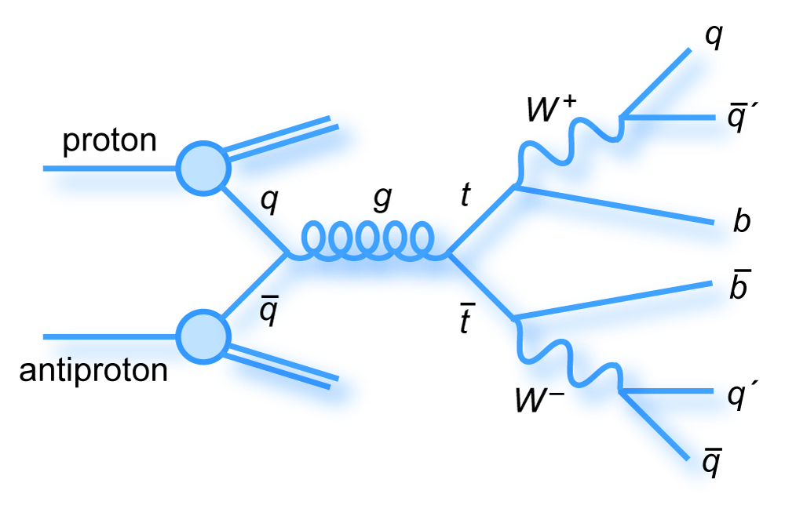
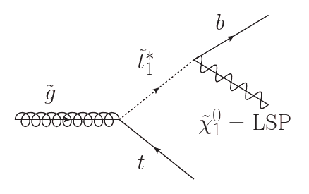
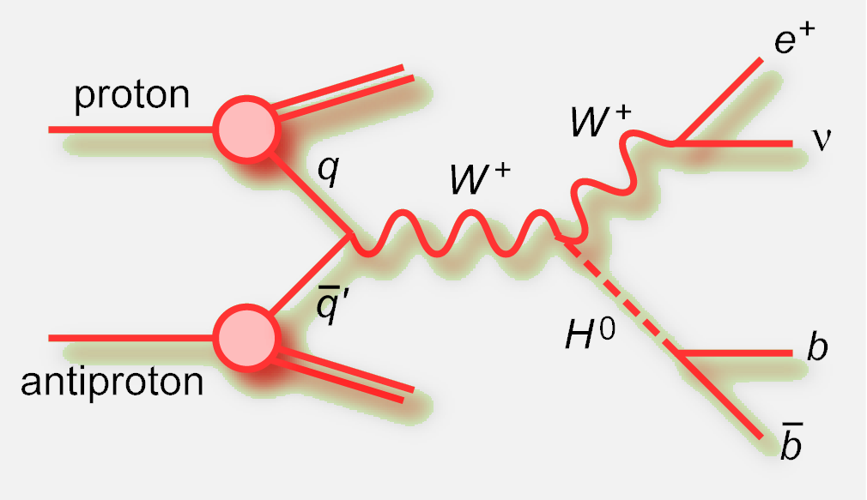
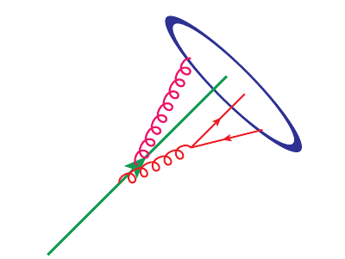
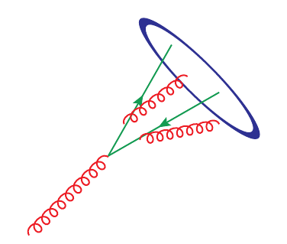
Introducción
Muchos procesos interesantes en altas energías producen quarks b
La técnica experimental para identificar los jets producidos por la fragmentación del quark b se denomina “b-tagging”.
Pero b-tagging también selecciona como b-jets a aquellos producidos en procesos no interesantes por gluon-splitting (gbb) en QCD.
Top Higgs Supersimetría
b
b
b
g
En esta tesis se desarrolló un método para distinguir b-jets genuinos de gbb jets
  Eliminar fondos en búsqueda de nueva física
  Estudiar en detalle los distintos mecanismos de producción de quarks b
Notes:
In particular, they tag jets containing a bb pair, with no net heavy
flavour, which do not correspond to the intuitive picture of a b-jet as a jet containing a single b-quark or
antiquark.
There are two possible strategies to attempt to identify b-jets containing two b-hadrons. One of
them relies on the direct reconstruction of the two b-decay secondary vertices [4]. This allows the mea-
surement of the angular separation between the b-hadrons, but suffers from the low efficiency of a double
b-tag requirement plus additional reconstruction inefficiencies at small angular separation between the
two b-hadrons. In this thesis we develop an alternative method that does not rely on explicit vertex find-
ing, but exploits the substructure differences between single and merged b-jets, combining them in a
multivariate analysis.
Tagging merged b-jets provides a handle to reduce background in different lines of analysis. where signal is known to produce single b-hadron jets.

Slide 4
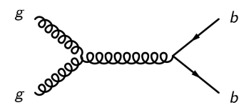
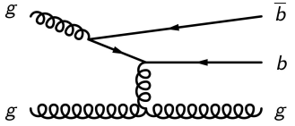
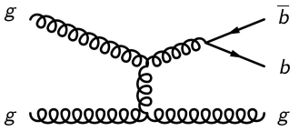
Producción de jets b en QCD
El mecanismo de producción de b-jets más común es Cromodinámica quántica (QCD). La producción de quarks pesados se clasifica en tres categorías:
FLAVOR CREATION
FLAVOR EXCITATION
GLUON SPLITTING.
Single b-jet
Single b-jet
Merged b-jet
Single b-jet
Single b-jet
En el caso de GLUON SPLITTING (GSP) se espera que los hadrones b sean producidos cercanos en ángulo, dando lugar a un “merged” jet.
gg → bb gb → gb gg → gg
Notes:
Jets produced by the fragmentation of $b$-quarks or $b$-jets, enter in many collider searches, notably because they are produced in the decays of various SM massive particles (top quarks, the $Z$ boson and the Higgs boson, if light), and of numerous particles appearing in proposed extensions of the SM. However, the most common mechanism of heavy-flavor production is Quantum Chromdynamics.
It is sometimes stated that it makes no sense, beyond LO, to separately discuss the different channels, for example because diagrams from separate channels interfere. However, each channel is associated with a different structure of logarithmic enhancements, $\ln^n (\pt / m_b )$, and so there is distinct physical meaning associated with each channel.
En el caso de Flavor Creation (FCR) los jets están balanceados en pT y son back-to-back en φ.
En el caso de Flavor Excitation (FEX) tenemos un jet central y otro. La separacion angular entre los dos es flat .
Dependiendo de como se compara la separacion de los hadrones b en GSP con el tamano del cono del jet, los dos hadrones van a ser clustereados en un jet o daran lugar a dos jets cercanos.

Slide 5
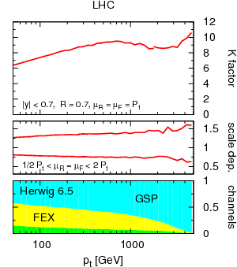
Medición de la producción de jets b en QCD
Sección eficaz de producción de b → incertezas teóricas altas
K = 2do orden / 1er orden (NLO/LO) K ~ 6 - 10
Dependencia con la escala: 50%
A LO solo está presente Flavor Creation (FCR), a NLO, 2 nuevos canales se abren: Flavor Excitation (FEX) and GSP.
Las incertezas más grandes estan asociadas con el canal GLUON SPLITTING, y la presencia de g→ bb jets.
Propuesta [Banfi et al JHEP07(2007)]: no considerar g→ bb jets como b-jets
Jets con igual número de b y b se consideran jets livianos
K ~ 1.2-1.4, scale dependence 10%
Notes:
The simplest and most fundamental measurement of heavy-quark jet production is the inclusive heavy-quark jet spectrum, which is dominated by pure QCD contributions.
1. Inclusive b-jet spectrum has large theoretical uncertainties, K~8 and scale dependence 50%. ( These uncertainties are quantified by the renormalization and factorization scale dependence of the calculation. In varying $\mu_R$ and $\mu_F$ between $\pt$/2 and 2$\pt$, $\pt$ being the transverse momentum of the hardest jet in the event, the heavy flavor cross section varies by up to 50\%)
2. The various channels can be approximately separated with a parton shower Monte Carlo generator such as {\sc Herwig} or {\sc Pythia}, where one can determine the underlying hard process from the event record. These MC generators effectively include NLO effects via parton showers.Largest uncertainties are associated with the gluon splitting channel. The relative importance of each channel in the $b$-jet spectrum is shown in the bottom panel of Fig.~\ref{fig:bjets_qcd}. It is found that the supposedly LO channel (FCR) channel has a much smaller contribution than the two channels that at fixed order enter only at NLO (FEXand GSP). This is because both NLO channels receive strong enhancement from collinear logarithms,
3. Proposal: use the flavour-kt algorithm where bbar jet is considered
as a light jet. With this, K ~ 1.3 and scale dependence 10%.

Slide 6
Esquema de la charla:
Introducción
Producción de jets b en QCD
El detector ATLAS en el LHC
Reconstrucción de jets y b-tagging con el detector ATLAS
Propiedades de jets con hadrones b
El identificador de jets con 2 hadrones b
Medición de la composición de b-jets en QCD
Conclusiones
Notes:
In particular, they tag jets containing a bb pair, with no net heavy
flavour, which do not correspond to the intuitive picture of a b-jet as a jet containing a single b-quark or
antiquark.
We will henceforth call “merged” b-jets the b-tagged jets containing two b-hadrons and single
b-jet the jets containing only one b-hadron, as depicted in Fig
There are two possible strategies to attempt to identify b-jets containing two b-hadrons. One of
them relies on the direct reconstruction of the two b-decay secondary vertices [4]. This allows the mea-
surement of the angular separation between the b-hadrons, but suffers from the low efficiency of a double
b-tag requirement plus additional reconstruction inefficiencies at small angular separation between the
two b-hadrons. In this paper we develop an alternative method that does not rely on explicit vertex find-
ing, but exploits the substructure differences between single and merged b-jets, combining them in a
multivariate analysis.
Tagging merged b-jets provides a handle to reduce background in different lines of analysis. where signal is known to produce single b-hadron jets.

Slide 7
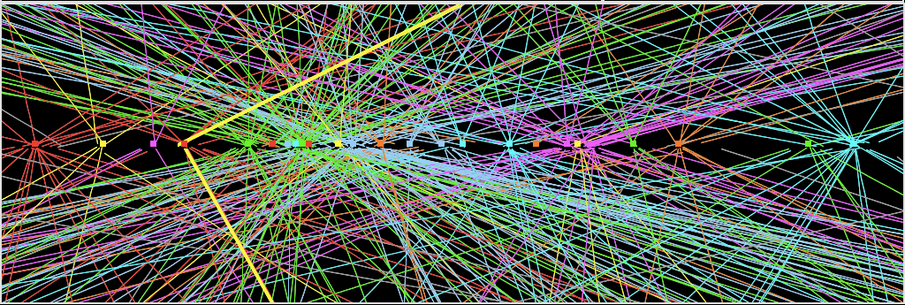
El LHC
Primeras colisiones pp en Noviembre 2009, 0.9 TeV en el cm.
2010 y 2011: 7 TeV.
2012: 8 TeV.
Múltiples interacciones pp por crossing: “pile-up”
  “in-time” pile-up
  “out-of-time” pile-up
Diseño
10¹¹ p
10¹¹ p
Notes:
It is important to note that when we speak about ``beams'' we refer to many bunches of protons separated by some uniform distance. Increasing the number of bunches is one of the ways to increase luminosity in a machine. At desinged beam intensity, when the bunches cross, there will be a maximum of about 20 collisions.
A large magnetic field is needed to guide and maintain the beam particles in their circular orbit.
on December 8, ATLAS and CMS detectors started recording data at energy of 2.36~TeV. By this time the LHC became the highest energy accelerator in the world.
During the 2010 run the beam parameters were tuned in order to increase the beam intensity. In particular, as the intensity of the beams increased, the mean number of interactions per bunch crossing augmented.
The experimental signature of this fact is obtain via the number of reconstructed primary vertices, or NPV. The effect of the event NPV is an important concern for the measurement of jet properties and will be discussed in the next chapters.
2010 45 pb-1
2011 5 fb-1
2012 21.7 fb-1

Slide 8
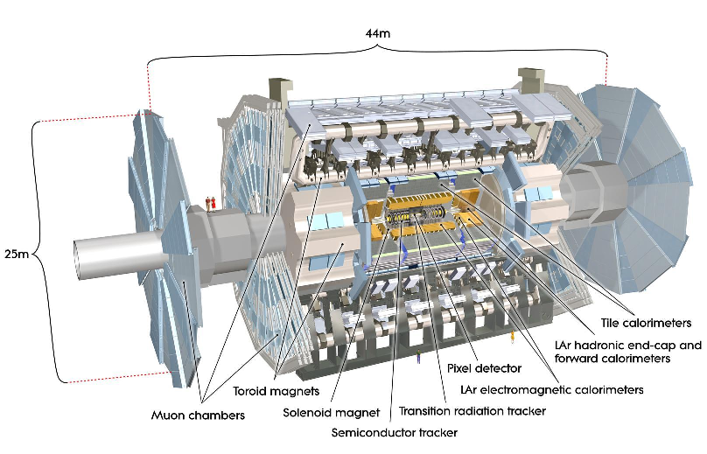

El detector ATLAS
7000 toneladas
88 Millones de canales
3000 km de cables
Solenoide B ~ 2T
Toroide B ~ 0.5T
η= 0
φ
η=infinito
Vamos a utilizar el detector de trazas y el calorímetro.
Notes:
The $x-y$ plane is referred to as the transverse plane, and the $z$ direction as the longitudinal
The transverse momentum $\pt$ is defined in the $x-y$ plane unless stated otherwise.

Slide 9
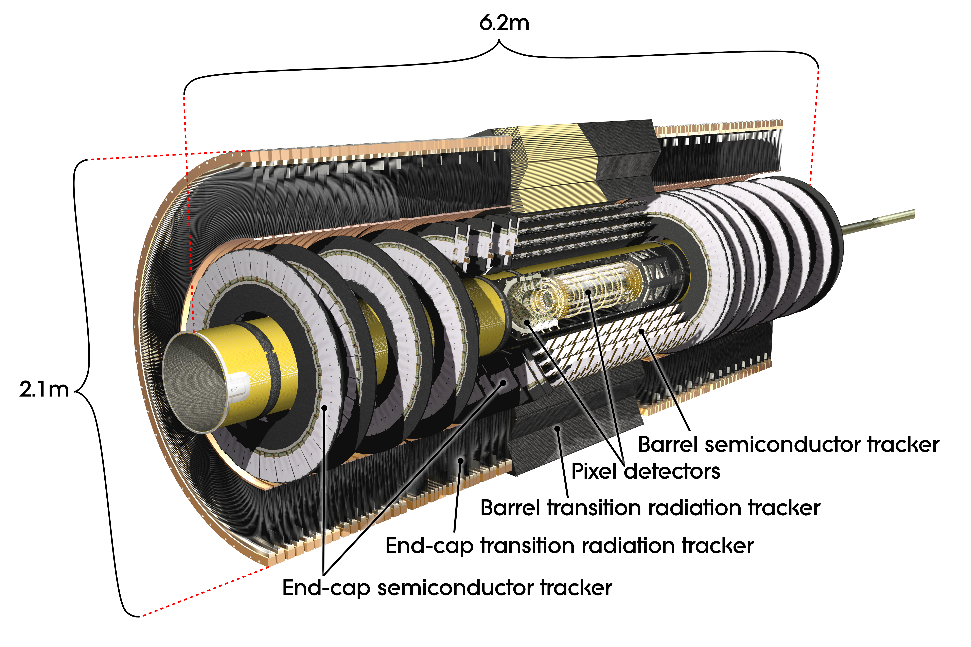
El detector de trazas
Reconstrucción de la trayectoria de partículas cargadas, medición del momento transverso, |η| < 2.5
B(solenoide) = 2T
<puntos> ~ 3 Pixel, 8 SCT, 30 TRT
Precisión
transversal 10 μm Pixel, 17 μm SCT, 120 μm TRT
Longitudinal 115 μm Pixel, 580 μm SCT
6.2 m
2.1 m
Notes:
The inside-out algorithm starts from 3-point
seeds in the silicon detectors and adds hits moving away from the interaction point using a combinato-
rial Kalman filter. Ambiguities in the track candidates found in the silicon detectors are resolved, and
tracks are extended into the TRT.
studies of the performance of ID recon-
struction in high pile-up [3] have indicated that fake tracks can be minimised by tightening the quality
requirements on reconstructed tracks.

Slide 10
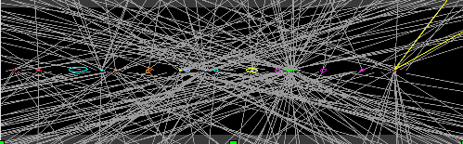
Reconstrucción del vértice primario
Las trazas con pT^{track} > 400 MeV son asociadas en vértices primarios (PV).
Resolución en reconstrucción de PV (z) ~ 100 μm.
El PV debe contar con al menos 5 trazas asociadas.
En el caso de múltiples interacciones pp, el PV con el mayor ∑trk(pT^{trk})² , es seleccionado como aquel asociado a la interacción “hard”.
PV
Notes:
The charged-particle tracks with pseudorapidity |η|<2.5 are reconstructed in the ID.
Tracks with pT^{track} > 400 MeV and consistent with the beam spot are associated in primary vertices via a finding/fitting sequential algorithm.
To ensure a good resolution on the vertex position, the primary vertex must be reconstructed from at least five tracks.

Slide 11
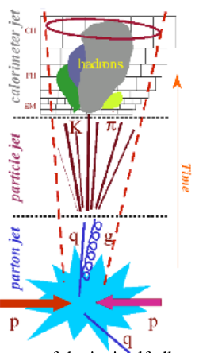
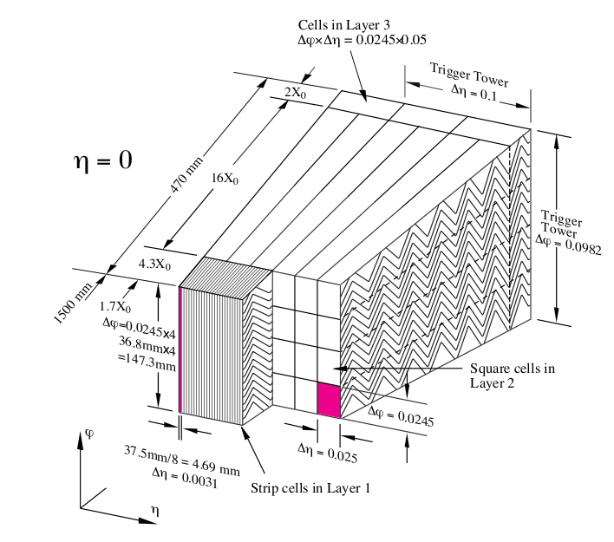
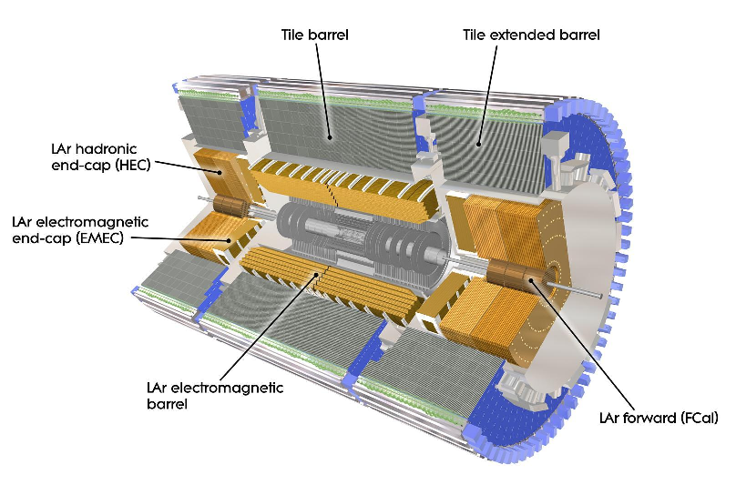
El calorímetro de ATLAS
Calorímetro de alta granuralidad: permite estudio de la estructura interna de jets.
Δ ηxΔφ ~0.025x0.025 en la región central
Hermético hasta |η|~4.9
44 m de largo
Quarks → partículas → celdas
Quarks y gluones se ven como
Jets en el calorímetro.
Notes:
The purpose of the ATLAS calorimeter system is to measure the energy of electrons, photons, taus and jets, within the pseudorapidity region of $|\eta| < $4.9 and with full $\phi$ symmetry and coverage around the beam axis. It also provides fast position and energy measurements to serve as trigger signals for these objects as well as the missing transverse energy.
The calorimeter detector consist of electromagnetic (EM) calorimeter and hadronic calorimeter components. The EM calorimeter provides fine granularity measurements of electrons and photons. Each calorimeter is segmented both transverse to the particle direction, to give position information, and along the particle direction, to chart the development of the particle shower.
To provide full coverage in $\phi$ without any cracks, an accordion-shaped absorber and electrode geometry is used
The figure highlights how this geometry is divided among rectangular cells in $\eta \times \phi$ space,
To minimize noise and increase speed the first level of readout is located on the detector. The front-end electronics amplify and shape the signal. the overall pulse shape and duration are optimized to effectively redefine the baseline of the energy measurement

Slide 12
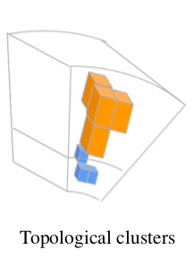
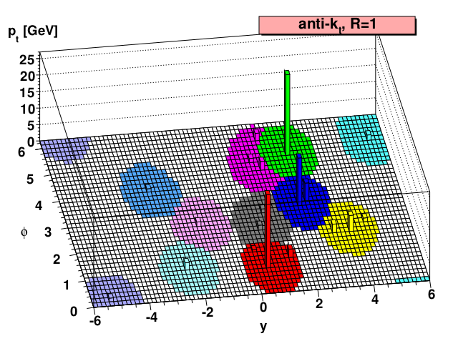
La reconstrucción de jets
Las celdas contiguas con deposiciones de energía se agrupan en clusters.
44 m de largo
Los clusters se combinan mediante un algoritmo de jets (ATLAS utiliza anti-kt)
La incerteza en la determinación de la energía (resolución) es del ~16% para jets de bajo momento y hasta 4% para jets con pT > 300 GeV (región central).
η
Notes:
the anti-$k_t$ algorithm is fast , it is well adapted to algorithms used in the trigger, and it has the best jet reconstruction efficiency at low $\pt$. exhibits the smallest fluctuations of the jet area showing good stability under pile-up
Topological clusters are groups of calorimeter cells that are designed to follow the shower development taking advantage of the fine segmentation of the ATLAS calorimeters.
Two different size parameters are used: $R = 0.4$, for narrow jets, more adecuate to describe the event substructure and associate matrix element partons to jets in multiparton final states; %($t\bar{t}, susy, $W$+jets, etc.)$ and $R = 0.6$, for wider jets, with very little out of cone radiation, more suitable for QCD studies.
Charged particle tracks reconstructed in the Inner Detectors are also used to define jets. The latter have the further advantage of being insensitive to pile-up and they provide a stable reference for systematic studies.
topological clusters are combined as massless four-momentum objects. In the case of track-jets, The final four-momentum of the jet is obtained from summing the four-momenta of its constituents in the so called ``four-vector recombination scheme''. allows a meaningful definition for the jet mass.
In Monte Carlo simulation, reference jets (``truth jets'') are formed from simulated stable particles
The baseline EM energy scale of the calorimeters is the result of the calibration of the electronics signal to the energy deposited in the calorimeter by electromagnetic showers
The purpose of the jet energy calibration, or jet energy scale (JES), is to correct the measured EM scale energy to the energy of the stable particles within a jet.
``EM+JES'' calibration, utilizes an energy and $\eta$-dependent calibration: pileup correction, origin correction, energy and direction correction based on response.

Slide 13
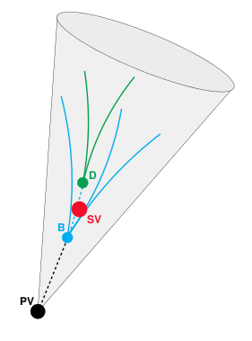
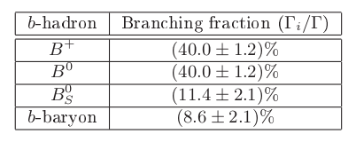
B-Tagging de jets
Identificación de jets con hadrones b (90% mesones y el resto, bariones), producidos por la fragmentación de quarks b.
τB~ 10⁻¹² s → longitud de decaimiento de B (50 GeV) ~ 5 mm
Las partículas producidas en su decaimiento formarán un vértice secundario.
Notes:
The aim of $b$-tagging is to identify the $b$-quark jets with high efficiency, while rejecting most of the background contamination from jets originating from the fragmentation of light ($u$, $d$, and $s$) quarks, gluons and $c$-quarks.
In most of the cases ($\approx$87\%), first an excited $b$-hadron is produced, like a $B^{*}$ or a $B^{**}$, which decays inmediately, strongly or electromagnetically, into a ground state $b$-hadron plus one or more further particles; while in the remaining cases, a ground state $b$-hadron is produced directly.
Any of the finally produced $b$-hadrons decay through weak interactions and therefore have a significant lifetime, which is on average, for all $b$-hadrons considered, $(1.568\pm0.009) \times 10^{-12}$~s. The effective distance travelled in the detector by the $b$-hadron before decaying depends on the $b$-hadron momentum, which enters the relativistic boost factor $\beta\gamma$. A $b$-quark with momentum of 50~GeV will travel around 3~mm, which is a visible flight length in the detector. Due to the combination of the $b$-hadron lifetime and relatively high mass ($m_B \approx 5.28$~GeV), which results in a non-negligible decay angle of the $b$-hadron decay products %PUEDO EXPLICAR ESTO?
with respect to the $b$-hadron flight direction, the charged particles produced at the decay vertex will be on average significantly displaced with respect to the primary vertex position.

Slide 14
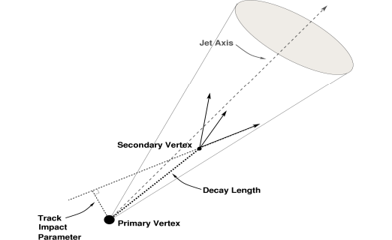
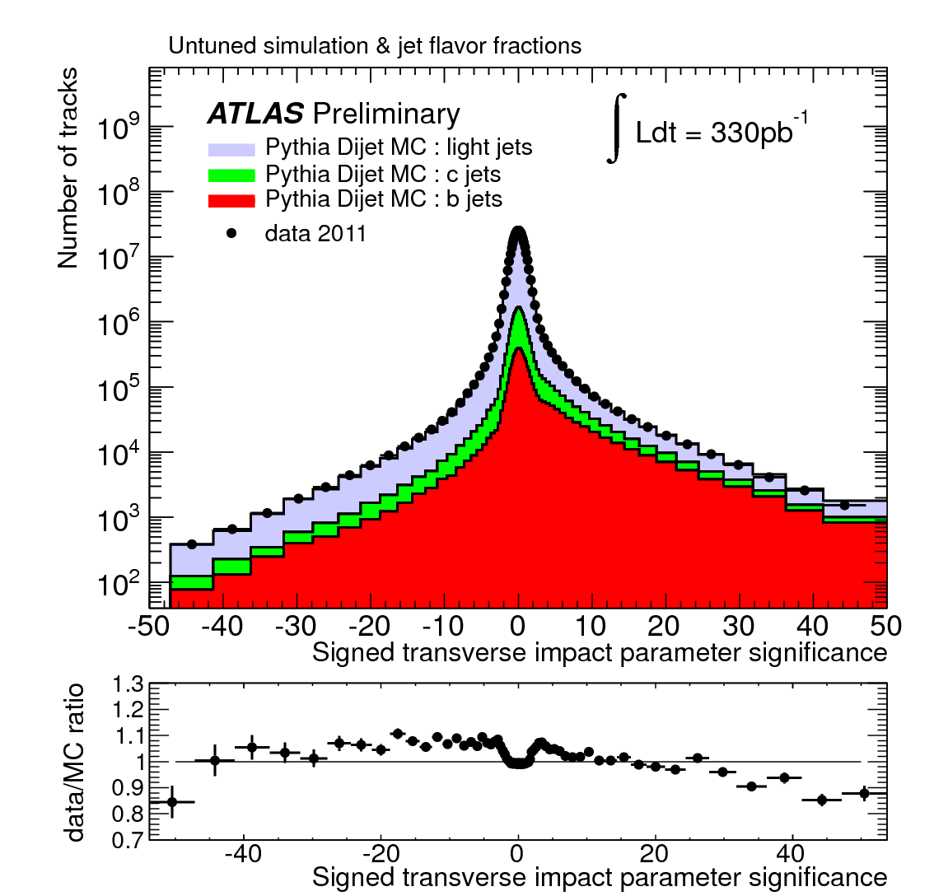
Algoritmos de b-tagging
Las características del decaimiento de los hadrones b dan lugar a dos clases de algoritmos básicos:
Alto parámetro de impacto
Reconstrucción de vértices secundarios.
Algoritmos “avanzados”: técnicas de multivariable, mejoran la discriminación entre jets b y jets de quarks livianos (“jets livianos”).
La calibración de estos algoritmos (medición de la eficiencia en datos) se realizó utilizando muestras de eventos ttbar y de jets asociados a muones.
Notes:
The ability to identify jets containing b-hadrons is important for the high-pT physics program of the
ATLAS experiment. Two robust b-tagging algorithms taking advantage of either the impact parameter
of tracks [1] or the reconstruction of secondary vertices [2] were developed and successfully used for
several analyses of the 2010 and 2011 data. Building on this experience, more advanced and performing
b-tagging algorithms have been commissioned with 2011 data [3]. b-tagging algorithms rely on the relatively long decay length of b-hadrons that gives rise to large impact parameter tracks and displaced decay secondary vertices, or on the presence of a soft lepton within the jet, the product of the semileptonic b-decay. The more advanced taggers use multivariate techniques to further increase the
discrimination between b-jets and light jets.
The $b$-tagging performance relies critically on the accurate reconstruction of the charged tracks in the ATLAS Inner Detector.
In order to reject badly reconstructed tracks, quality cuts are applied.
in order to increase the discriminating power of the impact parameter significance, a lifetime sign is assigned to these variables (replacing the sign of the geometrical definition of the impact parameter). The sign is positive if the track extrapolation crosses the jet direction in front of the primary vertex (i.e. is more compatible with having its origin in a secondary decay vertex in the direction of flight expected for the $b$-hadron) or negative if the track is more likely to intersect the flight axis behind the primary vertex, opposite to the jet direction.

Slide 15
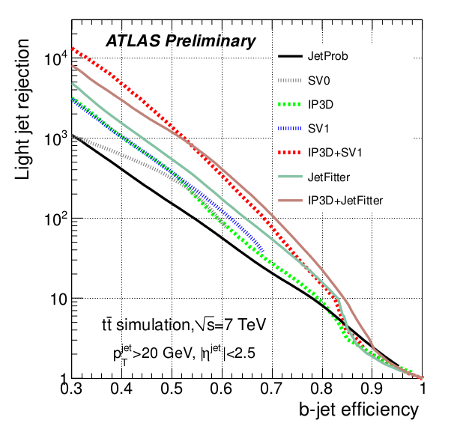
Performance
La información del parámetro de impacto de las trazas o de los SV es combinada en una única variable discriminadora
La performance es medida en términos de
rechazo de jets livianos y
eficiencia (fracción de b-jets taggeados).
Elección del punto de trabajo:
más eficiencia → menos rechazo
50% → 1/1100
80% → 1/200
Puntos de trabajo calibrados: 50%, 60%, 70%, 80% de eficiencia.
MV1 tagger

Slide 16
Esquema de la charla:
Introducción
Producción de jets b en QCD
El detector ATLAS en el LHC
Reconstrucción de jets y b-tagging con el detector ATLAS
Propiedades de jets con hadrones b
El identificador de jets con 2 hadrones b
Medición de la composición de b-jets en QCD
Conclusiones

Slide 17
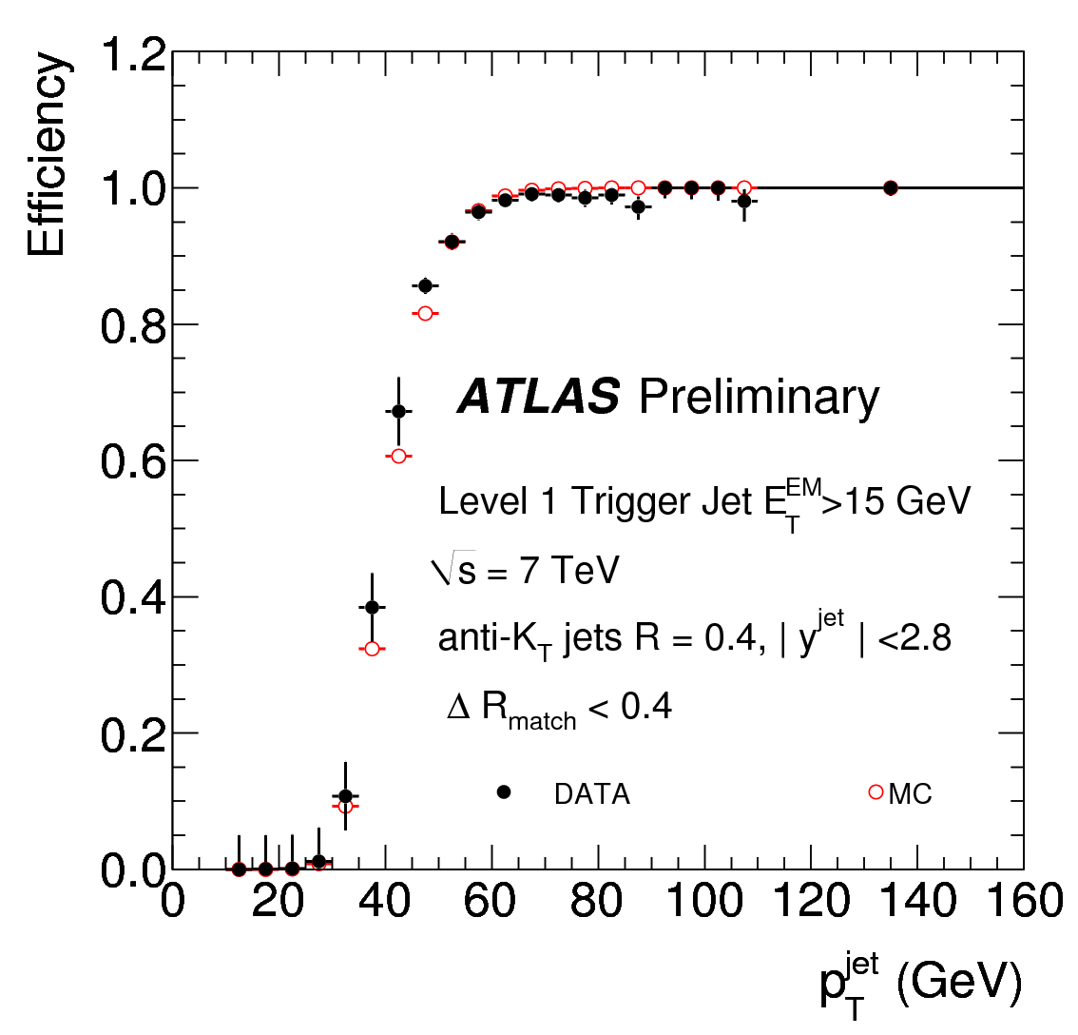
Datos analizados
Se analizan datos 2011 que contengan b-jets
Se dividen en 8 rangos de momento transverso del jet [GeV]:
40 → 60 → 80 → 110 → 150 → 200 → 270 → 360 → 480.
EF30
Cada rango corresponde a un trigger (condición para la selección de un evento durante la toma de datos)
Ejemplo:
Trigger “EF30” → rango 60–80 GeV

Slide 18
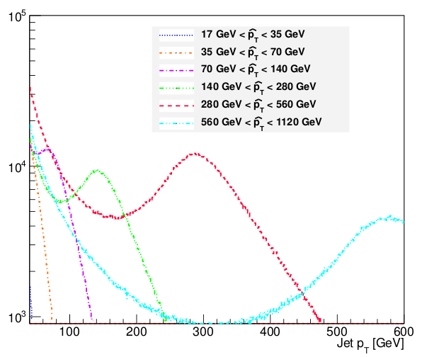
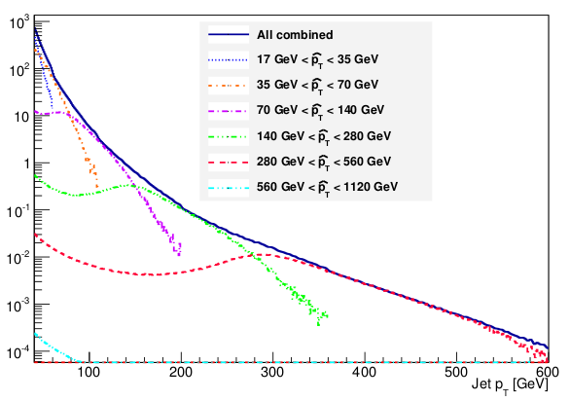
Simulaciones Monte Carlo
Generador de eventos PYTHIA
- Proceso 2 → 2 (gg → qq, etc)
- lluvia partónica
- hadronización.
De manera de tener suficiente estadística en todo el rango de pT se generaron 7 muestras con distintos umbrales en el momento transverso partónico
Las muestras se pesan por sus respectivas secciones eficaces de manera de tener un espectro que reproduzca los datos.

Slide 19
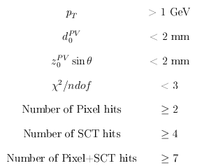
Selección de eventos
Selección de jets
Selección de trazas
Online: jet triggers (una simulación del trigger es utilizada en el caso del MC)
Offline: al menos un PV con 5 o más trazas asociadas
Anti-kt jets, R=0.4
Calibrados a la EM+JES
pT > 40 GeV, |η| < 2.5
ω > 0.905 (60% eficiencia)
Isolation: ΔR(jet, jet2) > 0.8

Slide 20

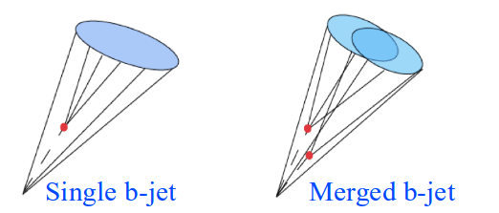
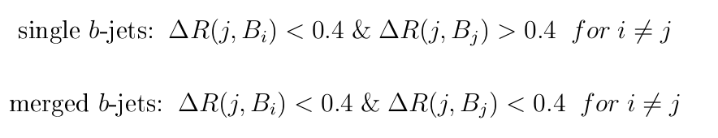
Identificación de single y merged b-jets via subestructura
Para la distinción entre jets b genuinos originados en la fragmentación de un quark b y jets con dos hadrones b producidos por gluon splitting se utilizaron variables sensibles a la estructura interna del jet.
Se espera para los merged b-jets
  Mayor número de trazas
  Más ancho
  Presencia de subjets

Slide 21
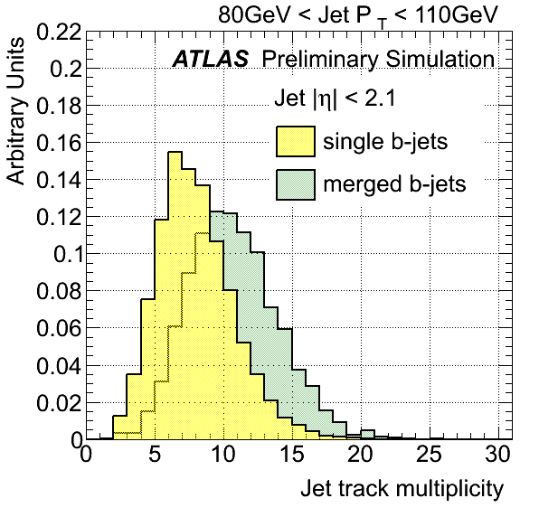
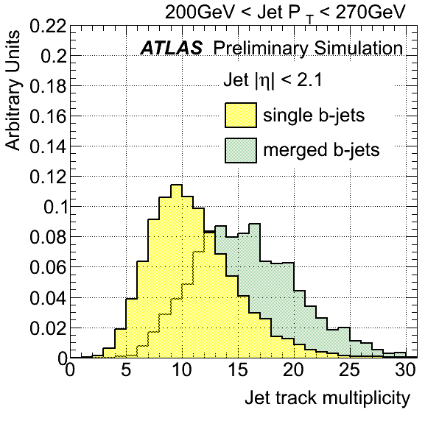
Número de trazas
Número de trazas con pT > 1GeV, contenidas en ΔR < 0.4.
Jets merged tienen en promedio un 50% (70%) más de trazas que jets single a bajo (alto) momento transverso.
Notes:
The jet track multiplicity is a variable simple to calculate that carries important information of the jet inner structure. It is defined as the number of tracks with pT above 1 GeV, satisfying the quality cuts
described in section 5, and contained within a cone of radius R = 0.4 around the jet axis.
The effect of the minimum track pT requirement was examined by lowering the selection cut to pT > 0.5 GeV. On the one hand this could lead to an improvement in discrimination if it captured more information about the fragmentation process, on the other, a lower minimum track pT can make the method more sensitive to pile-up with the addition of soft tracks incorrectly associated to the jets. It was observed that reducing the pT cut degrades the discrimination because it widens the distributions without increasing the separation between single and merged jets. No improvement was
obtained either by circumscribing the selection to tracks with a large impact parameter significance (> 2.5). The potential sensitivity achieved by enriching the sample in tracks associated to the b-hadron is counterbalanced by the lower number of associated tracks.

Slide 22
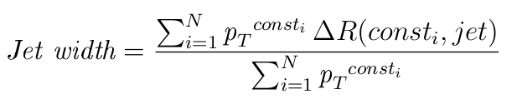
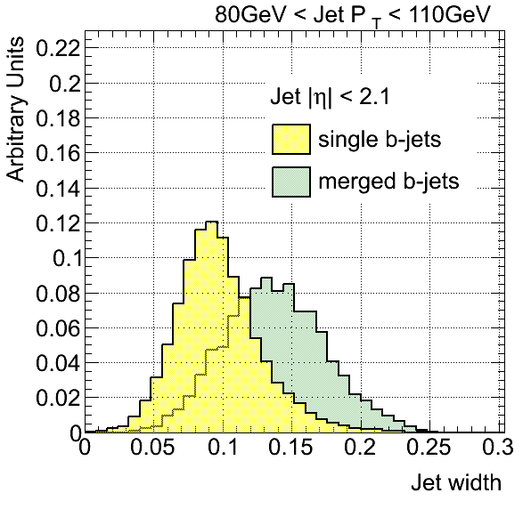
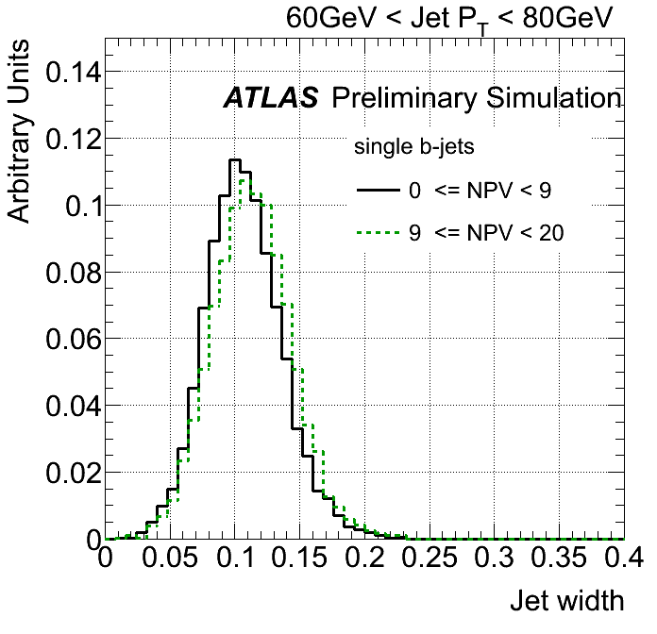
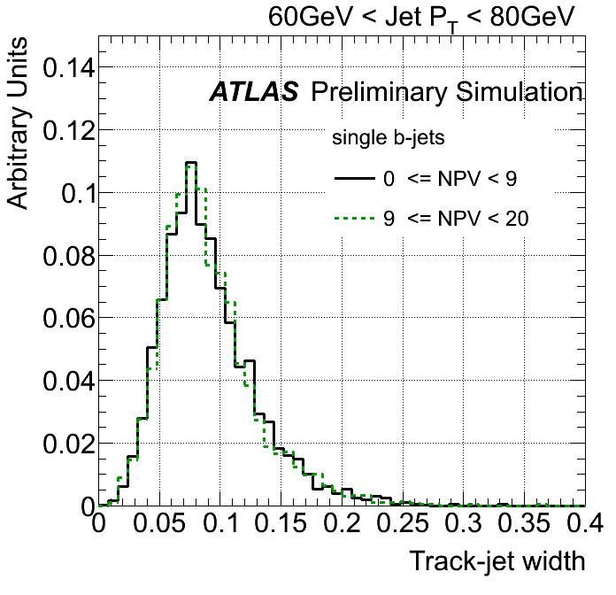
Ancho del jet
Constituyentes calorimétricos
Buena separación pero es sensible al número de PV en el evento. Utilizamos la versión calculada con trazas.
Notes:
weighted average of the ΔR distance between the associated tracks and the jet axis

Slide 23
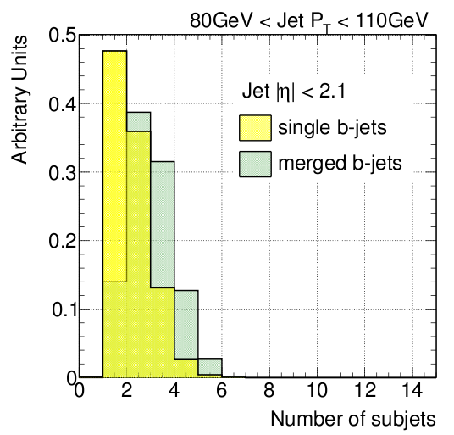
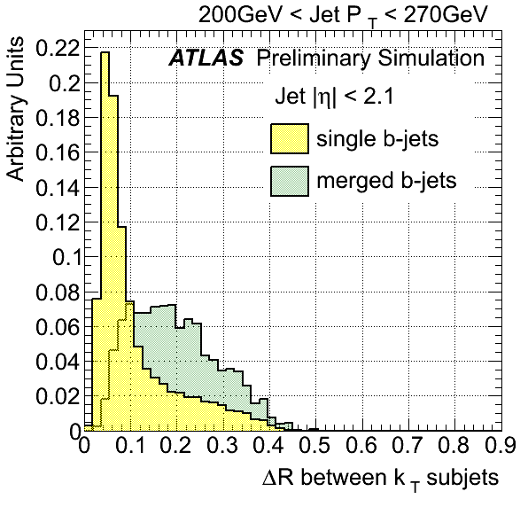
Presencia de subjets
Reconstrucción de subjets a partir de las trazas asociadas al jet (utilizando el algoritmo kt)
Dos estrategias:
1. Parámetro R fijo →
“exclusive” kt →
El poder discriminador del número de subjets es bajo (variable discreta con valores pequeños).
ΔR entre subjets presenta buen poder separador a alto pT.
R = 0.2, más pequeño que el tamaño del cono del jet. Variable: número de subjets.
Encuentra los dos subjets que combinados dan el jet original. Variable: ΔR.
Notes:
The $k_t$ algorithm is the only jet algorithm that correctly identifies the resulting substructure as physical objects and therefore is the algorithm used for substructure analysis.
Kt REPRESENTA EL DESARROLLO DE LA LLUVIA
As an alternative to fixed distance parameter subjets, it is also possible to undo the last step in the recombination sequence in order to identify the decay products of an object. This corresponds conceptually to undoing the first step in the fragmentation process that leads from interacting partons to jets. This cannot be done with anti-$k_t$.
Several other variables were investigated to expose the expected two-subjet substructure of merged
b-jets, with various levels of success. These are the maximum ∆R separation between track pairs,
∆R between leading constituents, and eccentricity,

Slide 24
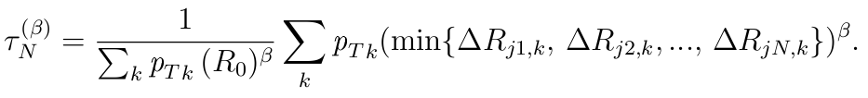
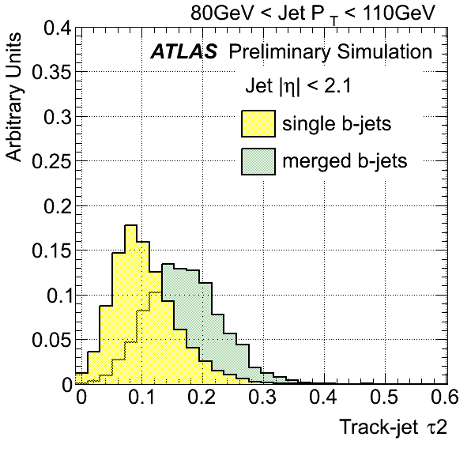
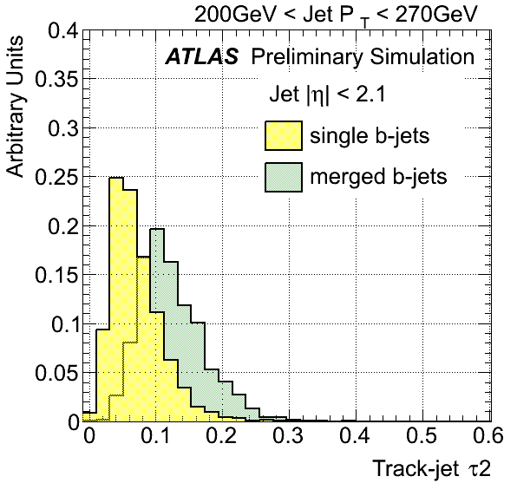
N-subjettiness
Variable propuesta para estudios de objetos masivos boosteados (Thaler & Van Tilburg, JHEP 1103:015,2011)
Consideramos τ2: indica en qué grado un jet está compuesto por dos subjets.
Buena separación entre single y merged b-jets, correlacionada con ancho.
Notes:
It is possible to extend the use of individual subjets in conjunction with more sophisticated jet shape variables.
it characterizes how consistent a jet is with an $N$-subjet substructure.
The sum runs over the $k$ constituents in a given jet where $p_{T,k}$ are their transverse momenta, and $\Delta R_{j1,k}$ is the distance between the candidate subjet $j1$ and a constituent particle $k$. $R_0$ is the characteristic jet radius used in the original jet clustering algorithm. The exponential weight, $\beta$, can optionally be applied to the angular distance computed between the subjets and the jet constituents.
Since is linear in the $\pt$ of the constituent particle, this variable is an infrared-safe observable
This jet shape was designed to separate boosted hadronic objects, like electroweak bosons and top quarks decaying into collimated showers of hadrons which a standard jet algorithm would reconstruct as single jets.
The correlation observed with width suggests to switch from an absolute to a width-normalized $\tau_2$, and evaluate the ratio $\tau_2/\tau_1$. Somewhat larger values are obtained for single than for merged $b$-jets, specially at high $\pt$. However, the difference is small, producing only a marginal discrimination, indicating that gluon splitting jets do not present a marked 2-subjet structure as boosted $Z$ or $H$ fat jets.
%I

Slide 25
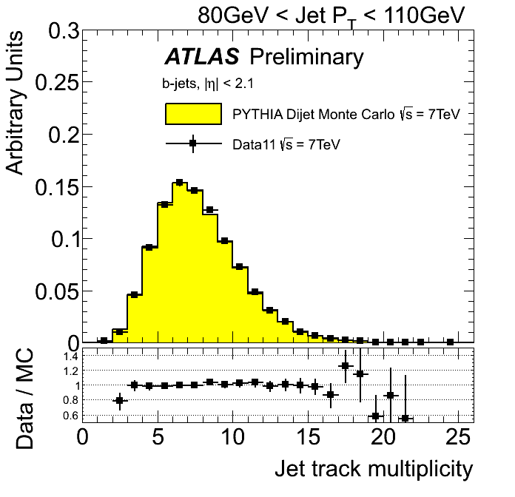
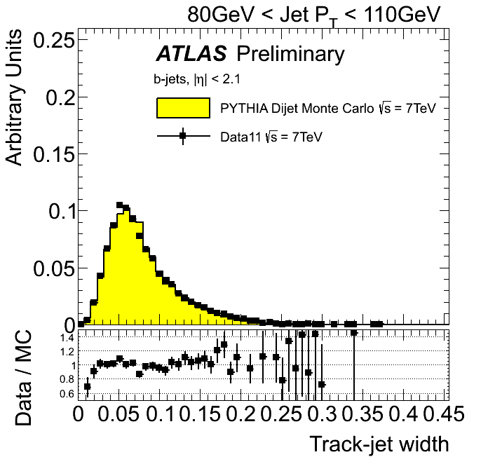
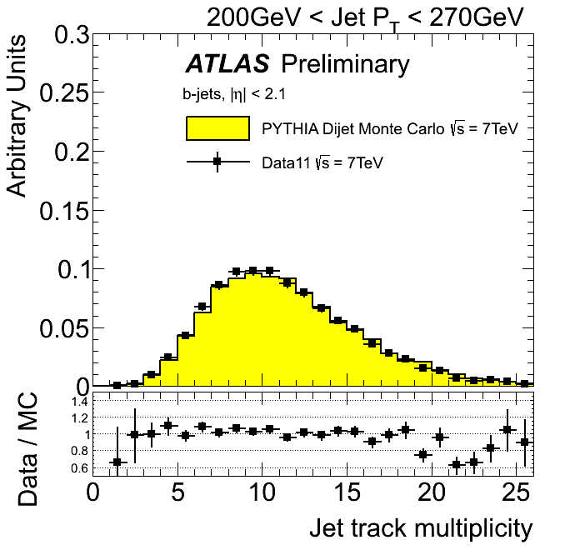
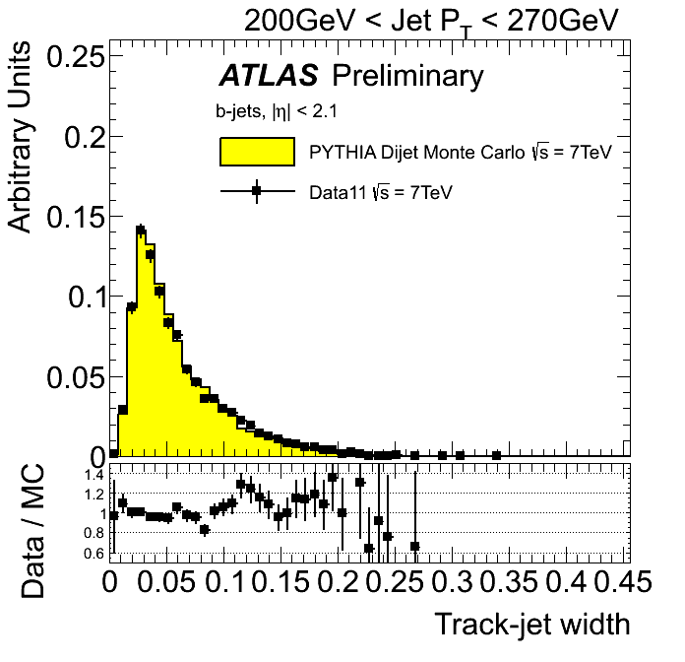
Validación de las variables en datos
Estudio exhaustivo de comparaciones data/MC para evaluar cuan bien reproduce la simulación las distribuciones observadas en datos.
El acuerdo entre datos y simulación es excelente.
Notes:
In order to study the extent to which the simulation reproduces the distributions observed in data for the
different variables explored a set of comparison plots is presented.
The distributions are normalized to unit area to allow for shape comparisons. There is a very
good agreement between data and simulation.
It should be remarked that the observed agreement is not a direct validation of the description in the
MC of the relevant variables, but its convolution with the simulated relative fractions of light-, c-, b- and
bb-jets in the b-tagged generated jet sample.
the agreement evaluated in b-jets selected with a looser cut of MV1
tagger as well as with another b-tagging algorithm is still very good, suggesting that this compensation
is not likely to occur in samples sufficiently enriched in b-jets.

Slide 26
Esquema de la charla:
Introducción
Producción de jets b en QCD
El detector ATLAS en el LHC
Reconstrucción de jets y b-tagging con el detector ATLAS
Propiedades de jets con hadrones b
El identificador de jets con 2 hadrones b
Medición de la composición de b-jets en QCD
Conclusiones
Notes:
In particular, they tag jets containing a bb pair, with no net heavy
flavour, which do not correspond to the intuitive picture of a b-jet as a jet containing a single b-quark or
antiquark.
We will henceforth call “merged” b-jets the b-tagged jets containing two b-hadrons and single
b-jet the jets containing only one b-hadron, as depicted in Fig
There are two possible strategies to attempt to identify b-jets containing two b-hadrons. One of
them relies on the direct reconstruction of the two b-decay secondary vertices [4]. This allows the mea-
surement of the angular separation between the b-hadrons, but suffers from the low efficiency of a double
b-tag requirement plus additional reconstruction inefficiencies at small angular separation between the
two b-hadrons. In this paper we develop an alternative method that does not rely on explicit vertex find-
ing, but exploits the substructure differences between single and merged b-jets, combining them in a
multivariate analysis.
Tagging merged b-jets provides a handle to reduce background in different lines of analysis. where signal is known to produce single b-hadron jets.

Slide 27
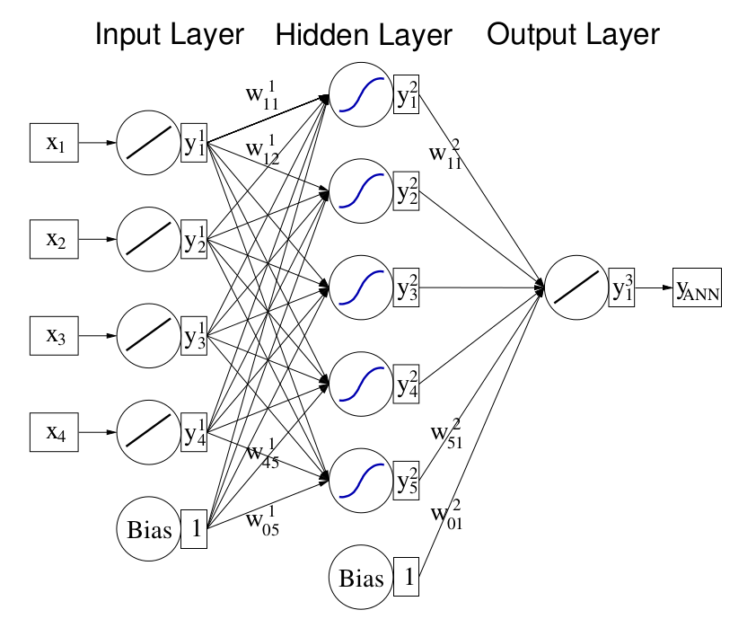
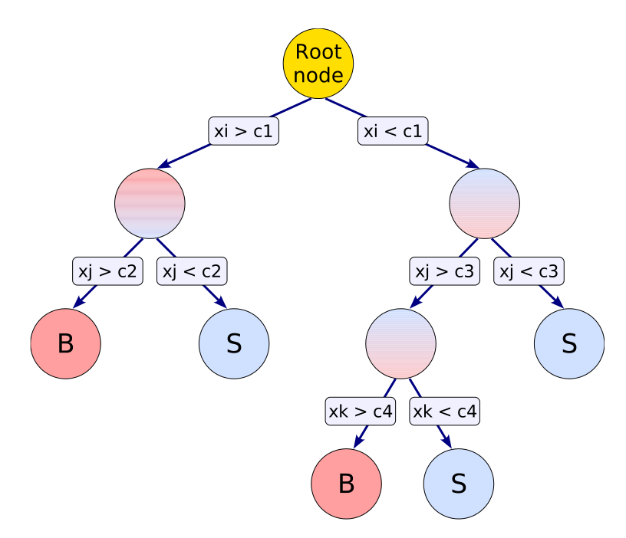
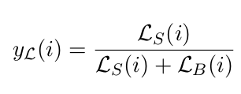
Identificación de jets con 2 hadrones b
Con el objetivo de desarrollar un algoritmo capaz de seleccionar eficientemente single b-jets, rechazando al mismo tiempo jets producidos por gluon splitting, se evaluaron diferentes métodos de multivariable.
Un método de multivariable es un método estadístico que permite combinar la información de múltiples factores o variables para arribar a un resultado
Se estudiaron 3 métodos:
Likelihood ratio
(LL)
Boosted decision tree
(BDT)
Neural network (NN)
Notes:
Likelihood
The method likelihood ratio consists of building a model out of probability density functions
(PDF) that reproduces the input variables for signal and background. The likelihood ratio yL (i) for event i is defined by
NN: For
a classification problem with nvar input variables the input layer consists of nvar neurons that hold
the input values, x1 , . . . , xnvar , and one neuron in the output layer that holds the output variable,
the neural net estimator yANN .
BDT
Repeated left/right (yes/no) decisions are taken on one single variable at a
time until a stop criterion is fulfilled.

Slide 28
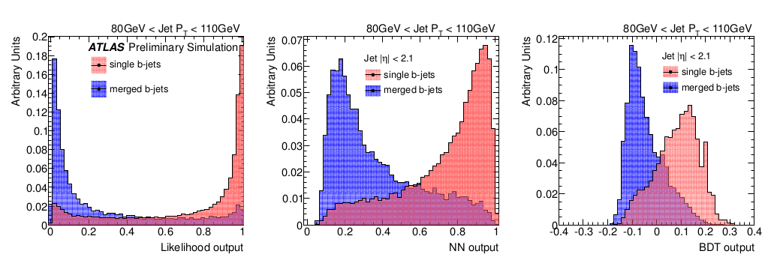
Identificación de jets con 2 hadrones b
Los tres métodos presentan performance similares.
Se eligió el estimador de likelihood por ser de rápida implementación y mostrarse más robusto ante cambios en los parámetros de entranamiento.

Slide 29
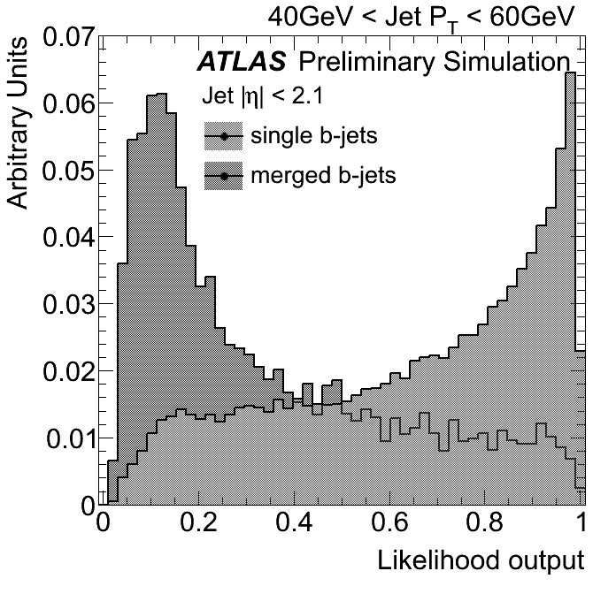


Identificación de jets con 2 hadrones b
Discriminador “entrenado” en una submuestra de eventos Monte Carlo, en bines de pT.
Variables: multiplicidad de trazas, ΔR entre kt subjets, ancho (trazas).

Slide 30

Performance
La performance mejora con pT
- pT > 40GeV: rechazo de merged jets > 8 a 50% de eficiencia.
- pT > 200GeV: rechazo > 30 a 50% eficiencia
Solo las incertezas estadísticas son exhibidas.
Notes:
The rejection of merged jets attained as a function of pT for the 50% and 60% single b-jet effi-
ciency working points are summarized in Table 1, together with their relative statistical error. These are
propagated from the Poisson fluctuations of the number of events in the merged and single b distribu-
tions. The error is slightly lower for the 60% efficiency working point because a higher efficiency allows
for a greater number of Monte Carlo events to measure the performance.

Slide 31
Incertezas sistemáticas
Las siguientes fuentes de errores sistemáticos fueron consideradas:
  La presencia de interacciones pp adicionales (pile-up);
  La incerteza en la determinación de la eficiencia de b-tagging;
  La incerteza en la eficiencia de reconstrucción de trazas;
  La resolución en el momento de las trazas;
  La incerteza en la determinación de la energía del jet (“JER”);
  La incerteza en la calibración del calorímetro (“JES”)
Las contribuciones principales son: la incerteza en la reconstrucción de trazas, (4%), en la JER (5%) y en la JES (5%).
Notes:
For many physics analyses, the uncertainty on the JES constitutes the dominant systematic uncertainty because of its tendency to shift jets in and out of analysis selections due to the steeply falling jet $\pt$ spectrum.

Slide 32


3. Incerteza en la reconstrucción de trazas
La incerteza en la efficiencia de reconstrucción proviene de nuestro limitado conocimiento del material en el detector interno:
Un aumento en el material conlleva un aumento en el número de interacciones, y luego a una disminución en la efficiencia de reconstrucción.
Para evaluar este efecto una fracción de trazas, determinada por la incerteza en la eficiencia fue removida.
Una degradación sistemática promedio del 4% se observa para todo el rango de pT y para ambos puntos de trabajo.
Notes:
This is the outline of my talk,
- I'm gonna give first a brief introduction, describing the goals and motivations of this study,
- after that I will explain the strategy that we followed,
- show pythia results on discriminating variables
- and the I'll go through ATLAS MC results and the validation in 2011 Data
- I will finalize with our next steps and the conclusions.
(next slide)

Slide 33
Esquema de la charla:
Introducción
Producción de jets b en QCD
El detector ATLAS en el LHC
Reconstrucción de jets y b-tagging con el detector ATLAS
Propiedades de jets con hadrones b
El identificador de jets con 2 hadrones b
Medición de la composición de b-jets en QCD
Conclusiones
Notes:
In particular, they tag jets containing a bb pair, with no net heavy
flavour, which do not correspond to the intuitive picture of a b-jet as a jet containing a single b-quark or
antiquark.
We will henceforth call “merged” b-jets the b-tagged jets containing two b-hadrons and single
b-jet the jets containing only one b-hadron, as depicted in Fig
There are two possible strategies to attempt to identify b-jets containing two b-hadrons. One of
them relies on the direct reconstruction of the two b-decay secondary vertices [4]. This allows the mea-
surement of the angular separation between the b-hadrons, but suffers from the low efficiency of a double
b-tag requirement plus additional reconstruction inefficiencies at small angular separation between the
two b-hadrons. In this paper we develop an alternative method that does not rely on explicit vertex find-
ing, but exploits the substructure differences between single and merged b-jets, combining them in a
multivariate analysis.
Tagging merged b-jets provides a handle to reduce background in different lines of analysis. where signal is known to produce single b-hadron jets.

Slide 34

Medición de la composición de b-jets en QCD
La distribución de LL permite medir la composición de una muestra de b-jets.
Un jet b-tagged puede originarse en la hadronización de:
b = un b-quark,
bb = gluon splitting a bb,
c = un c-quark
cc = gluon splitting a cc,
l = parton liviano (u,d,s,g).
Las distribuciones de LL (“templates”) son diferentes para cada uno de los 5 casos.
“Templates”
Notes:
The value of Wp is chosen as a compromise between good efficiency (the lower the Wp, the lower the probability that an actual single $b$-jet will be missed by the tagger), and rejection power (the higher the Wp the lower the probability that a non-single $b$-jet will be incorrectly flagged as single). Depending on the necessities of the particular analysis, an appropriate Wp is to be chosen. In particular, the performance results presented correspond to the 50\% and 60\% efficiency working points, two reasonable choices.
The shape of the distributions can be intuitively understood. The $b$ and $b\bar{b}$ templates behave as expected, respectively peaking at high and low values of LL. The $c$ template resembles its $b$ counterpart. The $c\bar{c}$ although similar to the $b\bar{b}$ template, also exhibits a spike for large values of LL.
This was to be expected, given that $c$-jets have less tracks than $b$-jets: they decay to $D$ mesons, $c \rightarrow D \rightarrow \mbox{light hadrons}$, as opposed to $b$-jets which present a longer decay chain, $b \rightarrow B \rightarrow D\rightarrow \mbox{light hadrons}$. They also show smaller angular separation (width), since $m_D < m_B$ ($m_D\sim 1.9$~GeV and $m_B \sim 5.3$~GeV).
The template of light jets has a larger peak at LL$\rightarrow 1$ than for single $b$-jets. This can be traced to the observation that gluons and light-quarks jets tend to be narrower and have lower track multiplicity than heavy-flavour jets, leading to a more single-like likelihood distributions (see Section~\ref{sec:gbbKine}).

Slide 35
Medición de la composición de b-jets en QCD
La composición de una dada muestra se puede determinar estimando (“ajustando”) las fracciones necesarias de cada uno de los templates para describir la distribucion de LL observada en datos, F(x).
Utilizamos la técnica de “Unbinned maximum likelihood fit”
L(x)
S(x)
M(x)
Sc(x)
Mc(x)
S(x), M(x), L(x), Sc(x), Mc(x): distribuciones de LL para b, bb, l, c, cc (conocidas)
ps, pm, pl, psc, pmc: fracciones de b-jets de tipo b, bb, l, c, cc (ajustados)
F(x)= distribucion de LL en los datos (medida)
Notes:
The measured composition can then be compared to the theoretical prediction from QCD.
We observe that the fraction of single (merged) $b$-jets tends to decrease (increase) with $\pt$. This is expected as, with increasing $\pt$, the larger the boost of the $b\bar{b}$ pair produced by gluon splitting and the higher the probability that they will be produced at a small angle and reconstructed within the same jet. The fraction of merged jets is slightly smaller for the first $\pt$ bin because the $b$-tagging efficiency drops at low $\pt$, bringing about a larger fraction of light jets.

Slide 36


Medición de la composición de b-jets en QCD
Resultado del ajuste de los templates a la distribución de la LL en datos, para b-jets en un rango de pT
Notes:
The measured composition can then be compared to the theoretical prediction from QCD.
We observe that the fraction of single (merged) $b$-jets tends to decrease (increase) with $\pt$. This is expected as, with increasing $\pt$, the larger the boost of the $b\bar{b}$ pair produced by gluon splitting and the higher the probability that they will be produced at a small angle and reconstructed within the same jet. The fraction of merged jets is slightly smaller for the first $\pt$ bin because the $b$-tagging efficiency drops at low $\pt$, bringing about a larger fraction of light jets.

Slide 37

Medición de la composición de b-jets en QCD
ps (%) pm (%) pl (%) psc (%) pmc (%)
La composición medida está en muy buen acuerdo con la predicción téorica
Notes:
The measured composition can then be compared to the theoretical prediction from QCD.
We observe that the fraction of single (merged) $b$-jets tends to decrease (increase) with $\pt$. This is expected as, with increasing $\pt$, the larger the boost of the $b\bar{b}$ pair produced by gluon splitting and the higher the probability that they will be produced at a small angle and reconstructed within the same jet. The fraction of merged jets is slightly smaller for the first $\pt$ bin because the $b$-tagging efficiency drops at low $\pt$, bringing about a larger fraction of light jets.

Slide 38
Medición de la composición de b-jets en QCD
La muestra inclusiva de QCD está compuesta de ~50% single b-jets.
Esta medición puede realizarse en una muestra semi-inclusiva con una composición diferente, permitiendo testear la descripción teórica de la producción de b-jets en QCD y al mismo tiempo validar los templates utilizados.
Producción de b-jets
Single
b-jet
Single b-jet
FCR
FEX
GSP
Podemos construir una submuestra enriquecida en single b-jets seleccionando eventos con exactamente 2 b-tagged jets.

Slide 39


Medición de la composición de b-jets en QCD
Enriquecida en single b-jets
Inclusiva
110 – 150 GeV: muestra inclusiva single 49% (56%) merged 12% (10%)
muestra enriquecida single 86% (85%) merged 4% (3%)
Excelente acuerdo con la predicción teórica!
Notes:
The measured composition can then be compared to the theoretical prediction from QCD.
We observe that the fraction of single (merged) $b$-jets tends to decrease (increase) with $\pt$. This is expected as, with increasing $\pt$, the larger the boost of the $b\bar{b}$ pair produced by gluon splitting and the higher the probability that they will be produced at a small angle and reconstructed within the same jet. The fraction of merged jets is slightly smaller for the first $\pt$ bin because the $b$-tagging efficiency drops at low $\pt$, bringing about a larger fraction of light jets.

Slide 40

Medición de la composición de b-jets en QCD
Muestra enriquecida en single b-jets, resultado del ajuste:
Enriquecida
Inclusiva

Slide 41
Conclusiones
Se desarrolló una nueva técnica para la identificación de b-jets originados por el desdoblamiento de un gluon en un par bb.
Este método combina en un estimador de likelihood variables que dan cuenta de la diferente subestructura de single y merged jets.
La distribución de las variables exploradas en Monte Carlo fueron validadas en datos recabados por el detector ATLAS durante 2011 (4.7 fb⁻¹).
La performance del tagger fue estudiada en función del momento del jet. A pT > 200 GeV y 50% de eficiencia, el rechazo de merged jets de 1/30.
Se midió la composición de b-jets de una muestra inclusiva QCD y una enriquecida en single jets a partir de la distribución de la likelilhood.
Los resultados experimentales están en excelente acuerdo con las predicciones teóricas.
La técnica desarrollada tiene aplicación en la medición de la sección eficaz de producción de b-jets y en la disminución del fondo de QCD en búsquedas de física más alla del Modelo Estándar.

Slide 42
Gracias!

Slide 43
Back-up slides

Slide 44
El Trigger de ATLAS
High Level trigger arquitecture (HLT)
Designed to reduce event rate 40MHz (1PB/s)->~200Hz-400Hz (300MB/s-700MB/s)
Selecting only interesting collision events for offline storage
Splitting data into several different streams for use in physics analysis.
Level 1:
75 KHz max. output rate ;2.5 μs max. latency
Implemented in hardware
Muon+Calorimeter based on coarse granularity
Select high pT (e/γ, μ, τ, jets),large(ET,Etmiss)
Define regions of interest (ROIs)
Level 2:
3 KHz output rate; ~40 ms execution time
Implemented in software
Inner Detector–Calorimeter-Muon spectrometer
Seeded by LV1 in ROIs, full granularity
Event Filter :
200-400 Hz output rate ; ~ 4 s execution time
Implemented in software
Off line reconstruction with access to all sub-detector data at full granularity
Calo,Muo, Min. Bias
Tracking
40 MHz
(1PB/s)
44 m de largo
Level-1
Fast Custom Electronics
t < 2.5μs
L1 Accept
Front End Pipelines
Requested Data in RoI
~<75 kHz
Level-2
500 PCs
<t> ≈ 40ms
Readout Buffers
~4kHz
Access to full event
Event Builder
Event Filter
1800 PCs
<t> ≈ 4s
Full Event Buffers
300-700 MB/s
200-400 Hz
Storage & offline processing
Notes:
The $x-y$ plane is referred to as the transverse plane, and the $z$ direction as the longitudinal
The transverse momentum $\pt$ is defined in the $x-y$ plane unless stated otherwise.

Slide 45
Minimum Bias Events
The definition of MB events is experimental (no theory!):
σmeas = fsd·σsd + fdd·σdd + fnd·σnd
where the fi are the acceptances, dependent on the detectors and triggers
Therefore MB can be defined as INELASTIC collisions of two protons
accepted by the trigger with the only requirement being some activity in
the detector, i.e. a minimal pT threshold of ≈100 MeV (ISR-experiments,
UA5, E735, CDF). (No energy threshold no bias).
A minimum-bias event is what one would see with a totally inclusive trigger.
it includes very rare high-pT scatters and very common low pT events
MB events occur all the collisions, and overlap to high-pT
events. Therefore it is important to study them:
main component of pileup -> unavoidable background for all processes!
allows prediction of radiation levels -> detector damage and occupancy
Notes:
The jet energies are corrected for inhomogeneities and for the non-compensating nature of the calorimeter

Slide 46
Parámetros de traza
Las trazas de las partículas cargadas que atraviesan el ID en presencia del campo magnético son descriptas por los 5 parámetros de una hélice:
1/Pt: inversa del momento transverso, σ(1/Pt)~0.02/Pt
φ0: ángulo que subtiende el vector momento en el punto de máximo acercamiento. Se define como positivo (negativo) cuando Py es positiva (negativa).
d0: Parámetro de impacto transverso. σ(d0)~20 μm (región central). Se define positivo cuando el ángulo φ del punto de máximo acercamiento es igual a φ0+π/2
Cot(θ): Cotangente del ángulo polar, Cot(θ)=Pz/Pt.
z0: Posición z de la traza de la partícula en el punto de máximo acercamiento.
Notes:
The charged-particle tracks with pseudorapidity |η|<2.5 are reconstructed in the ID.
Tracks with pT^{track} > 400 MeV and consistent with the beam spot are associated in primary vertices via a finding/fitting sequential algorithm.
To ensure a good resolution on the vertex position, the primary vertex must be reconstructed from at least five tracks.

Slide 47


Jet width II
merged b-jets son más anchos que single b-jets

Slide 48


Single/Double b-hadron jets: discriminating variables
Max{ΔR(trk,trk)}: maximum distance in the η−φ plane between track pairs in the jet.
Although it shows good discrimination between single and merged b-jets, we looked for alternatives to Max{∆R(trk,trk)} as it is sensitive to the presence of non-relevant soft tracks in the jet periphery.
Notes:
This is the outline of my talk,
- I'm gonna give first a brief introduction, describing the goals and motivations of this study,
- after that I will explain the strategy that we followed,
- show pythia results on discriminating variables
- and the I'll go through ATLAS MC results and the validation in 2011 Data
- I will finalize with our next steps and the conclusions.
(next slide)

Slide 49


Single/Double b-hadron jets: correlations
Studied correlation between variables to avoid using strongly correlated pairs, as illustrated here for τ2 and track-jet width.
Notes:
In spite of the separation observed, the
addition of τ2 did not improve the global discrimination power of the tagger. This could be traced to
the level of correlation between τ2 and track-jet width, displayed in Fig. 9a, to be compared to the much
lower correlation presented, for instance, between track-jet width and the jet track multiplicity, shown in
Fig. 9b.

Slide 50

Performance II
Notes:
The rejection of merged jets attained as a function of pT for the 50% and 60% single b-jet effi-
ciency working points are summarized in Table 1, together with their relative statistical error. These are
propagated from the Poisson fluctuations of the number of events in the merged and single b distribu-
tions. The error is slightly lower for the 60% efficiency working point because a higher efficiency allows
for a greater number of Monte Carlo events to measure the performance.

Slide 51




Validation of discriminating variables with data
Very good agreement between data and simulation.
Notes:
This is the outline of my talk,
- I'm gonna give first a brief introduction, describing the goals and motivations of this study,
- after that I will explain the strategy that we followed,
- show pythia results on discriminating variables
- and the I'll go through ATLAS MC results and the validation in 2011 Data
- I will finalize with our next steps and the conclusions.
(next slide)

