Slide 1


Identificación de jets con hadrones b producidos por desdoblamiento de gluones con el detector ATLAS
Trabajo de Tesis para optar por el título de Doctor de la
Universidad de Buenos Aires en el área de Cs. Físicas por Lic. M.Laura González Silva
Director: Dr. Ricardo Piegaia
Departamento de Física, FCEyN
Marzo 2013

Slide 2

En esta charla:
Introducción
Producción de jets b en QCD
Etiquetado y calibración de jets b con el detector ATLAS
Variables de trazas para la identificación de jets b de g->bb
Técnica de multivariable
Errores sistemáticos
Fracción de g->bb en datos
Notes:
In particular, they tag jets containing a bb pair, with no net heavy
flavour, which do not correspond to the intuitive picture of a b-jet as a jet containing a single b-quark or
antiquark.
We will henceforth call “merged” b-jets the b-tagged jets containing two b-hadrons and single
b-jet the jets containing only one b-hadron, as depicted in Fig
There are two possible strategies to attempt to identify b-jets containing two b-hadrons. One of
them relies on the direct reconstruction of the two b-decay secondary vertices [4]. This allows the mea-
surement of the angular separation between the b-hadrons, but suffers from the low efficiency of a double
b-tag requirement plus additional reconstruction inefficiencies at small angular separation between the
two b-hadrons. In this paper we develop an alternative method that does not rely on explicit vertex find-
ing, but exploits the substructure differences between single and merged b-jets, combining them in a
multivariate analysis.
Tagging merged b-jets provides a handle to reduce background in different lines of analysis. where signal is known to produce single b-hadron jets.

Slide 3
Introduction
B-tagging algorithms do not provide information on the number of b-hadrons within a jet.
The identification of close by b-hadron pairs has been approached using vertexing (CDF Collaboration, arxiv:hep-ex/0412006)
We developed an alternative method that exploits the substructure differences between single and merged b-jets.
Possible applications,
Measurement of QCD beauty production in the framework of the proposed flavour-kT jet algorithm, that discerns between single and merged b-jets (Banfi, Salam and Zanderighi, arxiv:hep-ph/0601139).
Rejection of QCD/W+jets background in BSM searches dominated by single b-jets
Notes:
In particular, they tag jets containing a bb pair, with no net heavy
flavour, which do not correspond to the intuitive picture of a b-jet as a jet containing a single b-quark or
antiquark.
We will henceforth call “merged” b-jets the b-tagged jets containing two b-hadrons and single
b-jet the jets containing only one b-hadron, as depicted in Fig
There are two possible strategies to attempt to identify b-jets containing two b-hadrons. One of
them relies on the direct reconstruction of the two b-decay secondary vertices [4]. This allows the mea-
surement of the angular separation between the b-hadrons, but suffers from the low efficiency of a double
b-tag requirement plus additional reconstruction inefficiencies at small angular separation between the
two b-hadrons. In this paper we develop an alternative method that does not rely on explicit vertex find-
ing, but exploits the substructure differences between single and merged b-jets, combining them in a
multivariate analysis.
Tagging merged b-jets provides a handle to reduce background in different lines of analysis. where signal is known to produce single b-hadron jets.

Slide 4
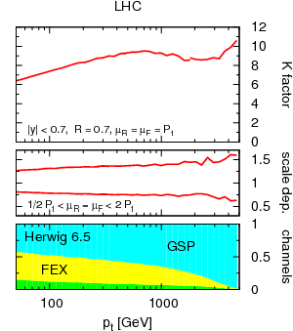
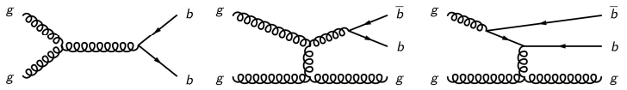
Accurate QCD predictions for heavy-quark jets at the Tevatron and LHC, A. Banfi, G. P. Salam, and G. Zanderighi,
JHEP 0707:026
Inclusive b-jet spectrum has large theoretical uncertainties
K-factor (NLO/LO) as obtained with MCFM: K~ 6-10
Scale dependence is large: 50%
At LO only FCR is present, at NLO, 2 new channels open up: FEX and GSP.
Largest uncertainties are associated with channel with most logarithms: GLUON SPLITTING
Proposal: Use the Flavour-kt algorithm: K ~ 1.2-1.4, scale dependence 10%
Jets containing equal number of b & b considered to be a light jet
Notes:
1. Inclusive b-jet spectrum has large theoretical uncertainties, K~8 and
scale dependence 50%.
2. Largest uncertainties are associated with the gluon splitting channel.
3. Proposal: use the flavour-kt algorithm where bbar jet is considered
as a light jet. With this, K ~ 1.3 and scale dependence 10%.

Slide 5
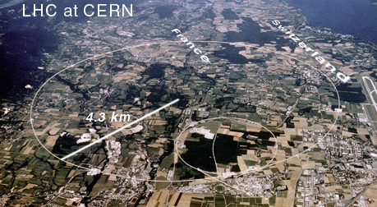
proton
E=7 TeV
proton
E=7 TeV
~ 10¹¹protones cada 25 ns
Circunferencia
del anillo ~ 27 km

Slide 6
Experimentos en el LHC
CMS
ATLAS

Slide 7
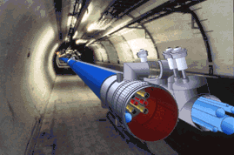
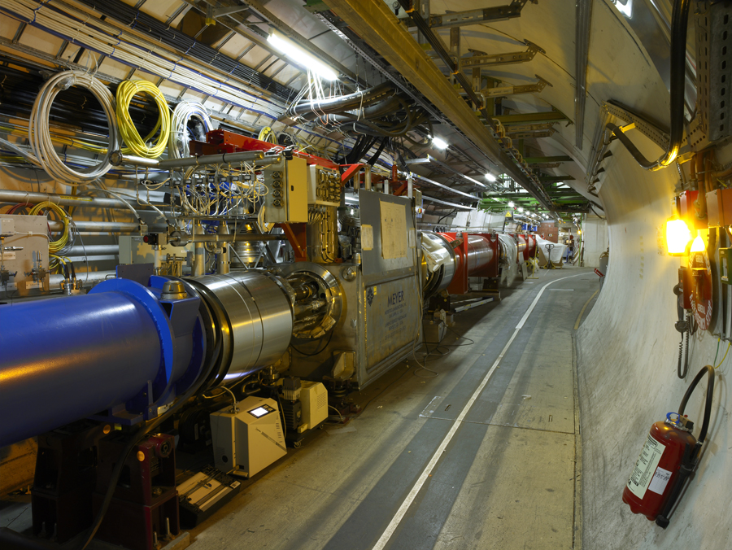
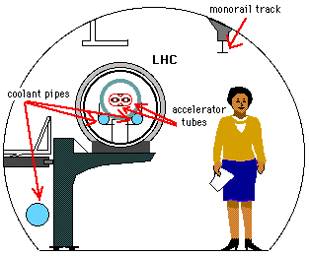
El LHC

Slide 8
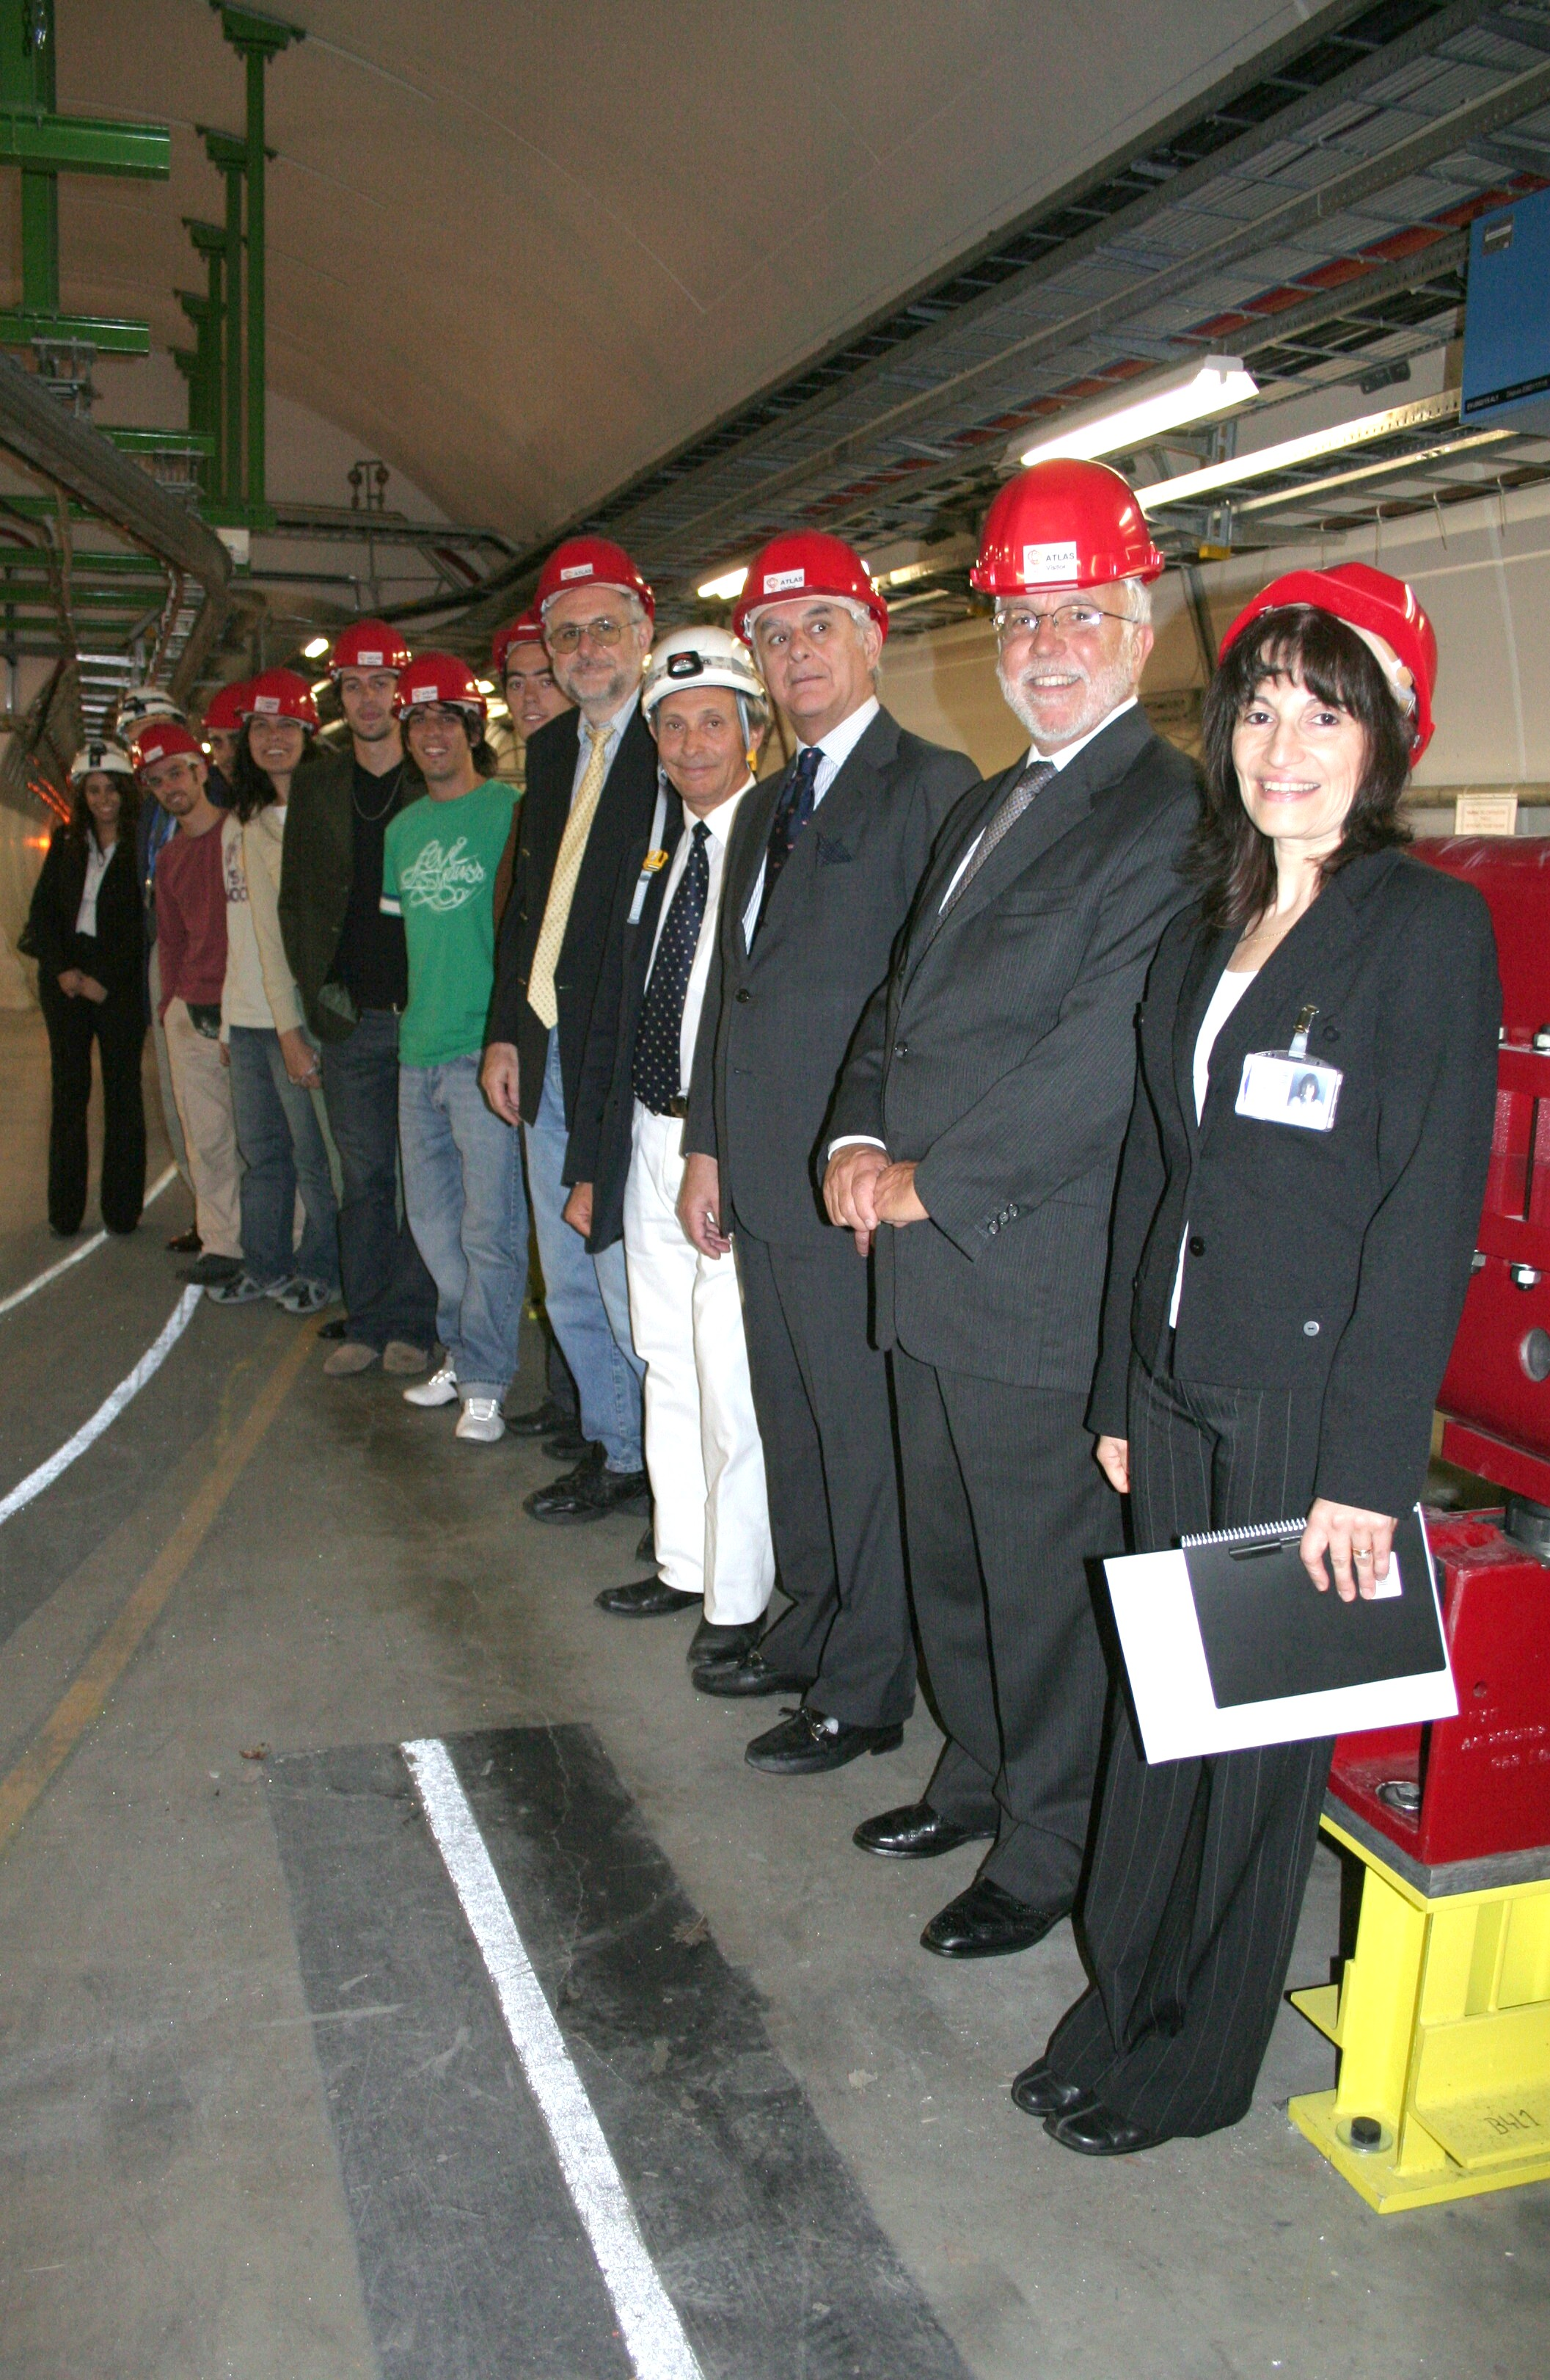
El LHC

Slide 9
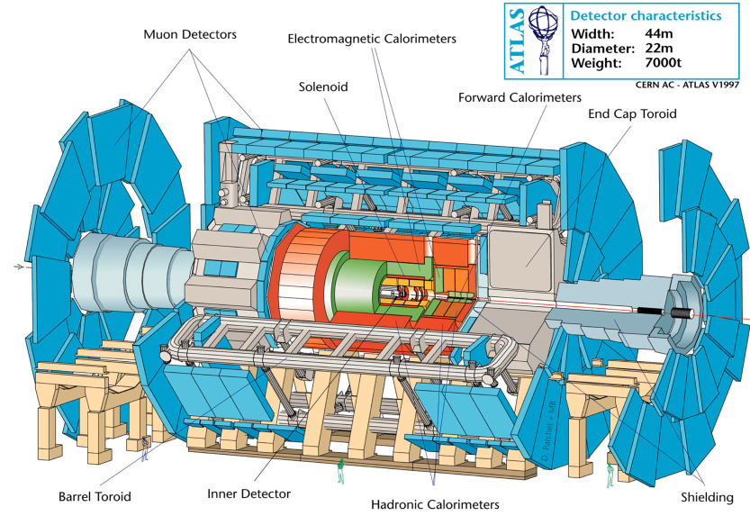
EL Experimento ATLAS

Slide 10
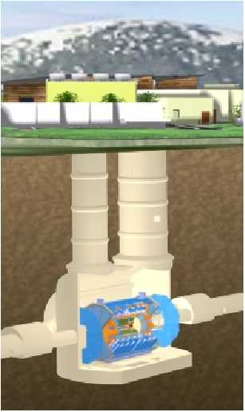
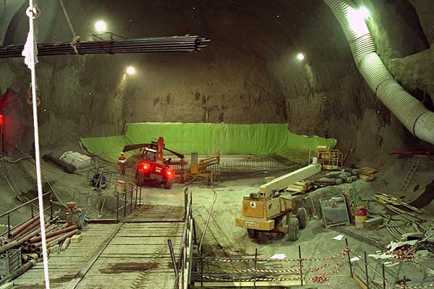
ATLAS
44 m de largo
22 metros de diámetro
7000 toneladas
~100 m de profundidad

Slide 11
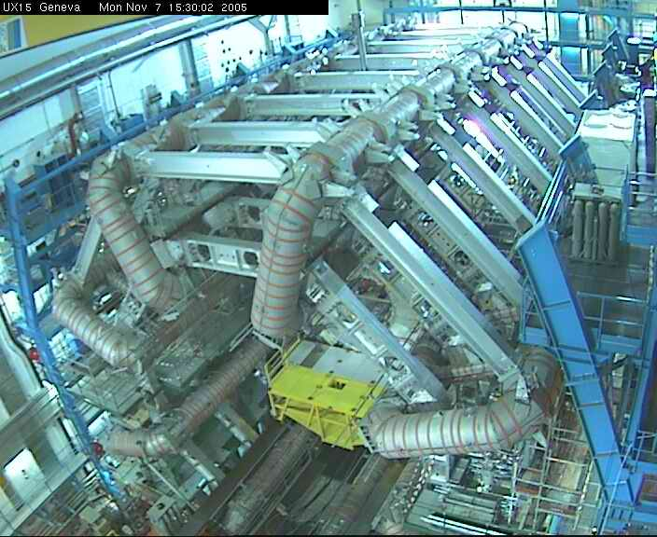
ATLAS
44 m de largo
22 metros de diámetro
7000 toneladas
~100 m de profundidad

Slide 12
EL Detector de ATLAS

Slide 13
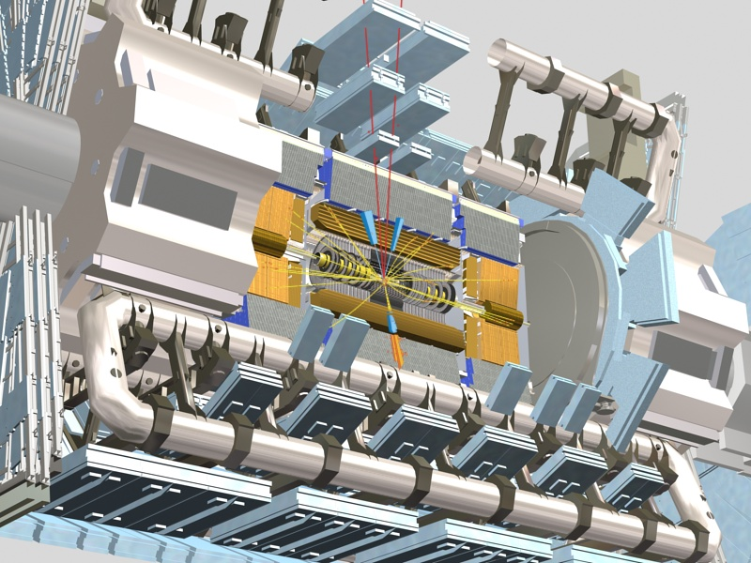
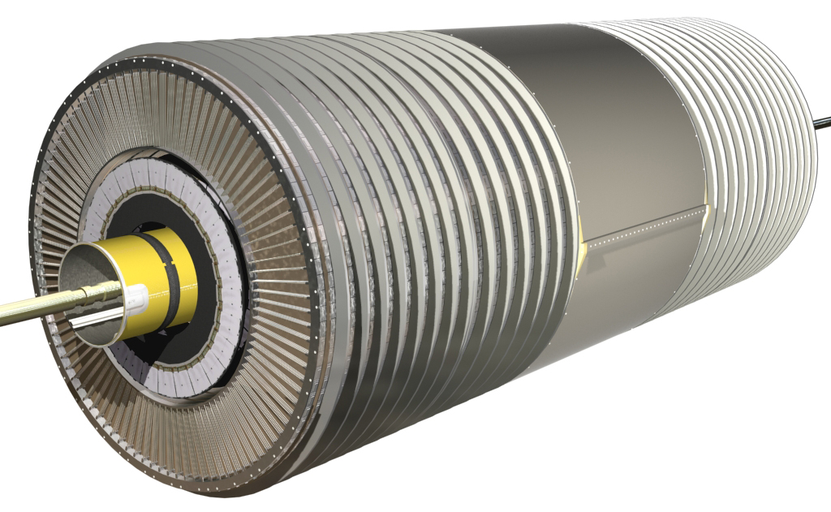
Detector interno
44 m de largo
Reconstrucción de trazas en un campo magnético de 2T.
7 metros de longitud: barril extendido en la cordenada z en ± 80 cm y dos tapas laterales (~1.5 m totales).

Slide 14
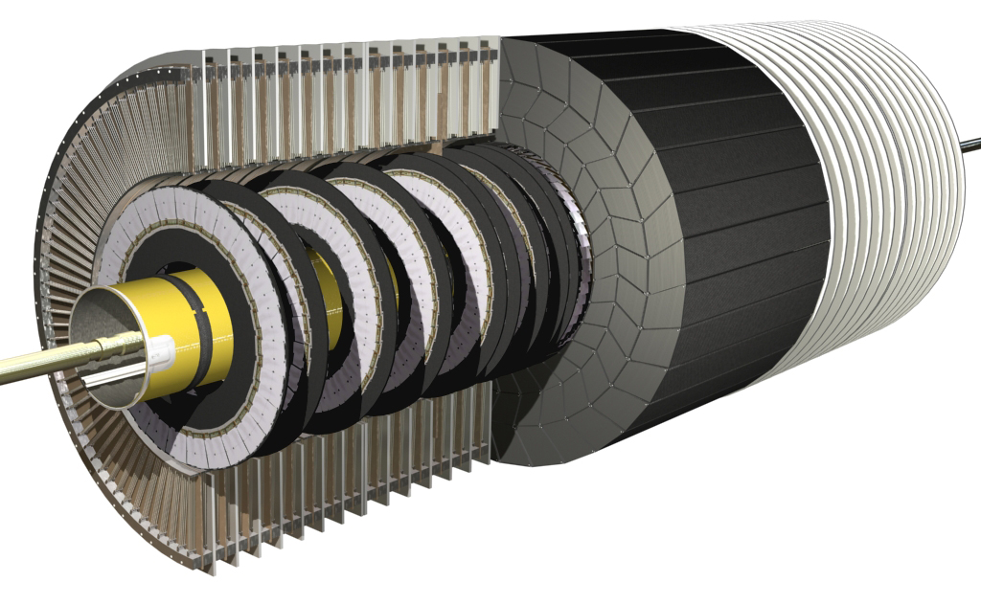
Detector interno
Detector de radiación de transición (TRT).
Arreglo de tubitos de 4 mm de diámetro.
Gran número de puntos por traza.

Slide 15
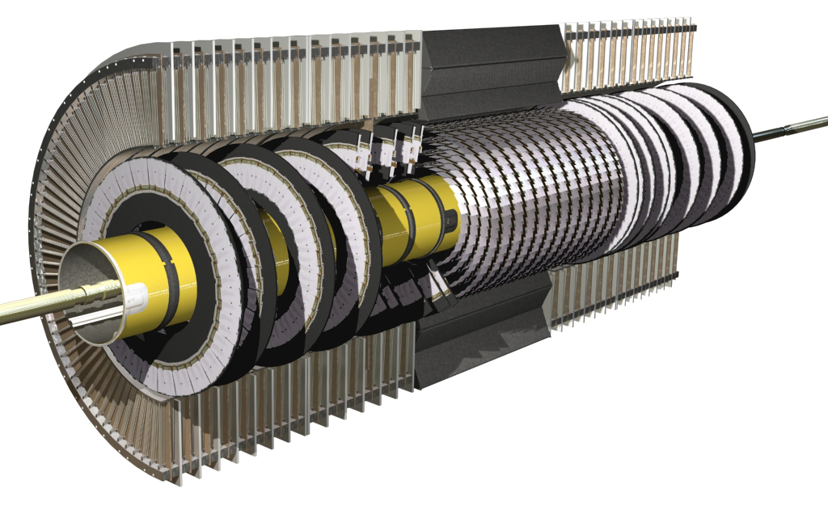
Detector interno
Detector de microbandas de silicio (SCT):
Barril central y dos tapas laterales (9 ruedas cada una)

Slide 16
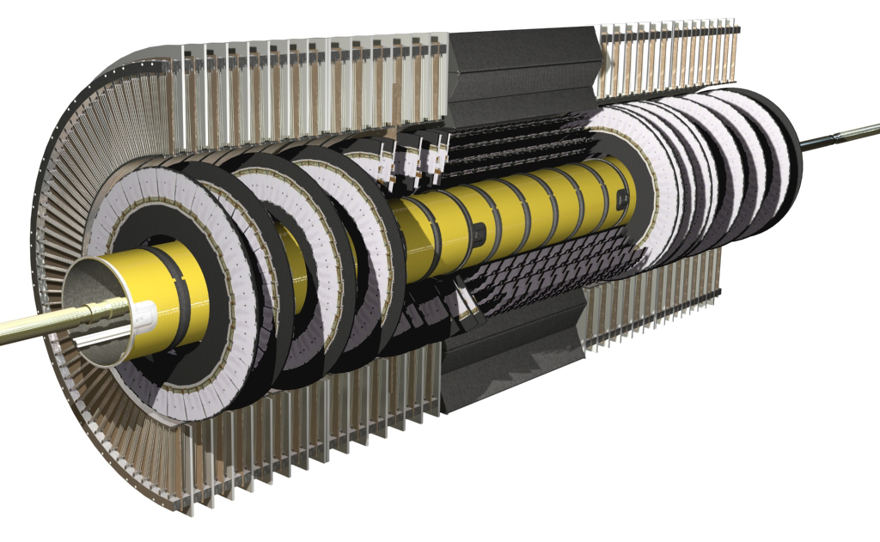
Detector interno
4 capas de ~30, 37,45 y 52 cm de radio
Módulos con dos capas de microbandas.

Slide 17
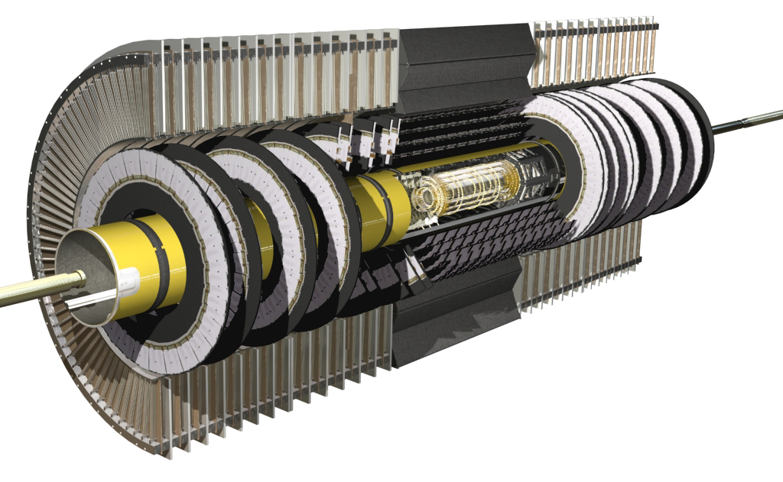
Detector interno
Detector de píxeles:
3 barriles de 4, 10 y 13 cm de radio medio
Mediciones de alta precisión cerca del vértice.

Slide 18

Detector de microbandas de silicio
4 barriles de módulos detectores de doble capa. Un impacto se referirá a un canal de detección por encima de un umbral de energía.
  Típicamente 8 capas de silicio serán atravesadas por cada traza proveniente del punto de interacción.
  Sendos impactos en las dos capas de un módulo, contribuirán a un punto tridimensional en el espacio, o SP (Space Point).

Slide 19
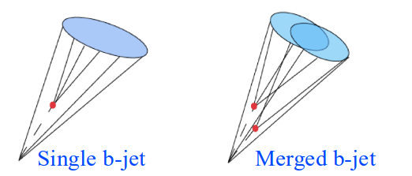
Analysis details
Looked at isolated anti-kT jets with distance parameter R = 0.4.
Use track-based kinematic/shape variables to avoid pile-up effects: jet width, charged multiplicity, sub-jets.
Charge particle tracks with pT > 1 GeV.
Double b-hadron jets:
Jets were labeled as “merged” if they contained two b-hadrons within a radius of 0.4.
Jets were tagged using ATLAS MV1 tagging algorithm.

Slide 20
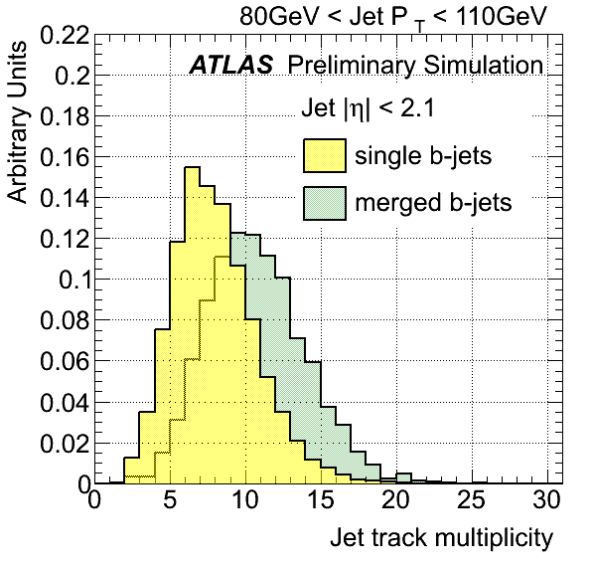
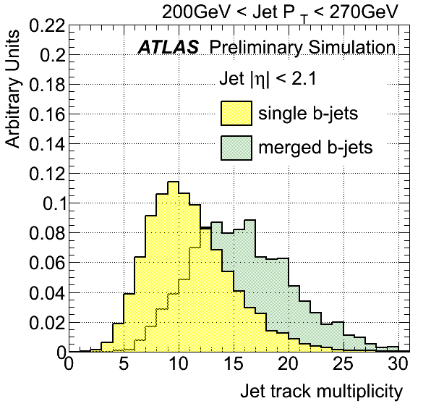
Single/Double b-hadron jets: discriminating variables
Jet track multiplicity: same as in q/g ntrk.
Merged b-jets contain on average 50% (70%) more tracks than single b-jets at low (high) jet pT.
Notes:
The jet track multiplicity is a variable simple to calculate that carries important information of the jet inner structure. It is defined as the number of tracks with pT above 1 GeV, satisfying the quality cuts
described in section 5, and contained within a cone of radius R = 0.4 around the jet axis.
The effect of the minimum track pT requirement was examined by lowering the selection cut to pT > 0.5 GeV. On the one hand this could lead to an improvement in discrimination if it captured more information about the fragmentation process, on the other, a lower minimum track pT can make the method more sensitive to pile-up with the addition of soft tracks incorrectly associated to the jets. It was observed that reducing the pT cut degrades the discrimination because it widens the distributions without increasing the separation between single and merged jets. No improvement was
obtained either by circumscribing the selection to tracks with a large impact parameter significance (> 2.5). The potential sensitivity achieved by enriching the sample in tracks associated to the b-hadron is counterbalanced by the lower number of associated tracks.

Slide 21
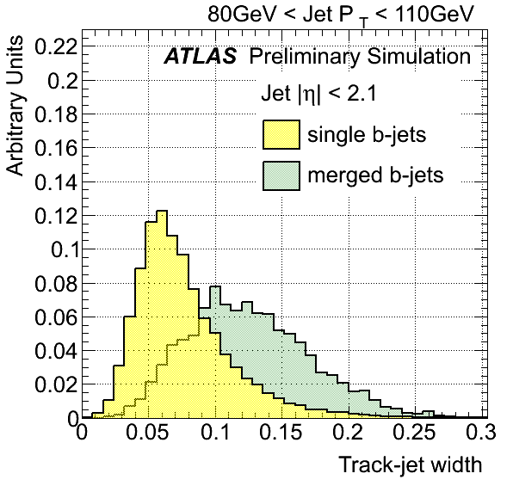
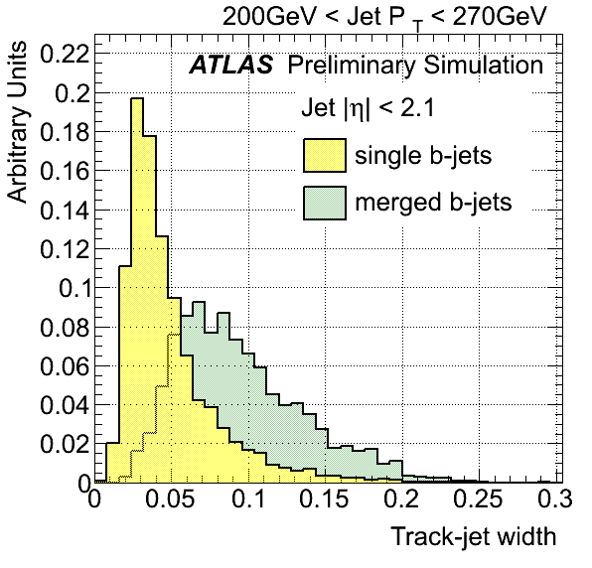
Single/Double b-hadron jets: discriminating variables
Track-jet width: pT weighted average of the ΔR distance between the associated tracks and the jet axis, as in q/g Track Width.
As expected, merged b-jets are wider than single b-jets.

Slide 22
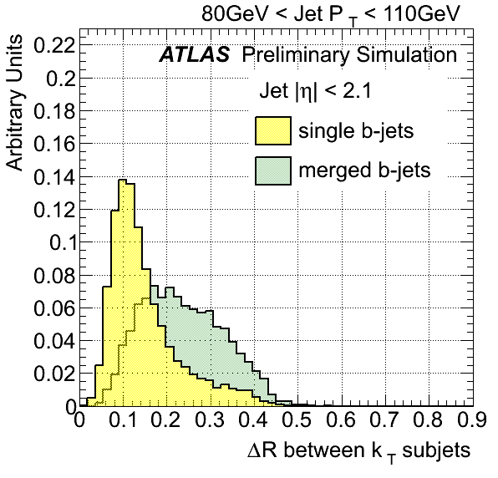
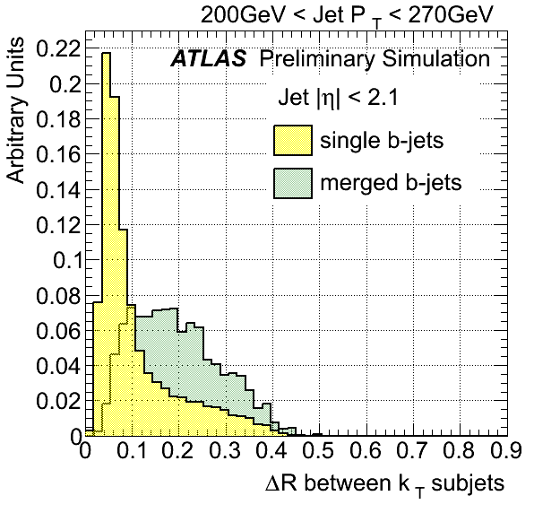
Single/Double b-hadron jets: discriminating variables
ΔR between kt subjets: kt algorithm is used to cluster all the tracks associated to the jet, stopping the clustering at exactly two jets.
Notes:
Several variables were investigated to expose the expected two-subjet substructure of merged
b-jets, with various levels of success. These are the maximum ∆R separation between track pairs,
∆R between exclusive kt subjets, ∆R between leading constituents, 2-subjettiness and eccentricity,

Slide 23
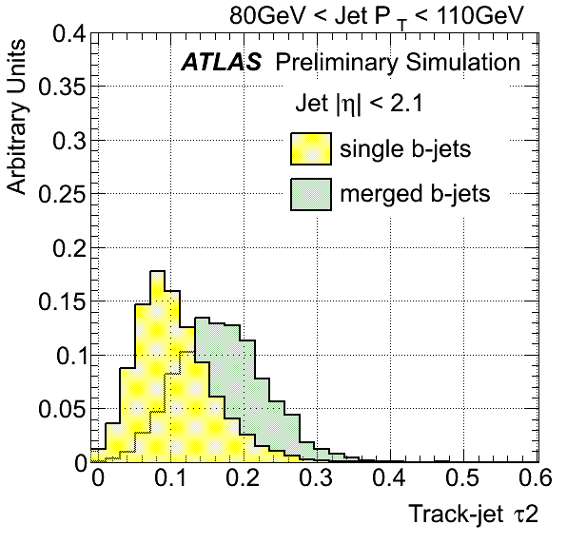
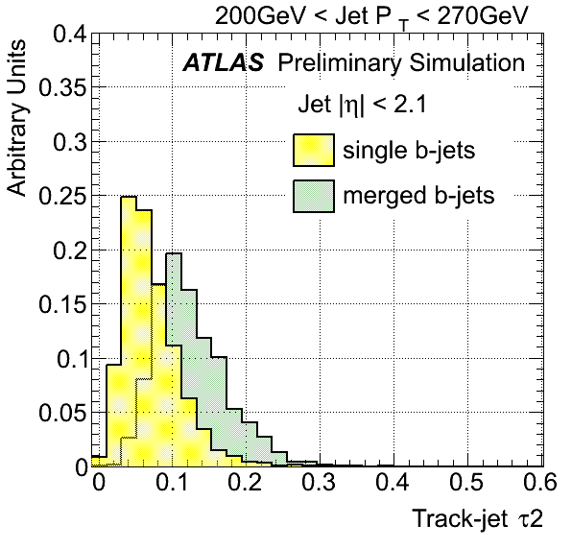
Single/Double b-hadron jets: discriminating variables
N-subjettiness: proposed for massive boosted jet studies by Thaler & Van Tilburg, arxiv:1011.2268v3.
Tau2 quantifies to what degree a jet can be regarded as composed of 2 subjets.
For b-jets (no mass scale) tau 2 is larger for merged than for single jets, and correlated with width.
Notes:
For instance, as seen for massive boosted objects, a jet with a two pronged structure, with all tracks
clustered along two directions, is expected to have a smaller τ2 value than a jet with a more uniform
track distribution.
good separation between single and
merged jets, with the latter showing larger values than single

Slide 24
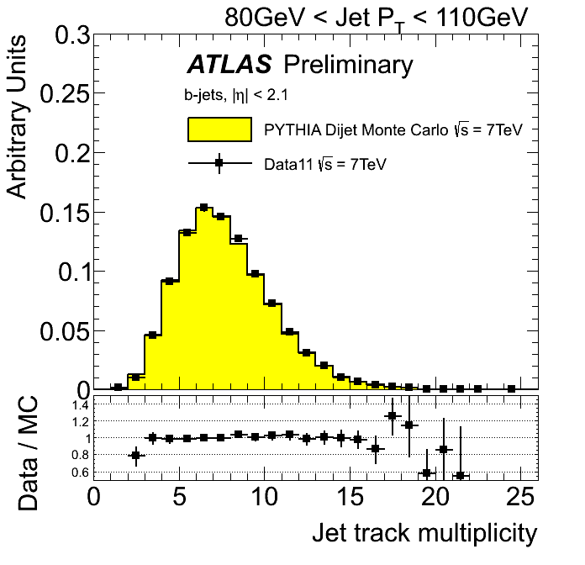
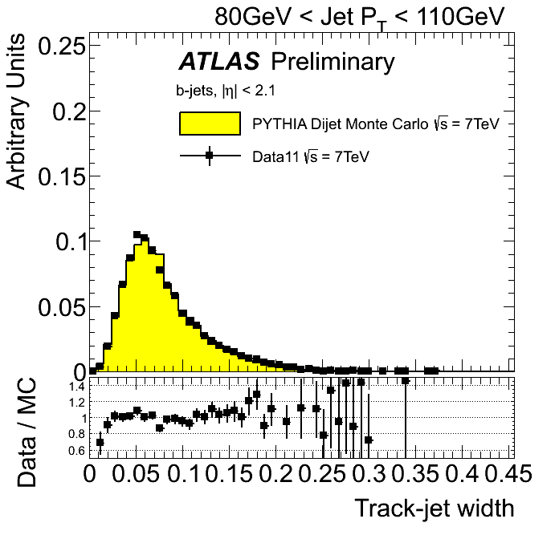
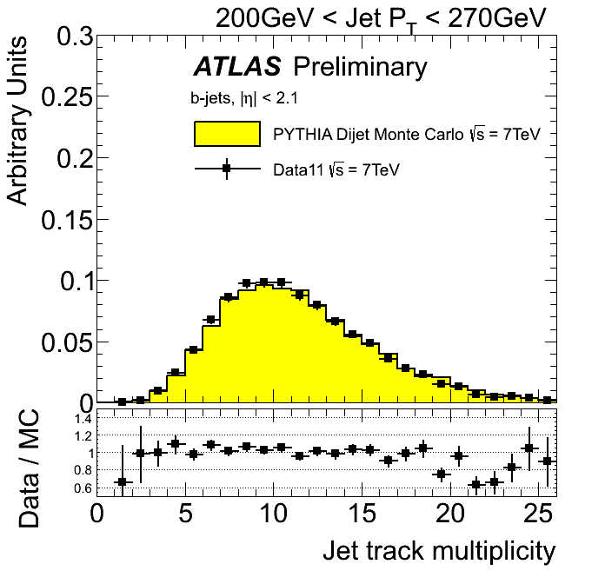
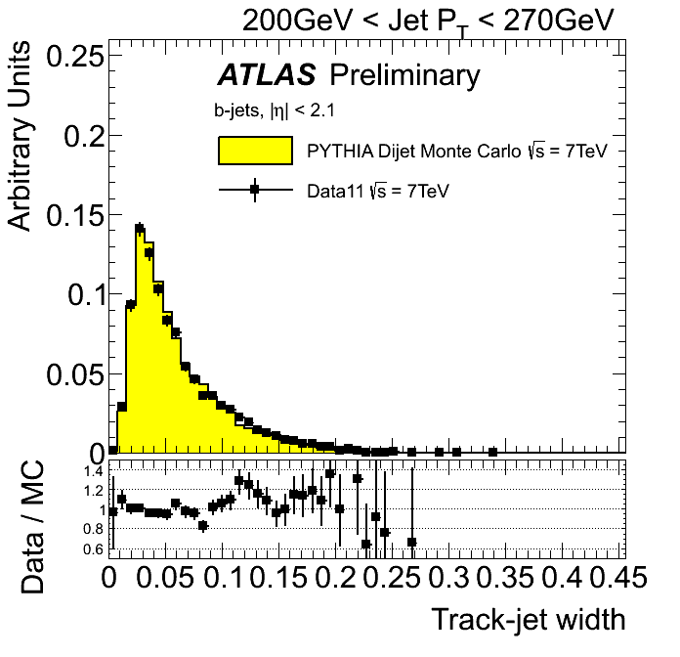
Validation of discriminating variables with data
Very good agreement between data and simulation.
Notes:
In order to study the extent to which the simulation reproduces the distributions observed in data for the
different variables explored a set of comparison plots is presented.
The distributions are normalized to unit area to allow for shape comparisons. There is a very
good agreement between data and simulation.
It should be remarked that the observed agreement is not a direct validation of the description in the
MC of the relevant variables, but its convolution with the simulated relative fractions of light-, c-, b- and
bb-jets in the b-tagged generated jet sample. To some extent, there could be some level of compensation
between these two effects, although the agreement evaluated in b-jets selected with a looser cut of MV1
tagger as well as with another b-tagging algorithm is still very good, suggesting that this compensation
is not likely to occur in samples sufficiently enriched in b-jets.

Slide 25
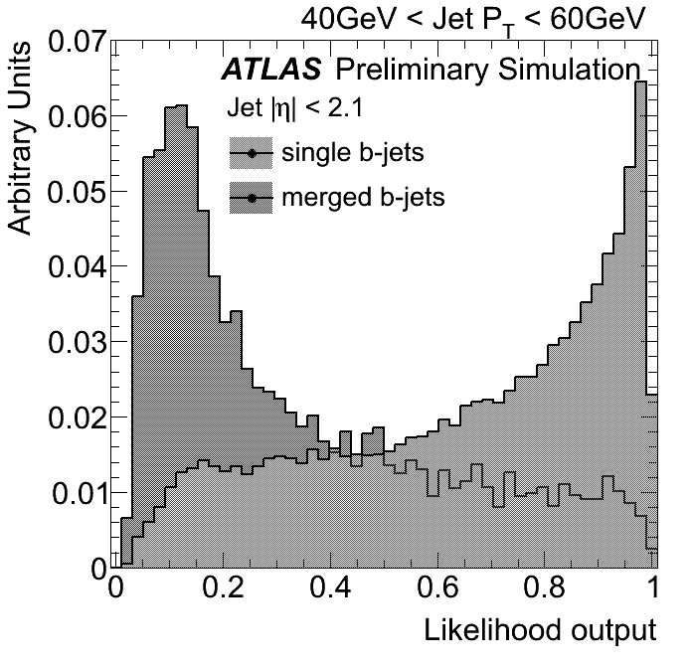
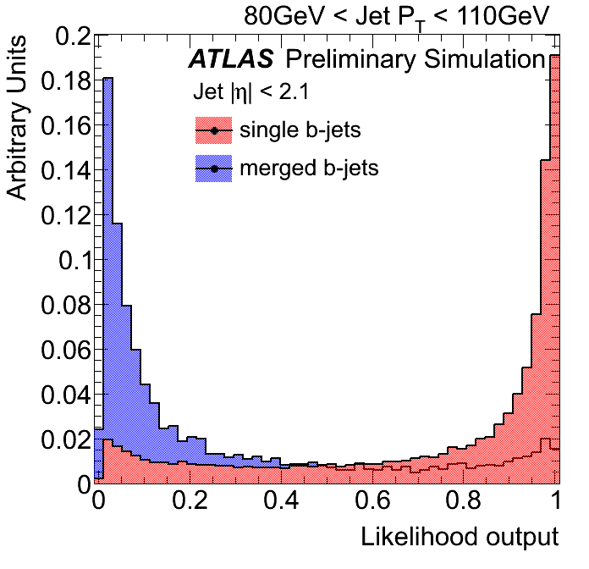
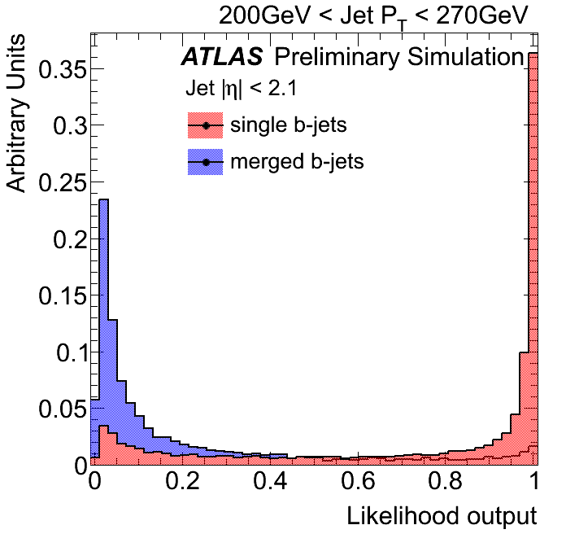
Multivariate Analysis
A discriminant between single b-jets and merged b-jets was built training a likelihood estimator in the context of TMVA.
After balancing discrimination power, pile-up independence and correlations, we kept three variables for our multivariate analysis:
1. Jet track multiplicity;
2. Track-jet width, and;
3. ΔR between the axes of the two exclusive kt subjets.

Slide 26
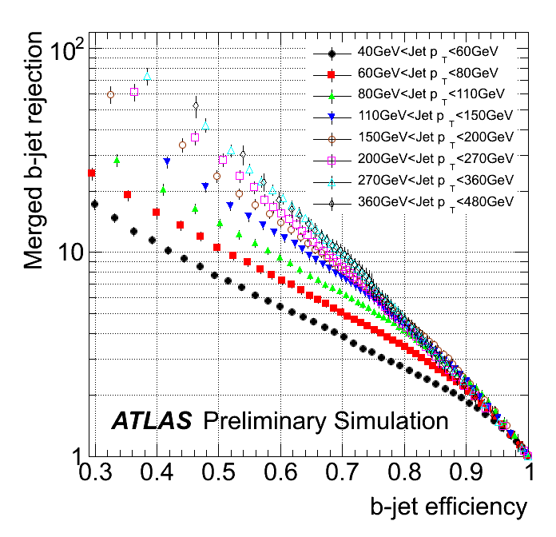
Multivariate Analysis: Performance
Performance improves with Pt
  Pt > 40GeV: rejection above 8 at 50% b-jet efficiency
  Pt > 200GeV: rejection above 30 at 50% efficiency
Only statistical errors are shown
Notes:
The rejection of merged jets attained as a function of pT for the 50% and 60% single b-jet effi-
ciency working points are summarized in Table 1, together with their relative statistical error. These are
propagated from the Poisson fluctuations of the number of events in the merged and single b distribu-
tions. The error is slightly lower for the 60% efficiency working point because a higher efficiency allows
for a greater number of Monte Carlo events to measure the performance.

Slide 27
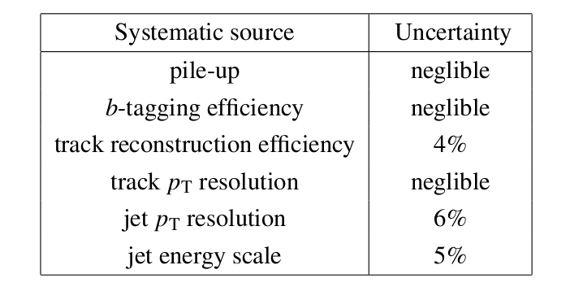
Systematic uncertainties
The following sources of systematic uncertainties were considered:
  The presence of additional interactions (pile-up);
  The b-tagging efficiency;
  The track reconstruction efficiency;
  The track transverse momentum resolution;
  The jet transverse momentum resolution (JER);
  The jet energy scale.
The main contributions are the uncertainties in track reconstruction efficiency, jet energy scale, and jet energy resolution.
Summary table:

Slide 28
Summary
A multivariate discriminant to identify b-tagged jets containing two B-hadrons was presented.
The method exploits shape and substructure differences between single b-jets and merged b-jets, produced for instance from gluon splitting.
The Monte Carlo distributions of the explored discriminant variables were validated using experimental data recorded by ATLAS during 2011.
The agreement between data and simulation is excellent.
The performance of the tagger in Monte Carlo was studied as a function of jet pT, achieving, at 50% single b-jet efficiency, a merged b-jet rejection of over 30 (8) for pT > 200 GeV (pT > 40 GeV).
This tool has applications in measurement of QCD beauty production, rejection of QCD/W+jets background in searches dominated by single b-jets and substructure studies in heavy boosted jets (Z->bb, H->bb)

Slide 29
Back-up slides

Slide 30
Jet reconstruction and calibration
Jets are reconstructed using anti-KT jet algorithm with R=0.4, using calorimeter topoclusters as inputs.
Jets are calibrated using three different calibration schemes: “EM+JES”, “LCW+JES” and “GS”.
The total uncertainty on the JES is smaller than ±10%.
Notes:
The jet energies are corrected for inhomogeneities and for the non-compensating nature of the calorimeter

Slide 31
Tracks & vertices
The charged-particle tracks with pseudorapidity |η|<2.5 are reconstructed in the ID.
Tracks with pT^{track} > 400 MeV are associated in primary vertices (PV).
The PV must be reconstructed from at least five tracks.
Several PV can be reconstructed per event due to the presence of pile-up.
The one with the largest ∑trk(pT^{trk})² , is selected as the one associated to the hard interaction.
Notes:
The charged-particle tracks with pseudorapidity |η|<2.5 are reconstructed in the ID.
Tracks with pT^{track} > 400 MeV and consistent with the beam spot are associated in primary vertices via a finding/fitting sequential algorithm.
To ensure a good resolution on the vertex position, the primary vertex must be reconstructed from at least five tracks.

Slide 32
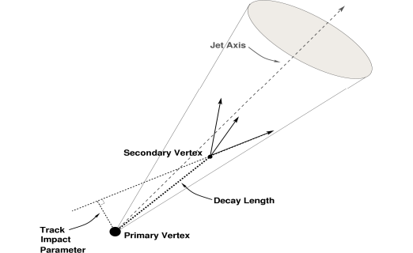
B-Tagging algorithms
Algorithms to identify heavy flavor content in reconstructed jets.
Impact parameter of tracks in jets:
IP3D: uses track weights based on longitudinal and transverse IP significance.
Displaced secondary vertex:
SV1: reconstructs inclusive displaced vertex
JetFitter: reconstructs multiple vertices along implied b-hadron line of flight.
Advanced NN taggers:
JetFitterCOMBNN: IP3D+JetFitter
MV1: IP3D+JetFitter+SV1
The b-tagging performance is determined using a simulated tt sample and is calibrated using experimental data with jets containing muons and with a sample of tt events.
Notes:
The ability to identify jets containing b-hadrons is important for the high-pT physics program of the
ATLAS experiment. Two robust b-tagging algorithms taking advantage of either the impact parameter
of tracks [1] or the reconstruction of secondary vertices [2] were developed and successfully used for
several analyses of the 2010 and 2011 data. Building on this experience, more advanced and performing
b-tagging algorithms have been recentlycommissioned with 2011 data [3]. b-tagging algorithms rely on the relatively long decay length of b-hadrons that gives rise to large impact parameter tracks and displaced decay secondary vertices, or on the presence of a soft lepton within the jet, the product of the semileptonic b-decay. The more advanced taggers use multivariate techniques to further increase the
discrimination between b-jets and light jets.

Slide 33
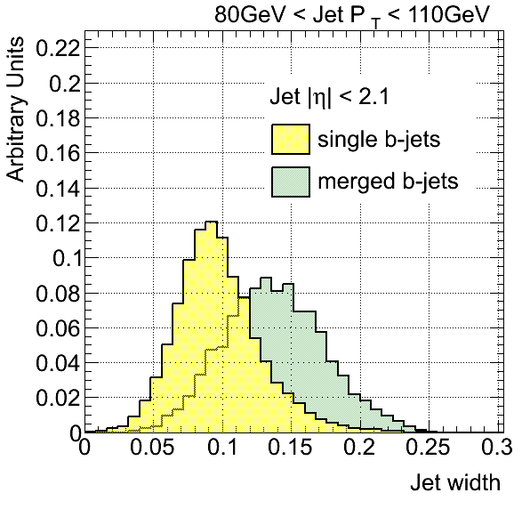
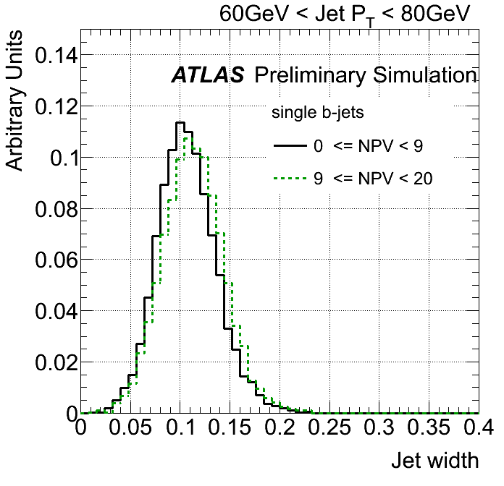
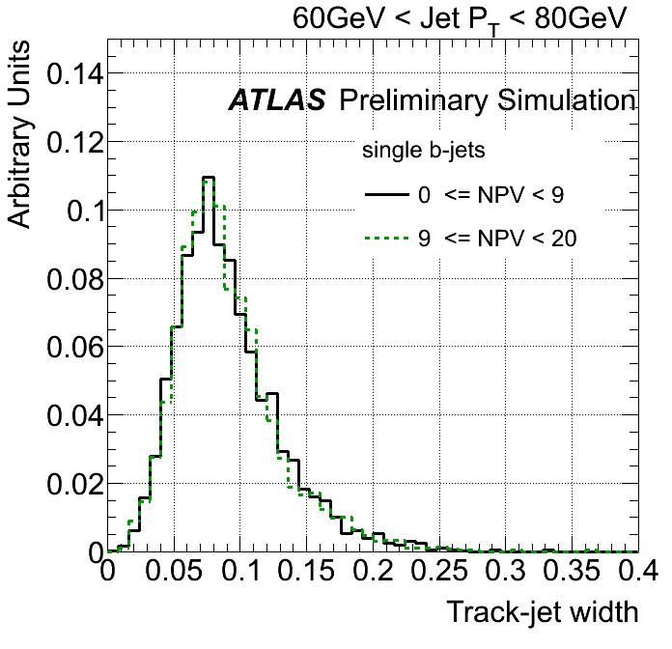

Single/Double b-hadron jets: discriminating variables
Jet width: uses calorimeter constituents (topoclusters) instead of the associated tracks.
It provides very good discrimination, but it is more sensitive to the amount of pile-up in the event than its track-based counterpart.
Notes:
This is the outline of my talk,
- I'm gonna give first a brief introduction, describing the goals and motivations of this study,
- after that I will explain the strategy that we followed,
- show pythia results on discriminating variables
- and the I'll go through ATLAS MC results and the validation in 2011 Data
- I will finalize with our next steps and the conclusions.
(next slide)

Slide 34
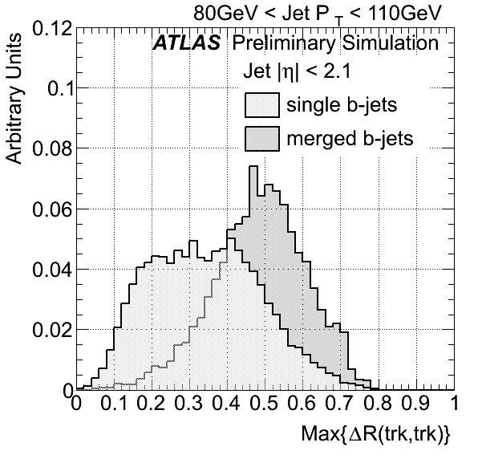
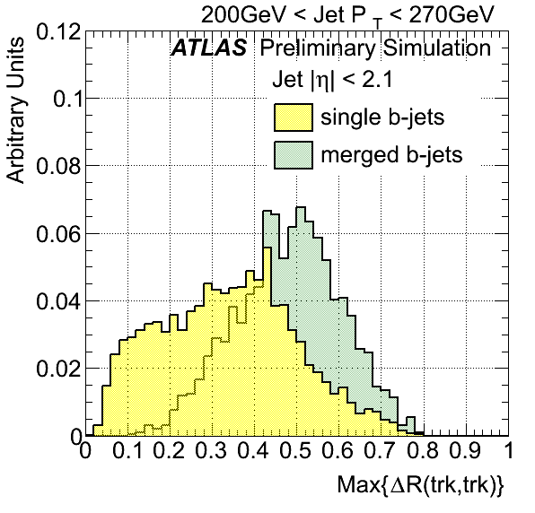
Single/Double b-hadron jets: discriminating variables
Max{ΔR(trk,trk)}: maximum distance in the η−φ plane between track pairs in the jet.
Although it shows good discrimination between single and merged b-jets, we looked for alternatives to Max{∆R(trk,trk)} as it is sensitive to the presence of non-relevant soft tracks in the jet periphery.
Notes:
This is the outline of my talk,
- I'm gonna give first a brief introduction, describing the goals and motivations of this study,
- after that I will explain the strategy that we followed,
- show pythia results on discriminating variables
- and the I'll go through ATLAS MC results and the validation in 2011 Data
- I will finalize with our next steps and the conclusions.
(next slide)

Slide 35
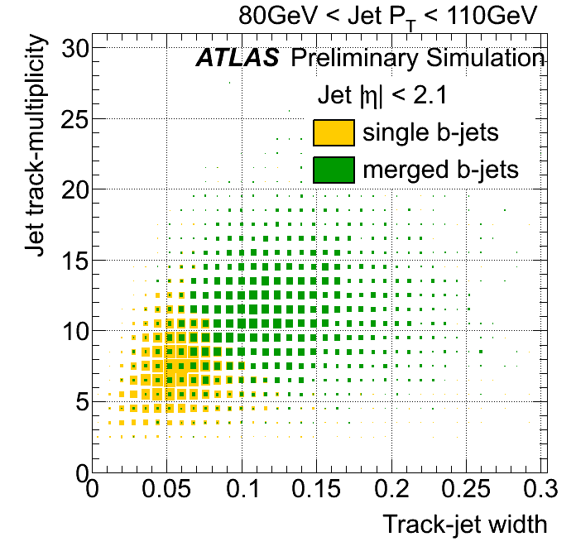
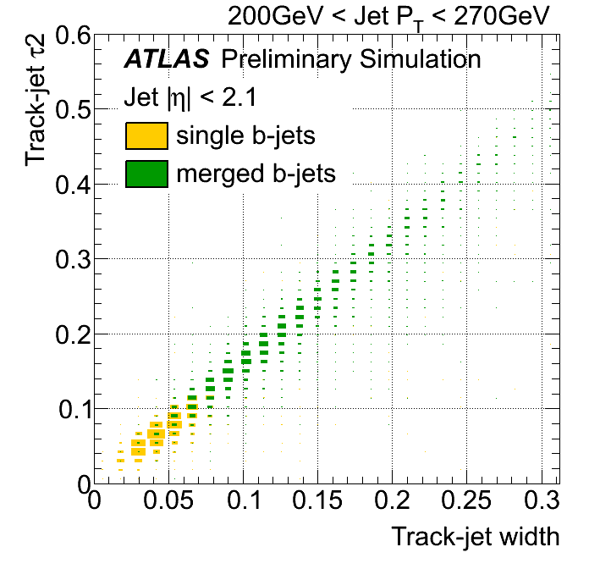
Single/Double b-hadron jets: correlations
Studied correlation between variables to avoid using strongly correlated pairs, as illustrated here for τ2 and track-jet width.
Notes:
In spite of the separation observed, the
addition of τ2 did not improve the global discrimination power of the tagger. This could be traced to
the level of correlation between τ2 and track-jet width, displayed in Fig. 9a, to be compared to the much
lower correlation presented, for instance, between track-jet width and the jet track multiplicity, shown in
Fig. 9b.

Slide 36
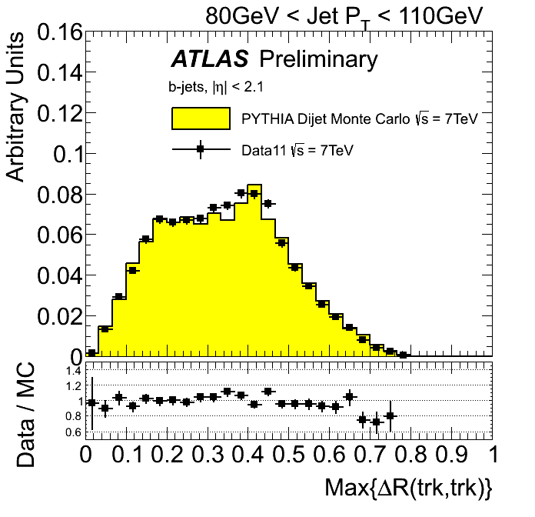
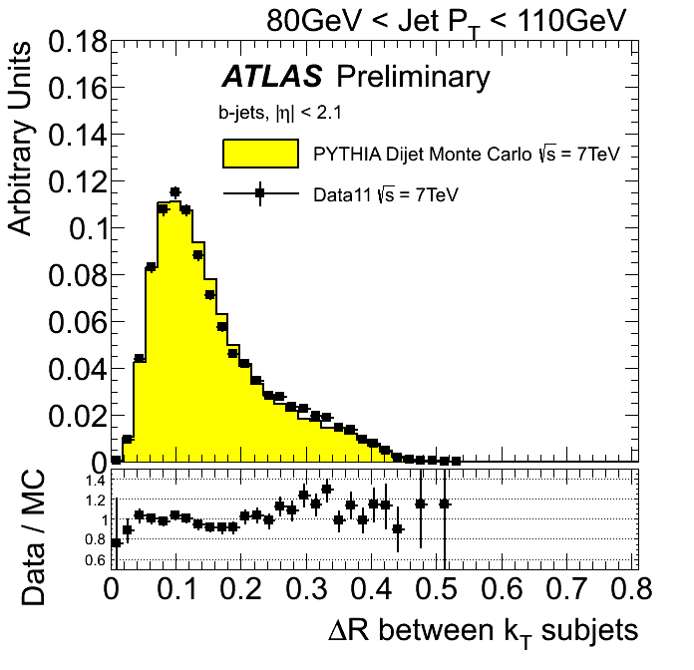
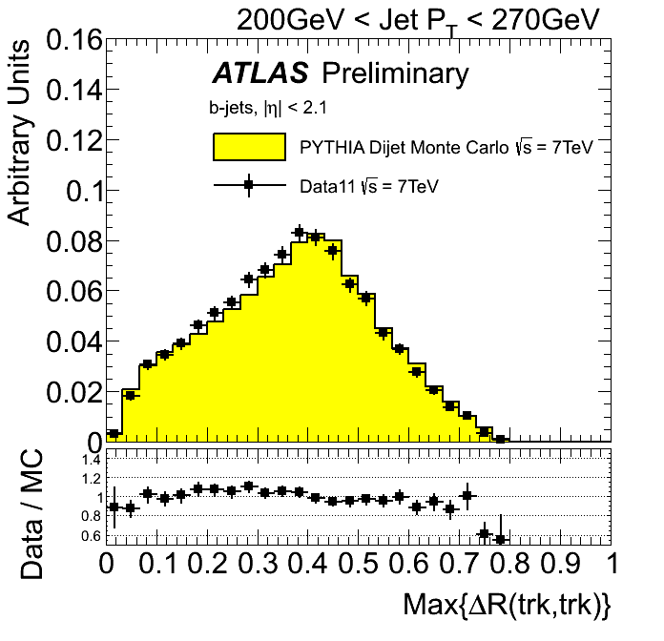
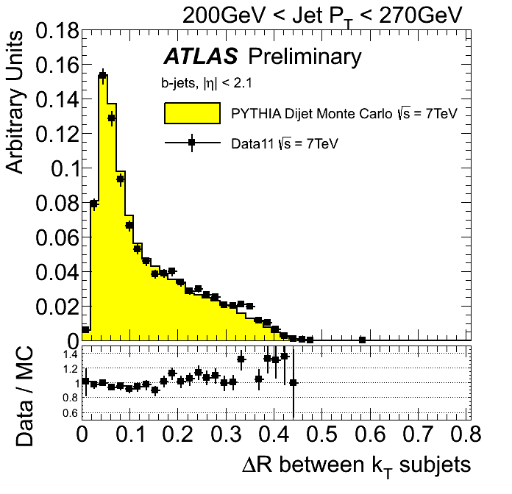
Validation of discriminating variables with data
Very good agreement between data and simulation.
Notes:
This is the outline of my talk,
- I'm gonna give first a brief introduction, describing the goals and motivations of this study,
- after that I will explain the strategy that we followed,
- show pythia results on discriminating variables
- and the I'll go through ATLAS MC results and the validation in 2011 Data
- I will finalize with our next steps and the conclusions.
(next slide)

Slide 37
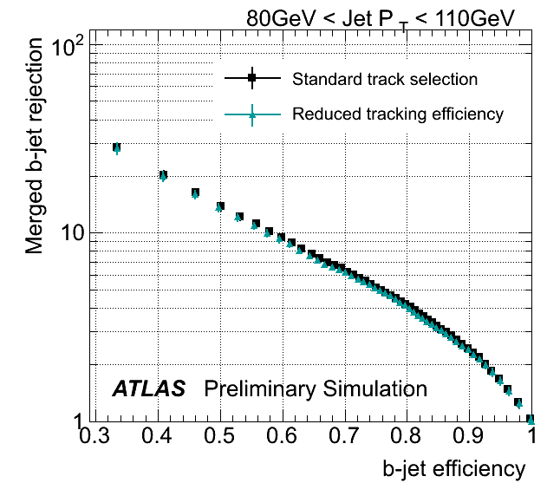
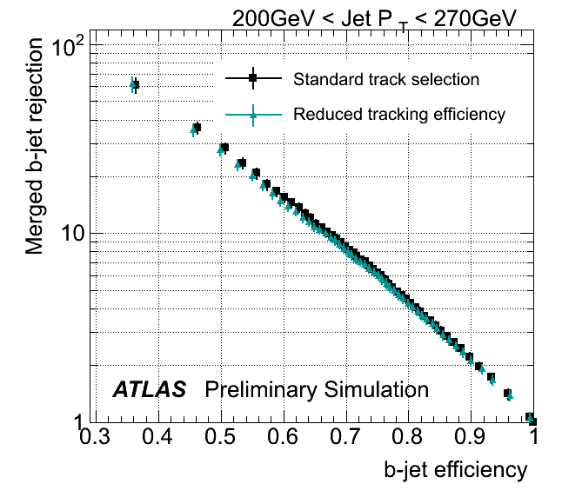
3. Uncertainty in the track reconstruction efficiency
An uncertainty arises from our limit in the understanding of the ID material layout
To test its impact a fraction of tracks determined from the track efficiency uncertainty was randomly removed.
A systematic degradation of the performance of 4% is present over all pt bins / 2 working points considered.
Notes:
This is the outline of my talk,
- I'm gonna give first a brief introduction, describing the goals and motivations of this study,
- after that I will explain the strategy that we followed,
- show pythia results on discriminating variables
- and the I'll go through ATLAS MC results and the validation in 2011 Data
- I will finalize with our next steps and the conclusions.
(next slide)

