Slide 1
MESSAGING LIFTED VERBATIM FROM THE DECKS
Lines ready for the site
POSITIONING
CONCEPT
An AI-agentic company that delivers finished outcomes around AI-native platforms. Not software seats. Not billable hours.
Everything between “the software is live” and “the final outcome is delivered.”
CONTRAST
PROOF OF NEED
Platforms deliver the capability. DaveroAI delivers the finished outcome
AI enablement is the bottleneck. We enable and deliver finished outcome.
GOVERNANCE
GOLDEN RULE
Humans review and approve. Agents do the rest.
The client identifies the gap. We build. The client validates. We own, run and improve the agent.
SCALE
CLOSE
Every engagement adds to the library, so the next client starts further ahead.
The last mile is where software, services and context meet.

Slide 2
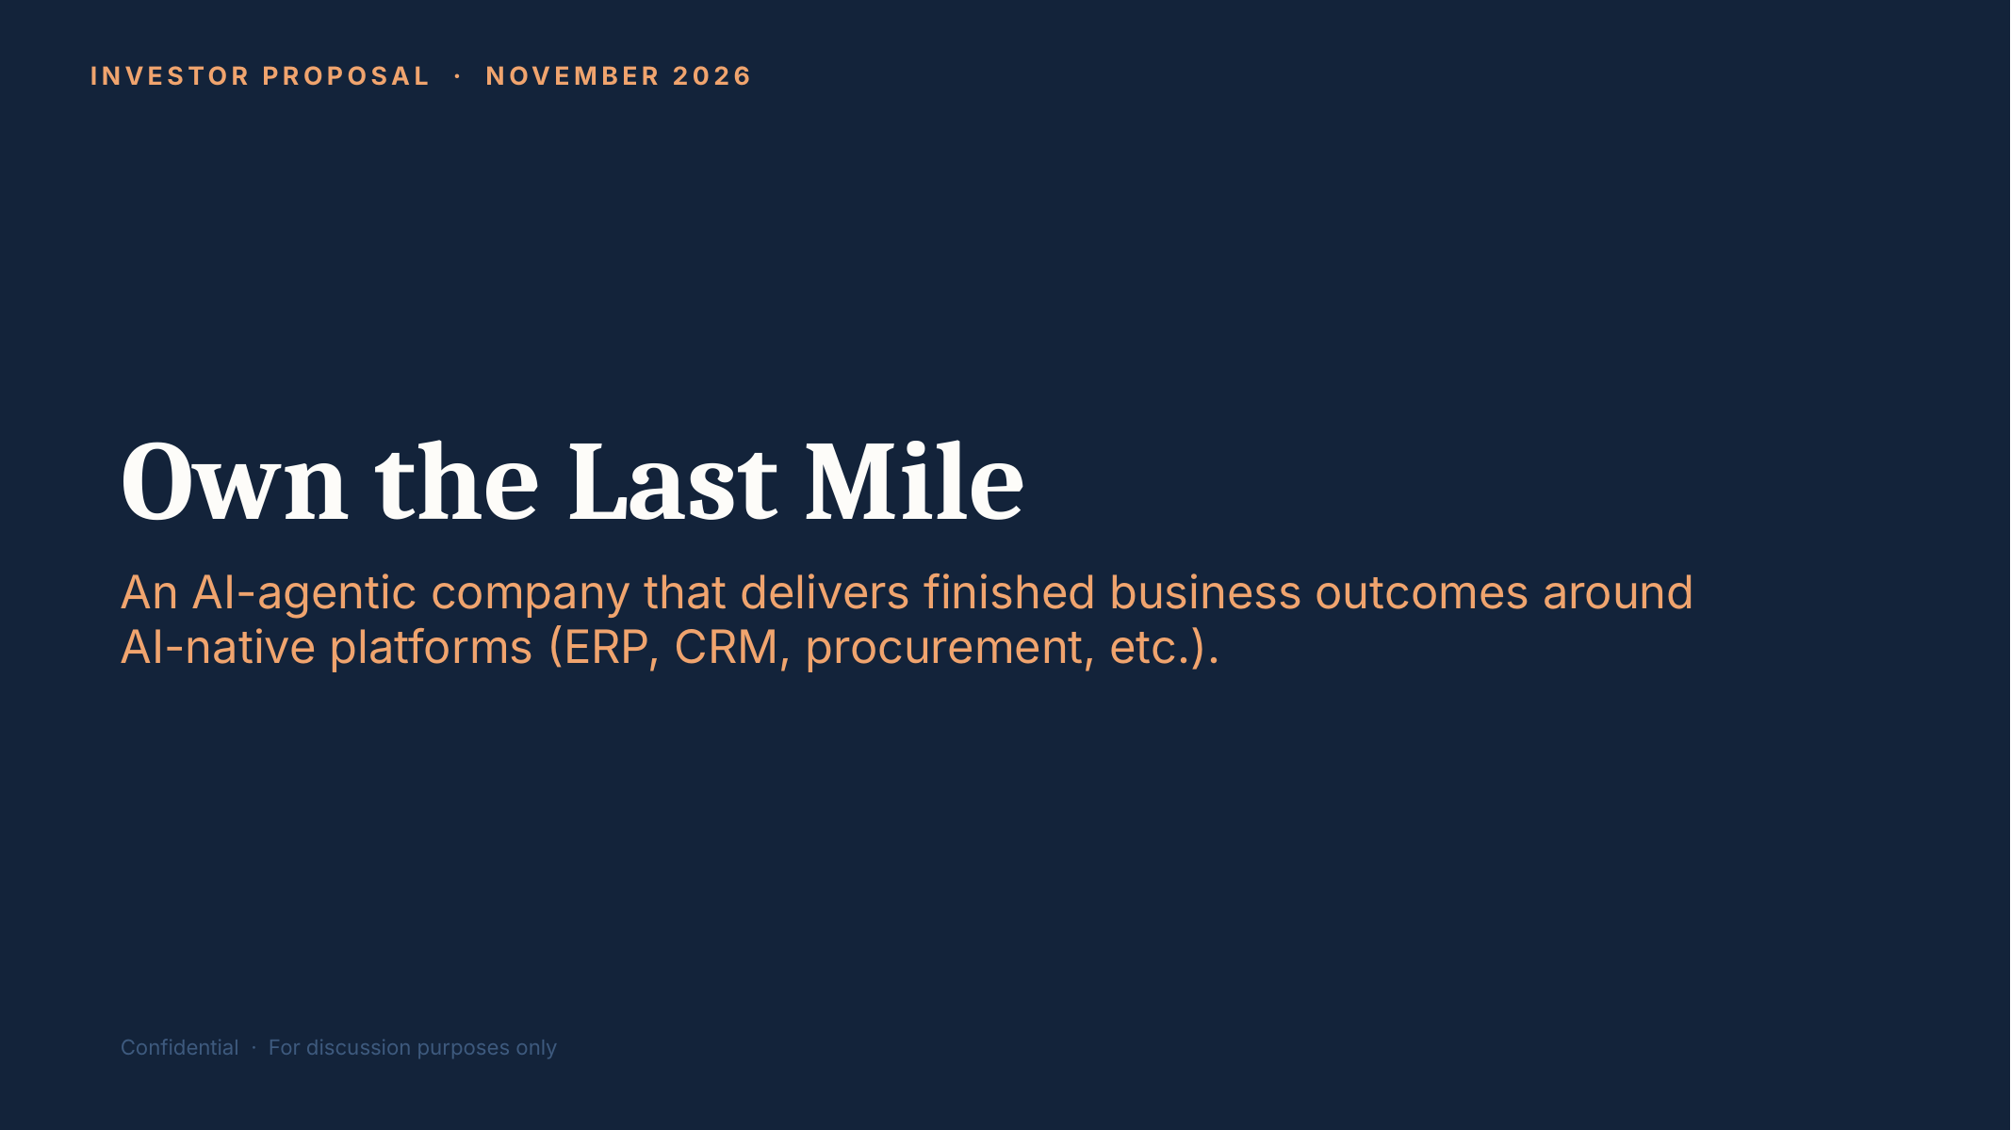
REFERENCE 01 · POSITIONING & THE CORE IDEA
Brand promise
WEBSITE PLACEMENT
Home · Hero (Section 1)
WHAT TO USE
Core positioning line: “DaveroAI is an agentic AI company that turns your business platforms into finished, end-to-end workflows, built, run and continuously improved by AI agents, with your team approving every result.”
Source: 3. DaveroAI Investor Deck, slide 1
Notes:
SOURCE: 3. DaveroAI Investor Deck, slide 1
PLACEMENT: Home · Hero (Section 1)
USE: Core positioning line: “An AI-agentic company that delivers finished business outcomes around AI-native platforms (ERP, CRM, procurement, etc.).” Candidate hero sub-line.
CAUTION: Remove “Investor proposal” and “Confidential” from any public hero.
--- Original slide text ---
INVESTOR PROPOSAL · NOVEMBER 2026
Own the Last Mile
An AI-agentic company that delivers finished business outcomes around AI-native platforms (ERP, CRM, procurement, etc.).
Confidential · For discussion purposes only

Slide 3
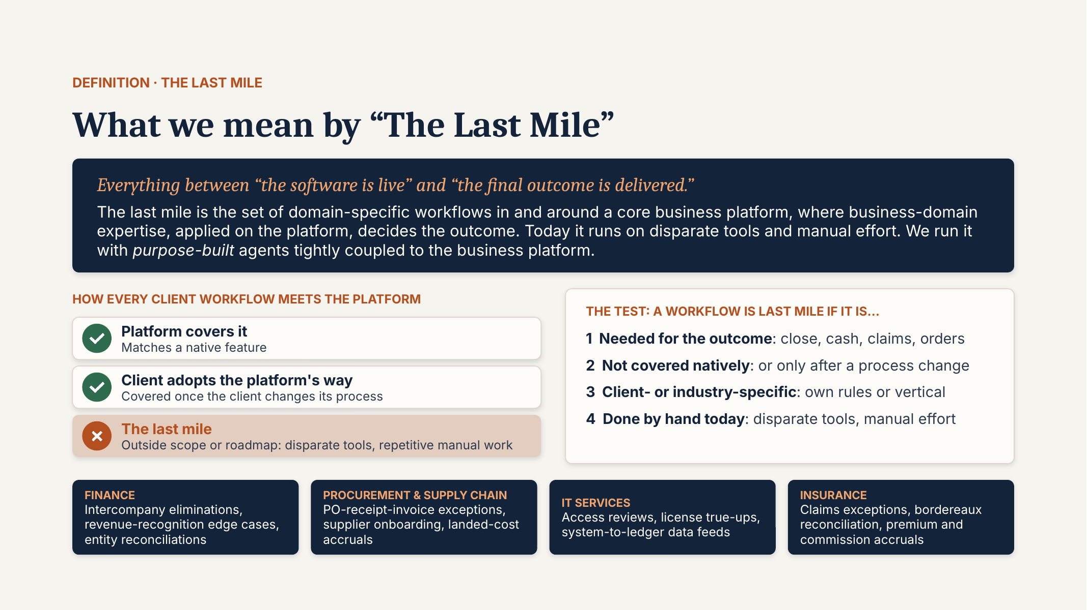
REFERENCE 02 · POSITIONING & THE CORE IDEA
Definition of “The Last Mile”
WEBSITE PLACEMENT
Agentic AI page · Home Section 3
WHAT TO USE
Signature concept. Use the three-state diagram (platform covers it / client adopts / the last mile), the 4-point test, and the four domain examples (Finance, Procurement & Supply Chain, IT Services, Insurance). Strong candidate for an interactive explainer.
Source: 0. One Pager on Last Mile, slide 1
Notes:
SOURCE: 0. One Pager on Last Mile, slide 1
PLACEMENT: Agentic AI page · Home Section 3
USE: Signature concept. Use the three-state diagram (platform covers it / client adopts / the last mile), the 4-point test, and the four domain examples (Finance, Procurement & Supply Chain, IT Services, Insurance). Strong candidate for an interactive explainer.
CAUTION: Same as Rillet deck slide 2; use this one-pager as master.
--- Original slide text ---
DEFINITION · THE LAST MILE
What we mean by “The Last Mile”
Everything between “the software is live” and “the final outcome is delivered.”
The last mile is the set of domain-specific workflows in and around a core business platform, where business-domain expertise, applied on the platform, decides the outcome. Today it runs on disparate tools and manual effort. We run it with purpose-built agents tightly coupled to the business platform.
HOW EVERY CLIENT WORKFLOW MEETS THE PLATFORM
Platform covers it
Matches a native feature
Client adopts the platform's way
Covered once the client changes its process
The last mile
Outside scope or roadmap: disparate tools, repetitive manual work
THE TEST: A WORKFLOW IS LAST MILE IF IT IS…
1 Needed for the outcome: close, cash, claims, orders
2 Not covered natively: or only after a process change
3 Client- or industry-specific: own rules or vertical
4 Done by hand today: disparate tools, manual effort
FINANCE
Intercompany eliminations, revenue-recognition edge cases, entity reconciliations
PROCUREMENT & SUPPLY CHAIN
PO-receipt-invoice exceptions, supplier onboarding, landed-cost accruals
IT SERVICES
Access reviews, license true-ups, system-to-ledger data feeds
INSURANCE
Claims exceptions, bordereaux reconciliation, premium and commission accruals

Slide 4
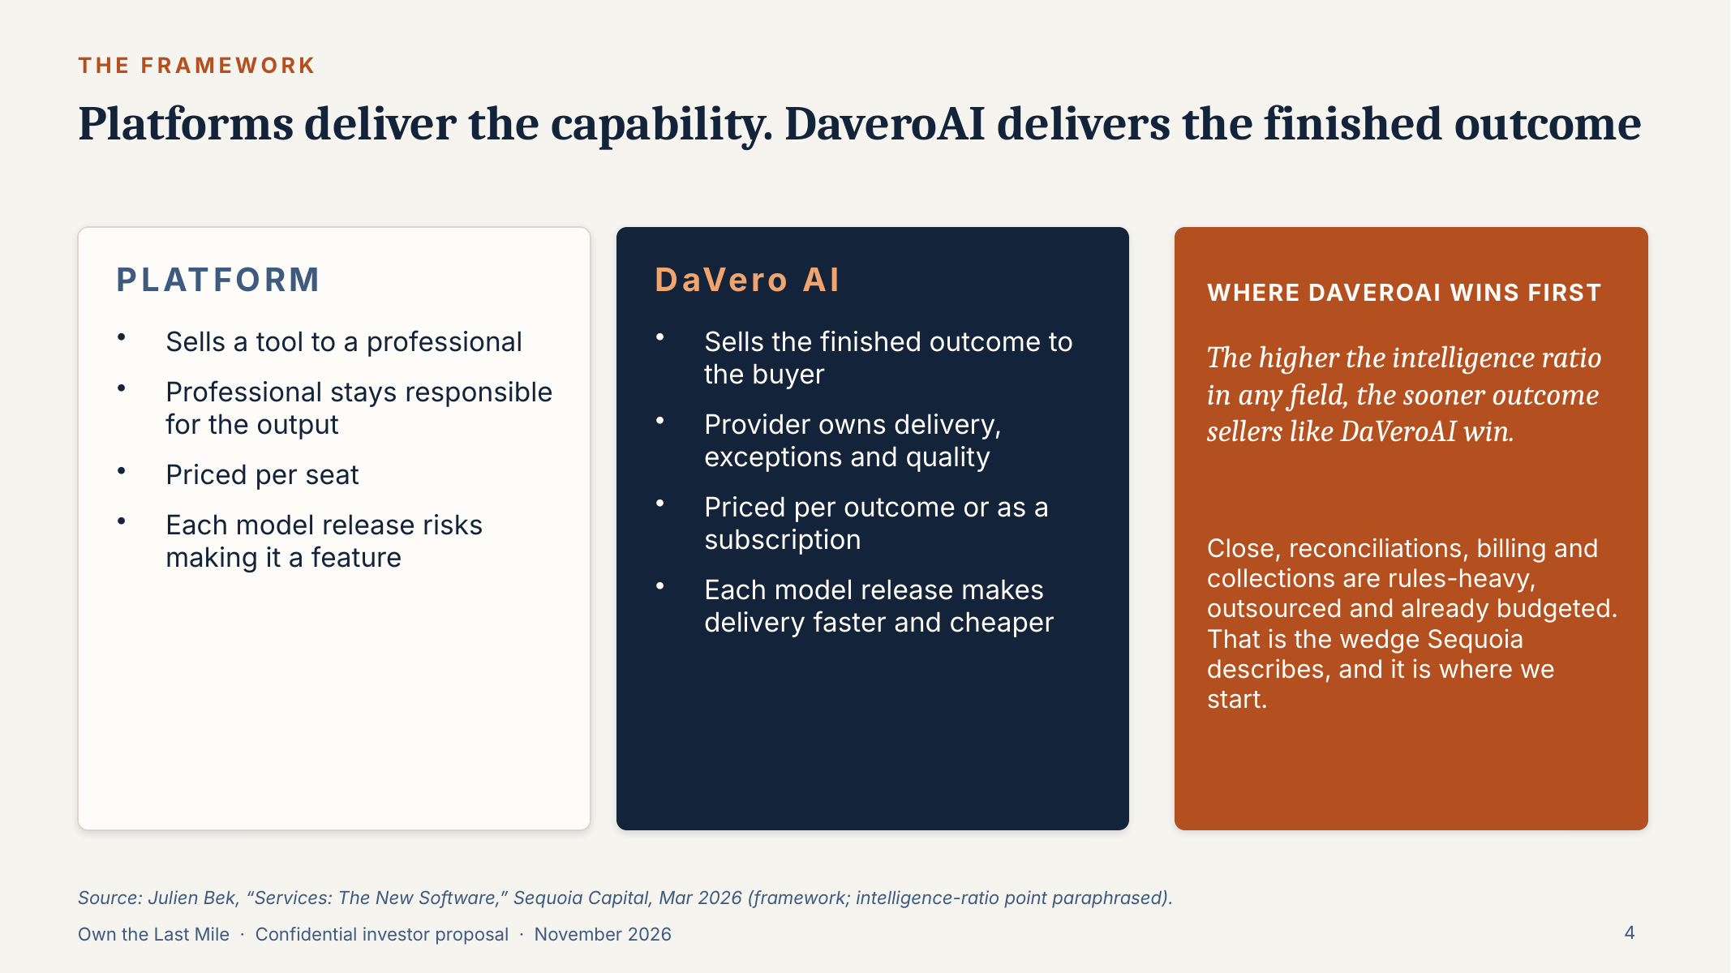
REFERENCE 03 · POSITIONING & THE CORE IDEA
Platform vs. DaVeroAI
WEBSITE PLACEMENT
Home Section 2 (Evolution of AI) · Agentic AI page
WHAT TO USE
The “Platforms deliver the capability. DaveroAI delivers the finished outcome” comparison. Use as the visual contrast for “traditional tools vs. agentic outcomes”.
Source: 3. DaveroAI Investor Deck, slide 4
Notes:
SOURCE: 3. DaveroAI Investor Deck, slide 4
PLACEMENT: Home Section 2 (Evolution of AI) · Agentic AI page
USE: The “Platforms deliver the capability. DaveroAI delivers the finished outcome” comparison. Use as the visual contrast for “traditional tools vs. agentic outcomes”.
CAUTION: The intelligence-ratio line is now a paraphrase of Sequoia, not a direct quote, so don’t show it in quotation marks on the site.
--- Original slide text ---
Platforms deliver the capability. DaveroAI delivers the finished outcome
THE FRAMEWORK
PLATFORM
Sells a tool to a professional
Professional stays responsible for the output
Priced per seat
Each model release risks making it a feature
DaVero AI
Sells the finished outcome to the buyer
Provider owns delivery, exceptions and quality
Priced per outcome or as a subscription
Each model release makes delivery faster and cheaper
WHERE DAVEROAI WINS FIRST
The higher the intelligence ratio in any field, the sooner outcome sellers like DaVeroAI win.
Close, reconciliations, billing and collections are rules-heavy, outsourced and already budgeted. That is the wedge Sequoia describes, and it is where we start.
Source: Julien Bek, “Services: The New Software,” Sequoia Capital, Mar 2026 (frameworks, company classifications and quote).

Slide 5
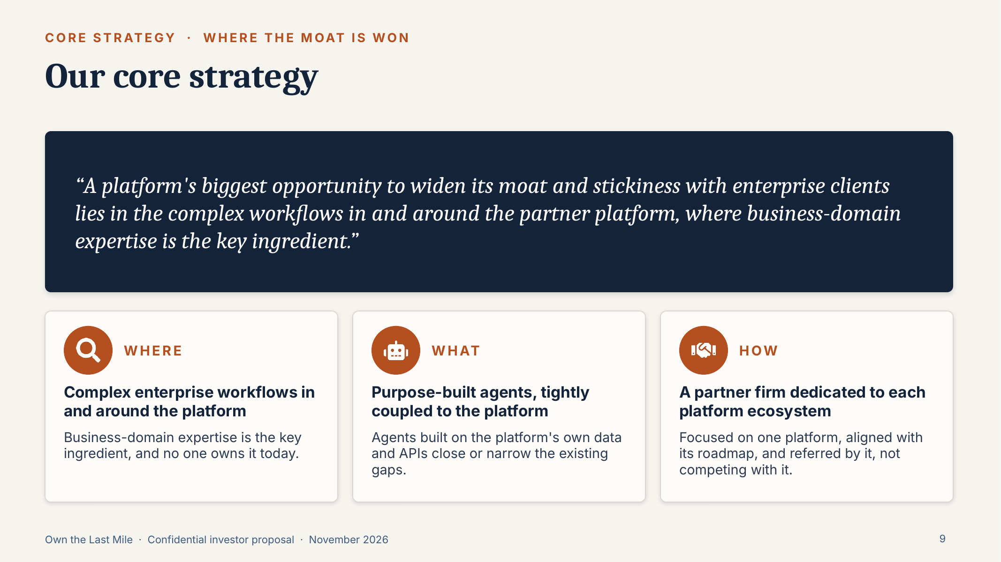
REFERENCE 04 · POSITIONING & THE CORE IDEA
Core strategy: Where / What / How
WEBSITE PLACEMENT
Home · Why Agentic AI · About
WHAT TO USE
Three-part strategy: complex workflows in and around the platform (WHERE), purpose-built platform-coupled agents (WHAT), a partner firm dedicated to each platform ecosystem (HOW). The quote works as a pull-quote.
Source: 3. DaveroAI Investor Deck, slide 9
Notes:
SOURCE: 3. DaveroAI Investor Deck, slide 9
PLACEMENT: Home · Why Agentic AI · About
USE: Three-part strategy: complex workflows in and around the platform (WHERE), purpose-built platform-coupled agents (WHAT), a partner firm dedicated to each platform ecosystem (HOW). The quote works as a pull-quote.
--- Original slide text ---
Our core strategy
CORE STRATEGY · WHERE THE MOAT IS WON
“A platform's biggest opportunity to widen its moat and stickiness with enterprise clients lies in the complex workflows in and around the partner platform, where business-domain expertise is the key ingredient.”
WHERE
Complex enterprise workflows in and around the platform
Business-domain expertise is the key ingredient, and no one owns it today.
WHAT
Purpose-built agents, tightly coupled to the platform
Agents built on the platform's own data and APIs close or narrow the existing gaps.
HOW
A partner firm dedicated to each platform ecosystem
Focused on one platform, aligned with its roadmap, and referred by it, not competing with it.

Slide 6
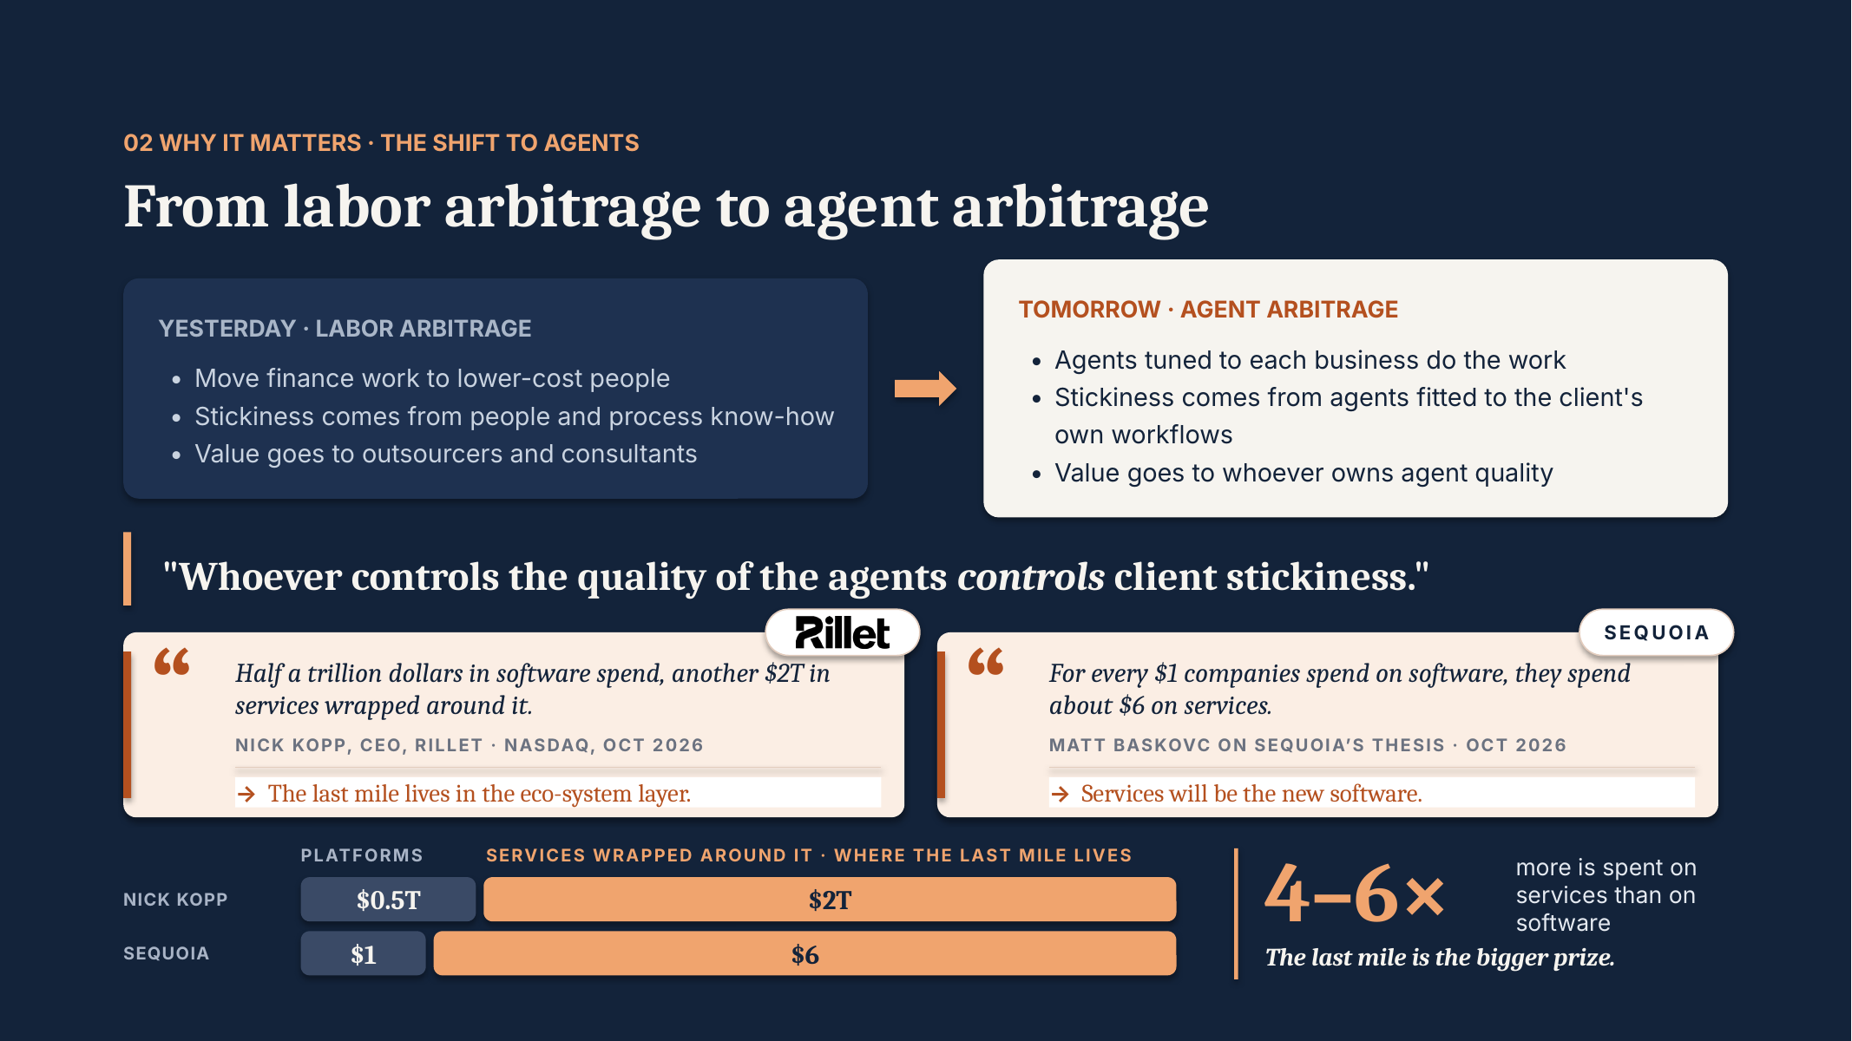
REFERENCE 05 · MARKET SHIFT & BUSINESS CHALLENGES
Labor arbitrage → agent arbitrage
WEBSITE PLACEMENT
Home Section 2 · Agentic AI page
WHAT TO USE
Yesterday vs. tomorrow comparison and the $0.5T software vs. $2T services bar. Good for an animated before/after.
CAUTION
Quotes from Nick Kopp (Rillet) and Sequoia need attribution; Rillet logo needs permission before public use.
Source: 1. Rillet – Own the Last Mile, slide 8
Notes:
SOURCE: 1. Rillet – Own the Last Mile, slide 8
PLACEMENT: Home Section 2 · Agentic AI page
USE: Yesterday vs. tomorrow comparison and the $0.5T software vs. $2T services bar. Good for an animated before/after.
CAUTION: Quotes from Nick Kopp (Rillet) and Sequoia need attribution; Rillet logo needs permission before public use.
--- Original slide text ---
02 WHY IT MATTERS · THE SHIFT TO AGENTS
From labor arbitrage to agent arbitrage
YESTERDAY · LABOR ARBITRAGE
Move finance work to lower-cost people
Stickiness comes from people and process know-how
Value goes to outsourcers and consultants
TOMORROW · AGENT ARBITRAGE
Agents tuned to each business do the work
Stickiness comes from agents fitted to the client's own workflows
Value goes to whoever owns agent quality
"Whoever controls the quality of the agents controls client stickiness."
platform SOFTWARE
SERVICES WRAPPED AROUND IT · WHERE THE LAST MILE LIVES
$0.5T
$2T
4–6×
more is spent on services than on software
The last mile is the bigger prize.
Half a trillion dollars in software spend, another $2T in services wrapped around it.
NICK KOPP, CEO, RILLET · NASDAQ, OCT 2026
→ The last mile lives in the eco-system layer.
For every $1 companies spend on software, they spend about $6 on services.
MATT BASKOVC ON SEQUOIA’S THESIS · OCT 2026
→ Services will be the new software.
SEQUOIA
$1
$6
NICK KOPP
SEQUOIA

Slide 7
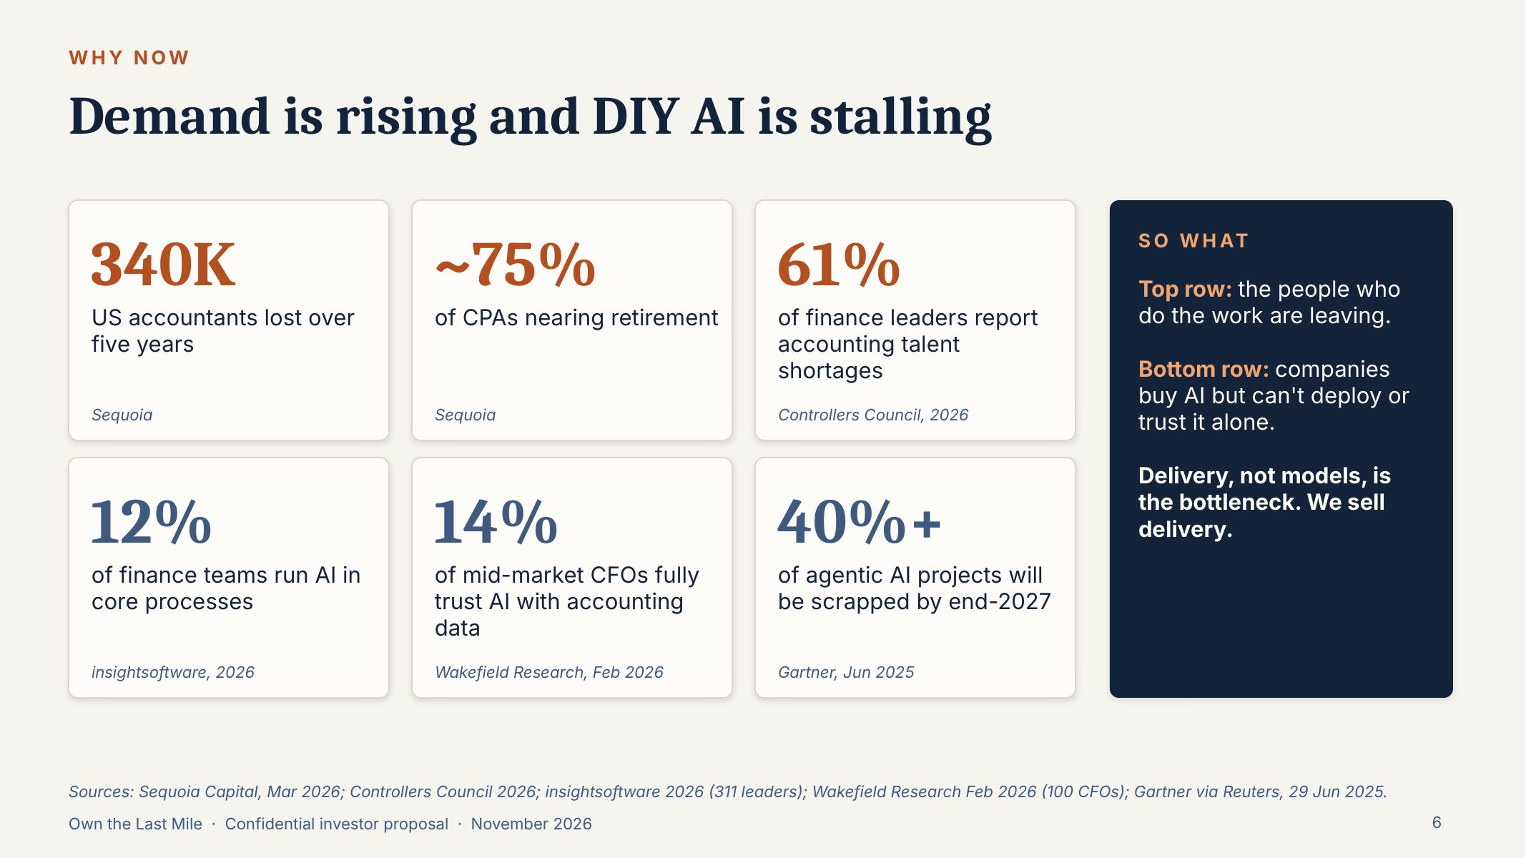
REFERENCE 07 · MARKET SHIFT & BUSINESS CHALLENGES
Demand rising, DIY AI stalling into Finance Domain
WEBSITE PLACEMENT
Home Section 3 (Business challenges)
WHAT TO USE
Six stat tiles: 340K accountants lost, ~75% CPAs nearing retirement, 61% talent shortage, 12% run AI in core processes, 14% trust AI, 40%+ agentic projects scrapped. Key line: “Delivery, not models, is the bottleneck. We sell delivery.”
CAUTION
Each stat must carry its source (Sequoia, Controllers Council, insightsoftware, Wakefield, Gartner).
Source: 3. DaveroAI Investor Deck, slide 6
Notes:
SOURCE: 3. DaveroAI Investor Deck, slide 6
PLACEMENT: Home Section 3 (Business challenges)
USE: Six stat tiles: 340K accountants lost, ~75% CPAs nearing retirement, 61% talent shortage, 12% run AI in core processes, 14% trust AI, 40%+ agentic projects scrapped. Key line: “Delivery, not models, is the bottleneck. We sell delivery.”
CAUTION: Each stat must carry its source (Sequoia, Controllers Council, insightsoftware, Wakefield, Gartner).
--- Original slide text ---
Demand is rising and DIY AI is stalling
WHY NOW
340K
US accountants lost over five years
Sequoia
~75%
of CPAs nearing retirement
Sequoia
61%
of finance leaders report accounting talent shortages
Controllers Council, 2026
12%
of finance teams run AI in core processes
insightsoftware, 2026
14%
of mid-market CFOs fully trust AI with accounting data
Wakefield Research, Feb 2026
40%+
of agentic AI projects will be scrapped by end-2027
Gartner, Jun 2025
SO WHAT
Top row: the people who do the work are leaving.
Bottom row: companies buy AI but can't deploy or trust it alone.
Delivery, not models, is the bottleneck. We sell delivery.
Sources: Sequoia Capital, Mar 2026; Controllers Council 2026; insightsoftware 2026 (311 leaders); Wakefield Research Feb 2026 (100 CFOs); Gartner via Reuters, 29 Jun 2025.

Slide 8
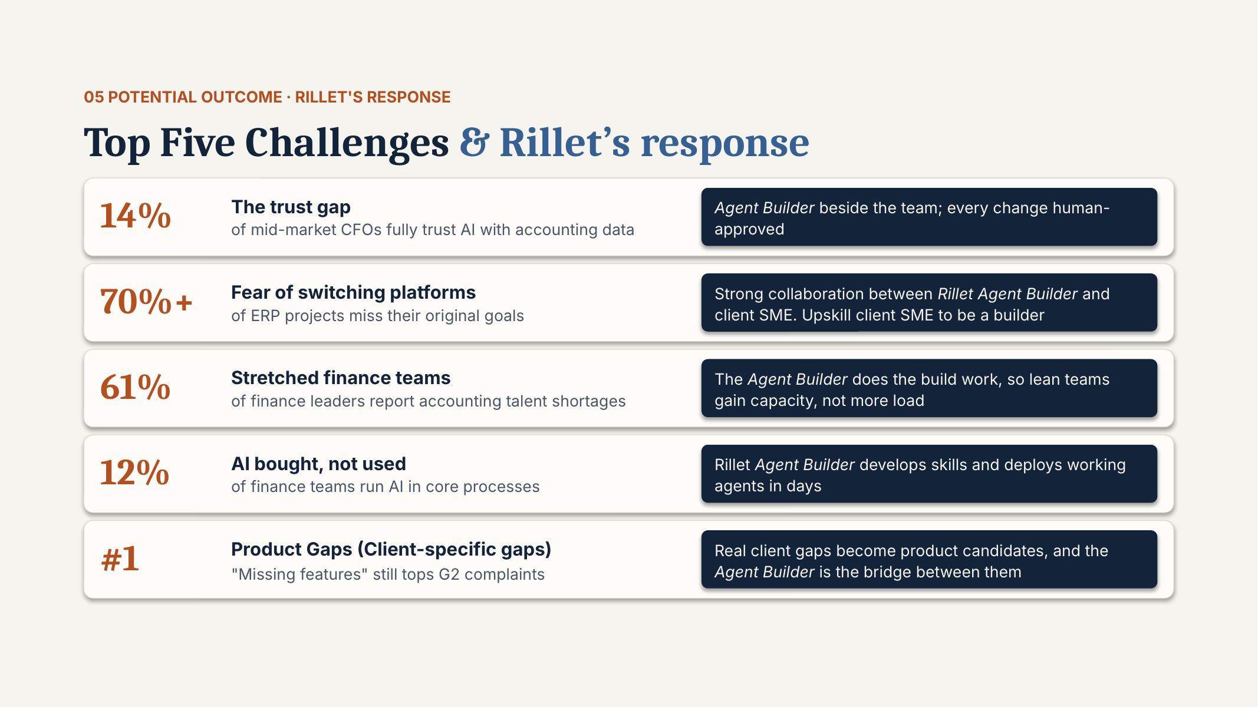
REFERENCE 08 · MARKET SHIFT & BUSINESS CHALLENGES
Top five challenges & our response
WEBSITE PLACEMENT
Home Section 3 · Solutions page
WHAT TO USE
Challenge → answer pairing (trust gap, platform-switching fear, stretched teams, AI not used, product gaps). Best structure for the challenge cards on the homepage.
CAUTION
Hidden slide in the source. Written for Rillet: replace “Rillet Agent Builder” with DaveroAI’s own role name. Source for “#1 missing features” differs from slide 6 (G2 vs. client complaints).
Source: 1. Rillet – Own the Last Mile, slide 23
Notes:
SOURCE: 1. Rillet – Own the Last Mile, slide 23
PLACEMENT: Home Section 3 · Solutions page
USE: Challenge → answer pairing (trust gap, platform-switching fear, stretched teams, AI not used, product gaps). Best structure for the challenge cards on the homepage.
CAUTION: Hidden slide in the source. Written for Rillet: replace “Rillet Agent Builder” with DaveroAI’s own role name. Source for “#1 missing features” differs from slide 6 (G2 vs. client complaints).
--- Original slide text ---
05 POTENTIAL OUTCOME · RILLET'S RESPONSE
Top Five Challenges & Rillet’s response
14%
The trust gap
of mid-market CFOs fully trust AI with accounting data
Agent Builder beside the team; every change human-approved
70%+
Fear of switching platforms
of ERP projects miss their original goals
61%
Stretched finance teams
of finance leaders report accounting talent shortages
The Agent Builder does the build work, so lean teams gain capacity, not more load
12%
AI bought, not used
of finance teams run AI in core processes
Rillet Agent Builder develops skills and deploys working agents in days
#1
Product Gaps (Client-specific gaps)
"Missing features" still tops G2 complaints
Real client gaps become product candidates, and the Agent Builder is the bridge between them
Strong collaboration between Rillet Agent Builder and client SME. Upskill client SME to be a builder

Slide 9
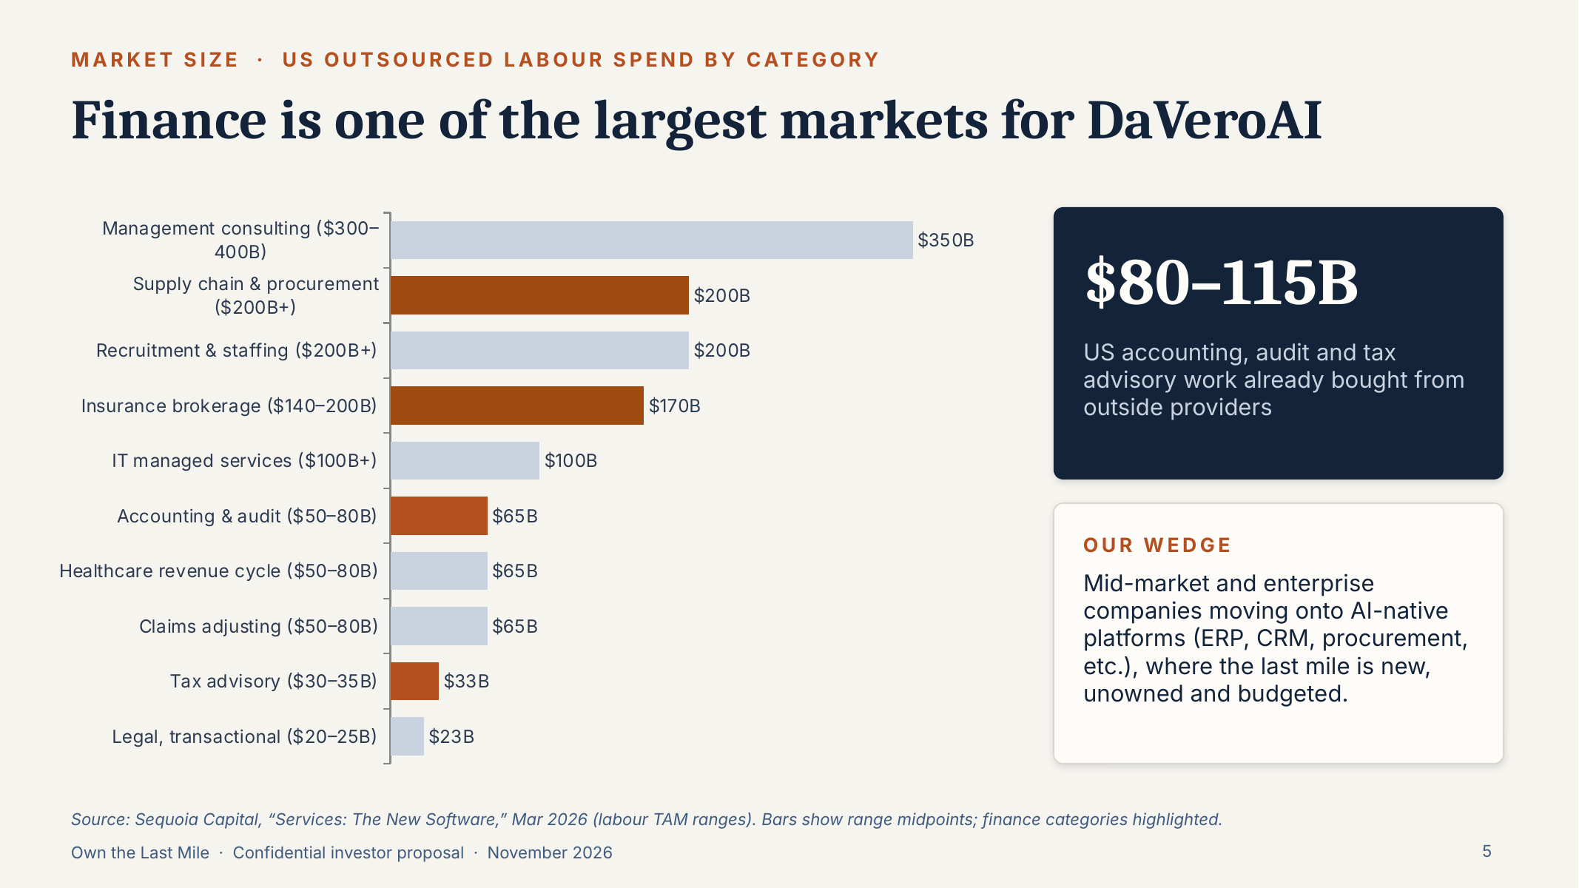
REFERENCE 10 · MARKET SHIFT & BUSINESS CHALLENGES
Market for DaVeroAI
WEBSITE PLACEMENT
Agentic AI page · Insights
WHAT TO USE
$80–115B US accounting, audit and tax work bought from outside providers. Use the “Our wedge” statement for audience targeting (mid-market and enterprise moving onto AI-native platforms (ERP, CRM, procurement, etc.)).
CAUTION
Market-size chart is investor-oriented; on the website use it in Insights rather than the homepage.
Source: 3. DaveroAI Investor Deck, slide 5
Notes:
SOURCE: 3. DaveroAI Investor Deck, slide 5
PLACEMENT: Agentic AI page · Insights
USE: $80–115B US accounting, audit and tax work bought from outside providers. Use the “Our wedge” statement for audience targeting (mid-market and enterprise moving onto AI-native platforms (ERP, CRM, procurement, etc.)).
CAUTION: Market-size chart is investor-oriented; on the website use it in Insights rather than the homepage.
--- Original slide text ---
Finance is one of the largest markets for DaVeroAI
MARKET SIZE · US OUTSOURCED LABOUR SPEND BY CATEGORY
$80–115B
US accounting, audit and tax advisory work already bought from outside providers
OUR WEDGE
Mid-market and enterprise companies moving onto AI-native platforms (ERP, CRM, procurement, etc.), where the last mile is new, unowned and budgeted.
Source: Sequoia Capital, “Services: The New Software,” Mar 2026 (labour TAM ranges). Bars show range midpoints; finance categories highlighted.

Slide 10
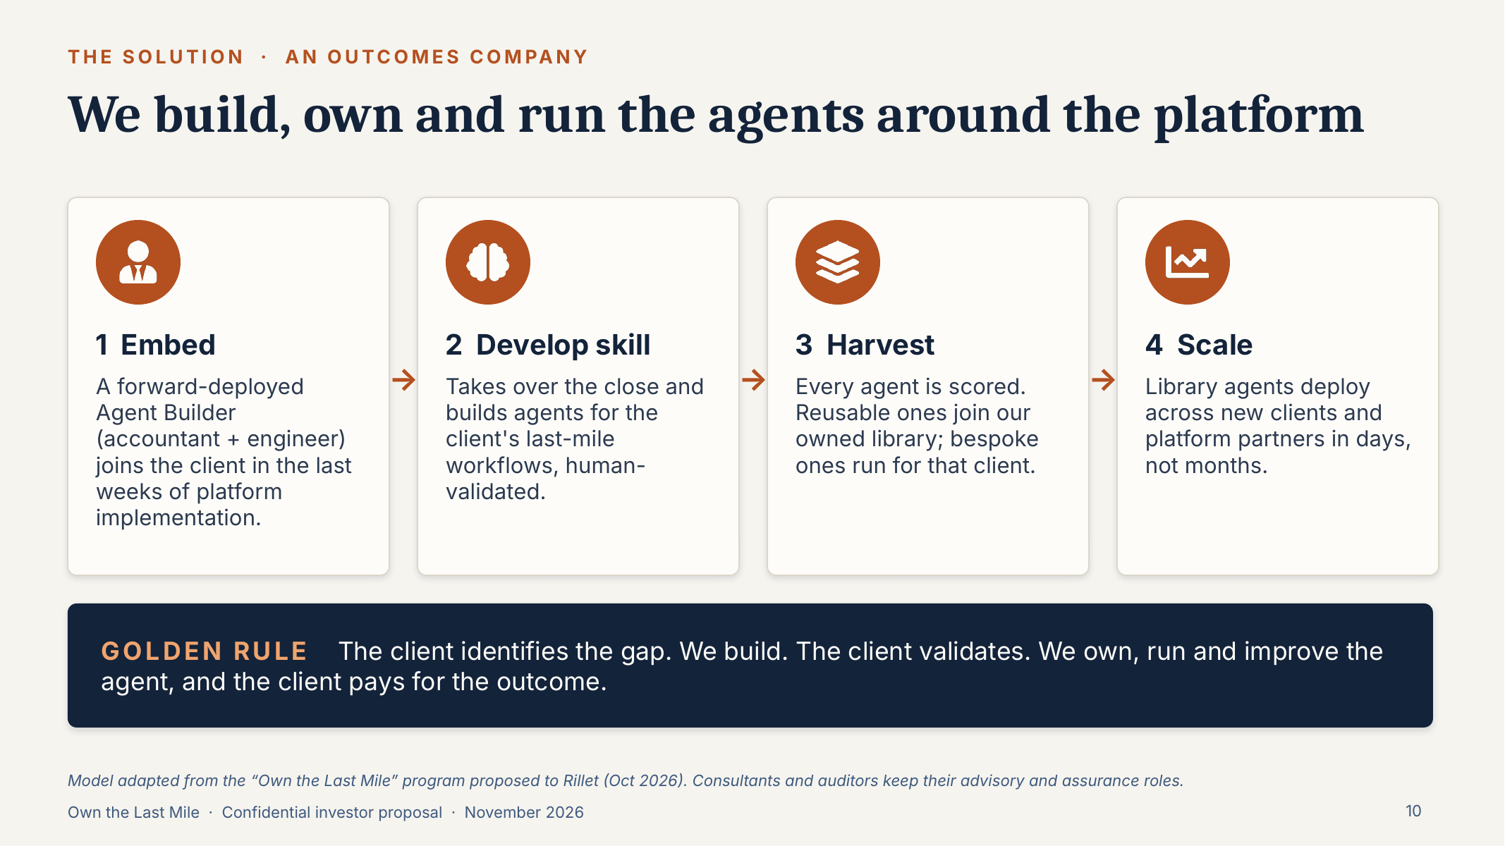
REFERENCE 11 · SOLUTION, SERVICES & METHODOLOGY
We build, own and run the agents
WEBSITE PLACEMENT
Home Section 7 (Methodology) · Our Approach
WHAT TO USE
The 4-step model: Embed → Develop skill → Harvest → Scale, plus the Golden Rule: “The client identifies the gap. We build. The client validates. We own, run and improve the agent.” Ideal for an animated journey.
CAUTION
Project brief proposes 7 steps (Discover → Optimize); the decks use 4 or 5. Confirm which to show.
Source: 3. DaveroAI Investor Deck, slide 10
Notes:
SOURCE: 3. DaveroAI Investor Deck, slide 10
PLACEMENT: Home Section 7 (Methodology) · Our Approach
USE: The 4-step model: Embed → Develop skill → Harvest → Scale, plus the Golden Rule: “The client identifies the gap. We build. The client validates. We own, run and improve the agent.” Ideal for an animated journey.
CAUTION: Project brief proposes 7 steps (Discover → Optimize); the decks use 4 or 5. Confirm which to show.
--- Original slide text ---
We build, own and run the agents around the platform
THE SOLUTION · AN OUTCOMES COMPANY
1 Embed
A forward-deployed Agent Builder (accountant + engineer) joins the client in the last weeks of platform implementation.
2 Develop skill
Takes over the close and builds agents for the client's last-mile workflows, human-validated.
3 Harvest
Every agent is scored. Reusable ones join our owned library; bespoke ones run for that client.
4 Scale
Library agents deploy across new clients and platform partners in days, not months.
GOLDEN RULE The client identifies the gap. We build. The client validates. We own, run and improve the agent, and the client pays for the outcome.
Model adapted from the “Own the Last Mile” program proposed to Rillet (Oct 2026). Consultants and auditors keep their advisory and assurance roles.

Slide 11
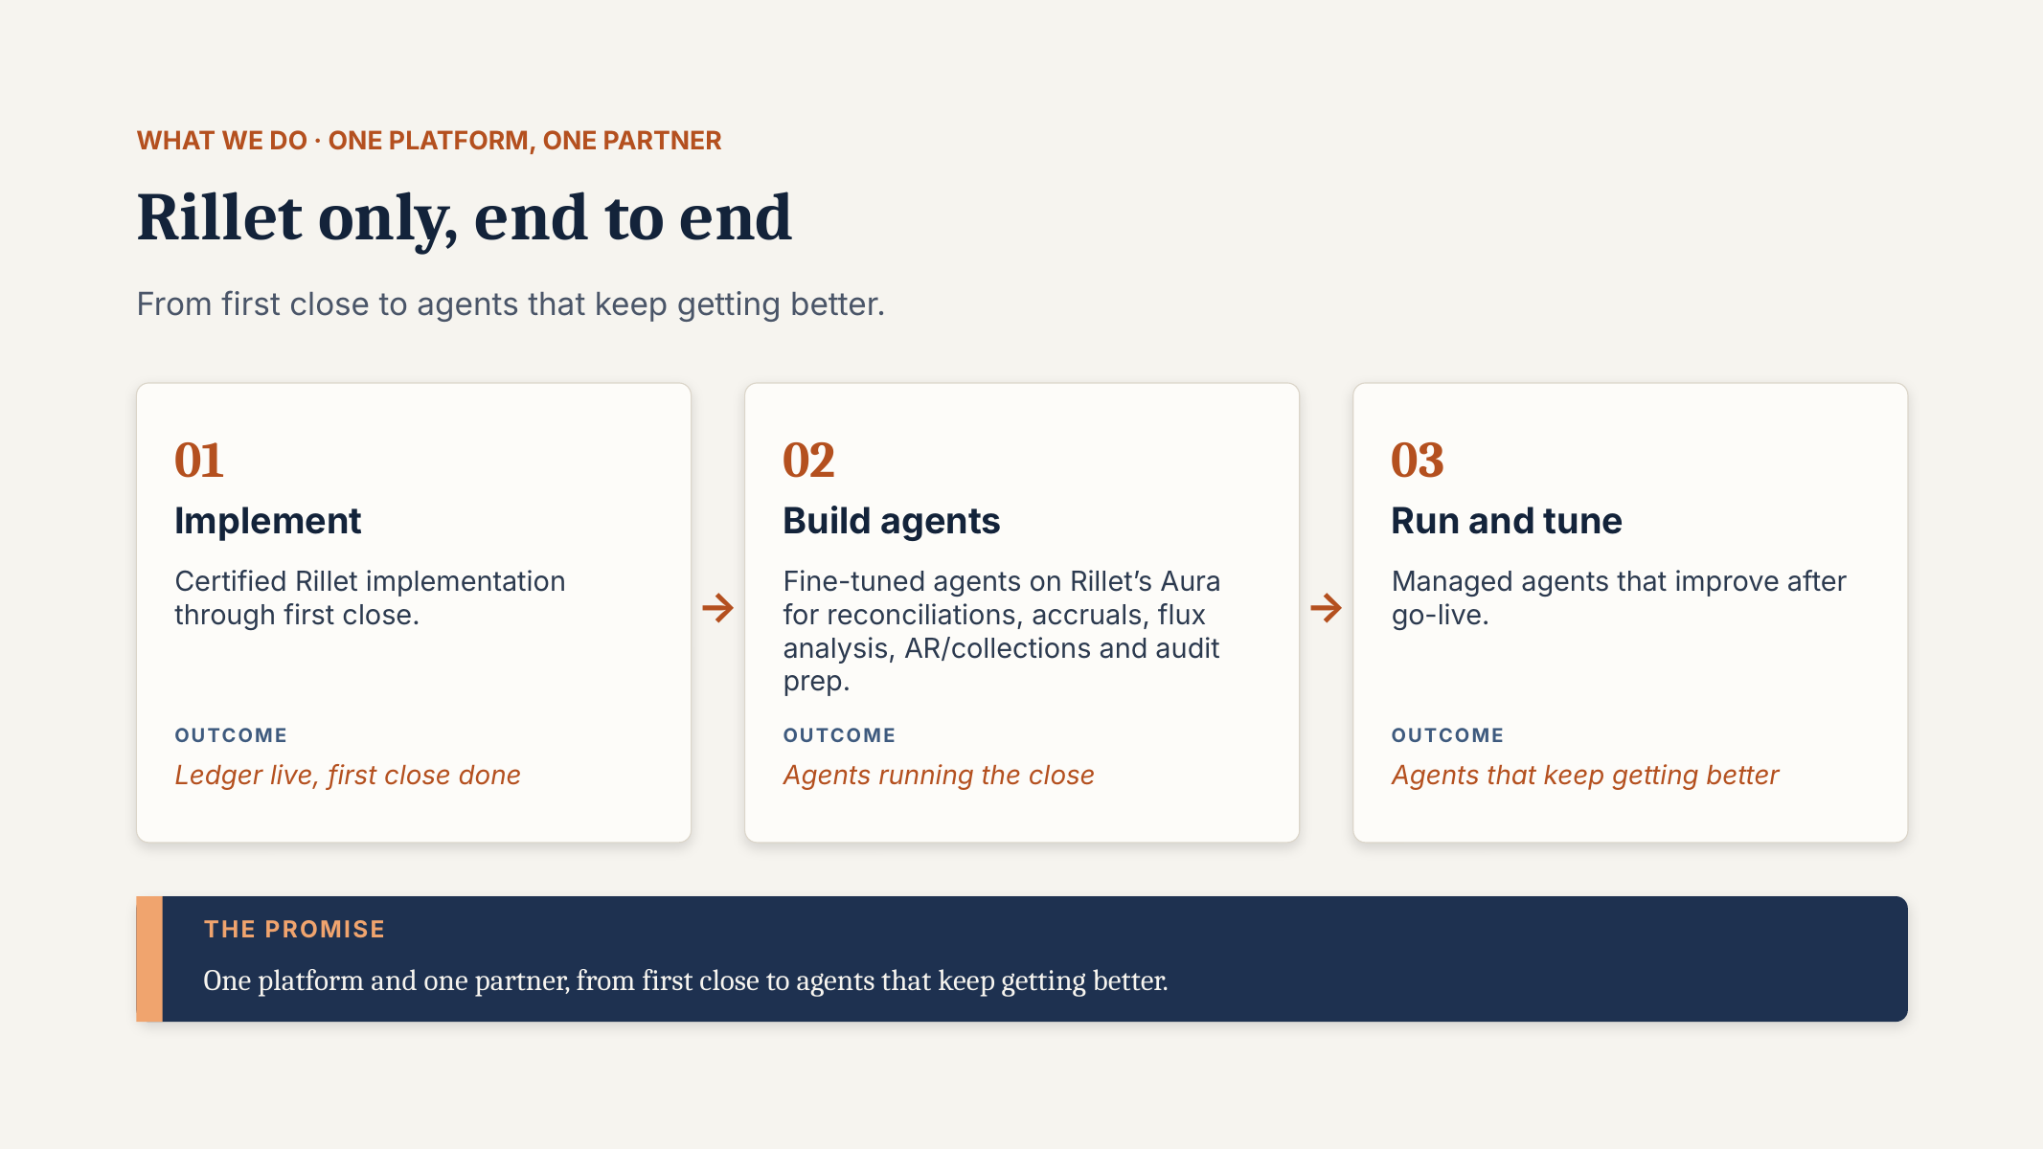
REFERENCE 12 · SOLUTION, SERVICES & METHODOLOGY
Service lines: Implement · Build agents · Run & tune
WEBSITE PLACEMENT
Services page · Home Section 4
WHAT TO USE
Three service cards with outcomes: ledger live / agents running the close / agents that keep getting better. Agent examples: reconciliations, accruals, flux analysis, AR/collections, audit prep.
CAUTION
Says “Rillet only”. Investor deck says multi-platform (Rillet, Tabs, Maxio, Campfire). Confirm scope.
Source: 2a. Operating Model – Last Mile Design, slide 5
Notes:
SOURCE: 2a. Operating Model – Last Mile Design, slide 5
PLACEMENT: Services page · Home Section 4
USE: Three service cards with outcomes: ledger live / agents running the close / agents that keep getting better. Agent examples: reconciliations, accruals, flux analysis, AR/collections, audit prep.
CAUTION: Says “Rillet only”. Investor deck says multi-platform (Rillet, Tabs, Maxio, Campfire). Confirm scope.
--- Original slide text ---
WHAT WE DO · ONE platform, ONE PARTNER
Rillet only, end to end
From first close to agents that keep getting better.
Implement
Certified Rillet implementation through first close.
OUTCOME
Ledger live, first close done
Build agents
Fine-tuned agents on Rillet’s Aura for reconciliations, accruals, flux analysis, AR/collections and audit prep.
OUTCOME
Agents running the close
Run and tune
Managed agents that improve after go-live.
OUTCOME
Agents that keep getting better
THE PROMISE
One platform and one partner, from first close to agents that keep getting better.

Slide 12
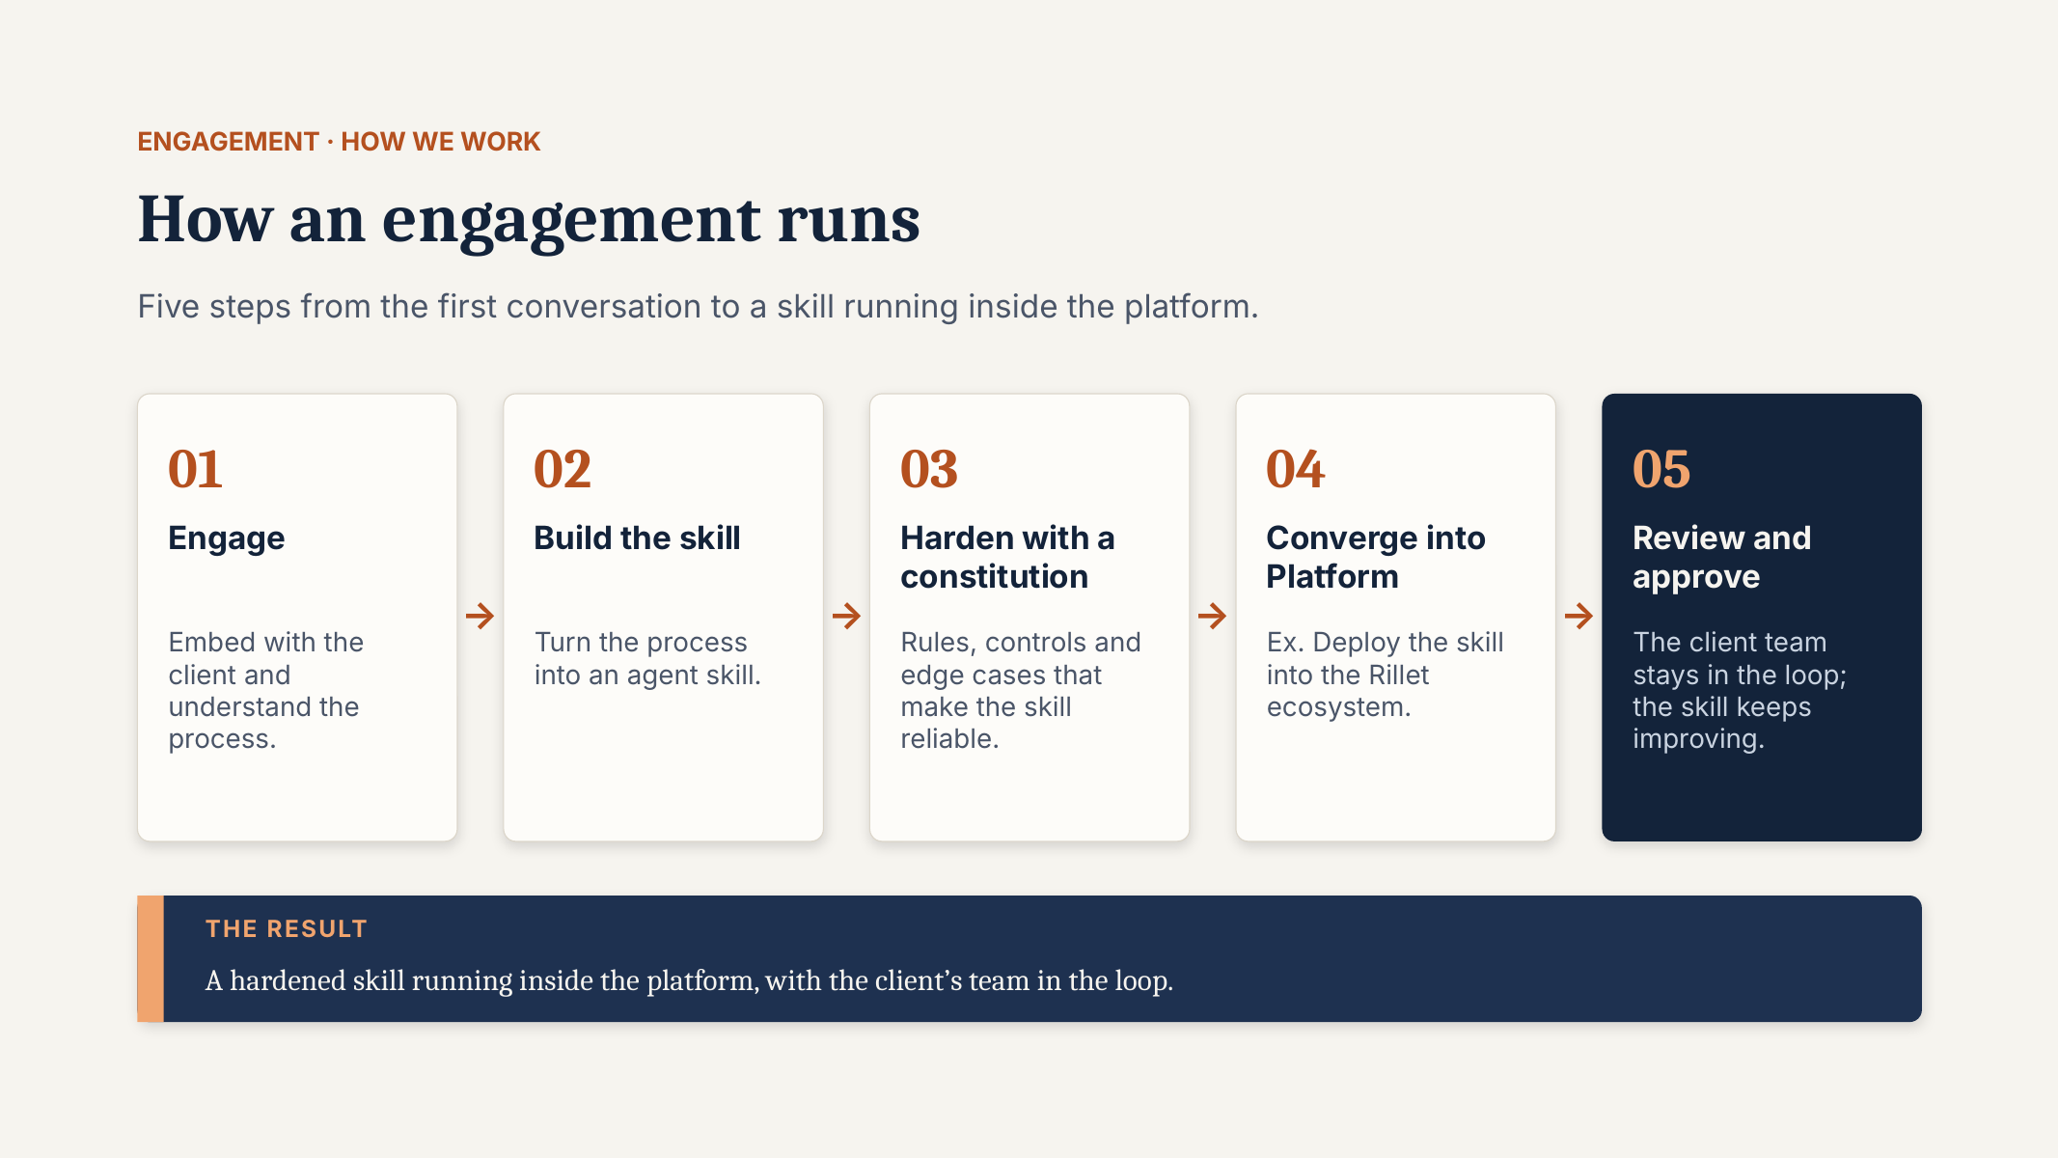
REFERENCE 13 · SOLUTION, SERVICES & METHODOLOGY
How an engagement runs (5 steps)
WEBSITE PLACEMENT
Our Approach · Services
WHAT TO USE
Engage → Build the skill → Harden with a constitution → Converge into the platform → Review and approve. The “constitution” idea is a distinctive differentiator.
Notes:
SOURCE: 2a. Operating Model – Last Mile Design, slide 8
PLACEMENT: Our Approach · Services
USE: Engage → Build the skill → Harden with a constitution → Converge into the platform → Review and approve. The “constitution” idea is a distinctive differentiator.
CAUTION: Alternative wireframe-style version in deck 2b, slide 8.
--- Original slide text ---
ENGAGEMENT · HOW WE WORK
How an engagement runs
Five steps from the first conversation to a skill running inside the platform.
Engage
Embed with the client and understand the process.
Build the skill
Turn the process into an agent skill.
Harden with a constitution
Rules, controls and edge cases that make the skill reliable.
Converge into Platform
Ex. Deploy the skill into the Rillet ecosystem.
Review and approve
The client team stays in the loop; the skill keeps improving.
THE RESULT
A hardened skill running inside the platform, with the client’s team in the loop.

Slide 13
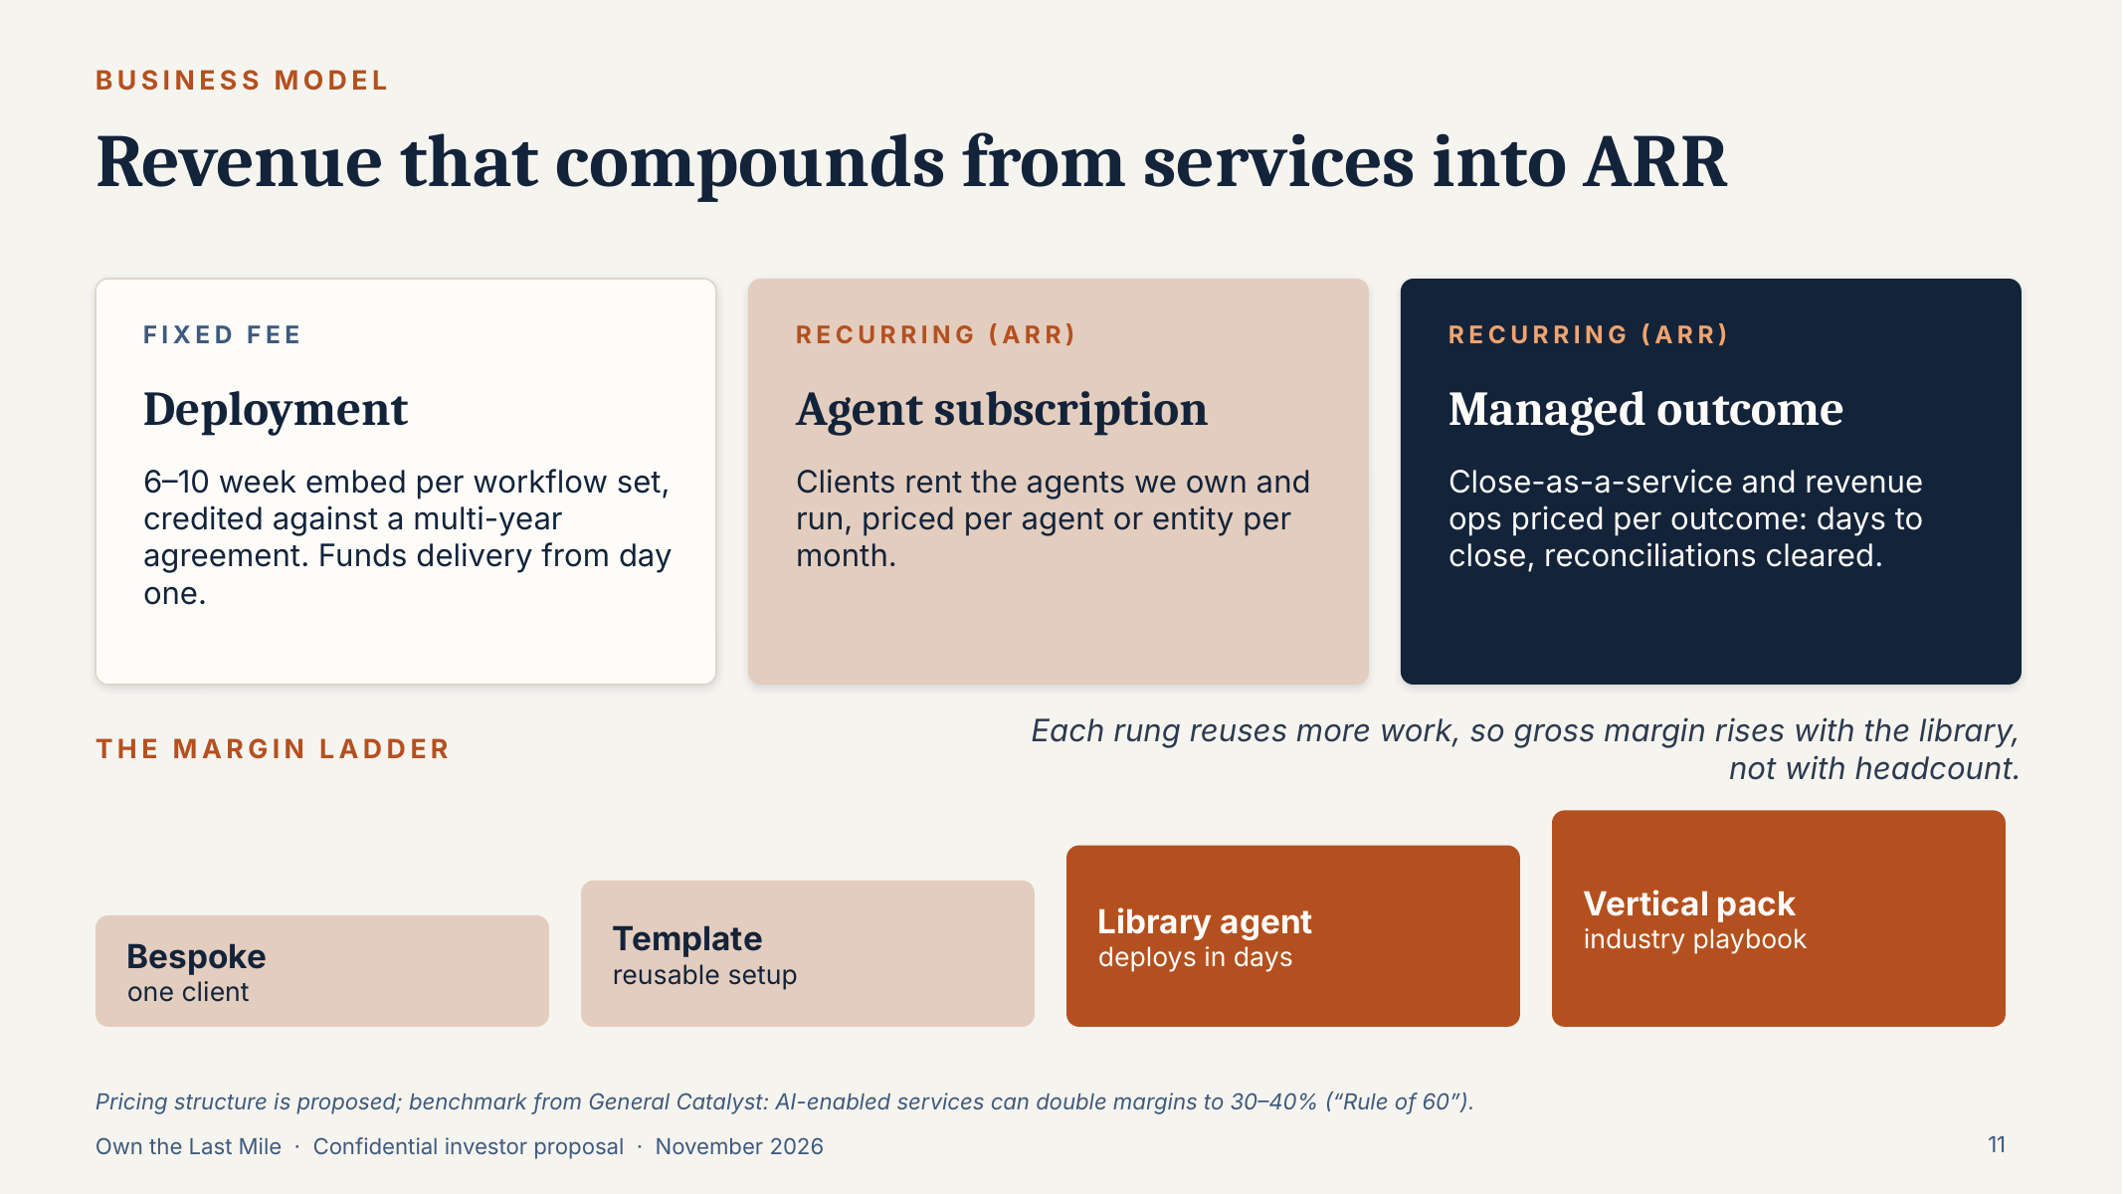
REFERENCE 14 · SOLUTION, SERVICES & METHODOLOGY
Engagement models
WEBSITE PLACEMENT
Services · “How we engage” block
WHAT TO USE
Deployment (fixed fee, 6–10 week embed) · Agent subscription · Managed outcome (close-as-a-service). The margin ladder (Bespoke → Template → Library agent → Vertical pack) explains the compounding library.
CAUTION
Pricing structure is marked as proposed. Show model names only, no margins or price logic.
Source: 3. DaveroAI Investor Deck, slide 11
Notes:
SOURCE: 3. DaveroAI Investor Deck, slide 11
PLACEMENT: Services · “How we engage” block
USE: Deployment (fixed fee, 6–10 week embed) · Agent subscription · Managed outcome (close-as-a-service). The margin ladder (Bespoke → Template → Library agent → Vertical pack) explains the compounding library.
CAUTION: Pricing structure is marked as proposed. Show model names only, no margins or price logic.
--- Original slide text ---
Revenue that compounds from services into ARR
BUSINESS MODEL
FIXED FEE
Deployment
6–10 week embed per workflow set, credited against a multi-year agreement. Funds delivery from day one.
RECURRING (ARR)
Agent subscription
Clients rent the agents we own and run, priced per agent or entity per month.
RECURRING (ARR)
Managed outcome
Close-as-a-service and revenue ops priced per outcome: days to close, reconciliations cleared.
THE MARGIN LADDER
Bespoke
one client
Template
reusable setup
Library agent
deploys in days
Vertical pack
industry playbook
Each rung reuses more work, so gross margin rises with the library, not with headcount.
Pricing structure is proposed; benchmark from General Catalyst: AI-enabled services can double margins to 30–40% (“Rule of 60”).

Slide 14
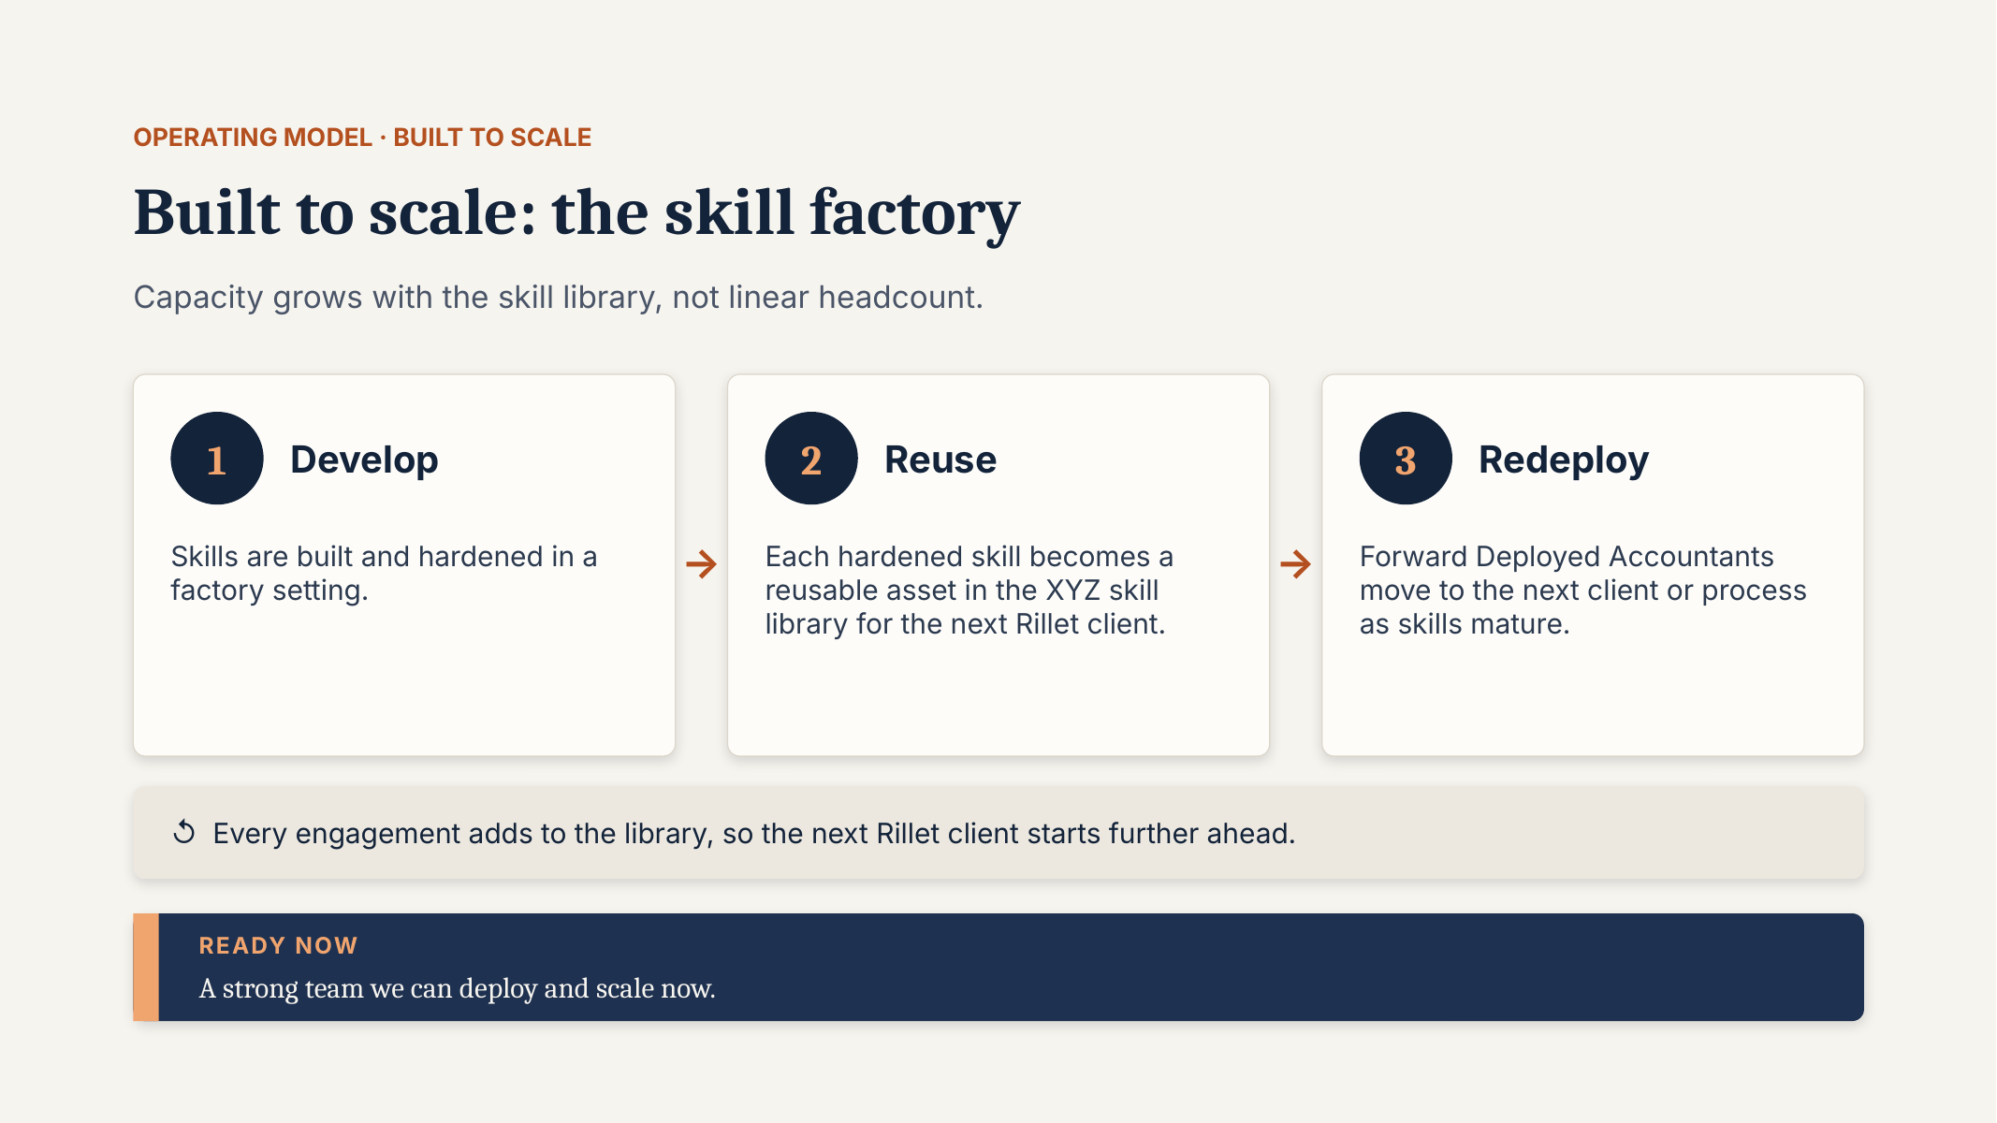
REFERENCE 15 · SOLUTION, SERVICES & METHODOLOGY
The skill factory
WEBSITE PLACEMENT
Our Approach · Why partner with us
WHAT TO USE
Develop → Reuse → Redeploy loop. “Every engagement adds to the library, so the next client starts further ahead.” Good looping animation.
CAUTION
Replace “XYZ skill library” with DaveroAI.
Source: 2a. Operating Model – Last Mile Design, slide 9
Notes:
SOURCE: 2a. Operating Model – Last Mile Design, slide 9
PLACEMENT: Our Approach · Why partner with us
USE: Develop → Reuse → Redeploy loop. “Every engagement adds to the library, so the next client starts further ahead.” Good looping animation.
CAUTION: Replace “XYZ skill library” with DaveroAI.
--- Original slide text ---
OPERATING MODEL · BUILT TO SCALE
Built to scale: the skill factory
Capacity grows with the skill library, not linear headcount.
Develop
Skills are built and hardened in a factory setting.
Reuse
Each hardened skill becomes a reusable asset in the XYZ skill library for the next Rillet client.
Redeploy
Forward Deployed Accountants move to the next client or process as skills mature.
↺ Every engagement adds to the library, so the next Rillet client starts further ahead.
READY NOW
A strong team we can deploy and scale now.

Slide 15
04
Trust, governance & delivery team
Human-in-the-loop controls, who does what around every agent, and why the model wins.
WEBSITE PAGES Technology & Architecture · Home Section 5 · Why partner
Human in the loop
Five actors around every agent
The delivery pod
Why we win and keep winning
Where we sit in the landscape

Slide 16
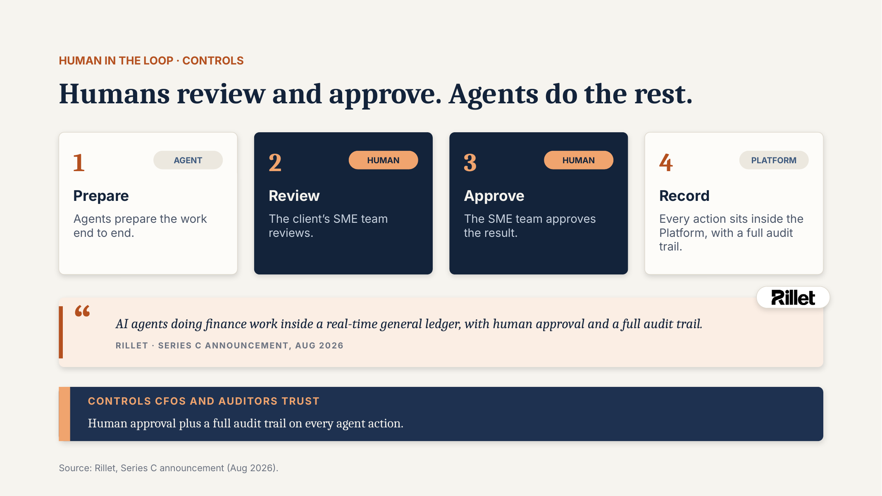
REFERENCE 16 · TRUST, GOVERNANCE & DELIVERY TEAM
Human in the loop
WEBSITE PLACEMENT
Home Section 5 (Agentic AI in action) · Technology & governance
WHAT TO USE
Prepare (agent) → Review (human) → Approve (human) → Record (GL, full audit trail). Core of the multi-agent demo: show agent vs. human steps clearly.
CAUTION
Quote is Rillet’s own wording (Series C announcement); attribute it or rephrase.
Source: 2a. Operating Model – Last Mile Design, slide 6
Notes:
SOURCE: 2a. Operating Model – Last Mile Design, slide 6
PLACEMENT: Home Section 5 (Agentic AI in action) · Technology & governance
USE: Prepare (agent) → Review (human) → Approve (human) → Record (GL, full audit trail). Core of the multi-agent demo: show agent vs. human steps clearly.
CAUTION: Quote is Rillet’s own wording (Series C announcement); attribute it or rephrase.
--- Original slide text ---
HUMAN IN THE LOOP · CONTROLS
Humans review and approve. Agents do the rest.
AGENT
Prepare
Agents prepare the work end to end.
HUMAN
Review
The client’s SME team reviews.
HUMAN
Approve
The SME team approves the result.
PLATFORM
Record
Every action sits inside the Platform, with a full audit trail.
AI agents doing finance work inside a real-time general ledger, with human approval and a full audit trail.
RILLET · SERIES C ANNOUNCEMENT, AUG 2026
CONTROLS CFOS AND AUDITORS TRUST
Human approval plus a full audit trail on every agent action.
Source: Rillet, Series C announcement (Aug 2026).

Slide 17
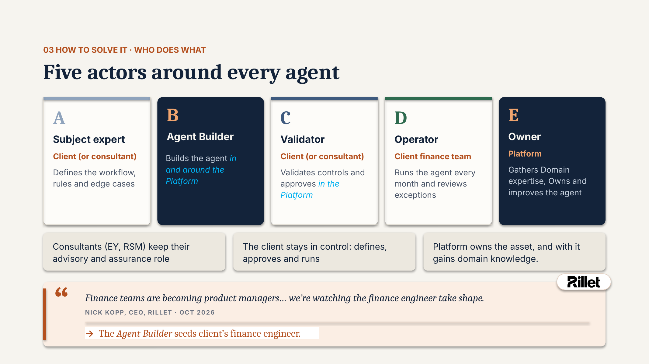
REFERENCE 17 · TRUST, GOVERNANCE & DELIVERY TEAM
Five actors around every agent
WEBSITE PLACEMENT
Technology & governance · Our Approach
WHAT TO USE
Subject expert, Agent Builder, Validator, Operator, Owner. Key message: the client stays in control (defines, approves, runs). Consultants keep advisory and assurance roles.
CAUTION
Owner is shown as “Platform”; on the site, make clear DaveroAI owns and runs the agent.
Source: 1. Rillet – Own the Last Mile, slide 13
Notes:
SOURCE: 1. Rillet – Own the Last Mile, slide 13
PLACEMENT: Technology & governance · Our Approach
USE: Subject expert, Agent Builder, Validator, Operator, Owner. Key message: the client stays in control (defines, approves, runs). Consultants keep advisory and assurance roles.
CAUTION: Owner is shown as “Platform”; on the site, make clear DaveroAI owns and runs the agent.
--- Original slide text ---
03 HOW TO SOLVE IT · WHO DOES WHAT
Five actors around every agent
A
Subject expert
Client (or consultant)
Defines the workflow, rules and edge cases
B
Agent Builder
Builds the agent in and around the Platform
C
Validator
Client (or consultant)
Validates controls and approves in the Platform
D
Operator
Client finance team
Runs the agent every month and reviews exceptions
E
Owner
Platform
Gathers Domain expertise, Owns and improves the agent
Consultants (EY, RSM) keep their advisory and assurance role
The client stays in control: defines, approves and runs
Platform owns the asset, and with it gains domain knowledge.
Finance teams are becoming product managers… we’re watching the finance engineer take shape.
NICK KOPP, CEO, RILLET · OCT 2026
→ The Agent Builder seeds client’s finance engineer.

Slide 18
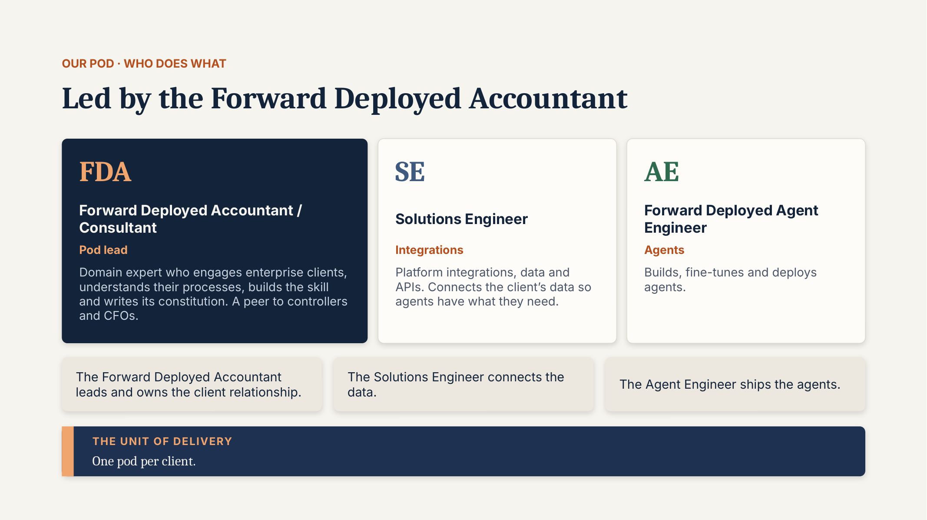
REFERENCE 18 · TRUST, GOVERNANCE & DELIVERY TEAM
The delivery pod
WEBSITE PLACEMENT
Why partner with us · About
WHAT TO USE
Forward Deployed Accountant (pod lead), Solutions Engineer (integrations), Forward Deployed Agent Engineer (agents). “One pod per client.”
CAUTION
Role naming conflicts with “Agent Builder (accountant + engineer)” in the investor deck. Pick one vocabulary.
Source: 2a. Operating Model – Last Mile Design, slide 7
Notes:
SOURCE: 2a. Operating Model – Last Mile Design, slide 7
PLACEMENT: Why partner with us · About
USE: Forward Deployed Accountant (pod lead), Solutions Engineer (integrations), Forward Deployed Agent Engineer (agents). “One pod per client.”
CAUTION: Role naming conflicts with “Agent Builder (accountant + engineer)” in the investor deck. Pick one vocabulary.
--- Original slide text ---
OUR POD · WHO DOES WHAT
Led by the Forward Deployed Accountant
FDA
Forward Deployed Accountant / Consultant
Pod lead
Domain expert who engages enterprise clients, understands their processes, builds the skill and writes its constitution. A peer to controllers and CFOs.
SE
Solutions Engineer
Integrations
Platform integrations, data and APIs. Connects the client’s data so agents have what they need.
AE
Forward Deployed Agent Engineer
Agents
Builds, fine-tunes and deploys agents.
The Forward Deployed Accountant leads and owns the client relationship.
The Solutions Engineer connects the data.
The Agent Engineer ships the agents.
THE UNIT OF DELIVERY
One pod per client.

Slide 19
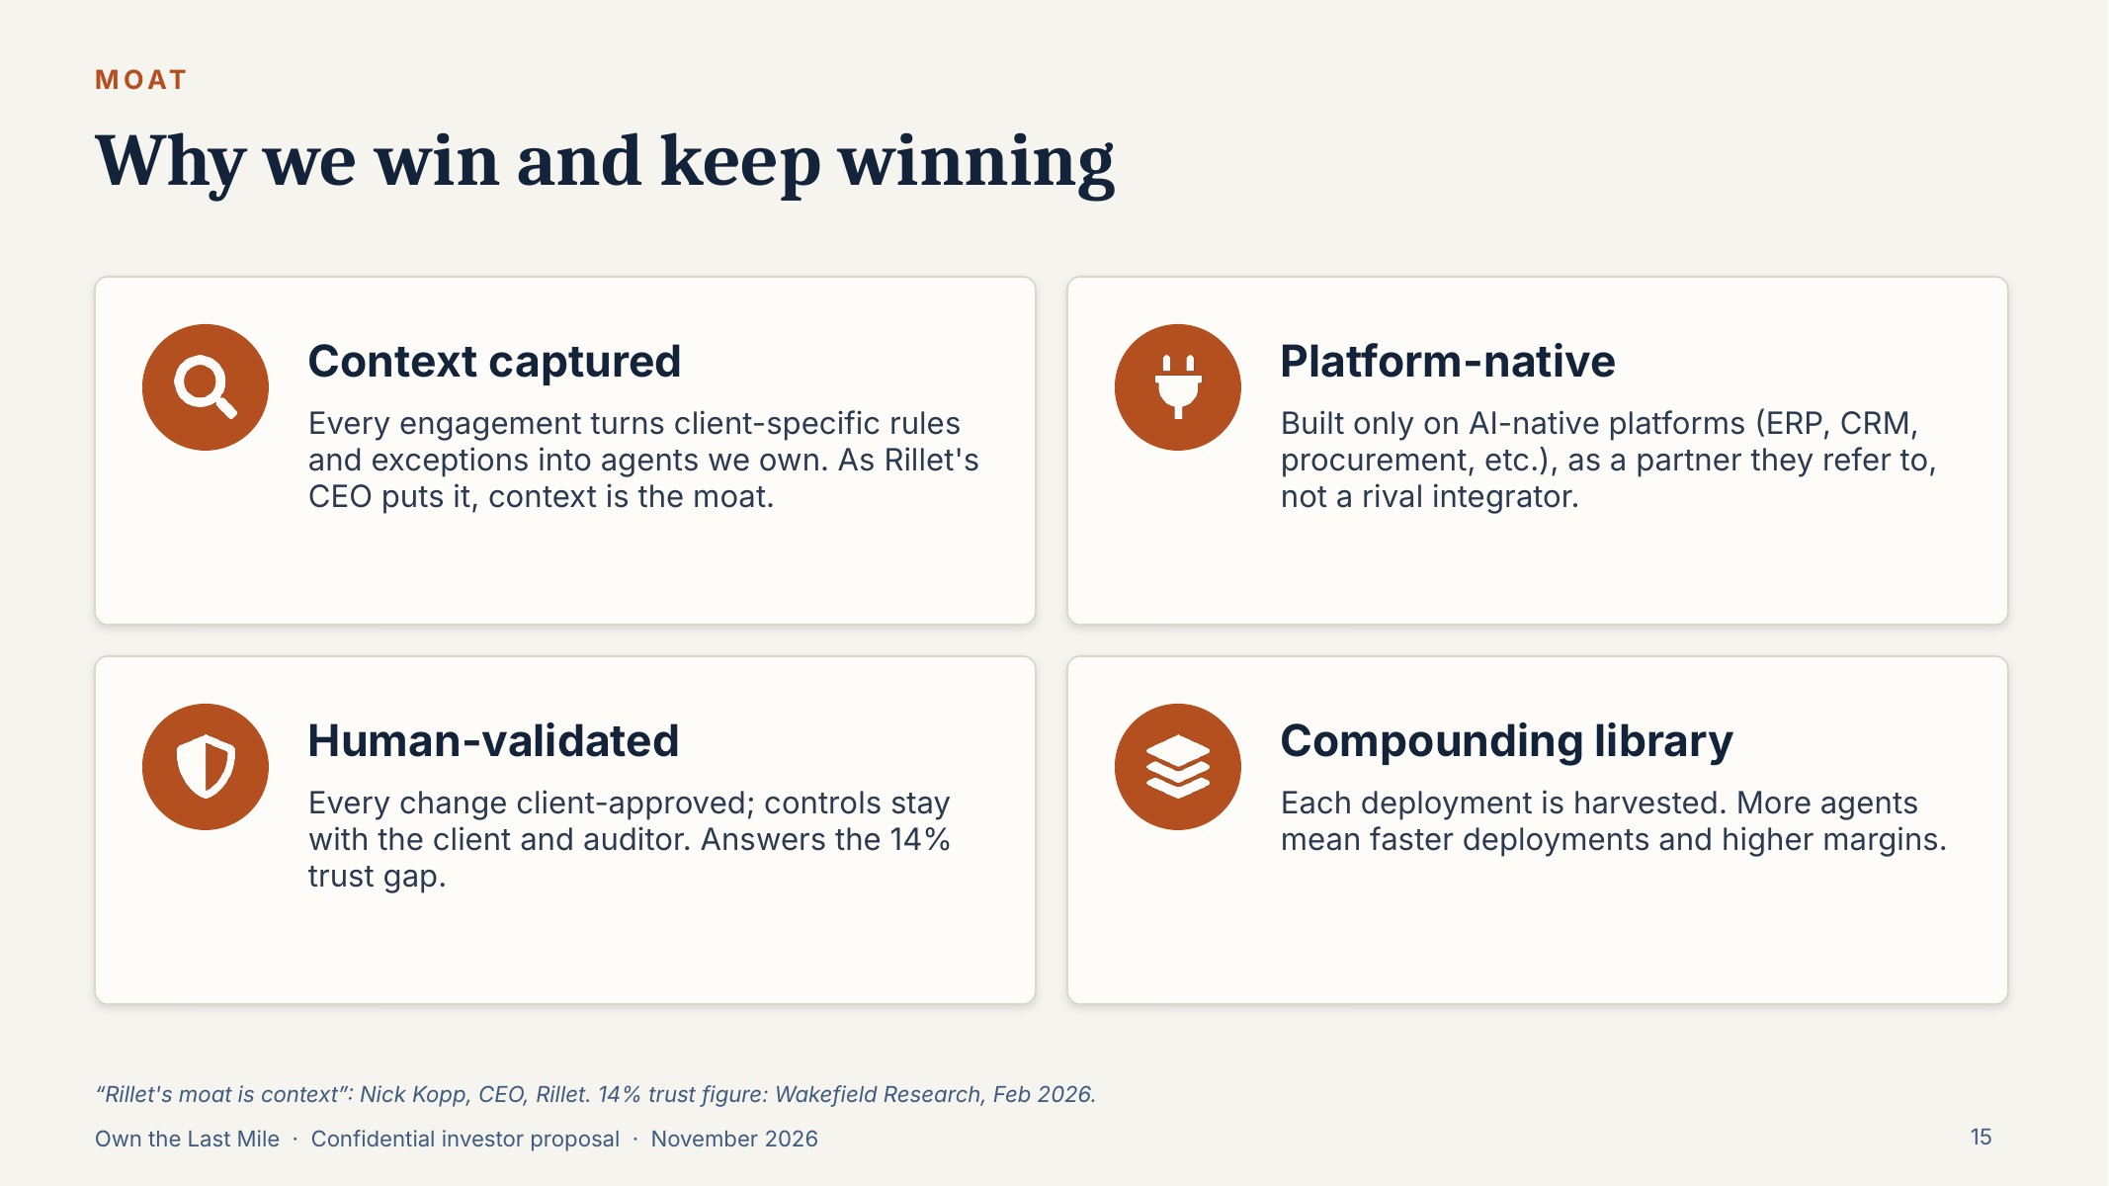
REFERENCE 19 · TRUST, GOVERNANCE & DELIVERY TEAM
Why we win and keep winning
WEBSITE PLACEMENT
Home Section 8 (Why partner with us)
WHAT TO USE
Four differentiators with icons: Context captured · Platform-native · Human-validated · Compounding library. Ready-made card set.
Source: 3. DaveroAI Investor Deck, slide 15
Notes:
SOURCE: 3. DaveroAI Investor Deck, slide 15
PLACEMENT: Home Section 8 (Why partner with us)
USE: Four differentiators with icons: Context captured · Platform-native · Human-validated · Compounding library. Ready-made card set.
--- Original slide text ---
Why we win and keep winning
MOAT
Context captured
Every engagement turns client-specific rules and exceptions into agents we own. As Rillet's CEO puts it, context is the moat.
Platform-native
Built only on AI-native platforms (ERP, CRM, procurement, etc.), as a partner they refer to, not a rival integrator.
Human-validated
Every change client-approved; controls stay with the client and auditor. Answers the 14% trust gap.
Compounding library
Each deployment is harvested. More agents mean faster deployments and higher margins.
“Rillet's moat is context”: Nick Kopp, CEO, Rillet. 14% trust figure: Wakefield Research, Feb 2026.

Slide 20
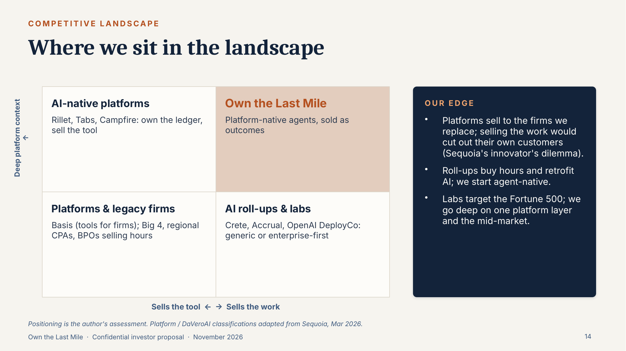
REFERENCE 20 · TRUST, GOVERNANCE & DELIVERY TEAM
Where we sit in the landscape
WEBSITE PLACEMENT
Why partner with us · Insights
WHAT TO USE
2×2: sells the tool ↔ sells the work vs. depth of platform context. “Our edge” bullets give the differentiation copy.
CAUTION
Positioning is the author’s own assessment. Avoid naming competitors on the public site unless approved.
Source: 3. DaveroAI Investor Deck, slide 14
Notes:
SOURCE: 3. DaveroAI Investor Deck, slide 14
PLACEMENT: Why partner with us · Insights
USE: 2×2: sells the tool ↔ sells the work vs. depth of platform context. “Our edge” bullets give the differentiation copy.
CAUTION: Positioning is the author’s own assessment. Avoid naming competitors on the public site unless approved.
--- Original slide text ---
Where we sit in the landscape
COMPETITIVE LANDSCAPE
AI-native platforms
Rillet, Tabs, Campfire: own the ledger, sell the tool
Own the Last Mile
Platform-native agents, sold as outcomes
Platforms & legacy firms
Basis (tools for firms); Big 4, regional CPAs, BPOs selling hours
AI roll-ups & labs
Crete, Accrual, OpenAI DeployCo: generic or enterprise-first
Sells the tool ← → Sells the work
Deep platform context ↑
OUR EDGE
Platforms sell to the firms we replace; selling the work would cut out their own customers (Sequoia's innovator's dilemma).
Roll-ups buy hours and retrofit AI; we start agent-native.
Labs target the Fortune 500; we go deep on one platform layer and the mid-market.
Positioning is the author's assessment. Platform / DaVeroAI classifications adapted from Sequoia, Mar 2026.

Slide 21
05
Outcomes, ecosystem & leadership
What clients get, the platform ecosystem, the founder story and the closing message.
WEBSITE PAGES Home Sections 6, 8 & 10 · Industries · About · Contact
What the client gets
Platform-anchored go-to-market
Founder
Closing message

Slide 22
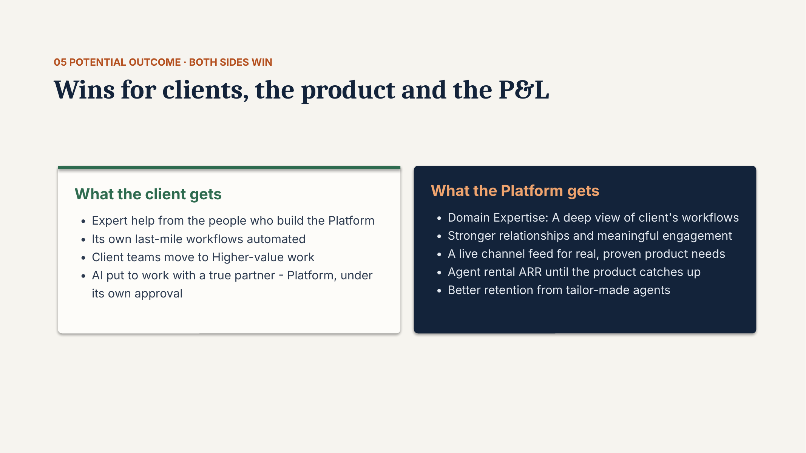
REFERENCE 21 · OUTCOMES, ECOSYSTEM & LEADERSHIP
What the client gets
WEBSITE PLACEMENT
Home · Business outcomes · Contact value proposition
WHAT TO USE
Use the left column only: expert help, last-mile workflows automated, teams move to higher-value work, AI put to work under the client’s own approval.
CAUTION
Right column (“What the Platform gets”) is partner-facing. Do not publish.
Source: 1. Rillet – Own the Last Mile, slide 19
Notes:
SOURCE: 1. Rillet – Own the Last Mile, slide 19
PLACEMENT: Home · Business outcomes · Contact value proposition
USE: Use the left column only: expert help, last-mile workflows automated, teams move to higher-value work, AI put to work under the client’s own approval.
CAUTION: Right column (“What the Platform gets”) is partner-facing. Do not publish.
--- Original slide text ---
05 POTENTIAL OUTCOME · BOTH SIDES WIN
Wins for clients, the product and the P&L
What the client gets
Expert help from the people who build the Platform
Its own last-mile workflows automated
Client teams move to Higher-value work
AI put to work with a true partner - Platform, under its own approval
What the Platform gets
Domain Expertise: A deep view of client's workflows
Stronger relationships and meaningful engagement
A live channel feed for real, proven product needs
Agent rental ARR until the product catches up
Better retention from tailor-made agents

Slide 23
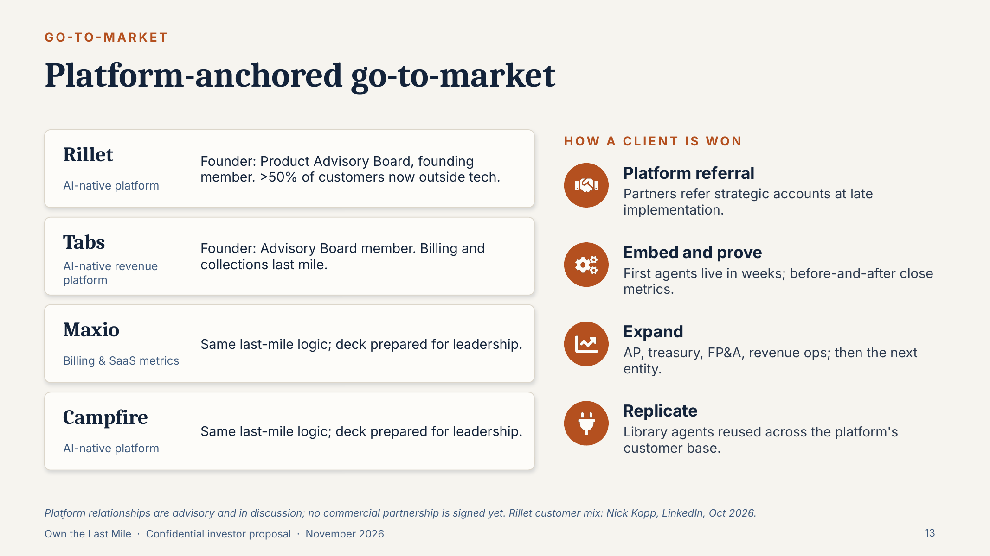
REFERENCE 22 · OUTCOMES, ECOSYSTEM & LEADERSHIP
Platform-anchored go-to-market
WEBSITE PLACEMENT
Industries / Ecosystem · Home Section 6
WHAT TO USE
Client journey: Platform referral → Embed and prove → Expand → Replicate. Platforms named: Rillet, Tabs, Maxio, Campfire.
CAUTION
Platform relationships are advisory and in discussion. No commercial partnership is signed, so don’t show logos as “partners”.
Source: 3. DaveroAI Investor Deck, slide 13
Notes:
SOURCE: 3. DaveroAI Investor Deck, slide 13
PLACEMENT: Industries / Ecosystem · Home Section 6
USE: Client journey: Platform referral → Embed and prove → Expand → Replicate. Platforms named: Rillet, Tabs, Maxio, Campfire.
CAUTION: Platform relationships are advisory and in discussion. No commercial partnership is signed, so don’t show logos as “partners”.
--- Original slide text ---
Platform-anchored go-to-market
GO-TO-MARKET
Rillet
AI-native platform
Founder: Product Advisory Board, founding member. >50% of customers now outside tech.
Tabs
AI-native revenue platform
Founder: Advisory Board member. Billing and collections last mile.
Maxio
Billing & SaaS metrics
Same last-mile logic; deck prepared for leadership.
Campfire
AI-native platform
Same last-mile logic; deck prepared for leadership.
HOW A CLIENT IS WON
Platform referral
Partners refer strategic accounts at late implementation.
Embed and prove
First agents live in weeks; before-and-after close metrics.
Expand
AP, treasury, FP&A, revenue ops; then the next entity.
Replicate
Library agents reused across the platform's customer base.
Platform relationships are advisory and in discussion; no commercial partnership is signed yet. Rillet customer mix: Nick Kopp, LinkedIn, Oct 2026.

Slide 24
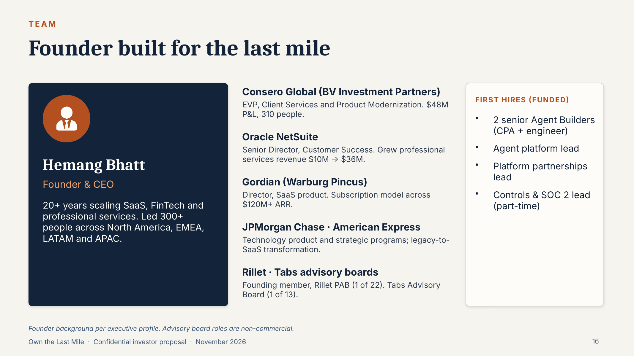
REFERENCE 23 · OUTCOMES, ECOSYSTEM & LEADERSHIP
Founder
WEBSITE PLACEMENT
About · Leadership
WHAT TO USE
Hemang Bhatt, Founder & CEO: 20+ years in SaaS, FinTech and professional services; Consero Global, Oracle NetSuite, Gordian, JPMorgan Chase, American Express; Rillet PAB and Tabs Advisory Board.
CAUTION
Advisory roles are non-commercial. Remove the “First hires (funded)” block. Confirm headshot and bio wording with Hemang.
Source: 3. DaveroAI Investor Deck, slide 16
Notes:
SOURCE: 3. DaveroAI Investor Deck, slide 16
PLACEMENT: About · Leadership
USE: Hemang Bhatt, Founder & CEO: 20+ years in SaaS, FinTech and professional services; Consero Global, Oracle NetSuite, Gordian, JPMorgan Chase, American Express; Rillet PAB and Tabs Advisory Board.
CAUTION: Advisory roles are non-commercial. Remove the “First hires (funded)” block. Confirm headshot and bio wording with Hemang.
--- Original slide text ---
Founder built for the last mile
TEAM
Hemang Bhatt
Founder & CEO
20+ years scaling SaaS, FinTech and professional services. Led 300+ people across North America, EMEA, LATAM and APAC.
Consero Global (BV Investment Partners)
EVP, Client Services and Product Modernization. $48M P&L, 310 people.
Oracle NetSuite
Senior Director, Customer Success. Grew professional services revenue $10M → $36M.
Gordian (Warburg Pincus)
Director, SaaS product. Subscription model across $120M+ ARR.
JPMorgan Chase · American Express
Technology product and strategic programs; legacy-to-SaaS transformation.
Rillet · Tabs advisory boards
Founding member, Rillet PAB (1 of 22). Tabs Advisory Board (1 of 13).
FIRST HIRES (FUNDED)
2 senior Agent Builders (CPA + engineer)
Agent platform lead
Platform partnerships lead
Controls & SOC 2 lead (part-time)
Founder background per executive profile. Advisory board roles are non-commercial.

Slide 25
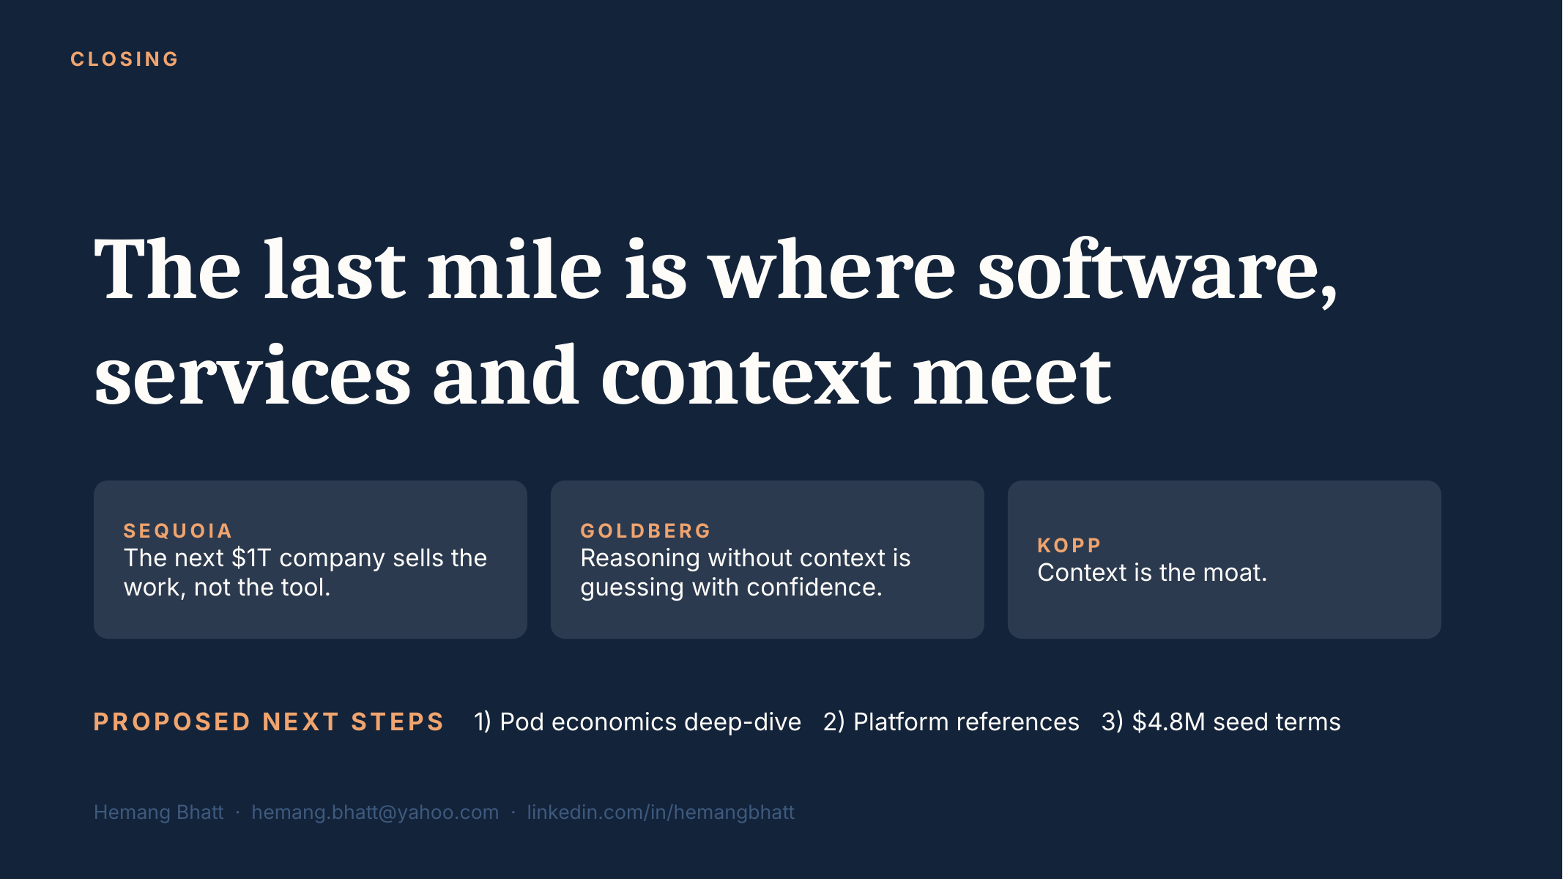
REFERENCE 24 · OUTCOMES, ECOSYSTEM & LEADERSHIP
Closing message
WEBSITE PLACEMENT
Home Section 10 (Final CTA) · Footer
WHAT TO USE
“The last mile is where software, services and context meet” and the three-quote trio (Sequoia, Goldberg, Kopp). Strong closing band before “Start a conversation”.
CAUTION
Replace investor next steps with the consultation CTA. Don’t publish the personal email address.
Source: 3. DaveroAI Investor Deck, slide 20
Notes:
SOURCE: 3. DaveroAI Investor Deck, slide 20
PLACEMENT: Home Section 10 (Final CTA) · Footer
USE: “The last mile is where software, services and context meet” and the three-quote trio (Sequoia, Goldberg, Kopp). Strong closing band before “Start a conversation”.
CAUTION: Replace investor next steps with the consultation CTA. Don’t publish the personal email address.
--- Original slide text ---
CLOSING
The last mile is where software, services and context meet
SEQUOIA
The next $1T company sells the work, not the tool.
GOLDBERG
Reasoning without context is guessing with confidence.
KOPP
Context is the moat.
PROPOSED NEXT STEPS 1) Pod economics deep-dive 2) Platform references 3) $4.8M seed terms
Hemang Bhatt · hemang.bhatt@yahoo.com · linkedin.com/in/hemangbhatt

