Slide 1

BucketListers
Team Bucketlisters
Miranda Schmidt, Zara de Matran, Laura Meckley, Corrina Teague, Meta LeCompte

Slide 2
App Overview

Slide 3
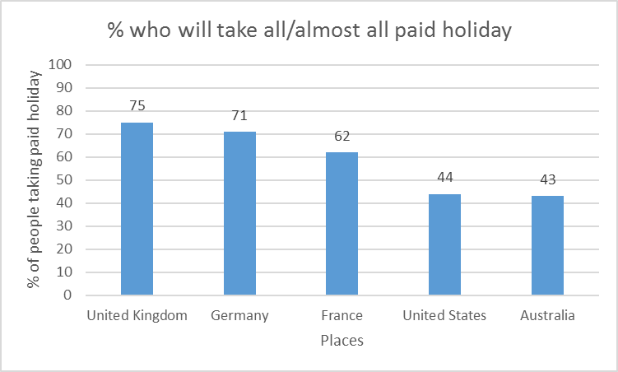

Slide 4
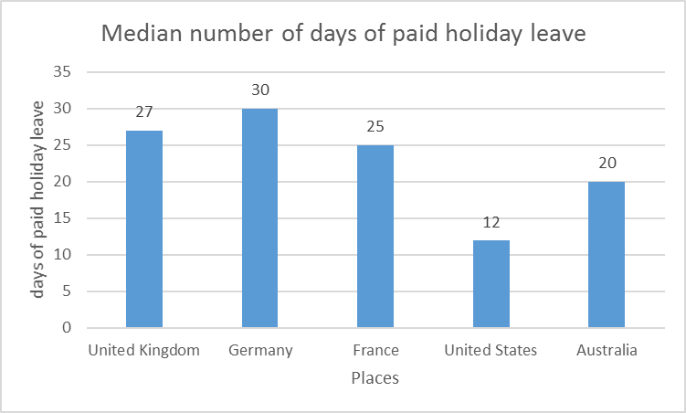

Slide 5


Our Opportunity
People should spend time in more memorable way
Notes:
3-5 slides

Slide 7

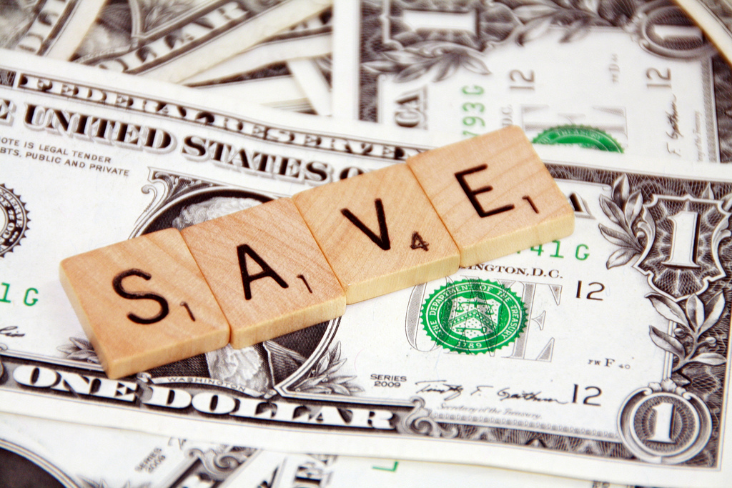
Why use it?
Feel accomplished
Social Media
Save $$$

Slide 8
Digital Presentation:
https://www.powtoon.com/online-presentation/e58Upq1htiv/?mode=movie#/

Slide 9
Target Market
Ages 40+ in America: 131 million
Smartphone ownership: 57%

Slide 10
Target Market-Upper middle class
Upper middle class: 19.5%

Slide 11
Target Market-App Usage
App usage: 13%

Slide 12
Total Target Market
1,892,885

Slide 13



Competitors
iWish
Soon
BUCKiTDREAM

Slide 14
BucketListers vs. The Competitors

Slide 15
Marketing Strategy
BucketListers will be marketed by two primary strategies:
Word of Mouth
Online Advertising

Slide 16
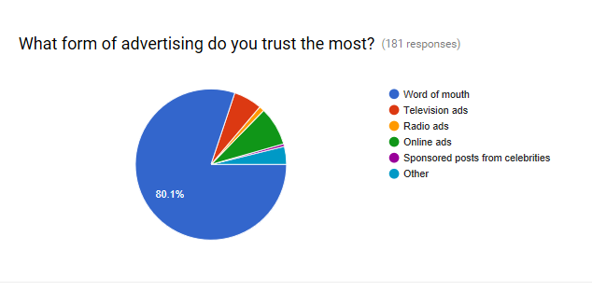
Data on Trustworthiness of Advertisements

Slide 17


Revenue Model
Targeted advertising
Travel and discount companies (Expedia, GroupOn)
Ads based on bucket list items

Slide 18
Questions?
Thank you!
-Team Bucketlisters

