Slide 1
Amy West –Broker/Realtor
Goal: To pay bills, save 10% in 401K and pay vacations

Slide 2
Competitive Advantage
Life skills, lived in 2 countries: Asia and Latino America
Speaks Spanish and understands the Latino Culture and other cultures
Construction experience during University years
Negotiation skills, Hostage Negotiator while a police officer
Knows and Respects rules and regulations especially related to real estate.
Proud of the Durham community and wants to play a part in making Durham a wonderful place to live, work and play

Slide 3
Objectives (3 years)
2018: 20% over 2017 incomes and listing 8 houses. Increase marketing post Cards , email etc.
2019: 30% over 2018 incomes and listing 12 houses.
2020: 20% over 2019 incomes and listing 15 houses.

Slide 4
Actions for 2017-2018
Create baseline for objectives to track progress.
Marketing plan, takes into consideration current customers ( developing a DB to help you remaining anniversaries), every 3,6 and 12 months base on the purchase of the house. Post Cards, Pop-bys and others.
Dashboard to control the current customer in progress...so you don't forget about actions( like Javier that you need to track the Filipino person for his house). Tracking customers in the process.
Replace Zillow with analytics from COLD DIRECTORY, using information of address and phones from Berkshire Hathaway to identify new potential customers.
Develop/buy a Web page/Facebook to promote you in internet as part of Marketing Plan.
Use of search Tool (internet/google) to identify business in NC with Latino workers.
Generate presentations in Spanish to promote you with Latino communities

Slide 5
Buyer Process
Contact interest People
1
2
Set up them in MLS
End DDP
Want to Buy?
No
Include in DB with minimum information
Contact to start seeing houses
Make sure lender is smood?
Yes
Under Contract
Attorney paperwork
Buyer Agreement
DDP escrow checks
Closing
Do they have lender?
No
Inspections
End
Help them to find one
Negotiation
Yes
1
2

Slide 6
Selling Process
Contact interest People
1
2
Negotiation
Attorney paperwork
Do they interested?
No
Include in DB with minimum information
Under Contract
Closing
Yes
DDP escrow checks
End
Go to house for recommendations
Negotiation
Set up them in MLS go life (market)
End DDP
Ensure house- when the house can be seen
Deed Paperwork
1
2

Slide 7
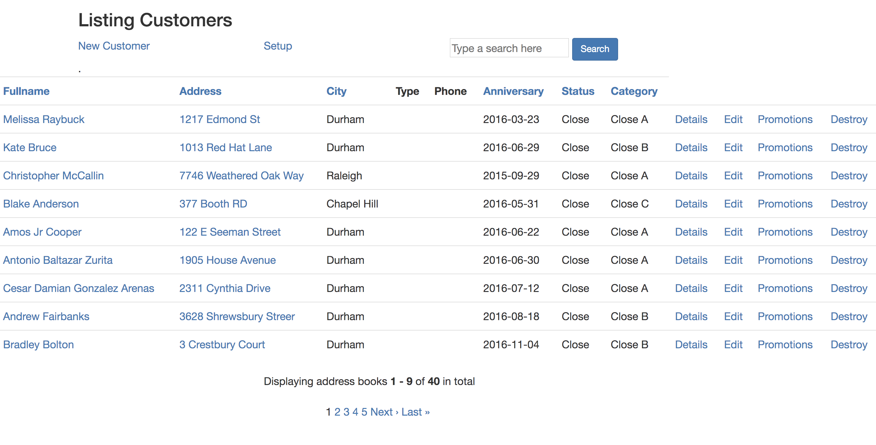
Project Documentation
Link to schema of DB
Link to code
The views include functions like search, sort and pagination

