Slide 1
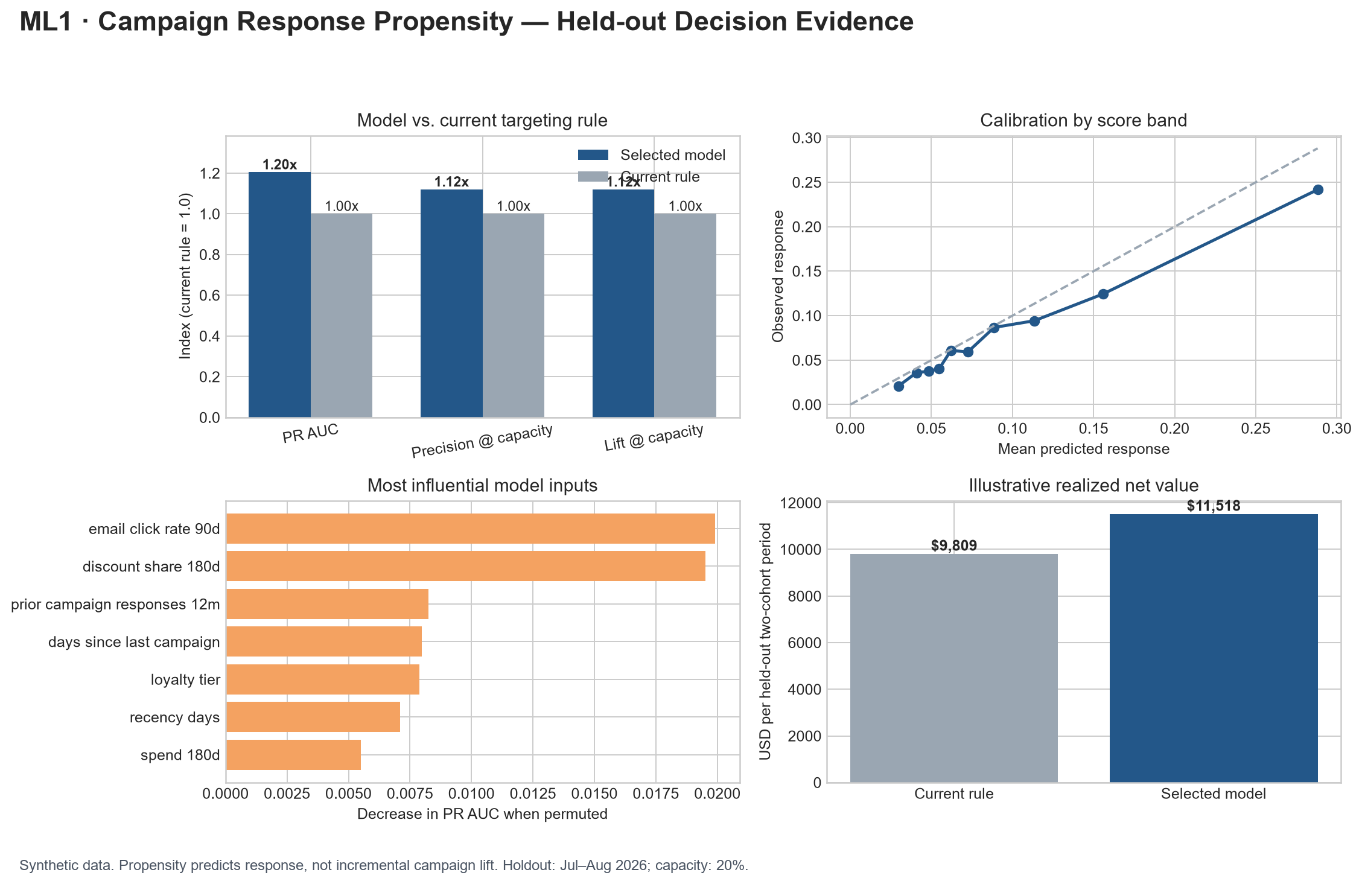
ML1 • SUPERVISED LEARNING
Campaign Response
Propensity
Who should receive limited outreach capacity?
Executive decision readout
Synthetic portfolio case • August 2026
Notes:
[Sources]
- ML1 stakeholder_readout.md
- ML1 ml1_executive_summary.png

Slide 2
DECISION
The model finds 47 more responders at the same contact limit
+47
additional responders
A 12% increase in captured responders without expanding the 2,399-customer contact capacity.
Recommendation: proceed to shadow scoring and a randomized pilot—not automatic rollout.
02
Notes:
[Sources]
- ML1 reference_results.json: test capacity and responder counts
- ML1 stakeholder_readout.md

Slide 3
EVIDENCE
Performance improves the constrained marketing decision
The model is evaluated where Marketing must act: within the available contact capacity.
18.30%
45.68%
2.28×
Precision at capacity
Responder recall
Lift
About 18 of every 100 contacted customers respond.
The shortlist captures nearly half of all future responders.
The shortlist responds at more than twice the population rate.
03
Notes:
[Sources]
- ML1 reference_results.json: selected model test metrics

Slide 4
INTERPRETATION
The score ranks likely responders—it does not prove incrementality
What the model supports
What still requires evidence
• Rank consented customers within a fixed capacity
• Compare expected response and economics
• Prepare a transparent, versioned audience for review
• Whether outreach causes incremental response
• Real-world performance beyond synthetic data
• Customer-experience and segment outcomes
• Calibration after policy and market changes
Human approval, consent, suppression, frequency caps, and campaign execution remain outside the model.
04
Notes:
[Sources]
- ML1 model_card.md: intended use, limitations, and approval boundary

Slide 5
NEXT ACTION
Scale only after the pilot demonstrates incremental value
1
2
3
4
Shadow score
Randomize
Measure
Approve
Run beside the current rule; verify data, timing, and audience controls.
Create treatment and holdout groups inside the ranked eligible audience.
Track incremental response, margin, opt-outs, and segment outcomes.
Scale, revise, or roll back against predeclared decision gates.
Decision requested: authorize a controlled pilot—not production automation.
05
Notes:
[Sources]
- ML1 monitoring_plan.md
- ML1 stakeholder_readout.md

