Slide 1
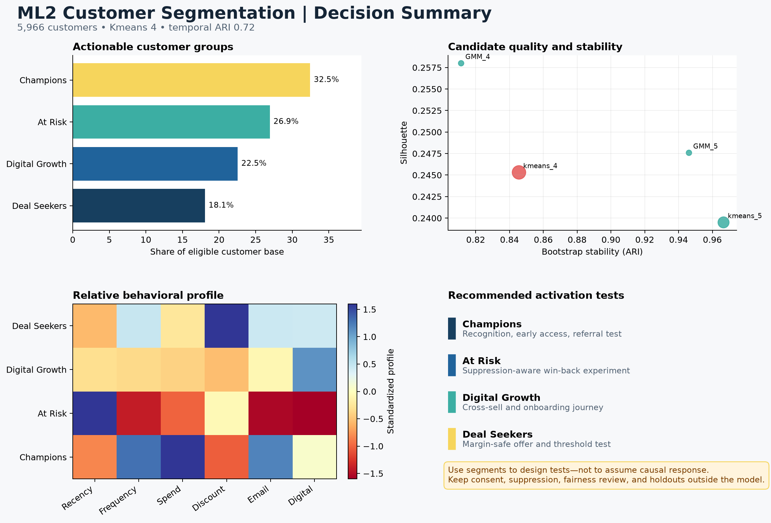
ML2 • UNSUPERVISED LEARNING
Customer
Segmentation
Which behavioral groups should guide differentiated marketing tests?
Executive decision readout
Synthetic portfolio case • August 2026
Notes:
[Sources]
- ML2 stakeholder_readout.md
- ML2 ml2_executive_summary.png

Slide 2
DECISION
Four groups create distinct, testable marketing hypotheses
Champions
Recognition and referral tests
At Risk
Suppression-aware win-back
Digital Growth
Onboarding and cross-sell
Deal Seekers
Margin-safe offer thresholds
Use the groups to design tests—not to assume which treatment will work.
02
Notes:
[Sources]
- ML2 reference_results.json: segment shares
- ML2 stakeholder_readout.md: activation hypotheses

Slide 3
MODEL CHOICE
K-means wins on operational usefulness, not the highest single score
The selection balances geometric separation with stability, coverage, and a usable minimum group size.
100%
0.846
18.1%
Coverage
Resampling stability
Smallest group
Every eligible customer receives an interpretable segment.
The structure remains consistent across bootstrap samples.
No micro-segment that Marketing cannot operate reliably.
GMM and DBSCAN showed attractive geometry, but created undersized groups or left too many customers unassigned.
03
Notes:
[Sources]
- ML2 reference_results.json: candidate comparison and selected-model metrics

Slide 4
INTERPRETATION
Segments are testable hypotheses—not fixed identities
What the model supports
What the model cannot establish
• A manageable behavioral taxonomy
• Distinct campaign hypotheses
• Experiment stratification and reporting
• Reviewable changes in customer behavior over time
• That segments are naturally or permanently real
• That every member behaves like the average
• That a segment-specific offer causes improvement
• That protected-group risk disappears when attributes are excluded
Consent, suppression, treatment choice, fairness review, and campaign execution remain human-owned controls.
04
Notes:
[Sources]
- ML2 model_card.md: intended use, limitations, and approval boundary

Slide 5
NEXT ACTION
Turn the four personas into measurable experiments
1
2
3
4
Validate
Design
Experiment
Operationalize
Recreate features and stability checks on governed historical customer data.
Define one treatment hypothesis, holdout, metric, and guardrails per segment.
Randomize within segments and measure incremental margin and experience.
Refresh only after data, stability, profile, and governance review.
Decision requested: approve a limited experiment-design phase, not automatic targeting.
05
Notes:
[Sources]
- ML2 monitoring_plan.md
- ML2 stakeholder_readout.md

