Slide 1
rupture dynamics
based on vogel et al.
Laura Baakman & Rick van Veen
Notes:
Rick
Welcome.

Slide 2
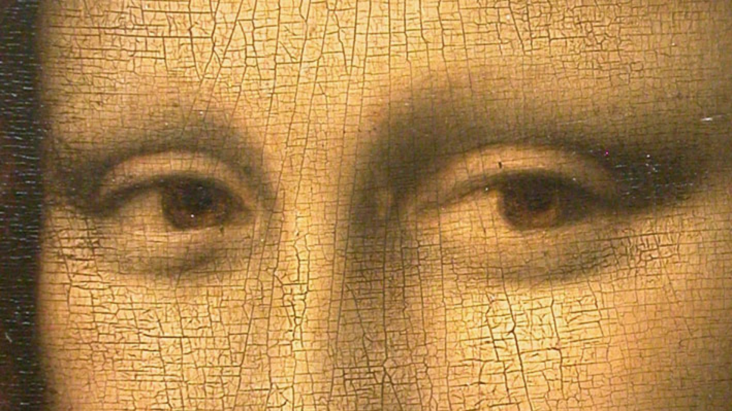
Notes:
Rick
Computationally expensive methods exist, e.g. Vogel
That method uses:
step by step simulation ->
we propose a simpler quasi static linear model ☺ -> Which Laura will explain now.

Slide 3
initial grid
fixing the border
adding springs
Notes:
Laura

Slide 4
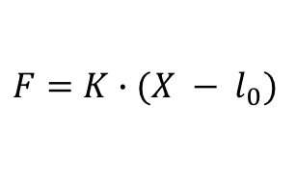
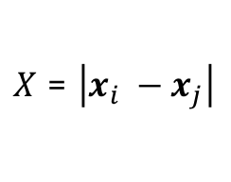



single spring
$X$ = $\left|x_{i} −x_{j}\right|$
$$x_{i}$$
$$x_{j}$$
$$l_{0}$$
$$F=K∙(X − l_{0})$$
Notes:
Rick
Hooks law.

Slide 5
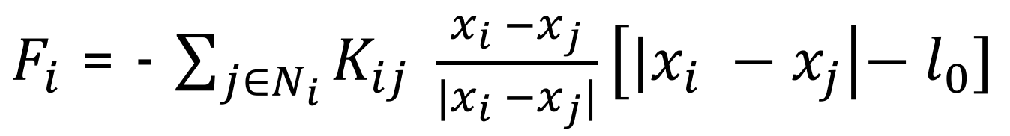
single particle (non-linear)
$F_{i}$ = - $\sum_{j∈N_{i}}{K_{ij}} \frac{x_{i} −x_{j}}{{|x}_{i} −x_{j}|}\left[{|x}_{i} −x_{j}\right|{− l}_{0}]$
Notes:
Rick
Very difficult to solve -> solution l_0 = 0.

Slide 6
full grid
$$F_{i}=0 ∀_{i}$$
Notes:
Rick
What is a Stable state.

Slide 7
vogel et al.
Decrease natural length
Break springs with a strain larger than some threshold
Stabilize the particles connected to the broken spring
Repeat radially for other particles up to a max number of steps.
Notes:
Rick
Decrease natural length of the springs
Break the springs for which the strain is larger than some threshold
Stabilize the particles that are connected to the (in previous step) broken spring. (Only if the force is larger than some resistance force)
This stabilization step is then radially expanded for a number of steps. (up to max steps)

Slide 8
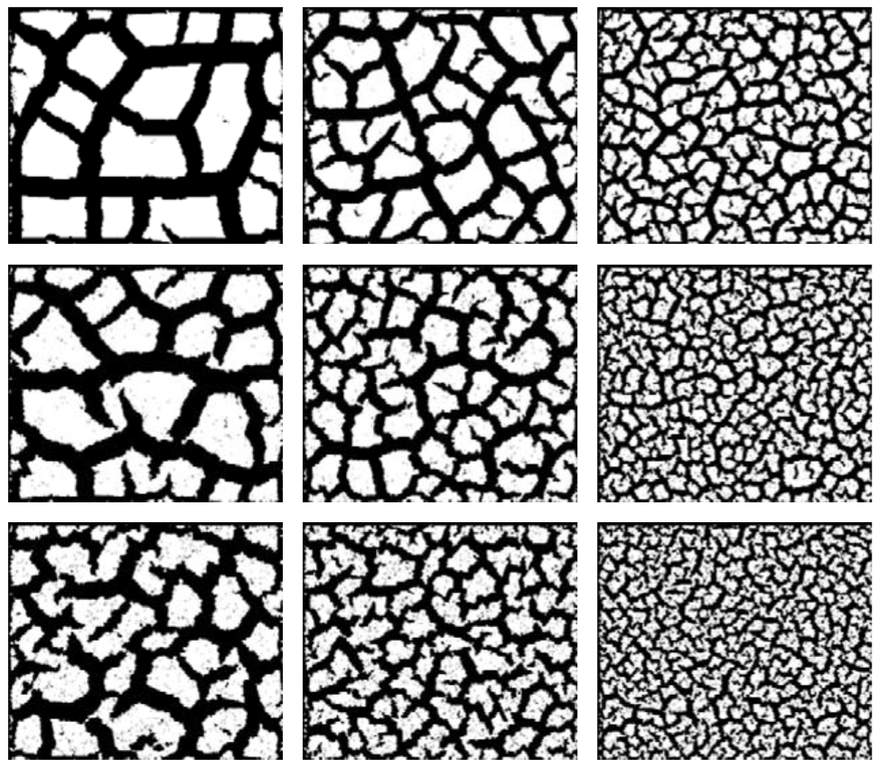
vogel results
Notes:
Rick

Slide 9
single step method
Notes:
Laura
No time steps.

Slide 10
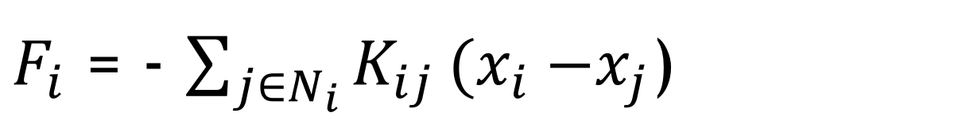
single particle (linear)
$F_{i}$ = - $\sum_{j∈N_{i}}{K_{ij}}{(x}_{i} −x_{j}$)
Note that we discard Newton’s and Stokes’ law
Notes:
Laura
We model the force on a particle as follows…
Note that the natural length is zero
Which can be solved ☺
Mass (Newton) and friction/drag/viscosity (Stokes)
Discard because naturally slow process.

Slide 11
initial grid
Notes:
Laura
K samples from gaussian so heterogenous material ☺

Slide 12
stabilize
Notes:
Laura
Solve the system

Slide 13
rupture
Notes:
Laura
Two methods:
Cut the 4 springs with greatest strain
Cut the springs with a strain greater than some paramter

Slide 14
stabilize
Notes:
Laura

Slide 15
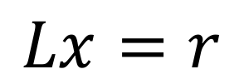
what do we want to solve
$$Lx=r$$
Notes:
Rick
Done for every component -> 2D, thus x and y component.

Slide 16
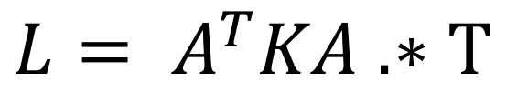
computing l(hs)
$${L= A}^{T}KA .∗T$$
Notes:
Rick
Problem -> How do we get the left hand side of the equation.
1 up to 4 on whiteboard.

Slide 17
compute r(hs)
for each particle in free particles
value = 0
for each fixed_particle attached to particle
value += spring(fixed_particle, particle).k() * fixed_particle.location()
end
r[particle] = value
end
Notes:
Rick
5 on whiteboard
Result 6 on whiteboard.

Slide 18




implementation
Notes:
Laura

Slide 19
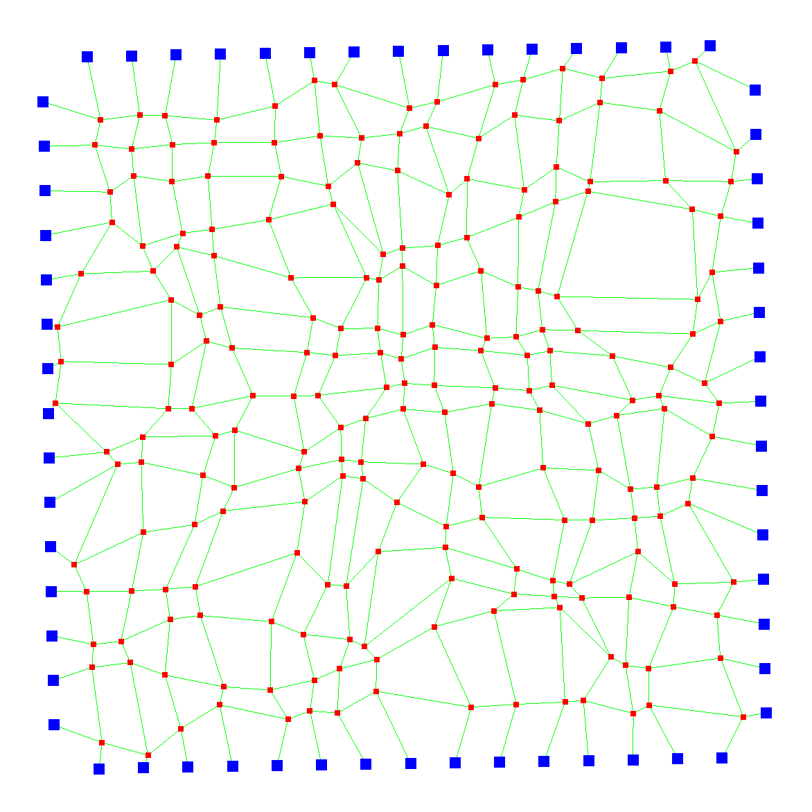
demo
Notes:
Laura
Meaning of the colors.
Problems when using large numbers of particles…..
Demo time. -> Rick
Small grid (16)
Medium grid (working number)
Large grid (not working number -> >800)

Slide 20
Notes:
Laura
Meaning of the colors.
Problems when using large numbers of particles…..
Demo time. -> Rick
Small grid (16)
Medium grid (working number)
Large grid (not working number -> >800)

Slide 21
research topics
Different cut technique
Different choices for K
Notes:
Laura
We can currently look at two different cut techniques and different choices for K

