Slide 1
rupture dynamics
watching paint dry
Laura Baakman & Rick van Veen

Slide 2
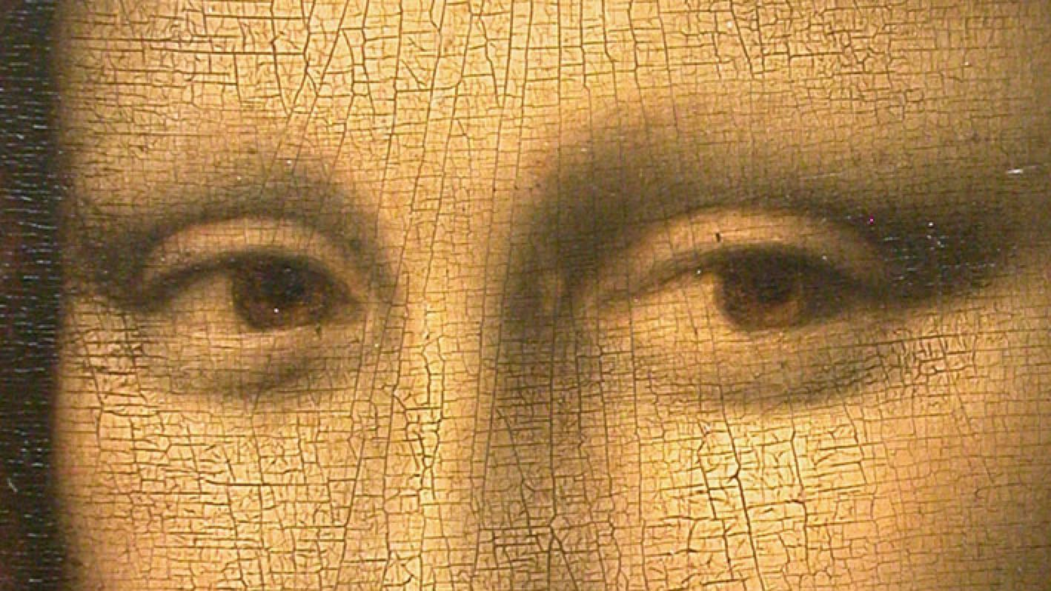
Notes:
Relevant! DUH
Computational expensive methods exist, e.g. Vogel -> we propose a simpler linear model ☺ -> Which we will explain now.

Slide 3
initial grid
fixing the border
adding springs

Slide 4




single spring
$X$ = $|x_{i} −x_{j}|$
$$x_{i}$$
$$x_{j}$$
$$F=K∙X$$

Slide 5
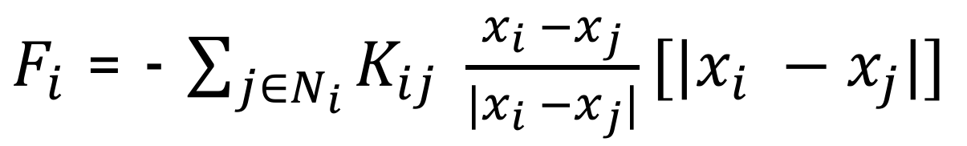
single particle
$F_{i}$ = - $\sum_{j∈N_{i}}{K_{ij}} \frac{x_{i} −x_{j}}{{|x}_{i} −x_{j}|}[{|x}_{i} −x_{j}|]$

Slide 6
full grid
$$F_{i}=0 ∀_{i}$$

Slide 7
initial grid

Slide 8
stabilize

Slide 9
rupture

Slide 10
stabilize

Slide 11
research topics
Random initialization
Different cut technique
Different choices for K
Different springs
Notes:
Random init: verschillend aantal veren, niet op een grid.

Slide 13
rupture

Slide 14
stabilize

