Slide 1
rupture dynamics
based on vogel et al.
Laura Baakman & Rick van Veen
Notes:
Rick
Welcome.

Slide 2
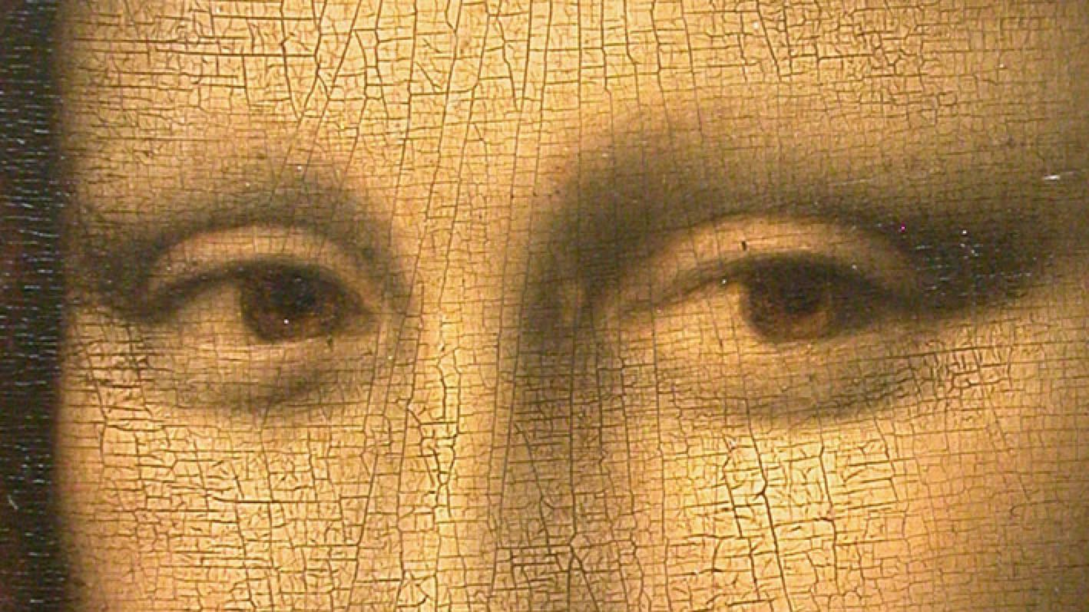
Notes:
Rick
Computationally expensive methods exist, e.g. Vogel
That method uses:
step by step simulation ->
we propose a simpler quasi static linear model ☺ -> Which Laura will explain now.

Slide 3
initial grid
fixing the border
adding springs
Notes:
Laura

Slide 4
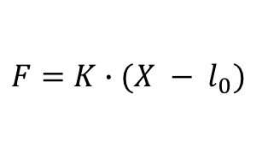
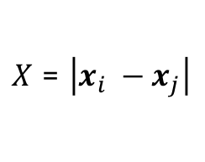



single spring
$X$ = $\left|x_{i} −x_{j}\right|$
$$x_{i}$$
$$x_{j}$$
$$l_{0}$$
$$F=K∙(X − l_{0})$$
Notes:
Rick
Hooks law.

Slide 5
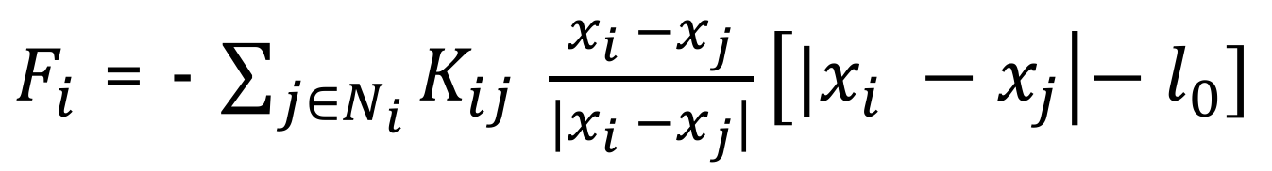
single particle (non-linear)
$F_{i}$ = - $\sum_{j∈N_{i}}{K_{ij}} \frac{x_{i} −x_{j}}{{|x}_{i} −x_{j}|}\left[{|x}_{i} −x_{j}\right|{− l}_{0}]$
Notes:
Rick
Very difficult to solve -> solution l_0 = 0.

Slide 6
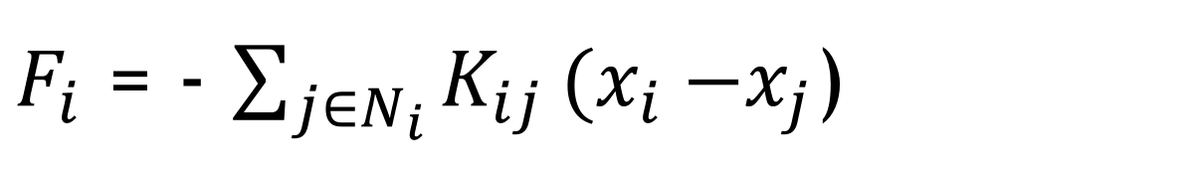
single particle (linear)
$F_{i}$ = - $\sum_{j∈N_{i}}{K_{ij}}{(x}_{i} −x_{j}$)
Note that we discard Newton’s and Stokes’ law
Notes:
Rick
Which can be solved ☺
Mass (Newton) and friction/drag/viscosity (Stokes)
Discard because naturally slow process.

Slide 7
full grid
$$F_{i}=0 ∀_{i}$$
Notes:
Rick
What is a Stable state.

Slide 8
initial grid
Notes:
Laura
K samples from gaussian so heterogenous material ☺

Slide 9
stabilize
Notes:
Laura
Solve the system

Slide 10
rupture
Notes:
Laura
Cut the 4 (in this case)

Slide 11
stabilize
Notes:
Laura

Slide 12
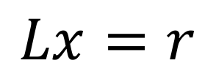
what do we want to solve
$$Lx=r$$
Notes:
Rick
Done for every component -> 2D, thus x and y component.

Slide 13
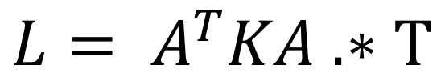
computing l(hs)
$${L= A}^{T}KA .∗T$$
Notes:
Laura
Problem -> How do we get the left hand side of the equation.
1 up to 4 on whiteboard.

Slide 14
compute r(hs)
for each particle in free particles
value = 0
for each fixed_particle attached to particle
value += spring(fixed_particle, particle).k() * fixed_particle.location()
end
r[particle] = value
end
Notes:
Rick
5 on whiteboard

Slide 15




implementation
Notes:
Rick

Slide 16
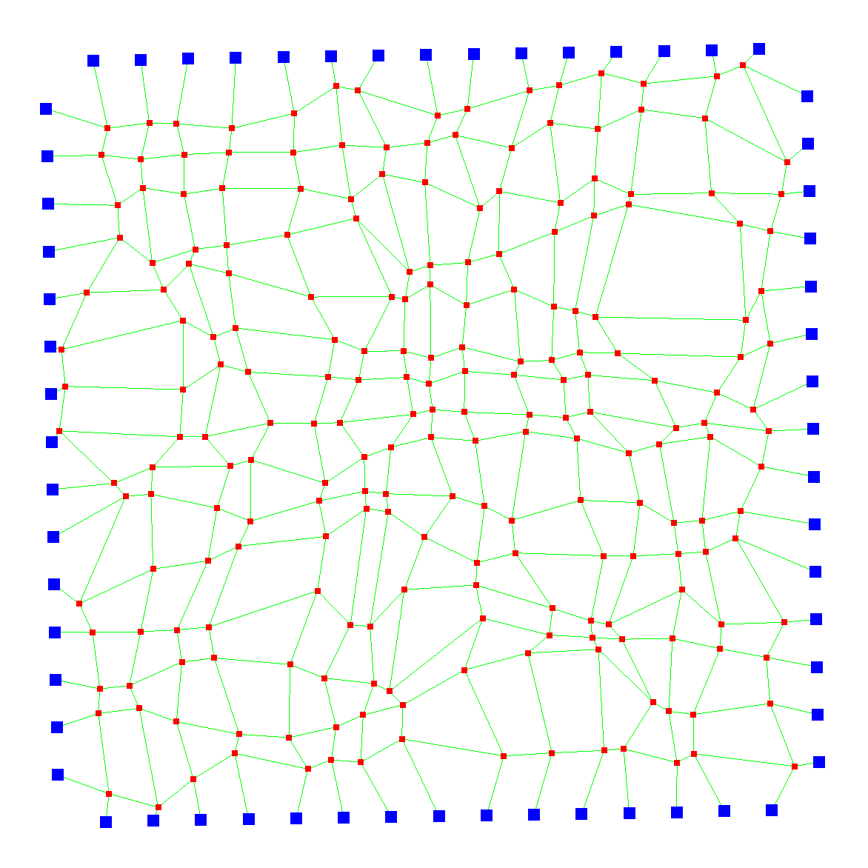
demo
Notes:
Rick
Meaning of the colors.
Problems when using large numbers of particles…..
Demo time.

Slide 17
research topics
Different cut technique
Different choices for K
Notes:
Random init: verschillend aantal veren, niet op een grid.

