Slide 1
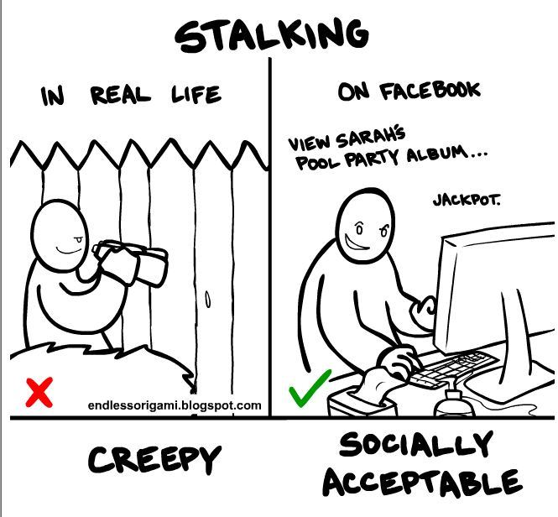
Web and Cloud Computing
11-09-2014
| <number>
| <number>
Social Stalker
Laura Baakman
Rick van Veen

Slide 2
Project 22: Social Media APIs
| <number>
“Use multiple APIs from social media applications to combine information in order to create a global profile of a specific person.”

Slide 3
Functional Requirements
| <number>
Users must be able to search a name or email*, and be able to select the social media they want to search on.
  *Depending on what the different APIs support
Store statistics and show statistics e.g.
  Most popular social media
  Etc…
Notes:
Yea what are we going to make? What can they expect.
What do we put in the database
We can store recent search to provide autocompletion, and allow users to share a link to our results page that we then can pull from the db.

Slide 4








Technology Stack: Frontend
| <number>
Notes:
Angular : MVC framework for java script
Bootstrap: Lay-out: Easy adaption to different devices, easy good looking lay-out
Require JS: javascript dependency management
Bower: Package manager
Protractor: End to end testing
Node.js: Scalability
Karma: unit tests of the front end
Openreplica: coordination service for distributed applications, e.g. have the database running on different devices

Slide 5



Technology Stack Backend and Database
| <number>
pip
Flask-PyMongo
virtualenvwrapper
virtualenv
Notes:
Python: better defined than scala, large community, enough previous experience that we wanted to learn how to use it better
Flask: micro web-framework, less complex than Django
MongoDB: easily store Json style documents, scalable
Rest API: easy to add other applications
Pip: the python moduels manager
Virtualenv: back-end dependency manager,
Virtualenv wrapper: easier to use than virtual env

Slide 6
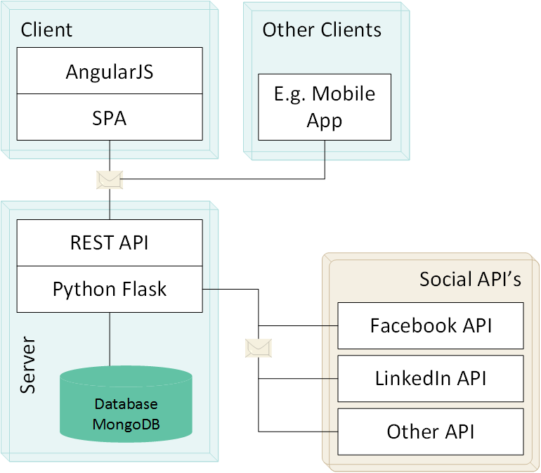
Architecture
| <number>
Notes:
I do not really know how to incorporate the OpenReplica in this picture

Slide 7
Planning
| <number>
Sept-24: UI/front-end logic
Oct-01: database/back-end logic
Nov-03: report deadline
Nov-05: final demos
Notes:
Mostly follows the deadlines. Given during the first lecture.
Can’t (don’t want to) make a more detailed planning

