Slide 1
Customer Churn Prevention
Laura Brown
October 2023

Slide 2
Project objective:
To decrease churn rate by identifying at risk customers and using proactive retention care.

Slide 3
Overview
Problem
High churn rate
Reactive retention care is ineffective
Voluntary churn is not being prevented
Outcome
Provide a list of customers at risk of churn
Provide possible reasons for dissatisfaction
Use the above to create a retention plan
Monitor churn rate and review process
Stakeholders
Customer
Support team
Sales team
Director of Customer Services
Notes:
Industry: Telecommunications
What are we trying to accomplish? Decrease churn rate
Key factors involved in the business task?
Identifying trends in churned customer accounts
Extrapolating this to current accounts to identify churn risk
Using these trends for outreach and proactive retention
What data will be appropriate for the analysis?
Customer data
Where will you obtain that data?
From internal databases
As this is an example, the data is from online opensource
@misc{customer-churn-prediction-2020, author = {Kostas Diamantaras}, title = {Customer Churn Prediction 2020}, publisher = {Kaggle}, year = {2020}, url = {https://kaggle.com/competitions/customer-churn-prediction-2020} }
Who is your audience, and what materials will help you present to them efectively?
Audience is the Director of Customer Services, Manager of Support/ Retentions, Manager of sales
Slideshow and visualisations with clear business outcomes in number format can ensure clarity and effective communication.

Slide 4
Understanding the problem
High Churn Rate
Reactive Vs Proactive Retention
Voluntary Churn
Companies current churn rate is 14%
Churn rate calculation:
Customers churned/ Total customers *100
Goal Churn rate is <10%
Reactive retention is often too late. The customers have another provider.
Proactive retention can eliminate voluntary churn reasons and show customers they are valued
Focusing on preventable churn puts the company in control.
Voluntary churn reasons:
Cost
Features
Issues
Service

Slide 5
Defining Success
Churn Risk Dashboard with list of high risk customers
Churn Rate Dashboard with list of churn reasons
Process defined and implemented for retention plan
Monitor future churn rate and iterate on process
All Stakeholders informed
Notes:
How do I define success for this project?
What kind of results are needed?
Who will be informed?
Am I answering the question being asked?
How quickly does a decision need to be made?

Slide 6
The Outcome
Churn Rate Dashboard
A dashboard that uses segmentation to identify what factors most impact churn risk
Churn Risk Dashboard
A dashboard that shows customers at highest churn risk
Proposed Retention Plan based on the churn risk factors
Future recommendations for churn rate analysis

Slide 7
Churn Rate Analysis

Slide 8
Churn Rate Analysis Process
Step 1 Define
Obtain recent account data
Define business goals, stakeholders and key metrics
Step 2 Clean & Validate
Use Big Query SQL to review data types, names, attribute length
Remove duplicates, null values, outliers
Create columns and segments to aid in analysis
Step 3 Analyse
Basic statistical analysis (mean, median, mode, stddev)
Segmentation analysis: Plan type, yrr, account length
Location specific analysis
Step 4 Visualise & Share
Build churn rate dashboard based on statistical analysis and segments
Build churn risk dashboard based on segment analysis

Slide 9
Segmentation Analysis
Account length
YRR
International Plan
Voicemail Plan
Number of Customer Service calls
The segments chosen are modelled on industry standard telecommunication segmentation and the available data

Slide 10
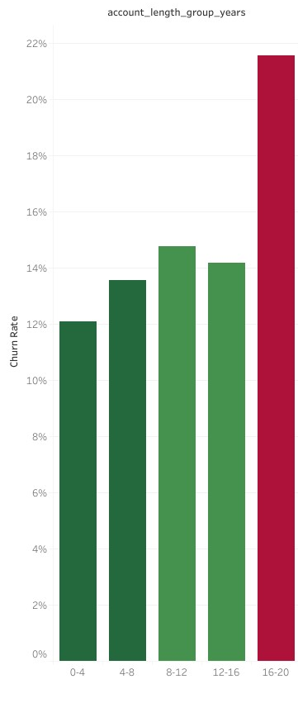
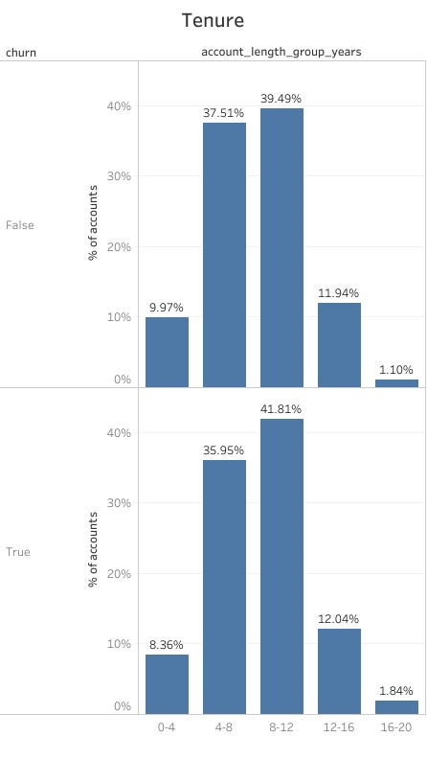
Account length key findings
Account Length
Table 1: Churn rate by account length
Table 2: Comparison of account length distribution between churn (false and true)
Segments:
0 - 4 years
4 - 8 years
8 - 12 years
12 - 16 years
16 - 20 years
Table 1
Table 2
Notes:
Similar mean and standard deviation between churned and active accounts. In total most accounts were > 1 year. We also saw that churn rate was higher for accounts >1 year

Slide 11
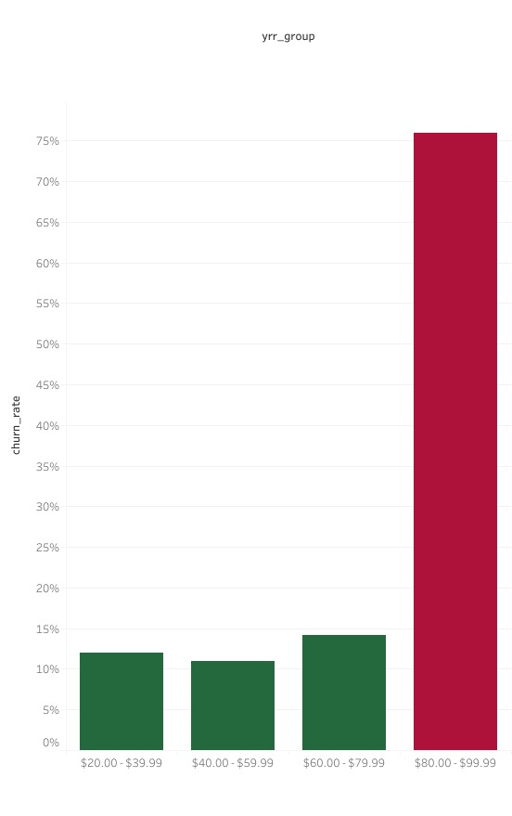
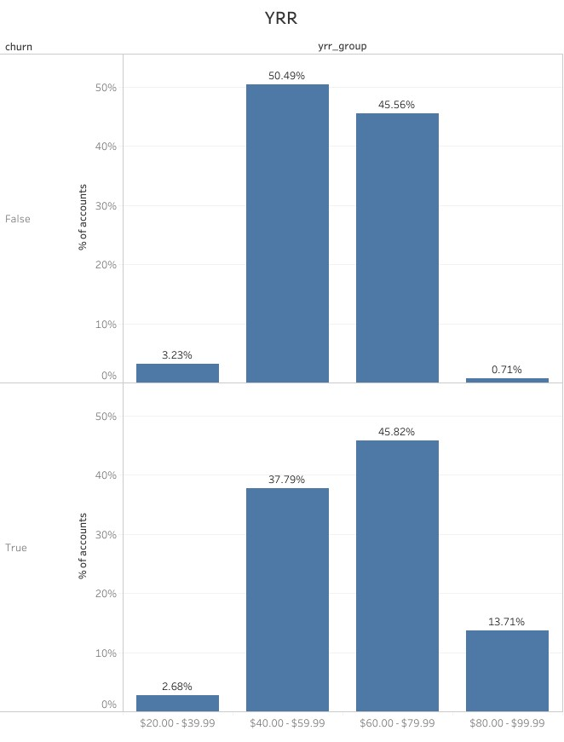
YRR key findings
YRR
Table 1: Churn rate by yrr
Table 2: Comparison of yrr distribution between churn (false and true)
Segments:
$20.00 - $39.99
$40.00 - $59.99
$60.00 - $79.99
$80.00 - $99.99
Table 1
Table 2
Notes:
Greater mean and standard deviation for churned accounts.
Accounts of $70+ significantly higher churn rate

Slide 12
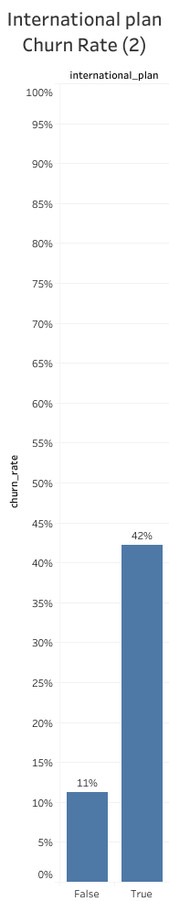
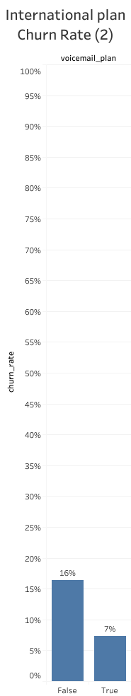
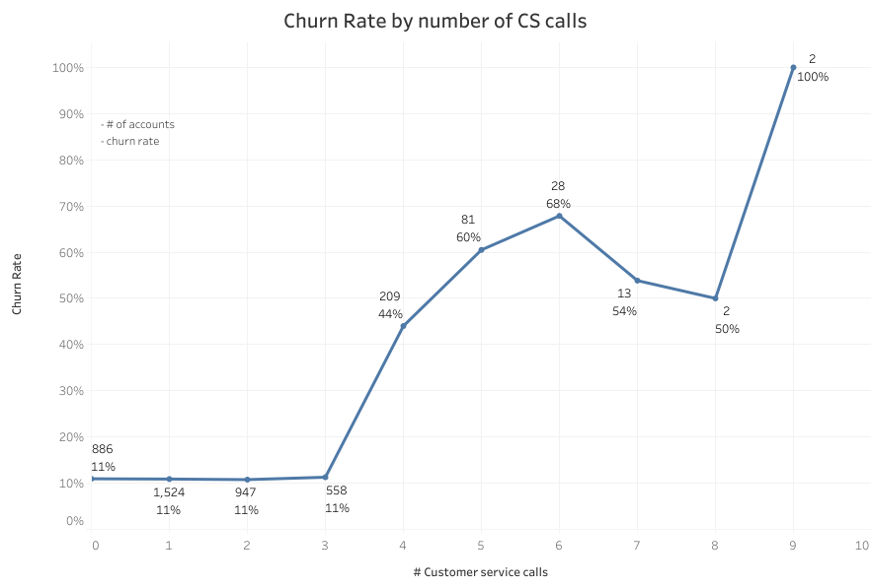
Plan Type key findings
Table 1
Table 2
Plan Type
Table 1: Churn rate by number of Customer Service Calls
Table 2: International Plan and Voicemail plan Churn Rate comparison
Segments:
International Plan
Voicemail Plan
Number of CS calls
Notes:
International plan True = greater churn rate
Number of CS calls >4 significantly increases churn rate (33% increase from 3 calls).

Slide 13
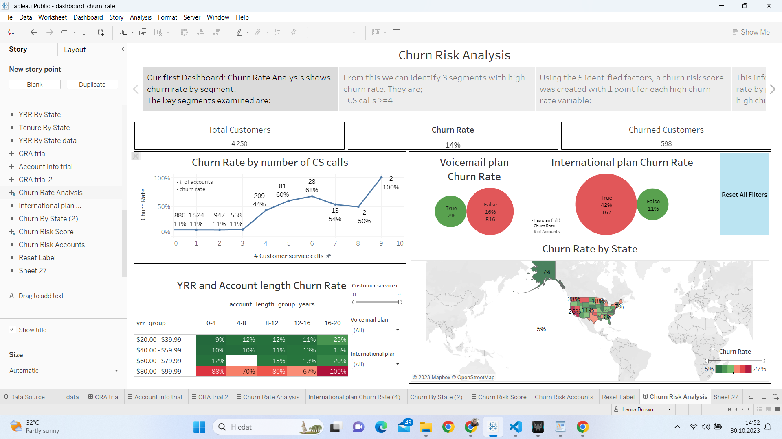
Churn Rate Dashboard
Access will be provided for:
Management
Retentions
Sales
Support

Slide 14
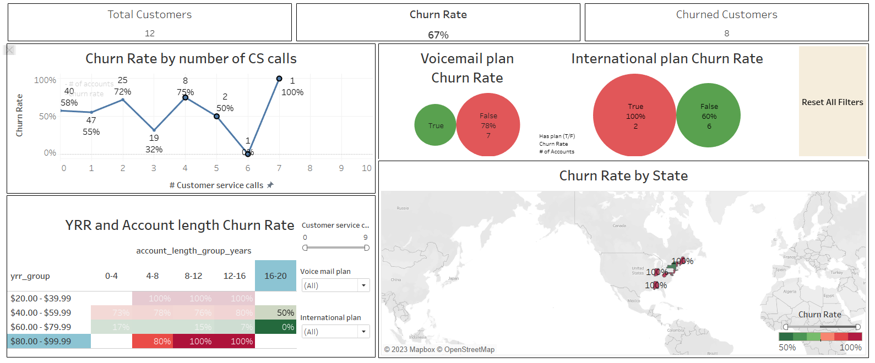
Churn Rate Analysis Insights
Churn Rate Insights
We have identified 3 segments with high churn rate. They are;
CS calls >=4
yrr_group = $80.00 - $99.99
account_length_group_years = 16-20
Filtering for the above shows extremely high churn rate (67%)
Two other segments show above average churn rate:
International plan = True
yrr_group = $60.00 - $79.99

Slide 15
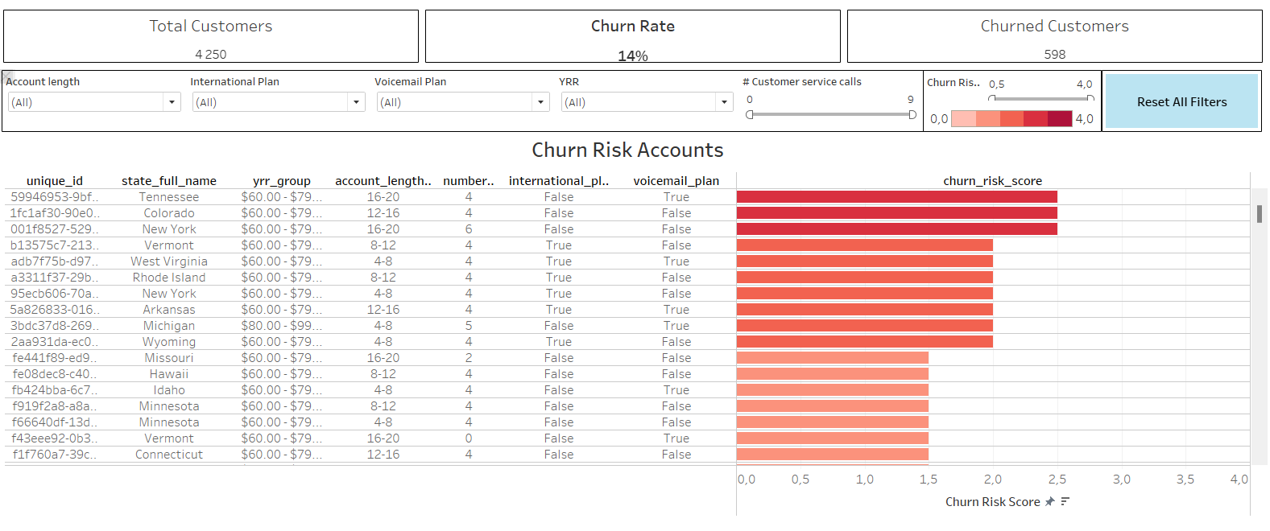
Churn Risk Dashboard
Churn Risk Factors
Using the 5 identified factors a churn risk score was created:
1 point
CS calls >=4
yrr_group = $80.00 - $99.99
account_length_group_years = 16-20
half a point
International plan = True
yrr_group = $60.00 - $79.99
The dashboard shows active accounts filtered and sorted for high churn risk score.

Slide 16
Proposed Retention Plan
Deliverable 1 Identify customers
Use churn risk dashboard to identify customers at highest risk
Deliverable 2 Analyse cs calls
Analyse customer service calls of at risk customers and address any outstanding issues
Deliverable 3 Review cost/plan
Review cost/plan type to ensure high risk customers feel valued and are maximising product use
Deliverable 4 Customer outreach
Schedule email/call outreach to discuss issues and optimise account costs and plan types

Slide 17
Future recommendations
Recommendation 1 Include time series data
Gather and include time series data to enable linear regression models for better forecasting
Recommendation 2 Include more data for analysis
Qualitative data: reason for CS call, reason for churn, month subscription started, month churned
Quantitative data: NPS score, how many times X feature is used
Boolean variables: do they have an overdue balance, have they churned and resigned
Recommendation 3 Monitor Results
Monitor future churn rate and account data
Is the retention plan making a difference on churn rate?
Recommendation 4 Review & Adjust Process
Review results and adjust churn risk analysis and retention plan to optimise results

Slide 18
Conclusion:
Churn rate is highest among the accounts that have the greatest total charges, the most customer service calls and the longest account length.
Speaking to customers with these attributes and addressing their issues and maximising their cost/value could help prevent churn.

