Slide 1
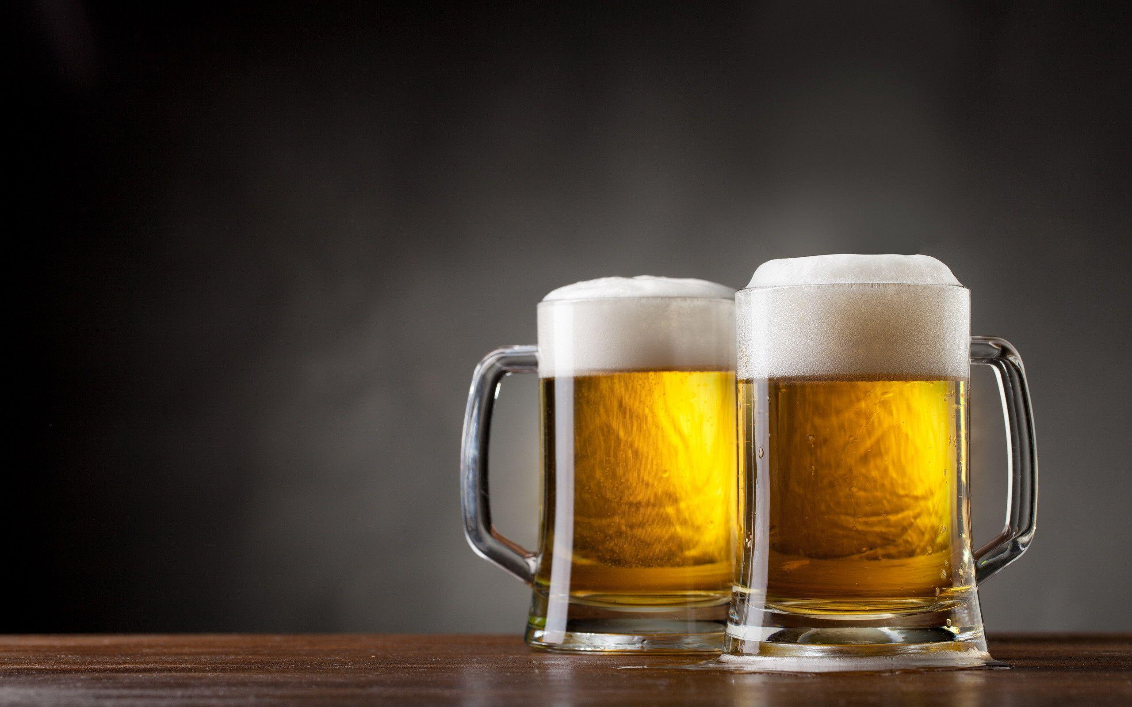
Breweries
EDA by:
Laura Ahumada

Slide 2
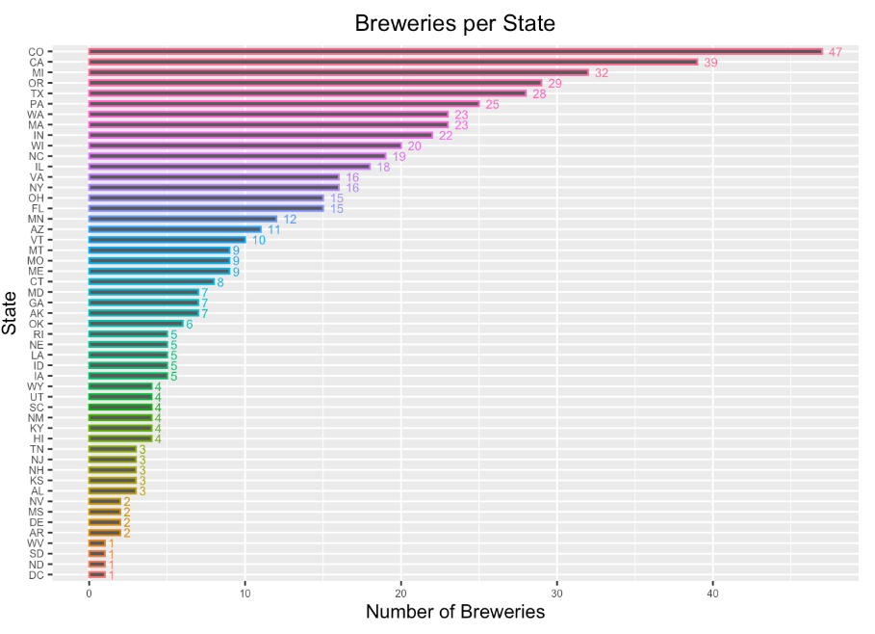
Number of breweries per state
There is a range of 1-47 Breweries per State
Colorado is the state with most breweries
Texas is the 5th State with most Breweries.

Slide 3
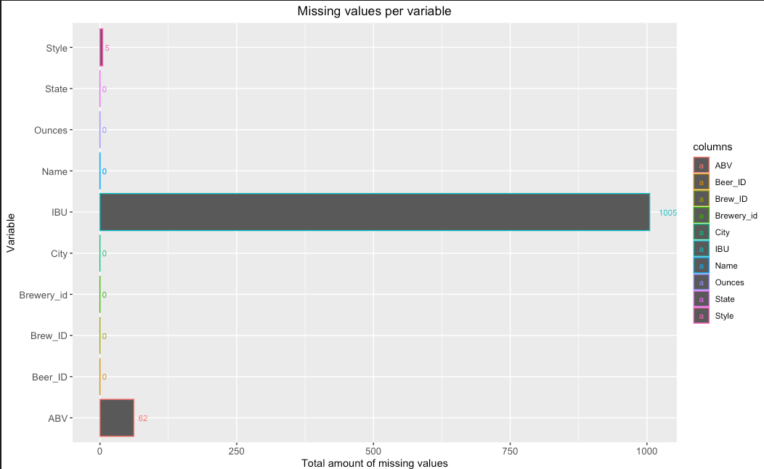
Total missing values
Brewery data size is 2,410

Slide 4
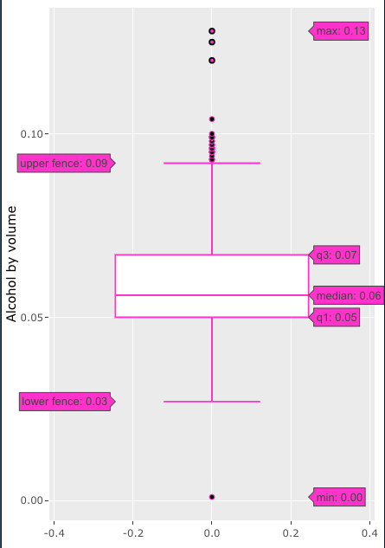
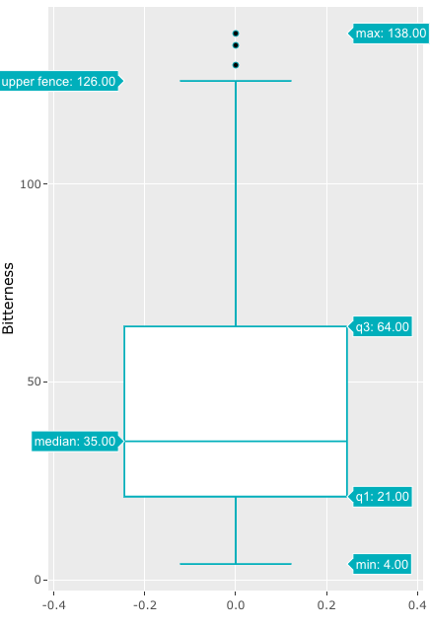
Dealing with the missing Values
Alcohol by Volume was the chosen column to help fill the missing values for bitterness.
Correlation between Bitterness vs Alcohol is 67% per pairplot

Slide 5
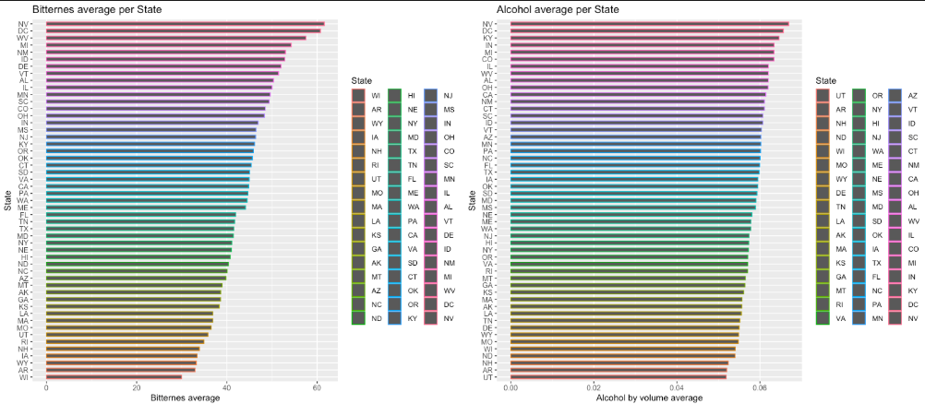
Alcohol Average per State
Bitterness Average per State
The highest mean bitterness unit average state is Nevada while the lowest is Wisconsin
State with the highest alcohol average per state is Nevada and lowest is UTAH
There are 6 states that are in common appear in the top 10 states for both IBU and ABV

Slide 6
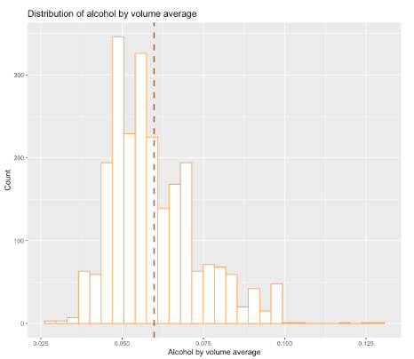
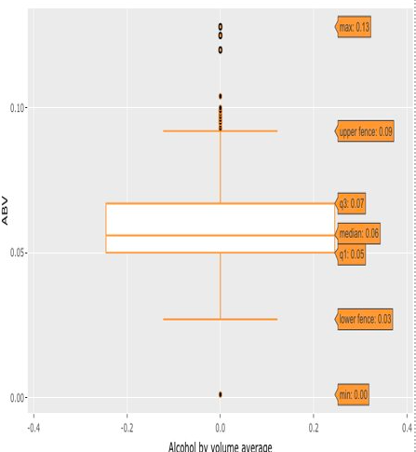
Alcohol Volume per beer Distribution
The alcohol volume is Right skewed
There are outlier on both edges.
There is only 1 outlier beneath the lower fence is 0.001 in California
The highest alcohol volume is 13%.
There we have 585 outliers on the top edge

Slide 7
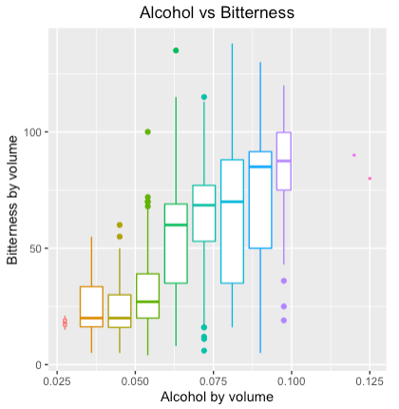
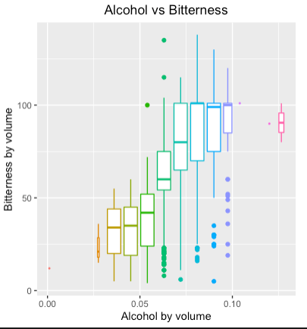
Relationship between the bitterness of the beer and its alcoholic content?
Initial analysis suggest , YES
The correlation went up 10 points, from 68% to 78% per pairplot
Corr_test using Spearman return a p-value 2.2e-16^.
Data with missing values
After missing values were updated

Slide 8
IPAs (India Pale Ales) and other types of Ale
KNN model returned an accuracy of 83%, sensitivity of 87%, and specificity of 76%.
Naïve Bayes model had an accuracy of 78%, sensitivity of 85% and specificity of 85%
Showing that there is a difference between IBU and ABV between IPA beer and the rest of the Ale beers. Based on the IBU and ABV combination KNN was able to predict the the style of the beer.
Beer Style | Mean IBU | Mean ABV
-Ale | 36.72559 | 0.05681330
IPA | 70.98929 | 0.06879286

Slide 9
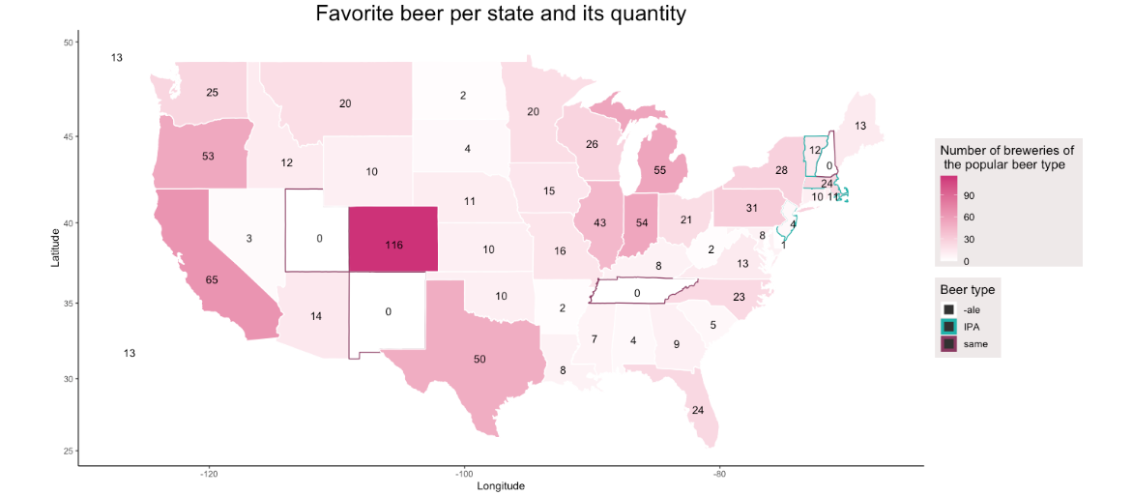
Favorite style beer per state
Most states have more –ale beers than India Pale ale
4 states have the same amount of IPA beers and the rest of the –ale beers
4 states in the north-east have more IPA beers than –ale beers

Slide 10
Thank you
Laura Ahumada and Jordan Eaddy
Emails: Lauraah10@gmail.com

