Slide 1

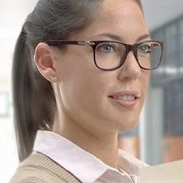
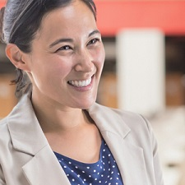
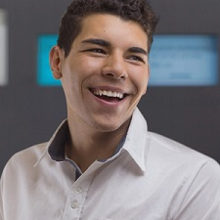


Photos for Imaginary Product Homepage
Logo on top left of page.
Testimonials. Left to Right: Clara Cache, Amy Zon, CP Yu.
Arrow pointing to “Sign up Now” button Small arrow for bullets and favicon.

