Slide 1
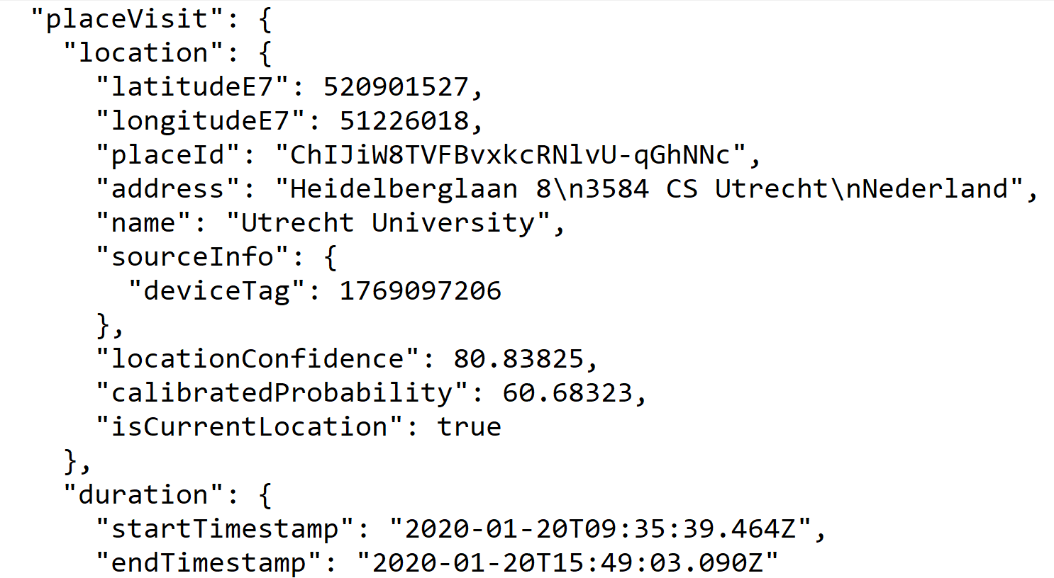
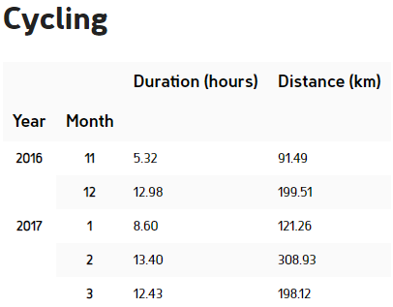
Raw Data
Aggregated Data
Data from the Google Semantic Location History (GSLH) package
Processed to extract the distance travelled and duration per activity

