Slide 1
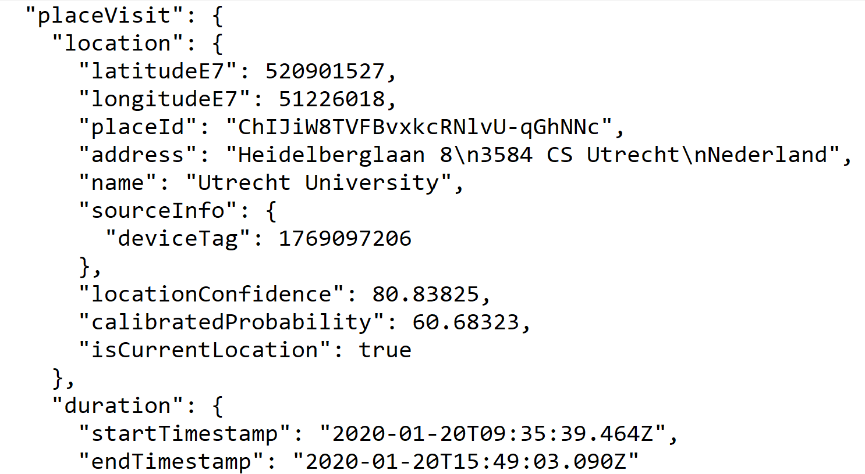
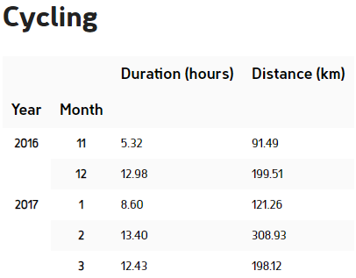
Raw Data
Aggregated Data
Data from the Google Semantic Location History (GSLH) package
Processed to extract the distance travelled and duration per activity

Slide 2
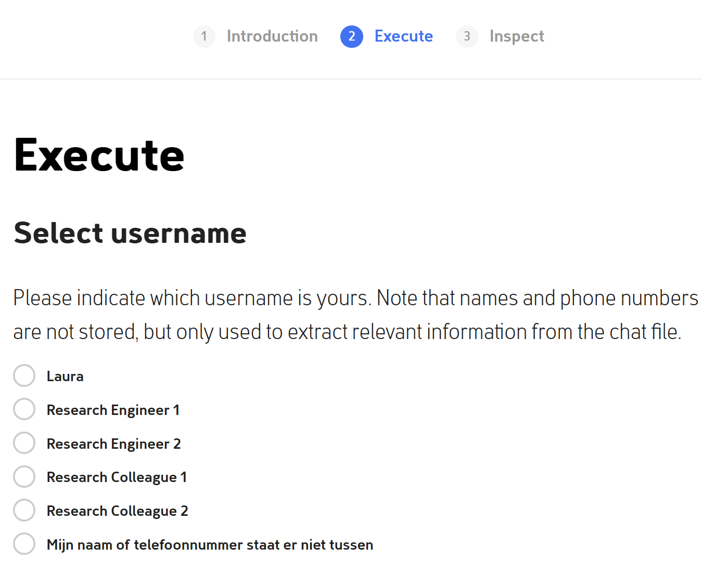
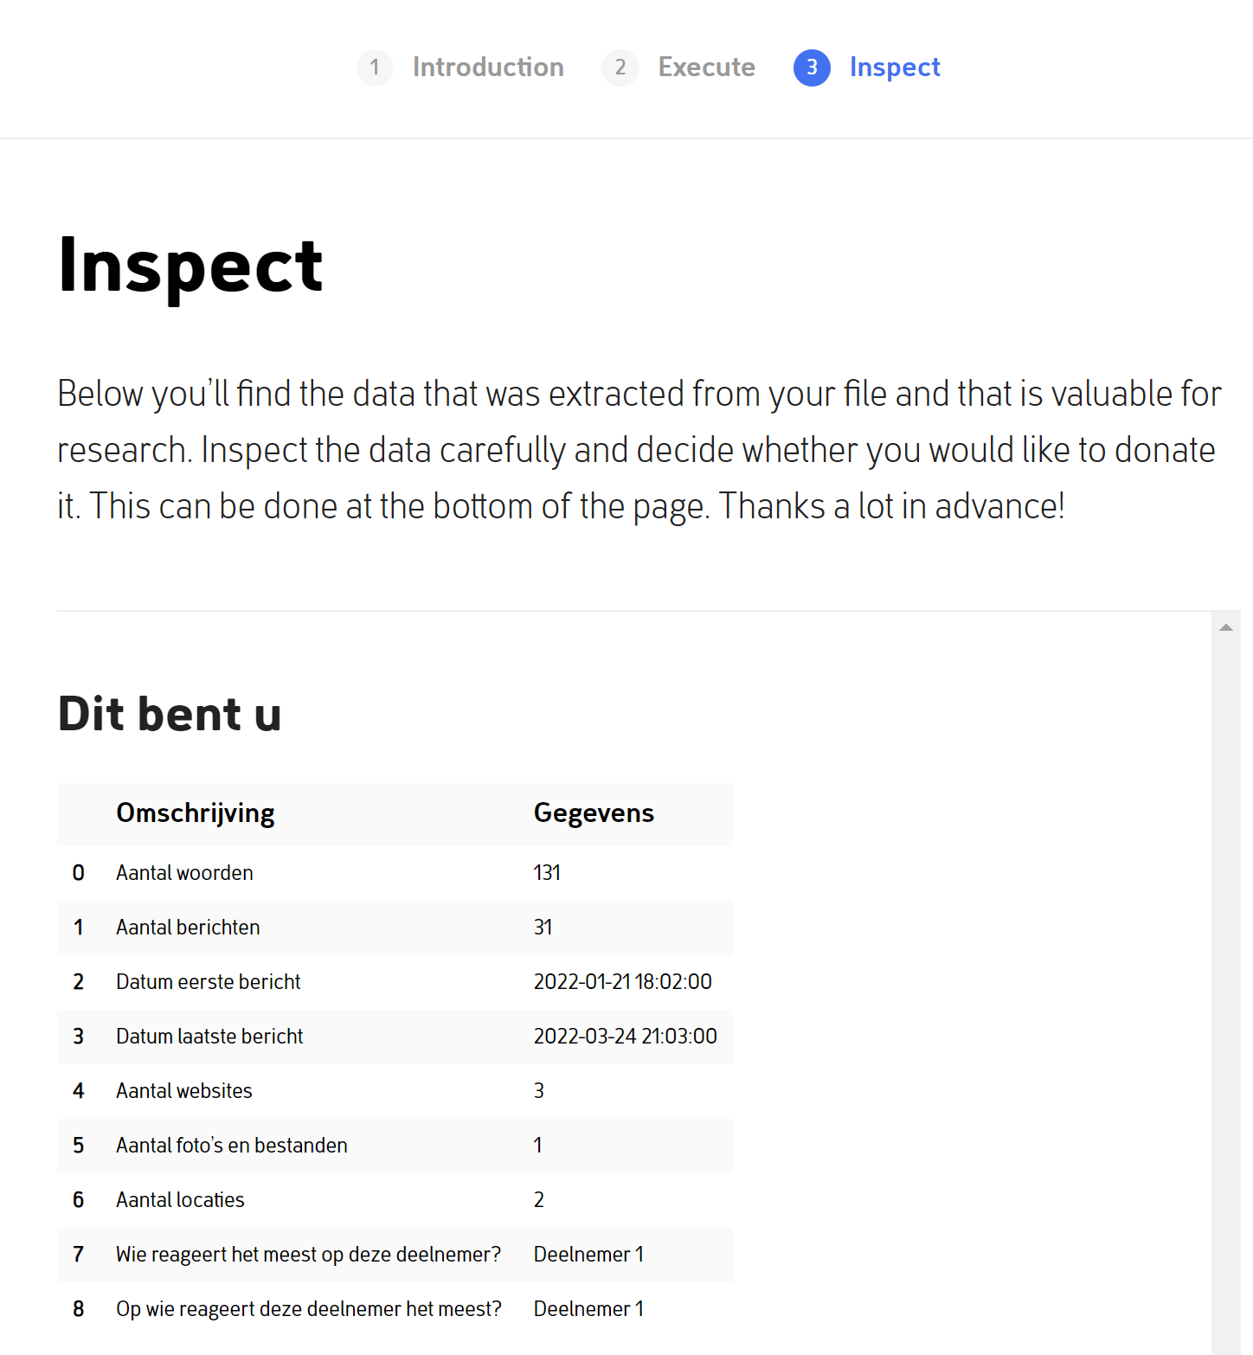
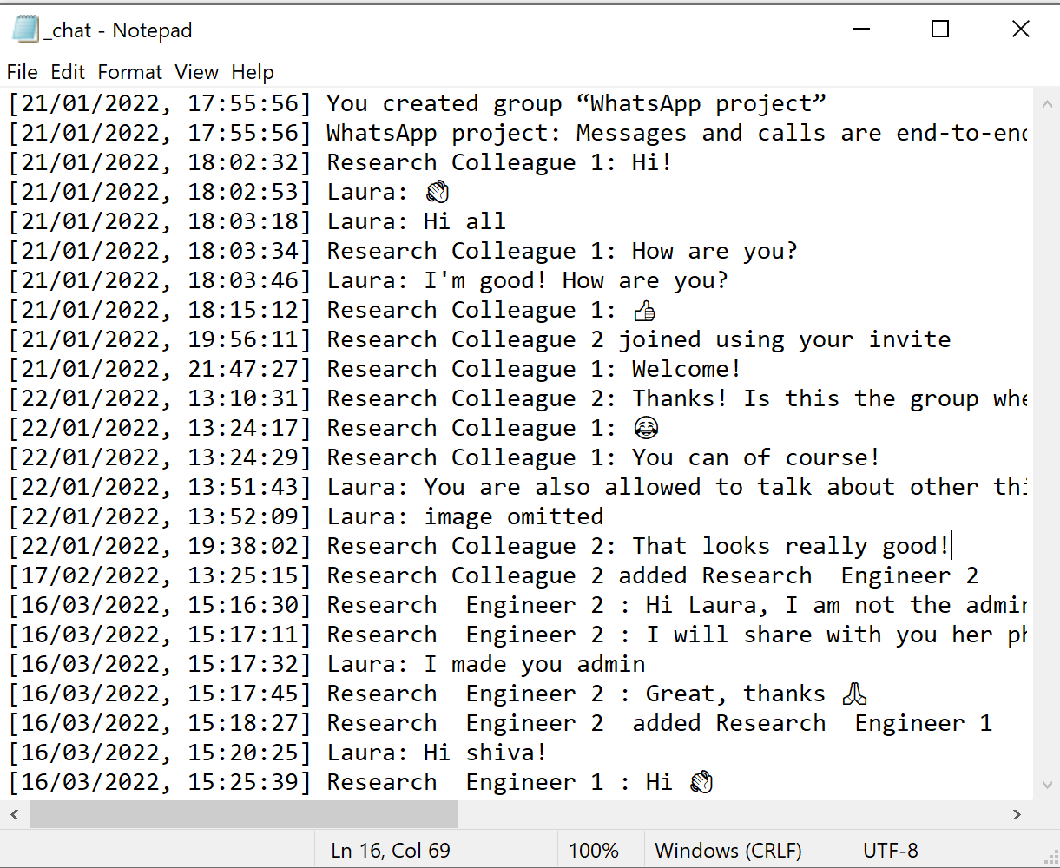
Raw Data
Local interaction
Extracted Data
The names in chat are locally extracted and presented. The participant selects their own name
Data from WhatsApp
chat export
Now only the participant is identified in the extracted data

