Slide 1
Inference by Eye How to Read Plots of Confidence Intervals
Audition for DataCamp
Laura Acion
Notes:
Hi DataCamp, I am Laura Acion and this is my audition video. I will be presenting an introduction on how to make inference by eye, that is, if you have a plot featuring one or two confidence íntervals, how can you approximate a p-value just by looking at the plot. (slide)

Slide 2
Previous Knowledge Required
Introduction to R
Introduction to the Tidyverse
Foundations of Inference
Inference for Numerical Data
Notes:
In this presentation I will assume you took the intro to R, the foundations of inference and the inference for numerical data courses from DataCamp. Or that you are familiar with introductory notions of R, estimation using confidence intervals, and inference using hypothesis test. (slide)

Slide 3
Example
200 observations randomly sampled from the High School and Beyond survey.
Same students took a reading and writing test.
Goal: determining if scores are different.
diff = reading score – writing score
95% Confidence Interval
H_{o}: μ_{diff} = 0
Notes:
In this presentation we will revisit an example from the Inference for Numerical Data class. (clic) We use 200 observations randomly sampled from the High School and Beyond survey. The same students took a reading and writing test. (clic) We are interested in determining if these scores are different. (clic)
To do this, we can construct a 95% confidence ínterval for the mean difference between the writing and reading scores or we can test the hypothesis that the population mean for the differences is cero. (slide)

Slide 4



R Code: Data
Notes:
In the following slides, we will use variations of the following R code.
First, we load the libraries ggplot2 and OpenIntro, where our dataframe hsb2 for the survey is included.
We calculate the differences between reading and writing scores.
Then we run a t.test for the difference and extract the estimated mean difference, the p-value, and the confidence interval limits for the estimated difference. Since the confidence interval is a numeric vector, to obtain the lower limit we ask for its first element and the upper limit corresponds to its second element.
We include all these elements in a dataframe and then we plot the results using ggplot.

Slide 5
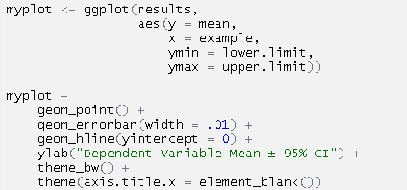
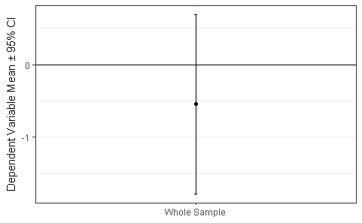
R Code: Plots
Notes:
With the data from the t.test results we will put together some helpful plots to visualize confidence intervals.
We map the confidence ínterval lower and upper limits to ymin and ymax. Then we use geom_point to plot the estimated mean and geom error bar to plot the confidence ínterval limits. You will need to play around with the option width so the end of the íntervals are not too wide.
Since we want to know how a mu diff of 0 relates to the ínterval, it is helpful to add this horizontal line.
Theme black and white gives us a minimalistic background and the last layer eliminates the title for the x axis.

Slide 6
One-to-One Relationship
Null hypothesis (H_{o})
Confidence Interval
p-value
Notes:
Ok, now that we have the tools to generate plots of confidence íntervals, let’s see some interesting results. (clic)
As you know, many times there is a one to one relationship between a confidence ínterval and the result of a hypothesis test. In other words (clic), given a null hypothesis Ho (clic), just by estimating the confidence ínterval, you can tell if the p-value for the hypothesis will be significant. Also, knowing the p-value, you can tell if the hypothesized parameter value will be within the ínterval.

Slide 7
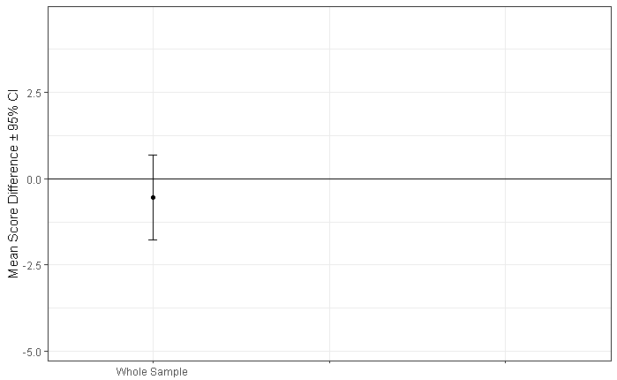
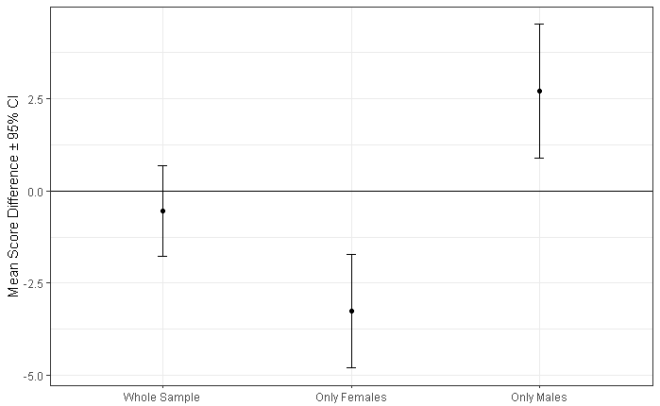
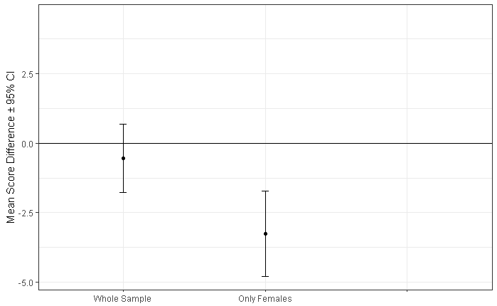
One-to-One Relationship
H_{o}: μ_{diff} = 0 p = 0.39
p < 0.0001
p = 0.004
Notes:
Going back to the example with the difference in exam scores, we see that the ínterval for the difference between the two scores in the whole sample includes 0.
Similarly (clic), a t test for the null hypothesis that the mean difference in the population = 0, yields a p value bigger than 0.05.
In this case, there is no evidence to reject the null hypothesis.
Let’s see what happens if we use only the subsample of females and compare the scores in both tests. (clic)
You will need this line of code to obtain the data for the plot and a p-value. Note that this part of the code is used to subset females. (clic)
For females, the confidence ínterval does not include cero. In fact, it is completely below cero, meaning that, for females, the writing scores were higher than the reading scores. This is because we subtracted the reading scores from the writing scores. (clic) Note that using the p-value, we would reject Ho at a 5% significance level. (clic)
Instead, for males, the confidence ínterval is completely above cero, meaning that the reading scores were higher than the writing scores for males. (clic) The p-value is also smaller than 0.05.
To obtain the values presented here you’ll just need to write male instead of female in this line of code.
In a nutshell, for a single confidence ínterval, if a confidence ínterval includes the value of the parameter we are testing, there is no evidence to reject the null hypothesis.
If it doesn’t include it and it’s below the value, we can reject the hypothesis and conclude that the parameter value must be smaller. When the confidence ínterval is above the tested value, we can conclude that the parameter value must be larger. (slide)

Slide 8
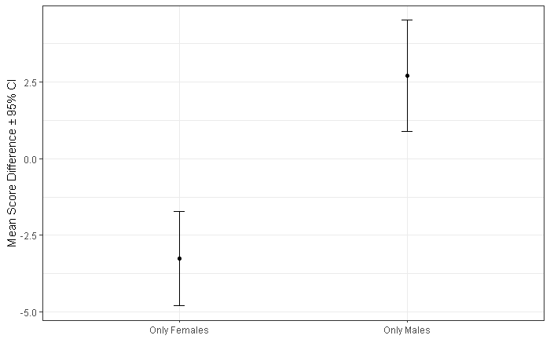
What If You Compared Two Groups?
H_{o}: μ_{diff females} = μ_{diff males} p < 0.0001
Notes:
Have you ever wondered how you could statistically compare two groups from a plot including side by side confidence íntervals?
An intuition that comes from what we saw in the previous slide is that one would reject the null hypothesis only if the two íntervals do not overlap. (clic)
That is true when we compare the score differences of females and males in our example. As you can see here, confidence íntervals do not overlap and the p value is very small. We can conclude that the difference for males is higher than the difference for females.
However, this intuition is not completely correct. (slide)

Slide 9
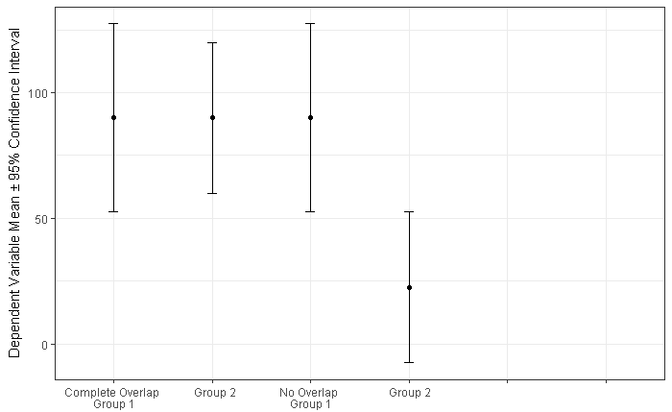
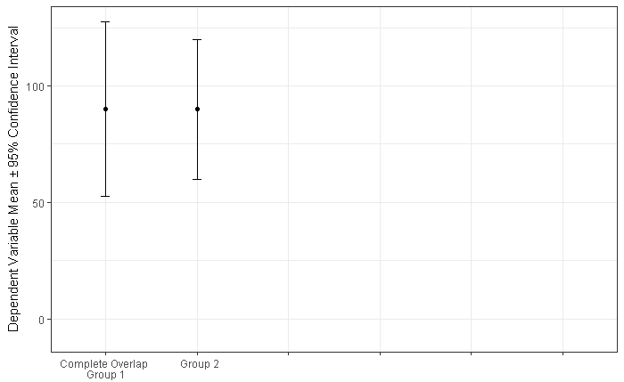
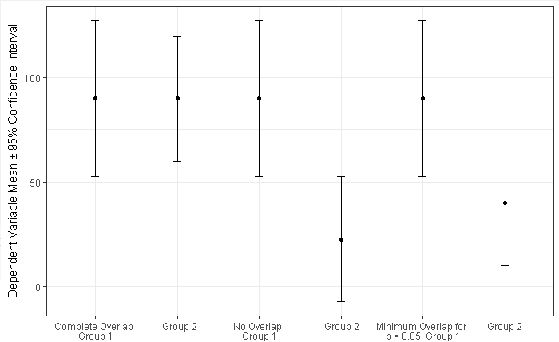



How Much Can Intervals Overlap?
$≈$ Half ME overlap
Margin of Error (ME)
H_{o}: μ_{group 1} = μ_{group 2} p = 1.00
p $≈$ 0.01
p $≈$ 0.05
Notes:
It turns out that, if two 95% confidence íntervals overlap, the corresponding p-value of comparing two groups, could still be smaller than 0.05.
Let’s arrive to this result using 3 generic visual examples. (clic)
Here we have complete overlap for the íntervals of group 1 and 2, the means in each group are equal and (clic) the corresponding p-value is 1. (clic)
In this second situation, the mean of the second group is smaller than that of the first group, (clic) the lower limit of the interval for group 1 touches the upper limit of the interval for group 2, so we have no overlap and, according to our initial intuition, we expect that p is smaller than 0.05. (clic) Well, it turns out that p is approximately 0.01 in this situation. Much smaller than expected with our intuition, isn’t it?
Hmmm, does that mean that there is a point where the intervals overlap and p is 0.05? The short answer is yes! Let’s see a third situation where that happens (clic). Here, the two íntervals overlap and p is approximately 0.05. How much can these intervals overlap? (clic) Well, it is safe to say that the overlap can be about half a margin of error. (slide)

Slide 10
When Does This Hold?
Both samples are independent.
Comparison of two means.
Both sample sizes are at least 10.
Sample sizes may be unequal.
Margins of error do not differ by more than 2.
Notes:
Please be aware that these results change in different situations. For instance, if the two groups are not independent or if the sample sizes in each group are less than 10, the amount of overlap until having a p-value of approximately 0.05 may change.
In spite of these limitations and that there is a lot more to say to completely understand how this works, now you know that two confidence íntervals can have some overlap but the two groups may still be statistically different. Whether that difference is meaningful is another discussion worth having.
Ok, now it is your turn to practice how confidence íntervals and p-values relate to each other and keep learning how to make inference by eye. (slide)

Slide 11
Thank You!
Notes:
Thank you very much for watching, I hope you enjoyed the presentation.

