Slide 1

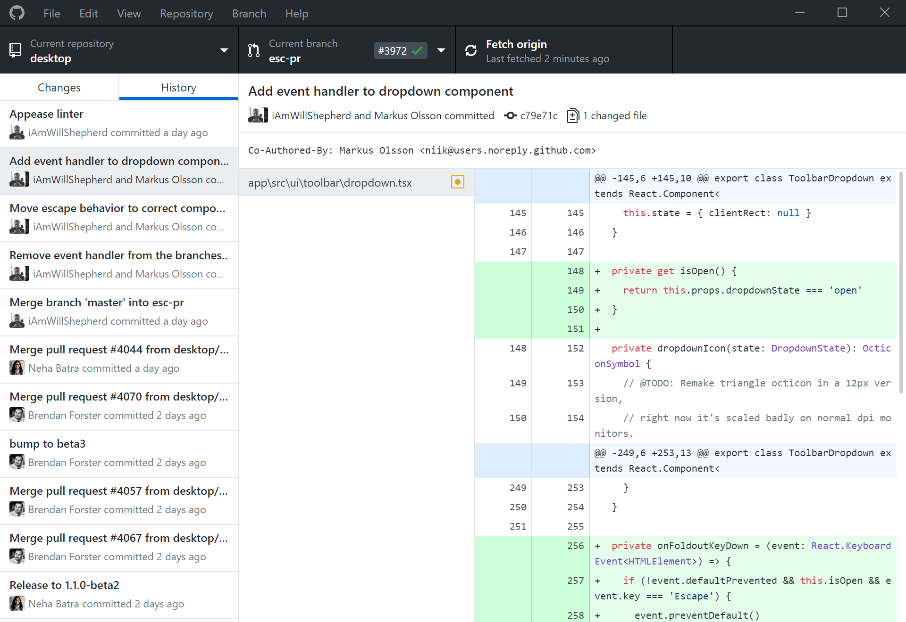



Git vs GitHub
git – a program for version control
VCS – version control system
There are several VCS programs.
examples: Git
Apache Subversion (SVN)
Mercurial
GitHub – a graphical user interface (GUI) used
to interface with git
and a central location for files
There are many GUIs that can be used with Git.
See: https://git-scm.com/downloads/guis
https://github.com
GitHub Desktop

Slide 2


Some Basic Git Commands and Terms
repo
repository – a collection of the different versions of files in a project
Repositories also contain the history and metadata for a project.
clone – an exact copy of a repository
(You generally start with a clone of a repository.)
pull – retrieve changed files from the repository to the local system
push – send changed files from the local system to the repository
fetch – check the remote repository for differences
merge – combining one or more files with changes
merge conflict – changes to the same part of one or more files
branches – a different version of a repository
(Branches contain their own history, metadata, and are mostly independent of each other.)
commit – a set of changes you’ve made to your local repository
(You can think of this as a package you’re going to send.)
remote repository – on GitHub
merge
commit
GitHub
clone
pull
fetch
push
merge
}
commit
noun
&
verb
local repository – on your system

Slide 3
Basic Process Used by the Lab
Developer:
clone
edit files
fetch (check remote repo for changes)
commit
push
clone
User: clone
pull
edit, add, subtract files
commit
push
pull (as needed)
fetch
pull (as needed)

Slide 4
Online GitHub Resources
Documentation:
Community:
https://docs.github.com/en/get-started
https://github.community

