Slide 1
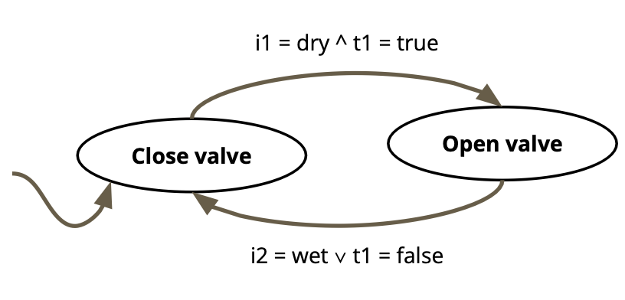
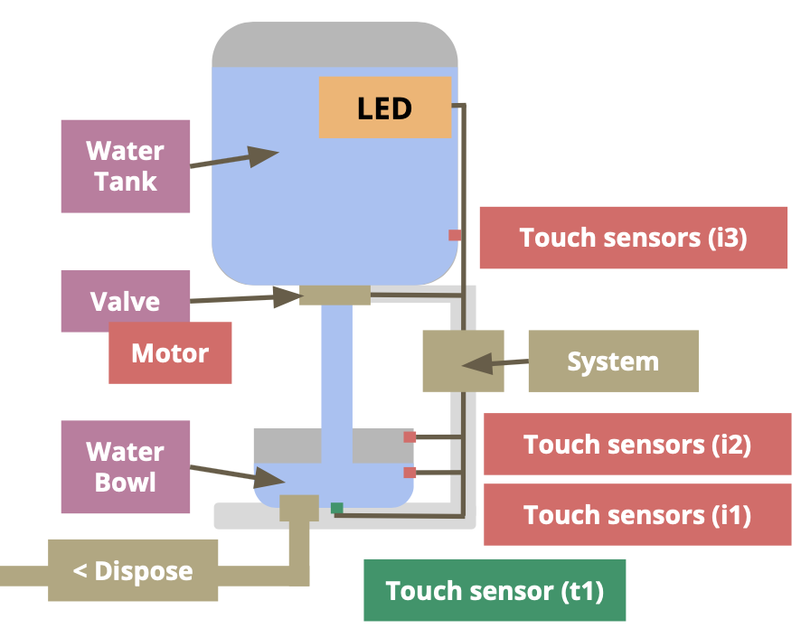
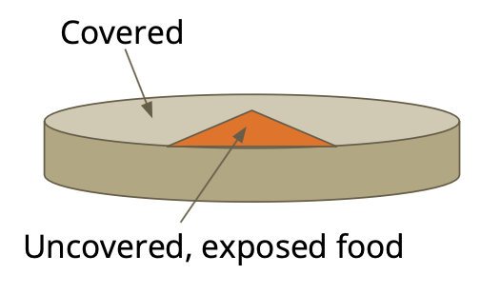
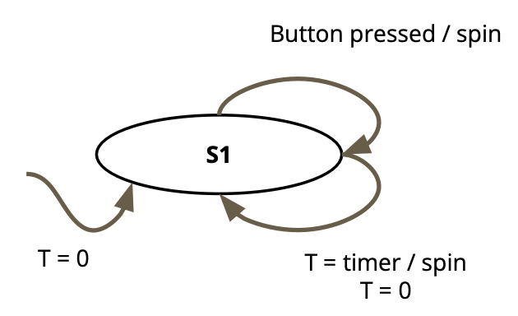
Autonomous Pet Food and Water Dispenser
Tiger Li, Stephanie Bai, Panda Atipunumphai, Laura Bryant
Cyber-Physical Systems: Foundations and Project
Summary
Materials
Complete System
Conclusion
We made an automated water/food dispenser for a pet cat or dog. This would be useful for taking care of a pet, especially if the owner is away as the system will be able to function on its own. The produce is fully autonomous and able to regulate the food and water completely on its own without supervision for an extended amount of time. The machine is be connected to a valve that controls the flow of water into the bowl, as well as a valve that controls the flow of water out. It is able to detect when the water level is below a certain threshold and fill the water bowl up again. There is also be a timer that refreshes the water in the bowl after a certain amount of time has passed in order to ensure that the water that the pet has is always fresh and clean. We hope that this product will make it easier for owners to take care of their pets, and reduce the amount of times that a pet is left without water because an owner is forgetful or busy.
Add your information, graphs and images to this section.
The system triggers lights to turn on when the supply is low and when it is gone so that the pet owner knows that it is time to replenish the supply. The system should allow the pet owner to leave the house and not have to worry about food and water for their pet for the whole day.
Add your information, graphs and images to this section.
Water Bowl Model
The system refills the water when the water is below a certain level. The water level is detected using a water level sensor, and the water will refill using a small motor that opens and closes a valve to the water supply. The water bowl is emptied out once at the end of day.
Food Bowl Model
Constraints and Challenges
The food supply delivers a fixed amount of food at a fixed time throughout the day specified by the owner. The amount of food dispensed is measured using a load cell, and the food is dispensed using a motor that opens a valve to the food supply and closes it when food is filled to the desired amount. Both the water and food supply are placed above the bowl such that a valve opening and closing will fill the bowl without needing pumps.
The most difficult constraint on this system is the size. There is limited space available in most homes or apartments, so the water and food reserve cannot be too large. On the other hand, if the reserve is too small there is little reason to use our product over a traditional bowl as it will have to be refilled frequently. Another constraint is that the system requires power. Each power option comes with its own unique constraint. A solar powered system must be placed in the sun, a battery powered system will not work if the user fails to replace the batteries regularly, and a system that plugs in must be near a power outlet in the home.
Acknowledgements
Add your information, graphs and images to this section.

