Slide 1


Advanced Machine Learning
UNIVERSITy BABEŞ-BOLYAI
Faculty of Mathematics and Computer Science
Machine Learning - review
Laura Dioşan

Slide 2
Topics
Intelligent systems
  Machine learning
    Concepts
    Problem definitions
    Evaluation
    ML algorithms
  Rule-based systems
  Hybrid systems
Advanced Machine Learning

Slide 3
Resources
Ch VI (18) of S. Russell, P. Norvig, Artificial Intelligence: A Modern Approach, Prentice Hall, 1995
Ch 10 & 11 of C. Groşan, A. Abraham, Intelligent Systems: A Modern Approach, Springer, 2011
Ch V of D. J. C. MacKey, Information Theory, Inference and Learning Algorithms, Cambridge University Press, 2003
Ch 3 of T. M. Mitchell, Machine Learning, McGraw-Hill Science, 1997 link
Ch 1 of C. Bishop, Pattern Recognition and Machine Learning, Springer, 2006 link
Ch 1 of S. Guido, A. C. Müller, Introduction to Machine Learning with Python, O’Reilly Media, 2016 link
Ch 1 & 2 of A. Geron, Hands-On Machine Learning with Scikit-Learn, Keras, and TensorFlow, O’Reilly Media, 2019 link
Advanced Machine Learning

Slide 4
Intelligent systems
  Autonomous systems
    Machine Learning - ML
      Problem
      Design
      Types
        Supervised learning
        Unsupervised learning
        Reinforcement learning
        Learning theory
      Examples
Advanced Machine Learning

Slide 5

Intelligent systems
Expert systems
Bayes
Fuzzy
    Decision trees
    Artificial Neural Networks
    Support Vector Machines
    …
Rule-based systems
Agents
Knowledge-based systems
Computational intelligence
Advanced Machine Learning

Slide 6
Machine Learning
Problem
  “How can we build computer systems that automatically improve with experience, and what are the fundamental laws that govern all learning processes?”
Applications
  Handwritten recognition
  Face recognition
  Voice recognition
  Obstacle recognition
  Weather prediction
  Medical diagnosis
  Fraud detection
  …
Advanced Machine Learning

Slide 7

Machine Learning
Definitions
  Arthur Samuel (1959)
    “field of study that gives computers the ability to learn without being explicity programmed”
  Herbert Simon (1970)
    “Learning is any process by which a system improves performance from experience.”
  Tom Mitchell (1998)
    “a well-posed learning problem is defined as follows: He says that a computer program is set to learn from an experience E with respect to some task T and some performance measure P if its performance on T as measured by P improves with experience E”
  Ethem Alpaydin (2010)
    Programming computers to optimize a performance criterion using example data or past experience.
  John L. Hennessy, President of Stanford (2000–2016)
    Machine learning is the hot new thing
  Bill Gates (Microsoft co-founder)
    A breakthrough in machine learning would be worth ten Microsofts
Advanced Machine Learning

Slide 8
Machine Learning
VIPs
  Peter Norvig, Stuart Russell → AI: a modern approach
  Michael Jordan (Bayesian Nets), Andrew Ng (Coursera)
  Elon Musk, Andrej Karpathy (TESLA)
  Fei Fei Li (AI for social good)
  Richard Sutton (Reinforcement Learning)
  Jurgen Schmidhuber (LSTM)
  Geoffrey Hinton, Yann LeCun, and Yoshua Bengio (CNN and deep CNN)
  John Koza (Genetic Programming)
  Rana el Kaliouby (Affectiva)
  Anca Andreica, Camelia Chira, Horia Pop, Gabriela Czibula (UBB)
Advanced Machine Learning

Slide 9
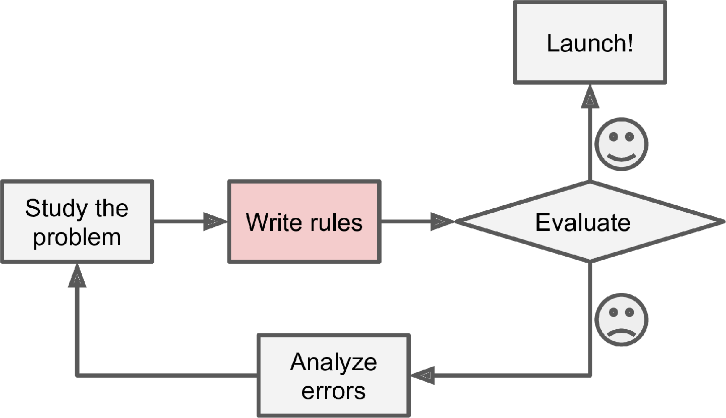
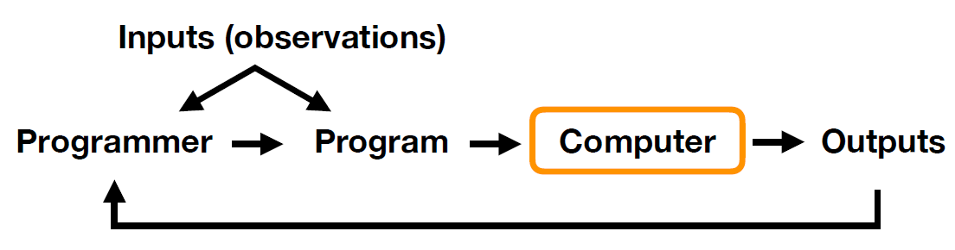
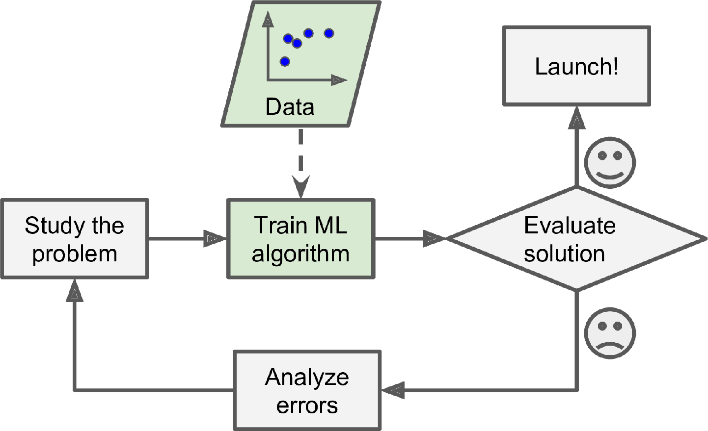
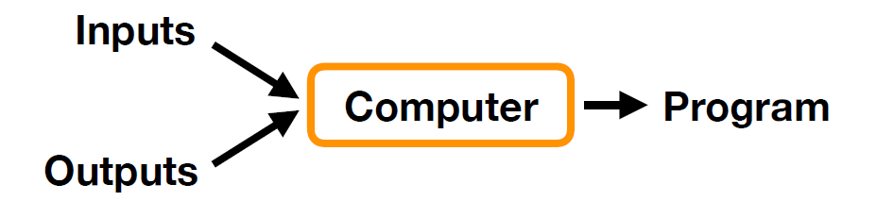
Machine Learning
Traditional programming
Machine Learning
Advanced Machine Learning

Slide 10
Machine Learning
Design
  Improve task T
    Learning objective
  Performance metric
    Quality of learning
  Using training data
    Relevant past data
Advanced Machine Learning

Slide 11

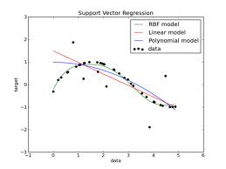
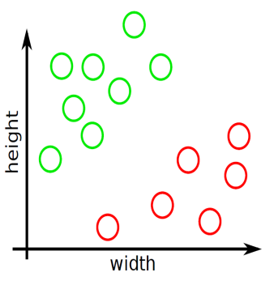
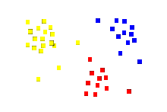
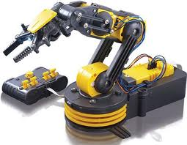
Machine learning
Learning objective
  Regression
    E.g. Water consumption prediction
  Classification
    E.g. Cancer recognition (malign vs. Benign)
  Planning
    E.g. Robot scheduling
Advanced Machine Learning

Slide 12
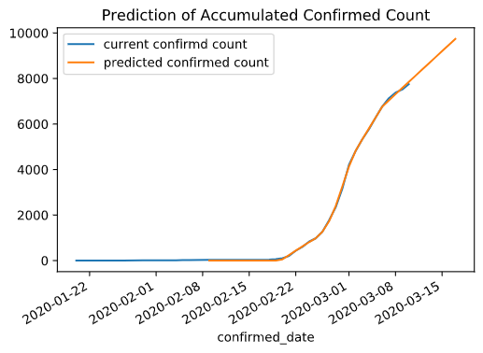
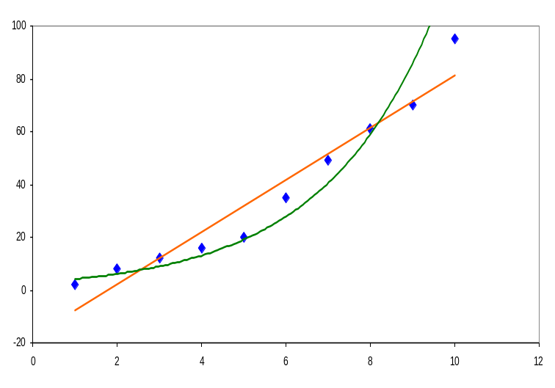
Machine learning
Regression
    Training data
      No of SARS CoV 2 infected persons (for the last 3 months)
    Testing data
      No of persons to be infected in the next 7 days / 4 weeks / 2 months
Advanced Machine Learning

Slide 13
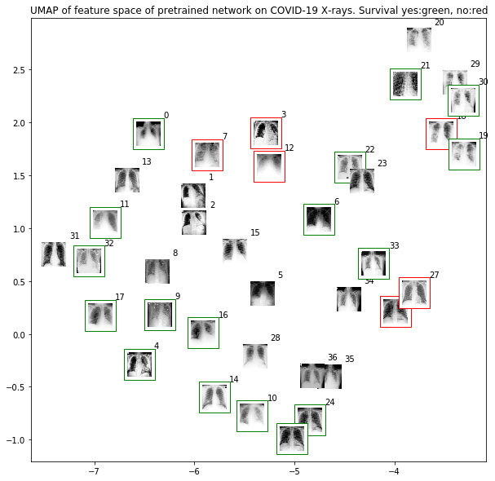
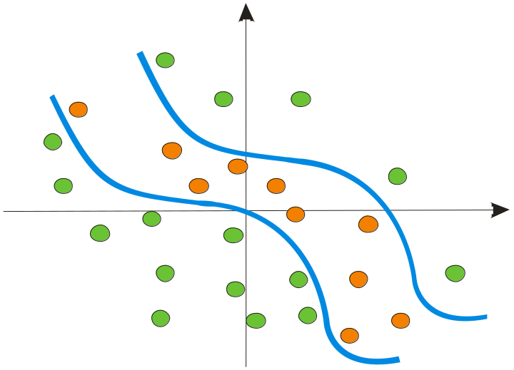
Machine learning
Classification
    Training data
      MRI images from patients and healthy persons
    Testing data
      Predict, based on the MRI, if a new person is infected or not
Advanced Machine Learning

Slide 14
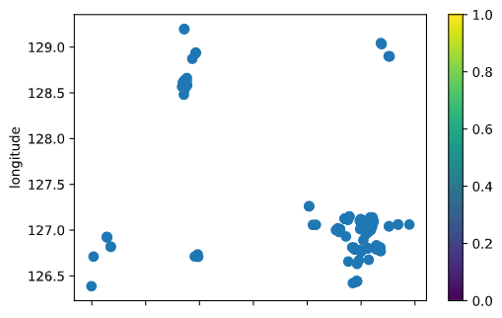
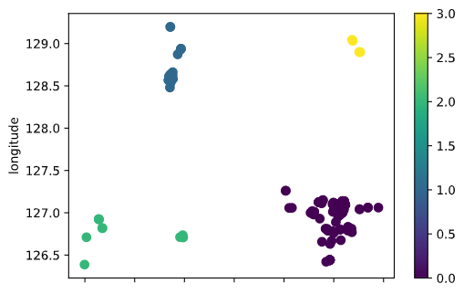
Machine learning
Clustering
    Training data
      Geographical localization of infected persons
    Testing data
      How are these persons organized in different groups/regions?
Advanced Machine Learning

Slide 15
Machine learning
Design -> ML algorithms
  Algorithm
    By using training data
    Infers a hypothesis that
      Fits the training data
      generalizes new data
  Types
    Supervised ML
    Unsupervised ML
    Semi-supervised learning
    Self-supervised learning
    Imitation learning
    Reinforcement learning
    …
Advanced Machine Learning

Slide 16
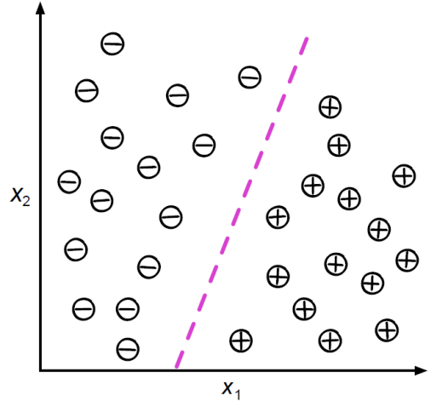
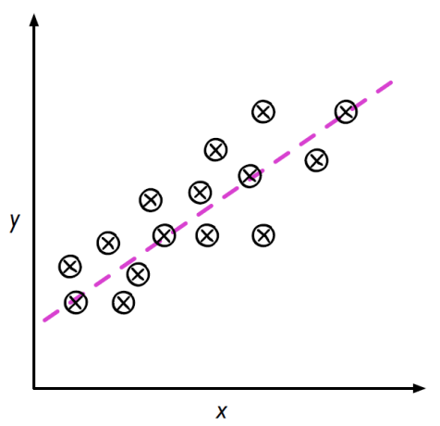
Machine learning
Supervised ML
    Ex. regression, classification
    Characteristics
      Labeled data (in & out) Ex. clusterizare, reducerea numărului de dimensiuni
    Carcteristici
      Date neetichetate (se cunosc o parte din datele de intrare**)
      Fără feedback direct în timpul învățării – pentru că nu se cunosc datele de ieșire
      Identificarea unor structuri în date (generarea de date de ieșire pentru datele de intrare din **)
  Învățare prin întărire
    Ex.
    Caracteristici
      Predicția unor secvențe de decizii / de acțiuni
      Sistem de recompense (pentru fiecare decizie / acțiune)
      Se învață un model de acțiune (o serie de acțiuni care trebuie efectuate)
Advanced Machine Learning

Slide 17
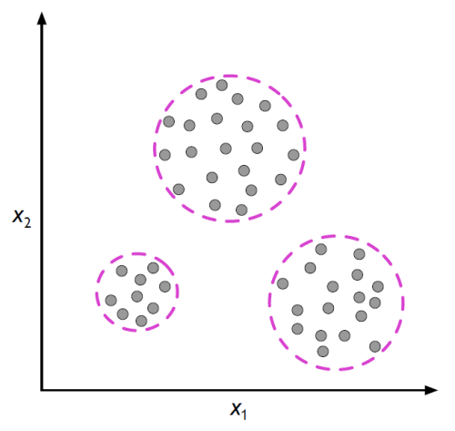
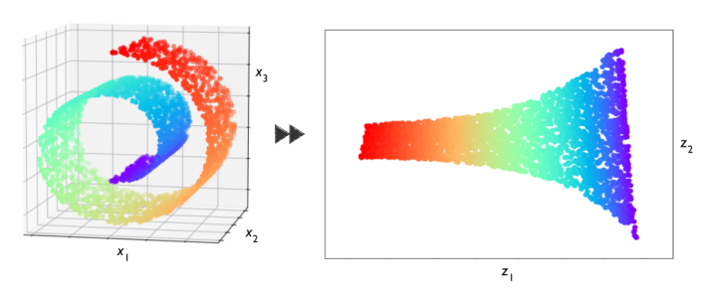
Sisteme inteligente – SIS – Învăţare automată
Unsupervised ML
    Ex. clusterization, dimension reduction
    Characteristics
      Unlabeld dataÎnvățare prin întărire
    Ex.
    Caracteristici
      Predicția unor secvențe de decizii / de acțiuni
      Sistem de recompense (pentru fiecare decizie / acțiune)
      Se învață un model de acțiune (o serie de acțiuni care trebuie efectuate)
Advanced Machine Learning

Slide 18
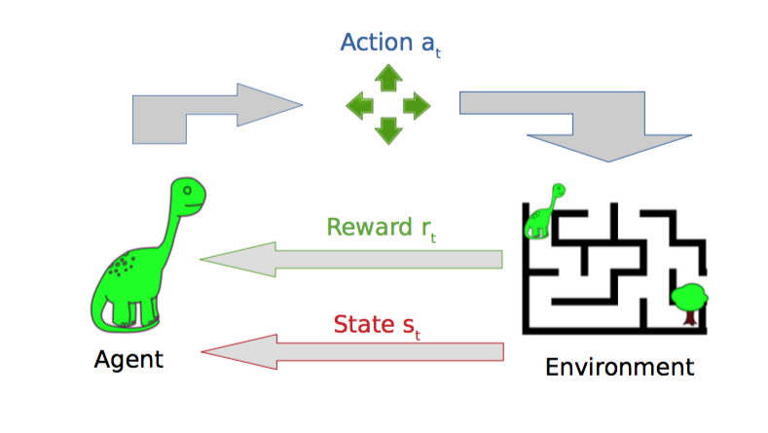
Sisteme inteligente – SIS – Învăţare automată
Reinforcement learning
    Ex. path learning
    Characteristics
      Predicting sequences of decisions
      Rewarding systems
Advanced Machine Learning

Slide 19
Machine Learning
Design
  Algorithm
    By using training data
    Infers a hypothesis that
      Fits the training data
      generalizes new data
  Basic principle
    Prediction error minimization (cost function, loss function) for training data
      Regression error (distance between predicted values and true values)
      Classification error (how many examples have been correctly classified)
      Error of structure creation (how homogenous / not-homogenous are the produced structures)
  Evaluation
    Experimental
      Comparing methods on various data (Cross-validation)
      Statistical evaluation (various metrics as accuracy, precision, etc.)
    Teorethical
      Mathematical analysis of the algorithms and theorem proofing
        Computational complexity
        Ability to fit by training data
        Complexity of sampling methods to ensure a correct learning (avoiding overfitting or underfitting)
Advanced Machine Learning

Slide 20
Machine Learning
Design → training and testing data
  Features (attributes, characteristics)
    Quantitative -> nominal or rational scale
      Continuous values → ice-cream weight
      Discrete values → number of computers
      Range values → event time
    Qualitative
      Nominal → colour
      Ordinal → sound intensity (low, medium, high)
    Structured
      Trees → the root generalizes its children (vehicle → car, bus, tractor, truck)
Advanced Machine Learning

Slide 21
Machine Learning
Design → training and testing data
  Data transformation
    Normalisation (standardization) → numerical features
      Removing scale effects (different scales and different measure units)
      Raw values are transformed in normalized values
        E.g. Z-score
        Z_{ij} = (x_{ij} – μ_{j})/σ_{j}, where
        x_{ij} – value of the j-th feature of the ith example
        μ_{j} (σ_{j}) – average (deviation) of the jth feature for all samples
    Feature selection
      Independent features
        E.g. correlation matrix
Advanced Machine Learning

Slide 22
Machine Learning
Design → Training and testing data
  Data sources
    [Random] generated data
    Positive examples collected by an atlas
    Real examples
  Composition
    Training data
      Learning data
      Validation data
    Test data
  Characteristics
    Independent data
    Same distribution of training and testing data
      If not → transfer learning
        E.g. Car recognition → truck recognition
        E.g. English Text mining → French text mining
Advanced Machine Learning

Slide 23
Machine learning
Supervised learning
  Definition
  Example
  Process
  Learning quality
    Evaluation methods
    Performance measures
  Algorithms
Advanced Machine Learning

Slide 24
Machine Learning
Supervised learning
Aim
  Computing the output data for a new input data
Definition
  Given a set of data (examples)
    Training data – pairs (features_{i}, output_{i}),
      i =1,N (N = # of training data)
      features_{i}= (feat_{i1}, feat_{i2}, ..., feat_{im}), m – # of features of an example
      output_{i}
        A category from a predefined set of k elements (k - # of classes) → classification problem
        A real value → regression problem
    Testing data – (features_{j}), j =1,n (n = # of testing data).
  Determine
    An unknown function that maps features into outputs
    The output associated to a test data by using the learnt function of training data
Other names
  Classification / regression, inductive learning
Advanced Machine Learning

Slide 25
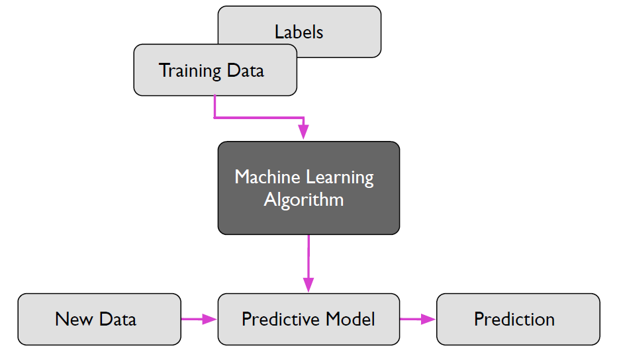
Machine learning
Supervised learning
Process → 2 stages
  Training
    Learning, by an algorithms, of the prediction model
  Testing
    Testing the model by using new test data (unseen data)
Characteristics
  Labeled databased (for learning the model)
Advanced Machine Learning

Slide 26
Machine Learning
Supervised learning
Problems
  Regression
    aim: output prediction for a new input
    Output continuous (real value)
    E.g.: predict the exchange rate EUR/RON based on GPB (gross domestic product = PIB in Romanian) and inflation rate
  Classification
    Aim: classification of a new input
    Discrete output (a label from a predefined set)
    E.g.: tumour detection in MRI images
Advanced Machine Learning

Slide 27
Machine Learning
Supervised learning
  Specific language (vocabulary)
    E.g. predicting the ice-cream consumption based of the daily temperature and financial resources of a person
    example (observation, instance, record)
      One instance of data
      Tabular data → one line
      Attributes of processed data
    feature (property, attribute)
      Know property of an example, used as input data by the ML algorithm (independent variables from the prediction model)
      Tabular data → values from columns (for all data)
      E.g. Temperature, money
Example | Temperature | Money | #ice-cream
Ex1 | 30 | 25 | 2
Ex2 | 5 | 100 | 0
Ex3 | 19 | 55 | 2
Ex4 | 35 | 75 | 4
Advanced Machine Learning

Slide 28
Machine Learning
Supervised learning
  Specific language
    E.g. predicting the ice-cream consumption based of the daily temperature and financial resources of a person
    target (real value/label, ground-truth)
      Property of an example used as dependent variable
      Known for the training data
      Unknown for testing data
      E.g. #ice-cream
    computed value/label
      Property of an example estimated (computed) by the ML algorithm
      NTH: as close as possible to the target value
Example | Temperature | Money | #ice-cream
Ex1 | 30 | 25 | 2
Ex2 | 5 | 100 | 0
Ex3 | 19 | 55 | 2
Ex4 | 35 | 75 | 4
Advanced Machine Learning

Slide 29
Machine learning
Supervised learning
Learning quality
  Definition
    Performance measure
      E.g. accuracy (Acc) = # correct classified examples / # examples
    Possible measures
      Statistical measures
        Prediction error
        Accuracy
        Precision
        Recall
        F1 score
Advanced Machine Learning

Slide 30

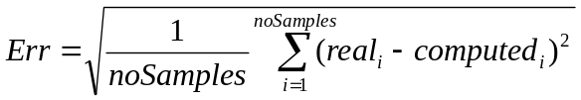
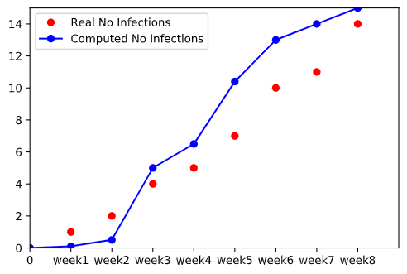
Machine Learning
Supervised learning
Learning quality → Performance measure → Statistical measures
  Prediction error (regression tasks)
    Sum of absolute differences between real and computed outputs
    Sum of squared differences between real and computed outputs
Advanced Machine Learning

Slide 31
Machine learning
Supervised learning
Learning quality → Performance measure → Statistical measures
  Accuracy (classification tasks)
    = # correct classified examples / # examples
    Opposite to Error
    Computed for
      Validation data
      Testing data
    Sometimes
      Text analysis
      Intrusion detection in a large network
      Financial analysis
    Just one class is important (the positive class)
Advanced Machine Learning

Slide 32
Machine learning
Supervised learning
Learning quality → Performance measure → Statistical measures
  Accuracy (classification tasks)
  Precision (P) (classification tasks)
    # of positive examples that are corrected predicted / # of examples predicted as positive
    Probability that a positive example to be relevant
    TP / (TP + FP)
  Recall (R) (classification tasks)
    # of positive examples that are corrected predicted / # of positive examples
    Probability that a positive example to be identified as positive by the ML algorithms
    TP/ (TP +FN)
    Confusion matrix → real results vs. predicted results
  F1 score (classification tasks)
    Combine precicion and recall
    Harmonic mean of precision and recall
    2PR/(P+R)
 |  | Real results
 |  | Positive class | Negative class
Predicted result | Positive class | True positiv (TP) | False positiv (FP)
 | Negative class | False negative (FN) | True negative (TN)
Advanced Machine Learning

Slide 33
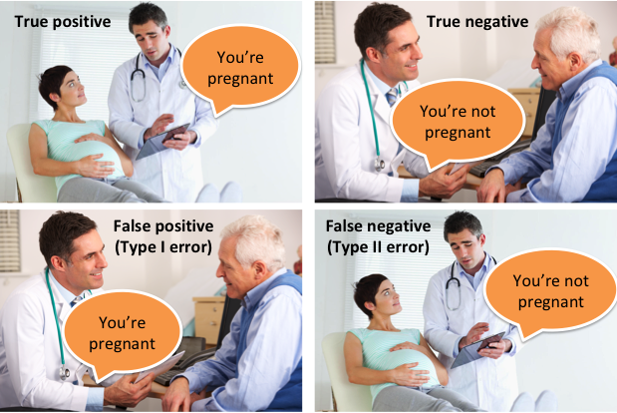
Machine learning
Supervised learning
Learning quality → Performance measure → Statistical measures
  Accuracy
  Precision (P)
    # of positive examples that are corrected predicted / # of examples predicted as positive
    Probability that a positive example to be relevant
    TP / (TP + FP)
  Recall (R)
    # of positive examples that are corrected predicted / # of positive examples
    Probability that a positive example to be identified as positive by the ML algorithms
    TP/ (TP +FN)
    Confusion matrix → real results vs. predicted results
  F1 score
    Combine precicion and recall
    Harmonic mean of precision and recall
    2PR/(P+R)
Advanced Machine Learning

Slide 34
Machine learning
Supervised learning
Learning quality
  Definition
    Performance measure
      E.g. accuracy (Acc) = # correct classified examples / # examples
    Possible measures
      Statistical measures
        Prediction error
        Accuracy
        Precision
        Recall
        F1 score
      Efficiency
        For model building (training)
        For model testing (inference process)
      Robustness
        Noisy data
        Unknown values / features
      Scalability
        Managing large/big data
      Interpretability & explinability
      Governance (fairness, trustworthiness, contestability & accountability)
Advanced Machine Learning

Slide 35
Machine learning
Supervised learning
Learning quality
  Definition - Performance measure
  Evaluation methods
    Disjoint training and testing data sets
      Training data = learning data and validation data
      A large training dataset
    Cross-validation (k-fold CV)
      Training data split in k folds (k-1 folds for learning and one fold forvalidation)
      A small dataset
    Leave-one-out cross-validation
      Similar to k-fold, but k = # data (one example in a fold)
      Just a few data
  Challenges
    overfitting → good performance on training data, weak performance on testing data
    Too complex models
    Black-box models
Advanced Machine Learning

Slide 36

Review
Intelligent systems
  Machine learning
    Concepts
    Problem definitions
    Evaluation
    ML algorithms
  Rule-based systems
  Hybrid systems
Advanced Machine Learning

Slide 37
Next lecture
Intelligent systems
  Machine learning
    Concepts
    Problem definitions
    Evaluation
    ML algorithms
  Rule-based systems
  Hybrid systems
Advanced Machine Learning

