Slide 1
Advanced Machine Learning
RNN & Vision Transformers
Laura Dioşan

Slide 2
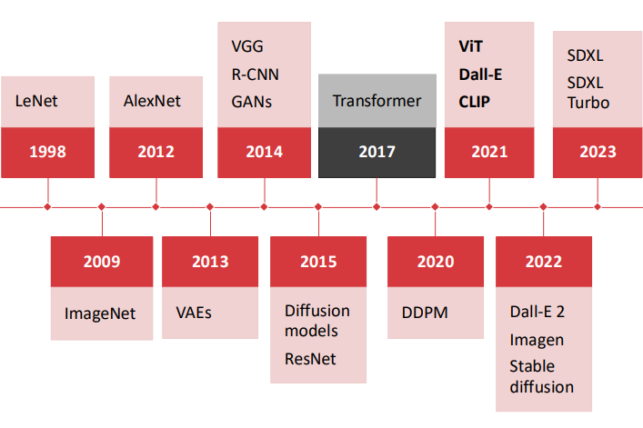
CV & Deep Learning History

Slide 3
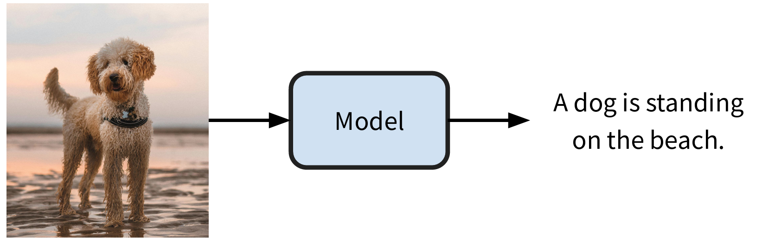
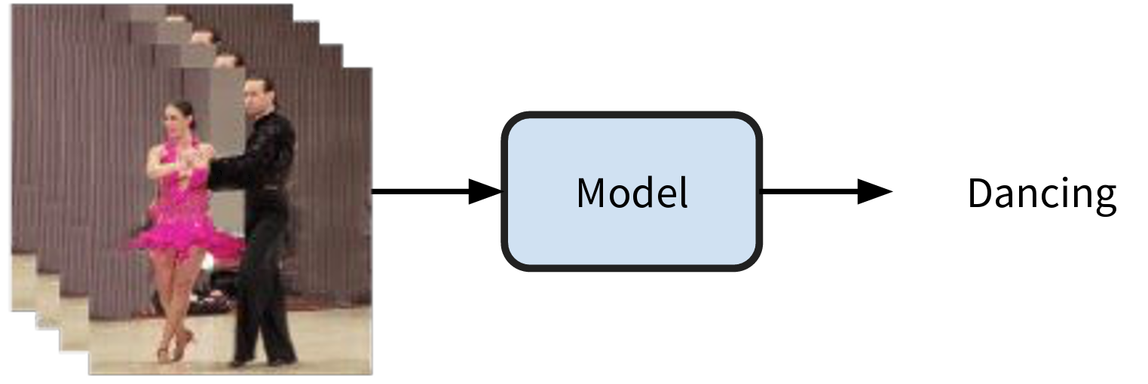
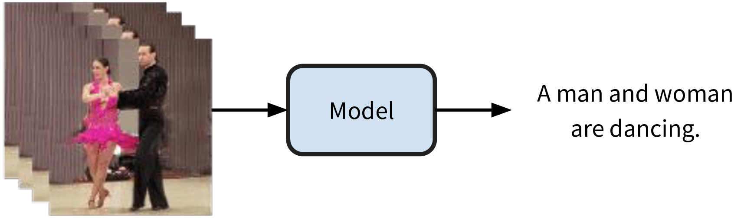
CV & Deep Learning History
Input & output
  Fixed-size – before RNN & transformers
  Variable-size – with RNN & transformers
Examples
  Image captioning → 1-to-n
  Activity/sentiment recognition → n-to-1
  Video captioning → n-to-n

Slide 4
CV & Deep Learning History
New models that can
  Handle variable-length input and output sequences
    How do compute/memory scale with sequence length?
  Preserve temporal structure and order
    Can the model be parallelized across time steps?
    Inductive Bias: How well do models capture temporal/locality structure?
  Capture long-range dependencies
    How do models learn which past inputs are relevant?

Slide 5
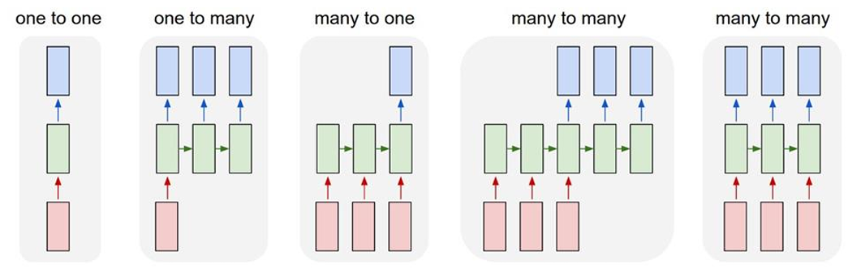
Process sequences
Image captioning
In: image
Out: more words
Action prediction
In: video (frames)
Out: action class
Video captioning
In: video (frames)
Out: more words
Video classification
In: video (frames)
Out: frame labels

Slide 6
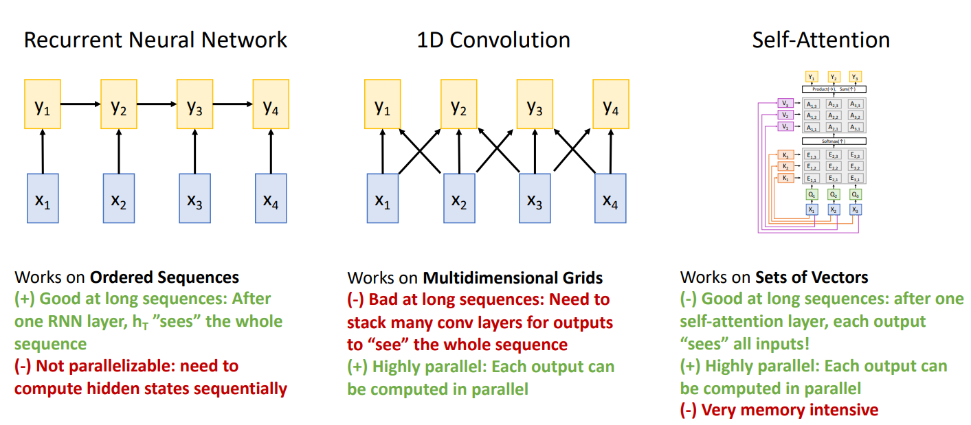
Process an input sequence

Slide 7
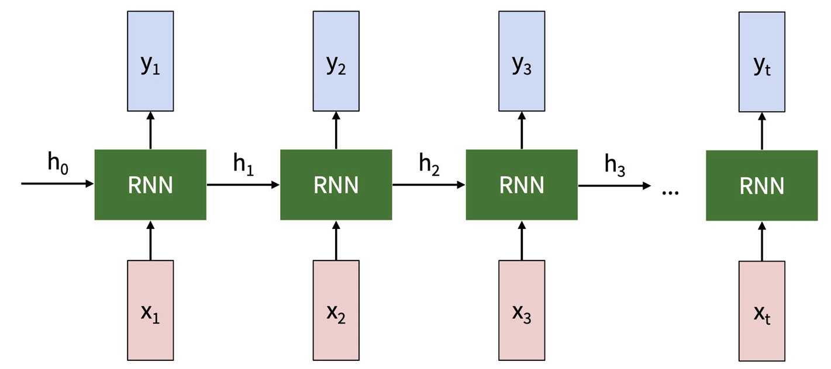
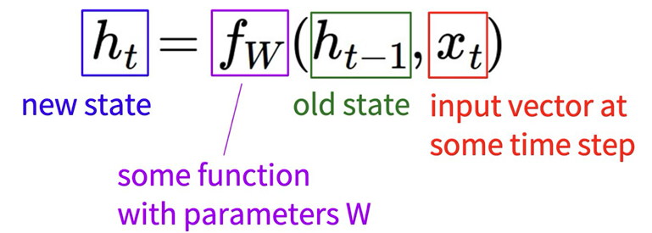
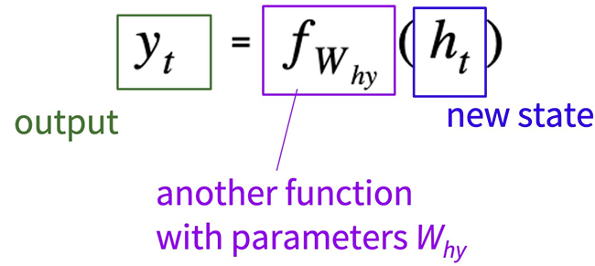
RNNs
Main idea
  RNNs process sequences one step at a time, maintaining an “internal state” (hidden state) that summarizes past inputs & is updated as the sequence is processed
  At every time step, we use the same function / parameters to update the hidden state, which allows us to process input sequences of arbitrary length.
  We use another function / parameters to decode the hidden state into an output, to generate output sequences.

Slide 8

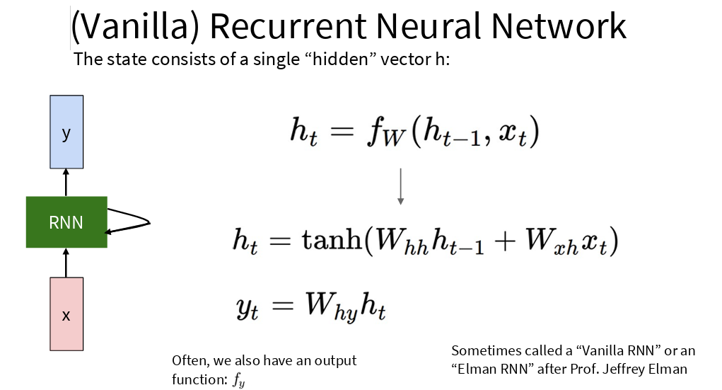
RNNs

Slide 9
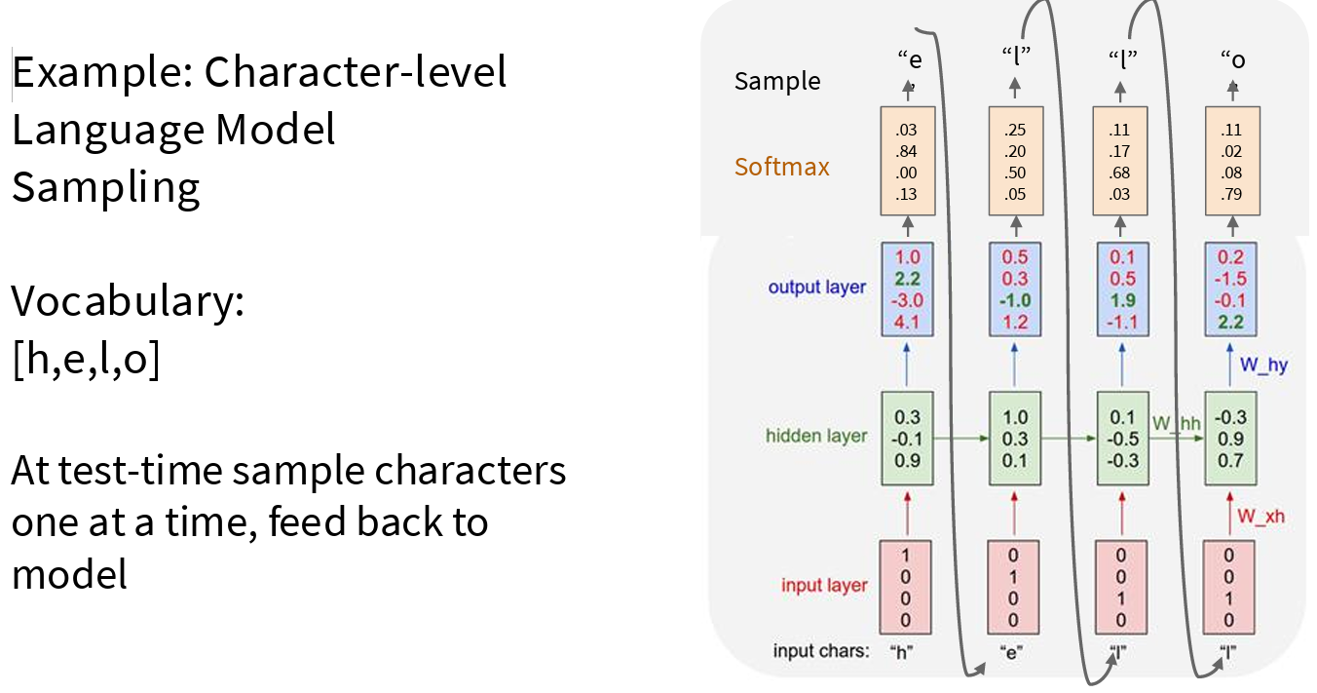
RNNs
See Karpathy example link and details

Slide 10
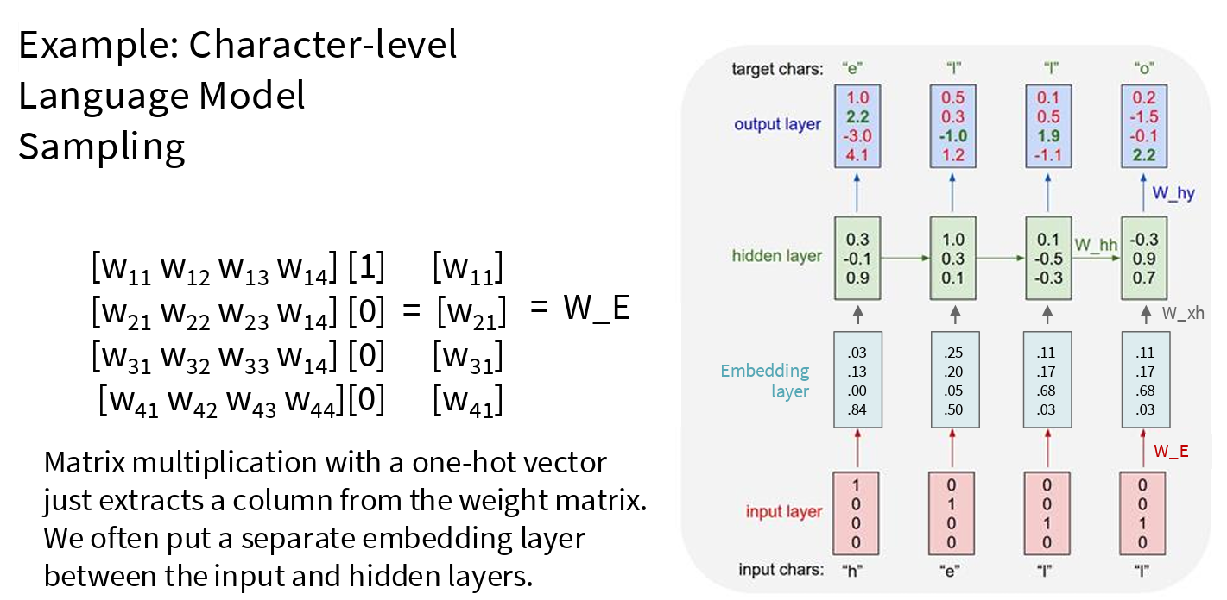
RNNs

Slide 11
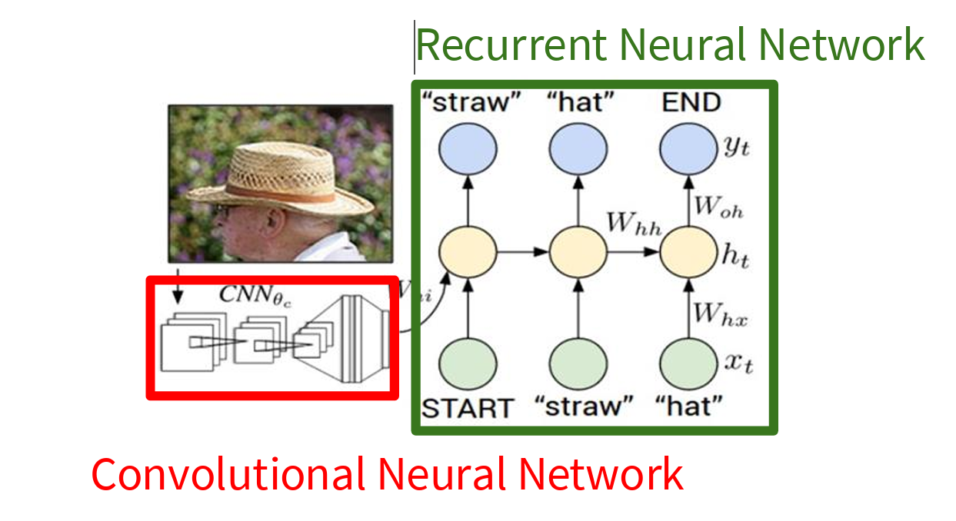
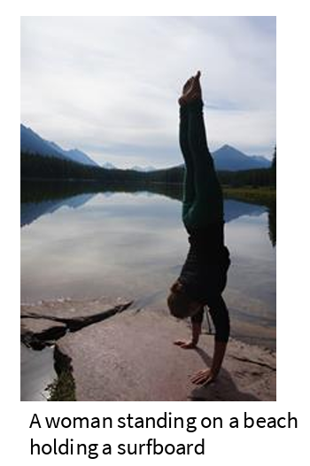
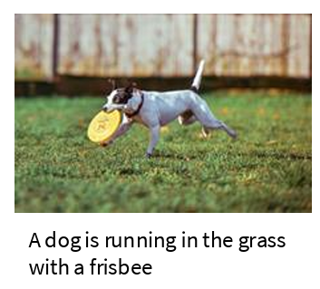
RNNs
Image captioning

Slide 12
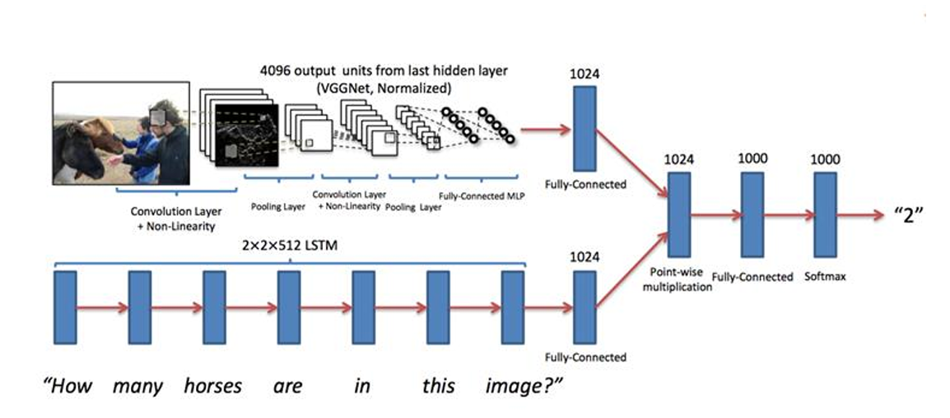
RNNs
Visual question answering

Slide 13
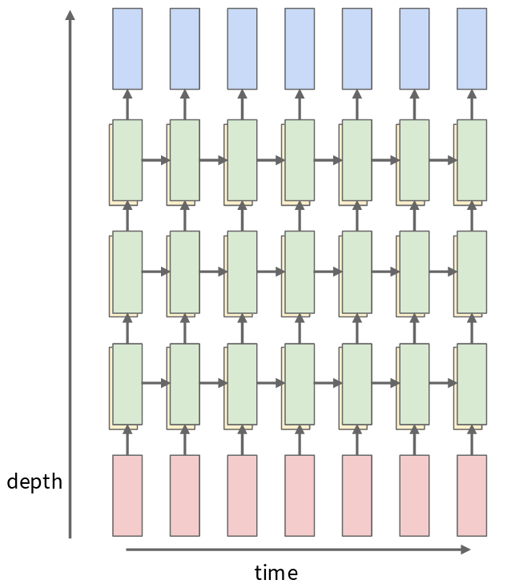
RNNs
Single layer RNN
Multilayer RNN

Slide 14
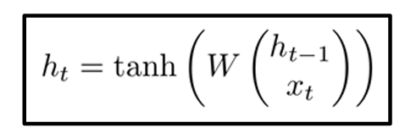
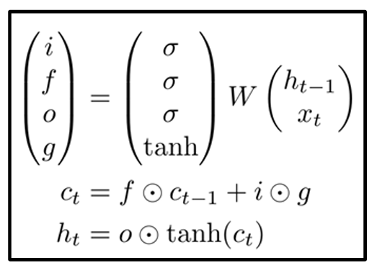
RNNs
Vanila RNN
LSTM
Modern RNNs = state space models

Slide 15
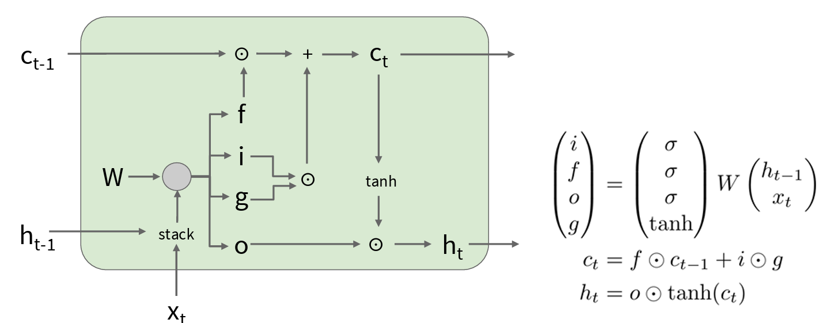
LSTM
Proposed in 1997
  Hochreiter and Schmidhuber, “Long Short Term Memory”, Neural Computation 1997 link
Input gate – whether to write to cell
Forget gate – whether to erase cell
Output gate – how much to reveal cell
Gate gate – how much to write to cell

Slide 16
RNNs
Modern RNNs
  State space models
  E.g. Simplified state space layers for sequence modeling
    Mamba
More details
  https://www.deeplearningbook.org/contents/rnn.html
  https://colah.github.io/posts/2015-08-Understanding-LSTMs/

Slide 17
RNNs
RNN Advantages
  Can process any length of the input (no context length)
  Computation for step t can (in theory) use information from many steps back
  Model size does not increase for longer input
  The same weights are applied on every timestep, so there is symmetry in how inputs are processed.
RNN Disadvantages:
  Recurrent computation is slow
  In practice, difficult to access information from many steps back

Slide 18
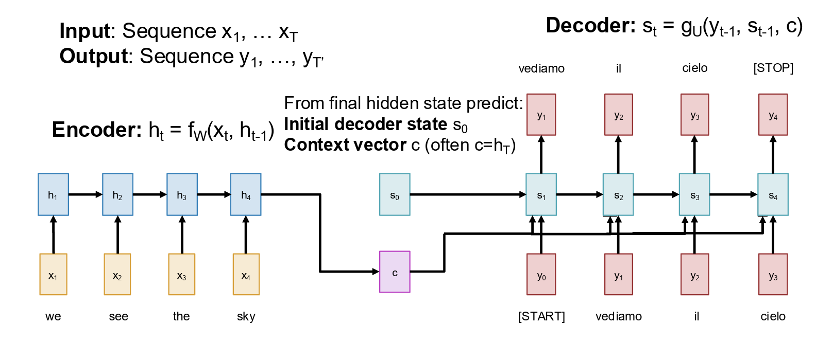
Seq2seq with RNNs
Machine translation
  Input: sequence x1, x2, …, xT
  Output: sequence y1, y2, …, yL (T != L)

Slide 19
Process an input sequence

Slide 20
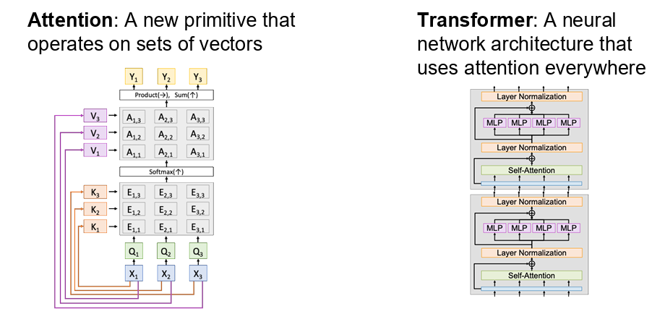
Attention and transformer

Slide 21
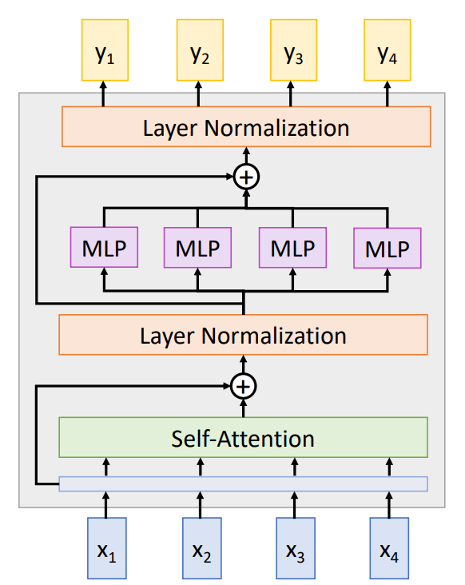
Transformer*
use self-attention to process all elements in parallel and let the model attend to most relevant parts of the input
Transformer blocks have
  Input – vectors (set of vectors)
  Output – vectors (set of vectors)
  Hyper-parameters:
    # blocks
    # heads / block
    width
Vectors communicate each other though [self-]attention mechanism of
  a single head
  more heads
Vaswani, A. (2017). Attention is all you need. Advances in Neural Information Processing Systems link

Slide 22

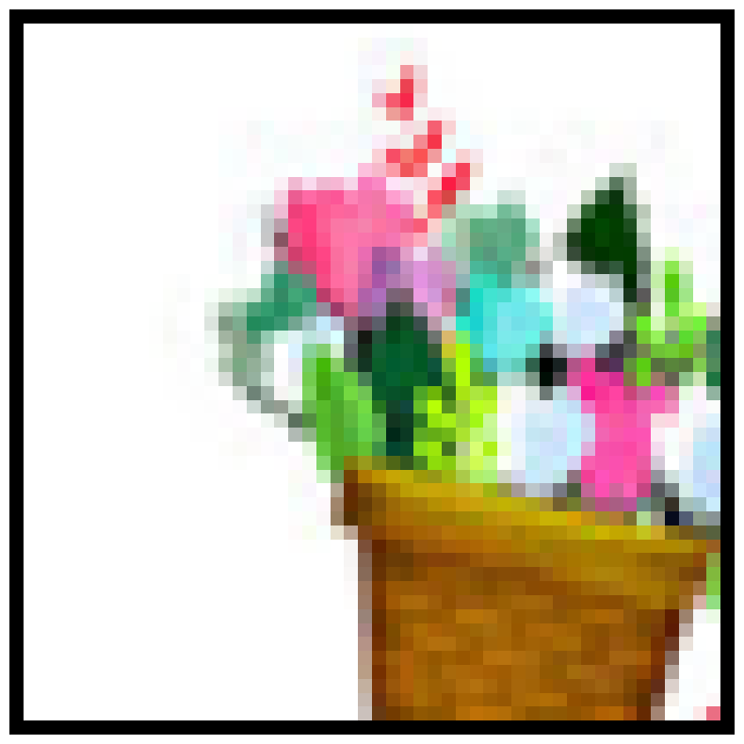
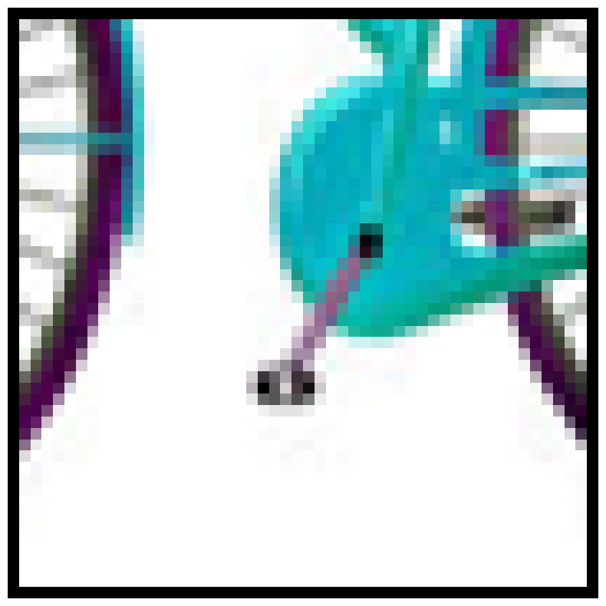
Attention mechanism
Remember – embeddings
  Images / isolated patches:
  Suppose two features:
    caracterul tehnologic
    nivelul de delicatete
Attention
  Context is like an attractor
  for those elements that seems
  to be similar
Nivelul de delicatete
Caracterul tehnologic

Slide 23

Attention mechanism
Path similarity
sim ( , ) = 0.97
sim([4,1], [3,0]) = (4*3+1*0)/(√17*√9)
= 12/(4.12*3)=0.97
sim( , ) = 0.24
sim([4,1],[0,4]) = (4*0+1*4)/(√17*√16)
= 4 / (4.12*4) = 0.24
sim( , ) = 0
sim([3,0],[0,4]) = (3*0+0*4)/(√9*√16)
= 0
Visual word | caracterul tehnologic | nivelul de delicatete
 | 3 | 0
 | 4 | 1
 | 0 | 4
Nivelul de delicatete
Caracterul tehnologic

Slide 24
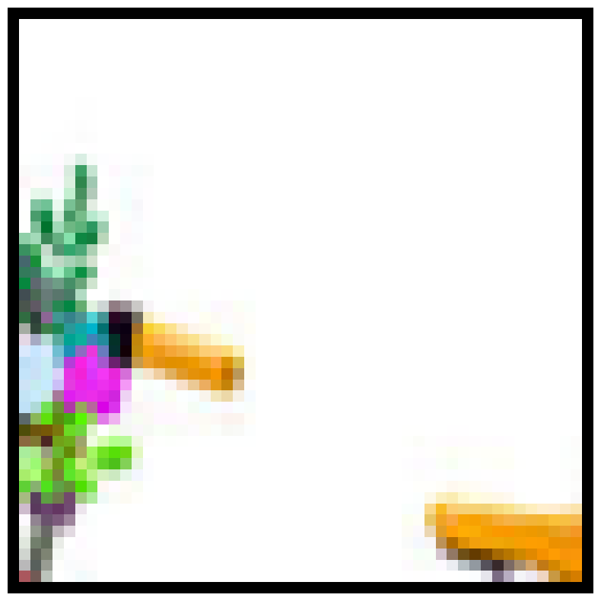
Attention mechanism
Patch context – affinity matrix
sim( , ) = 1 / √2 = 0.7
sim( , ) =
sim([2,2], [0,4]) =
(2*0 + 2*4) / √2 =
8 /√2 = 5.65
Nivelul de delicatete
Caracterul tehnologic

Slide 25
Attention mechanism
Patch context – affinity matrix
sim( , ) = 1 / √2 = 0.7
sim( , ) =
sim([2,2], [0,4]) =
(2*0 + 2*4) / √2 =
8 /√2 = 5.65
 | 0.70 | 5.65
 | 5.65 | 0.70
Nivelul de delicatete
Caracterul tehnologic

Slide 26
Attention mechanism
Patch context – affinity matrix
= 0.7 * +5.65 *
 | 0.70 | 5.65
 | 5.65 | 0.70
Nivelul de delicatete
Caracterul tehnologic

Slide 27
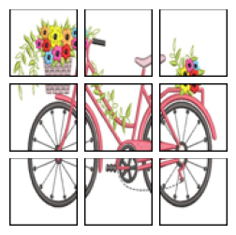
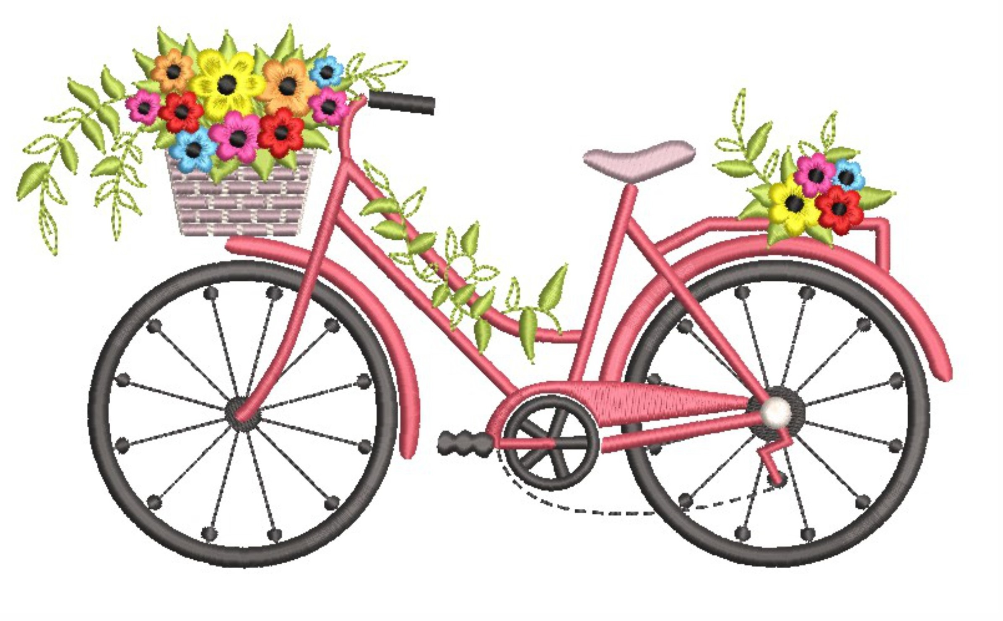

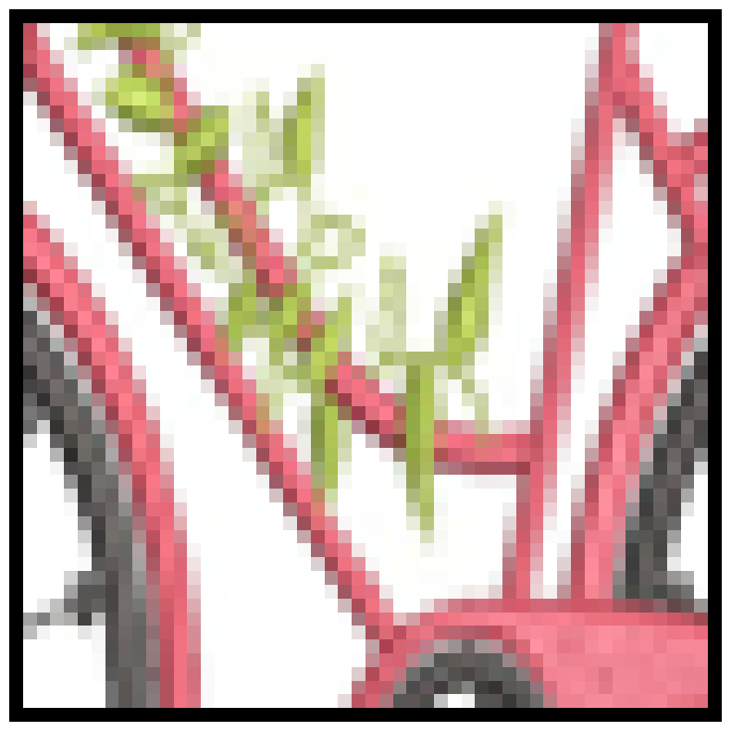
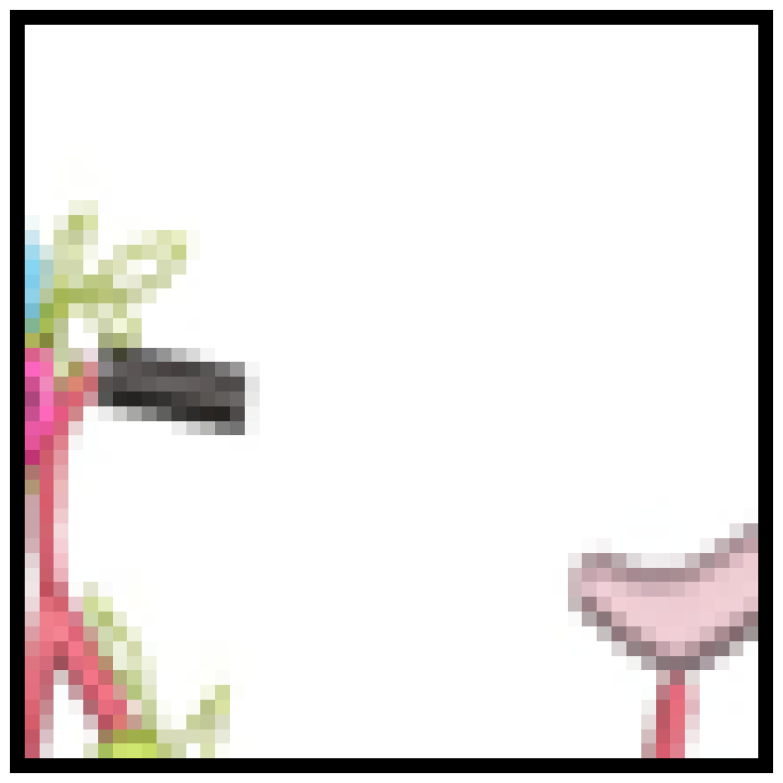
Attention mechanism
Patch context – affinity matrix
= 0.7 * +8.48 *
 | 0.70 | 8.48
 | 8.48 | 0.70
Nivelul de delicatete
Caracterul tehnologic

Slide 28
Attention mechanism
Patch context –affinity matrix
= 0.7 * +5.65 *
= 0.7 * +8.48 *
= ? * + ? *
= ? * + ? *
Normalizare – de care?

Slide 29
Attention mechanism
Patch context – affinity matrix
= 0.7 * + 5.65 *
= 0.7 * + 8.48 *
=0.0070 * + 0.9929 *
=0.0004 * + 0.9958 *
Normalizare – softmax

Slide 30
Attention mechanism
Patch context – affinity matrix
= 0.7 * + 5.65 *
= 0.7 * + 8.48 *
=0.0070 * [2,2] + 0.9929 * [0,4]
=0.0004 *[2,2] + 0.9958 * [3,3]
Nivelul de delicatete
Caracterul tehnologic

Slide 31
Attention mechanism
Patch context – affinity matrix
= 0.7 * + 5.65 *
= 0.7 * + 8.48 *
=[0.1400, 3.9850]
=[0.0008, 3.9840]
Nivelul de delicatete
Caracterul tehnologic

Slide 32


Attention mechanism
Nivelul de delicatete
Caracterul tehnic

Slide 33





Attention mechanism
Nivelul de delicatete
Nivelul de delicatete
Caracterul tehnic
Caracterul tehnic
a) reprez1 b) reprez2

Slide 34






Attention mechanism
Nivelul de delicatete
Nivelul de delicatete
Nivelul de delicatete
Caracterul tehnic
Caracterul tehnic
Caracterul tehnic
a) reprez1 b) reprez2 c) reprez3

Slide 35

Attention mechanism
Nivelul de delicatete
Nivelul de delicatete
Nivelul de delicatete
Caracterul tehnic
Caracterul tehnic
Caracterul tehnic
a) reprez1 b) reprez2 c) reprez3
Q1: reprez1 = f(reprez2) = g(reprez3) ???
Yes!!! Liniar transformation!!!

Slide 36
Attention mechanism
Nivelul de delicatete
Nivelul de delicatete
Nivelul de delicatete
Caracterul tehnic
Caracterul tehnic
Caracterul tehnic
a) reprez1 b) reprez2 c) reprez3
Q2: The best representation (to discriminate between the patch characteristics)?
Reprezentation 1 or 3!

Slide 37



Attention mechanism
Nivelul de delicatete
Sim( , ) =
sim( , )=
Sim( , ) =
sim( , )=
Caracterul tehnic
Transformare
liniară
Nivelul de delicatete
Transformare
liniară
Caracterul tehnic

Slide 38



Attention mechanism
Nivelul de delicatete
sim( , ) =
sim( , )=
sim( , ) = sim( , ) =
sim( , )=
Caracterul tehnic
Transformare
liniară
Nivelul de delicatete
K (Key) =
Transformare
liniară
Caracterul tehnic
Valorile optime - ANN
Q (Queries) =

Slide 39
Attention mechanism
Patch context – affinity matrix
= 0.7 * + 5.65 *
= 0.7 * + 8.48 *
=0.0070 * [2,2] + 0.9929 * [0,4] = [0.1400, 3.9850]
=0.0004 *[2,2] + 0.9958 * [3,3] = [0.0008, 3.9840]
Nivelul de delicatete
Caracterul tehnologic

Slide 40
Attention mechanism
Patch context - affinity matrix
= 0.7 * + 5.65 *
= 0.7 * + 8.48 *
=0.0070 * [2,2] + 0.9929 * [0,4] = [0.1400, 3.9850]
=0.0004 *[2,2] + 0.9958 * [3,3] = [0.0008, 3.9840]
Nivelul de delicatete
Caracterul tehnic

Slide 41


Attention mechanism
Patch context – affinity matrix
= 0.7 * + 5.65 *
= 0.7 * + 8.48 *
=0.0070 * + 0.9929 *
=0.0004 * + 0.9958 *
Nivelul de delicatete
Caracterul tehnic
in spatiul proiectiei definite de K si Q

Slide 42
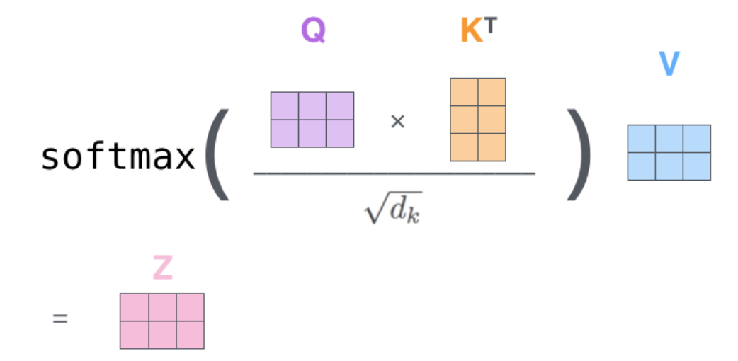
Attention mechanism
Input – x – vectors of dimension (N, #patches x #patches + 1, De)
Output – vectors of dimension (N, #patches x #patches + 1, D)
  Q = x * W^{q}
  K = x * W^{k}
  V = x * W^{v}

Slide 43




Attention mechanism
Input
representation
Queries
Keys
Values
Similarities | q₁ • k₁ | q₁ • k₂ | q₁ • k₃ | q₁ • k₄ | q₁ • k₅ | q₁ • k₆ | q₁ • k₇ | q₁ • k₈ | q₁ • k₉
Scores s= [s1, s2, .., s9] | q₁ • k₁ / √ D | q₁ • k₂ / √ D | q₁ • k₃ / √ D | q₁ • k₄ / √ D | q₁ • k₅ / √ D | q₁ • k₆ / √ D | q₁ • k₇ / √ D | q₁ • k₈ / √ D | q₁ • k₉ / √ D
w = Softmax(s)
Weightening the values | z₁=w₁*v₁+w₂*v₂+…+w₉*v₉

Slide 44
Attention mechanism
DB interrogations
  Intput:
    A set of records { (key_{i}, value_{i}), i =1,2, …, m}
    A query q
  Output
    value_{j} such that q is similar to key_{j}
  Exemple - text
    {(Apostol, Mihai), (Baciu, Alina), (Cretu, Gabriel), (Pop, Ionica),(Popa, Madalina), (Popescu, Cosmina)}
    Q = “Pop”
    Answer:
      Ionica – perfect match (e.g. Hamming Distance)
      Ionica, Madalina, Cosmina – partial match (e.g. Levenshtein Distance), top-k answers
Q=Pop | Apostol | Baciu | Cretu | Pop | Popa | Popescu
Hamming | 6 | 5 | 5 | 0 | 4 | 7
Levenshtein | 6 | 5 | 5 | 0 | 1 | 4

Slide 45
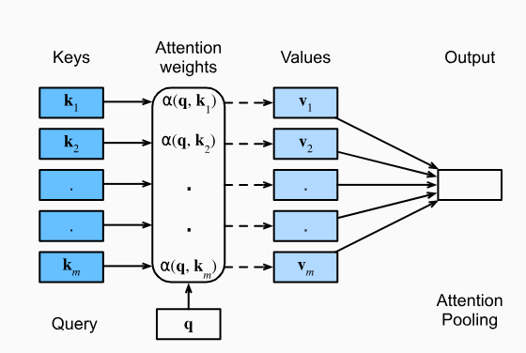
Attention mechanism
DB interrogations
  Exemple - text
    DB = {(Apostol, Mihai), (Baciu, Alina), (Cretu, Gabriel), (Pop, Ionica),(Popa, Madalina), (Popescu, Cosmina)}
    Q = “Pop”
    Answer:
      {Ionica} – perfect match (e.g. Hamming Distance)
      {Ionica, Madalina, Cosmina} – partial match (e.g. Levenshtein Distance), top-k raspunsuri
  Attention mechanism
    Attention(q,DB) = Σ α(q,key_{i})*value_{i},
    α(q,key_{i}) – attention weights
      If only one coefficient is 1 (others are 0) → classical DB interrogations
      If all coefficients are α = 1/m → Average Pooling
      For having weights
        α’(q,key_{i}) = α(q,key_{i}) / Σ α(q,key_{j})
        α’(q,key_{i}) = exp(α(q,key_{i})) / Σ exp(α(q,key_{j}))
Q=Pop | Apostol | Baciu | Cretu | Pop | Popa | Popescu
Hamming | 6 | 5 | 5 | 0 | 4 | 7
Levenshtein | 6 | 5 | 5 | 0 | 1 | 4

Slide 46
Attention mechanism
Weights
Weigths = [0.90, 0.70, 0.80, 0.50, 0.20, 0.60, 0.15, 0.10, 0.20]
Weigths_softmax = [0.16, 0.13, 0.14, 0.11, 0.08, 0.12, 0.078, 0.074, 0.08]
Keys
Computing similarities between patch projections!!!
Query

Slide 47
Attention mechanism
Weights
Keys
Computing similarities between patch projections!!!
Query

Slide 48


Attention mechanism
Weights
1 x 9
Keys
9 x D
All keys
x
1 query
1 x D
Query

Slide 49
Attention mechanism
Weights
1 x 9
Keys
9 x D
All keys
x
1 query
1 x D
Query

Slide 50
Attention mechanism
Weights
1 x 9
Keys
9 x D
All keys
x
1 query
1 x D
Query

Slide 51

Attention mechanism
Q x K
softmax =
√ D
Un fel de heap map al atentiei!
Suma pe fiecare linie e 1!!!
[9 x 9]
…

Slide 52
Attention mechanism
Q x K
V^{T}x softmax =( V^{T} )x
√ D
=
T
…
D x 9
Fiecare coloana e un token re-ponderat!!!

Slide 53
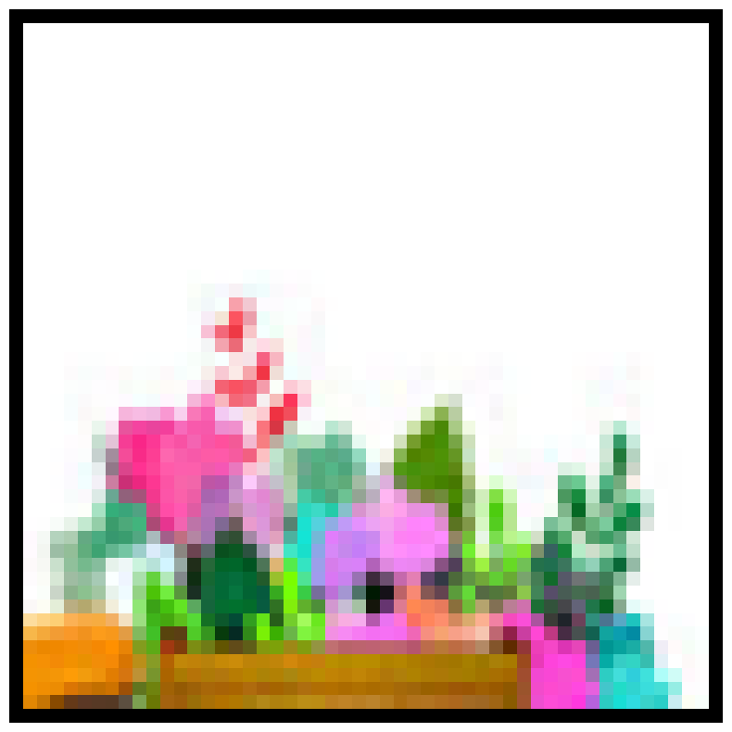
Attention mechanism
Suma valorilor re-ponderate
( V^{T} ) x = x + x + x + … =

Slide 54
Attention types
Simple attention
  Each output is a linear combination of all values, weighted by attention weights
Cross-attention
  Each query produces one output, which is a mix of information in the data vectors
Self-attention (intr-attention)
  Each input produces one output, which is a mix of information from all inputs
  works on sets of vectors → positional embeddings (e.g. RoPE)
Masked self-attention
  Don’t let vectors “look ahead” in the sequence
Multi-head self-attention
  Run H copies of SA in parallel
  Flash attention

Slide 55
Attention types
Soft attention (q=1) – bars
  A single query attends over the source (encoder) tokens.
  Soft attention = cross-attention (query from one context → attends to another context).
Self attention (q=n) — matrix
  Every token attends to every other token.
  We call the attention function with the same tensor for queries, keys, and values.
  Self-attention = intra-attention (tokens attend to each other within the same context)
Cross-attention – matrix q x n
  Queries from one sequence attend to keys/values from another sequence (e.g., decoder → encoder).
  Cross-attention = interaction between two contexts
Local (windowed) self-attention — banded matrix
  Restricts attention to a local neighborhood around each token (± w positions). Instead of attending to all tokens (as in full self-attention), each token only considers nearby tokens, creating a band-diagonal attention matrix.
Hard attention — greedy vs. Gumbel-Softmax
  Discrete selection vs. differentiable approximation.

Slide 56
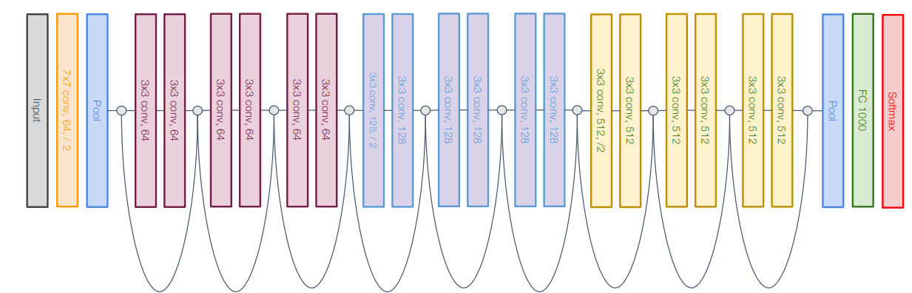
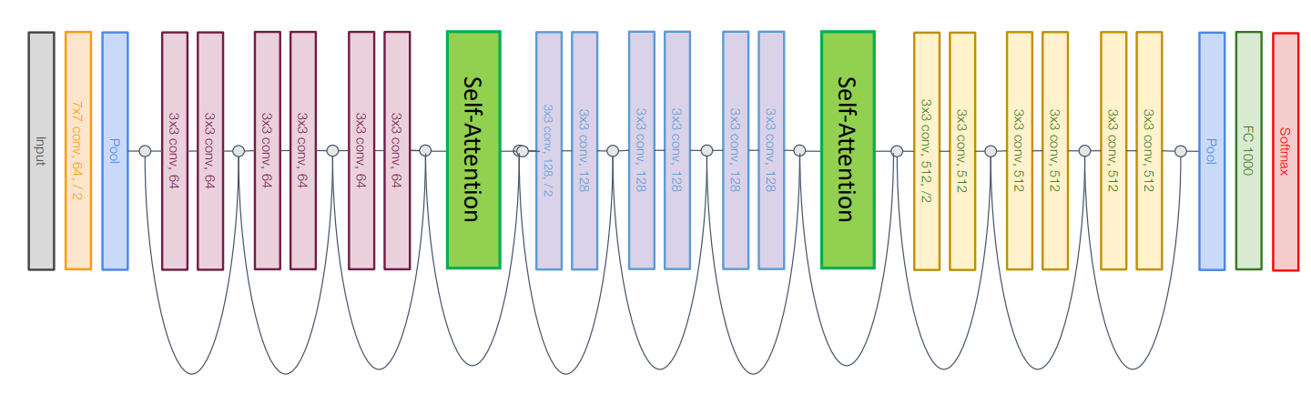
Attention integration into an ANN for image processing
V1: CNN integration – e.g. ResNet¹
  How?
    Additional layers
  +
    Simple integration
  -
    The model (architecture) is dominated by the convolutions
Wang, X., Girshick, R., Gupta, A., & He, K. (2018). Non-local neural networks. In Proceedings of the IEEE conference on computer vision and pattern recognition (pp. 7794-7803) link

Slide 57
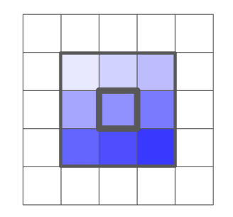
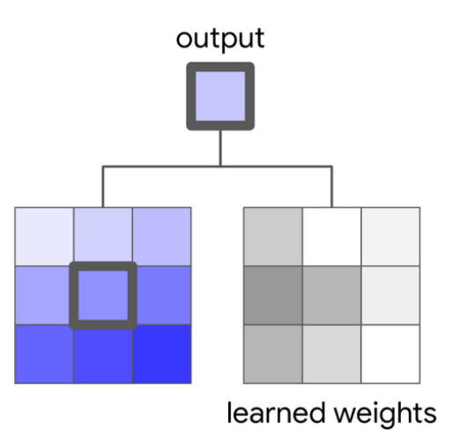
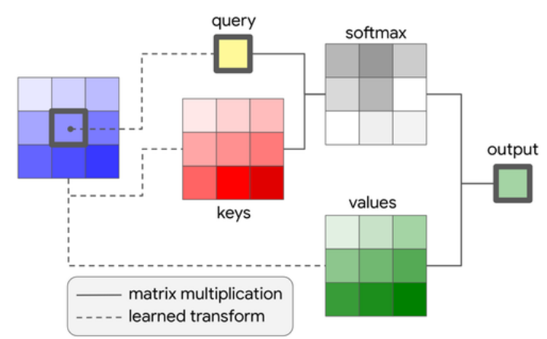
Attention integration into an ANN for image processing
V2: replace the classic convolution with a local attention (“local relation”)
  How?
    Convolution = dot product (filter, patch)
    Local attention
      Center of patch → query (vector with D elements)
      Each patch element →
        Keys (vector R x R x D)
        Values (vector R x R x C’)
      Output is computed based on the attention mechanism
  +
    Small #params (Hu et al.: ResNet-50 has 25.5x10⁶ params, LR-Net-50 has 23.3x10⁶ params)
  -
    Complex implementation (tricky details)
    Just a small improvement over ResNet
Hu, H., Zhang, Z., Xie, Z., & Lin, S. (2019). Local relation networks for image recognition. In Proceedings of the IEEE/CVF international conference on computer vision (pp. 3464-3473) link
Ramachandran, P., Parmar, N., Vaswani, A., Bello, I., Levskaya, A., & Shlens, J. (2019). Stand-alone self-attention in vision models. Advances in neural information processing systems, 32 link

Slide 58
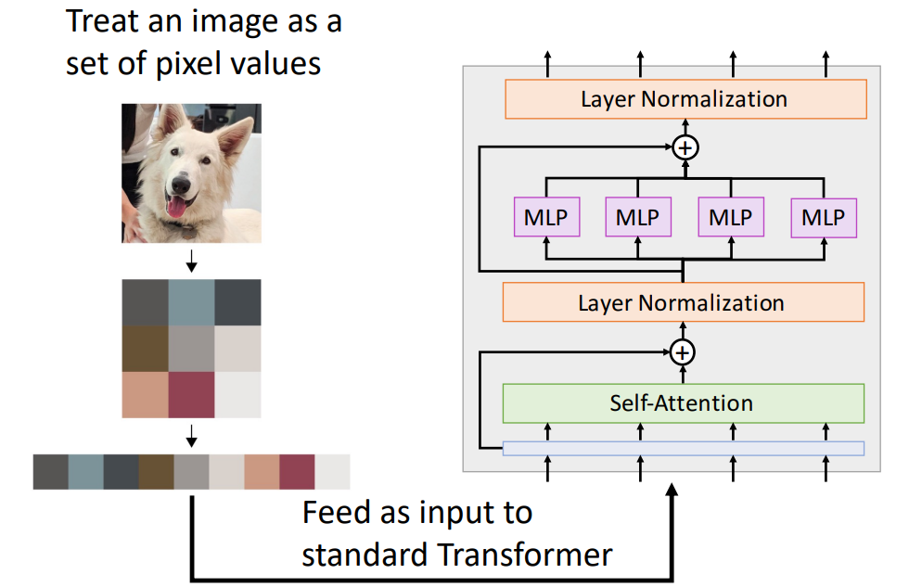
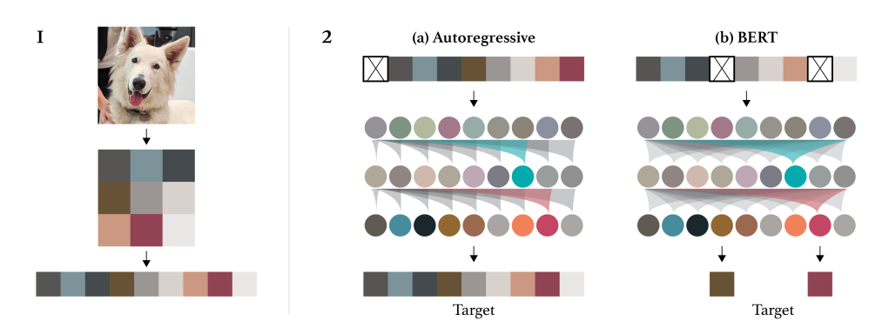
Attention integration into an ANN for image processing
V3: transformer applied on pixels
  How?
    Input – the image (resized and flatten)
+
  Simple (conceptual)
-
  An n x n image requires n⁴ elements in the attention matrix → a lot of memory
Chen, M., Radford, A., Child, R., Wu, J., Jun, H., Luan, D., & Sutskever, I. (2020, November). Generative pretraining from pixels. In International conference on machine learning (pp. 1691-1703). PMLR link

Slide 59
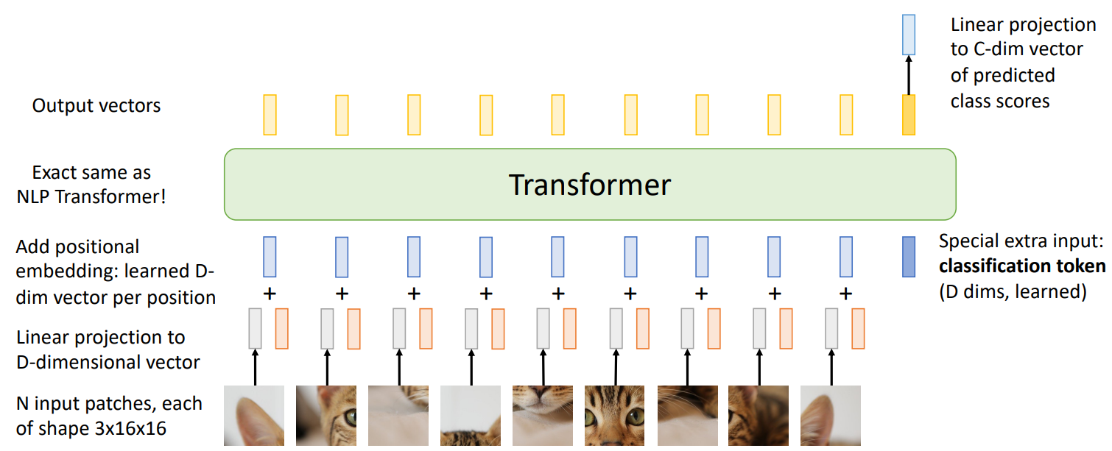
Attention integration into an ANN for image processing
V4: patch-based transformer
  How?
  +
    Reduced # convolutions
  -
    Large # params
    Large training datasets
Dosovitskiy, A. (2020). An image is worth 16x16 words: Transformers for image recognition at scale. arXiv preprint arXiv:2010.11929. link

Slide 60
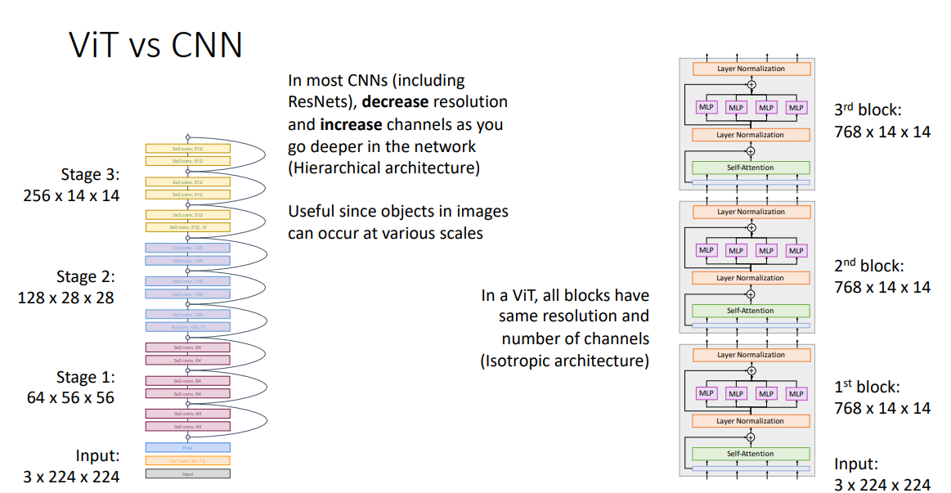
How to improve the performance of a ViT?

Slide 61
How to improve the performance of a ViT?
Input:
A matrix of n x m values (e.g. a grayscale image of n x m pixels)
Layers:
1 convolution with F filters of k x k (stride 1)
  Output: a matrix of (n -1) x (m – 2) x F values
    #operations: [(n – 2) * (m – 2) * (k * k)] * F
    #parameters: (k * k + 1) * F
1 pooling of p x p
  Output: a matrix of (n / p) x (m / p) values
    #operations: (n / p) * (m / p) * (p * p – 1)
    #parameters: 0
1 fully connected layer
  #input neurons = n * m
  #output neurons = c
    #operations: (n * m) * c
    #parameters: (n * m) * c + c
Transformer
  Patching (p x p patches => L = n * m / (p * p) patches)) and Liniar transformation into a space of dimension d
    Output: a matrix L x d
      #operations: L * [(p * p) * d]
      #parameters: [L * (p * p)] * d
  Attention for an input of L x d values
    Output: a matrix of L x d_{model} values
      #operations:
        Projections (Q, K, V): 3 * L * d * d_{model}
        QK: L *L * d_{model}
        Softmax: L * L
        Weights: L * L * d_{model}
      #parameters: 3 * (d * d_{model} * d_{model})
  FeedForward layer:
    Input: a matrix of L x d_{model} values
    Output: a matrix of L x out values
      #operations: (L * L) * (d_{model} * d_{out} + d_{out})
      #parameters: d_{model} * d_{out} + d_{out}

Slide 62
How to improve the performance of a ViT?
Regularisation
  Weight decay, stochastic depth, dropout
Data augmentation
  MixUp, RandAugment
Steiner, A., Kolesnikov, A., Zhai, X., Wightman, R., Uszkoreit, J., & Beyer, L. (2021). How to train your vit? data, augmentation, and regularization in vision transformers. arXiv preprint arXiv:2106.10270. link

Slide 63
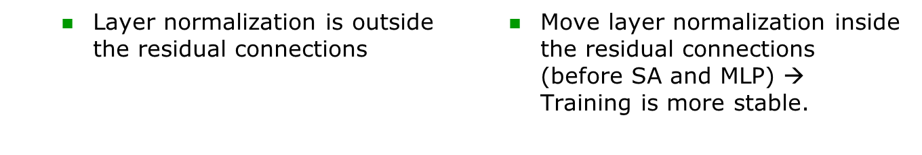
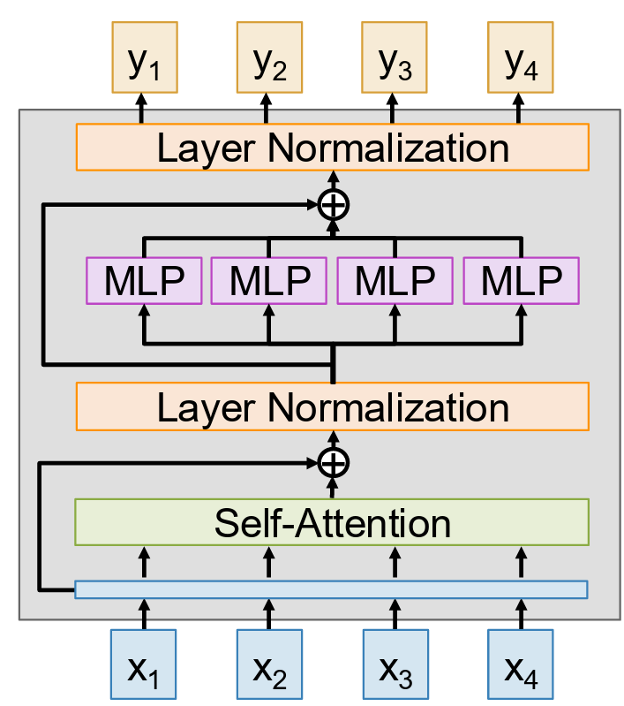
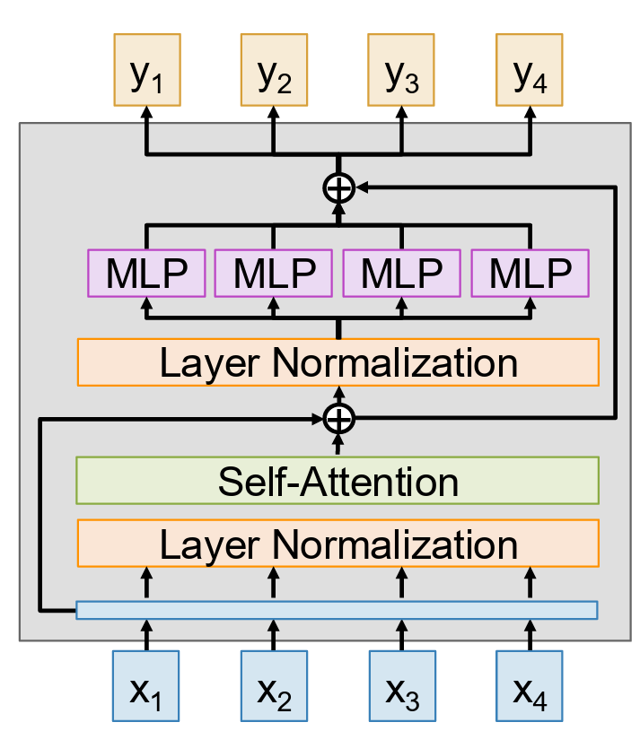
Tweaking Transformers
Pre-norm transformer - link

Slide 64
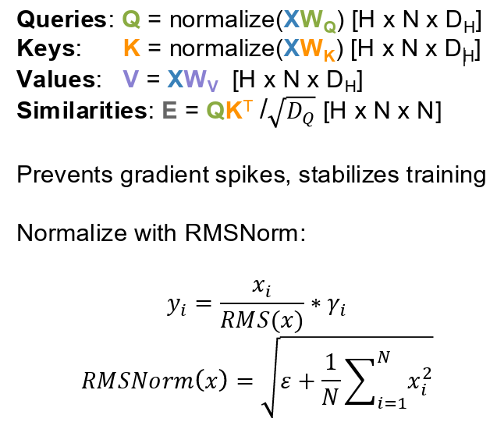
Tweaking Transformers
QK-norm – link, link
  A new version of layer normalization
  Normalize queries and keys before computing attention similarities

Slide 65
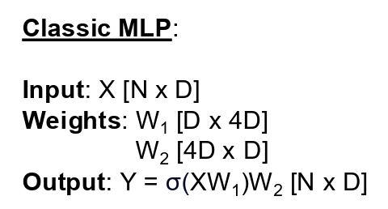
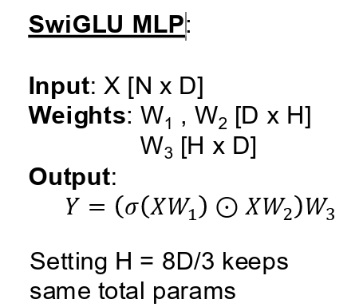
Tweaking Transformers
SwiGLU MLP – link
  GLU = gated linear units

Slide 66
Tweaking Transformers
Mixture of Experts (MoE) – link
  https://newsletter.maartengrootendorst.com/p/a-visual-guide-to-mixture-of-experts

Slide 67
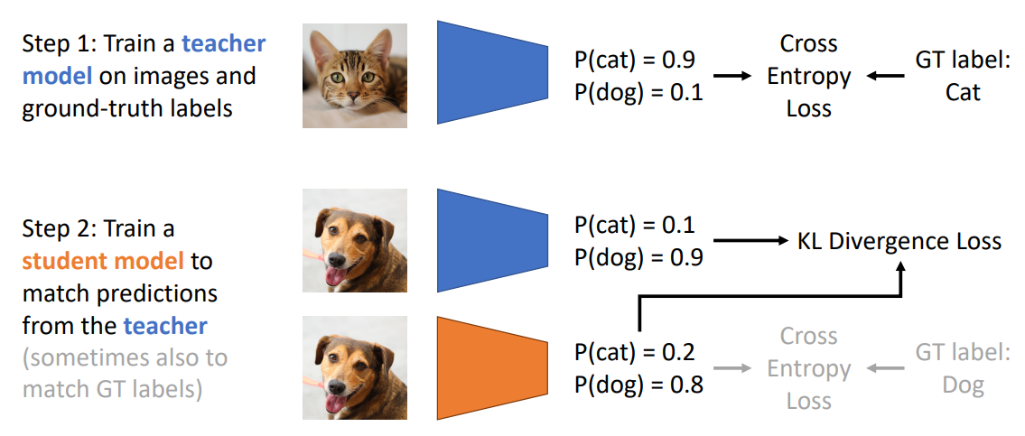
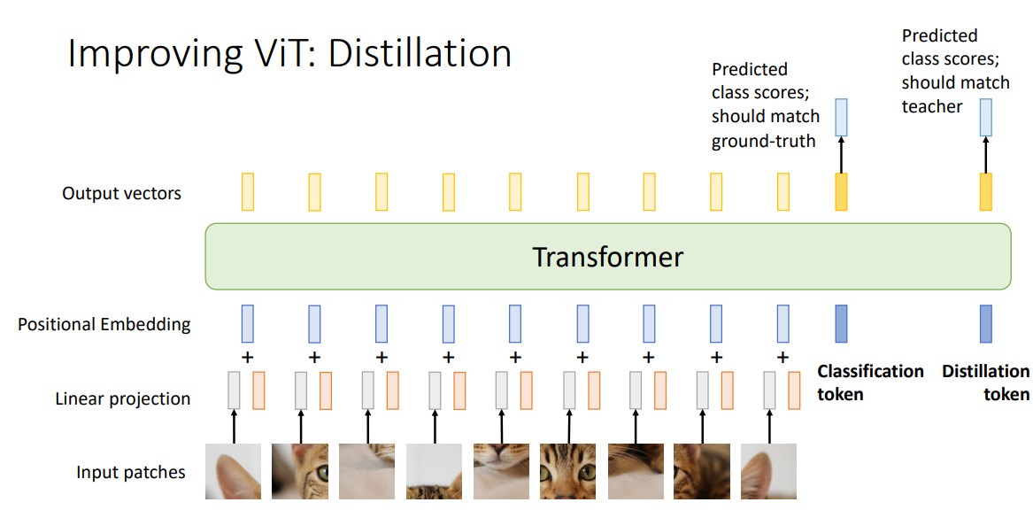

How to improve the performance of a ViT?
CNN
Distillation
Hinton, G. (2015). Distilling the Knowledge in a Neural Network. arXiv preprint arXiv:1503.02531 link
Touvron, H., Cord, M., Douze, M., Massa, F., Sablayrolles, A., & Jégou, H. (2021, July). Training data-efficient image transformers & distillation through attention. In International conference on machine learning (pp. 10347-10357). PMLR link

Slide 68
How to improve the performance of a ViT?

Slide 69

RNNs vs Tranformers

Slide 70
More details
https://github.com/google-research/vision_transformer
https://huggingface.co/docs/transformers/model_doc/vit

