Slide 1
Intelligent modelling
Laura Dioşan
Image detection

Slide 2
Automatic image processing
Image classification
  Does an image contain object X? [yes/no]
Object detection and image segmentation
  Does an image contain object X? [yes/no]
  Where is the object X? ➔ Location of the object
    Pixel-based granularity ➔ semantic segmentation
    Object-based granularity ➔ object detection
      Single object
      Multiple objects ➔ instance segmentation
  Which object does this image contain? [where?]
  Aprox. localisation (Bounding box)
  Accurate localisation (contour) → Segmentation
Object detection

Slide 3
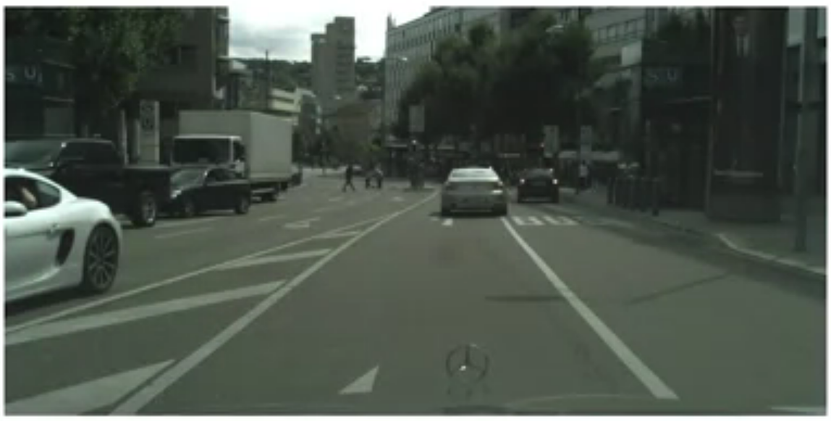
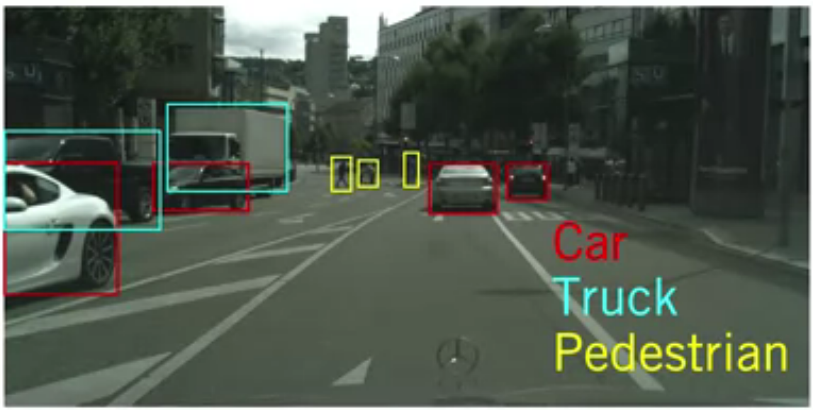
Object detection
  Aim
    Estimate the location and the class of all objects
    A regression problem and a classification problem
  Challenges
    Extent of objects is not fully observed
      Occlusion
      Truncation
    Scale
    Illumination changes
  Metrics
    Intersection over union (IoU)
    Average precision
  Methods
    Traditional (sliding window)
    Modern (neural networks)
Object detection

Slide 4
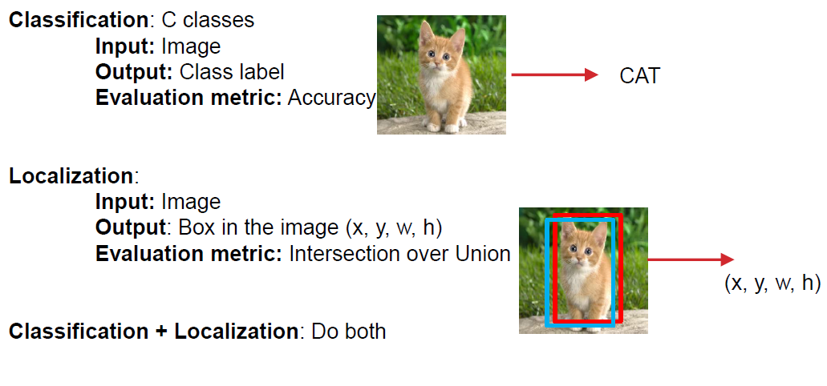
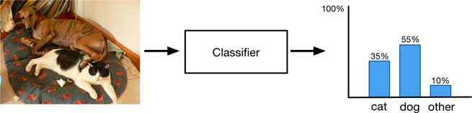
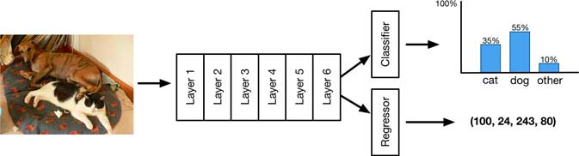
Object detection
Aim
  Identify which object appears and where the object appears in an image
Tasks:
  Localisation
    Find a fixed number of objects (one or many)
    L2 regression from CNN features to box coordinates
    Much simpler than detection
    Overfeat: Regression + efficient sliding window with FC -> conv conversion
    Deeper networks do better
  Detection
    Find a variable number of objects by classifying image regions
    Before CNNs: dense multiscale sliding window (HoG, DPM)
    Avoid dense sliding window with region proposals
    R-CNN: Selective Search + CNN classification / regression
    Fast R-CNN: Swap order of convolutions and region extraction
    Faster R-CNN: Compute region proposals within the network
    Deeper networks do better
Object detection

Slide 5
Object detection
Databases
  Pascal VOC http://host.robots.ox.ac.uk/pascal/VOC/
    2005 – image detection task (4 classes, 1578 images, 2209 objects)
    2006 – image detection task (10 classes, 2618 images, 4754 objects)
    …
    2012 – image detection task (20 classes, 11 530 images, 6929 objects)
  ImageNet http://www.image-net.org/
    2010 – image classification task only (1000
    classes, 14,197,122 images, )
    2011 – classification and localisation task
    2012 = 2011 & Fine-grained classification
    2013 – detection task (200 classes)
    2014, 2015, 2016, 2017 – detection task (200 classes)
  COCO http://cocodataset.org/#home
    2015 – detection task (more than 200,000 images and 80 object categories)
    2019 – detection task (more than 200,000 images and 80 object categories)
 |  | PASCAL VOC 2012 | ILSVRC 2013
Number of object classes |  | 20 | 200
Training | Num images | 5717 | 395909
 | Num objects | 13609 | 345854
Validation | Num images | 5823 | 20121
 | Num objects | 13841 | 55502
Testing | Num images | 10991 | 40152
 | Num objects | --- | ---
Object detection

Slide 6
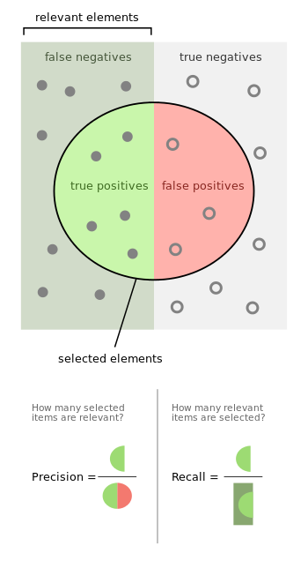
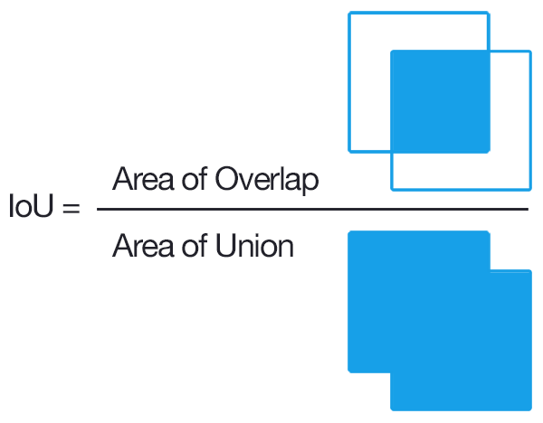
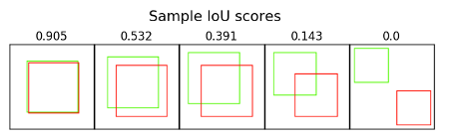
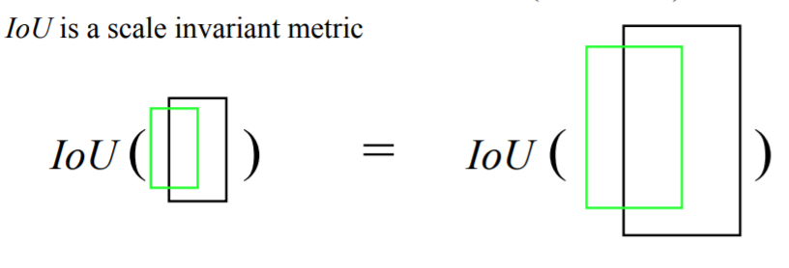
Object detection
  Remember:
  Classification → Problem specification
  Input: image
  Output: class
    Label
    Class probability
  Evaluation metric: accuracy, precision, recall
Localisation → Problem specification
  Input: image
  Output: bounding box’s
    Class probability
    coordinates
      (x_{corner}, y_{corner}, w, h)
      (x_{corner1}, y_{corner1}, x_{corner2}, y_{corner2})
      (x_{center}, y_{center}, w, h)
    Confidence score
  Evaluation metric¹:
    L1-distance, L2-distance – scale variant
    intersection over union (IoU) – scale invariant
    Generalised IoU (see https://giou.stanford.edu/GIoU.pdf)
    average precision
Object detection

Slide 7
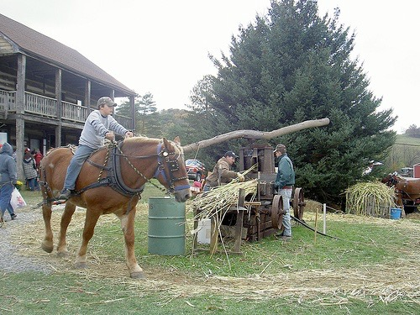
Object detection
Localisation → Evaluation
0.2
0.9
0.6
‘person’ detector predictions
ground truth ‘person’ boxes
Object detection

Slide 8
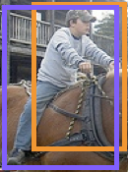


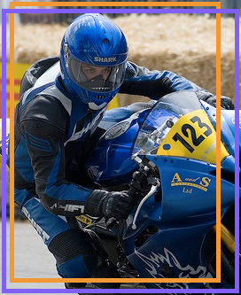


Object detection
Localisation → Evaluation
  Sort by confidence
0.9
0.8
0.6
0.5
0.2
0.1
...
...
...
...
...
✓
X
✓
✓
X
X
true
positive
(high overlap)
false
positive
(no overlap,
low overlap, or
duplicate)
Object detection
Notes:
Let’s define the problem a bit more so we’re all on the same page.

Slide 9

Object detection
Localisation → Evaluation
  Sort by confidence
  Precision = TP@t / (TP@t + FP@t)
  Recall = TP@t / #GroundTruthObjects
0.9
0.8
0.6
0.5
0.2
0.1
...
...
...
...
...
✓
X
✓
✓
X
X
✓
✓ +
X
Object detection
Notes:
Let’s define the problem a bit more so we’re all on the same page.

Slide 10
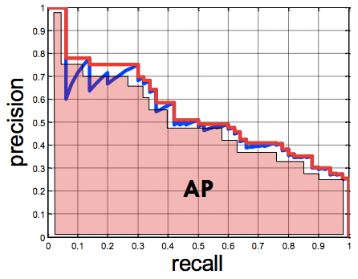
Object detection
Localisation → Evaluation
0.9
0.8
0.6
0.5
0.2
0.1
...
...
...
...
...
✓
X
✓
✓
X
X
Average Precision (AP)
0% is worst
100% is best
mean AP over classes (mAP)
Object detection
Notes:
Let’s define the problem a bit more so we’re all on the same page.

Slide 11
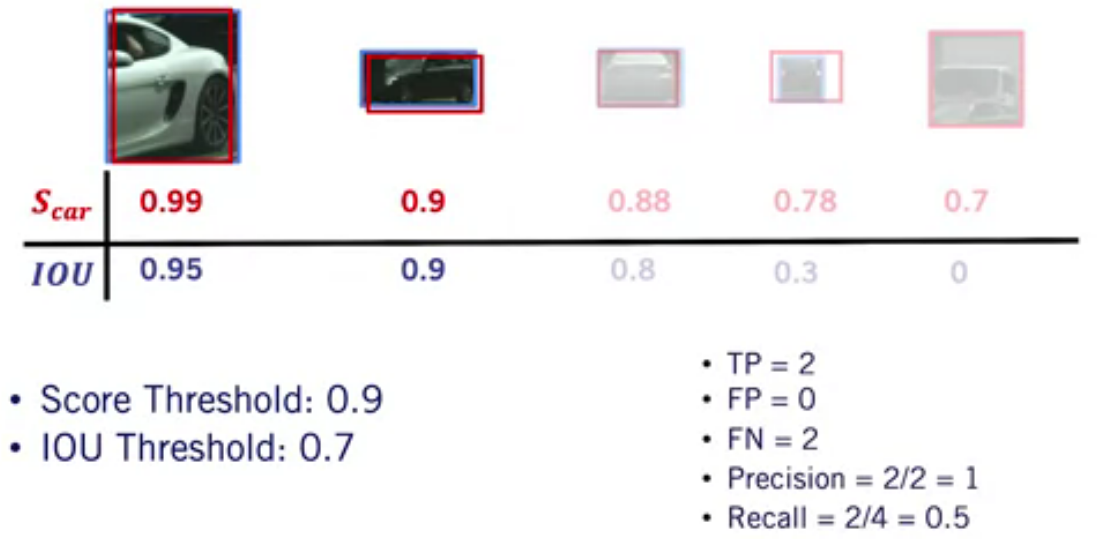
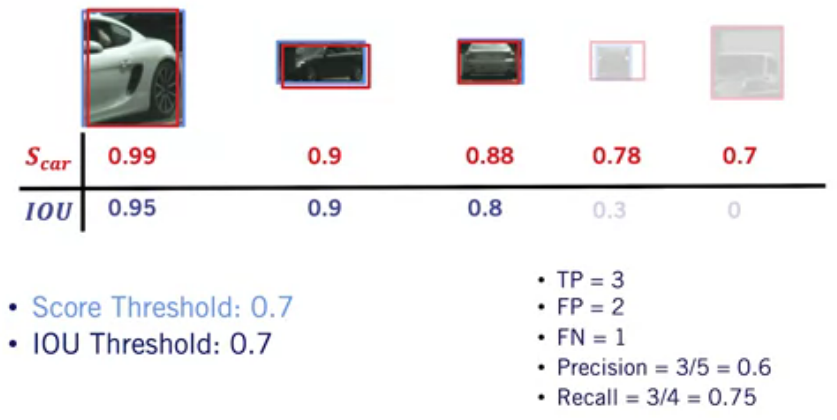
Object detection
Detection → Evaluation
  Intersection over union (IoU)
  Average precision
    TP: object class score > score threshold and IoU > IoU threshold
    FP: object class score > score threshold and IoU < IoU threshold
    FN: number of GT objects not detected by the algorithm
    Precision = TP / (TP + FP)
    Recall = TP / (TP + FN)
    Precision-Recall curve (PR-Curve) – for different classification score thresholds
    Average Precision (AP) – area under PR-Curve for a single class (approximation based on min 10 points)
Object detection

Slide 12
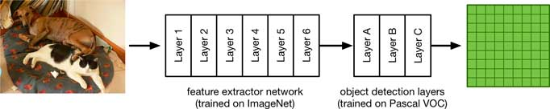
Object detection
Algorithms
  Classification and localisation
    Localisation as regression problem (predict bb’s coordinates)
    Localisation as classification (sliding window and classify each window)
  Object detection → as classification
    Many positions and scales
      HOG +SVM
      DPM
    2-stages detectors
      A model proposes a set of regions
        Selective search, bing, superpixels, etc.
        Regional proposal network
      A classifier processes the proposed regions
        R-CNN
        SPP net
        Fast R-CNN
        Faster R-CNN
        …
    1-stage detectors ➔ Run classifier over a dense sampling of possible locations
      assigning each bounding box detector to a specific position in the image
      YOLO (v1, v2, v3), SSD, RetinaNet
Object detection

Slide 13
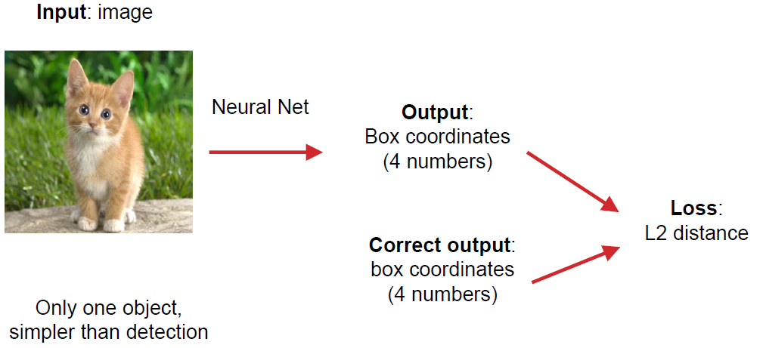
Classification and localisation
Localisation = regression problem
  Predict the bounding-box coordinates
    Input:
      Images
    Output:
      (x_{left},x_{right},y_{top},y_{bottom}) - coordinates of the bounding box edges.
Object detection

Slide 14
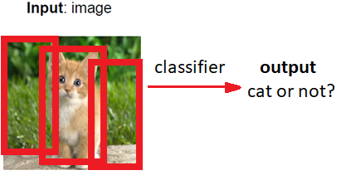
Classification and localisation
Localisation = classification problem
  Sliding window & classification of various patches
    Input:
      Images (transformed in a set of patches)
    Output:
      Label of each patch
      Non-max supression processing
      Resulted bounding box
Object detection

Slide 15
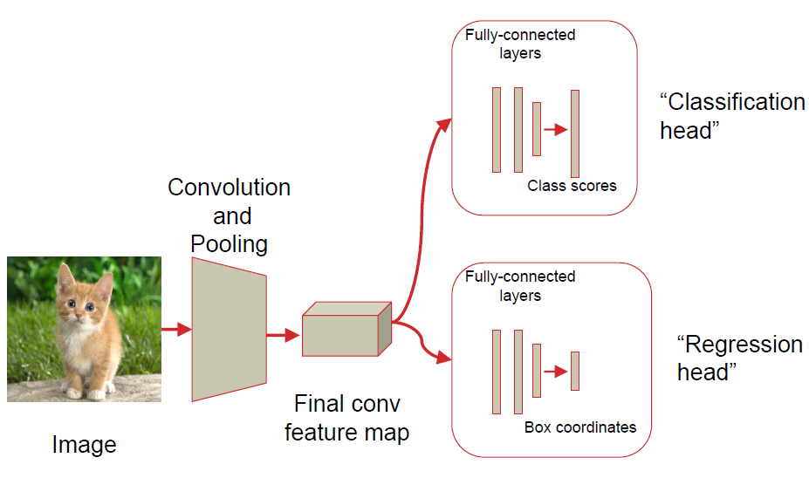
Classification and localisation
As regression problem
  Training
    Train (or use a pretrained) a classification model
    Attach new fully-connected “regression head” to the network
    Train the regression head only with SGD and L2 loss
  Testing
    At test time use both heads
Object detection

Slide 16
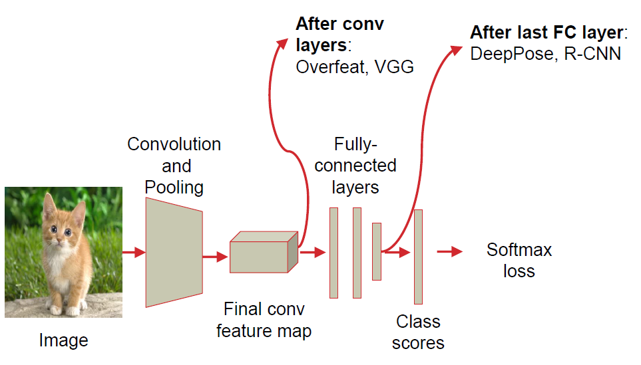
Classification and localisation
As regression problem
  Where to attach the regressor head?
Object detection

Slide 17
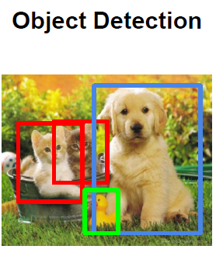


Object detection
Algorithms → Classification and localisation
Algorithms → Object detection → as classification
  Many/all positions and scales
    Haar-like features
    HOG +SVM
    DPM
  Using an object proposal
    2-stages detectors
      A model proposes a set of regions (instead of sliding window)
        Selective search, bing, superpixels, etc.
        Regional proposal network
      A classifier processes the proposed regions
        R-CNN
        Fast R-CNN
        Faster R-CNN
    1-stage detectors ➔ Run classifier over a dense sampling of possible locations
      assigning each bounding box detector to a specific position in the image
      YOLO (v1, v2, v3), SSD, RetinaNet, Detectron
Image
Feature extraction
Classification
Object detection

