Slide 1


INTELLIGENT MODELING
UNIVERSITy BABEŞ-BOLYAI
Faculty of Mathematics and Computer Science
Machine Learning
Laura Dioşan

Slide 2
Topics
Intelligent systems
  Machine learning
    Concepts
    Problem definitions
    Evaluation
    ML algorithms
  Rule-based systems
  Hybrid systems
Intelligent modeling

Slide 3
Resources
Ch VI (18) of S. Russell, P. Norvig, Artificial Intelligence: A Modern Approach, Prentice Hall, 1995
Ch 10 & 11 of C. Groşan, A. Abraham, Intelligent Systems: A Modern Approach, Springer, 2011
Ch V of D. J. C. MacKey, Information Theory, Inference and Learning Algorithms, Cambridge University Press, 2003
Ch 3 of T. M. Mitchell, Machine Learning, McGraw-Hill Science, 1997 link
Ch 1 of C. Bishop, Pattern Recognition and Machine Learning, Springer, 2006 link
Ch 1 of S. Guido, A. C. Müller, Introduction to Machine Learning with Python, O’Reilly Media, 2016 link
Ch 1 & 2 of A. Geron, Hands-On Machine Learning with Scikit-Learn, Keras, and TensorFlow, O’Reilly Media, 2019 link
Intelligent modeling

Slide 4

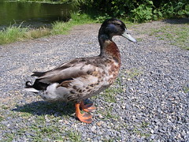
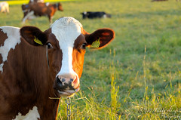

Supervised Learning
Starts with Feature Extraction
Start with a matrix X of extracted features
Input data
X: features
✔ Beak
? Webbed feet
✔ Quacks
✔ Beak
✔ Webbed feet
✔ Quacks
x Beak
x Webbed feet
x Quacks
Notes:
You’ve probably heard the saying, “If it looks like a duck and quacks like a duck, it’s probably a duck.” How could we formalize this?
Rubber duck, https://www.dutchwatersector.com/news/giant-rubber-duck-continues-china-tour-in-macao
Duck – CC BY-SA 2.0 https://ccsearch.creativecommons.org/photos/21e6f7bd-0d1b-41bd-8d18-4d7816a0bb55
Cow – Markku Akerfelt, CC-Attribution-NonCommercial-NODerivs 2.0 https://www.flickr.com/photos/44758702@N07/4944275265

Slide 5
Supervised Learning
Starts with Feature Extraction, Then Training
Train using a matrix X and a label or class, in vector y
Input
X: features
y: class
✔ Beak
? Webbed feet
✔ Quacks
✔ Is a duck
✔ Beak
✔ Webbed feet
✔ Quacks
✔ Is a duck
x Beak
x Webbed feet
x Quacks
x Is NOT a duck
Notes:
Rubber duck, https://www.dutchwatersector.com/news/giant-rubber-duck-continues-china-tour-in-macao
Duck – CC BY-SA 2.0 https://ccsearch.creativecommons.org/photos/21e6f7bd-0d1b-41bd-8d18-4d7816a0bb55
Cow – Markku Akerfelt, CC-Attribution-NonCommercial-NODerivs 2.0 https://www.flickr.com/photos/44758702@N07/4944275265

Slide 6
Under the Covers…
Supervised learning finds a function to map from values of X to values of y
Won’t always be perfect: goal is to minimize the error or loss function
✔ Beak
✔ Webbed feet
✔ Quacks
?
✔ Is a duck

Slide 7

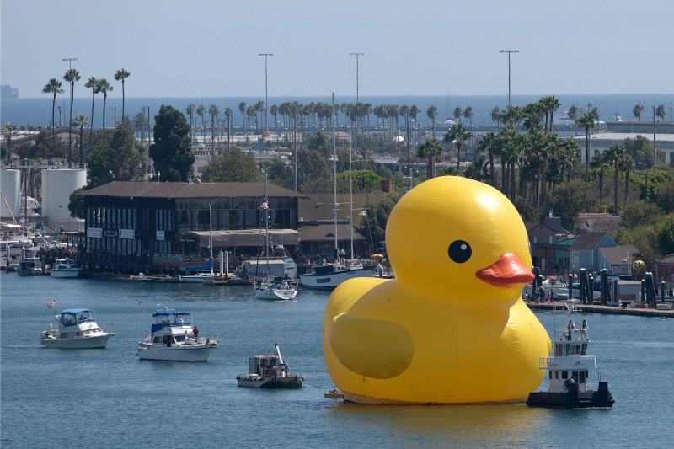
Then: Prediction
X_{new}: features
✔ Beak
? Webbed feet
✔ Quacks
✔ Is a duck
How well the classifier does on its training data may be different
from how it does on completely new data!
Notes:
Once we’ve learned the function, we can use it to predict whether other things are ducks!
https://time.com/3153925/giant-rubber-duck-los-angeles/

Slide 8
Types of Supervised Learning
  Regression: y is continuous
    each value is numeric within a continuous range,
    e.g., age, dollars spent
  Classification: y is categorical
    each value is from a finite set,
    e.g., nationality, page will be clicked on, item is a duck

Slide 9
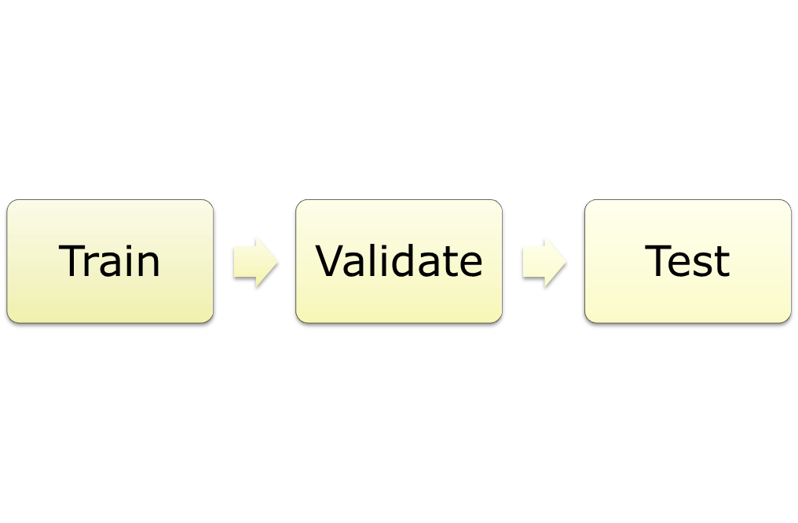
Process of Building and Evaluating an ML algorithm
(optional)
Find the function
from X to y;
fit parameters
Tune
parameters,
choose from
multiple
models
Assess
performance
Notes:
We’ll explain why we have these three stages in the next slide

Slide 10
Why the Three Stages?
Challenges Faced in Building an ML model
Goal: Learn from training data – but generalize!
  Risk of overfitting on the training data
    Need roughly as many observations as features
  Validation data helps us to compare different model settings (each trained on the training data) to see which is better
  Test data helps us to evaluate the final regressor by comparing its predictions vs the “gold standard”
Training may be computationally costly (esp. neural nets)
Notes:
Overfitting: the classifier too closely learns the dataset it was trained on, making it ineffective on new data that is slightly different.
Validation is an optional stage, which we’ll get to in Module 7 as we seek to tune classifiers.

Slide 11
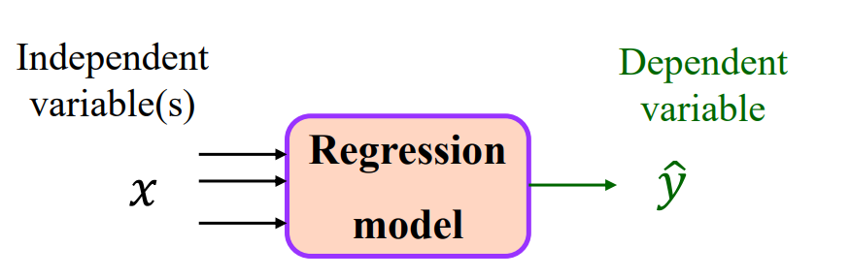
Supervised Learning - Regression
In statistical modeling, regression analysis is a set of statistical processes for estimating the relationships among variables.
It includes many techniques for modeling and analyzing several variables, when the focus is on the relationship between a dependent variable and one or more independent variables (or 'predictors’).
A regression model have to learn the correlation between data.
Today: assume we know the function and are looking to find its parameters
  Parametric learning, as opposed to decision trees that are non-parametric (future lectures)
Notes:
For regression, we are learning a set of weights (coefficients) that are combined with feature values via dot product, then we may apply a function to that.

Slide 12
simple linear regression
  The case of one input variable (explanatory variable; independent variable)
multiple linear regression
  For more input variables (explanatory variables; independent variable)
Regression techniques available to make predictions. These techniques are mostly driven by three metrics:
  number of independent variables
  type of dependent variables
  shape of regression line
Intelligent modeling

Slide 13
Regression
Two general cases we’ll consider today:
  To solve the regression problem for continuous output:
    Linear regression – fit a linear function to “optimally” match data
  To solve the classification problem:
    Logistic regression – generalize the techniques to classification (requires us to move to a non-linear function)

Slide 14
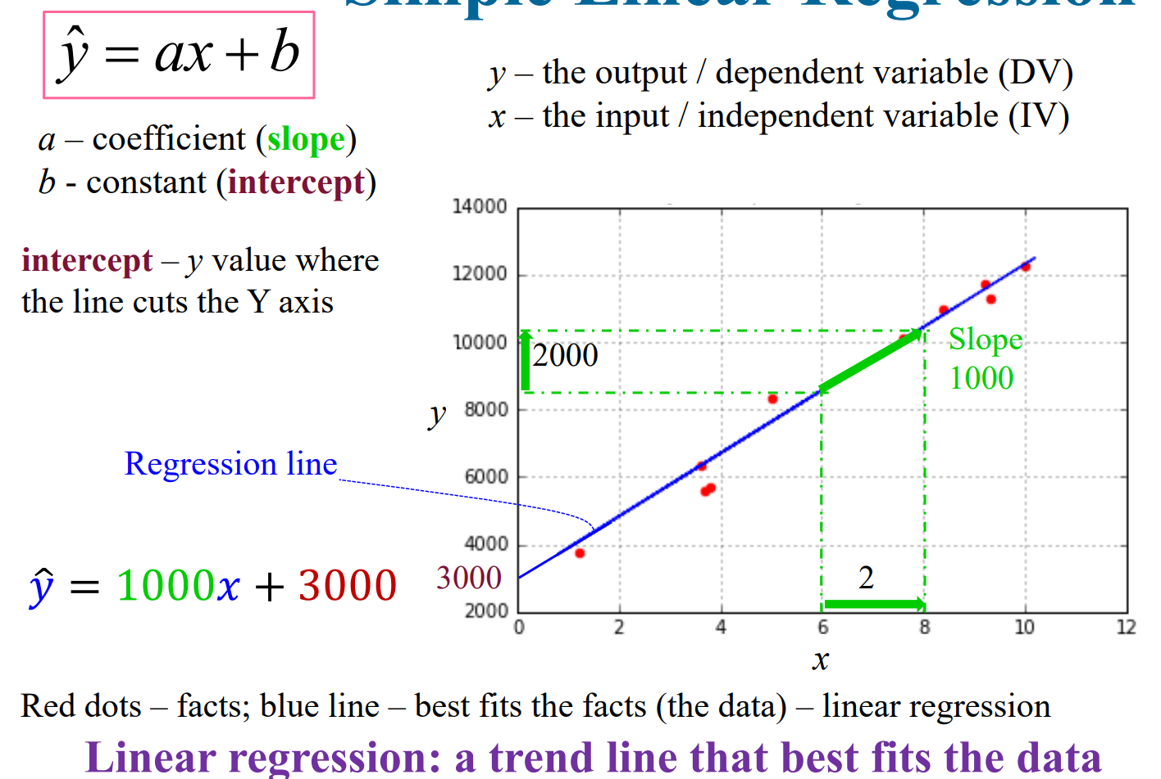

Regression – simple, linear
Intelligent modeling

Slide 15
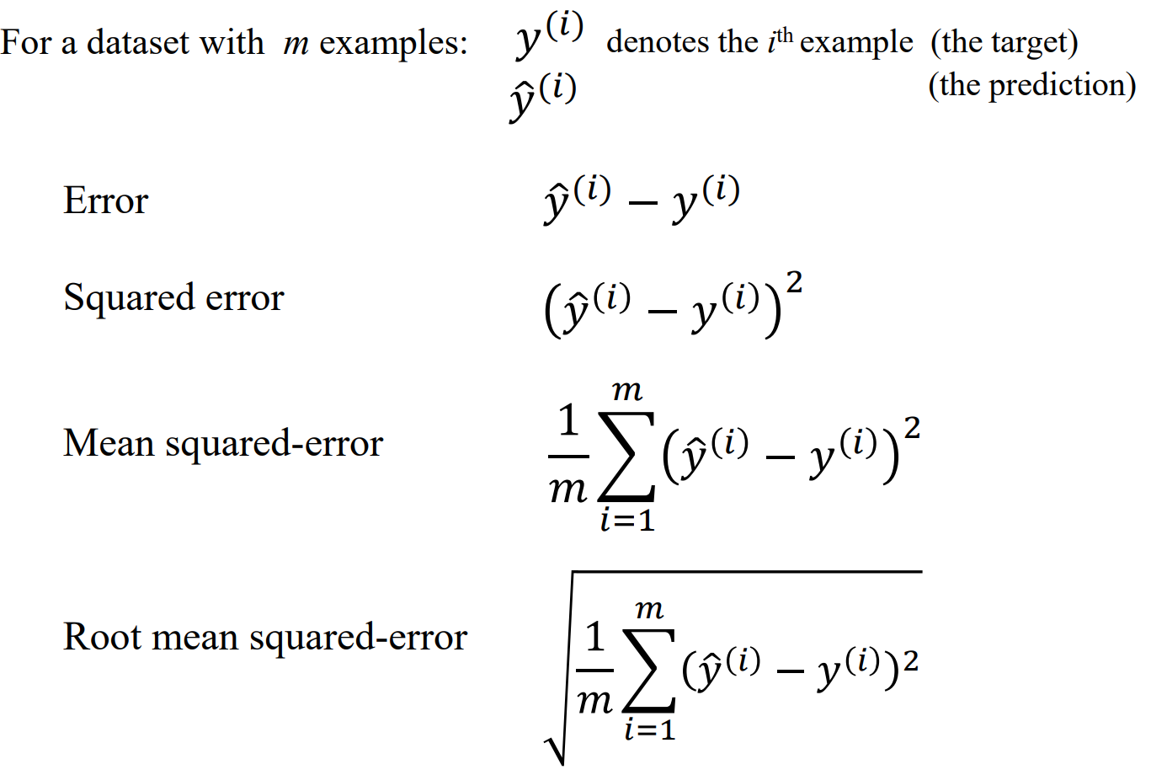
Regression - metrics
Intelligent modeling

Slide 16
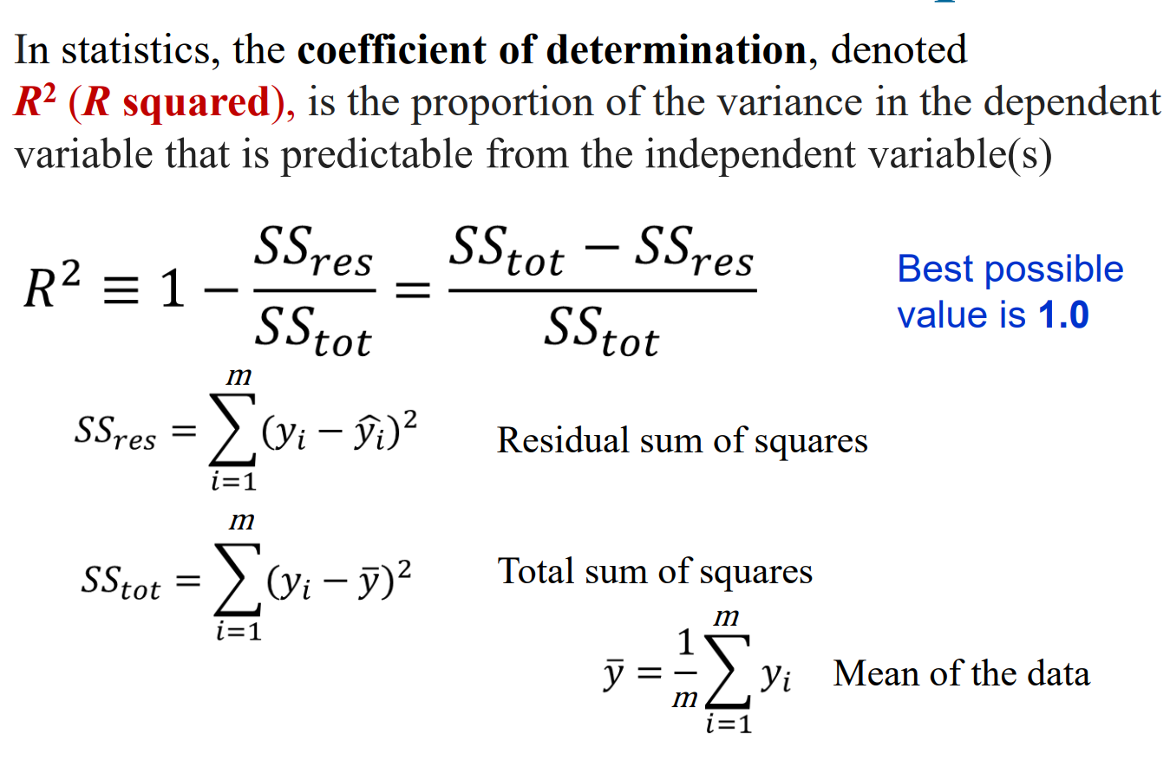
Regression - metrics
Intelligent modeling

Slide 17
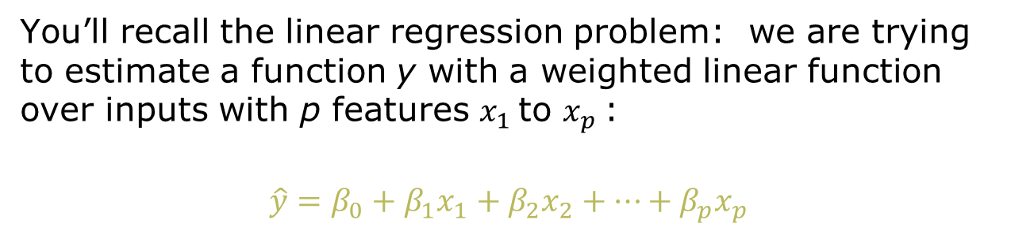
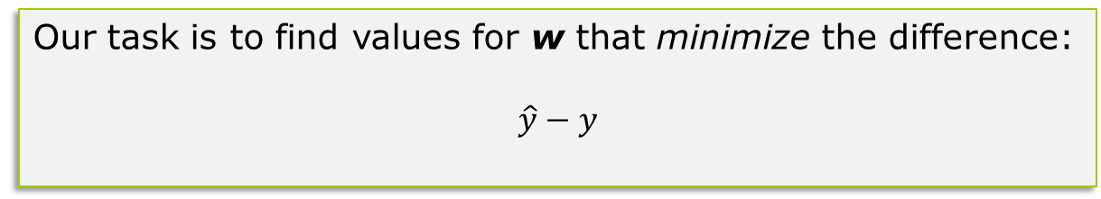
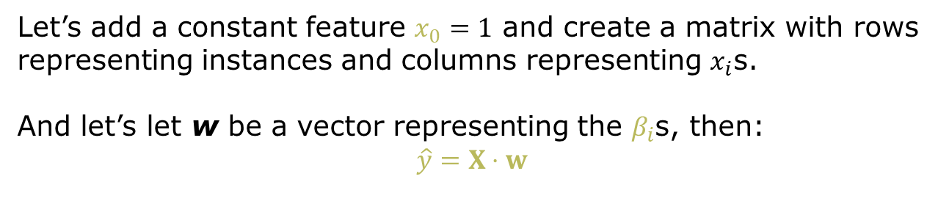
The Basics: Linear Regression
(which should look familiar)
Notes:
Note we add an extra term w₀ here, called a bias, which is basically the intercept if you think of the slope-intercept equation of a line.

Slide 18
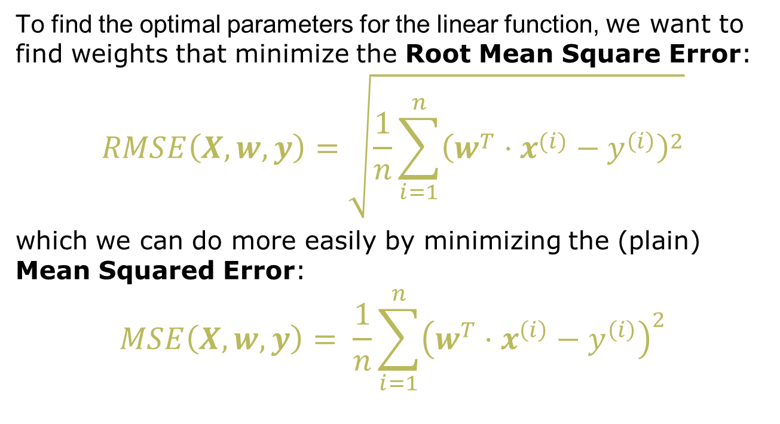
Linear Regression Minimizes Squared Error
Notes:
Here’s how we typically optimize the coefficients (weights) in the line…

Slide 19
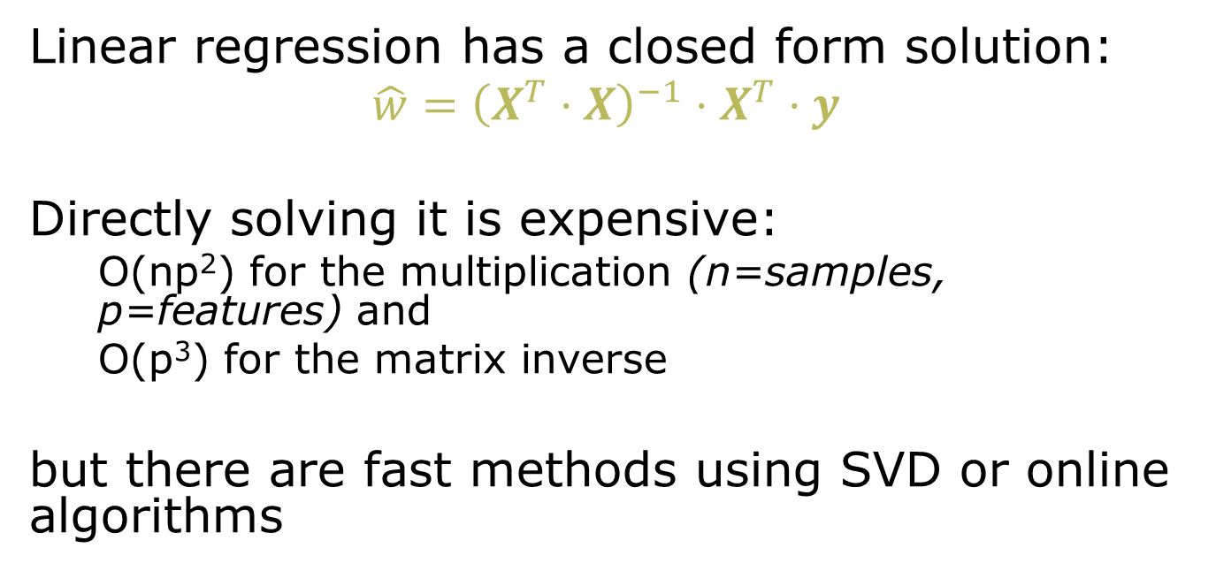
Linear Regression Algorithms
Notes:
We won’t go into detail, but please see https://www.thekerneltrip.com/machine/learning/computational-complexity-learning-algorithms/

Slide 20
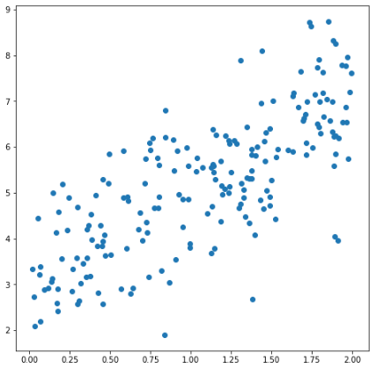
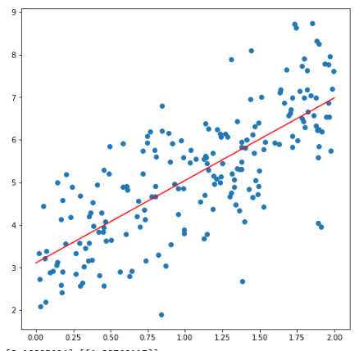
An Example of Linear Regression:
Fitting a Scatter Plot for y = 2x + 3 + random factor
rgr = LinearRegression()
rgr.fit(X, y)
# Scatter plot for the data
fig, ax = plt.subplots(figsize=(8,8))
ax.scatter(X, y)
# Plot regression line from 0 - 2
X2 = range(0,3)
y2 = rgr.coef_*X2 + rgr.intercept_
ax.plot(X2, y2.T, color='red')
plt.show()
print (rgr.coef_, rgr.intercept_)
[[1.93760117]][3.10825094]
Notes:
Here we are plotting the regression line against the scatter plot of 2D values…

Slide 21
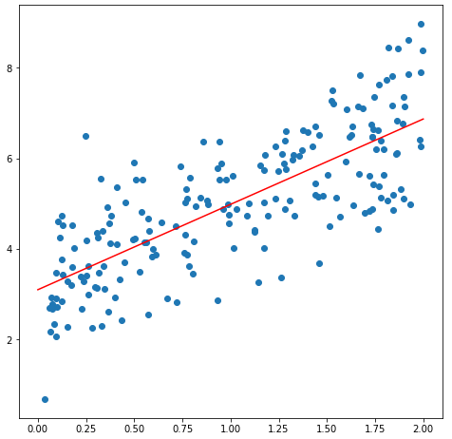
And Done Using Linear Algebra
# Insert the x_0 column
X_with_bias = np.ones((X.shape[0],2))
X_with_bias[:,1] = X.T
b = inv(X_with_bias.T.dot(X_with_bias)).dot\
(X_with_bias.T).dot(y)
yhat = X_with_bias.dot(b)
ax.scatter(X, y)
plt.plot(X, yhat, color='red')
plt.show()
Intercept: [3.10237355] Coefficient: [[1.88463454]]

Slide 22
Things to Beware Of
“Multicollinearity”: multiple features are correlated with each other
  Plot correlation matrix, remove highly correlated features
  Use PCA beforehand (sometimes this is called Principal Components Regression or PCR)
  Use Partial Least Squares Regression
Overfitting:
often we will get a model that uses more adjustable parameters than optimal
Leads us to variations on the algorithm we’ll talk about next

Slide 23
Summary of Linear Regression
Finds a set of weights defining a linear function from input features (and the bias) to the output value
  A type of parametric learning: we know the class of function, just need its parameters
  Fairly easy to express as closed-form solution, though expensive
  Often solved other faster techniques
“Ordinary least squares” or standard linear regression
  minimizes Mean Squared Error, but may overfit

Slide 24
Feature Selection
A major issue: with many features, “ordinary least squares” regression tends to overfit!
What can we do? “Regularize” to reduce model complexity
  Focus the classifier on the most important contributing features, shrink the rest to 0
Notes:
Now the question is: how many features do we assign weights to?
By default linear regression will pick a nonzero weight to each feature if this makes any difference on the training data set.
But often this makes it more brittle, i.e., it doesn’t generalize to data outside the training set.
This motivates ways of changing the function we are optimizing – aka regularization.

Slide 25

Encouraging “Sparse” Models:
Lasso (L1) Regression
Add a penalty based on L1 norm: sum of the weights
Pushes weights towards zero, if they don’t have a significant effect on the error

Slide 26
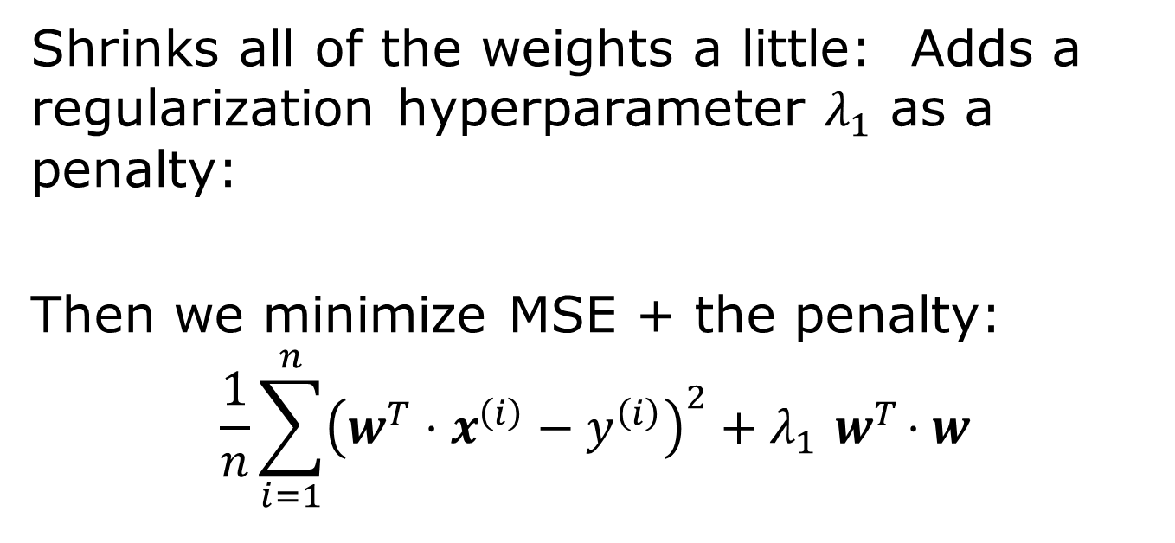
Ridge (L2) Regression
Notes:
Here, we see the normal MSE cost on the left, and then the “ridge regularization” parameter on the right.

Slide 27
Lasso vs Ridge
Lasso tends to work well if there are a few significant parameters and the others aren’t significant
Ridge works well when there are many large parameters of around the same value
Can we put the two together?

Slide 28
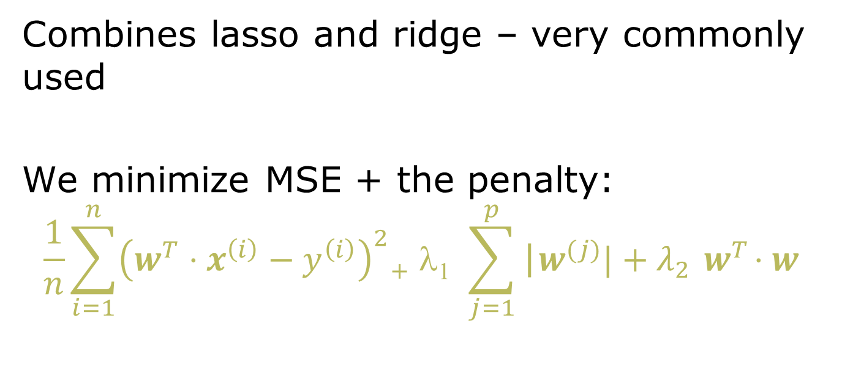
Elastic Net Regression: L1 + L2

Slide 29
Three Techniques to Reduce Overfitting
Lasso (L1 penalty):
  reduces overfitting when a small number of features are important
Ridge (squared L2 penalty):
  preferable when there are many heavily weighted parameters
Elastic Net
  combines the two
We’ll see later how to optimize the size of the penalty terms

Slide 30
Summary: Linear Regression
Finds weights that best fit a linear model to a training set
  Typically minimizing the mean-squared error
  Closed-form solution works for 10Ks of features
  For more, need to use gradient descent or similar methods
  (we’ll see this later)
Various regularization strategies can be used to make the model more robust

Slide 31

Review
Intelligent systems
  Machine learning
    Concepts
    Problem definitions
    Evaluation
    ML algorithms – regression
  Rule-based systems
  Hybrid systems
Intelligent modeling

Slide 32
Next lecture
Intelligent systems
  Machine learning
    Concepts
    Problem definitions
    Evaluation
    ML algorithms
  Rule-based systems
  Hybrid systems
Intelligent modeling

