Slide 1
INSTRUMENTE INTELIGENTE PENTRU BUNĂSTARE SOCIALĂ
Laura Dioşan
Tema 4
Facultatea de Matematică și Informatică
Universitatea Babeș-Bolyai

Slide 2
Quality of an ML-based system
  ML algorithm
  Learnt model
  Data
  Entire System

Slide 3
Measuring quality -> how?
ML perspective -> building models that could do good numerical or class-related predictions
  Prediction quality
  Model size
  Inference time
  User interaction model
  Kinds of mistakes made
  How the system deals with mistakes
  Ability to incrementally learn
  Safety, security, fairness, privacy
  Explainability
SE perspective -> conventional software development
  Black box testing
  White box testing
  …

Slide 4
Measuring quality – ML perspective
Prediction quality
  Classification problem
    Accuracy = correct predictions / all predictions
      Measuring success of all classes predictions
      Higher is better
    Precision = TP / (TP + FP)
      Measuring rate of false classifications (or noise)
      Higher is better
    Recall = TP / (TP + FN)
      Measuring success of correct classifications (or missing results)
      Higher is better
      False negative rate = 1 – recall
  Regression problem
    Prediction error
      Mean Absolute Error MAE = 1/n ∑| realValue - predictedValue |
      Mean Absolute Percentage Error MAPE = 1/n ∑| (realValue – predictedValue) / realValue |
      Mean Squared Error MSE = 1/n ∑ ( realValue - predictedValue )^2

Slide 5
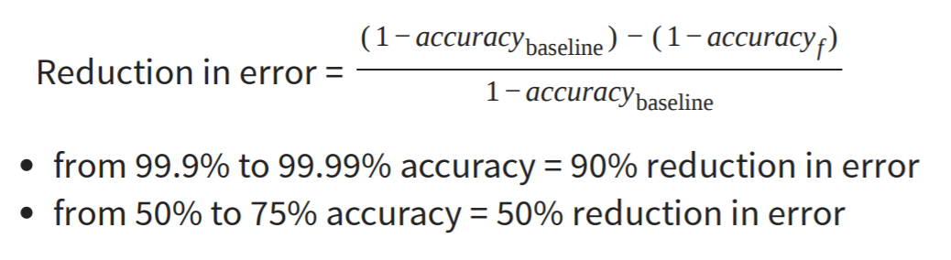
Measuring quality – ML perspective
Prediction quality
  Suppose the accuracy metric
    What does mean a good accuracy? 99%? 75%?
    Always compare to a base rate!

Slide 6
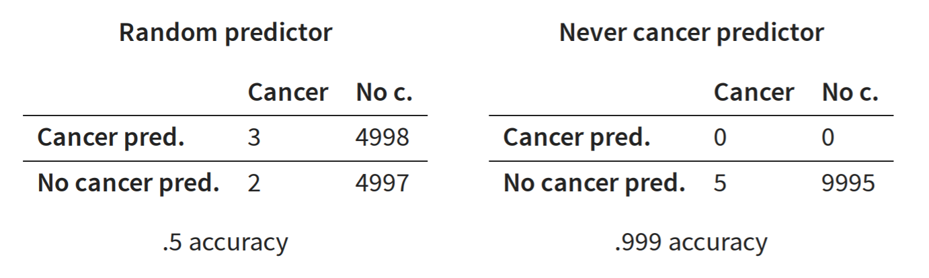
Measuring quality – ML perspective
Prediction quality
  Baseline = ?
    Random predictor
      Acc = (3 + 4997) / (3 + 2 + 4998 + 4997) = 0.5
      Precision(cancer) = 3 / (3 + 4998) ~0.0006
      Recall (cancer) = 3 / (3 + 2) = 0.6
    all true,
    all false,
    repeat last observation,
    simple heuristics,
    simpler model,
    SOTA
  Extreme classifiers
    Never cancer predictor = Identifies every instance as negative (e.g., no cancer)
      Precision = ? => 0 / (0 + 0) - undefined (no false predictions, but no predictions at all)
      Recall = ? => 0 / (0 + 5)
    Always cancer predictor = Identifies every instance as positive (e.g., has cancer)
      Precision = ? => x / (x + y), y >> x => low (also reports cancer for all noncancer cases)
      Recall = ? => x / (x + 0) = 100%

Slide 7
Measuring quality – ML perspective
Generalisation quality
  Training data (seen)
    problems
      If acc(learning) >> acc(validation) => overfitting
        Model learned exactly for the input data, but does not generalize to unseen data (e.g., exact memorization)
      If acc(learning) << acc(validation) => underfitting
        Model makes very general observations but poorly fits to data (e.g., brightness in picture)
    Solutions
      Parameter tunning
        Control the degrees of freedom (no of parameters)
      Cross-validation
        Repeated partitioning of data into train and validation data, train and evaluate model on each partition, average results
  Testing data (unseen)

Slide 8
Measuring quality – SE perspective
ML systems = ‘non-testable’ software?
  white-box testing
    testing the functionality of an application WITH knowing the details of its implementation
    structure-based testing -> test cases are created with reference to the internal structure of the software component
    remember that we deal by an ML model, not a piece of code
  black-box testing
    testing the functionality of an application WITHOUT knowing the details of its implementation
    specification-based testing -> test cases are created based on the requirement specifications
    specification = ?
      Input data= known
      Output data (results) = unknown

Slide 9
Measuring quality – SE perspective
ML systems = ‘non-testable’ software?
  an ML system follows a data-driven programming paradigm
    the model’s behaviour may evolve over time, in response to the frequent provision of new data
  oracle problem
    when we know that an answer is a good one?
  testing level
    Unit testing
    Contract test
    Integration testing
    …

Slide 10
Testing an ML algorithm
Challenges & possible solutions
  ???

