Slide 1
INSTRUMENTE INTELIGENTE PENTRU BUNĂSTARE SOCIALĂ
Laura Dioşan
Facultatea de Matematică și Informatică
Universitatea Babeș-Bolyai

Slide 2
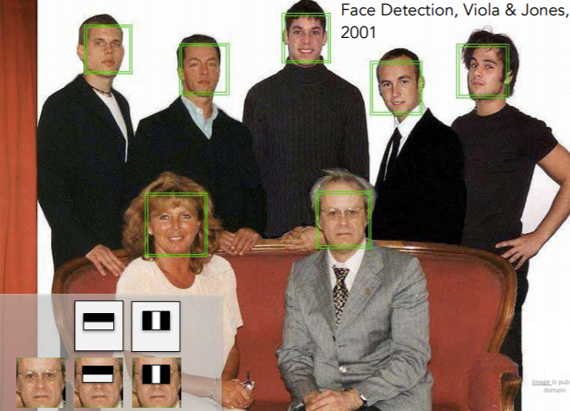
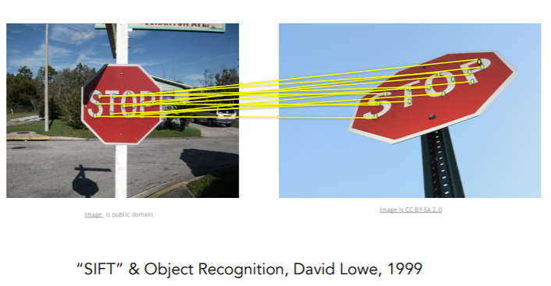
Image processing
Classic approach
  Image enhancement
  How?
    Filters
ML-based approaches
  Image classification and recognition
  How?
    Feature extraction & ML algorithms
      Features
        Haar
        HOG
        SIFT
        SURF
        LBP
      ML algorithms
        kNN
        SVM
        Decision trees → Ada boost
    Feature learning & ML algorithms
      Use ANN for both feature extraction and ML

Slide 3
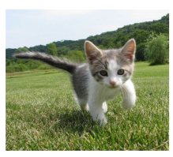
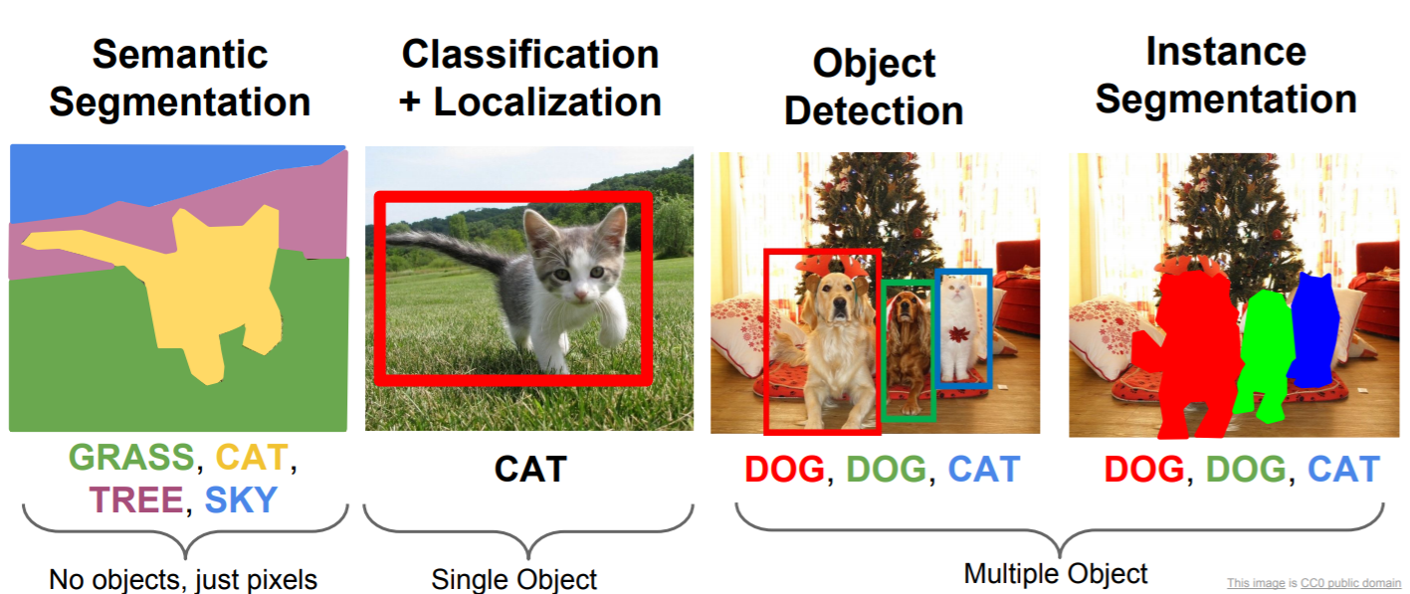
Automatic image processing
Image classification
Other tasks
CAT or DOG or OTHER?

Slide 4
Image classification
Input
  More labeled images (for training)
  More (n) images (for testing – without labels)
Output
  Label associated to input images
Evaluation
  Datasets – image classification task form
    MNIST
    CIFAR
    Pascal VOC http://host.robots.ox.ac.uk/pascal/VOC/ (4-20 classes)
    ImageNet http://www.image-net.org/ (1000 classes)
    COCO dataset
  Metrics
    Accuracy
    Precision
    Recall
    AUC

Slide 5
Image classification
How?
  Features + ML algorithm
    Features: histograms, HOG, Bag of words, …
    ML algorithm: Decision trees, SVM, ANN
  ML algorithm (that processes the raw images)
    kNN
    ANN

Slide 6
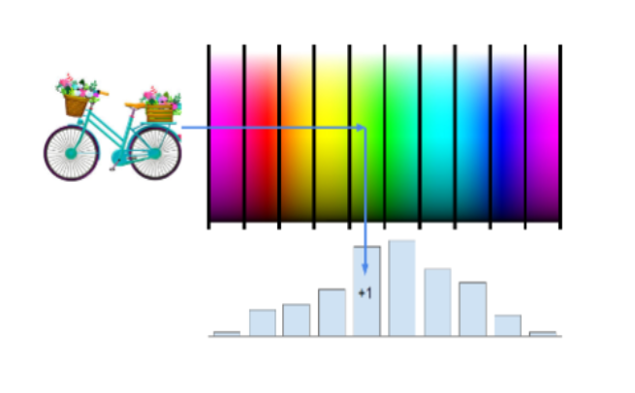
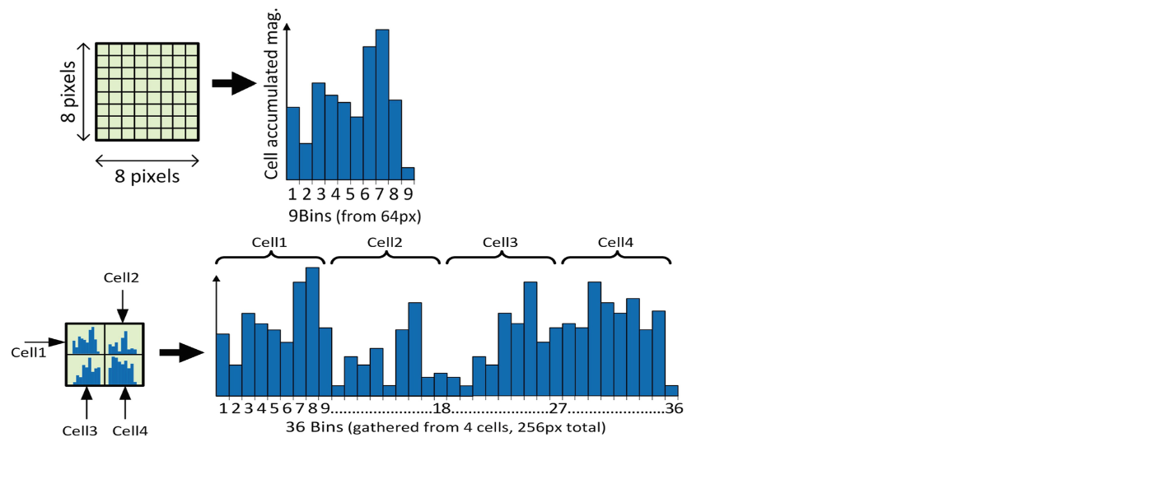
Image classification
How? -> Features + ML algorithm
  Why features?
    Features can transform a non-linear problem into a linear one
  What features?
    Histogram of colours (Gray, RGB)
      + reducing input size
      - loosing localization
    Histogram of oriented gradients
      + preserved localization
      - sensitive to image rotation

Slide 7
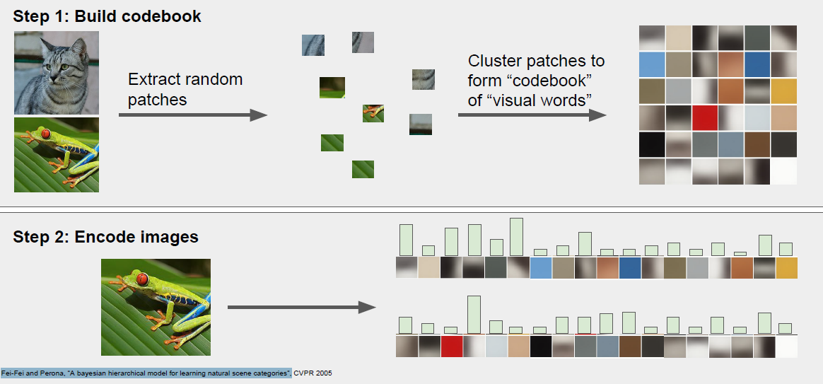
Image classification
How? -> Features + ML algorithm
  Why features?
    Features can transform a non-linear problem into a linear one
  What features?
    Histogram of colours (Gray, RGB)
    Histogram of oriented gradients & patches
    Bag of words (see http://www.micc.unifi.it/delbimbo/wp-content/uploads/2011/10/slide_corso/A31_bag_of_visual_words_representation.pdf)
      + deals well with occlusion, scale invariant, rotation invariant
      - efficiency of generating the vocabulary, spatial relationship among patches

Slide 8
Image classification
How? -> ML algorithm (that processes the raw images)
  kNN
  ANN

Slide 9
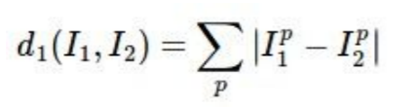
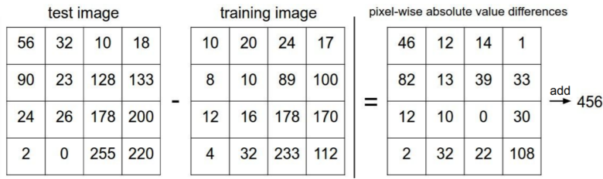
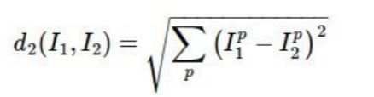
Image classification
kNN
  Train
    Memorize all data and labels
    O(1)
  Test
    Predict the label of the most k similar training image
    O(n) – too slow!!!
  Hyperparameters – optimised on a validation dataset
    k (no of neighbours)
    Similarity metric
      L1 (Manhattan) distance
      L2 (Euclidean) distance

Slide 10
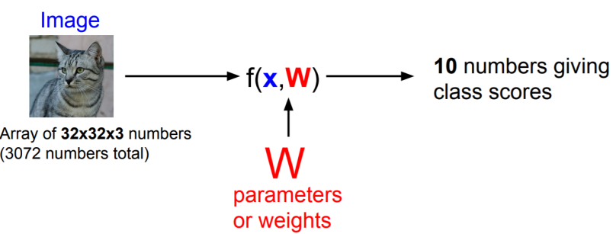
Image classification (raw images)
ANN
  Encodes parameters W
  Train
    Optimise the parameters W based on training data
      W – net’s architecture
      Loss function
    O(|W| * n * noEpochs)
  Test
    Use the learnt parameters to predict the label
  Hyperparameters
    net’s architecture
    Learning rate
    …
  Type
    Classic ANN (Multi Layer Perceptron)
    Convolutional NN (LeNet, AlexNet, VGG, DenseNet, ResNet, …) – see this repo https://github.com/rasbt/deeplearning-models

Slide 11
Automatic image processing
Image classification
Other tasks
CAT or DOG or OTHER?

Slide 12
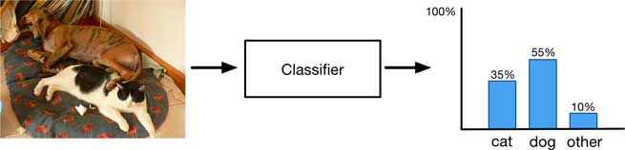
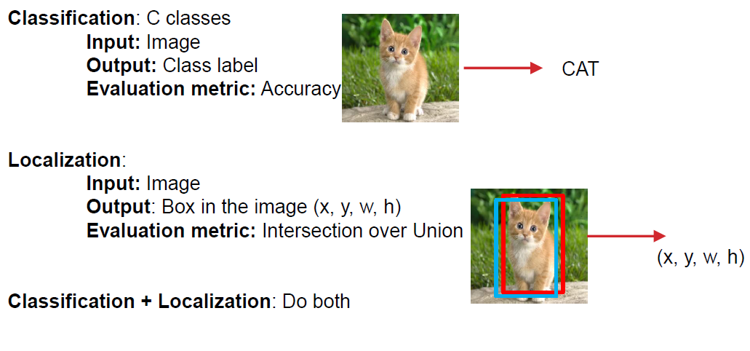
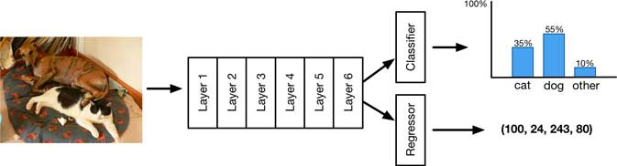
Object detection
Object detection
  Identify which object appears and where the object appears in an image

Slide 13
Object detection
Databases
  Pascal VOC http://host.robots.ox.ac.uk/pascal/VOC/
    2005 – image detection task (4 classes, 1578 images, 2209 objects)
    2006 – image detection task (10 classes, 2618 images, 4754 objects)
    …
    2012 – image detection task (20 classes, 11 530 images, 6929 objects)
  ImageNet http://www.image-net.org/
    2010 – image classification task only (1000
    classes, 14,197,122 images, )
    2011 – classification and localisation task
    2012 = 2011 & Fine-grained classification
    2013 – detection task (200 classes)
    2014, 2015, 2016, 2017 – detection task (200 classes)
  COCO http://cocodataset.org/#home
    2015 – detection task (more than 200,000 images and 80 object categories)
    2019 – detection task (more than 200,000 images and 80 object categories)
 |  | PASCAL VOC 2012 | ILSVRC 2013
Number of object classes |  | 20 | 200
Training | Num images | 5717 | 395909
 | Num objects | 13609 | 345854
Validation | Num images | 5823 | 20121
 | Num objects | 13841 | 55502
Testing | Num images | 10991 | 40152
 | Num objects | --- | ---

Slide 14
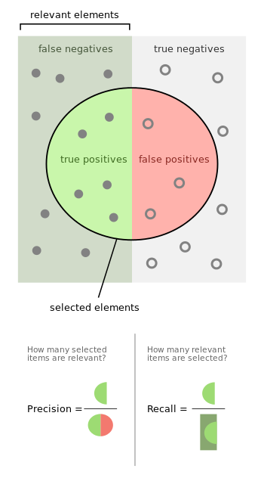
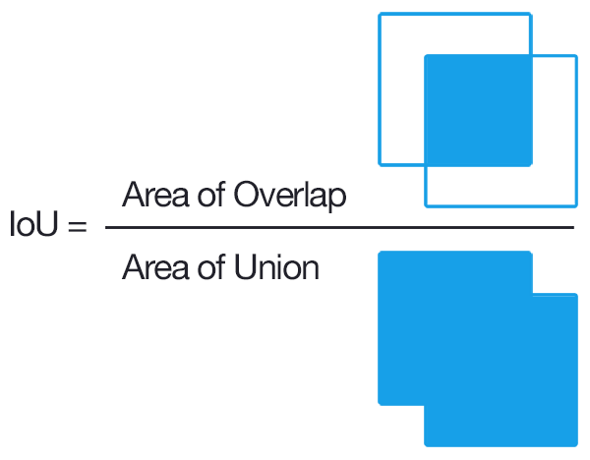
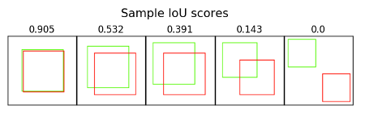
Object detection
  Remember:
  Classification → Problem specification
  Input: image
  Output: class
    Label
    Class probability
  Evaluation metric: accuracy, precision, recall
Localisation → Problem specification
  Input: image
  Output: bounding box’s
    Class probability
    coordinates
      (x_{corner}, y_{corner}, w, h)
      (x_{corner1}, y_{corner1}, x_{corner2}, y_{corner2})
      (x_{center}, y_{center}, w, h)
    Confidence score
  Evaluation metric:
    intersection over union
    average precision

Slide 15
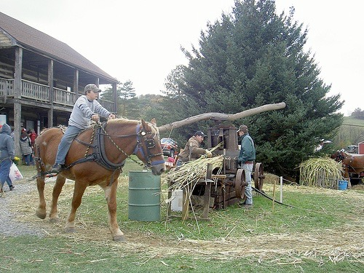
Object detection
Localisation → Evaluation
0.2
0.9
0.6
‘person’ detector predictions
ground truth ‘person’ boxes

Slide 16
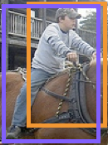


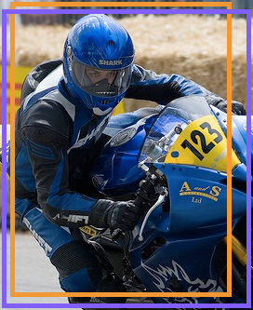


Object detection
Localisation → Evaluation
  Sort by confidence
0.9
0.8
0.6
0.5
0.2
0.1
...
...
...
...
...
✓
X
✓
✓
X
X
true
positive
(high overlap)
false
positive
(no overlap,
low overlap, or
duplicate)
Notes:
Let’s define the problem a bit more so we’re all on the same page.

Slide 17

Object detection
Localisation → Evaluation
  Sort by confidence
  Precision = TP@t / (TP@t + FP@t)
  Recall = TP@t / #GroundTruthObjects
0.9
0.8
0.6
0.5
0.2
0.1
...
...
...
...
...
✓
X
✓
✓
X
X
✓
✓ +
X

Slide 18
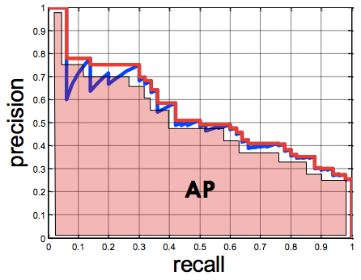
Object detection
Localisation → Evaluation
0.9
0.8
0.6
0.5
0.2
0.1
...
...
...
...
...
✓
X
✓
✓
X
X
Average Precision (AP)
0% is worst
100% is best
mean AP over classes (mAP)

Slide 19
Object detection
Localisation → Algorithms
  Detectron https://github.com/facebookresearch/detectron2

Slide 20
Object detection
Tasks:
  Localisation
    Find a fixed number of objects (one or many)
    L2 regression from CNN features to box coordinates
    Much simpler than detection
    Overfeat: Regression + efficient sliding window with FC -> conv conversion
    Deeper networks do better
  Detection
    Find a variable number of objects by classifying image regions
    Before CNNs: dense multiscale sliding window (HoG, DPM)
    Avoid dense sliding window with region proposals
    R-CNN: Selective Search + CNN classification / regression
    Fast R-CNN: Swap order of convolutions and region extraction
    Faster R-CNN: Compute region proposals within the network
    Deeper networks do better

Slide 21
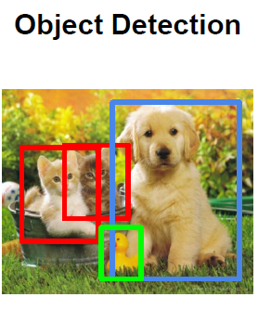


Object detection
Algorithms → Classification and localisation
Algorithms → Object detection → as classification
  Many/all positions and scales
    Haar-like features
    HOG +SVM
    DPM
  Using an object proposal
    2-stages detectors
      A model proposes a set of regions (instead of sliding window)
        Selective search, bing, superpixels, etc.
        Regional proposal network
      A classifier processes the proposed regions
        R-CNN
        Fast R-CNN
        Faster R-CNN
    1-stage detectors ➔ Run classifier over a dense sampling of possible locations
      assigning each bounding box detector to a specific position in the image
      YOLO (v1, v2, v3), SSD, RetinaNet
Image
Feature extraction
Classification

Slide 22
Object detection
Detection → Evaluation
  “mean average precision” (mAP)
    Compute average precision (AP) separately for each class, then average over classes
    A detection is a true positive if it has IoU with a ground-truth box greater than some threshold (usually 0.5) (mAP@0.5)
    Combine all detections from all test images to draw a precision / recall curve for each class; AP is area under the curve

Slide 23
Automatic image processing
Image classification
Other tasks
CAT or DOG or OTHER?

Slide 24
Automatic image processing
Image classification
  Does an image contain object X? [yes/no]
Image detection and segmentation
  Does an image contain object X? [yes/no]
  Where is the object X? ➔ Location of the object
    Pixel-based granularity ➔ semantic/instance segmentation
    Object-based granularity ➔ object detection
  Which object does this image contain? [where?]
  Aprox. localisation (Bounding box)
  Accurate localisation (contour) → Segmentation

Slide 25
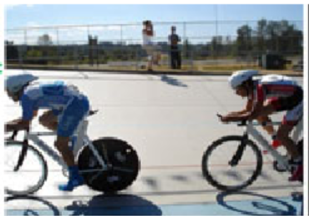
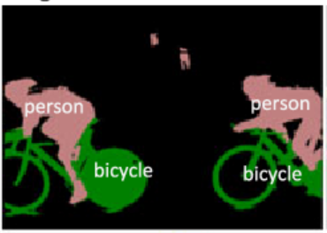
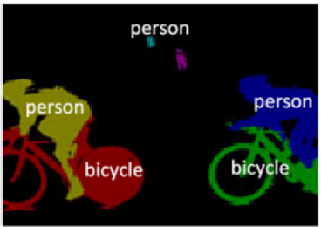
Image segmentation
Tasks
  Semantic segmentation
    Labels for every pixel
    No differences across different
    instances of the same object
  Instance segmentation
    Labels for every pixel
    unique label to every instance of a particular object in the image

Slide 26
Image segmentation
How?
  Region-based segmentation (->Thresholding, Region growing)
    + simple, fast,
    - doesn’t work if there are overlapped gray levels in image
    GrowCut
  Edge detection segmentation
    + Fast (apply filters)
    - if there are too many edges or less contrast objects
  Based on clustering (->K-means, Hierarchical, Mean Shift)
    + works well on a small dataset with convex clusters
    - large computational time, shape of clusters
  Mask R-CNN
    + simple, general
    - high training time

Slide 27
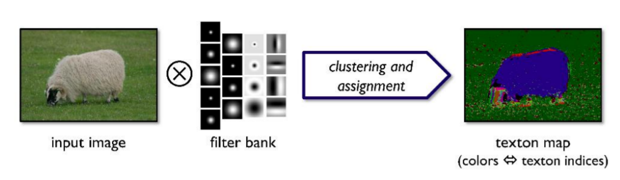
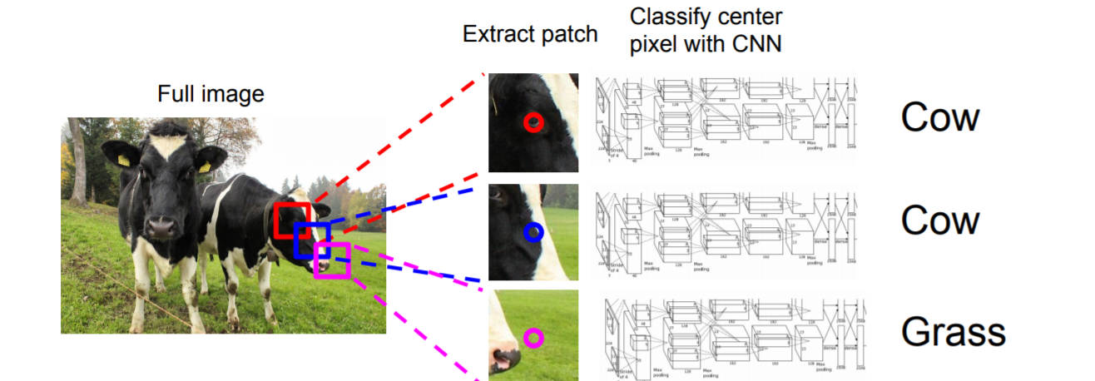
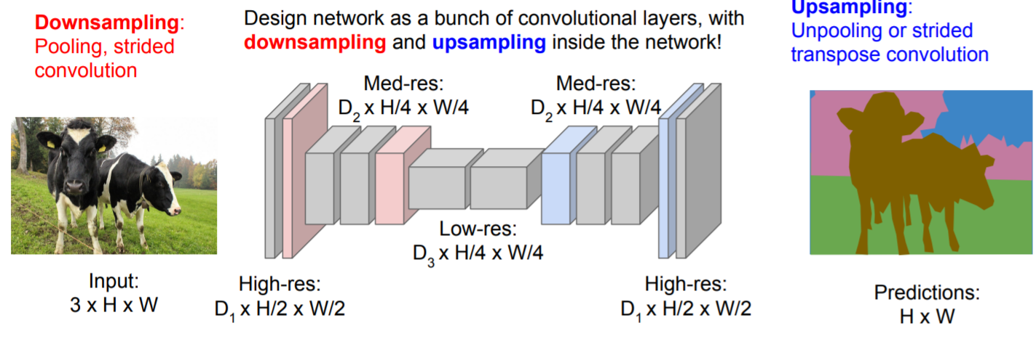
Image segmentation
Semantic segmentation
  Methods
    Before deep learning
      CRF + pixels/superpixels
        https://jamie.shotton.org/work/publications/ijcv07a.pdf
        CRFs https://pub.ist.ac.at/~chl/papers/nowozin-fnt2011.pdf
      Sliding window
        http://yann.lecun.com/exdb/publis/pdf/farabet-pami-13.pdf
        https://ronan.collobert.com/pub/matos/2014_scene_icml.pdf
    Deep learning era
      Unet
      SegNet
      DeepLab
      FCN
      DenseNet
      … (See https://github.com/mrgloom/awesome-semantic-segmentation )

Slide 28
Image segmentation
Instance segmentation
  Methods
    Deep learning era
      Mask R-CNN -> Detectron (1, 2) framework
      Mask scoring R-CNN = Mask R-CNN + MaskIoU head module
      YOLACT (You Only Look At CoefficienTs)

Slide 29
Image segmentation
Metrics
  Pixel accuracy
  Intersection over union (IOU)
  Frequency weighted IOU
Loss functions
  Cross-entropy loss
  Focal loss
  Dice loss
  Haussdorff distance
Datasets
  Pascal VOC https://cs.stanford.edu/~roozbeh/pascal-context/
  COCO http://cocodataset.org/
  Cityscapes https://www.cityscapes-dataset.com/
  INRIA aerial images https://project.inria.fr/aerialimagelabeling/

Slide 30
https://cs231n.github.io/
https://www.youtube.com/watch?v=jGwO_UgTS7I&list=WL&index=28
CNNs
  https://github.com/cs231n/cs231n.github.io/blob/master/convolutional-networks.md
GANs
  https://github.com/cs231n/cs231n.github.io/blob/master/generative-modeling.md
  https://github.com/cs231n/cs231n.github.io/blob/master/generative-models.md

Slide 31
Presented information was collected from various sources:
  https://cs230.stanford.edu/
  http://cs231n.stanford.edu/
  https://d2l.ai/
  https://berkeley-deep-learning.github.io/cs294-131-s17/
  https://machinethink.net/
  https://cedar.buffalo.edu/~srihari/CSE676/
  http://karpathy.github.io/

