Slide 1
INSTRUMENTE INTELIGENTE PENTRU BUNĂSTARE SOCIALĂ
Laura Dioşan
Text mining
Facultatea de Matematică și Informatică
Universitatea Babeș-Bolyai

Slide 2
Natural Language Processing
  Text classification
  Language modelling
  Machine translation
  …

Slide 3
From Languages to Information
Aim
  Automatically extracting meaning and structure from:
    Human language text and speech (news, social media, etc.)
    Social networks
    Genome sequences
  Interacting with humans via language
    Dialog systems/Chatbots
    Question Answering
    Recommendation Systems

Slide 4
From Languages to Information
How?
  Extracting information from language
    Information Retrieval
    Text Classification
    Extracting Sentiment and Social Meaning
    …
  Interacting with humans via language
    IBM’s Watson
    …
    Counseling conversations
      https://www.aclweb.org/anthology/Q16-1033.pdf
      https://web.stanford.edu/class/cs124/lec/counseling_slides.pdf
    Understanding police officer respect
      https://www.pnas.org/content/114/25/6521
      https://nlp.stanford.edu/robvoigt/124_lecture/

Slide 5
Text classification
Definition
  Text categorization
    Assign (predefined) labels (categories) to some documents
    Documents
      Technical reports, web pages, messages, books, etc.
    Categories:
      Topics (art, economy)
      Attributes (spams, ham)
Data and various text classification problems
  https://nlpprogress.com/english/text_classification.html
 | Cuvinte | Documente
Învăţare supervizată | Etichetarea părţilor de vorbire | Clasificarea textelor, Filtrarea, Detectarea subiectelor
Învăţare nesupervizată | Indexarea semantică, construcţia automată a tezaurelor, extragerea cuvintelor cheie | Clusterizarea documentelor, Detectarea subiectelor

Slide 6
Text classification
Automatic approaches
  Based on knowledges
    From experts
    Encoded as rules
  Based on learning
    Experts label some training examples
    The algorithm label the test examples
    Learning
      Supervised
      Unsupervised
Evaluation
  Accuracy, Precision, Recall, AUC, etc.

Slide 7
Text classification
Process
  Data training analysis
    Document indexing
      Construct a document representation
        Attributes / features
        Weights of these features
      Reduce the dimension of these representations
        Feature selection
        Feature extraction
    Learning a classification model
  Classification of test data
    Text indexing
    Apply the learnt model -> categories

Slide 8
Text classification
Document indexing
  Construct a document representation
    Attributes / features
    Weights of these features
  4 steps:
    Document linearization
    Filtering
    Canonical form
    Weighting
Reduce the vocabulary size

Slide 9
Text classification – indexing
Step 1: linearization (segmentation)
  Reduce the document to a vector of terms (attributes)
    bag of words model
    A matrix
      Documents -> lines
      Terms -> colomns
      Each cell 1/0 – if the current term belongs to the current document
  2-stage process for term identification
    Format removal
      E.g. Elimination of HTML tags
    Tokenization
      Parsing (segmentation)
      Removal of punctuation mark
      Conversion of capital letters
Iniţial | Liniarizat
Interactive query expansion modifies queries using terms from a user. Automatic query expansion expands queries automatically. | interactive query expansion modifies queries using terms from a user automatic query expansion expands queries automatically
Notes:
During linearization all Cascading Style Sheets (CSS) instructions are removed

Slide 10
Text classification -> indexing
Paul 2: filtering
  Select some terms that are able to
    Describe the content of the document
    Make a difference between two documents
  Removal of stopwords
    From a predefined list
    Based on their frequencies (under a given threshold)
Segmentat | Filtrat
interactive query expansion modifies queries using terms from a user automatic query expansion expands queries automatically | interactive query expansion modifies queries terms automatic query expansion expands queries automatically

Slide 11
Text classification – indexing
Step 3 – canonical form (normalization/standardisation)
  Lematisation
    Morphological analysis
    Based on context
    Ex. “better” → “good”
  Stemming
    Term-level
    Ex. "computer", "computing", "compute" → "comput"
    stemming algorithm
      Martin Porter
      WordNet
Filtrat | Redus
interactive query expansion modifies queries terms automatic query expansion expands queries automatically | interact queri expan modifi queri term automat queri expan expand queri automat

Slide 12
Text classification – indexing
Step 4: weighting
  Pre-determined (manual)
    Ex. Bag of Words
  Automatic (learnt)
    Ex. embedded representations

Slide 13
Text classification - indexing
Step 4: manual weighting
  Usage of a particular model
  Weights relative to
    A single document
      term frequency – TF
    A collection of documents
      inverse document frequency – IDF
    hybrid TF and IDF
      TF → cu cât un termen este mai frecvent într-un document, cu atât el este mai important pentru acel document
      IDF → cu cât un termen apare în mai multe documente, cu atât el este mai puţin important în descrierea semanticii acelui document
  Range of frequencies
    Binary → presence / absence of a term (One-Hot encoding)
    Real ([0,1]) → importance of that term
  For a set of D documents and a set of T termns, the weight p_{ij} of term t_{i} in document d_{j} (i=1,2,...,|T|, j=1,2,...,|D|) can be:
    binary: p_{ij} = 1, if t_{i} belongs to d_{j}
    0, otherwise
    TF: p_{ij}=tf_{ij} (no of appearances of term t_{i} in document d_{j})
    TF.IDF: p_{ij}=tf_{ij}*log₂(|D|/df_{i}), where df_{i}=no of documents where term t_{i} is found

Slide 14
Text classification – indexing
Step 4 – weight learning
  Unsupervised learnt representation
  Classical models https://web.stanford.edu/class/cs124/lec/languagemodeling.pdf
  https://web.stanford.edu/class/cs124/lec/lm2021.pdf
    Probability of a target word based on k previous words
    Document-level context
      Semantic relation (boat – water)
    Count-based models
      Latent Semantic Analysis (LSA)
      Latent Dirichlet Allocation (LDA)
  Modern models
    Word-level context
      Semantic similarity (boat – sheep)

Slide 15
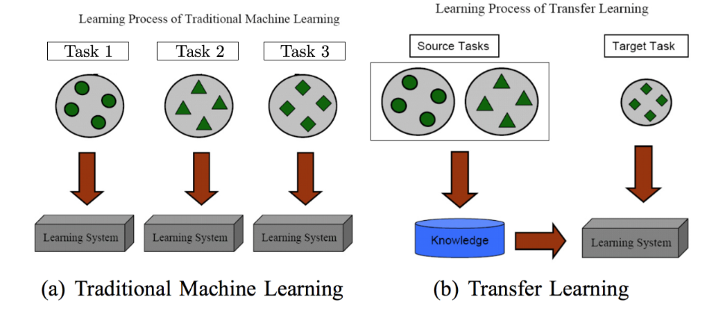
Text classification – indexing
Step 4 – weight learning (word representations)
  Methodologies
    Traditional Machine Learning
    Transfer learning https://www.cse.ust.hk/~qyang/Docs/2009/tkde_transfer_learning.pdf

Slide 16
Text classification – indexing
Learning word representations (vectors)
Why?
  Embeddings = parameters -> they can be learnt
  Share representation across tasks
  Lower dimensional space
How?
  Pre-NN
    1990 - Latent Semantic Analysis (LSA) http://lsa.colorado.edu/papers/JASIS.lsi.90.pdf
    1992 – n-gram models https://www.aclweb.org/anthology/J92-4003.pdf
    2003 - Latent Dirichlet Allocation (LDA)—Documents are mixtures of topics and topics are mixtures of words https://www.jmlr.org/papers/volume3/blei03a/blei03a.pdf
  NN-based
    Word-level (2003 - …)
    Sentence (document) level (2014 - … )
    Contextual word-vectors (Word vectors compress all contexts into a single vector) (2016 - …)

Slide 17
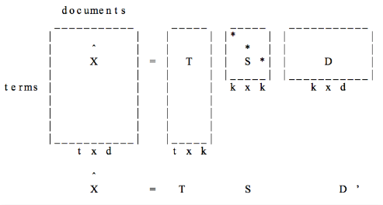
Text classification – indexing
Learning word representations (vectors)
How?
  Pre-NN
    1990 - Latent Semantic Analysis (LSA) http://lsa.colorado.edu/papers/JASIS.lsi.90.pdf

Slide 18
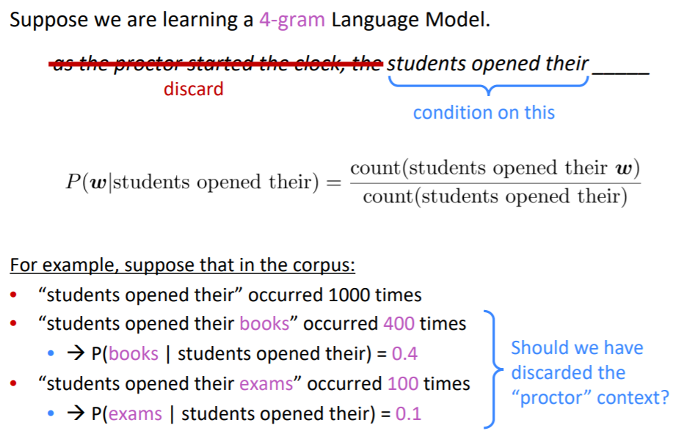
Text classification – indexing
Learning word representations (vectors)
How?
  Pre-NN
    1992 – n-gram models https://www.aclweb.org/anthology/J92-4003.pdf
    https://web.stanford.edu/~jurafsky/slp3/3.pdf

Slide 19
Text classification – indexing
Learning word representations (vectors)
How? -> NN-based
  Word-level (2003 - …)
    2003 - N-gram Neural language model (Montreal - Bengio)
      https://www.jmlr.org/papers/volume3/bengio03a/bengio03a.pdf
      Probability of the target word based on previous k words
      Estimation of the probability by an ANN -> prediction of the next word in a sequence
        Embedding layer -> word embeddings
        Intermediate layer(s) -> intermediate representation (non-linear); standard (HardTanh layer) or recurrent layers
        softmax layer for producing probabilities over vocabulary) -> main bottleneck
        Cross-entropy loss (max the probability of the next word)

Slide 20
Text classification – indexing
Learning word representations (vectors)
How? -> NN-based
  Word-level (2003 - …)
    2008 – multi-task model (Princeton – Collobert)
      https://ronan.collobert.com/pub/matos/2008_nlp_icml.pdf
      Probability of MORE target words (a sequence of words)
      Estimation of the probability by an ANN –similar to Bengio’s model, but
        a pairwise ranking criterion
        outputs a higher score for a correct word sequence than for an incorrect one

Slide 21
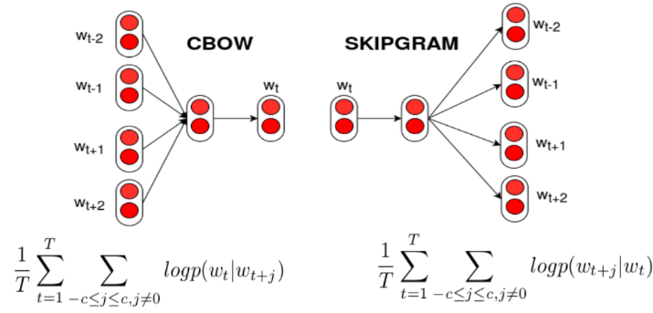
Text classification – indexing
Learning word representations (vectors)
How? -> NN-based
  Word-level (2003 - …)
    2013 – word2vec (Google – Mikolov)
      https://papers.nips.cc/paper/2013/file/9aa42b31882ec039965f3c4923ce901b-Paper.pdf
      Continous BOW model -> try to predict a word based on its context (neighbours); input = neighbour words, output = target word
      Skip-gram model -> try to predict context (neighbours) of a word; input = target word; output = neighbour words;
      Visualisation of embeddings https://ronxin.github.io/wevi/
      Trained vectors https://radimrehurek.com/gensim/models/word2vec.html or https://github.com/3Top/word2vec-api#where-to-get-a-pretrained-models

Slide 22
Text classification – indexing
Learning word representations (vectors)
How? -> NN-based
  Word-level (2003 - …)
    2014 – GloVe (Stanford – Pennington, Manning)
      https://nlp.stanford.edu/projects/glove/
    2017 - fastText (Facebook – Mikolov)
      https://arxiv.org/abs/1607.04606
      https://radimrehurek.com/gensim/models/fasttext.html

Slide 23
Text classification – indexing
Learning word representations (vectors)
How? -> NN-based
  Word-level (2003 - …)
  Sentence (document) level (2014 - … )
    2014 - Paragraph embedding
      https://arxiv.org/abs/1405.4053
    2015 – skip-thought vectors
      Predict previous / next sentence with seq2seq model)
      https://arxiv.org/abs/1506.06726
    2015 – auto-encoders (semi or unsupervised)
      https://arxiv.org/abs/1511.01432 ,
      https://arxiv.org/pdf/1511.06349.pdf,
      https://arxiv.org/abs/1602.03483

Slide 24
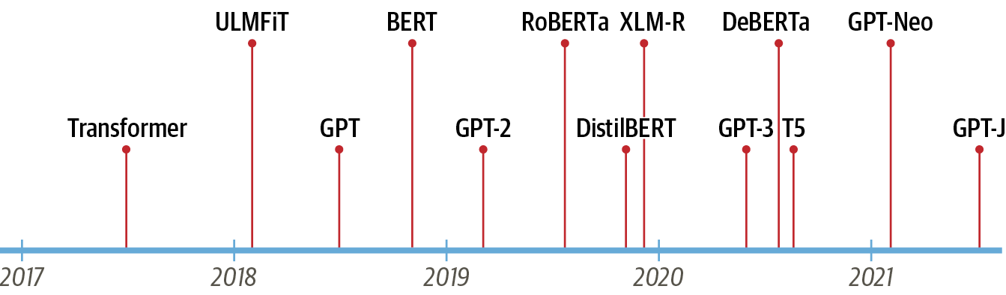
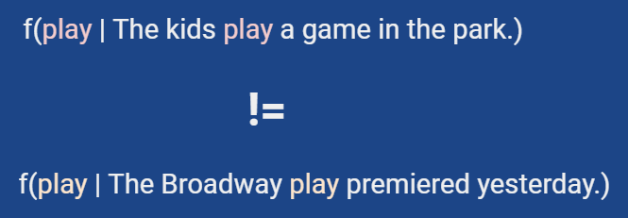
Text classification – indexing
Learning word representations (vectors)
How? -> NN-based
  Word-level (2003 - …)
  Sentence (document) level (2014 - … )
  Contextual word-vectors (Word vectors compress all contexts into a single vector) (2016 - …)
    2016 context2vec https://www.aclweb.org/anthology/K16-1006.pdf
    2017 tagLM https://arxiv.org/abs/1705.00108
    2017 CoVe https://papers.nips.cc/paper/2017/hash/20c86a628232a67e7bd46f76fba7ce12-Abstract.html
    2018 ELMo https://www.aclweb.org/anthology/N18-1202/
    2018 ULMFiT https://arxiv.org/abs/1801.06146
    2018 GPT (→ 2023 GPT4)
      Generative Pre-trained Transformer
      OpenAI
    2019 BERT
      Bidirectional Encoder Representations from Transformers
      Google
      https://arxiv.org/abs/1810.04805
    2019 T5
      Text-to-Text Transfer Transformer
      Google
  cross-lingual pre-training https://arxiv.org/abs/1706.04902
    Code example https://github.com/huggingface/naacl_transfer_learning_tutorial
    See also https://machinelearningmastery.com/use-word-embedding-layers-deep-learning-keras/

Slide 25
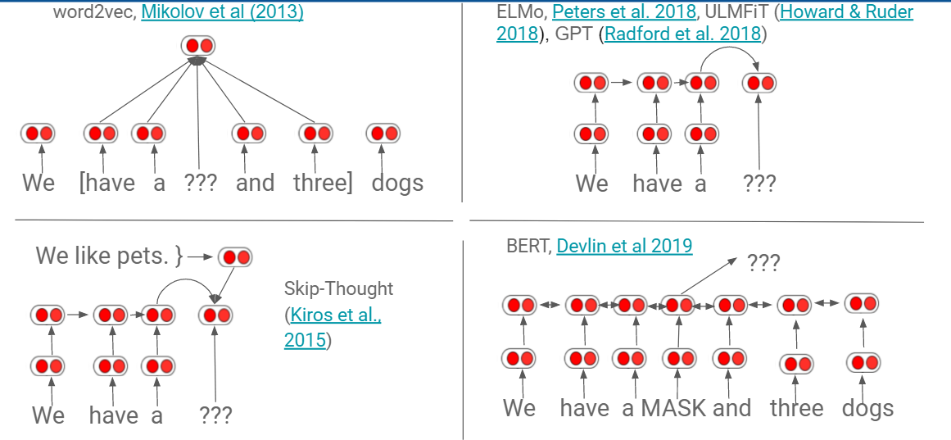
Text classification – indexing
Learning word representations (vectors)
How? -> NN-based

Slide 26
Embeddings
Process
  Text representation (pre-processing)
    Token-based models
    Token-free models
  Feature computation
    Frequency-based embeddings
      TF-IDF
      Co-occurrence matrix
    Prediction based embeddings
      Word / subword embeddings
        Word2vec (Skip-gram or Continuous Bag of Words (CBOW))

Slide 27
Embeddings
Process → Text representation
  Token-based models
    White Space: Splits on spaces (simple but limited)
    Word: Breaks into words (common for English)
    Sentence: Divides text into sentences
    Character: Splits into individual characters
    N-gram: Creates sequences of n items/elements
      fastText
    Subword: Breaks words into smaller parts
      Byte Pair Encoding (BPE): Merges common character pairs
      WordPiece: Google's method for balancing words and subwords
      Unigram
  Token-free models
    CharFormer
    byT5
    MegaByte
    Byte-latent transformer
Method | Complexity | Best For | Drawback
White Space | Low | Simple tasks | Fails with some languages
Word | Low | General NLP | Struggles with contractions
Subword | High | Unknown words | More complex

Slide 28
FastText – 2016
Text tokenization
  Subwords = each word is represented as a bag of character n-grams in addition to the word itself.
  E.g. “biking” would be represented by
    the 2-grams: “bi”, “ik”, “ki”, “in”, “ng” and “<biking>”
    The 3-grams: “bik”, “iki”, “kin”, “ing” and “<biking>”
  Dictionary
    union of the subwords of all words
    Subwords for various n (n=3, 4, 5, 6)
    Larger than for original 1-hot representation from Word2Vec → more parameters
  Representation
    Each word → 1-hot encoding for the extended dictionary
Feature computation
  Apply skip-gram model principles for training the weights
  Each word is represented by the sum of its subword embeddings.
Advantages
  Handles Out-of-Vocabulary (OOV) Words (e.g bikelane)
  Captures Morphological Information (e.g., “biking” and “biker”)
Weaknesses
  High memory requirement
Example
  Word: “bikelane“ (OOV)
  Character 3-grams: “bik", “ike", “kel", “ela“, “lan”, “ane”
  Embedding: The embedding for “bikelane" is the sum of the embeddings of its n-grams.
More details
  Bojanowski, P., Grave, E., Joulin, A., & Mikolov, T. (2016). Enriching word vectors with subword information (2016). arXiv preprint arXiv:1607.04606 link
  https://fasttext.cc/docs/en/supervised-tutorial.html
  https://github.com/facebookresearch/fastText/

Slide 29
BPE – 2016
Text tokenization
  subwords = each word is represented as a list of tokens composed of characters
  a compression algorithm adapted for subword tokenization. It iteratively merges the most frequent pairs of characters or character sequences in a corpus to form subword units.
  deterministic algorithm – based on the occurrences of words in the given text
  Process of tokenization = building with Legos (from tiny pieces to bigger ones by various combinations)
    Token learning = raw training text → learnt vocabulary (set of tokens)
      Begin with single characters
      Find the most common character pair
      Merge that pair into a new token
      Repeat until you hit your token limit
    Segmenting / Processing = raw test text → list of tokens (based on the vocabulary)
      Apply the merge rules learned in order on the individual characters of the given text

Slide 30
BPE – 2016
Text tokenization
  E.g.
    Training text = {bike, biker, like}
    Segmented the text by using elementary units (e.g. chars): (b, i, k, e), (b, i, k, e, r), (l, i, k, e)
    Vocabulary of elements: b, i, k, e, r, l
    Iter1
      Form all possible pairs of 2 elements from the vocabulary and that are on consecutive position in the original text
        b + i, i + k, k + e, e + r, l + i
      Compute the score = the frequency of each pair
        b + i → 2, i + k → 3, k + e -> 3, e + r → 1, l + i → 1
      Greedy select the pair of the maximum score
        b + i → 2, i + k → 3, k + e -> 3, e + r → 1, l + i → 1
      Merge the 2 elements, store the merging rule, add the new element into the vocabulary
        Vocab: b, i, k, e, r, l, ik
      Update the segmented text based on the merge rule
        (b, i, k, e), (b, i, k, e, r), (l, i, k, e) → (b, ik, e), (b, ik, e, r), (l, ik, e)
    Iter2
      Form all possible pairs of 2 elements from the vocabulary and that are on consecutive position in the original text
        b + ik, ik + e, e + r, l + ik
      Compute the score = the frequency of each pair
        b + ik → 2, ik + e → 3, e + r → 1, l + ik → 1
      Greedy select the pair of the maximum score
        b + ik → 2, ik + e → 3, e + r → 1, l + ik → 1
      Merge the 2 elements, store the merging rule, add the new element into the vocabulary
        Vocab: b, i, k, e, r, l, ik, ike
      Update the segmented text based on the merge rule
        (b, ik, e), (b, ik, e, r), (l, ik, e) → (b, ike), (b, ike, r), (l, ike)
    Iter3
      Form all possible pairs of 2 elements from the vocabulary and that are on consecutive position in the original text
        b + ike, ike + r, l + ike
      Compute the score = the frequency of each pair
        b + ike → 2, ike + r → 1, l + ike → 1
      Greedy select the pair of the maximum score
        b + ike → 2, ike + r → 1, l + ike → 1
      Merge the 2 elements, store the merging rule, add the new element into the vocabulary
        Vocab: b, i, k, e, r, l, ik, ike, bike
      Update the segmented text based on the merge rule
      (b, ike), (b, ike, r), (l, ike) → (bike), (bike, r), (l, ike)
    Tokenize a new text:
      Segment the text in iniatial elements (chars) and apply the “learnt” rules
      E.g. biking
        Start: b, i, k, I, n, g
        First rule: b, ik, i, n, g
        Second rule: b, ik, i, n, g
        Third rule: b, ik, i, n, g
      E.g. bikelane
        Start: b, i, k, e, l, a, n, e
        First rule: b, ik, e, l, a, n, e
        Second rule: b, ike, l, a, n, e
        Third rule: bike, l, a, n, e
    Homework:
      Repeat the training and the tokenization for the same two words by using as training data the text: {bike, biker, like, biking, riding, bike, running)}

Slide 31
BPE – 2016
Text tokenization
  Dictionary
    union of the subwords / tokens of all words
    Larger than for original 1-hot representation from Word2Vec → more parameters
  Representation
    Each word → 1-hot encoding for the extended dictionary
Feature computation
  Apply skip-gram model principles for training the weights
  Each word is represented by the sum of its subword embeddings.
Advantages
  BPE works best with languages that build long words from smaller ones. It's not as great for languages with simple word structures.
  Scalability → Sequences of longer length can be encoded succinctly
  Improved Efficiency for Large Datasets since the vocabulary size can be reduced significantly.
  Flexibility → by handling of Rare Wordsand Out-of-Vocabulary Words → Better Handling of Domain-Specific Language (medical, legal, genomics texts etc.)
  Efficient Vocabulary Size: BPE creates a fixed-size vocabulary of subword units, balancing between character-level and word-level representations.
Weaknesses
  Computational Complexity
More details
  Sennrich, R. (2015). Neural machine translation of rare words with subword units. arXiv preprint arXiv:1508.07909 link
  BPE as data compression algorithm → Gage, P. (1994). A new algorithm for data compression. The C Users Journal, 12(2), 23-38. link
  Byte-level BPE – GPT2, RoBERTa don’t look at words as being written with Unicode characters, but with bytes. This way the base vocabulary has a small size (256), but every character you can think of will still be included and not end up being converted to the unknown token.
  GPT-2 starts with 256 bytes base tokens, a special end-of-text token and the symbols learnt during 50 000 merges → 50 257 tokens
  Comparison of more tokenization methods - Bostrom, K., & Durrett, G. (2020). Byte pair encoding is suboptimal for language model pretraining. arXiv preprint arXiv:2004.03720 link
  HuggingFace docs https://huggingface.co/learn/nlp-course/chapter6/5

Slide 32
WordPiece – 2012
Text tokenization
  Similar to BPE - starts with individual characters and merges the most frequent pairs. It merges based on both frequency and likelihood of the formed subword
  Process of tokenization = building with Legos (from tiny pieces to bigger ones by various combinations)
    Token learning = raw training text → learnt vocabulary (set of tokens)
      Begin with single characters
      Find the pair that maximizes the likelihood of the training data once added to the vocabulary
        Greedy search → deterministic algorithm
      Merge that pair into a new token
      Repeat until you hit your token limit
    Segmenting / Processing = raw test text → list of tokens (based on the vocabulary)
      Apply the merge rules learned in order on the individual characters of the given text

Slide 33
WordPiece – 2012
Text tokenization
  E.g. Training text = {bike, biker, like}
    Segmented the text by using elementary units (e.g. chars and ##char): (b, ##i, ##k, ##e), (b, ##i, ##k, ##e, ##r), (l, ##i, ##k, ##e)
    Vocabulary of elements: b, ##i, ##k, ##e, ##r, l
    Iter1
      Form all possible pairs of 2 elements from the vocabulary and that are on consecutive position in the original text
        b + ##i, ##i + ##k, ##k + ##e, ##e + ##r, l + ##i
      Compute the score = the frequency of each pair / (frequency of the first element * frequency of the second element
        b + ##i → 2 / (2 + 3), ##i + ##k → 3 / (3 + 3), ##k + ##e → 3 / (3 + 3), ##e + ##r → 1 / (3 + 1), l + ##i → 1 / (1 + 3)
        b + ##i → 0.4, ##i + ##k → 0.5, ##k + ##e → 0.5, ##e + ##r → 0.25, l + ##i → 0.25
      Greedy select the pair of the maximum score
        b + ##i → 0.4, ##i + ##k → 0.5, ##k + ##e → 0.5, ##e + ##r → 0.25, l + ##i → 0.25
      Merge the 2 elements, store the merging rule, add the new element into the vocabulary
        Vocab: b, i, k, e, r, l, ##ik
      Update the segmented text based on the merge rule
        (b, ##i, ##k, ##e), (b, ##i, ##k, ##e, ##r), (l, ##i, ##k, ##e) → (b, ##ik, ##e), (b, ##ik, ##e, ##r), (l, ##ik, ##e)
    Iter2
      Form all possible pairs of 2 elements from the vocabulary and that are on consecutive position in the original text
        b + ##ik, ##ik + ##e, ##e + ##r, l + ##ik
      Compute the score = the frequency of each pair / (frequency of the first element * frequency of the second element
        b + ##ik → 2 / (2 + 3), ##ik + ##e → 3 / (3 + 2), ##e + ##r → 1 / (2 + 1), l + ##ik → 1 / (1 + 3)
        b + ##ik → 0.4, ##ik + ##e → 0.6, ##e + ##r → 0.33, l + ##ik → 0.25
      Greedy select the pair of the maximum score
        b + ##ik → 0.4, ##ik + ##e → 0.6, ##e + ##r → 0.33, l + ##ik → 0.25
      Merge the 2 elements, store the merging rule, add the new element into the vocabulary
        Vocab: b, i, k, e, r, l, ik, ##ike
      Update the segmented text based on the merge rule
        (b, ##ik, ##e), (b, ##ik, ##e, ##r), (l, ##ik, ##e) → (b, ##ike), (b, ##ike, ##r), (l, ##ike)

Slide 34
WordPiece – 2012
Text tokenization
  E.g. Training text = {bike, biker, like}
    Segmented the text by using elementary units (e.g. chars and ##char): (b, ##i, ##k, ##e), (b, ##i, ##k, ##e, ##r), (l, ##i, ##k, ##e)
    Vocabulary of elements: b, ##i, ##k, ##e, ##r, l
    Iter3
      Form all possible pairs of 2 elements from the vocabulary and that are on consecutive position in the original text
        b + ##ike, ##ike + ##r, l + ##ike
      Compute the score = the frequency of each pair
        b + ##ike → 2 / (2 + 3), ##ike + ##r → 1 / (3 +1), l + ##ike → 1 / (1 + 3)
        b + ##ike → 0.4, ##ike + ##r → 0.25, l + ##ike → 0.25
      Greedy select the pair of the maximum score
        b + ##ike → 0.4, ##ike + ##r → 0.25, l + ##ike → 0.25
      Merge the 2 elements, store the merging rule, add the new element into the vocabulary
        Vocab: b, i, k, e, r, l, ik, ike, bike
      Update the segmented text based on the merge rule
        (b, ##ike), (b, ##ike, ##r), (l, ##ike) → (bike), (bike, ##r), (l, ##ike)
  Tokenize a new text:
    Search for the longest elements of the vocabulary that the text start with
    E.g. biking
      Vocab: b, i, k, e, r, l, ik, ike, bike
      biking → [b, iking]
      Iking → [ik, ing]
      ing → [i, ng]
      biking → [b, ik, i, ng]
    E.g. bikelane
      Vocab: b, i, k, e, r, l, ik, ike, bike
      bikelane → [bike, lane]
      lane -> l, ane
      bikelane → [bike, l, ane]
  Homework:
    Repeat the training and the tokenization for the same two words by using as training data the text: {bike, biker, like, biking, riding, bike, running)}

Slide 35
WordPiece – 2012
Text tokenization
  Similar to BPE - starts with individual characters and merges the most frequent pairs. It merges based on both frequency and likelihood of the formed subword
  E.g.
    …
  Dictionary
    union of the subwords / tokens of all words
    Larger than for original 1-hot representation from Word2Vec → more parameters
  Representation
    Each word → 1-hot encoding for the extended dictionary
Feature computation
  Apply skip-gram model principles for training the weights
  Each word is represented by the sum of its subword embeddings.
Advantages
  WordPiece works best when:
    The training data is fixed
    New data is similar to the training set
    dealing with morphologically rich languages
Weaknesses
  Spelling mistakes can cause a massive decrease in model performance - Kumar, A., Makhija, P., & Gupta, A. (2020). Noisy text data: Achilles' heel of BERT. arXiv preprint arXiv:2003.12932. link
  WordPeice fails when it gets the word boundaries wrong (because it is greedy)
More details
  Schuster, M., & Nakajima, K. (2012, March). Japanese and korean voice search. In 2012 IEEE international conference on acoustics, speech and signal processing (ICASSP) (pp. 5149-5152). IEEE. Link
  Pro & cons for BPE vs WordPiece https://medium.com/@atharv6f_47401/wordpiece-tokenization-a-bpe-variant-73cc48865cbf
  TEnsorFlow https://www.tensorflow.org/text/guide/subwords_tokenizer#optional_the_algorithm
  HuggingFace docs https://huggingface.co/learn/nlp-course/en/chapter6/6?fw=pt
"WordPiece ensures that the most common words are represented in the vocabulary as a single token while rare words are broken down into smaller subword tokens." - Schuster et al., 2012
Aspect | WordPiece | BPE
Selection | Maximizes data likelihood | Picks most frequent pair
Optimization | Dataset-specific | More general
Vocab Size | Usually smaller | Often larger
Training | Faster convergence | Can take longer

Slide 36
Unigram – 2018
Text tokenization
  uses a probabilistic model to determine the likelihood of subword sequences and selects the most probable subword segmentation
  Process of tokenization = starts from a big vocabulary and removes tokens from it until it reaches the desired vocabulary size
    Token learning = raw training text → learnt vocabulary (set of tokens)
      Start with a large initial vocabulary that includes [all] possible subwords from the corpus → individual characters, words, and subwords.
      Frequency Calculation: Calculate the frequency of each subword in the initial vocabulary based on the training corpus.
      Loss Calculation: For each subword, compute the loss, which is a measure of how much the overall likelihood of the corpus decreases if that subword is removed from the vocabulary.
        Loss = Σ freq * ( - log(P(word))
      Pruning: Remove the subwords that contribute the least to the overall likelihood (i.e., those with the smallest impact on the loss). This step is repeated iteratively until the desired vocabulary size is reached.
        computes a loss over the corpus given the current vocabulary. Then, for each symbol in the vocabulary, the algorithm computes how much the overall loss would increase if the symbol was removed, and looks for the symbols that would increase it the least. Those symbols have a lower effect on the overall loss over the corpus, so in a sense they are “less needed” and are the best candidates for removal.
      Repeat until you hit your token limit
    Segmenting / Processing = raw test text → list of tokens (based on the vocabulary)
      by selecting the most probable sequence of subwords that compose each word. This is typically done using a dynamic programming algorithm like the Viterbi algorithm.

Slide 37
Unigram – 2018
Text tokenization
  E.g. Training text = {bike, biker, like}
    Segmented the text by using elementary units (e.g. chars and bigrams): (b, i, k, e), (b, i, k, e, r), (l, i, k, e)
    Vocabulary of elements: b, i, k, e, r, l, bi, ik, ke, er, li
    Iter1
    Frequencies: b → 2, i → 3, k → 3, e → 3, r → 1, l → 1, bi → 2, ik → 3, ke → 3, er → 1, li → 1, sum of all frequencies = 23
    For all the words, identify the segmentation of maximum probability
      bike →
        P([b, i, k ,e]) = 2 / 23 * 3 / 23 * 3 / 23 * 3 / 23 = (2 * 3 *3 * 3) / 23⁴
        P([bi, k, e]) = 2 / 23 * 3 / 23 * 3 / 23 = (2 * 3 * 3) / 23³
        P([b, ik, e]) = 2 / 23 * 3 / 23 * 3 / 23 = (2 * 3 * 3) / 23³
        P([b, i, ke]) = 2 / 23 * 3 /23 * 3 / 23 = (2 * 3 * 3) / 23³
        P([bi, ke]) = 2/ 23 * 3 / 23 = (2 * 3) / 23²
      Biker →
        P([b, i, k ,e, r]) = 2 / 23 * 3 / 23 * 3 / 23 * 3 / 23 * 1 / 23= (2 * 3 *3 * 3 * 1) / 23⁵
        P([bi, k, e, r]) = 2 / 23 * 3 / 23 * 3 / 23 * 1 / 23 = (2 * 3 * 3 * 1) / 23⁴
        P([b, ik, e, r]) = 2 / 23 * 3 / 23 * 3 / 23 * 1 / 23 = (2 * 3 * 3 * 1) / 23⁴
        P([b, i, ke, r]) = 2 / 23 * 3 /23 * 3 / 23 * 1 / 23= (2 * 3 * 3 * 1) / 23⁴
        P([b, i, k, er]) = 2 / 23 * 3 /23 * 3 / 23 * 1 / 23= (2 * 3 * 3 * 1) / 23⁴
        P([bi, ke, r]) = 2/ 23 * 3 / 23 * 1 / 23 = (2 * 3 * 1) / 23³
        P([bi, k, er]) = 2/ 23 * 3 / 23 * 1 / 23 = (2 * 3 * 1) / 23³
        P([b, ik, er]) = 2/ 23 * 3 / 23 * 1 / 23 = (2 * 3 * 1) / 23³
      like
        P([l, i, k, e]) = = 1 / 23 * 3 / 23 * 3 / 23 * 3 / 23 = (1 * 3 *3 * 3) / 23⁴
        P([li, k, e]) = 1 / 23 * 3 / 23 * 3 / 23 = (1 * 3 * 3) / 23³
        P([l, ik, e]) = 1 / 23 * 3 / 23 * 3 / 23 = (1 * 3 * 3) / 23³
        P([l, i, ke]) = 1 / 23 * 3 /23 * 3 / 23 = (1 * 3 * 3) / 23³
        P([li, ke]) = 1 / 23 * 3 / 23 = (1 * 3) / 23²
    Loss computation
      Loss = Σ freq * ( - log(P(word)) = 1 * (- log(6 / 23²) + 1 * (- log(6 / 23³) + 1 * (- log(3 / 23²) = 7.589
 |  | V
Freq | Word | Score
1 | bike | 0.0019
1 | biker | 0.0006
1 | like | 0.0068
Loss |  | 7.589

Slide 38
Unigram – 2018
Text tokenization
  E.g. Training text = {bike, biker, like}
    Segmented the text by using elementary units (e.g. chars and bigrams): (b, i, k, e), (b, i, k, e, r), (l, i, k, e)
    Vocabulary of elements: b, i, k, e, r, l, bi, ik, ke, er, li
    Iter2
    Frequencies: b → 2, i → 3, k → 3, e → 3, r → 1, l → 1, bi → 0, ik → 3, ke → 3, er → 1, li → 1, sum of all frequencies = 21
    For all the words, identify the segmentation of maximum probability
      Bike →
        P([b, i, k ,e]) = 2 / 21 * 3 / 21 * 3 / 21 * 3 / 21 = (2 * 3 *3 * 3) / 21⁴
        P([bi, k, e]) = 0 / 21 * 3 / 21 * 3 / 21 = 0
        P([b, ik, e]) = 2 / 21 * 3 / 21 * 3 / 21 = (2 * 3 * 3) / 21³
        P([b, i, ke]) = 2 / 21 * 3 /21 * 3 / 21 = (2 * 3 * 3) / 21³
        P([bi, ke]) = 0 / 21 * 3 / 21 = 0
      Biker →
        P([b, i, k ,e, r]) = 2 / 21 * 3 / 21 * 3 / 21 * 3 / 21 * 1 / 21= (2 * 3 *3 * 3 * 1) / 21⁵
        P([bi, k, e, r]) = 0 / 21 * 3 / 21 * 3 / 21 * 1 / 21 = (2 * 3 * 3 * 1) / 21⁴
        P([b, ik, e, r]) = 2 / 21 * 3 / 21 * 3 / 21 * 1 / 21 = (2 * 3 * 3 * 1) / 21⁴
        P([b, i, ke, r]) = 2 / 21 * 3 /21 * 3 / 21 * 1 / 21= (2 * 3 * 3 * 1) / 21⁴
        P([b, i, k, er]) = 2 / 21 * 3 /21 * 3 / 21 * 1 / 21= (2 * 3 * 3 * 1) / 21⁴
        P([bi, ke, r]) = 0 / 21 * 3 / 21 * 1 / 21 = 0
        P([bi, k, er]) = 0 / 21 * 3 / 21 * 1 / 21 = 0
        P([b, ik, er]) = 2/ 21 * 3 / 21 * 1 / 21 = (2 * 3 * 1) / 21³
      like
        P([l, i, k, e]) = = 1 / 21 * 3 / 21 * 3 / 21 * 3 / 21 = (1 * 3 *3 * 3) / 21⁴
        P([li, k, e]) = 1 / 21 * 3 / 21 * 3 / 21 = (1 * 3 * 3) / 21³
        P([l, ik, e]) = 1 / 21 * 3 / 21 * 3 / 21 = (1 * 3 * 3) / 21³
        P([l, i, ke]) = 1 / 21 * 3 /21 * 3 / 21 = (1 * 3 * 3) / 21³
        P([li, ke]) = 1 / 21 * 3 / 21 = (1 * 3) / 21²
    Loss computation
      Loss = Σ freq * ( - log(P(word)) = 1 * (- log(18 / 21³) + 1 * (- log(6 / 21³) + 1 * (- log(3 / 21²) = 8.05
 |  | V | V – {bi}
Freq | Word | Score | Score
1 | bike | 0.0019 | 0.0113
1 | biker | 0.0006 | 0.0004
1 | like | 0.0068 | 0.0056
Loss |  | 7.589 | 8.050

Slide 39
Unigram – 2018
Text tokenization
  E.g. Training text = {bike, biker, like}
    Segmented the text by using elementary units (e.g. chars and bigrams): (b, i, k, e), (b, i, k, e, r), (l, i, k, e)
    Vocabulary of elements: b, i, k, e, r, l, bi, ik, ke, er, li
    Iter3
    Frequencies: b → 2, i → 3, k → 3, e → 3, r → 1, l → 1, bi → 2, ik → 0, ke → 3, er → 1, li → 1, sum of all frequencies = 20
    For all the words, identify the segmentation of maximum probability
      Bike →
        P([b, i, k ,e]) = 2 / 20 * 3 / 20 * 3 / 20 * 3 / 20 = (2 * 3 *3 * 3) / 20⁴
        P([bi, k, e]) = 2 / 20 * 3 / 20 * 3 / 20 = (2 * 3 * 3) / 20³
        P([b, ik, e]) = 2 / 20 * 0 / 20 * 3 / 20 = 0
        P([b, i, ke]) = 2 / 20 * 3 /20 * 3 / 20 = (2 * 3 * 3) / 20³
        P([bi, ke]) = 2 / 20 * 3 / 20 = (2 * 3) / 20²
      Biker →
        P([b, i, k ,e, r]) = 2 / 20 * 3 / 20 * 3 / 20 * 3 / 20 * 1 / 20= (2 * 3 *3 * 3 * 1) / 20⁵
        P([bi, k, e, r]) = 2 / 20 * 3 / 20 * 3 / 20 * 1 / 20 = (2 * 3 * 3 * 1) / 20⁴
        P([b, ik, e, r]) = 2 / 20 * 0 / 20 * 3 / 20 * 1 / 20 = 0
        P([b, i, ke, r]) = 2 / 20 * 3 /20 * 3 / 20 * 1 / 20= (2 * 3 * 3 * 1) / 20⁴
        P([b, i, k, er]) = 2 / 20 * 3 /20 * 3 / 20 * 1 / 20= (2 * 3 * 3 * 1) / 20⁴
        P([bi, ke, r]) = 2/ 20 * 3 / 20 * 1 / 20 = (2 * 3 * 1) / 20³
        P([bi, k, er]) = 2/ 20 * 3 / 20 * 1 / 20 = (2 * 3 * 1) / 20³
        P([b, ik, er]) = 2/ 20 * 0 / 20 * 1 / 20 = 0
      like
        P([l, i, k, e]) = = 1 / 20 * 3 / 20 * 3 / 20 * 3 / 20 = (1 * 3 *3 * 3) / 20⁴
        P([li, k, e]) = 1 / 20 * 3 / 20 * 3 / 20 = (1 * 3 * 3) / 20³
        P([l, ik, e]) = 1 / 20 * 0 / 20 * 3 / 20 = 0
        P([l, i, ke]) = 1 / 20 * 3 /20 * 3 / 20 = (1 * 3 * 3) / 20³
        P([li, ke]) = 1 / 20 * 3 / 20 = (1 * 3) / 20²
    Loss computation
      Loss = Σ freq * ( - log(P(word)) = 1 * (- log(6 / 20²) + 1 * (- log(6 / 20³) + 1 * (- log(3 / 20²) = 7.071
 |  | V | V – {bi} | V – {ik}
Freq | Word | Score | Score | Score
1 | bike | 0.0019 | 0.0113 | 0.0150
1 | biker | 0.0006 | 0.0004 | 0.0007
1 | like | 0.0068 | 0.0056 | 0.0075
Loss |  | 7.589 | 8.050 | 7.071

Slide 40
Unigram – 2018
Text tokenization
  E.g. Training text = {bike, biker, like}
    Segmented the text by using elementary units (e.g. chars and bigrams): (b, i, k, e), (b, i, k, e, r), (l, i, k, e)
    Vocabulary of elements: b, i, k, e, r, l, bi, ik, ke, er, li
    Iter4
    Frequencies: b → 2, i → 3, k → 3, e → 3, r → 1, l → 1, bi → 2, ik → 3, ke → 0, er → 1, li → 1, sum of all frequencies = 20
    For all the words, identify the segmentation of maximum probability
      Bike →
        P([b, i, k ,e]) = 2 / 20 * 3 / 20 * 3 / 20 * 3 / 20 = (2 * 3 *3 * 3) / 20⁴
        P([bi, k, e]) = 2 / 20 * 3 / 20 * 3 / 20 = (2 * 3 * 3) / 20³
        P([b, ik, e]) = 2 / 20 * 0 / 20 * 3 / 20 = (2 * 3 * 3) / 20³
        P([b, i, ke]) = 2 / 20 * 3 /20 * 0 / 20 = 0
        P([bi, ke]) = 2 / 20 * 0 / 20 = 0
      Biker →
        P([b, i, k ,e, r]) = 2 / 20 * 3 / 20 * 3 / 20 * 3 / 20 * 1 / 20= (2 * 3 *3 * 3 * 1) / 20⁵
        P([bi, k, e, r]) = 2 / 20 * 3 / 20 * 3 / 20 * 1 / 20 = (2 * 3 * 3 * 1) / 20⁴
        P([b, ik, e, r]) = 2 / 20 * 3 / 20 * 3 / 20 * 1 / 20 = (2 * 3 * 3 * 1) / 20⁴
        P([b, i, ke, r]) = 2 / 20 * 3 /20 * 0 / 20 * 1 / 20 = 0
        P([b, i, k, er]) = 2 / 20 * 3 /20 * 3 / 20 * 1 / 20 = (2 * 3 * 3 * 1) / 20⁴
        P([bi, ke, r]) = 2/ 20 * 0 / 20 * 1 / 20 = 0
        P([bi, k, er]) = 2/ 20 * 3 / 20 * 1 / 20 = (2 * 3 * 1) / 20³
        P([b, ik, er]) = 2/ 20 * 3 / 20 * 1 / 20 = (2 * 3 * 1) / 20³
      like
        P([l, i, k, e]) = = 1 / 20 * 3 / 20 * 3 / 20 * 3 / 20 = (1 * 3 *3 * 3) / 20⁴
        P([li, k, e]) = 1 / 20 * 3 / 20 * 3 / 20 = (1 * 3 * 3) / 20³
        P([l, ik, e]) = 1 / 20 * 3 / 20 * 3 / 20 = (1 * 3 * 3) / 20³
        P([l, i, ke]) = 1 / 20 * 3 /20 * 0 / 20 = 0
        P([li, ke]) = 1 / 20 * 0 / 20 = 0
    Loss computation
      Loss = Σ freq * ( - log(P(word)) = 1 * (- log(18 / 20³) + 1 * (- log(6 / 20³) + 1 * (- log(9 / 20³) = 8.719
 |  | V | V – {bi} | V – {ik} | V – {ke}
Freq | Word | Score | Score | Score | Score
1 | bike | 0.0019 | 0.0113 | 0.0150 | 0.0022
1 | biker | 0.0006 | 0.0004 | 0.0007 | 0.0007
1 | like | 0.0068 | 0.0056 | 0.0075 | 0.0011
Loss |  | 7.589 | 8.050 | 7.071 | 8.719

Slide 41
Unigram – 2018
Text tokenization
  E.g. Training text = {bike, biker, like}
    Segmented the text by using elementary units (e.g. chars and bigrams): (b, i, k, e), (b, i, k, e, r), (l, i, k, e)
    Vocabulary of elements: b, i, k, e, r, l, bi, ik, ke, er, li
    Iter5
    Frequencies: b → 2, i → 3, k → 3, e → 3, r → 1, l → 1, bi → 2, ik → 3, ke → 3, er → 0, li → 1, sum of all frequencies = 22
    For all the words, identify the segmentation of maximum probability
      Bike →
        P([b, i, k ,e]) = 2 / 22 * 3 / 22 * 3 / 22 * 3 / 22 = (2 * 3 *3 * 3) / 22⁴
        P([bi, k, e]) = 2 / 22 * 3 / 22 * 3 / 22 = (2 * 3 * 3) / 22³
        P([b, ik, e]) = 2 / 22 * 3 / 22 * 3 / 22 = (2 * 3 * 3) / 22³
        P([b, i, ke]) = 2 / 22 * 3 /22 * 3 / 22 = (2 * 3 * 3) / 22³
        P([bi, ke]) = 2 / 22 * 3 / 22 = (2 * 3) / 22²
      Biker →
        P([b, i, k ,e, r]) = 2 / 22 * 3 / 22 * 3 / 22 * 3 / 22 * 1 / 22= (2 * 3 *3 * 3 * 1) / 22⁵
        P([bi, k, e, r]) = 2 / 22 * 3 / 22 * 3 / 22 * 1 / 22 = (2 * 3 * 3 * 1) / 22⁴
        P([b, ik, e, r]) = 2 / 22 * 3 / 22 * 3 / 22 * 1 / 22 = (2 * 3 * 3 * 1) / 22⁴
        P([b, i, ke, r]) = 2 / 22 * 3 /22 * 3 / 22 * 1 / 22 = (2 * 3 * 3 * 1) / 22⁴
        P([b, i, k, er]) = 2 / 22 * 3 /22 * 3 / 22 * 0 / 22 = 0
        P([bi, ke, r]) = 2/ 22 * 3 / 22 * 1 / 22 = (2 * 3 * 1) / 22³
        P([bi, k, er]) = 2/ 22 * 3 / 22 * 0 / 22 = 0
        P([b, ik, er]) = 2/ 22 * 3 / 22 * 0 / 22 = 0
      like
        P([l, i, k, e]) = = 1 / 22 * 3 / 22 * 3 / 22 * 3 / 22 = (1 * 3 *3 * 3) / 22⁴
        P([li, k, e]) = 1 / 22 * 3 / 22 * 3 / 22 = (1 * 3 * 3) / 22³
        P([l, ik, e]) = 1 / 22 * 3 / 22 * 3 / 22 = (1 * 3 * 3) / 22³
        P([l, i, ke]) = 1 / 22 * 3 /22 * 3 / 22 = (1 * 3 * 3) / 22³
        P([li, ke]) = 1 / 22 * 3 / 22 = (1 * 3) / 22²
    Loss computation
      Loss = Σ freq * ( - log(P(word)) = 1 * (- log(6/ 22²) + 1 * (- log(6 / 22³) + 1 * (- log(3 / 22²) = 7.362
 |  | V | V – {bi} | V – {ik} | V – {ke} | V – {er}
Freq | Word | Score | Score | Score | Score | Score
1 | bike | 0.0019 | 0.0113 | 0.0150 | 0.0022 | 0.0123
1 | biker | 0.0006 | 0.0004 | 0.0007 | 0.0007 | 0.0005
1 | like | 0.0068 | 0.0056 | 0.0075 | 0.0011 | 0.0061
Loss |  | 7.589 | 8.050 | 7.071 | 8.719 | 7.362

Slide 42
Unigram – 2018
Text tokenization
  E.g. Training text = {bike, biker, like}
    Segmented the text by using elementary units (e.g. chars and bigrams): (b, i, k, e), (b, i, k, e, r), (l, i, k, e)
    Vocabulary of elements: b, i, k, e, r, l, bi, ik, ke, er, li
    Iter6
    Frequencies: b → 2, i → 3, k → 3, e → 3, r → 1, l → 1, bi → 2, ik → 3, ke → 3, er → 1, li → 0, sum of all frequencies = 22
    For all the words, identify the segmentation of maximum probability
      Bike →
        P([b, i, k ,e]) = 2 / 22 * 3 / 22 * 3 / 22 * 3 / 22 = (2 * 3 *3 * 3) / 22⁴
        P([bi, k, e]) = 2 / 22 * 3 / 22 * 3 / 22 = (2 * 3 * 3) / 22³
        P([b, ik, e]) = 2 / 22 * 3 / 22 * 3 / 22 = (2 * 3 * 3) / 22³
        P([b, i, ke]) = 2 / 22 * 3 /22 * 3 / 22 = (2 * 3 * 3) / 22³
        P([bi, ke]) = 2 / 22 * 3 / 22 = (2 * 3) / 22²
      Biker →
        P([b, i, k ,e, r]) = 2 / 22 * 3 / 22 * 3 / 22 * 3 / 22 * 1 / 22= (2 * 3 *3 * 3 * 1) / 22⁵
        P([bi, k, e, r]) = 2 / 22 * 3 / 22 * 3 / 22 * 1 / 22 = (2 * 3 * 3 * 1) / 22⁴
        P([b, ik, e, r]) = 2 / 22 * 3 / 22 * 3 / 22 * 1 / 22 = (2 * 3 * 3 * 1) / 22⁴
        P([b, i, ke, r]) = 2 / 22 * 3 /22 * 3 / 22 * 1 / 22 = (2 * 3 * 3 * 1) / 22⁴
        P([b, i, k, er]) = 2 / 22 * 3 /22 * 3 / 22 * 1 / 22 = (2 * 3 * 3 * 1) / 22⁴
        P([bi, ke, r]) = 2/ 22 * 3 / 22 * 1 / 22 = (2 * 3 * 1) / 22³
        P([bi, k, er]) = 2/ 22 * 3 / 22 * 1 / 22 = (2 * 3 * 1) / 22³
        P([b, ik, er]) = 2/ 22 * 3 / 22 * 1 / 22 = (2 * 3 * 1) / 22³
      like
        P([l, i, k, e]) = = 1 / 22 * 3 / 22 * 3 / 22 * 3 / 22 = (1 * 3 *3 * 3) / 22⁴
        P([li, k, e]) = 0 / 22 * 3 / 22 * 3 / 22 = 0
        P([l, ik, e]) = 1 / 22 * 3 / 22 * 3 / 22 = (1 * 3 * 3) / 22³
        P([l, i, ke]) = 1 / 22 * 3 /22 * 3 / 22 = (1 * 3 * 3) / 22³
        P([li, ke]) = 0 / 22 * 3 / 22 = 0
    Loss computation
      Loss = Σ freq * ( - log(P(word)) = 1 * (- log(6/ 22²) + 1 * (- log(6 / 22³) + 1 * (- log(9 / 22³) = 8.228
 |  | V | V – {bi} | V – {ik} | V – {ke} | V – {er} | V – {li}
Freq | Word | Score | Score | Score | Score | Score | Score
1 | bike | 0.0019 | 0.0113 | 0.0150 | 0.0022 | 0.0123 | 0.0123
1 | biker | 0.0006 | 0.0004 | 0.0007 | 0.0007 | 0.0005 | 0.0005
1 | like | 0.0068 | 0.0056 | 0.0075 | 0.0011 | 0.0061 | 0.0008
Loss |  | 7.589 | 8.050 | 7.071 | 8.719 | 7.362 | 8.228

Slide 43
Unigram – 2018
Text tokenization
  E.g. Training text = {bike, biker, like}
    Segmented the text by using elementary units (e.g. chars and bigrams): (b, i, k, e), (b, i, k, e, r), (l, i, k, e)
    Vocabulary of elements: b, i, k, e, r, l, bi, ik, ke, er, li
    Choose to eliminate the token with the minimum loss → ik
      Vocabulary of elements: b, i, k, e, r, l, bi, ke, er, li
  Tokenize a new text (e.g. bike):
    identify the segmentation of maximum probability
    Frequencies: b → 2, i → 3, k → 3, e → 3, r → 1, l → 1, bi → 2, ke → 3, er → 1, li → 1, sum of all frequencies = 20
      kerb →
        P([k, e, r, b]) = 3 / 20 * 3 / 20 * 1 / 20 * 2 / 20 = (3 * 3 * 1 * 2) / 20⁴
        P([ke, r, b]) = 3 / 20 * 1 / 20 * 2 / 20 = (3 * 1 * 2) / 20³
        P([k, er, b]) = 3 / 20 * 1 / 20 * 2 / 20 = (3 * 1 * 2) / 20³
        P([k, e, rb]) = 3 / 20 * 3 / 20 * 0 / 20 = 0
        P([ke, rb]) = 3 / 20 * 0 / 20 = 0
  A faster approach for reducing the vocabulary
    Prunning by Expectation Maximisation algorithm combined with Viterbi algorithm
 |  | V | V – {bi} | V – {ik} | V – {ke} | V – {er} | V – {li}
Freq | Word | Score | Score | Score | Score | Score | Score
1 | bike | 0.0019 | 0.0113 | 0.0150 | 0.0022 | 0.0123 | 0.0123
1 | biker | 0.0006 | 0.0004 | 0.0007 | 0.0007 | 0.0005 | 0.0005
1 | like | 0.0068 | 0.0056 | 0.0075 | 0.0011 | 0.0061 | 0.0008
Loss |  | 7.589 | 8.050 | 7.071 | 8.719 | 7.362 | 8.228

Slide 44
Unigram – 2018
Text tokenization
Feature computation
  Apply skip-gram model principles for training the weights
  Each word is represented by the sum of its subword embeddings.
Advantages
  Language-Agnostic Handle
  Lossless tokenization
Weaknesses
    Tokenisation of numbers (left-to-right vs. right-to-left)
More details
  Kudo, T. (2018). Subword regularization: Improving neural network translation models with multiple subword candidates. arXiv preprint arXiv:1804.10959. Link
  https://everdark.github.io/k9/notebooks/ml/natural_language_understanding/subword_units/subword_units.nb.html#121_expectation-maximization
  https://guillaume-be.github.io/2020-05-30/sentence_piece
  https://huggingface.co/spaces/huggingface/number-tokenization-blog

Slide 45
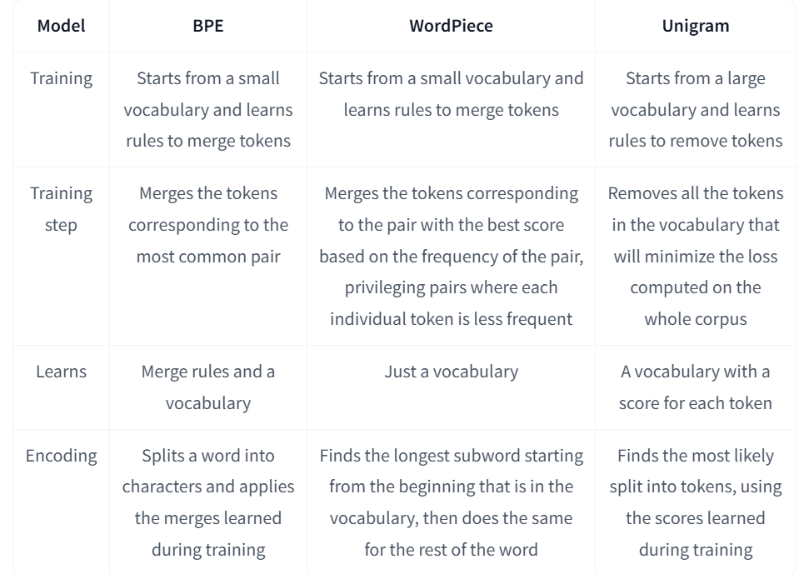
Token-based models
Integration in LLMs
  WordPiece
    BERT (VocabSize = 30 000 tokens)
  BPE
    GPT, GPT2, GPT3 (VocabSize = 175 000 tokens), GPT4, RoBERTa
  Unigram
    T5, AlBERT, mBART, Big Bird, XLNet

Slide 46
Embeddings
Process → Text representation
  Token-based models
    White Space: Splits on spaces (simple but limited)
    Word: Breaks into words (common for English)
    Sentence: Divides text into sentences
    Character: Splits into individual characters
    N-gram: Creates sequences of n items/elements
      fastText
    Subword: Breaks words into smaller parts
      Byte Pair Encoding (BPE): Merges common character pairs
      WordPiece: Google's method for balancing words and subwords
      Unigram
  Token-free models
    CharFormer
    byT5
    MegaByte
    Byte-latent transformer
Method | Complexity | Best For | Drawback
White Space | Low | Simple tasks | Fails with some languages
Word | Low | General NLP | Struggles with contractions
Subword | High | Unknown words | More complex

Slide 47
Token-free models
Token-free models
  ByT5
    https://arxiv.org/abs/2105.13626
  Charformer
    https://arxiv.org/abs/2106.12672
  MegaByte (OpenAI, 2023)
    Yu, L., Simig, D., Flaherty, C., Aghajanyan, A., Zettlemoyer, L., & Lewis, M. (2023). Megabyte: Predicting million-byte sequences with multiscale transformers. Advances in Neural Information Processing Systems, 36, 78808-78823. link
    GitHub - lucidrains/MEGABYTE-pytorch: Implementation of MEGABYTE, Predicting Million-byte Sequences with Multiscale Transformers, in Pytorch
  SpaceByte (2024)
    Slagle, K. (2024). SpaceByte: Towards Deleting Tokenization from Large Language Modeling. arXiv preprint arXiv:2404.14408. link
    GitHub - jxiw/MambaByte: [CoLM 24] Official Repository of MambaByte: Token-free Selective State Space Model
  Byte-latent transformer (MetaAI, 2024)
    Artidoro Pagnoni, Ram Pasunuru, Pedro Rodriguez, John Nguyen, Benjamin Muller, Margaret Li, Chunting Zhou, Lili Yu, Jason Weston, Luke Zettlemoyer, Gargi Ghosh, Mike Lewis, Ari Holtzman†, Srinivasan Iyer (2024) Byte Latent Transformer: Patches Scale Better Than Tokens link
    https://github.com/facebookresearch/blt
    GitHub - waefrebeorn/bytropix: Combining the XJDR's Entropix Sampler and Model code with Meta's BYTE paper idea on a basic 0-255 byte demo

Slide 48
Byte-latent transformer
  It works directly with raw bytes (it skips tokenization step)
    Better for new words (OOV problem)
  No predefined vocabularies
  Memory-efficient and scalable (compact design)
  Main idea
    Dynamic patching → different representation of information (based on its complexity)
    3 components
      Encoder:
        Aim: raw bytes → dynamic patches (segments of variable length) = local byte-level representations
        Architecture: a transformer with few layers that learns the byte embeddings
      Global latent transformer
        Aim: sequences of patches → features
        Architecture: a large autoregressive transformer
      Decoder
        Aim: features → sequences of bytes
  Tokenisation based models
    Fixed set of tokens (chosen offline)
    Tokens compress bytes by heuristics methods
    A rigid separation between raw input and the transformer
  BLT
    Patches are formed dynamically (larger for repetitive/predictable input or smaller for unfamiliar input
    A strong connection between raw input and the transformer
  More details
    https://github.com/facebookresearch/blt

Slide 49
Embeddings
Process
  Text representation (pre-processing)
    Token-based models
    Token-free models
  Feature computation
    Frequency-based embeddings
      TF-IDF
      Co-occurrence matrix
    Prediction based embeddings
      Word / subword embeddings
        Word2vec (Skip-gram or Continuous Bag of Words (CBOW))

Slide 50
Word2Vec
Principles
Examples
Advantages
Weaknesses

Slide 51
De ce reprezentari vectoriale ale intelesului unui cuvant/text?
Permit determinarea similaritatii intre cuvinte/texte
  fast is similar to rapid
  tall is similar to height
Question answering:
Q: “How tall is Mt. Everest?”
Candidate A: “The official height of Mount Everest is 29029 feet”

Slide 52
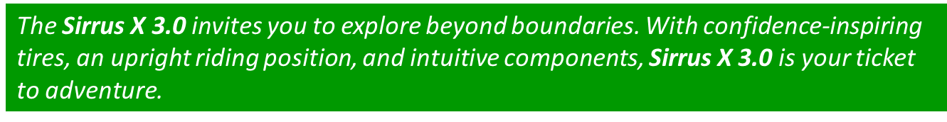
Intuitia din spatele similaritatii
Exemplu: Ce este o Sirrus X 3.0?
Din context, o persoana poate ghici ca Sirrus X 3.0 este un model de bicicleta
Pentru un algoritm, intuitia e ca doua cuvinte sunt similar daca ele sunt folosite in context similare

Slide 53
Diferite reprezentari vectoriale pentru text
Reprezentari rare (sparse):
  Mutual-information weighted word co-occurrence matrices
Reprezentari dense (compacte) :
  Singular Value Decomposition (si Latent Semantic Analysis)
  Neural-network-inspired models (skip-grams, CBOW)
  Altele (e.g. brown clusters)

Slide 54
Vectori rari vs. densi
Vectorii → matricea de co-ocurenta a termenilor
  lungi (length |V|= 20,000 -> 50,000)
  rari (f multe elemente sunt 0)
Alternativa: vectori invatati (prin AI/ML)
  scurti (length 200-1000)
  densi (multe elemente nu sunt 0)
De ce vectori densi?
  Vectorii scurti -> folositi mai usor ca si features in algoritmii de invatare (mai putini coeficienti de invatat)
  Vectorii densi pot generaliza mai bine, captand sinonimia termenilor
    Bike – scooter
    Car – automobile
    House – apartment

Slide 55
Modele de predictive (invatare) a reprezentarilor
Modelul Word2vec
  Skip-gram (Mikolov et al. 2013a), CBOW (Mikolov et al. 2013b)
  Se invata reprezentari, numite embeddings, ca parte din procesul de predictive/generare a textului
  Se antreneaza o retea neuronala pentru prezicerea urmatorului cuvant
  Avantaje
    Rapid, simplu de antrenat
    Modele gata antrente disponibile online

Slide 56
Invatare supervizata fara etichetare manuala de date
Text: “She rides a bike. He rides a scooter in park. My father drives a motorcycle. …”
Vocabular V = {she, ride, bike, he, scooter, park, my, father, drive, motorcycle}
Perechi (context, cuvant)
  E.g. context = cele 2 cuvinte precedente cuvantului curent
Negative sampling
[she ride] bike | 1 |  | [she ride] he | 0
[ride bike] he | 1 |  | [she ride] scooter | 0
[he ride] scooter | 1 |  | [she ride] park | 0
[ride scooter] park | 1 |  | [she ride] my | 0
[my father] drive | 1 |  | [she ride] father | 0
[father drive] motorcycle | 1 |  | [she ride] drive | 0
 |  |  | [ride bike] scooter | 0
 |  |  | [ride bike] park | 0
 |  |  | …
 |  |  | [father drive] she | 0

Slide 57
Arhitecturi

Slide 58

CBOW (Continuous Bag of Words)
 | she | ride | bike | he | scooter | park | my | father | drive | motorcycle
She | 1 | 0 | 0 | 0 | 0 | 0 | 0 | 0 | 0 | 0
Ride | 0 | 1 | 0 | 0 | 0 | 0 | 0 | 0 | 0 | 0
Bike | 0 | 0 | 1 | 0 | 0 | 0 | 0 | 0 | 0 | 0
Input layer
Index of she in vocabulary
1
0
0
she
0
Hidden layer
Output layer
0
0
0
0
0
0
…
1
one-hot
vector
0
0
one-hot
vector
0
bike
0
0
0
1
o
0
…
0
0
ride
0
0
0
0
…
0

Slide 59


CBOW (Continuous Bag of Words)
 | she | ride | bike | he | scooter | park | my | father | drive | motorcycle
She | 1 | 0 | 0 | 0 | 0 | 0 | 0 | 0 | 0 | 0
Ride | 0 | 1 | 0 | 0 | 0 | 0 | 0 | 0 | 0 | 0
Bike | 0 | 0 | 1 | 0 | 0 | 0 | 0 | 0 | 0 | 0
De invatat: W si W’
Input layer
Index of she in vocabulary
1
0
0
she
0
Hidden layer
Output layer
0
0
0
0
0
0
…
1
V-dim
0
one-hot
vector
0
0
one-hot
vector
0
bike
0
0
1
o
0
N-dim
…
V-dim
0
0
ride
0
0
0
0
…
V-dim
N = dimensiunea reprezentarii (lungimea embedding-ului)
0

Slide 60



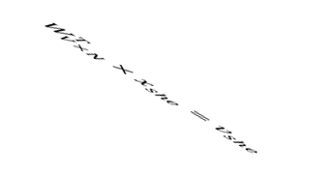


CBOW (Continuous Bag of Words)
0.1 | 2.4 | 1.6 | 1.8 | 0.5 | 0.9 | … | … | … | 3.2
0.5 | 2.6 | 1.4 | 2.9 | 1.5 | 3.6 | … | … | … | 6.1
… | … | … | … | … | … | … | … | … | …
… | … | … | … | … | … | … | … | … | …
0.6 | 1.8 | 2.7 | 1.9 | 2.4 | 2.0 | … | … | … | 1.2
1
0.1
0.5
…
…
0.6
Embeding(she)
0
0
Input layer
0
0
1
0
0
0
x_{she}
0
0
she
0
Hidden layer
…
Output layer
0
0
0
0
0
0
0
…
1
one-hot
vector
0
0
one-hot
vector
0
bike
0
0
0
1
o
x_{ride}
0
Hidden layer
…
0
0
ride
0
N-dim
0
0
0
…
0

Slide 61


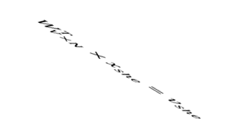

CBOW (Continuous Bag of Words)
0.1 | 2.4 | 1.6 | 1.8 | 0.5 | 0.9 | … | … | … | 3.2
0.5 | 2.6 | 1.4 | 2.9 | 1.5 | 3.6 | … | … | … | 6.1
… | … | … | … | … | … | … | … | … | …
… | … | … | … | … | … | … | … | … | …
0.6 | 1.8 | 2.7 | 1.9 | 2.4 | 2.0 | … | … | … | 1.2
0
2.4
2.6
…
…
1.8
Embeding(ride)
1
0
Input layer
0
0
1
0
0
0
0
0
0
Hidden layer
…
Output layer
0
0
x_{she}
0
0
0
0
0
…
1
one-hot
vector
0
0
one-hot
vector
0
bike
0
0
0
1
o
0
…
0
0
x_{ride}
0
0
0
0
…
0

Slide 62





CBOW (Continuous Bag of Words)
Input layer
1
0
0
0
Hidden layer
Output layer
0
x_{she}
0
0
0
0
0
V-dim
…
1
one-hot
vector
0
0
0
0
0
0
1
o
0
…
0
N-dim
0
V-dim
x_{ride}
0
0
0
N will be the size of word vector
0
V-dim
…
0

Slide 63






CBOW (Continuous Bag of Words)
Input layer
1
0
0
0
Hidden layer
Output layer
0.01
0.02
0.00
0.02
0.01
0.02
0.01
0.7
…
0.00
0
x_{she}
0
0
0
0
0
V-dim
…
1
one-hot
vector
0
0
0
0
0
0
1
o
0
…
0
N-dim
0
V-dim
x_{ride}
0
0
0
N will be the size of word vector
0
V-dim
…
0

Slide 64
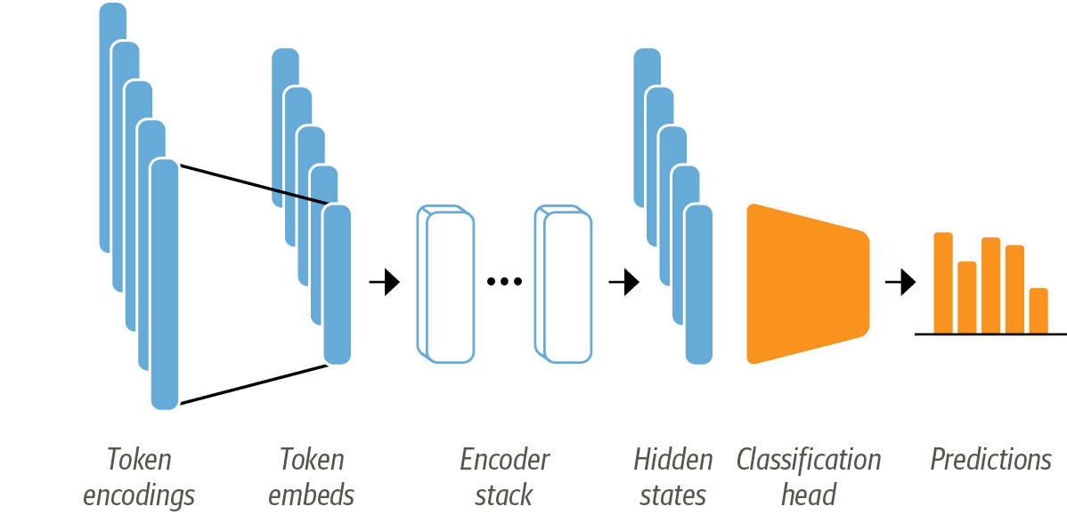
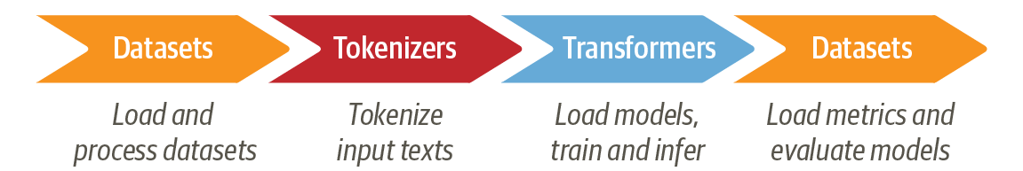
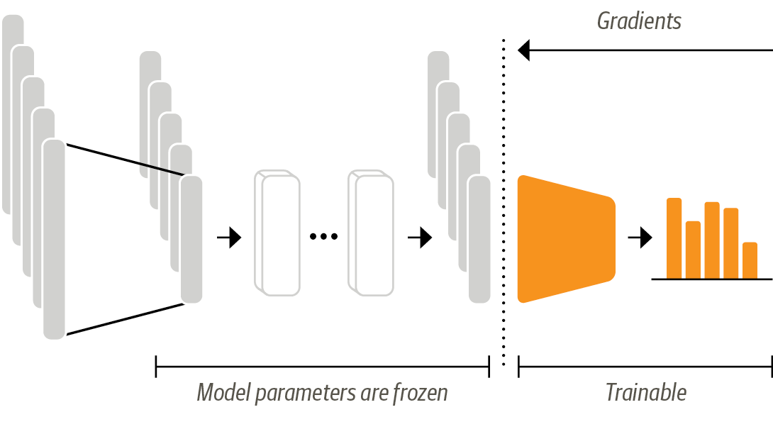
Going further to text classification
Pipeline
Scenarios
  Transformers as feature extractors

Slide 65
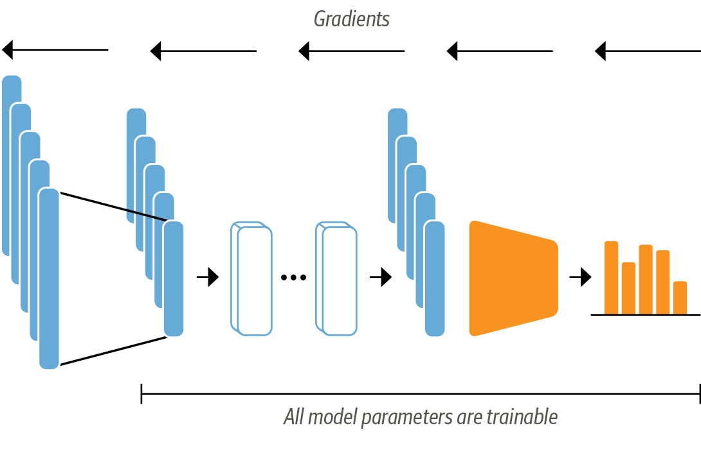
Going further to text classification
Scenarios
  Transformers as feature extractors
  Fine-tuning transformers

Slide 66
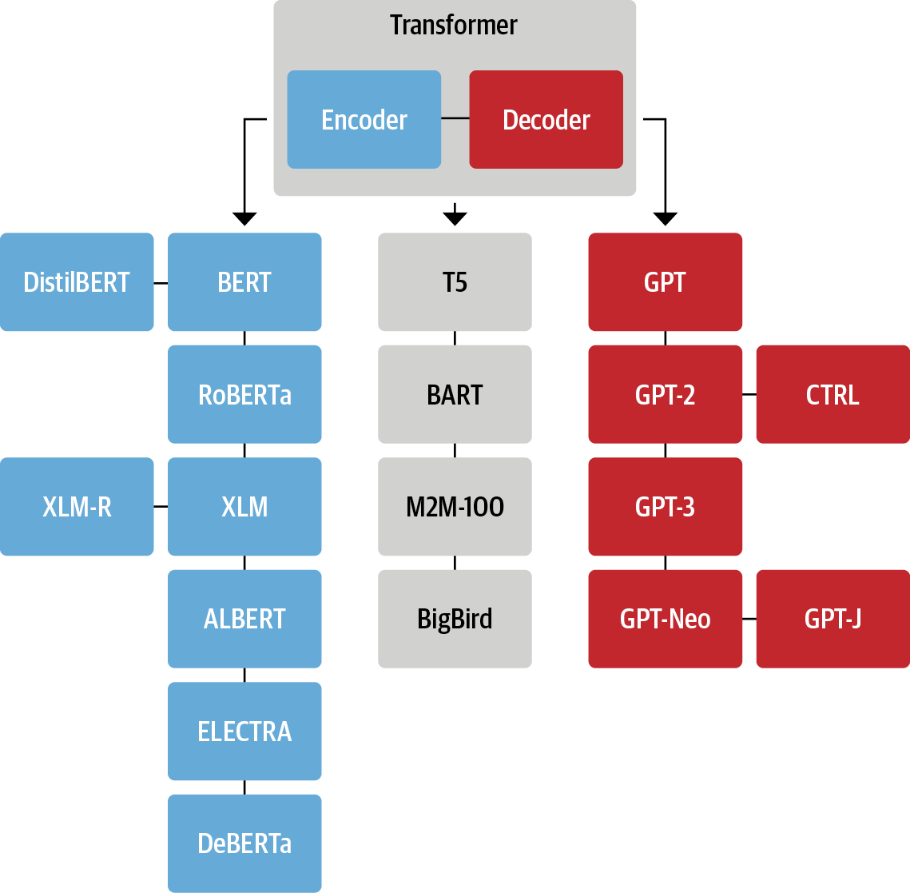
Going further to text classification
Architectures

Slide 67
Going further to text classification
Tokenisation and Vocabulary
Pre-training objectives
  BERT → masked LM & Next Sentence Prediction
  GPT → causal LM (next token prediction)
  T5 → denoising objective (span corruption)
Input representation
  BERT → [CLS] + Token + [SEP] + Token + [SEP]
  GPT → [start] + Token1 + Token2 + …
  T5 → task prefix followed by input text
Attention mechanism
  BERT → absolute positional encodings and bidirectional attention (left and right)
  GPT → absolute positional encodings and unidirectional attention (left)
  T5 → relative positional biases
Architecture
  BERT → Encoder-only
  GPT → decoder-only
  T5 → encoder-decoder

