Slide 1
INSTRUMENTE INTELIGENTE PENTRU BUNĂSTARE SOCIALĂ
Laura Dioşan
Facultatea de Matematică și Informatică
Universitatea Babeș-Bolyai

Slide 2
Quality of an ML-based system
  ML algorithm
  Learnt model
  Data
  Entire System

Slide 3
Measuring quality -> how?
ML perspective -> building models that could do good numerical or class-related predictions
  Prediction quality
  Model size
  Inference time
  User interaction model
  Kinds of mistakes made
  How the system deals with mistakes
  Ability to incrementally learn
  Safety, security, fairness, privacy
  Explainability
SE perspective -> conventional software development
  Black box testing
  White box testing
  …

Slide 4
Measuring quality – ML perspective
Prediction quality
  Classification problem
    Accuracy = correct predictions / all predictions
      Measuring success of all classes predictions
      Higher is better
    Precision = TP / (TP + FP)
      Measuring rate of false classifications (or noise)
      Higher is better
    Recall = TP / (TP + FN)
      Measuring success of correct classifications (or missing results)
      Higher is better
      False negative rate = 1 – recall
  Regression problem
    Prediction error
      Mean Absolute Error MAE = 1/n ∑| realValue - predictedValue |
      Mean Absolute Percentage Error MAPE = 1/n ∑| (realValue – predictedValue) / realValue |
      Mean Squared Error MSE = 1/n ∑ ( realValue - predictedValue )^2

Slide 5
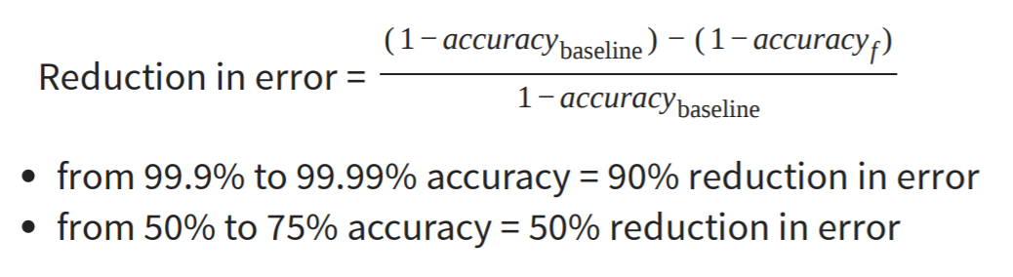
Measuring quality – ML perspective
Prediction quality
  Suppose the accuracy metric
    What does mean a good accuracy? 99%? 75%?
    Always compare to a base rate!

Slide 6
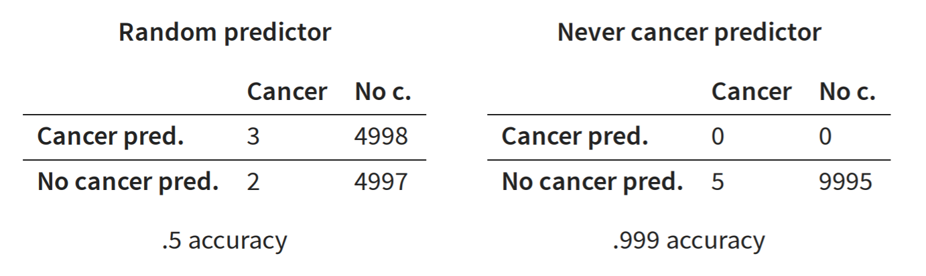
Measuring quality – ML perspective
Prediction quality
  Baseline = ?
    Random predictor
      Acc = (3 + 4997) / (3 + 2 + 4998 + 4997) = 0.5
      Precision(cancer) = 3 / (3 + 4998) ~0.0006
      Recall (cancer) = 3/ (3 + 2) = 0.6
    all true,
    all false,
    repeat last observation,
    simple heuristics,
    simpler model,
    SOTA
  Extreme classifiers
    Never cancer predictor = Identifies every instance as negative (e.g., no cancer)
      Precision = ? / 0 / (0 + 0) - undefined (no false predictions, but no predictions at all)
      Recall = ? / 0 / (0 + 5)
    Always cancer predictor = Identifies every instance as positive (e.g., has cancer)
      Precision = ? / x / (x + y), y >> x => low (also reports cancer for all noncancer cases)
      Recall = ? / x / (x + 0) = 100%

Slide 7
Measuring quality – ML perspective
Generalisation quality
  Training data (seen)
    problems
      If acc(learning) >> acc(validation) => overfitting
        Model learned exactly for the input data, but does not generalize to unseen data (e.g., exact memorization)
      If acc(learning) << acc(validation) => underfitting
        Model makes very general observations but poorly fits to data (e.g., brightness in picture)
    Solutions
      Parameter tunning
        Control the degrees of freedom (no of parameters)
      Cross-validation
        Repeated partitioning of data into train and validation data, train and evaluate model on each partition, average results
  Testing data (unseen)

Slide 8
Measuring quality – SE perspective
Testing
  White-box testing
    testing the functionality of an application WITH knowing the details of its implementation
    Structure-based testing -> test cases are created with reference to the internal structure of the software component
    Remember that we deal by an ML model, not a piece of code
  Black-box testing
    testing the functionality of an application WITHOUT knowing the details of its implementation
    specification-based testing -> test cases are created based on the requirement specifications
    Specification = ?
      Input data= known
      Output data (results) = unknown

Slide 9
Measuring quality – SE perspective
machine learning systems = ‘non-testable’ software?
  a machine learning system inherently follows a data-driven programming paradigm
    The model’s behaviour may evolve over time, in response to the frequent provision of new data
  oracle problem
    When we know that an answer is a good one?
  Testing level
    Unit testing
    Contract test
    Integration testing
    …

Slide 10
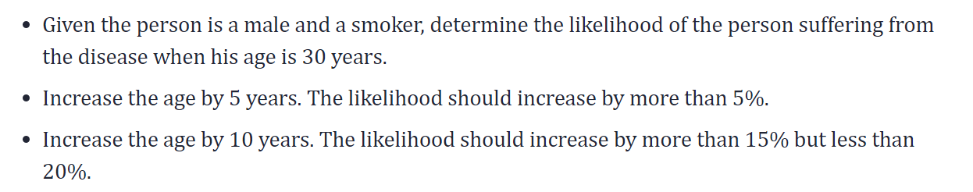
Black-box testing of an ML algorithm
Challenges & possible solutions
  identify the test oracle which could verify the test outcome against the expected values known beforehand
    validation data -> ok
    Test data (new/unseen data) -> ???
      Pseudo-oracle – statistical comparison of model performance (acc, P, R, …)
        Metamorphic testing – explore metamorphic relations between inputs and output -> if we increase X by delta, then Y will change (increase/decrease)
        https://arxiv.org/ftp/arxiv/papers/2002/2002.12543.pdf
        https://www.ncbi.nlm.nih.gov/pmc/articles/PMC3019603/pdf/nihms200711.pdf
    PDCA cycle (Plan-Do-Check-Act)
      https://vitalflux.com/qa-machine-learning-models-pdca-cycle/
  Dual coding - build different models based on different algorithms and comparing the prediction from each of these models given a particular input data set
  Coverage guided fuzzing is a technique where data to be fed into the Machine Learning models could be planned appropriately such that all of the features activations get tested.
    https://arxiv.org/abs/1807.10875

Slide 11
Test input generation
  Domain-specific Test Input Synthesis
  Fuzz and Search-based Test Input Generation
  Symbolic Execution Based Test Input Generation
  Synthetic Data to Test Learning Program
Test- oracle (Pseudo-oracle)
  Metamorphic testing
    Coarse-grained Data Transformation (e.g. shuffle)
    Fine-grained Data Transformation (e.g. data perturbation – noisy data)
  Cross-Referencing
    Differential testing is a traditional software testing technique that detects bugs by observing whether similar applications yield different outputs regarding identical inputs
    N-version programming aims to generate multiple functionally equivalent programs based on one specification, so that the combination of different versions are more fault-tolerant and robust.
Test adequacy evaluation is to find out whether the existing tests have a good fault-revealing ability
  Test Coverage
  Mutation Testing
  Surprise Adequacy
  Rule-based Checking of Test Adequacy
Test Prioritisation and Reduction
Bug Report Analysis
Debug and Repair
General Testing Framework and Tools

Slide 12
ML PROPERTIES TO BE TESTED
Functional properties
  Correctness
  Model Relevance
    Overfitting or underfitting
Non-functional
  Robustness and Security (a robust system should maintain performance in the presence of noise)
    Robustness measurement criteria
      pointwise robustness, indicating the minimum input change a classifier fails to be robust;
      adversarial frequency, indicating how often changing an input changes a classifier’s results;
      adversarial severity, indicating the distance between an input and its nearest adversarial example
    Perturbation Targeting Test Data
    Perturbation Targeting the Whole System
  Efficiency
  Fairness
    Fairness Definitions and Measurement Metrics
    Test Generation Techniques for Fairness Testing
  Interpretability
  Privacy

Slide 13
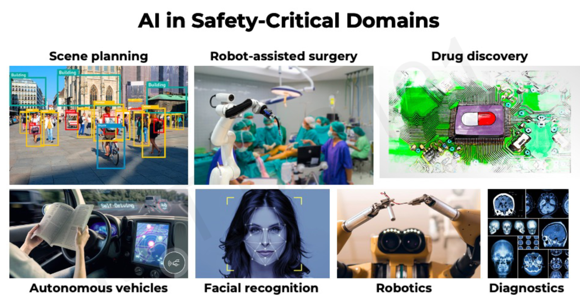
About trust
Challenges in robust, safe and trustworthy ML
  Interpretability – why?
  Fairness – for all subgroups?
  Robustness – for a large variety of data?
  Uncertainty -

Slide 14
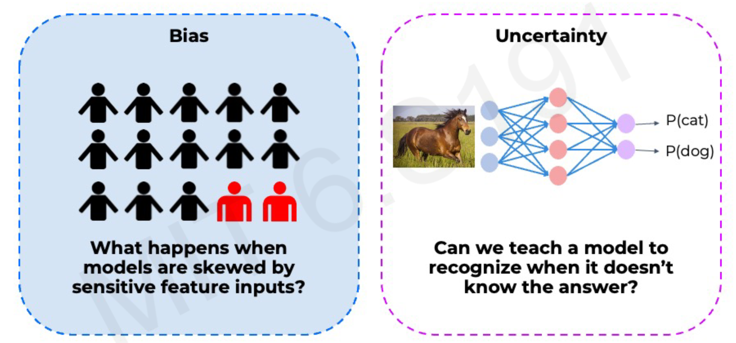
About trust
Challenges in robust, safe and trustworthy ML
  Bias
  Uncertainty

Slide 15
Bias
What?
  When ML models do better on some demographics than others
Bias in AI/ML lifecycle
  Data
    E.g. Sampling bias – over-sampling from some regions of the input data distribution and under-sampling from other regions
      e.g. health data (a few diseased patients, a lot healthy patients)
    E.g. Selection bias – proportion of data in dataset does not reflect the real-world
      E.g. voice recognition for English
  Model
    Lack of uncertainty benchmarks and metrics
  Deployment
    Distribution shifts and feedback loops
  Evaluation
    Subgroups that are not or un-represented in the evaluation dataset
  Interpretation
    Human errors

Slide 16
Bias
common human biases that can manifest in the data:
  Reporting bias → strong opinions for books’ review
  Historical bias → house prices from ’60-’80
  Automation bias → ground-truth validation for tooth implants
  Selection bias
    Coverage bias → questionaires just for some groups (e.g. females & yogurt)
    Participation-bias → different responding rate for different sub-groups
    Sampling-bias → first 200 answers that are more enthusiastic
  Implicit bias → gesture recognition and cultural particularities
  experiment bias → train the model in a particular setup
How to identify the bias?
  Missing values for sub-groups of examples
  Unexpected values
  Data skew
Mitigating the bias
  Augmenting the training data
  Adjusting the loss function

Slide 17
Bias
How to evaluate the bias?
  Demographic parity
  Equality of opportunity
 | Majority |  | Minority
 | accepted | rejected | accepted | rejected
 | 16 | 64 | 4 | 16
Acceptance rate | 16 / 64 ~ 25% |  | 4 / 16 ~ 25%
 | Majority |  | Minority
 | accepted | rejected | accepted | rejected
Qualified | 16 | 19 | 4 | 11
Unqualified | 0 | 45 | 0 | 5
Acceptance rate | 16 / (16 + 19) ~ 46% |  | 4 / (4 + 11) ~ 27%

Slide 18

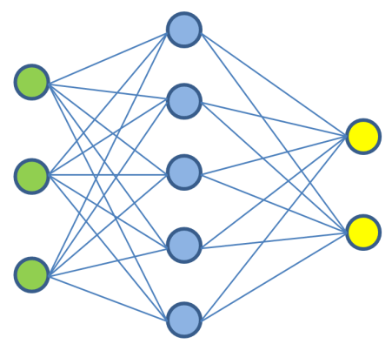

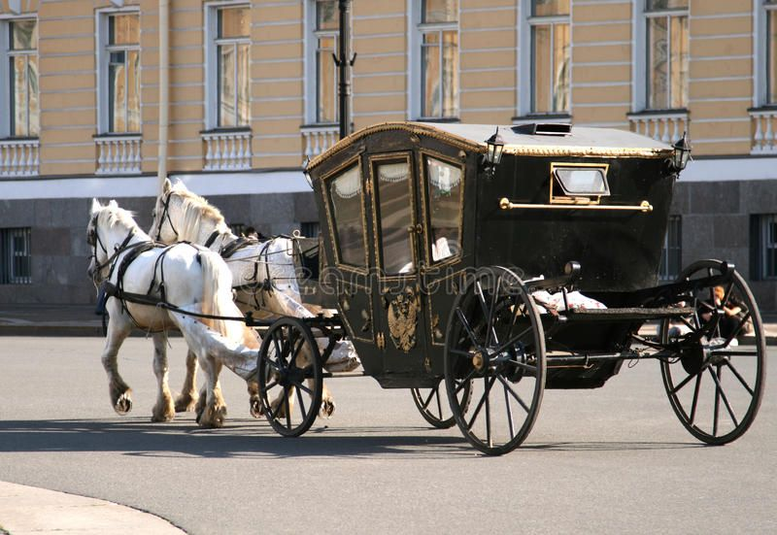
Model uncertainty
Can we teach a model when it does or doesn’t know the answer?
Uncertainty estimation gives us a measure of confidence in the prediction
Prob(bike)
Prob(car)
OR
Prob(bike) = 0.2
Prob(car) = 0.8

Slide 19
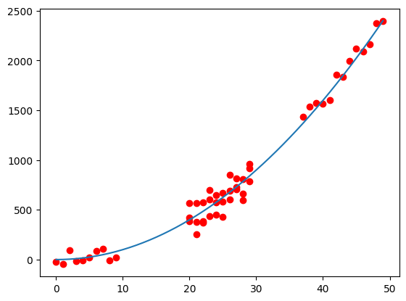
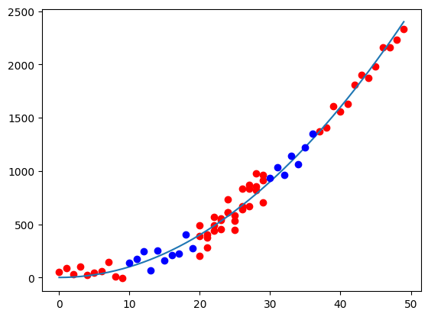
Types of uncertainity
Data uncertainty
  Similar inputs & very different outputs
Model uncertainty
  Inputs out of distribution
What happens if we add new data?
  Model uncertainty is reduced

Slide 20
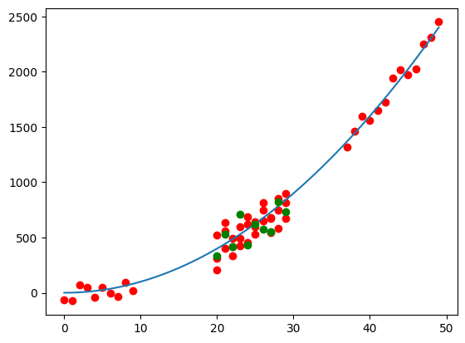
Types of uncertainity
Data uncertainty
  Similar inputs & very different outputs
Model uncertainty
  Inputs out of distribution
What happens if we add new data?
  data uncertainty is irreducible

Slide 21
Types of uncertainity
Data uncertainty
  Aleatoric uncertainty (intrinsic uncertainty)
  Irreducible!!!
  Can be learnt from data
Model uncertainty
  Epistemic uncertainty (uncertainty due to limitations in our knowledge about the world)
  Can be reduced by adding data / knowledge
  Cannot be learnt from data

Slide 22
Types of uncertainity
Gave a loan to an individual, but they failed to repay; why?
Data uncertainty
  Aleatoric uncertainty (intrinsic uncertainty)
  They were robbed
Model uncertainty
  Epistemic uncertainty (uncertainty due to limitations in our knowledge about the world)
  They had bad credit score, but we didn’t bother checking

Slide 23
Explainability
What?
  Explanation = interpretable description of the model behavior
Aim
  Explain why the model made a particular prediction on a specific input
How?
  Select/rank a subset of input features that contributed the most to model prediction → Feature Attribution Methods

Slide 24
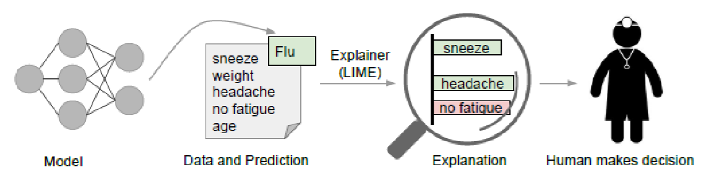
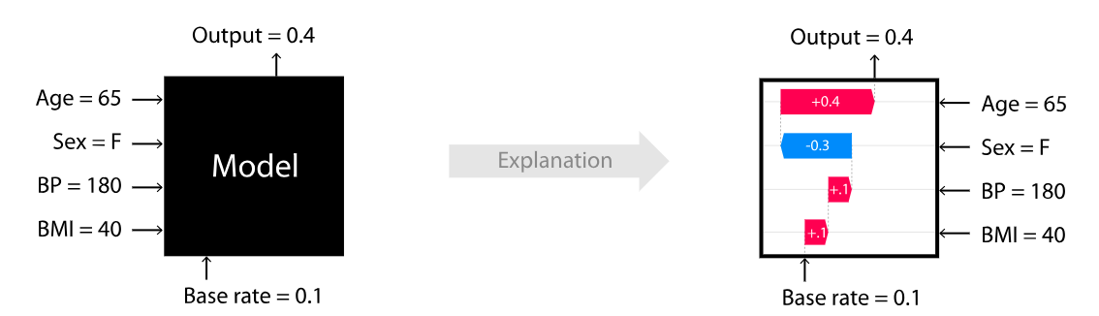
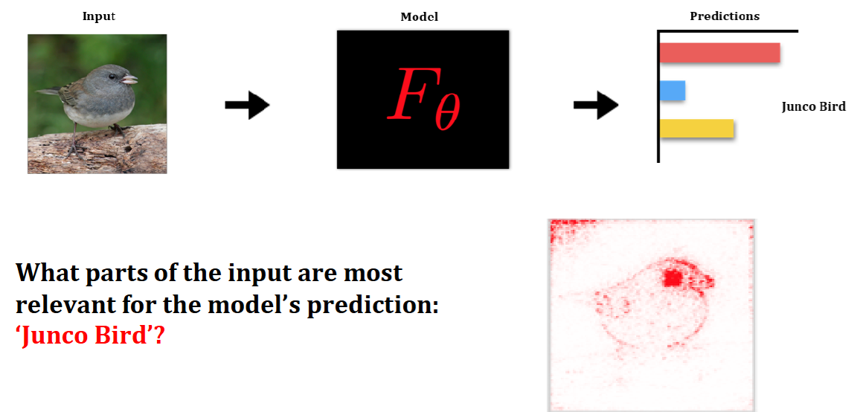
Explainability
Approaches
  LIME algorithm: “Why should I trust you?” Explaining the predictions of any classifier - Local Interpretable Model-agnostic Explanations https://github.com/marcotcr/lime
  SHAP = SHapley Additive exPlanations - method based on cooperative game theory https://github.com/shap/shap
  Saliency Maps (e.g. for images) https://christophm.github.io/interpretable-ml-book/pixel-attribution.html

Slide 25
Limitations and new frontiers
  What I cannot create, I cannot understand (R. Feynman)

Slide 26
detect conceptual errors in ML models
  Black-box testing
    generation of an adversarial data set that is used to test the ML models
    Adversarial ML: Alteration of existing inputs
    Mutation Testing: Alteration of ML model internals
  White-box testing
    Pseudo-Test Oracle,
    Metamorphic Testing
    Test Adequacy Evaluation
      Neuronal coverage
      Modified Condition/Decision Coverage (MC/DC Coverage)
      Combinatorial Testing Coverage Criteria
      Multi-granularity Coverage Levels
      Surprise Adequacy
    Automated Test Input Generation
      Gradient-Based Optimization

Slide 27
detect errors in ML code implementations
  Numerical-based testing: Finite-difference techniques
  Property-based testing
  Metamorphic testing
  Mutation testing
  Coverage-Guided fuzzing
  Proof-based testing

Slide 28
https://drops.dagstuhl.de/opus/volltexte/2020/13060/pdf/dagrep_v010_i002_p076_20091.pdf
https://github.com/helloful/Machine-Learning-Books/blob/master/book/Building%20Intelligent%20Systems%20-%20A%20Guide%20to%20Machine%20Learning%20Engineering.pdf
https://martinfowler.com/articles/cd4ml.html#TestingAndQualityInMachineLearning
https://ckaestne.github.io/seai/F2020/slides/03_modelquality/modelquality.pdf
https://ieeexplore.ieee.org/stamp/stamp.jsp?arnumber=9000651&casa_token=9n3hR8ciH_MAAAAA:BWPwL97lzq-IWPKdlrGx5S6Cc8YAiu7uj8410Jf89YJomK0CTG9Lt_4IyL5pAzFdG3E8D79xwSR1&tag=1
https://www.sciencedirect.com/science/article/abs/pii/S0164121220300248

