Slide 1
INSTRUMENTE INTELIGENTE PENTRU BUNĂSTARE SOCIALĂ
Laura Dioşan
Tema 3
Facultatea de Matematică și Informatică
Universitatea Babeș-Bolyai

Slide 2
Natural Language Processing
  Text classification
  Language modelling
  Machine translation
  …

Slide 3
From Languages to Information
Aim
  Automatically extracting meaning and structure from:
    Human language text and speech (news, social media, etc.)
    Social networks
    Genome sequences
  Interacting with humans via language
    Dialog systems/Chatbots
    Question Answering
    Recommendation Systems

Slide 4
From Languages to Information
How?
  Extracting information from language
    Information Retrieval
    Text Classification
    Extracting Sentiment and Social Meaning
    …
  Interacting with humans via language
    IBM’s Watson
    …
    Counseling conversations
      https://www.aclweb.org/anthology/Q16-1033.pdf
      https://web.stanford.edu/class/cs124/lec/counseling_slides.pdf
    Understanding police officer respect
      https://www.pnas.org/content/114/25/6521
      https://nlp.stanford.edu/robvoigt/124_lecture/

Slide 5
Text classification
Definition
  Text categorization
    Assign (predefined) labels (categories) to some documents
    Documents
      Technical reports, web pages, messages, books, etc.
    Categories:
      Topics (art, economy)
      Attributes (spams, ham)
Data and various text classification problems
  https://nlpprogress.com/english/text_classification.html
 | Cuvinte | Documente
Învăţare supervizată | Etichetarea părţilor de vorbire | Clasificarea textelor, Filtrarea, Detectarea subiectelor
Învăţare nesupervizată | Indexarea semantică, construcţia automată a tezaurelor, extragerea cuvintelor cheie | Clusterizarea documentelor, Detectarea subiectelor

Slide 6
Text classification
Automatic approaches
  Based on knowledges
    From experts
    Encoded as rules
  Based on learning
    Experts label some training examples
    The algorithm label the test examples
    Learning
      Supervised
      Unsupervised
Evaluation
  Accuracy, Precision, Recall, AUC, etc.

Slide 7
Text classification
Process
  Data training analysis
    Document indexing
      Construct a document representation
        Attributes / features
        Weights of these features
      Reduce the dimension of these representations
        Feature selection
        Feature extraction
    Learning a classification model
  Classification of test data
    Text indexing
    Apply the learnt model -> categories

Slide 8
Text classification
Document indexing
  Construct a document representation
    Attributes / features
    Weights of these features
  4 steps:
    Document linearization
    Filtering
    Canonical form
    Weighting
Reduce the vocabulary size

Slide 9
Text classification – indexing
Step 1: linearization (segmentation)
  Reduce the document to a vector of terms (attributes)
    bag of words model
    A matrix
      Documents -> lines
      Terms -> colomns
      Each cell 1/0 – if the current term belongs to the current document
  2-stage process for term identification
    Format removal
      E.g. Elimination of HTML tags
    Tokenization
      Parsing (segmentation)
      Removal of punctuation mark
      Conversion of capital letters
Iniţial | Liniarizat
Interactive query expansion modifies queries using terms from a user. Automatic query expansion expands queries automatically. | interactive query expansion modifies queries using terms from a user automatic query expansion expands queries automatically
Notes:
During linearization all Cascading Style Sheets (CSS) instructions are removed

Slide 10
Text classification -> indexing
Paul 2: filtering
  Select some terms that are able to
    Describe the content of the document
    Make a difference between two documents
  Removal of stopwords
    From a predefined list
    Based on their frequencies (under a given threshold)
Segmentat | Filtrat
interactive query expansion modifies queries using terms from a user automatic query expansion expands queries automatically | interactive query expansion modifies queries terms automatic query expansion expands queries automatically
Notes:
During linearization all Cascading Style Sheets (CSS) instructions are removed

Slide 11
Text classification – indexing
Step 3 – canonical form (normalization/standardisation)
  Lematisation
    Morphological analysis
    Based on context
    Ex. “better” → “good”
  Stemming
    Term-level
    Ex. "computer", "computing", "compute" → "comput"
    stemming algorithm
      Martin Porter
      WordNet
Filtrat | Redus
interactive query expansion modifies queries terms automatic query expansion expands queries automatically | interact queri expan modifi queri term automat queri expan expand queri automat
Notes:
During linearization all Cascading Style Sheets (CSS) instructions are removed

Slide 12
Text classification – indexing
Step 4: weighting
  Pre-determined (manual)
    Ex. Bag of Words
  Automatic (learnt)
    Ex. embedded representations
Notes:
During linearization all Cascading Style Sheets (CSS) instructions are removed

Slide 13
Text classification - indexing
Step 4: manual weighting
  Usage of a particular model
  Weights relative to
    A single document
      term frequency – TF
    A collection of documents
      inverse document frequency – IDF
    hybrid TF and IDF
      TF → cu cât un termen este mai frecvent într-un document, cu atât el este mai important pentru acel document
      IDF → cu cât un termen apare în mai multe documente, cu atât el este mai puţin important în descrierea semanticii acelui document
  Range of frequencies
    Binary → presence / absence of a term (One-Hot encoding)
    Real ([0,1]) → importance of that term
  For a set of D documents and a set of T termns, the weight p_{ij} of term t_{i} in document d_{j} (i=1,2,...,|T|, j=1,2,...,|D|) can be:
    binary: p_{ij} = 1, if t_{i} belongs to d_{j}
    0, otherwise
    TF: p_{ij}=tf_{ij} (no of appearances of term t_{i} in document d_{j})
    TF.IDF: p_{ij}=tf_{ij}*log₂(|D|/df_{i}), where df_{i}=no of documents where term t_{i} is found
Notes:
During linearization all Cascading Style Sheets (CSS) instructions are removed

Slide 14
Text classification – indexing
Step 4 – weight learning
  Unsupervised learnt representation
  Classical models https://web.stanford.edu/class/cs124/lec/languagemodeling.pdf
    Probability of a target word based on k previous words
    Document-level context
      Semantic relation (boat – water)
    Count-based models
      Latent Semantic Analysis (LSA)
      Latent Dirichlet Allocation (LDA)
  Modern models
    Word-level context
      Semantic similarity (boat – sheep)
Notes:
During linearization all Cascading Style Sheets (CSS) instructions are removed

Slide 15
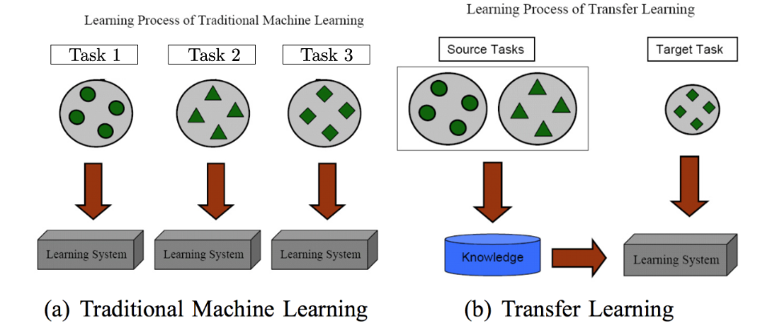
Text classification – indexing
Step 4 – weight learning (word representations)
  Methodologies
    Traditional Machine Learning
    Transfer learning https://www.cse.ust.hk/~qyang/Docs/2009/tkde_transfer_learning.pdf

Slide 16
Text classification – indexing
Learning word representations (vectors)
Why?
  Embeddings = parameters -> they can be learnt
  Share representation across tasks
  Lower dimensional space
How?
  Pre-NN
    1990 - Latent Semantic Analysis (LSA) http://lsa.colorado.edu/papers/JASIS.lsi.90.pdf
    1992 – n-gram models https://www.aclweb.org/anthology/J92-4003.pdf
    2003 - Latent Dirichlet Allocation (LDA)—Documents are mixtures of topics and topics are mixtures of words https://www.jmlr.org/papers/volume3/blei03a/blei03a.pdf
  NN-based
    Word-level (2003 - …)
    Sentence (document) level (2014 - … )
    Contextual word-vectors (Word vectors compress all contexts into a single vector) (2016 - …)

Slide 17
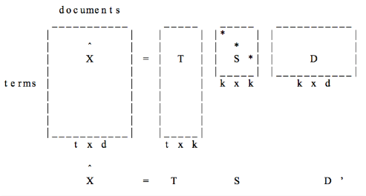
Text classification – indexing
Learning word representations (vectors)
How?
  Pre-NN
    1990 - Latent Semantic Analysis (LSA) http://lsa.colorado.edu/papers/JASIS.lsi.90.pdf

Slide 18
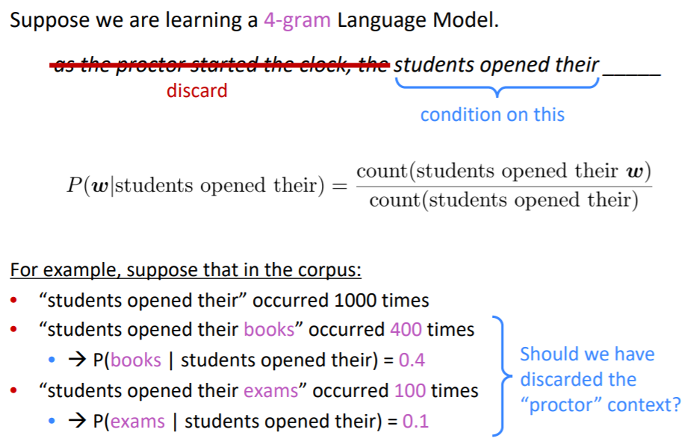
Text classification – indexing
Learning word representations (vectors)
How?
  Pre-NN
    1992 – n-gram models https://www.aclweb.org/anthology/J92-4003.pdf
    https://web.stanford.edu/~jurafsky/slp3/3.pdf

Slide 19
Text classification – indexing
Learning word representations (vectors)
How?
  NN-based
    Word-level (2003 - …)
      2003 - N-gram Neural language model (Montreal - Bengio)
        https://www.jmlr.org/papers/volume3/bengio03a/bengio03a.pdf
        Probability of the target word based on previous k words
        Estimation of the probability by an ANN
      2008 – multi-task model (Princeton – Collobert)
        https://ronan.collobert.com/pub/matos/2008_nlp_icml.pdf
        Probability of MORE target words (a sequence of words)
        Estimation of the probability by an ANN

Slide 20
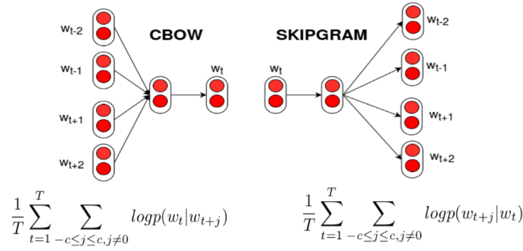
Text classification – indexing
Learning word representations (vectors)
How?
  NN-based
    Word-level (2003 - …)
      2013 – word2vec (Google – Mikolov)
        https://papers.nips.cc/paper/2013/file/9aa42b31882ec039965f3c4923ce901b-Paper.pdf
        Continous BOW model -> try to predict a word based on its context (neighbours); input = neighbour words, output = target word
        Skip-gram model -> try to predict context (neighbours) of a word; input = target word; output = neighbour words;
        Visualisation of embeddings https://ronxin.github.io/wevi/
        Trained vectors https://radimrehurek.com/gensim/models/word2vec.html or https://github.com/3Top/word2vec-api#where-to-get-a-pretrained-models

Slide 21
Text classification – indexing
Learning word representations (vectors)
How?
  NN-based
    Word-level (2003 - …)
      2014 – GloVe (Stanford – Pennington, Manning)
        https://nlp.stanford.edu/projects/glove/
      2017 - fastText (Facebook – Mikolov))
        https://arxiv.org/abs/1607.04606
        https://radimrehurek.com/gensim/models/fasttext.html

Slide 22
Text classification – indexing
Learning word representations (vectors)
How?
  NN-based
    Word-level (2003 - …)
    Sentence (document) level (2014 - … )
      2014 - Paragraph embedding
        https://arxiv.org/abs/1405.4053
      2015 – skip-thought vectors
        Predict previous / next sentence with seq2seq model)
        https://arxiv.org/abs/1506.06726
      2015 – auto-encoders (semi or unsupervised)
        https://arxiv.org/abs/1511.01432 ,
        https://arxiv.org/pdf/1511.06349.pdf,
        https://arxiv.org/abs/1602.03483

Slide 23
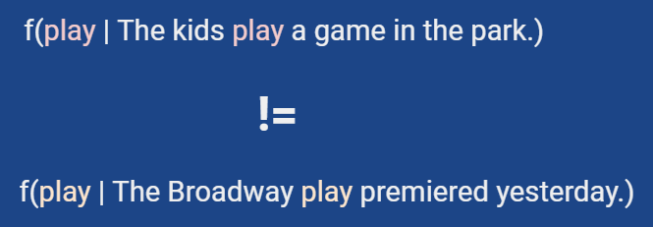
Text classification – indexing
Learning word representations (vectors)
How?
  NN-based
    Word-level (2003 - …)
    Sentence (document) level (2014 - … )
    Contextual word-vectors (Word vectors compress all contexts into a single vector) (2016 - …)
      2016 context2vec https://www.aclweb.org/anthology/K16-1006.pdf
      2017 tagLM https://arxiv.org/abs/1705.00108
      2017 CoVe https://papers.nips.cc/paper/2017/hash/20c86a628232a67e7bd46f76fba7ce12-Abstract.html
      2018 ELMo https://www.aclweb.org/anthology/N18-1202/
      2018 ULMFiT https://arxiv.org/abs/1801.06146
      2019 BERT https://arxiv.org/abs/1810.04805
    cross-lingual pre-training https://arxiv.org/abs/1706.04902
      Code example https://github.com/huggingface/naacl_transfer_learning_tutorial
    See also https://machinelearningmastery.com/use-word-embedding-layers-deep-learning-keras/

Slide 24
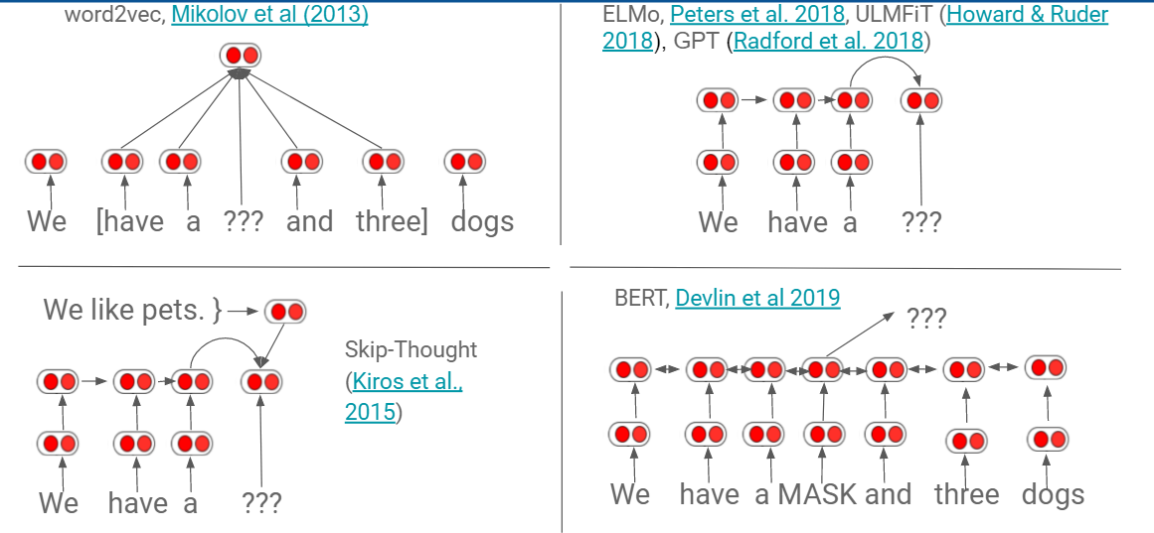
Text classification – indexing
Learning word representations (vectors)
How?
  NN-based

Slide 25
Text classification
Process
  Data training analysis
    Document indexing
      Construct a document representation
        Attributes / features
        Weights of these features
      Reduce the dimension of these representations
        Feature selection
        Feature extraction
    Learning a classification model
  Classification of test data
    Text indexing
    Apply the learnt model -> categories

Slide 26
Natural Language Processing
  Text classification
  Language modeling
  Machine translation
  …

Slide 27
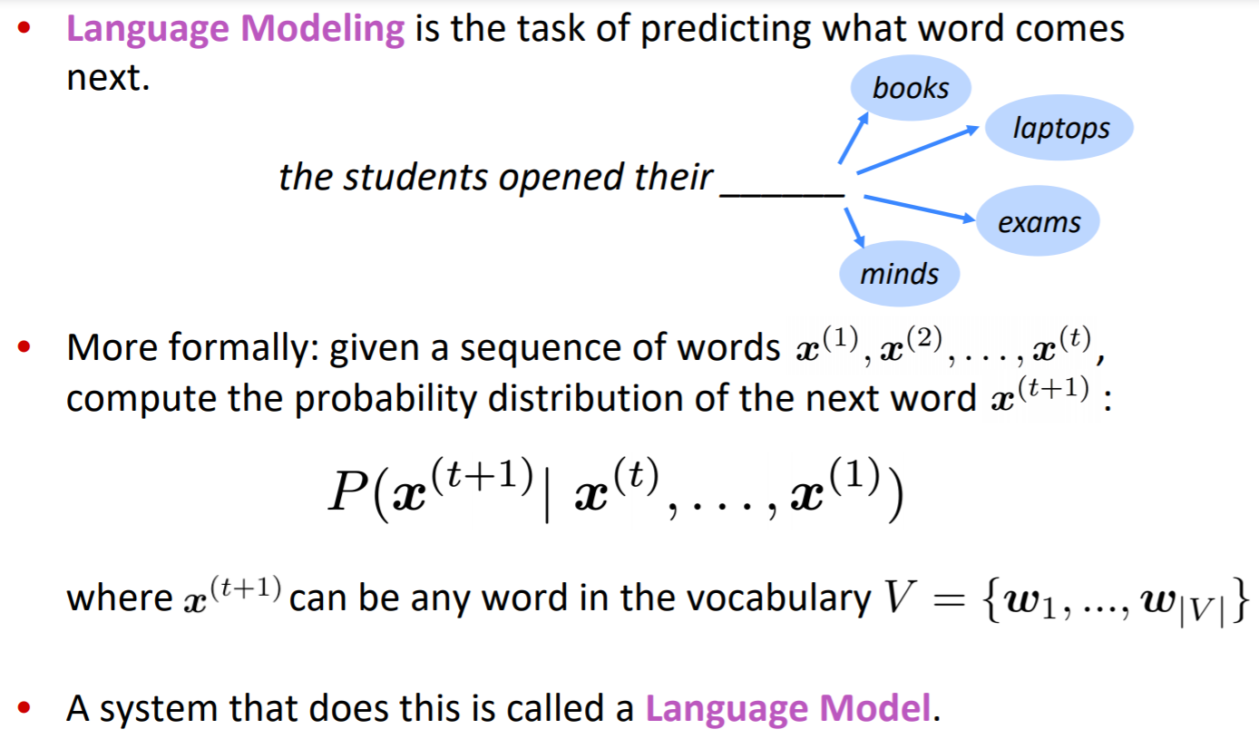

Language modelling

Slide 28
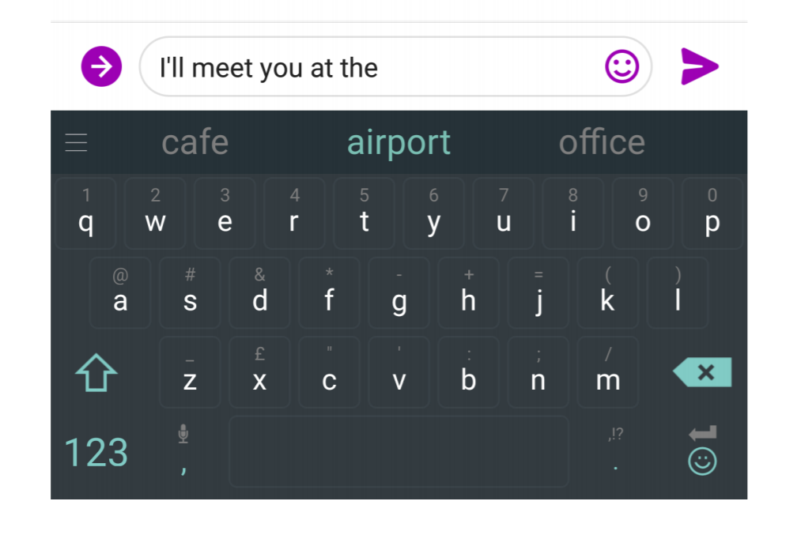
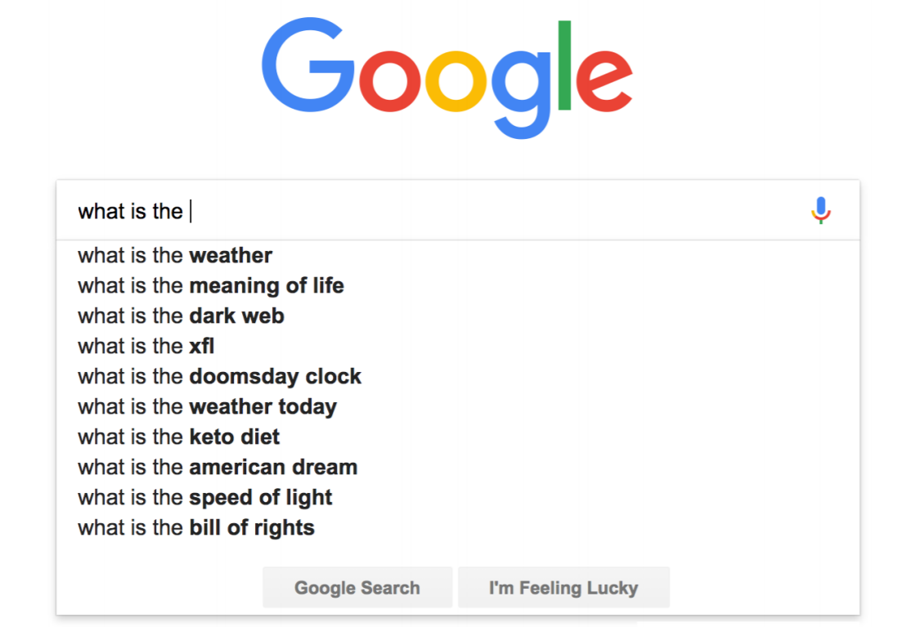
Language modelling
Practical tasks
  Sentence or document classification (e.g. sentiment)
  Sentence pair classification (e.g. NLI, paraphrase)
  Word level (e.g. sequence labeling, extractive Q&A)
  Structured prediction (e.g. parsing)
  Generation (e.g. dialogue, summarization, machine translation )
    See https://medium.com/@samim/obama-rnn-machine-generated-political-speeches-c8abd18a2ea0

Slide 29
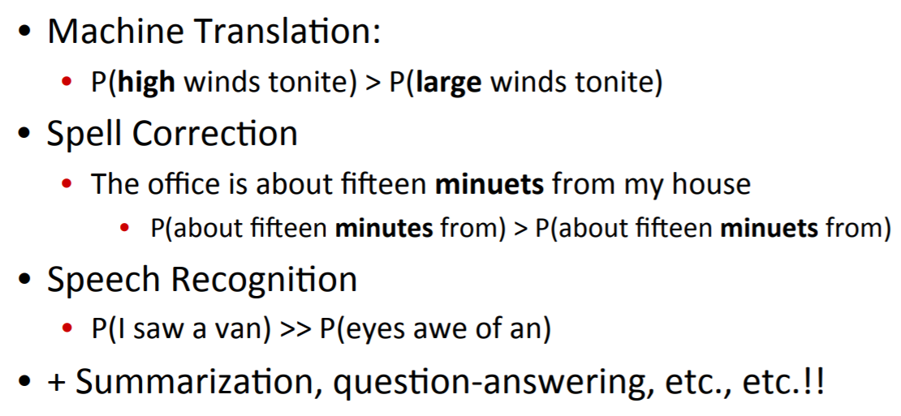
Language modelling
Formal task
  Assign a probability to a sentence

Slide 30
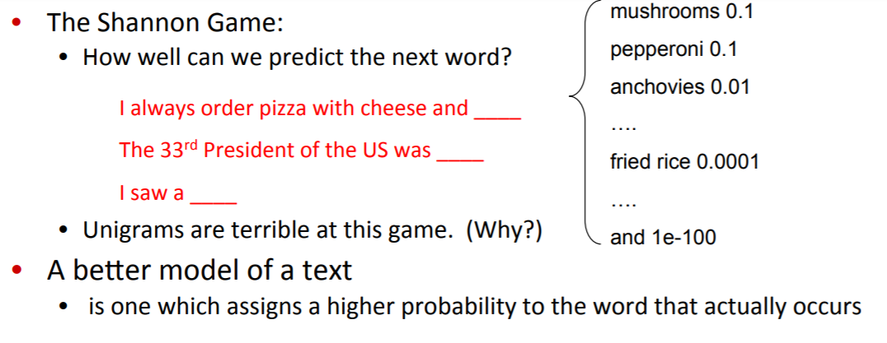
Language modelling
Datasets
  https://nlpprogress.com/english/language_modeling.html
Evaluation
  Extrinsic
    Run two models on the same task and compare the accuracies
    +: simple, relevant
    -: time consuming
  Intrinsic
    Perplexity
      measure how well a probability distribution predicts a sample
      Remember: Cross-entropy (H) -> classification performance (max)
      Perplexity = 2^H (lower = better)

Slide 31
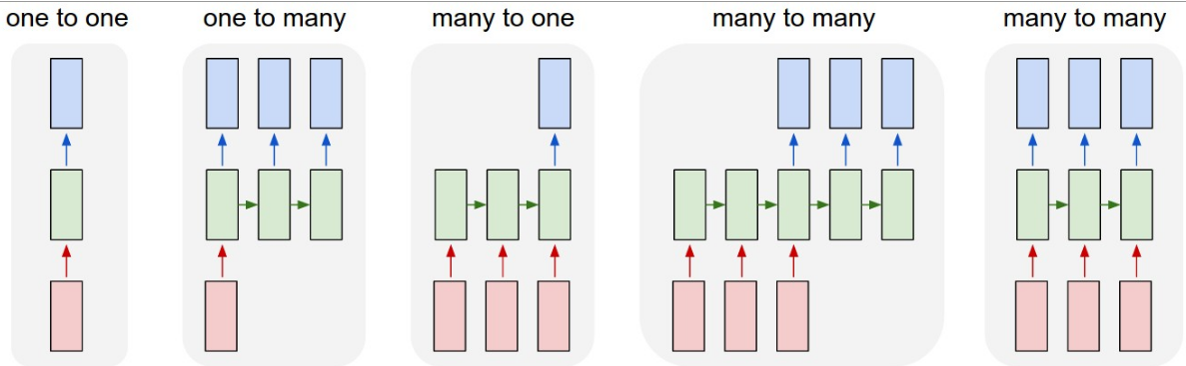
Language modelling
How?
  1 to 1 – name entity recognition
  1 to many – image captioning
  many to one – sentiment classification in sentences
  many to many – machine translation

Slide 32
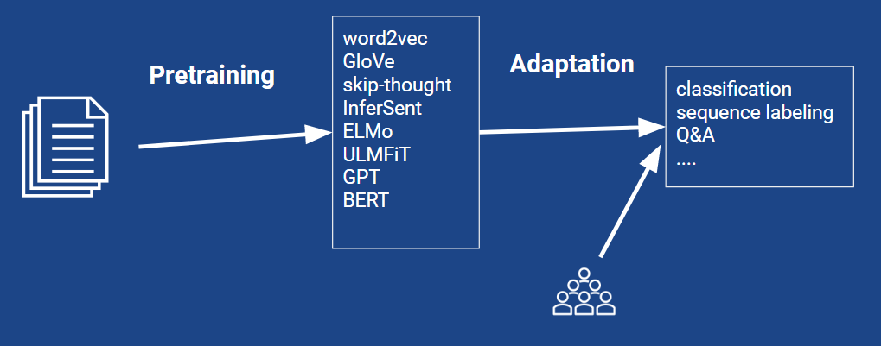
Language modelling
How?
  Traditional machine learning approaches
  Transfer learning approaches

Slide 33
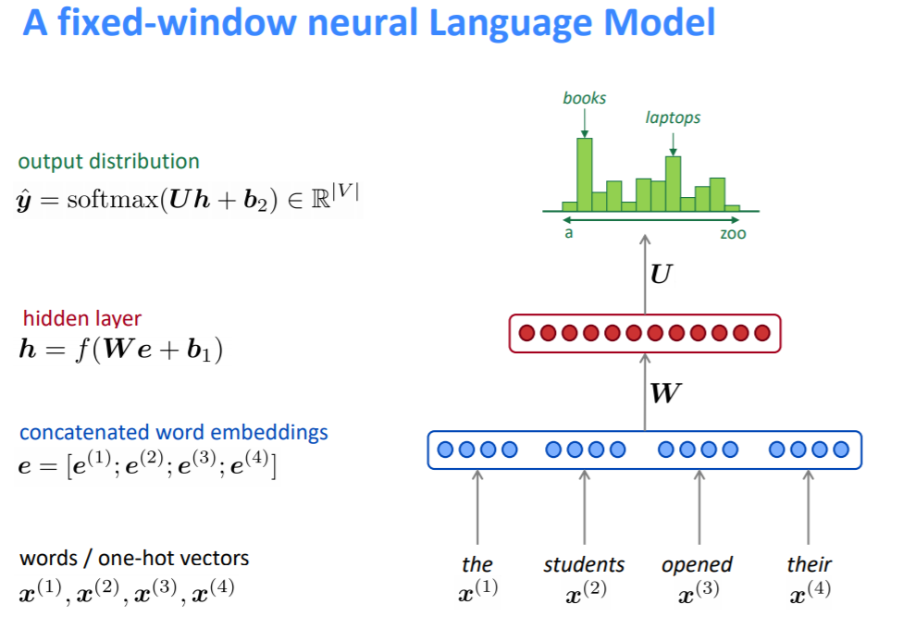
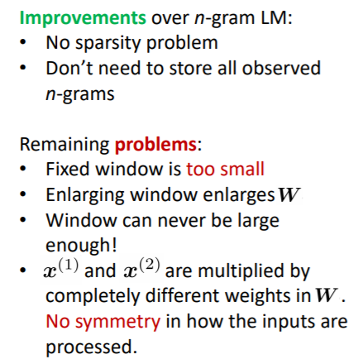
Language modelling
How?
  NN-based -> standard NNs

Slide 34
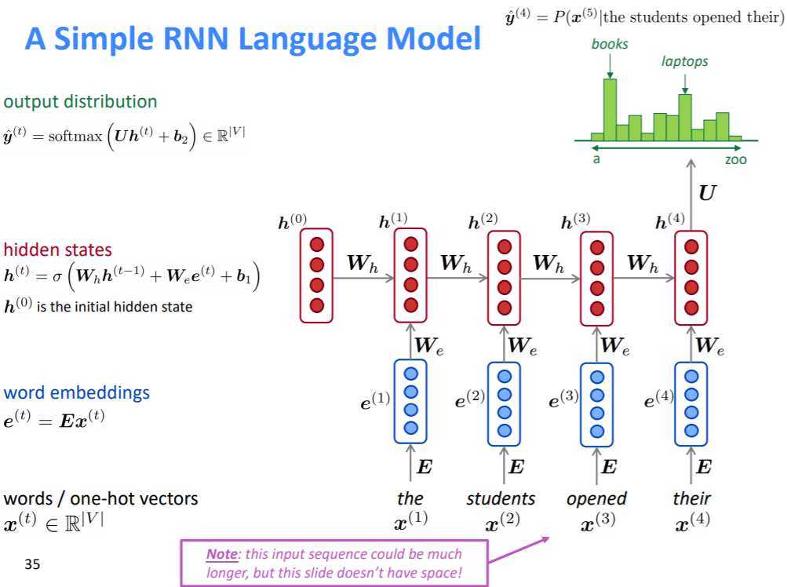
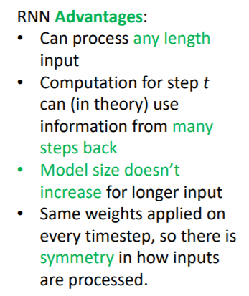
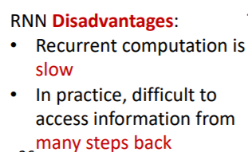
Language modelling
How?
  NN-based -> recurrent NNs
    Standard NN versus Recurrent NN
      https://www.deeplearningbook.org/contents/rnn.html
      http://karpathy.github.io/2015/05/21/rnn-effectiveness/
    Char-level recurrent NN
      https://github.com/karpathy/char-rnn

Slide 35
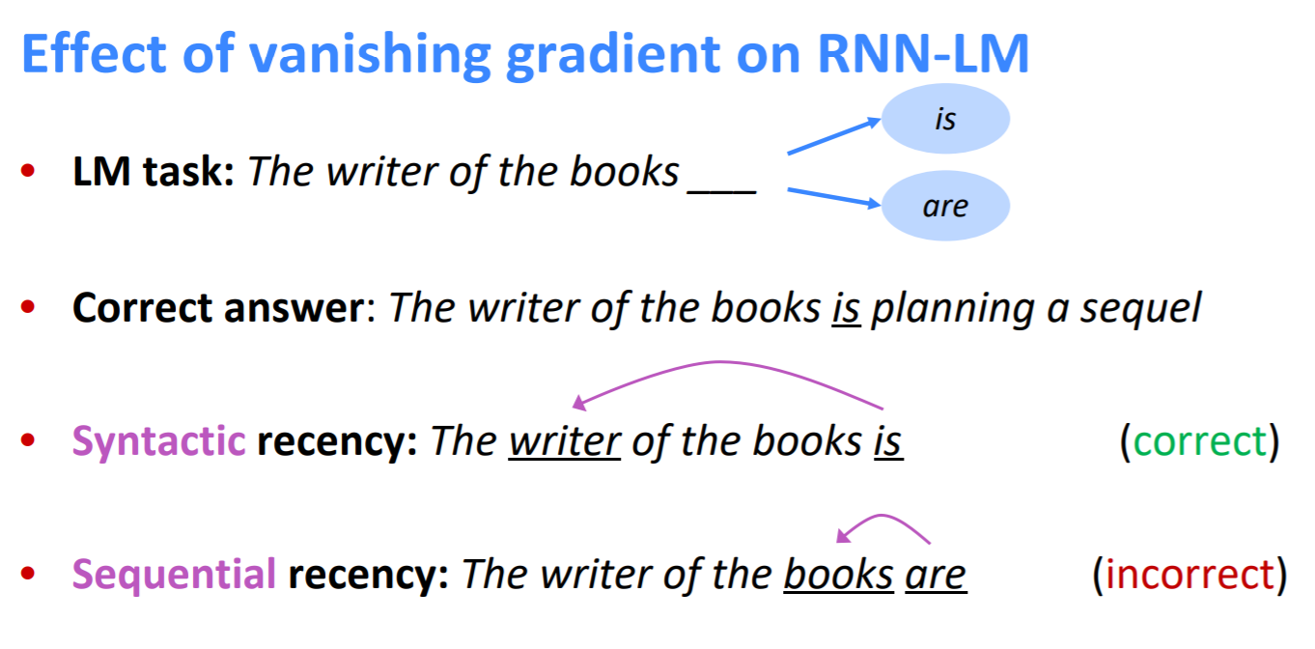
Language modelling
How?
  NN-based -> recurrent NNs
LSTM

Slide 36
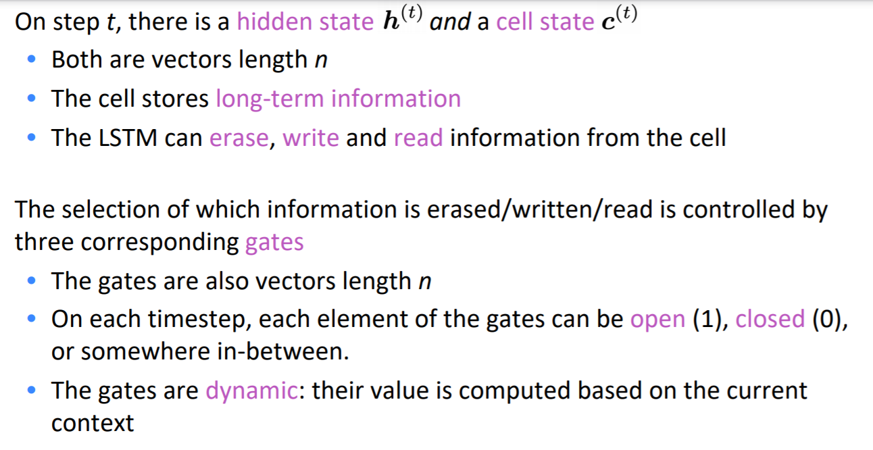
Language modelling
How?
  NN-based -> special recurrent NNs
    LSTM (2013-2015) –
      https://www.bioinf.jku.at/publications/older/2604.pdf
      http://colah.github.io/posts/2015-08-Understanding-LSTMs/
    Gated Recurrent Units (2014) https://arxiv.org/pdf/1406.1078v3.pdf
      Better speed and few parameters

Slide 37
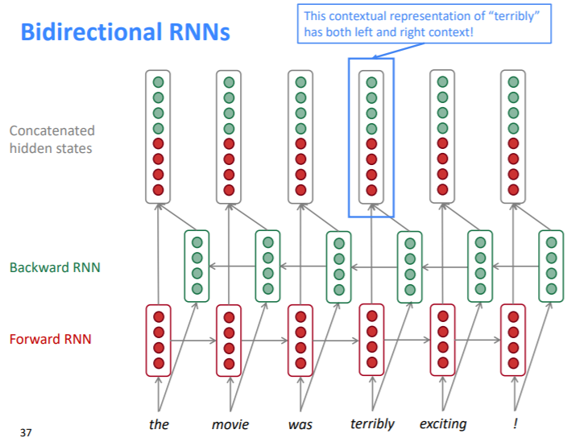
Language modelling
How?
  NN-based -> fancy recurrent NNs
    Bidirectional RNNs
      Transformers (2017)
        https://arxiv.org/abs/1706.03762
        https://github.com/tensorflow/tensor2tensor
        https://ai.googleblog.com/2017/08/transformer-novel-neural-network.html
        https://jalammar.github.io/illustrated-transformer/
      BERT (Bidirectional Encoder Representations from Transformers)
    Multi-layer RNNs

Slide 38
More details:
  Cross-lingual transfer learning
    https://ruder.io/talks/
    https://docs.google.com/presentation/d/1fIhGikFPnb7G5kr58OvYC3GN4io7MznnM0aAgadvJfc/edit#slide=id.g5a24b37ba6_3_12
  https://nlpprogress.com/

