Slide 1
INSTRUMENTE INTELIGENTE PENTRU BUNĂSTARE SOCIALĂ
Laura Dioşan
Tema 2
Facultatea de Matematică și Informatică
Universitatea Babeș-Bolyai

Slide 2
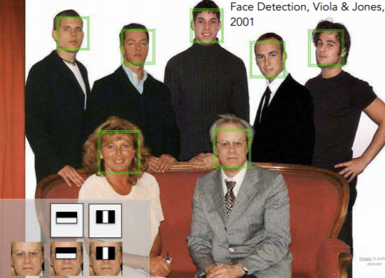
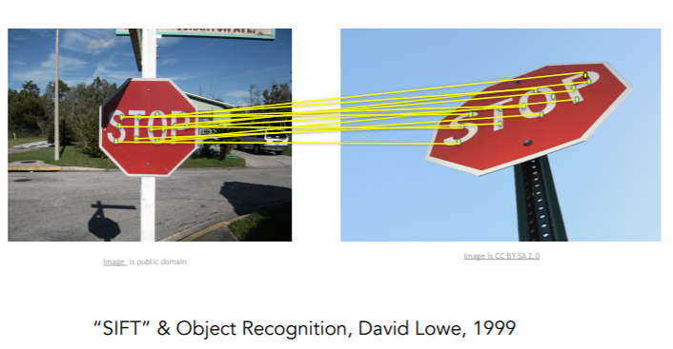
Image processing
Classic approach
  Image enhancement
  How?
    Filters (see https://github.com/jbhuang0604/awesome-computer-vision)
ML-based approaches
  Image classification and recognition
  How?
    Feature extraction & ML algorithms
      Features
        Haar
        HOG
        SIFT
        SURF
        LBP
      ML algorithms
        kNN
        SVM
        Decision trees → Ada boost
    Feature learning & ML algorithms
      Use ANN for both feature extraction and ML

Slide 3
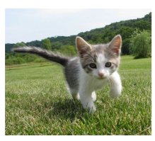
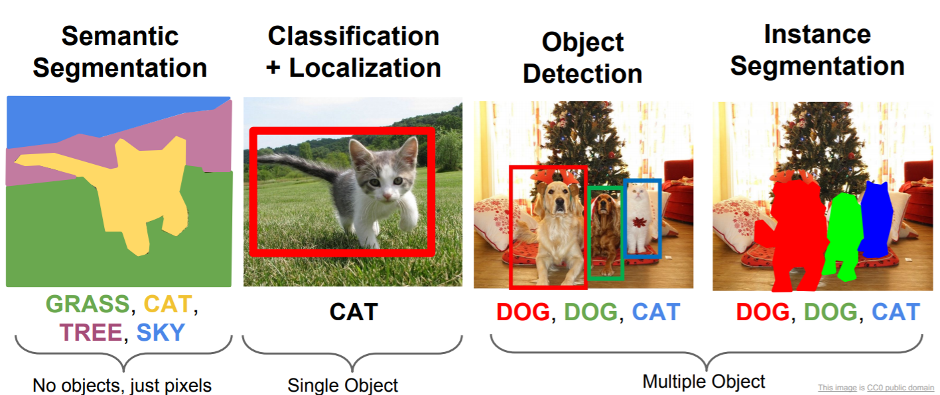
Automatic image processing
Image classification
Other tasks
CAT or DOG or OTHER?

