Slide 1
INSTRUMENTE INTELIGENTE PENTRU BUNĂSTARE SOCIALĂ
Laura Dioşan
Tema 4
Facultatea de Matematică și Informatică
Universitatea Babeș-Bolyai

Slide 2
Quality of an ML-based system
  ML algorithm
  Learnt model
  Data
  Entire System

Slide 3
Measuring quality -> how?
ML perspective -> building models that could do good numerical or class-related predictions
  Prediction quality
  Model size
  Inference time
  User interaction model
  Kinds of mistakes made
  How the system deals with mistakes
  Ability to incrementally learn
  Safety, security, fairness, privacy
  Explainability
SE perspective -> conventional software development
  Black box testing
  White box testing
  …

Slide 4
Measuring quality – ML perspective
Prediction quality
  Classification problem
    Accuracy = correct predictions / all predictions
      Measuring success of all classes predictions
      Higher is better
    Precision = TP / (TP + FP)
      Measuring rate of false classifications (or noise)
      Higher is better
    Recall = TP / (TP + FN)
      Measuring success of correct classifications (or missing results)
      Higher is better
      False negative rate = 1 – recall
  Regression problem
    Prediction error
      Mean Absolute Error MAE = 1/n ∑| realValue - predictedValue |
      Mean Absolute Percentage Error MAPE = 1/n ∑| (realValue – predictedValue) / realValue |
      Mean Squared Error MSE = 1/n ∑ ( realValue - predictedValue )^2

Slide 5
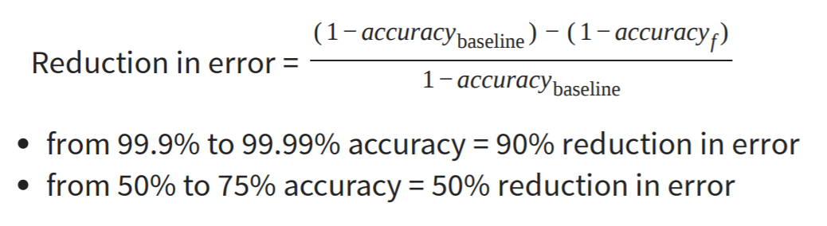
Measuring quality – ML perspective
Prediction quality
  Suppose the accuracy metric
    What does mean a good accuracy? 99%? 75%?
    Always compare to a base rate!

Slide 6
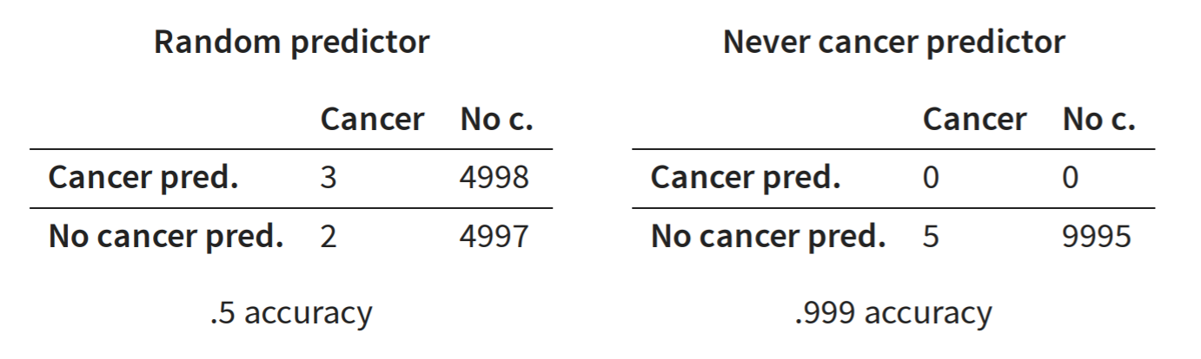
Measuring quality – ML perspective
Prediction quality
  Baseline = ?
    Random predictor
      Acc = (3 + 4997) / (3 + 2 + 4998 + 4997) = 0.5
      Precision(cancer) = 3 / (3 + 4998) ~0.0006
      Recall (cancer) = 3/ (3 + 2) = 0.6
    all true,
    all false,
    repeat last observation,
    simple heuristics,
    simpler model,
    SOTA
  Extreme classifiers
    Never cancer predictor = Identifies every instance as negative (e.g., no cancer)
      Precision = ? / 0 / (0 + 0) - undefined (no false predictions, but no predictions at all)
      Recall = ? / 0 / (0 + 5)
    Always cancer predictor = Identifies every instance as positive (e.g., has cancer)
      Precision = ? / x / (x + y), y >> x => low (also reports cancer for all noncancer cases)
      Recall = ? / x / (x + 0) = 100%

Slide 7
Measuring quality – ML perspective
Generalisation quality
  Training data (seen)
    problems
      If acc(learning) >> acc(validation) => overfitting
        Model learned exactly for the input data, but does not generalize to unseen data (e.g., exact memorization)
      If acc(learning) << acc(validation) => underfitting
        Model makes very general observations but poorly fits to data (e.g., brightness in picture)
    Solutions
      Parameter tunning
        Control the degrees of freedom (no of parameters)
      Cross-validation
        Repeated partitioning of data into train and validation data, train and evaluate model on each partition, average results
  Testing data (unseen)

Slide 8
Measuring quality – SE perspective
Testing
  White-box testing
    testing the functionality of an application WITH knowing the details of its implementation
    Structure-based testing -> test cases are created with reference to the internal structure of the software component
    Remember that we deal by an ML model, not a piece of code
  Black-box testing
    testing the functionality of an application WITHOUT knowing the details of its implementation
    specification-based testing -> test cases are created based on the requirement specifications
    Specification = ?
      Input data= known
      Output data (results) = unknown

Slide 9
Measuring quality – SE perspective
machine learning systems = ‘non-testable’ software?
  a machine learning system inherently follows a data-driven programming paradigm
    The model’s behaviour may evolve over time, in response to the frequent provision of new data
  oracle problem
    When we know that an answer is a good one?
  Testing level
    Unit testing
    Contract test
    Integration testing
    …

Slide 10
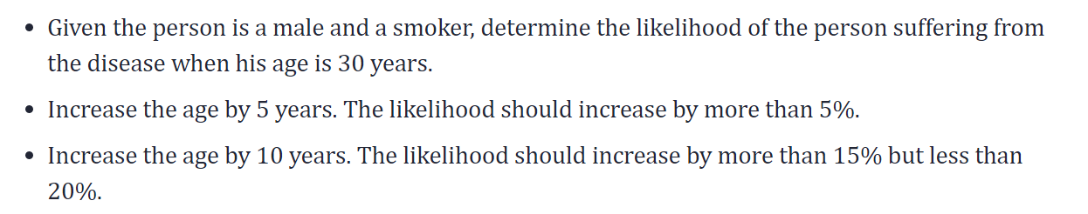
Black-box testing of an ML algorithm
Challenges & possible solutions
  identify the test oracle which could verify the test outcome against the expected values known beforehand
    validation data -> ok
    Test data (new/unseen data) -> ???
      Pseudo-oracle – statistical comparison of model performance (acc, P, R, …)
        Metamorphic testing – explore metamorphic relations between inputs and output -> if we increase X by delta, then Y will change (increase/decrease)
        https://arxiv.org/ftp/arxiv/papers/2002/2002.12543.pdf
        https://www.ncbi.nlm.nih.gov/pmc/articles/PMC3019603/pdf/nihms200711.pdf
    PDCA cycle (Plan-Do-Check-Act)
      https://vitalflux.com/qa-machine-learning-models-pdca-cycle/
  Dual coding - build different models based on different algorithms and comparing the prediction from each of these models given a particular input data set
  Coverage guided fuzzing is a technique where data to be fed into the Machine Learning models could be planned appropriately such that all of the features activations get tested.
    https://arxiv.org/abs/1807.10875

Slide 11
Test input generation
  Domain-specific Test Input Synthesis
  Fuzz and Search-based Test Input Generation
  Symbolic Execution Based Test Input Generation
  Synthetic Data to Test Learning Program
Test- oracle (Pseudo-oracle)
  Metamorphic testing
    Coarse-grained Data Transformation (e.g. shuffle)
    Fine-grained Data Transformation (e.g. data perturbation – noisy data)
  Cross-Referencing
    Differential testing is a traditional software testing technique that detects bugs by observing whether similar applications yield different outputs regarding identical inputs
    N-version programming aims to generate multiple functionally equivalent programs based on one specification, so that the combination of different versions are more fault-tolerant and robust.
Test adequacy evaluation is to find out whether the existing tests have a good fault-revealing ability
  Test Coverage
  Mutation Testing
  Surprise Adequacy
  Rule-based Checking of Test Adequacy
Test Prioritisation and Reduction
Bug Report Analysis
Debug and Repair
General Testing Framework and Tools

Slide 12
ML PROPERTIES TO BE TESTED
Functional properties
  Correctness
  Model Relevance
    Overfitting or underfitting
Non-functional
  Robustness and Security (a robust system should maintain performance in the presence of noise)
    Robustness measurement criteria
      pointwise robustness, indicating the minimum input change a classifier fails to be robust;
      adversarial frequency, indicating how often changing an input changes a classifier’s results;
      adversarial severity, indicating the distance between an input and its nearest adversarial example
    Perturbation Targeting Test Data
    Perturbation Targeting the Whole System
  Efficiency
  Fairness
    Fairness Definitions and Measurement Metrics
    Test Generation Techniques for Fairness Testing
  Interpretability
  Privacy

Slide 13
detect conceptual errors in ML models
  Black-box testing
    generation of an adversarial data set that is used to test the ML models
    Adversarial ML: Alteration of existing inputs
    Mutation Testing: Alteration of ML model internals
  White-box testing
    Pseudo-Test Oracle,
    Metamorphic Testing
    Test Adequacy Evaluation
      Neuronal coverage
      Modified Condition/Decision Coverage (MC/DC Coverage)
      Combinatorial Testing Coverage Criteria
      Multi-granularity Coverage Levels
      Surprise Adequacy
    Automated Test Input Generation
      Gradient-Based Optimization

Slide 14
detect errors in ML code implementations
  Numerical-based testing: Finite-difference techniques
  Property-based testing
  Metamorphic testing
  Mutation testing
  Coverage-Guided fuzzing
  Proof-based testing

Slide 15
https://drops.dagstuhl.de/opus/volltexte/2020/13060/pdf/dagrep_v010_i002_p076_20091.pdf
https://github.com/helloful/Machine-Learning-Books/blob/master/book/Building%20Intelligent%20Systems%20-%20A%20Guide%20to%20Machine%20Learning%20Engineering.pdf
https://martinfowler.com/articles/cd4ml.html#TestingAndQualityInMachineLearning
https://ckaestne.github.io/seai/F2020/slides/03_modelquality/modelquality.pdf
https://ieeexplore.ieee.org/stamp/stamp.jsp?arnumber=9000651&casa_token=9n3hR8ciH_MAAAAA:BWPwL97lzq-IWPKdlrGx5S6Cc8YAiu7uj8410Jf89YJomK0CTG9Lt_4IyL5pAzFdG3E8D79xwSR1&tag=1
https://www.sciencedirect.com/science/article/abs/pii/S0164121220300248

