Slide 1
INSTRUMENTE INTELIGENTE PENTRU BUNĂSTARE SOCIALĂ
Laura Dioşan
Tema 6 – despre date
Facultatea de Matematică și Informatică
Universitatea Babeș-Bolyai

Slide 2
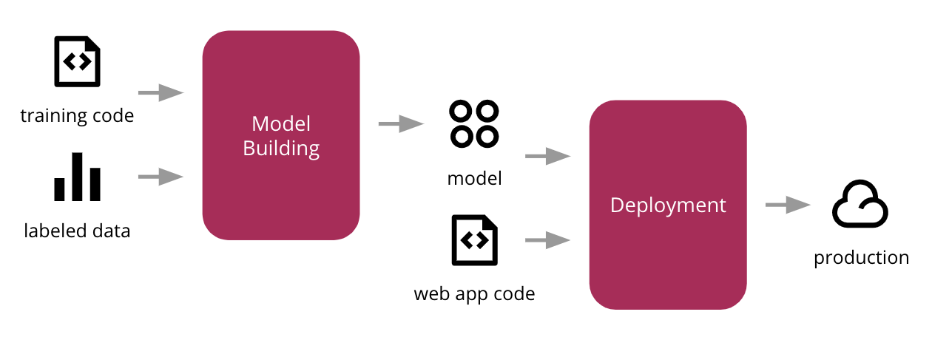
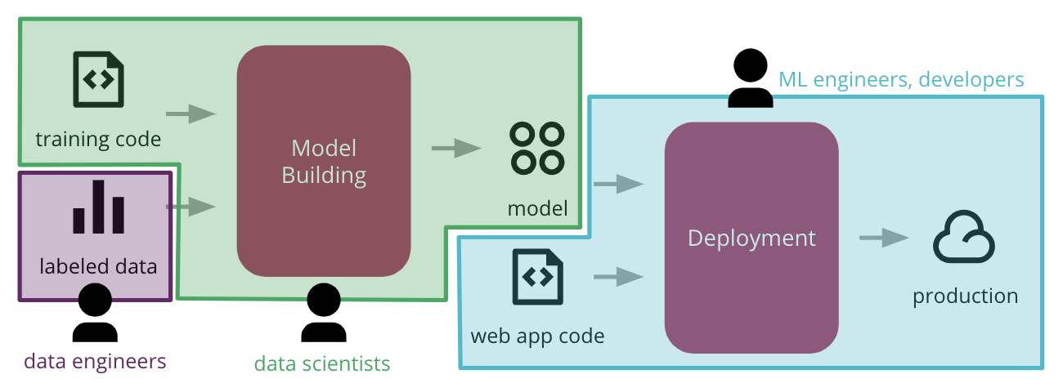
Developing an ML-based application
Process
Challenges
rolls and tasks of each member
how to make the process reproducible and auditable
different tools & workflows

Slide 3
Versioning
A classical SW system
[inputs +] Code
Versioning
Code only
Tool: Git
An ML-based SW system
Data + Model + Code
Model
Algorithmic approach + hyperparameters)
Data
Schema (shape of data)
Values (distribution of data)
Code
Raw-implementation or API calls
Versioning
All three components
Tool: Data Science Version Control https://dvc.org

Slide 4
Understanding the data
Steps
Exploratory data analysis
Clean up activities
Normalisation
Principles
Reliability -> easily discoverable and accessible
Data versioning
Structural changes?
Sampling over time?
How often?
How will you know when that system changes?
Necessity
Does the usefulness of the feature justify the cost of including it?
Correlations
Feedback loops

Slide 5
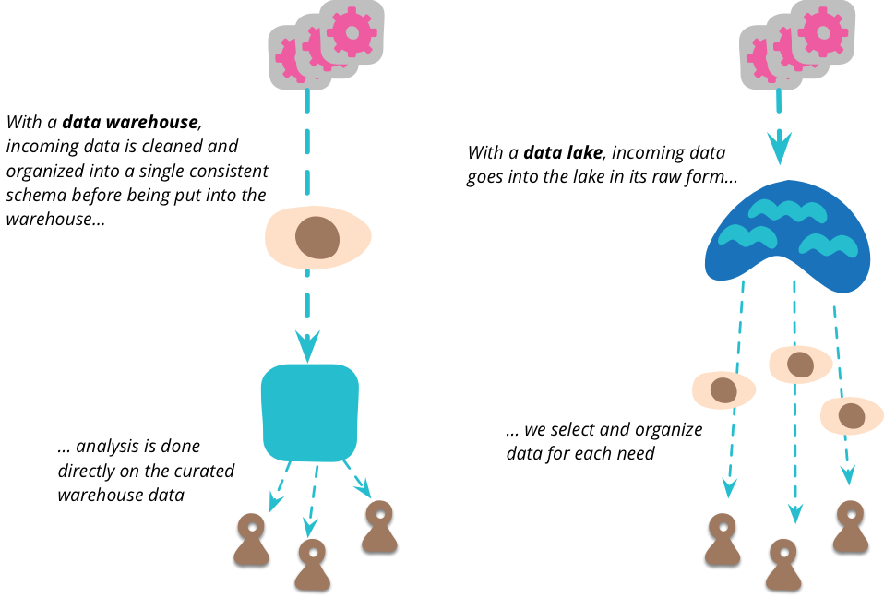
Understanding the data
How the data is collected? Which is the data source?
public / open source data or private data
real data or synthetic data
How the data is stored?
Data storage format:
binary data (e.g. Amazon S3, Ceph),
metadata (e.g. postgres),
data lake (Amazon Redshift),
features (FEAST, Michelangelo Pallete)
Data storage organisation:
Data warehouse,
Data streams,
Data lake (raw data -> Hadoop)
https://jamesdixon.wordpress.com/2014/09/25/data-lakes-revisited/
Data mesh
https://martinfowler.com/articles/data-monolith-to-mesh.html
…

Slide 6
Understanding the data
How the data is labeled?
platforms / frameworks for labelling
Computer Vision: Diffgram, Prodigy, HIVE, Supervisely, Labelbox, Scale AI;
Text: Prodigy, Scale AI
who?
sources of labor for labelling
Crowdsourcing,
Hiring own annotators or data labeling service companies
What is the data pipeline?
Spark
Scala

Slide 7
Understanding the data
How the data is visualized and analysed (before to run an AI algorithm)?
FACETS
https://pair-code.github.io/facets
PyViz
https://pyviz.org
Altair
https://altair-viz.github.io
Embedded projector
http://projector.tensorflow.org
Code examples:
https://github.com/parulnith/Data-Visualisation-libraries

Slide 8
More details
Practical advice for analysis of large, complex data sets
https://www.unofficialgoogledatascience.com/2016/10/practical-advice-for-analysis-of-large.html
Data Preparation and Feature Engineering in ML
https://developers.google.com/machine-learning/data-prep/?utm_source=mlcc&utm_campaign=mlcc-next-steps&utm_medium=referral&utm_content=data-prep-ss
About the limitation of using human-level performance (HLP) as a metric to beat in machine learning applications for manufacturing and other fields
https://blog.deeplearning.ai/blog/the-batch-ai-predicts-the-vote-face-recognition-looks-for-criminals-model-cow-makes-milk-transformers-prove-theorems

