Slide 1
METODE INTELIGENTE DE REZOLVARE A PROBLEMELOR REALE
Laura Dioşan
Attention
Facultatea de Matematică și Informatică
Universitatea Babeș-Bolyai

Slide 2
why attention mechanisms matter?
Overcome limitations of fixed-size context in RNNs.
Enable models to focus on relevant parts of input.
Critical for Transformers, which dominate NLP and vision.

Slide 3

Definition
A method to compute a weighted combination of input features based on relevance.

Slide 4
Softness of the attention
Soft-attention
a deterministic attention
uses a weighted average of all keys to building the context vector.
the attention module is differentiable with respect to the inputs, so the whole system can still be trained by standard back-propagation methods.
Hard-attention
a stochastic attention
the context vector is computed from stochastically sampled keys
computationally less expensive because it does not need to calculate attention weights of all elements at each time
making a hard decision at each position of the input feature will make the module non-differentiable and difficult to optimize, so the whole system can be trained by maximizing an approximate variational lower bound
global attention
similar to soft attention.
local attention
an interesting blend between the hard and soft attention, in which only a subset of source words are considered at a time.
computationally less expensive than global attention or soft attention.
differentiable almost everywhere, making it easier to implement and train.

Slide 5
Forms of the input features
item-wise
input is either explicit items or an additional preprocessing step is added to generate a sequence of items from the source data
the encoderencodes each item as a separate code, and assigns different weightsto them during decoding
E.g. single word embedding, single feature map
Computing perspective
item-wise soft attention calculates a weight for each item, and then makes a linear combination of them
item-wise hard attention stochastically picks one or someitems based on their probabilities.
location-wise
the decoder
processes the multi-resolution crop of the input image at each step
transforms the task related region into a canonical, expected pose to simplify inference in the subsequent layers
Computing perspective
location-wise soft attention accepts an entire feature map as input and generates a transformed version through the attention module
location-wise hard attention stochastically picks a sub-region as input and the location ofthe sub-region to be picked is calculated by the attention module

Slide 6
Input representation
Distinctive attention
a single input and corresponding output sequence
Keys and queries belong to two independent sequences
Co-attention
self (inner) attention which computes attention only based on the input sequence
query, key and value are different representations of the sameinput sequence

Slide 7
Output representation
Single-output
Multi-head attention
Multi-dimensional attention

Slide 8
sparse attention, because instead of computing attention weights for all n×nn \times nn×n token pairs (dense), it restricts computation to a subset of positions (e.g., a sliding window). This reduces complexity from O(n2)O(n^2)O(n2) to approximately O(n⋅k)O(n \cdot k)O(n⋅k), where kkk is the average number of positions each token attends to.✅ Why is it “sparse”?Dense attention: Every token attends to every other token → full n×nn \times nn×n matrix.Sparse attention: Only a fraction of entries are computed (others are masked out).Local attention uses a band-diagonal mask, so most entries are zero (ignored).✅ Taxonomy of Sparse Attention MechanismsSparse attention patterns can be categorized by how they select positions:1. Fixed PatternsSliding Window (Local)Each token attends to neighbors within ± w positions.Example: Longformer, local attention in speech models.Block-SparseSequence divided into blocks; tokens attend within block and nearby blocks.Example: BigBird, Reformer (with hashing).2. Global TokensA few tokens (e.g., [CLS]) attend to all positions and vice versa.Example: Longformer, BigBird.3. Random PatternsRandomly selected positions per token to improve connectivity.Example: BigBird adds random links to avoid isolated regions.4. Dilated / Strided PatternsTokens attend at regular intervals (e.g., every d steps).Example: Sparse Transformers for images.5. Hybrid PatternsCombine multiple strategies (window + global + random).Example: BigBird uses all three.6. Learnable PatternsAttention sparsity learned during training (dynamic).Example: Routing Transformers, Adaptive Sparse Attention.

Slide 9
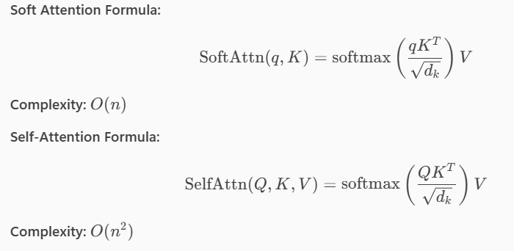
1. Soft Attention
Description: Computes a weighted sum of all input features, where weights represent relevance.
How it works: Uses a scoring function (e.g., dot product, additive) to assign attention weights, normalized via softmax.
Applications: Machine translation, image captioning.
Pros: Differentiable and trainable end-to-end.
Cons: Computationally expensive for long sequences.
2. Hard Attention
Description: Selects a subset of inputs (discrete choice) rather than weighting all.
How it works: Uses sampling or reinforcement learning to pick positions.
Applications: Image regions in visual question answering.
Pros: More efficient than soft attention.
Cons: Non-differentiable → requires complex training (e.g., REINFORCE).
3. Self-Attention (Intra-Attention)
Description: Each element in a sequence attends to all other elements.
How it works: Computes attention scores between every pair of tokens.
Applications: Transformers (BERT, GPT), summarization, speech recognition.
Pros: Captures long-range dependencies.
Cons: Quadratic complexity in sequence length.
4. Multi-Head Attention
Description: Runs multiple self-attention mechanisms in parallel.
How it works: Each head learns different relationships; outputs are concatenated and projected.
Applications: Core of Transformer architecture.
Pros: Improves representation power.
Cons: Higher computational cost.
5. Cross-Attention
Description: One sequence attends to another (e.g., decoder attends to encoder outputs).
Applications: Machine translation, multimodal models (text + image).
Pros: Enables interaction between different modalities or stages.
6. Local Attention
Description: Restricts attention to a neighborhood around each token.
Applications: Long sequence modeling (e.g., speech, DNA).
Pros: Reduces complexity.
Cons: May miss global context.
7. Sparse Attention
Description: Only attends to a subset of tokens based on a pattern (e.g., fixed, learned).
Applications: Longformer, BigBird for long documents.
Pros: Scales to very long sequences.
Cons: Requires careful design of sparsity pattern.
8. Hierarchical Attention
Description: Applies attention at multiple levels (e.g., word-level, sentence-level).
Applications: Document classification.
Pros: Captures structure in data.

Slide 10
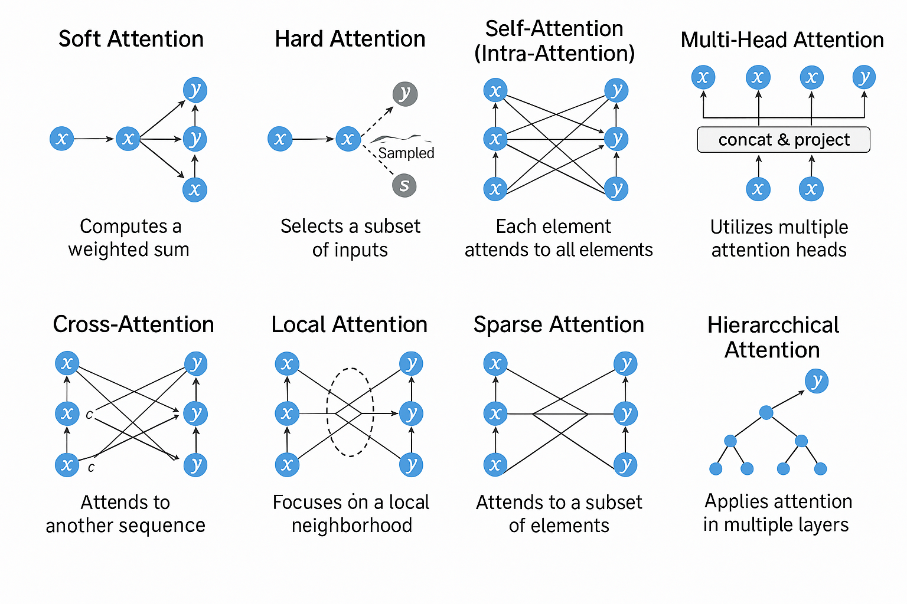

Slide 11
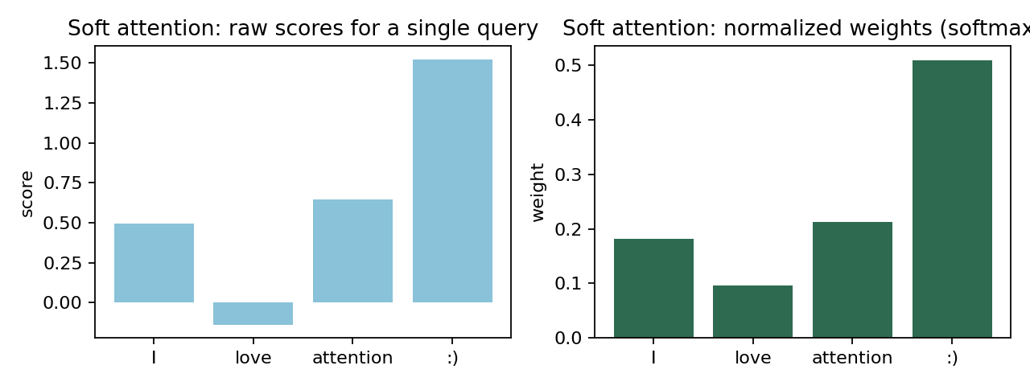
Soft attention
single query → encoder keys
one query produces a 1‑D distribution over the source tokens.

Slide 12
Attention Mechanism | Complexity
Soft Attention | O(n)
Hard Attention | O(n)
Self-Attention | O(n²)
Multi-Head Attention | O(h · n²)
Local Attention | O(n · w)
Sparse Attention | O(n · √n)
(n = sequence length, d = dimension, h = number of heads, w = window size)

