Slide 1
METODE INTELIGENTE DE REZOLVARE
A PROBLEMELOR REALE
Laura Dioşan
Tema 10
Facultatea de Matematică și Informatică
Universitatea Babeș-Bolyai

Slide 2
Graph neural networks
  Why?
  How?
  Applications

Slide 3
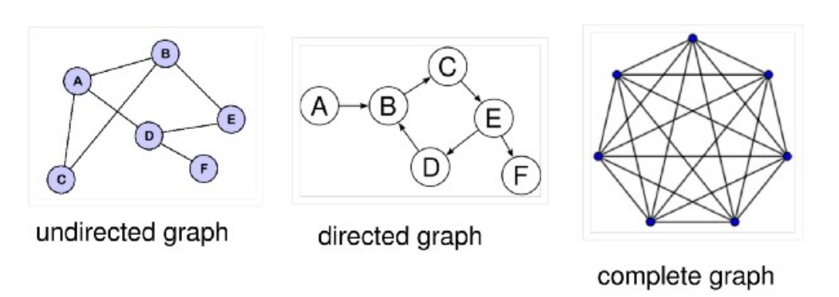
Graphs
  a type of data structure having two components:
    nodes (or vertices)
      Homogenous
      Heterogenous
    edges, which connect two nodes
      Unidirectional
      Bidirectional
      With or without weights
  a graph = a collection of loosely inter-connected nodes via edges

Slide 4
Graph NNs
neural network architectures that operate on a graph.
Aim:
  for each node in the graph to learn an embedding containing information about its neighborhood (nodes directly connected to the target node via edges).
  This embedding can then be used for different problems like node labelling, node prediction, edge prediction, etc.
Real-life applications
  Social Network Analysis — Similar posts prediction, tags prediction, and recommending content to users.
  Natural Sciences — GNNs have also gained popularity in dealing with molecular interactions like protein-protein interactions.
  Recommender Systems — A heterogenous graph can be used to capture relationships between users and items to recommend relevant items to a buyer.

Slide 5
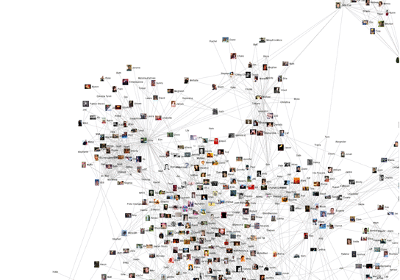
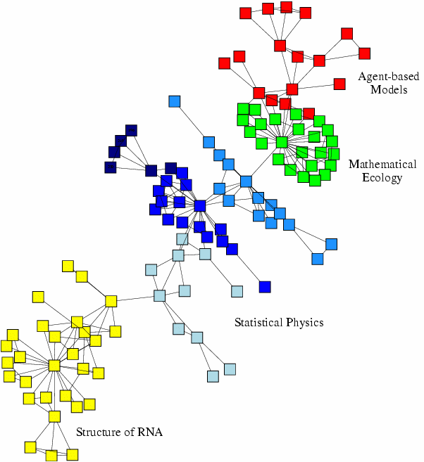
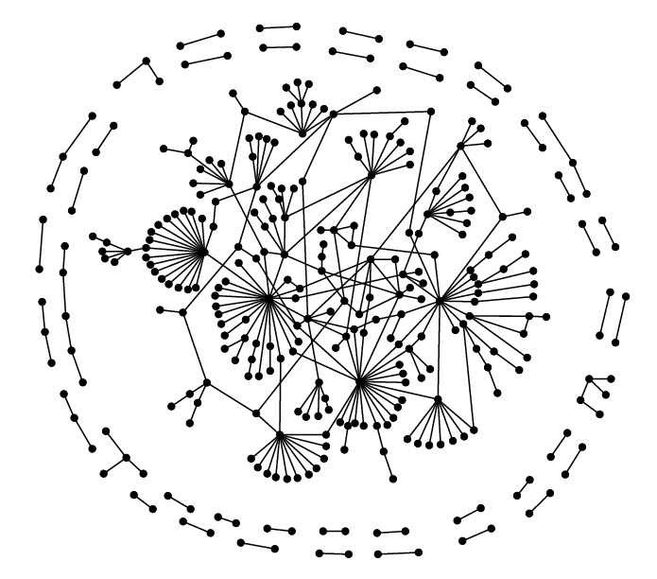
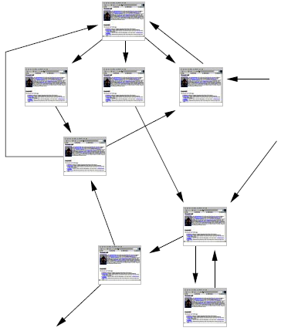
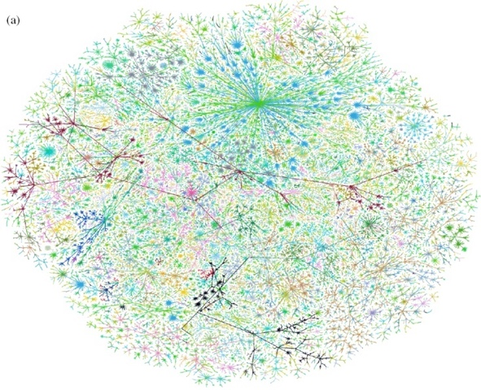
Why graphs?
  Graphs (= networks, systems) are a general language for describing and modeling complex systems
  Many data are represented as graphs
Social networks
Economic networks
Biomedical networks
5
Information networks:
Web & citations
Internet
Networks of neurons

Slide 6
Why graphs?
Graphs (= networks, systems) are a general language for describing and modeling complex systems
Many data are represented as graphs
Universal language for describing complex data
  Networks from science, nature, and technology
  are more similar than one would expect
Shared vocabulary between fields
  Computer Science, Social science, Physics, Economics, Statistics, Biology
Data availability (+computational challenges)
  Web/mobile, bio, health, and medical
Impact!
  Social networking, Social media, Drug design

Slide 7
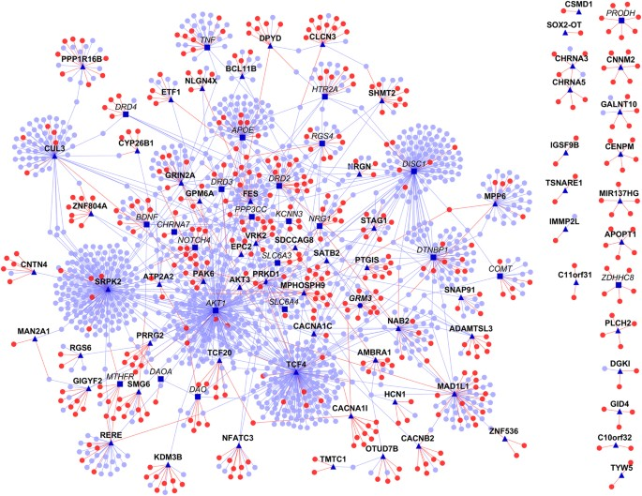
Machine learning with / in graphs
Node classification
  Predict the type of a given node
  Classifying the function of proteins in the interactome!
    See Ganapathiraju, M. K., Thahir, M., Handen, A., Sarkar, S. N., Sweet, R. A., Nimgaonkar, V. L., ... & Chaparala, S. (2016). Schizophrenia interactome with 504 novel protein–protein interactions. NPJ schizophrenia, 2(1), 1-10. https://www.nature.com/articles/npjschz201612
?
?
?
?
Machine Learning
?

Slide 8
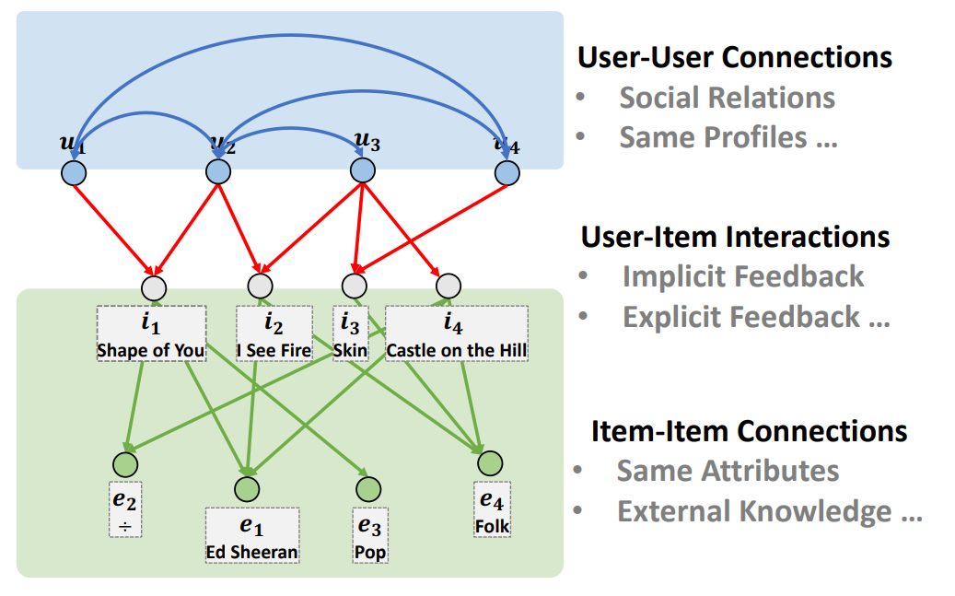







Machine learning with / in graphs
?
  Node classification
  Link prediction
    Predict whether two nodes are linked
    Recommender systems
?
x
?
Machine Learning
?

Slide 9
Machine learning with / in graphs
  Node classification
    Predict a type of a given node
  Link prediction
    Predict whether two nodes are linked
  Community detection
    Identify densely linked clusters of nodes
  Network similarity
    How similar are two (sub)networks

Slide 10
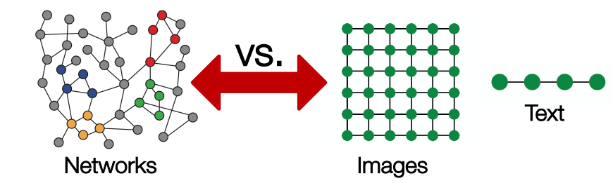
Graph neural networks
Data structures
  Text/speech -> sequences -> RNN
  Images -> regular grids (matrix) -> CNN
  Graphs
    Arbitrary size
    Complex topological structure

Slide 11
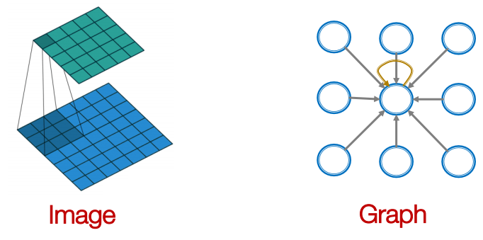
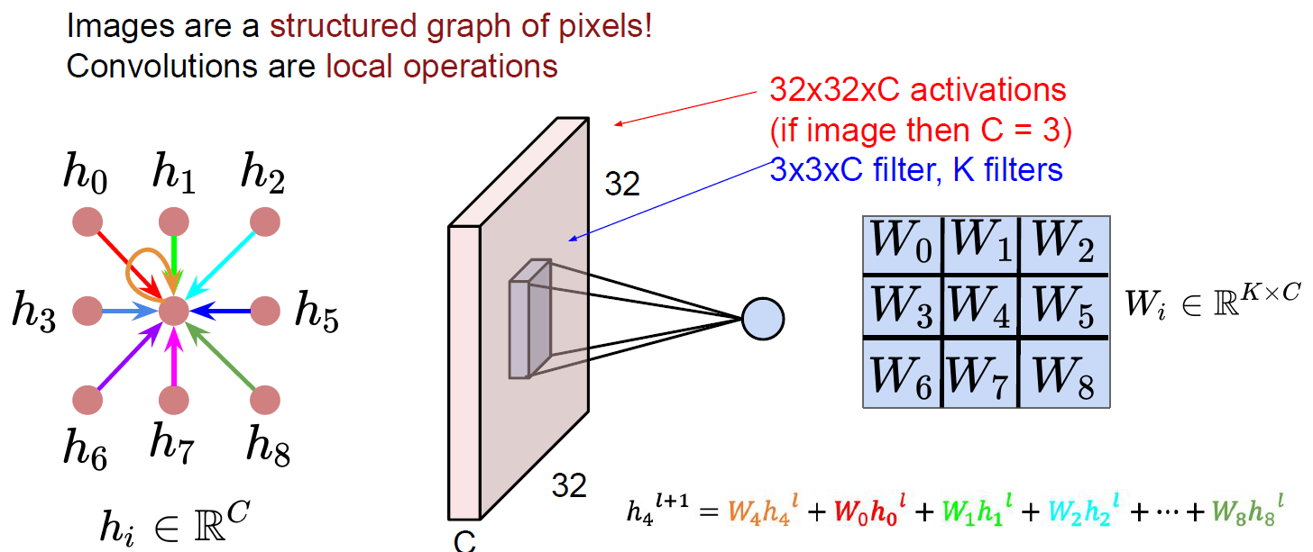
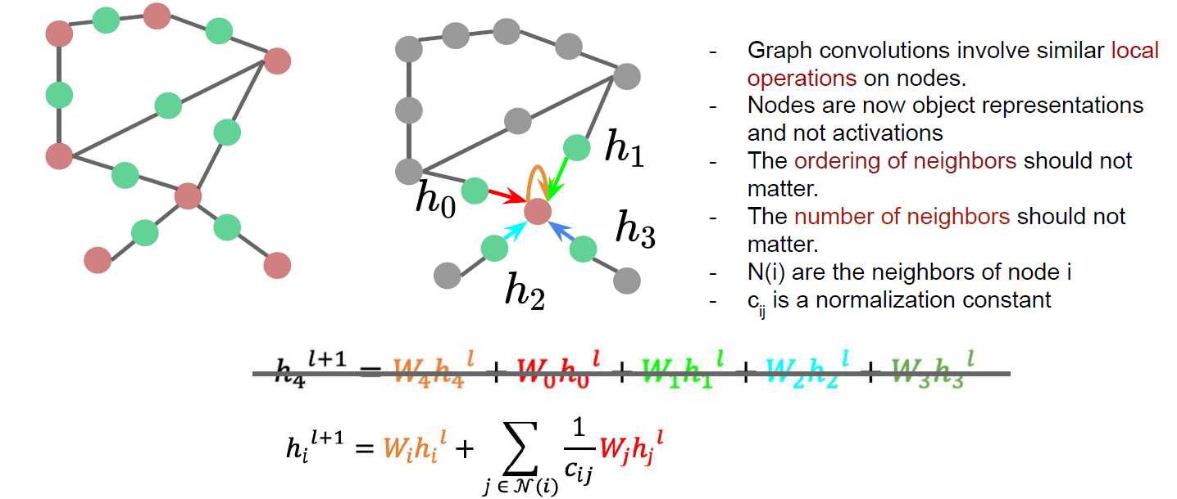
Graph neural networks
Convolutions over data
  Combine the information from the current element with that from neighbours ∑w_{i}h_{i}
  How to deal with more complex graphs?

Slide 12
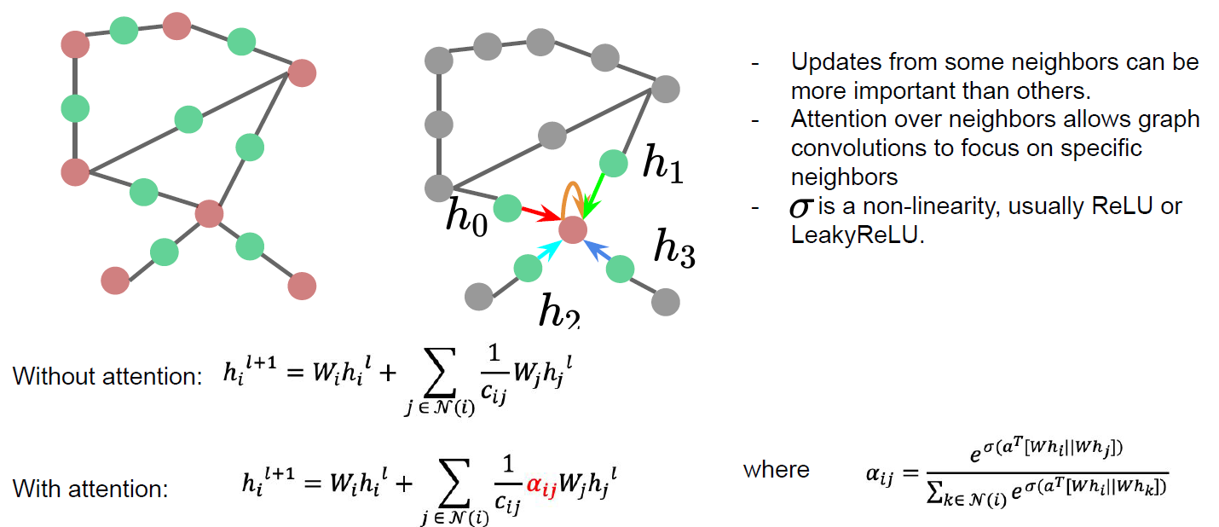
Graph neural networks
Convolutions over graphs

Slide 13
Graph neural networks
Naïve approach
  A fusion between the adjacency matrix and other node features -> input for an ANN
  + easy
  - a lot of parameters = O(no of nodes)
  - doesn’t work for graphs of different sizes
  - not invariant to node ordering
Graph convolutional networks
  Node’s neighbourhood defines a computational graph
  An ML algorithm is used to learn how to transform and transmit the information across the nodes

Slide 14
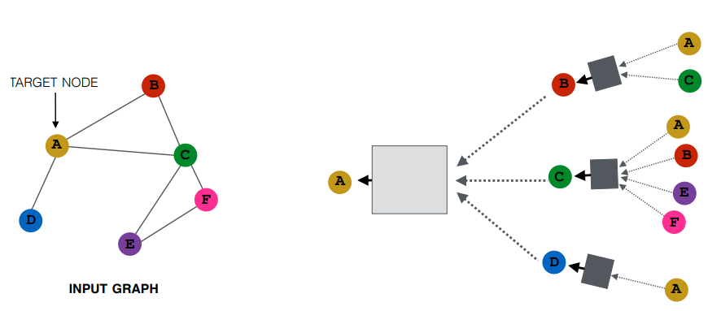
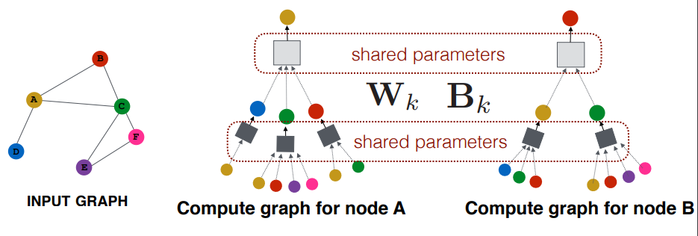
Graph convolutional networks
  step1: generate node embeddings based on local graph neighbourhood
    Aggregate messages from neighbours and apply an ANN
    Every node defines a computation graph based on its neighbourhood

Slide 15
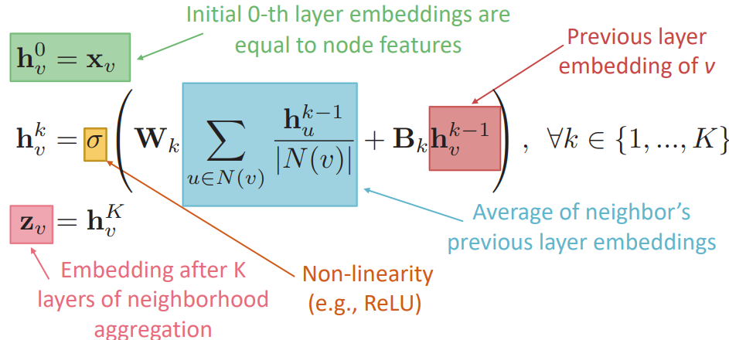
Graph convolutional networks
  step1: setup for generating node embeddings based on local graph neighbourhood
    Aggregate messages from neighbours and apply an ANN
      Aggregation by an order invariant operator
        Average (mean) or Max or Sum
      ANN

Slide 16
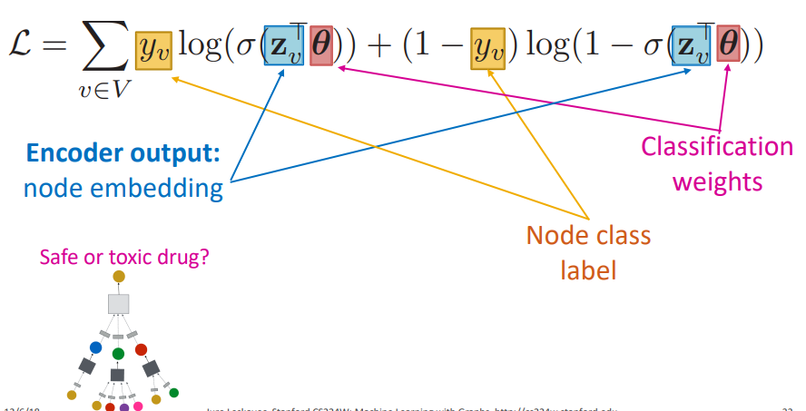
Graph convolutional networks
  step2: prepare the model training
    Parameters of the graph model: Wk, Bk
    Classification weights θ
    Loss function
      E.g supervised binary classification task = safe or toxic drug
      E.g. unsupervised task – random walk optimization
        See DeepWalk https://arxiv.org/pdf/1403.6652.pdf
        See node2vec https://cs.stanford.edu/~jure/pubs/node2vec-kdd16.pdf

Slide 17
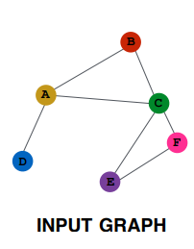
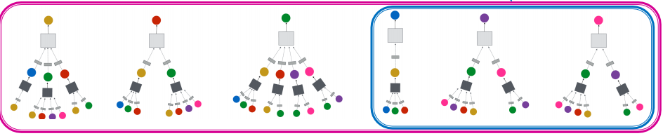
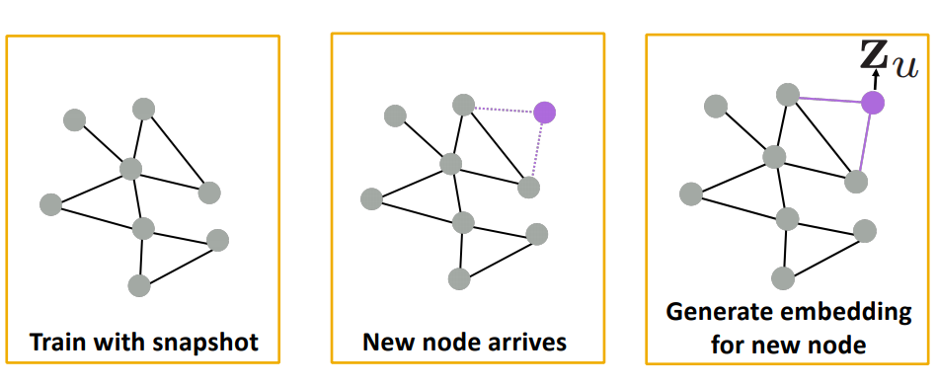
Graph convolutional networks
  step3: train the model and test
  Step 4: generalize for new nodes / graphs

Slide 18
Graph CNNs - applications
  Action Genome: Understanding Action with Spatio-Temporal Scene Graphs
    http://actiongenome.org
    Ji, Krishna et al. Action Genome: Actions as Compositions of Spatio-Temporal Scene Graphs, CVPR 2020
  RecSys
    Pinterest - PinSage
      https://medium.com/pinterest-engineering/pinsage-a-new-graph-convolutional-neural-network-for-web-scale-recommender-systems-88795a107f48
      https://arxiv.org/pdf/1806.01973.pdf
    Model and predict side effects of drug pairs
      http://snap.stanford.edu/decagon/
      https://arxiv.org/pdf/1802.00543.pdf
  Data generation
    Drug discovery = Molecule generation (with high value of a given chemical property)
      https://cs.stanford.edu/people/jure/pubs/gcpn-neurips18.pdf
      https://github.com/bowenliu16/rl_graph_generation
      https://www.cell.com/cell/pdf/S0092-8674(20)30102-1.pdf

Slide 19
Additional information
  Code example for GNN
    https://colab.research.google.com/drive/1DIQm9rOx2mT1bZETEeVUThxcrP1RKqAn
  SNAP project
    http://snap.stanford.edu/
  GNN and RecSys
    https://github.com/yazdotai/graph-networks#tensorflow-implementations
    https://next-nus.github.io/slides/tuto-cikm2019-public.pdf
  Graph-based Deep Learning
    https://github.com/naganandy/graph-based-deep-learning-literature
    https://www.cs.mcgill.ca/~wlh/grl_book/
    https://github.com/thunlp/GNNPapers
Materials are considered from various sources like:
  Fei-Fei Li’s lecture about Graph Convolutions http://vision.stanford.edu/teaching/cs231n/slides/2020/lecture_18.pdf
  Jure Leskovec’s Lecture about Graph NNs http://web.stanford.edu/class/cs224w/slides/08-GNN.pdf
  …

