Slide 1
INTELIGENŢĂ ARTIFICIALĂ
Sisteme inteligente
Sisteme care învaţă singure
– generative AI–
Laura Dioşan

Slide 2
Sumar
Scurtă introducere în Inteligenţa Artificială (IA)
Sisteme inteligente
Sisteme care învaţă singure
Arbori de decizie
Reţele neuronale artificiale
kNN
Algoritmi evolutivi
Maşini cu suport vectorial
Sisteme bazate pe reguli
Sisteme hibride
Rezolvarea problemelor prin căutare
Definirea problemelor de căutare
Strategii de căutare
Strategii de căutare neinformate
Strategii de căutare informate
Strategii de căutare locale (Hill Climbing, Simulated Annealing, Tabu Search, Algoritmi evolutivi, PSO, ACO)
Strategii de căutare adversială

Slide 3
Materiale de citit şi legături utile
https://www.tensorflow.org/text/tutorials/word2vec
https://radimrehurek.com/gensim/models/word2vec.html
https://www.ruder.io/word-embeddings-1/
https://aylien.com/blog/a-review-of-the-recent-history-of-natural-language-processing?ref=ruder.io
https://nlp.stanford.edu/~manning/ - a lot of lectures about NLP

Slide 4
De ce reprezentari vectoriale ale intelesului unui cuvant/text?
Permit determinarea similaritatii intre cuvinte/texte
fast is similar to rapid
tall is similar to height
Question answering:
Q: “How tall is Mt. Everest?” Candidate A: “The official height of Mount Everest is 29029 feet”

Slide 5
Intuitia din spatele similaritatii
Exemplu: Ce este o Sirrus X 3.0?
Din context, o persoana poate ghici ca Sirrus X 3.0 este un model de bicicleta
Pentru un algoritm, intuitia e ca doua cuvinte sunt similar daca ele sunt folosite in context similare
The Sirrus X 3.0 invites you to explore beyond boundaries. With confidence-inspiring tires, an upright riding position, and intuitive components, Sirrus X 3.0 is your ticket to adventure.

Slide 6
Diferite reprezentari vectoriale pentru text
Reprezentari rare (sparse):
Mutual-information weighted word co-occurrence matrices
Reprezentari dense (compacte) :
Singular Value Decomposition (si Latent Semantic Analysis)
Neural-network-inspired models (skip-grams, CBOW)
Altele (e.g. brown clusters)

Slide 7
Vectori rari vs. densi
Vectorii → matricea de co-ocurenta a termenilor
lungi (length |V|= 20,000 -> 50,000)
rari (f multe elemente sunt 0)
Alternativa: vectori invatati (prin AI/ML)
scurti (length 200-1000)
densi (multe elemente nu sunt 0)
De ce vectori densi?
Vectorii scurti -> folositi mai usor ca si features in algoritmii de invatare (mai putini coeficienti de invatat)
Vectorii densi pot generaliza mai bine, captand sinonimia termenilor
Bike – scooter
Car – automobile
House – apartment

Slide 8
Modele de predictie (invatare) a reprezentarilor
Evolutie
Word-level
2003 - N-gram Neural language model (Montreal - Bengio)
https://www.jmlr.org/papers/volume3/bengio03a/bengio03a.pdf
Probability of the target word based on previous k words
Estimation of the probability by an ANN -> prediction of the next word in a sequence
2008 – multi-task model (Princeton – Collobert)
https://ronan.collobert.com/pub/matos/2008_nlp_icml.pdf
Probability of MORE target words (a sequence of words)
Estimation of the probability by an ANN –similar to Bengio’s model,
2013 – word2vec (Google – Mikolov)
https://papers.nips.cc/paper/2013/file/9aa42b31882ec039965f3c4923ce901b-Paper.pdf
Continous BOW model -> try to predict a word based on its context (neighbours); input = neighbour words, output = target word
Skip-gram model -> try to predict context (neighbours) of a word; input = target word; output = neighbour words;
Visualisation of embeddings https://ronxin.github.io/wevi/
Trained vectors https://radimrehurek.com/gensim/models/word2vec.html or https://github.com/3Top/word2vec-api#where-to-get-a-pretrained-models
Sentence (document) level (2014 - … )
2014 - Paragraph embedding https://arxiv.org/abs/1405.4053
Contextual word-vectors (Word vectors compress all contexts into a single vector) (2016 - …)
2016 context2vec https://www.aclweb.org/anthology/K16-1006.pdf
2017 tagLM https://arxiv.org/abs/1705.00108
2017 CoVe https://papers.nips.cc/paper/2017/hash/20c86a628232a67e7bd46f76fba7ce12-Abstract.html
2018 ELMo https://www.aclweb.org/anthology/N18-1202/
2018 ULMFiT https://arxiv.org/abs/1801.06146
2019 BERT https://arxiv.org/abs/1810.04805

Slide 9
Modele de predictive (invatare) a reprezentarilor
Modelul Word2vec
Skip-gram (Mikolov et al. 2013a), CBOW (Mikolov et al. 2013b)
Se invata reprezentari, numite embeddings, ca parte din procesul de predictive/generare a textului
Se antreneaza o retea neuronala pentru prezicerea urmatorului cuvant
Avantaje
Rapid, simplu de antrenat
Modele gata antrente disponibile online

Slide 10
Invatare supervizata fara etichetare manuala de date
Text: “She rides a bike. He rides a scooter in park. My father drives a motorcycle. …”
Vocabular V = {she, ride, bike, he, scooter, park, my, father, drive, motorcycle}
Perechi (context, cuvant)
Negative sampling
[she ride] bike | 1 |  | [she ride] he | 0
[ride bike] he | 1 |  | [she ride] scooter | 0
[he ride] scooter | 1 |  | [she ride] park | 0
[ride scooter] park | 1 |  | [she ride] my | 0
[my father] drive | 1 |  | [she ride] father | 0
[father drive] motorcycle | 1 |  | [she ride] drive | 0
 |  |  | [ride bike] scooter | 0
 |  |  | [ride bike] park | 0
 |  |  | …
 |  |  | [father drive] she | 0

Slide 11
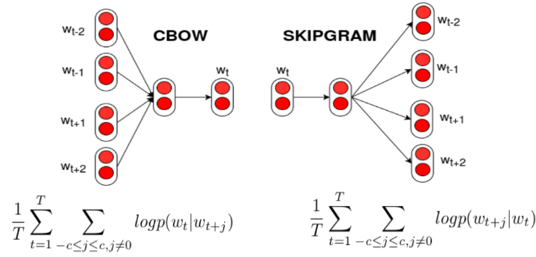
Arhitecturi

Slide 12
CBOW (Continuous Bag of Words)
 | she | ride | bike | he | scooter | park | my | father | drive | motorcycle
She | 1 | 0 | 0 | 0 | 0 | 0 | 0 | 0 | 0 | 0
Ride | 0 | 1 | 0 | 0 | 0 | 0 | 0 | 0 | 0 | 0
Bike | 0 | 0 | 1 | 0 | 0 | 0 | 0 | 0 | 0 | 0
Input layer
Index of she in vocabulary
1
0
0
she
0
Hidden layer
Output layer
0
0
0
0
0
0
…
1
one-hot
vector
0
0
one-hot
vector
0
bike
0
0
0
1
o
0
…
0
0
ride
0
0
0
0
…
0

Slide 13


CBOW (Continuous Bag of Words)
 | she | ride | bike | he | scooter | park | my | father | drive | motorcycle
She | 1 | 0 | 0 | 0 | 0 | 0 | 0 | 0 | 0 | 0
Ride | 0 | 1 | 0 | 0 | 0 | 0 | 0 | 0 | 0 | 0
Bike | 0 | 0 | 1 | 0 | 0 | 0 | 0 | 0 | 0 | 0
De invatat: W si W’
Input layer
Index of she in vocabulary
1
0
0
she
0
$$W_{V×N}$$
Hidden layer
Output layer
0
0
0
0
0
0
…
1
V-dim
one-hot
vector
0
0
one-hot
vector
0
bike
0
0
0
1
o
0
$$W_{V×N}$$
N-dim
…
V-dim
0
0
ride
0
0
0
0
…
V-dim
N = dimensiunea reprezentarii (lungimea embedding-ului)
0

Slide 14
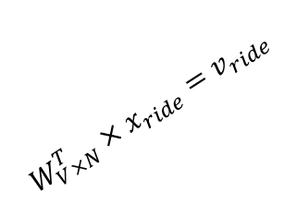

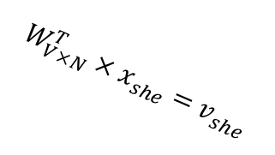



CBOW (Continuous Bag of Words)
$$W_{V×N}^{T} ×x_{she}=v_{she}$$
0.1 | 2.4 | 1.6 | 1.8 | 0.5 | 0.9 | … | … | … | 3.2
0.5 | 2.6 | 1.4 | 2.9 | 1.5 | 3.6 | … | … | … | 6.1
… | … | … | … | … | … | … | … | … | …
… | … | … | … | … | … | … | … | … | …
0.6 | 1.8 | 2.7 | 1.9 | 2.4 | 2.0 | … | … | … | 1.2
1
0.1
0.5
…
…
0.6
Embeding(she)
0
0
Input layer
$$×$$
0
$$=$$
0
1
0
0
0
x_{she}
0
0
she
0
Hidden layer
…
Output layer
0
$$W_{V×N}^{T}×x_{she}=v_{she}$$
0
0
0
0
0
0
…
$$\hat{v}=\frac{v_{she}+v_{ride}}{2}$$
1
one-hot
vector
0
0
one-hot
vector
0
bike
0
0
0
$$W_{V×N}^{T}×x_{ride}=v_{ride}$$
o
1
…
x_{ride}
0
Hidden layer
0
ride
0
0
N-dim
0
0
0
…
0

Slide 15
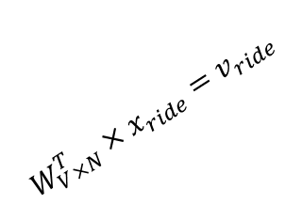
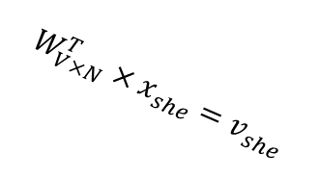


CBOW (Continuous Bag of Words)
$$W_{V×N}^{T} ×x_{ride}=v_{ride}$$
0.1 | 2.4 | 1.6 | 1.8 | 0.5 | 0.9 | … | … | … | 3.2
0.5 | 2.6 | 1.4 | 2.9 | 1.5 | 3.6 | … | … | … | 6.1
… | … | … | … | … | … | … | … | … | …
… | … | … | … | … | … | … | … | … | …
0.6 | 1.8 | 2.7 | 1.9 | 2.4 | 2.0 | … | … | … | 1.2
0
2.4
2.6
…
…
1.8
Embeding(ride)
1
$$×$$
0
Input layer
0
$$=$$
0
1
0
0
0
0
0
0
Hidden layer
…
Output layer
0
0
x_{she}
0
0
0
0
$$W_{V×N}^{T}×x_{she}=v_{she}$$
0
…
$$\hat{v}=\frac{v_{she}+v_{ride}}{2}$$
1
one-hot
vector
0
0
one-hot
vector
0
bike
0
0
0
1
o
0
…
0
0
$$W_{V×N}^{T}×x_{ride}=v_{ride}$$
x_{ride}
0
0
0
0
…
0

Slide 16





CBOW (Continuous Bag of Words)
Input layer
1
0
0
0
Hidden layer
Output layer
$$W_{V×N}$$
0
x_{she}
0
0
0
0
0
$$\hat{y}=softmax(z)$$
V-dim
…
1
one-hot
vector
0
$$W_{V×N}^{′}×\hat{v}=z$$
0
0
0
0
0
1
o
0
…
$$W_{V×N}$$
0
0
N-dim
V-dim
x_{ride}
0
${\hat{y}}_{bike}$
0
0
N will be the size of word vector
0
V-dim
…
0

Slide 17




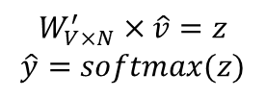

CBOW (Continuous Bag of Words)
Input layer
1
We would prefer $\hat{y}$ close to ${\hat{y}}_{bike}$
0
0
0
Hidden layer
Output layer
0.01
0.02
0.00
0.02
0.01
0.02
0.01
0.7
…
0.00
0
$$W_{V×N}$$
x_{she}
0
0
0
0
0
V-dim
…
$$W_{V×N}^{′}×\hat{v}=z$$
$$\hat{y}=softmax(z)$$
1
one-hot
vector
0
0
0
0
0
0
1
$$W_{V×N}$$
o
0
…
0
N-dim
0
0
V-dim
x_{ride}
0
${\hat{y}}_{bike}$
0
N will be the size of word vector
$\hat{y}$
0
V-dim
…
0

Slide 18
Cursul următor
Scurtă introducere în Inteligenţa Artificială (IA)
Sisteme inteligente
Sisteme care învaţă singure
Arbori de decizie
Reţele neuronale artificiale - transformers
Maşini cu suport vectorial
Algoritmi evolutivi
Sisteme bazate pe reguli
Sisteme hibride
Rezolvarea problemelor prin căutare
Definirea problemelor de căutare
Strategii de căutare
Strategii de căutare neinformate
Strategii de căutare informate
Strategii de căutare locale (Hill Climbing, Simulated Annealing, Tabu Search, Algoritmi evolutivi, PSO, ACO)
Strategii de căutare adversială

Slide 19
Informaţiile prezentate au fost colectate din diferite surse de pe internet, precum şi din cursurile de inteligenţă artificială ţinute în anii anteriori de către:
Conf. Dr. Mihai Oltean – www.cs.ubbcluj.ro/~moltean
Lect. Dr. Crina Groşan - www.cs.ubbcluj.ro/~cgrosan
Prof. Dr. Horia F. Pop - www.cs.ubbcluj.ro/~hfpop
Prof. Dr. Radu Ionescu - https://raduionescu.herokuapp.com/

