Slide 1
METODE INTELIGENTE DE REZOLVARE
A PROBLEMELOR REALE
Laura Dioşan
Fairness in AI
Facultatea de Matematică și Informatică
Universitatea Babeș-Bolyai

Slide 2
Useful resources
  Kate Crawford, “The Trouble with Bias”,NeurIPS 2017 Keynote https://www.youtube.com/watch?v=fMym_BKWQzk
  Timnit Gebru and Emily Denton, CVPR 2020 Tutorial on FATE/CV https://sites.google.com/view/fatecv-tutorial/schedule?authuser=0
  Movie “The Social Dilemma” https://www.imdb.com/title/tt11464826/?ref_=vp_close
  S. Borocas, M. Hardt, A. Narayanan, Fairness and ML, 2023 https://fairmlbook.org/
  C. Molnar, A Guide for Making Black Box Models Explainable, 2024 https://christophm.github.io/interpretable-ml-book/

Slide 3
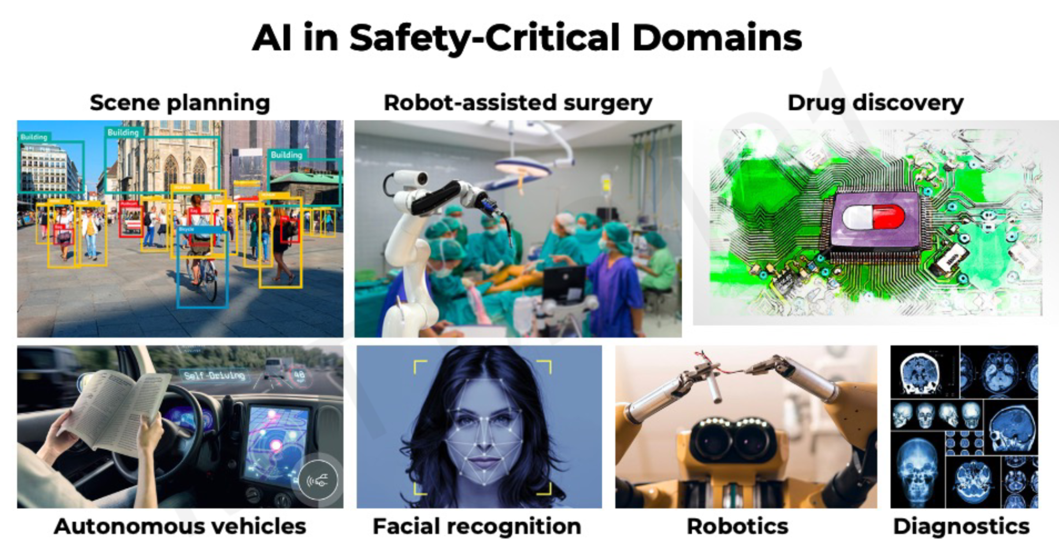
About trust
Challenges in robust, safe and trustworthy ML
  Interpretability – why?
  Fairness – for all subgroups?
  Robustness – for a large variety of data?
  Uncertainty -

Slide 4
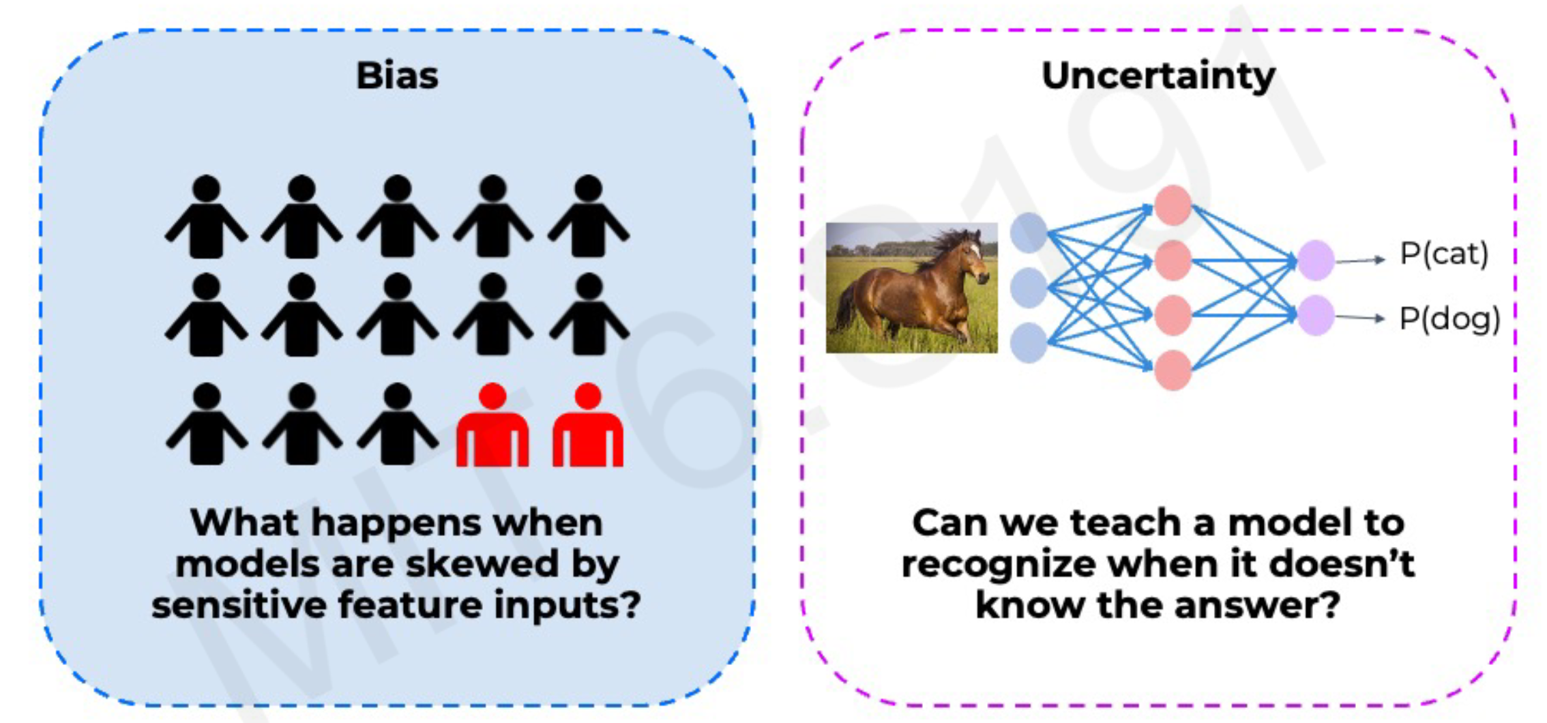
About trust
Challenges in robust, safe and trustworthy ML
  Bias
  Uncertainty

Slide 5
Bias
What?
  When ML models do better on some demographics than others
Bias in AI/ML lifecycle
  Data
    E.g. Sampling bias – over-sampling from some regions of the input data distribution and under-sampling from other regions
      e.g. health data (a few diseased patients, a lot healthy patients)
    E.g. Selection bias – proportion of data in dataset does not reflect the real-world
      E.g. voice recognition for English
  Model
    Lack of uncertainty benchmarks and metrics
  Deployment
    Distribution shifts and feedback loops
  Evaluation
    Subgroups that are not or un-represented in the evaluation dataset
  Interpretation
    Human errors

Slide 6
Bias
common human biases that can manifest in the data:
  Reporting bias → strong opinions for books’ review
  Historical bias → house prices from ’60-’80
  Automation bias → ground-truth validation for tooth implants
  Selection bias
    Coverage bias → questionaires just for some groups (e.g. females & yogurt)
    Participation-bias → different responding rate for different sub-groups
    Sampling-bias → first 200 answers that are more enthusiastic
  Implicit bias → gesture recognition and cultural particularities
  experiment bias → train the model in a particular setup
How to identify the bias?
  Missing values for sub-groups of examples
  Unexpected values
  Data skew
Mitigating the bias
  Augmenting the training data
  Adjusting the loss function

Slide 7
Bias
How to evaluate the bias?
  Demographic parity
  Equality of opportunity
 | Majority |  | Minority
 | accepted | rejected | accepted | rejected
 | 16 | 64 | 4 | 16
Acceptance rate | 16 / 64 ~ 25% |  | 4 / 16 ~ 25%
 | Majority |  | Minority
 | accepted | rejected | accepted | rejected
Qualified | 16 | 19 | 4 | 11
Unqualified | 0 | 45 | 0 | 5
Acceptance rate | 16 / (16 + 19) ~ 46% |  | 4 / (4 + 11) ~ 27%

Slide 8

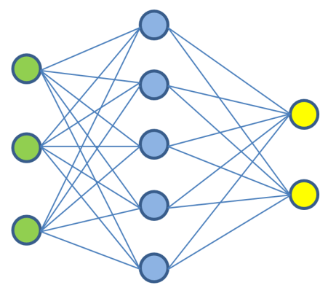

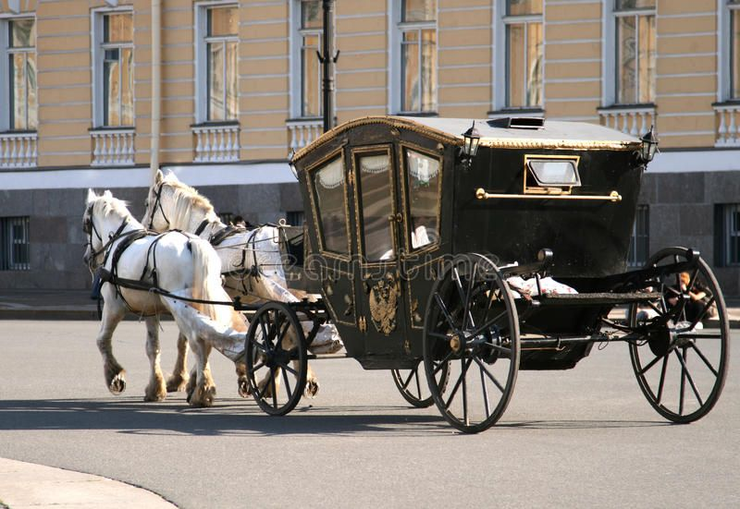
Model uncertainty
Can we teach a model when it does or doesn’t know the answer?
Uncertainty estimation gives us a measure of confidence in the prediction
Prob(bike)
Prob(car)
OR
Prob(bike) = 0.2
Prob(car) = 0.8

Slide 9
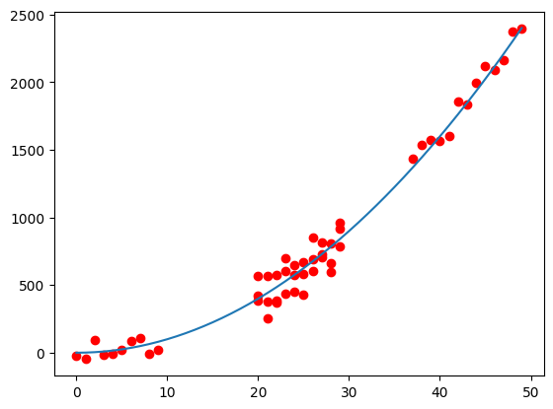
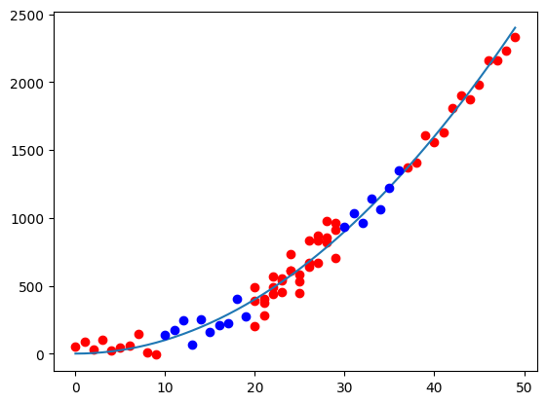
Types of uncertainity
Data uncertainty
  Similar inputs & very different outputs
Model uncertainty
  Inputs out of distribution
What happens if we add new data?
  Model uncertainty is reduced

Slide 10
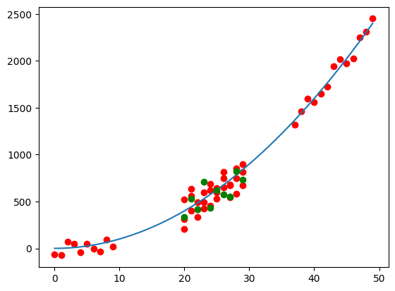
Types of uncertainity
Data uncertainty
  Similar inputs & very different outputs
Model uncertainty
  Inputs out of distribution
What happens if we add new data?
  data uncertainty is irreducible

Slide 11
Types of uncertainity
Data uncertainty
  Aleatoric uncertainty (intrinsic uncertainty)
  Irreducible!!!
  Can be learnt from data
Model uncertainty
  Epistemic uncertainty (uncertainty due to limitations in our knowledge about the world)
  Can be reduced by adding data / knowledge
  Cannot be learnt from data

Slide 12
Types of uncertainity
Gave a loan to an individual, but they failed to repay; why?
Data uncertainty
  Aleatoric uncertainty (intrinsic uncertainty)
  They were robbed
Model uncertainty
  Epistemic uncertainty (uncertainty due to limitations in our knowledge about the world)
  They had bad credit score, but we didn’t bother checking

Slide 13
Explainability
What?
  Explanation = interpretable description of the model behavior
Aim
  Explain why the model made a particular prediction on a specific input
How?
  Select/rank a subset of input features that contributed the most to model prediction → Feature Attribution Methods

Slide 14
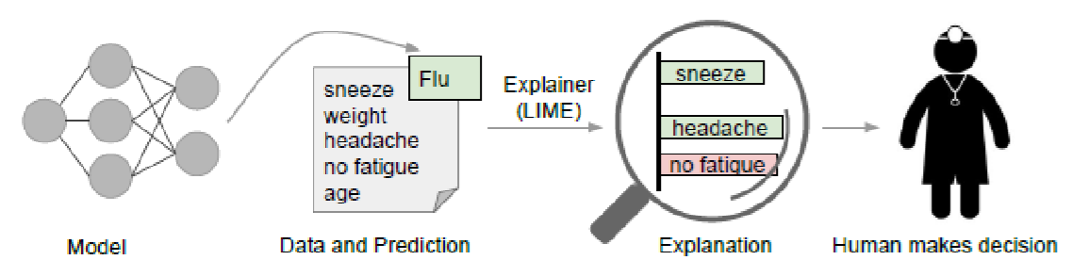
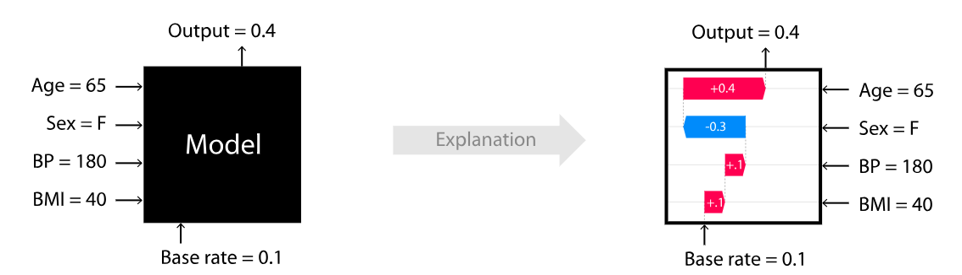
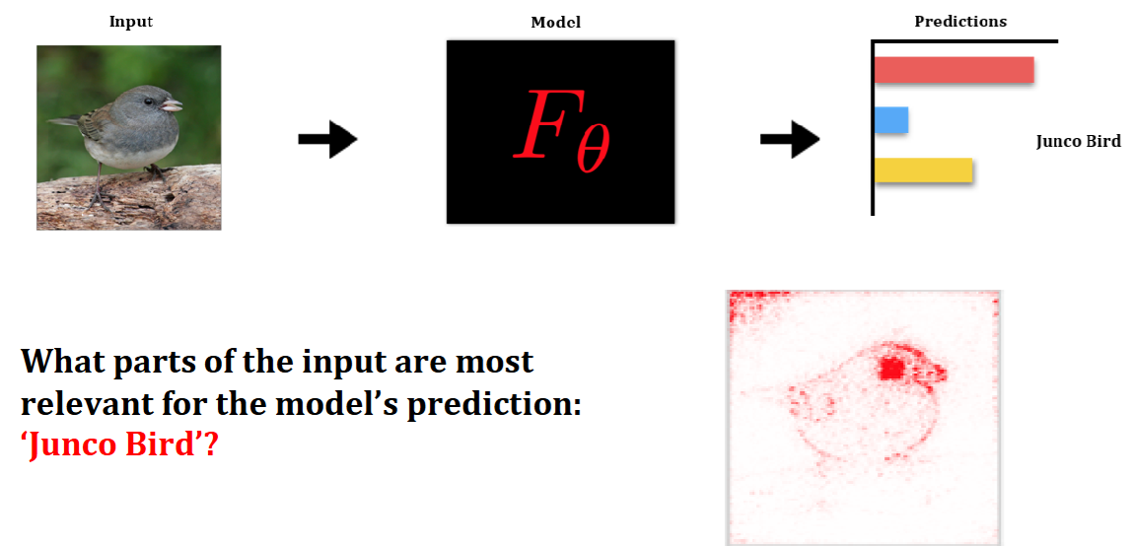
Explainability
Approaches
  LIME algorithm: “Why should I trust you?” Explaining the predictions of any classifier - Local Interpretable Model-agnostic Explanations https://github.com/marcotcr/lime
  SHAP = SHapley Additive exPlanations - method based on cooperative game theory https://github.com/shap/shap
  Saliency Maps (e.g. for images) https://christophm.github.io/interpretable-ml-book/pixel-attribution.html

Slide 15
Limitations and new frontiers
  What I cannot create, I cannot understand (R. Feynman)

