Slide 1
Engineering Quiz
Rudra Bhatt, Laura Dobson, Sarah Watts, Johnson Kan
November 30th, 2016

Slide 2

Motivation
To include Biomedical Engineering
Improve quiz accuracy
Change the quiz questions to be less obvious

Slide 3
Data
Just under 1000 responses received
99 from Management Engineering
Made answers required (no missing data)
Removed responses with happy with program = no

Slide 4
Main Hypothesis
By including more questions relating to future employment and related industries, the chosen model can result in a higher accuracy than the first iteration of the Engineering Quiz

Slide 5
Results – Models
Model (1 Class) | Accuracy | Stratified 5 Fold Validation
Naïve Bayes | 61% | 54%
Random Forest | 55% | 50%
Decision Tree | 41% | 36%
1R | 40%

Slide 6
Results – Naïve Bayes
Model | Accuracy | Stratified 5 Fold Validation
Naive Bayes – predicting 1 class using 19 features | 61% | 54%
Naive Bayes – predicting 1 class using 9 features | 58% | 54%
Naive Bayes – predicting 2 classes using 9 features | 77% | 71%
Naive Bayes – predicting 2 classes using 7 features | 61% | 57%

Slide 7
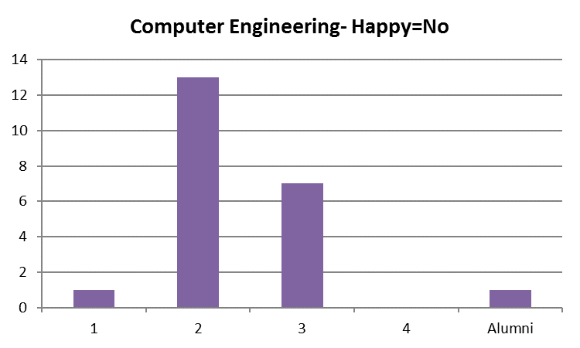
Interesting Findings
Data Exploration
Overall 13% of records indicated they were not happy in their program
33% of Computer Engineers, mostly in 2nd year
Association Rule Mining
Rule 1: I Prefer To = 'Talk', I Would Rather Prefer to Work On = 'Multidisciplinary team' ==> Leader of a Team = 'Yes' Confidence = 91%
Rule 2: Program = 'Software Engineering' ==> Field of Interest = 'Software Development‘ Confidence = 97%

Slide 8
Final Quiz Questions
What field interests you the most?
I would like to have been part of the team that was responsible for:
I would rather design something that...
I would rather work as part of a...
When working on a project would you rather
What cause do you care about the most?
You are most likely to eavesdrop in a conversation regarding
In an ideal setting, you are working with:
When you start work, ideally you would want to...

Slide 9
Thank you

