Slide 1

Today’s Plan
Intro to Power Laws
Our Process
This Week’s System and Question
Announcements and Debrief

Slide 2
Why are we doing this?
describe
Models/Equations
expectations
Real-World Data
experimentation

Slide 3
Why are we doing this?
No model → no expectations
Where do we start?
Models/Equations
expectations
Real-World Data
experimentation
lead to

Slide 4
Brainstorm!
Why are we doing this?
How can we use the skills we’ve learned so far to study a system for which a mathematical model does not exist?
First: Brainstorm independently
Then: Discuss with your group
Roles:
Partner A: Scribe
Partner B: Spokesperson
Partner C: Discussion Leader

Slide 5
POWER LAWS
Intro to Power Laws
Assume our data should produce a model like this:
y = Cx^{n}
y: dependent variable
C: some constant
x: independent variable
n: some other constant

Slide 6
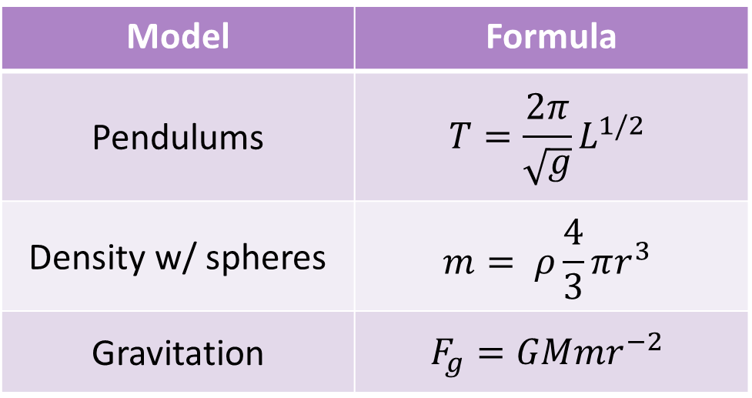
POWER LAWS
Intro to Power Laws
Assume our data should produce a model like this:
y = Cx^{n}
y: dependent variable
C: some constant
x: independent variable
n: some other constant
Model | Formula
Pendulums | $$T=\frac{2π}{\sqrt{g}}L^{1/2}$$
Density w/ spheres | $$m= ρ\frac{4}{3}πr^{3}$$
Gravitation | $$F_{g}=GMmr^{−2}$$

Slide 7
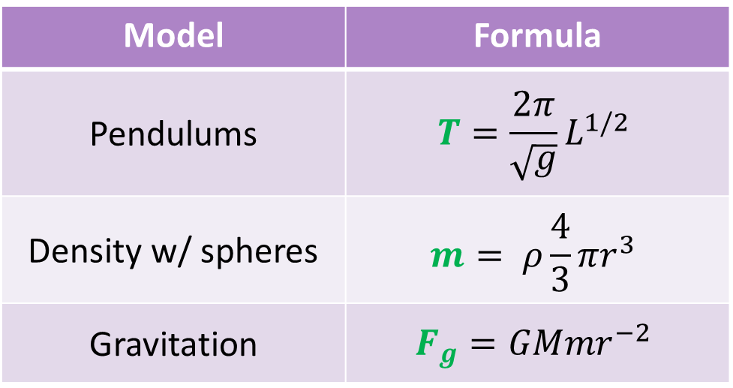
POWER LAWS
Intro to Power Laws
Assume our data should produce a model like this:
y = Cx^{n}
y: dependent variable
C: some constant
x: independent variable
n: some other constant
Model | Formula
Pendulums | $$T=\frac{2π}{\sqrt{g}}L^{1/2}$$
Density w/ spheres | $$m= ρ\frac{4}{3}πr^{3}$$
Gravitation | $$F_{g}=GMmr^{−2}$$

Slide 8
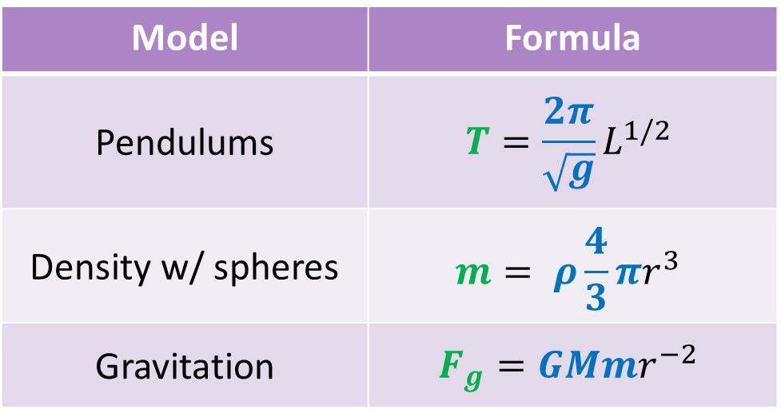
POWER LAWS
Intro to Power Laws
Assume our data should produce a model like this:
y = Cx^{n}
y: dependent variable
C: some constant
x: independent variable
n: some other constant
Model | Formula
Pendulums | $$T=\frac{2π}{\sqrt{g}}L^{1/2}$$
Density w/ spheres | $$m= ρ\frac{4}{3}πr^{3}$$
Gravitation | $$F_{g}=GMmr^{−2}$$

Slide 9
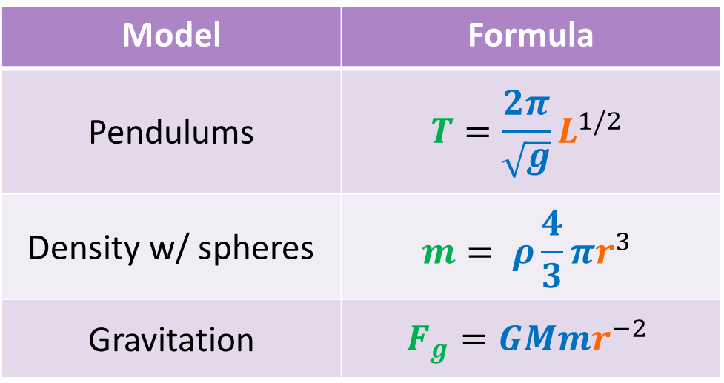
POWER LAWS
Intro to Power Laws
Assume our data should produce a model like this:
y = Cx^{n}
y: dependent variable
C: some constant
x: independent variable
n: some other constant
Model | Formula
Pendulums | $$T=\frac{2π}{\sqrt{g}}L^{1/2}$$
Density w/ spheres | $$m= ρ\frac{4}{3}πr^{3}$$
Gravitation | $$F_{g}=GMmr^{−2}$$

Slide 10
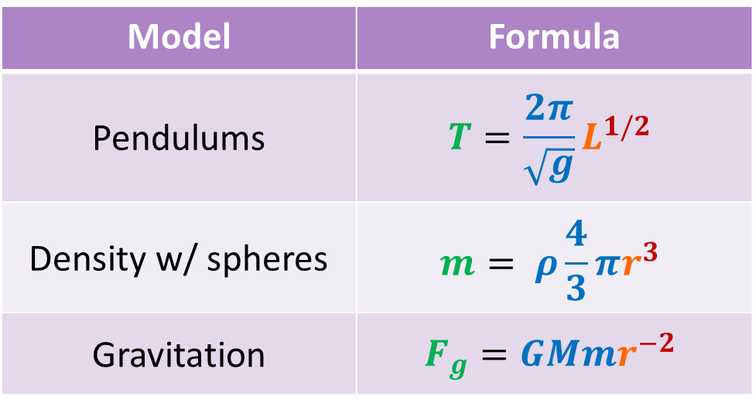
POWER LAWS
Intro to Power Laws
Assume our data should produce a model like this:
y = Cx^{n}
y: dependent variable
C: some constant
x: independent variable
n: some other constant
Model | Formula
Pendulums | $$T=\frac{2π}{\sqrt{g}}L^{1/2}$$
Density w/ spheres | $$m= ρ\frac{4}{3}πr^{3}$$
Gravitation | $$F_{g}=GMmr^{−2}$$

Slide 11
Sample Problem!
Intro to Power Laws
In your groups, work through the problems on page 53.
Roles:
Partner A: Spokesperson
Partner B: Discussion Leader
Partner C: Scribe

Slide 12

What’s going on w/ C and n?
Intro to Power Laws
$$KE=\frac{930 \text{kg}}{2}∙v^{2}$$
$$F=13 \text{kg}∙a^{1}$$
$$T= \frac{2π}{\sqrt{9.81\frac{\text{m}}{{\text{s}}^{2}}}}L^{\frac{1}{2}}$$
What do the C values have that n values don’t?

Slide 13
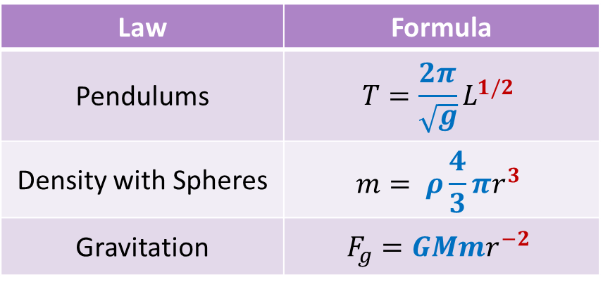
Constants give us information about our system!
Intro to Power Laws
Law | Formula
Pendulums | $$T=\frac{2π}{\sqrt{g}}L^{1/2}$$
Density with Spheres | $$m= ρ\frac{4}{3}πr^{3}$$
Gravitation | $$F_{g}=GMmr^{−2}$$
Constants are hard numbers --- won’t change from trial to trial in an experiment.
n characterizes the fundamental relationship between IV and DV. It has no units, and is a pattern you should see regardless of how you measure IV and DV.
C gives us real-world context: has units. It can change depending on how you measure IV and DV.
What about y and x?
Y and x are variables referring to the IV and DV in our experiment.
They change in an experiment and in a system, so we can’t find hard numbers for them.
We’ll leave these as variables or change them to letters that describe what we’re interested in (e.g. m for mass, a for acceleration).

Slide 14
Building a new model with y = Cx^{n}
Our Process of Building a New Model
Previously, we’ve tested already developed models.
We knew C and n.
What if we’re building a new model from scratch? How do we find C and n?

Slide 15
Our Process of Building a New Model
1. Gather and take the natural logs of your data!
2. Use a ln-ln plot to find n.
Our
Process
4. Write your mathematical model!
3. Use a y vs x^{n} plot to find C.

Slide 16
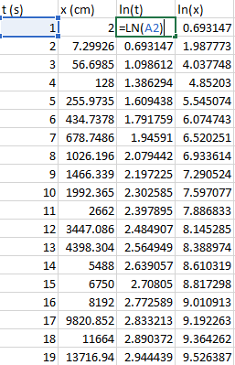
1. Gather data, take natural logs
Our Process of Building a New Model
Gather your raw data
IV data → x in our power law
DV data → y in our power law
Set up two new columns: ln(IV) and ln(DV)
Instead of “IV” and “DV” or “x” and “y”, use variables that tell you what you’re measuring
Use Excel to take the natural log of each data point: LN()

Slide 17
Logarithms and exponents
Our Process of Building a New Model
Power functions have powers!
That is, they have exponents.
Logarithms (logs) and exponents go hand-in-hand.
Basically inverses of each other.
Using logarithms will let us manipulate power functions.

Slide 18
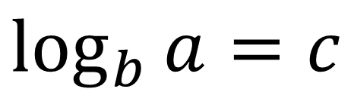
Logarithms in general
Our Process of Building a New Model
$$\log_{b}{a}=c$$

Slide 19
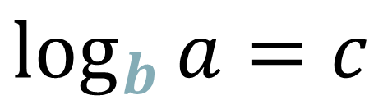
Logarithms in general
Our Process of Building a New Model
$$\log_{b}{a}=c$$
Base

Slide 20
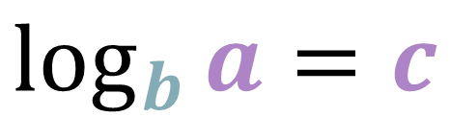
Logarithms in general
Our Process of Building a New Model
Just some numbers
(no special names)
$$\log_{b}{a}=c$$
Base

Slide 21
Logarithms in general
Our Process of Building a New Model
$$\log_{b}{a}=c$$
log_𝑏⁡𝑎=𝑐
$$b^{c}=a$$
𝑏^𝑐=𝑎

Slide 22
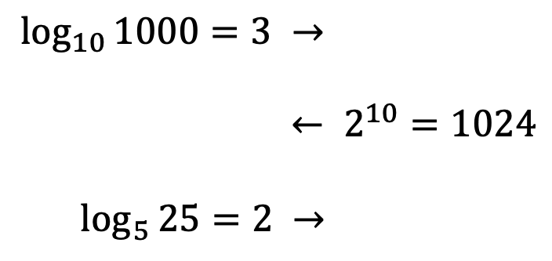
Logarithms in general
Our Process of Building a New Model
$$\log_{b}{a}=c$$
log_𝑏⁡𝑎=𝑐
$$b^{c}=a$$
𝑏^𝑐=𝑎
$$\log_{10}{1000}=3 →$$
$$← 2^{10}=1024$$
$$\log_{5}{25}=2 →$$

Slide 23
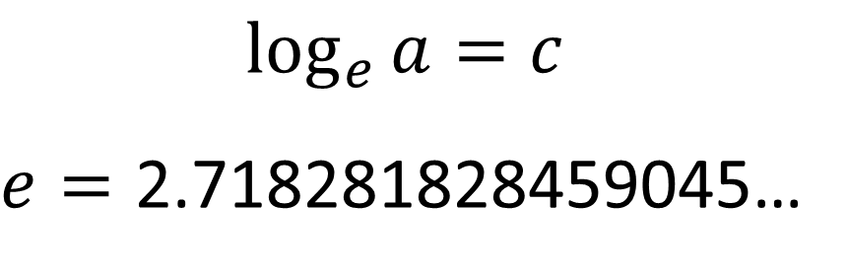

Using the natural log → $ln$
Our Process of Building a New Model
$$\log_{e}{a}=c$$
$e=\text{2.718281828459045}$…
$$\ln{a}=c$$
ln⁡𝑎=𝑐
$$e^{c}=a$$
𝑒^𝑐=𝑎

Slide 24
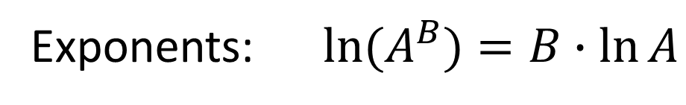
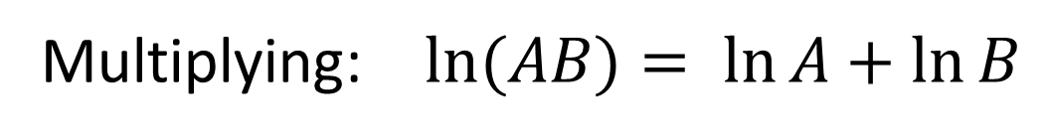
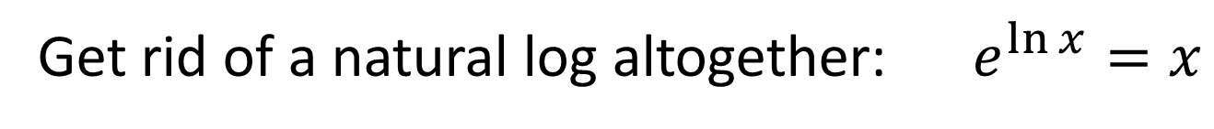
Handy log rules
Our Process of Building a New Model
Multiplying: $\ln{(AB)= \ln{A}+\ln{B}}$
Exponents: $\ln{(A^{B})=B∙\ln{A}}$
Get rid of a natural log altogether: $e^{\ln{x}}=x$

Slide 25


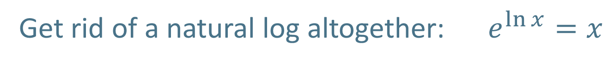
Handy log rules
Our Process of Building a New Model
Multiplying: $\ln{(AB)= \ln{A}+\ln{B}}$
We’ll use these a lot!
Exponents: $\ln{(A^{B})=B∙\ln{A}}$
Get rid of a natural log altogether: $e^{\ln{x}}=x$
Less essential to the linearization process but good to have in your back pocket.

Slide 26
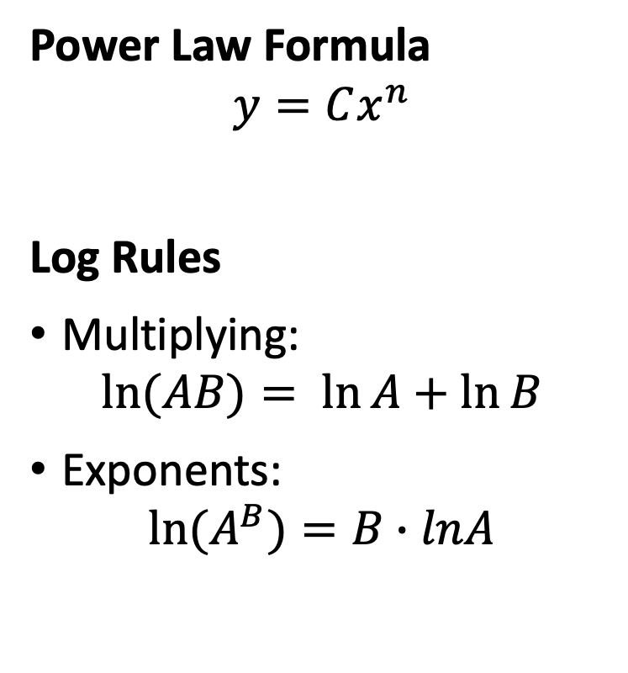
Q4U: Why do we need to take the log of IV and DV?
Our Process of Building a New Model
In your groups, do the following:
Take the ln of both sides of our power law equation
Use the log rules to …
Separate C from x^{n}
Separate n from x
Roles for our regroup:
Partner A: Discussion Leader
Partner B: Scribe
Partner C: Spokesperson
Power Law Formula
$$y=Cx^{n}$$
Log Rules
Multiplying:
$$\ln{(AB)= \ln{A}+\ln{B}}$$
Exponents:
$$\ln{(A^{B})=B∙lnA}$$

Slide 27
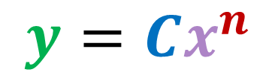
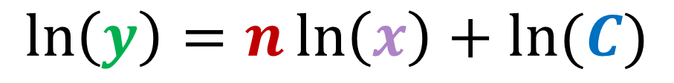
Linearizing power functions
Our Process of Building a New Model
Logging both sides
$$y=Cx^{n}$$
$$\ln\left(y\right)=n\ln\left(x\right)+\ln{(C)}$$
y
m
x
b
If we make a graph of ln(y) vs. ln(x), the slope of that line will be n.
Then, we can use n to find C.

Slide 28

2. Use a ln-ln plot to find n
Our Process of Building a New Model
Graph ln(DV) against ln(IV).
The slope of that line is our best estimate of the exponent n in
Based on our graph and LINEST(), choose the most appropriate value for n.
$$y=Cx^{n}$$

Slide 29
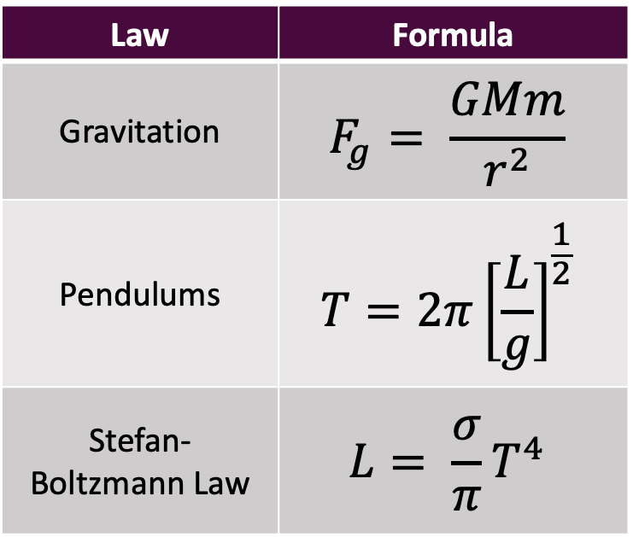
We can use our growing understanding of the system to make informed choices
Our Process of Building a New Model
Law | Formula
Gravitation | $$F_{g}= \frac{GMm}{r^{2}}$$
Pendulums | $$T=2π{\left[\frac{L}{g}\right]}^{\frac{1}{2}}$$
Stefan-Boltzmann Law | $$L= \frac{σ}{π}T^{4}$$
We can use uncertainty to our advantage!
If we have a physical reason to believe that n is not the true value, we can choose another number in our min → max range!

Slide 30
More on finding n
Our Process of Building a New Model
Rounded LINEST() Output:
I can go with n = 1.60 …
… but what if I’d read a bunch of papers, and other scientists keep getting an exponent around 1.75?
 | Slope | y-int
BE | 1.60 | 2.1
SE | 0.05 | 0.1
AE | 0.09 | 0.2
Min | 1.51 | 1.9
Max | 1.69 | 2.3

Slide 31
More on finding n
Our Process of Building a New Model
Rounded LINEST() Output:
Your n value can be any value in your range.
If you have physical reason to choose something other than your BE, you absolutely can and should!
 | Slope | y-int
BE | 1.60 | 2.1
SE | 0.05 | 0.1
AE | 0.09 | 0.2
Min | 1.51 | 1.9
Max | 1.69 | 2.3

Slide 32
Think-Pair-Share
Our Process of Building a New Model
In your groups, talk through the Think-Pair-Share on page 58.
Roles:
Partner A: Scribe
Partner B: Spokesperson
Partner C: Discussion Leader

Slide 33
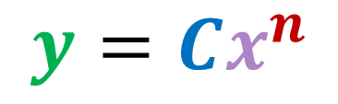
3. Use a y vs x^{n} graph to find C
Our Process of Building a New Model
You now have an n value!
In a new column, calculate [IV]^{n}
Graph DV against [IV]^{n}.
The slope of that line is our coefficient C in
$$y=Cx^{n}$$

Slide 34
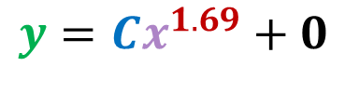
Why it works
Our Process of Building a New Model
If we graph y vs. x^{1.69}, what should the slope of the best fit line be?
$$y=Cx^{1.69}+0$$

Slide 35



4. Write your model!
Our Process of Building a New Model
$$y=Cx^{n}$$
Let’s say I’m interested in how the saplings of a particular species of tree grow. I measure a bunch of trees’ diameters and masses because I think the total mass depends on diameter. Then I analyze the data and find C = 2.38 + 0.05 kg/cm^{1.89} and n = 1.89.
Step | What it looks like
Replace y and x with variable letters that makes sense for what you’re measuring/studying.
Replace C with the value you found — and include units!
Replace n with the value you settled on.
$$m=Cd^{n}$$
$$m=2.38 {\text{kg}}/{\text{c}{\text{m}}^{1.89}}d^{n}$$
$$m=2.38 {\text{kg}}/{\text{c}{\text{m}}^{1.89}}d^{1.89}$$

Slide 36
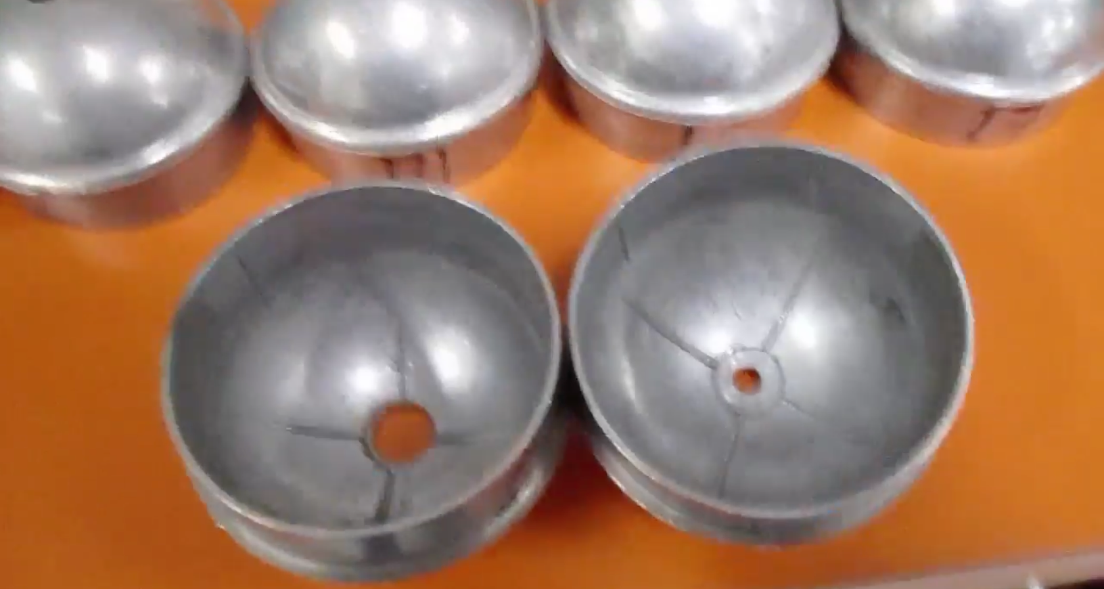
This Week’s System: Saxon Bowls
This Week’s Lab
This Week’s Question:
What controls the rate of sinking of a Saxon bowl?
But, like, really specifically — you’ll build a new model describing this!

Slide 37
Resources in the Lab 10 Module
Resources
This PPT
Linearization and Logarithm Resources
Khan Academy on logarithms
You can review as much as you like!
Excel demo vid!
Takes you through the whole process, from raw data to the final model.
Data manipulation with natural logs flowchart
An overview of the process
Lab Stuff > Demonstration of Timing Process

