Slide 1
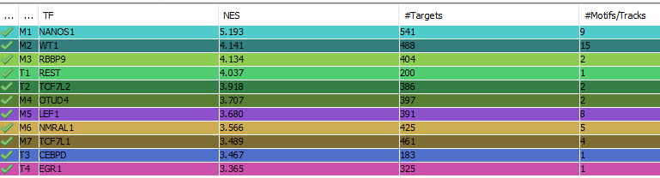
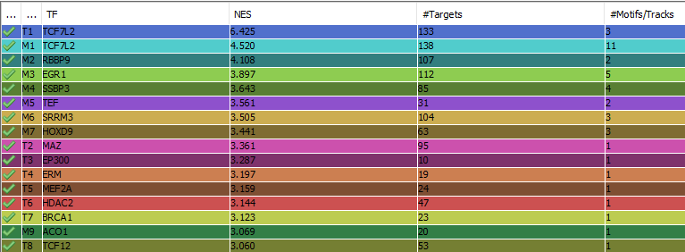
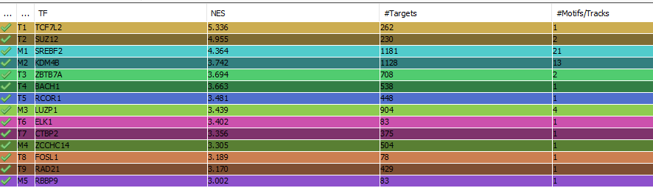
Assie LEF1 median
Heaton LEF1 median
TCGA LEF1 median

Slide 2
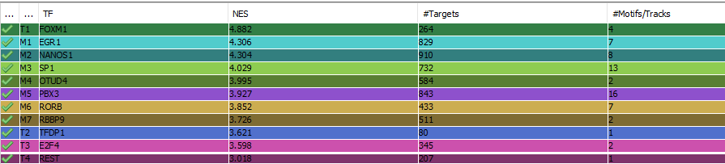
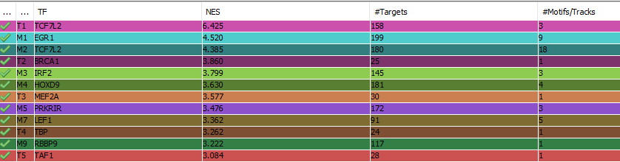
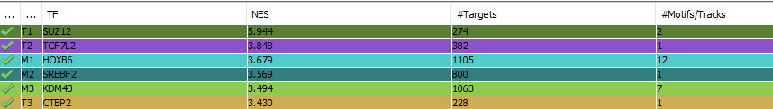
Assie signature median
In the transcription factor view of iRegulon output, for each group of transcription factors able to recognize the enriched TFBS(s) identified by iRegulon only one random representative is shown.
This is why I added manually the TF of interest TCF7L1 in the group of TFs where PBX3 is.
TCF7L1
Heaton signature median
TCGA signature median

