Slide 1
The association between L1 transfer, L2 proficiency, L2 use and visuospatial prediction and morphophonological prediction
Laura Fernández Arroyo
Rutgers University
January 21, 2021

Slide 2
Table of Contents
Introduction
Language prediction
Exp. 1 – L2 experience
Exp. 2 – L2 experience and L1 experience
Cognition
Exp. 3 – Non-language prediction
2

Slide 3
Prediction
Notes:
Prediction essential for information processing and learning in a variety of domains
Sometimes explicitly learned, oftentimes not

Slide 4
Morphophonological prediction
Lexical stress – tense suffixes
Spanish: CANta (s/he sings) vs. canTÓ (s/he sang)
English: PROduce (n.) vs. proDUCE (v.)
Mandarin Chinese: tones
4
Notes:
Prediction essential for information processing and learning in a variety of domains
Sometimes explicitly learned, oftentimes not

Slide 5
L2 experience
L2 proficiency facilitates phonomorphological prediction in L2 Swedish and L2 Spanish (e.g., Schremm et al., 2016; Sagarra & Casillas, 2018)
Anticipatory experience contributes to faster prediction (Lozano-Argüelles et al., 2020)
L2 use facilitates phonemic discrimination (e.g., Flege & McKay, 2004; Black et al., 2020)
L2 use more important than L2 proficiency in codeswitching, white matter microstructure and neuroplasticity (Beatty-Martinez et al., 2020; DeLuca et al., 2020; Del Maschio et al., 2020)
Do L2 proficiency and L2 use affect Spanish monolinguals and L1 English learners of L2 Spanish’s ability to generate predictions based on lexical stress-tense suffix associations? If so, how are their effects similar or different?
5

Slide 6
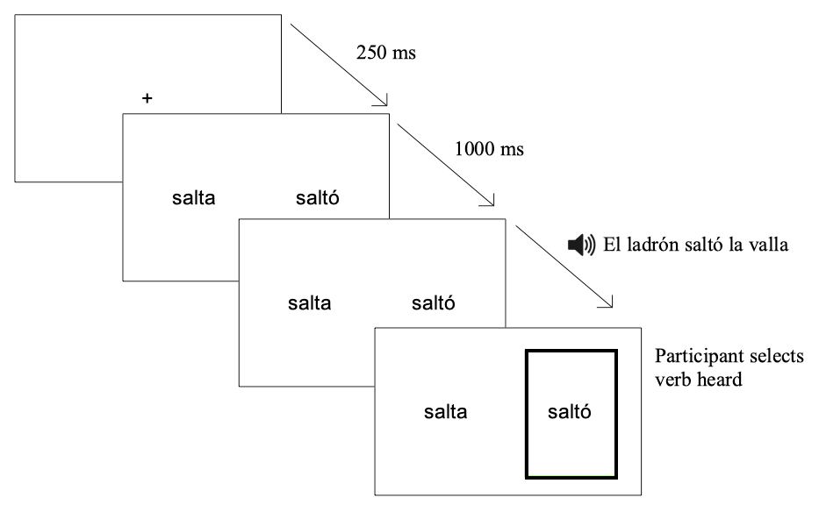
6

Slide 7
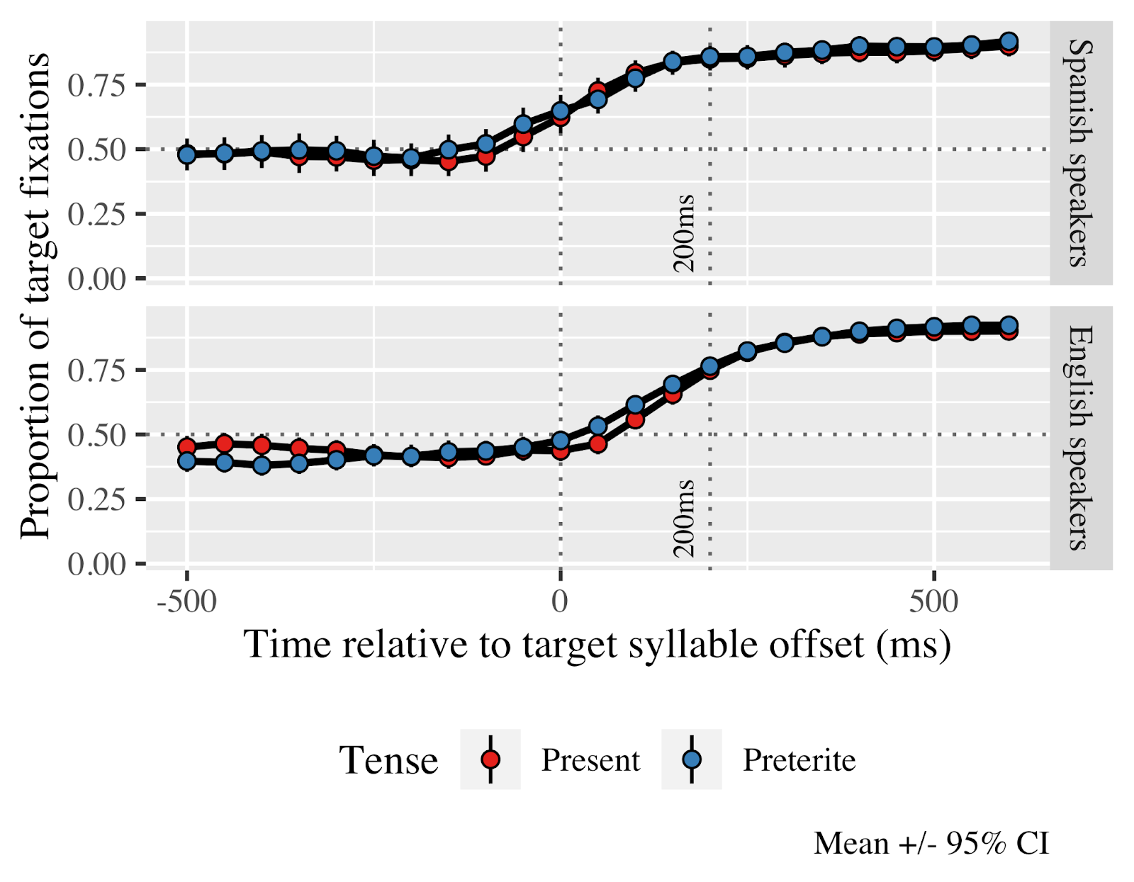
Results Timecourse
7

Slide 8
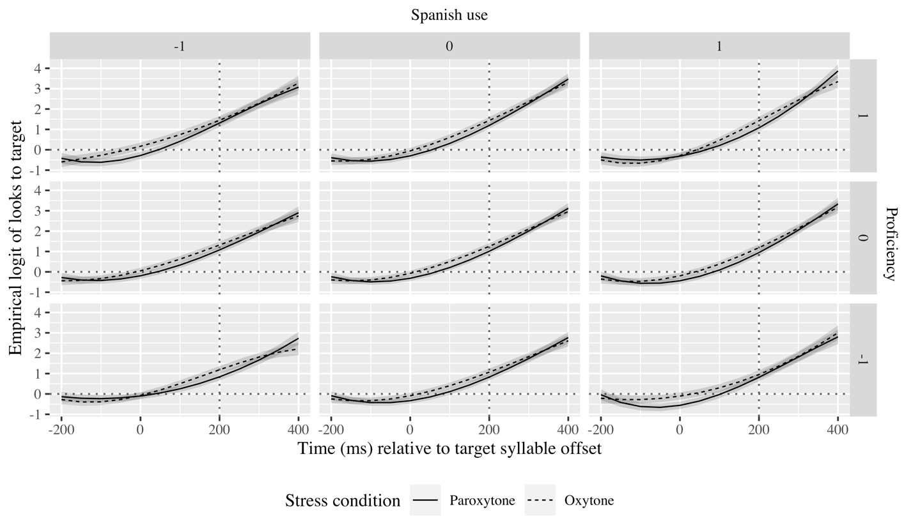
Results GCA English speakers
8

Slide 9
L1 transfer
Similarly sounding words cross-activated, but cross-activation decreases as proficiency increases (Berghoff et al., 2021)
Spanish-speakers more accurate at identifying stress patterns in L2 English than Korean-speakers (Lee et al., 2019)
In L2 nonce tone-number suffix associations, Swedes generate predictions, but Germans do not (Gosselke Berthelsen et al., 2020, 2021)
Do Spanish monolinguals, and intermediate and advanced Mandarin and English learners of Spanish with different levels of L2 use employ lexical stress to anticipate verbal suffixes in Spanish?
9

Slide 10
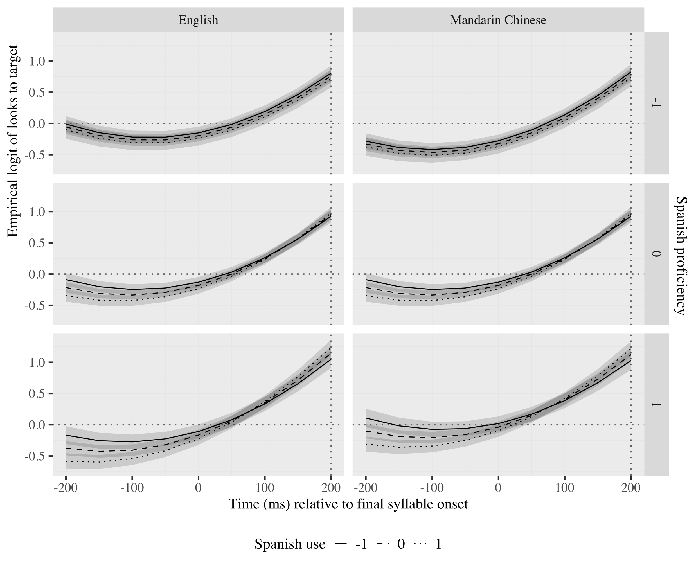
Results
10

Slide 11
Discussion of language experience studies
L2 proficiency and L2 use have distinct effects
Usage-based models (Bates & MacWhinney, 1982; Ellis, 2006)
Consequences in the brain models (Del Maschio et al., 2020)
L1 interacts with L2 experience
Cross-linguistic transfer models (Bates & MacWhinney, 1982; Schwartz & Sprouse, 1994)
Lexical models of spoken word recognition (Hopp, 2015; Patterson et al., 2017; Kaan, 2014)
Utility of prediction (Kaan & Grüter, 2021; Kuperberg & Jaeger, 2016 )
11

Slide 12
Prediction in cognition
Domain-specific models of learning (Ericsson & Charness, 1994; Gobet, 2015)
Domain-general models of learning (Anderson, 1990; Thorndike & Woodworth, 1901)
Predictions generated in other domains too:
Sports (e.g., Bishop et al., 2013; Wimshurst et al., 2016)
Driving (e.g., Morando et al., 2016; Yamani et al., 2018)
Music (e.g., Huron, 2016)
12

Slide 13
Prediction in cognition
Vision/space ~ Language:
Reading abilities (Helland & Morken, 2016; Estes & Barsalou, 2018)
Space organization and expressions to talk about it (Crawford et al., 2000)
Deixis as a cue to prediction in adults (Reuter et al., 2021)
Visuospatial expectations updated faster in children the larger their vocabulary (Reuter et al., 2018)
Is linguistic prediction of word morphology based on lexical stress associated with visuospatial prediction in Spanish monolinguals?
13

Slide 14
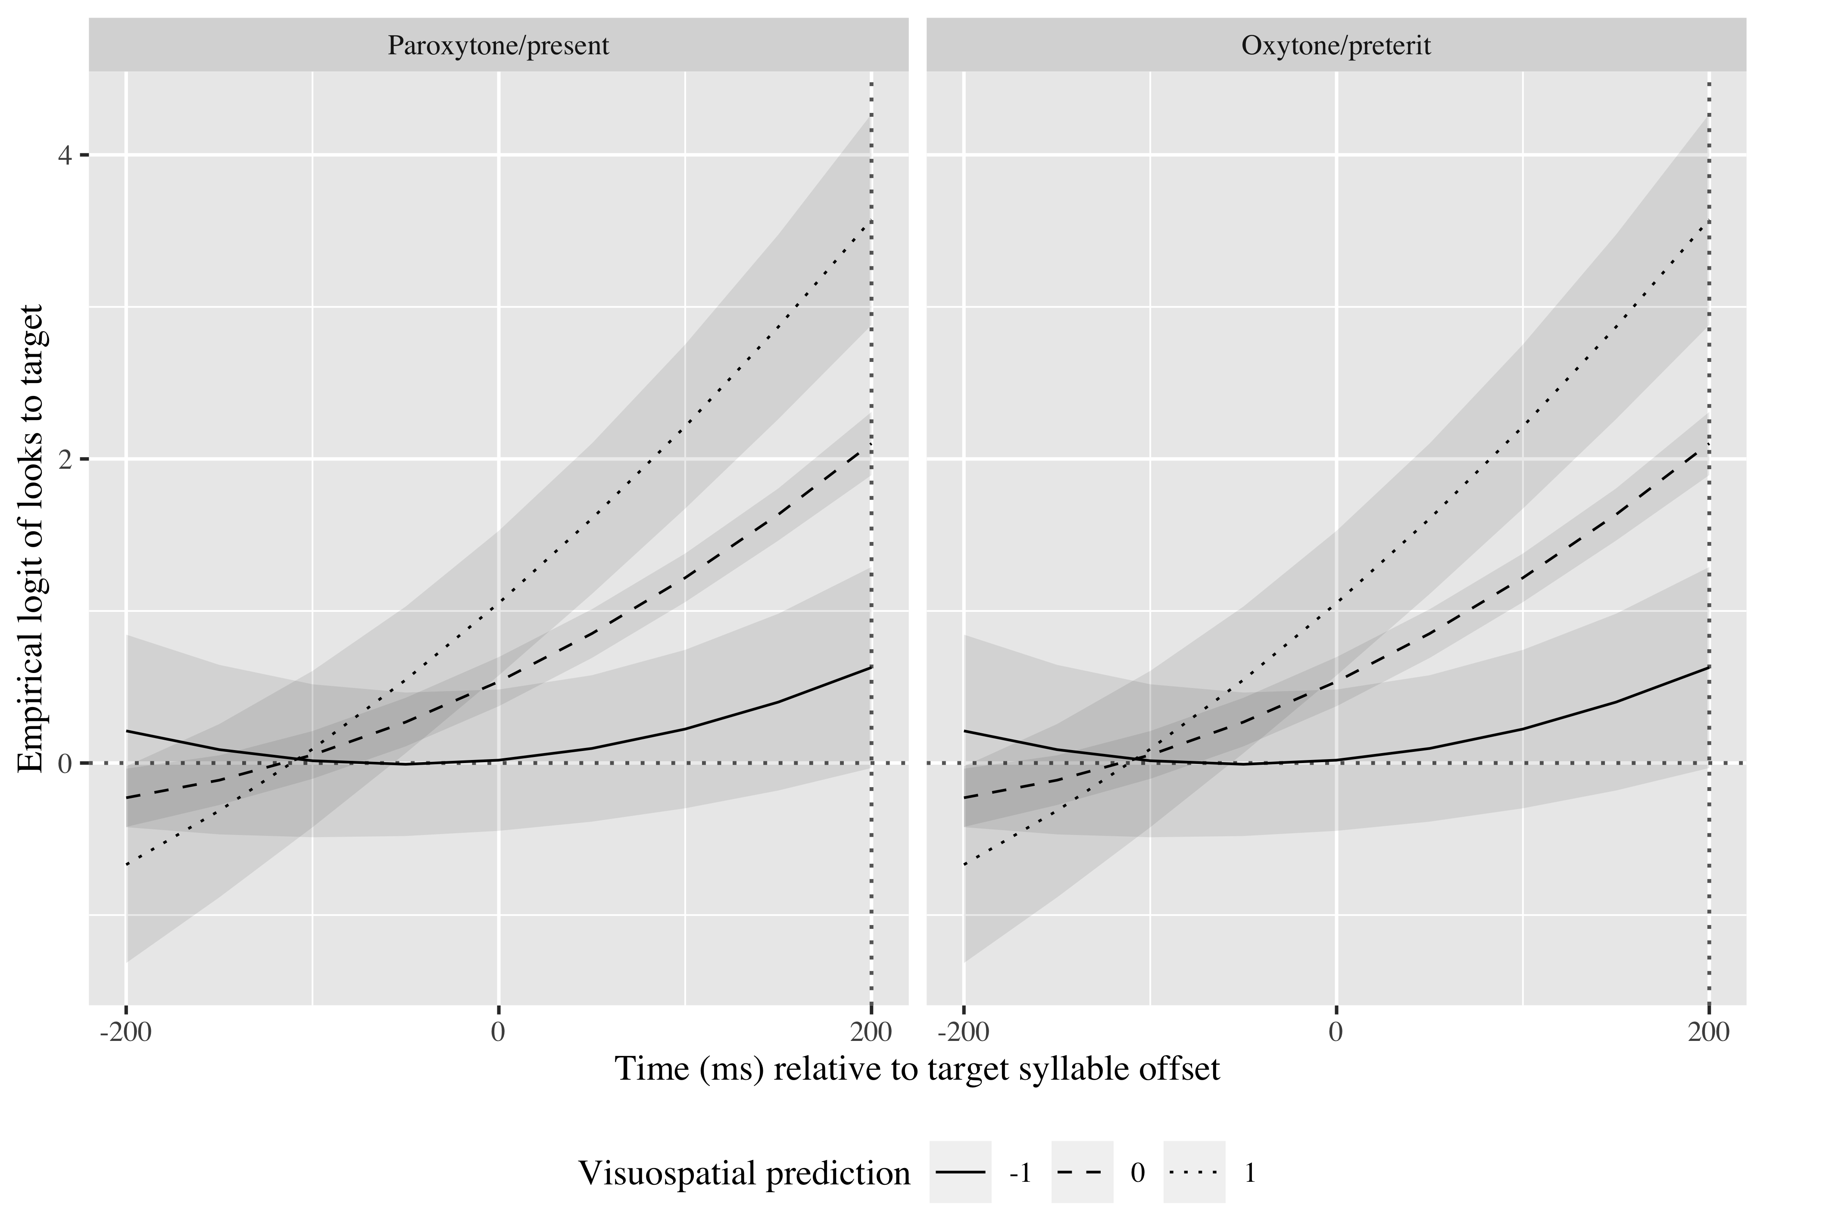
Results
14
Notes:
domain-general models for prediction, in which transfer across domains is possible if the domains share common features (Thorndike & Woodworth, 1901) and cognitive elements (Anderson, 1990). However, the finding does not completely support domain-general accounts arguing that the information shared needs to be both perceptual and conceptual (Singley & Anderson, 1989).

Slide 15
Discussion
Domain-general models of learning
Neural reuse theories (Asano et al., 2021)
Neuroemergentist approach (Hernández et al., 2019)
15
Notes:
domain-general models for prediction, in which transfer across domains is possible if the domains share common features (Thorndike & Woodworth, 1901) and cognitive elements (Anderson, 1990). However, the finding does not completely support domain-general accounts arguing that the information shared needs to be both perceptual and conceptual (Singley & Anderson, 1989).

Slide 16
Future research
Association between language and music prediction
Association between language and non-language prediction in bilinguals
Facilitation of learning of new prediction associations
16

Slide 17
Pedagogical implications
Importance of teaching L2 prosody
Expanding real life situations in which L2 learners use the L2

Slide 18
Conclusion
Distinct language experiences shape language processing and prediction differently
Need to heed language use more closely
Prediction abilities may share common mechanisms across cognition
18

Slide 19
Thank you.
Notes:
Acknowledgments

