Slide 1
The association between L1 transfer, L2 proficiency, L2 use and visuospatial prediction and morphophonological prediction
Laura Fernández Arroyo
Rutgers University
January 21, 2021
Notes:
Hello everyone. Thank you all for attending my dissertation defense. In my dissertation project I have addressed several issues in L1 and L2 morphophonological prediction. Specifically, the role of language experience factors and the association of morphophonological prediction with non-linguistic visuospatial prediction.

Slide 2
Table of Contents
Introduction
Language prediction
Exp. 1 – L2 experience
Exp. 2 – L2 experience and L1 experience
Cognition
Exp. 3 – Non-language prediction
2
Notes:
To study these two points I have conducted three experiments. Thus, my dissertation consists of four chapters. The first chapter summarizes the whole project and discusses the general findings, and illustrates pedagogical implications as well.
The other three chapters are the three experiments. The first experiment addressed second L2 experience factors, namely, proficiency and use.
The second experiment addressed the combination of these L2 experience factors with L1 cross-linguistic effects.
The last experiment focused on the relationship between language and non-language prediction.

Slide 3
Prediction
Notes:
But, why prediction?
Prediction essential for information processing and learning in a variety of domains
Based on probabilistic associations that Sometimes explicitly learned, oftentimes not
I wanted to explore the factors that condition how we learn implicitly associations that will enable us to make predictions.

Slide 4

Morphophonological prediction
Lexical stress – tense suffixes
Spanish: CANto (I sing) vs. canTÓ (s/he sang)
English: PROduce (n.) vs. proDUCE (v.)
Mandarin Chinese: tones mother 妈 vs. horse 马
4
Notes:
In language, one of those associations we learn implicitly is the association between a phonological cue, or a language sound, and a morphological outcome, or a part of a word.
In this case, the phonological cue…
The morphological outcome…

Slide 5
L2 experience
L2 proficiency facilitates phonomorphological prediction in L2 Swedish and L2 Spanish (e.g., Schremm et al., 2016; Sagarra & Casillas, 2018)
Anticipatory experience contributes to faster prediction (Lozano-Argüelles et al., 2020)
L2 use facilitates phonemic discrimination (e.g., Flege & McKay, 2004; Black et al., 2020)
L2 use more important than L2 proficiency in codeswitching, white matter microstructure and neuroplasticity (Beatty-Martinez et al., 2020; DeLuca et al., 2020; Del Maschio et al., 2020)
Do L2 proficiency and L2 use affect Spanish monolinguals and L1 English learners of L2 Spanish’s ability to generate predictions based on lexical stress-tense suffix associations? If so, how are their effects similar or different?
5
Notes:
In an L2, some factors conditioning the acquisition of this association have been examined.

Slide 6
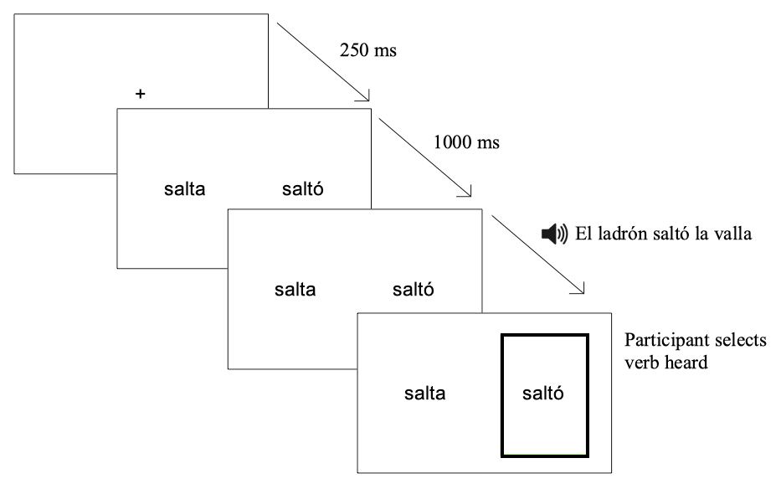
6
Notes:
CAMBIAR POR GIF
65 English bilinguals completed a sociolinguistic background questionnaire, a language use survey, a proficiency test and an eye-tracking task. Their results were compared to those of a control group of 30 Spanish speakers.
In the eye-tracking task…
The data were analyzed with a Growth Curve Analysis, which is a modelling technique that allows to see the relationship between different variables over time.

Slide 7
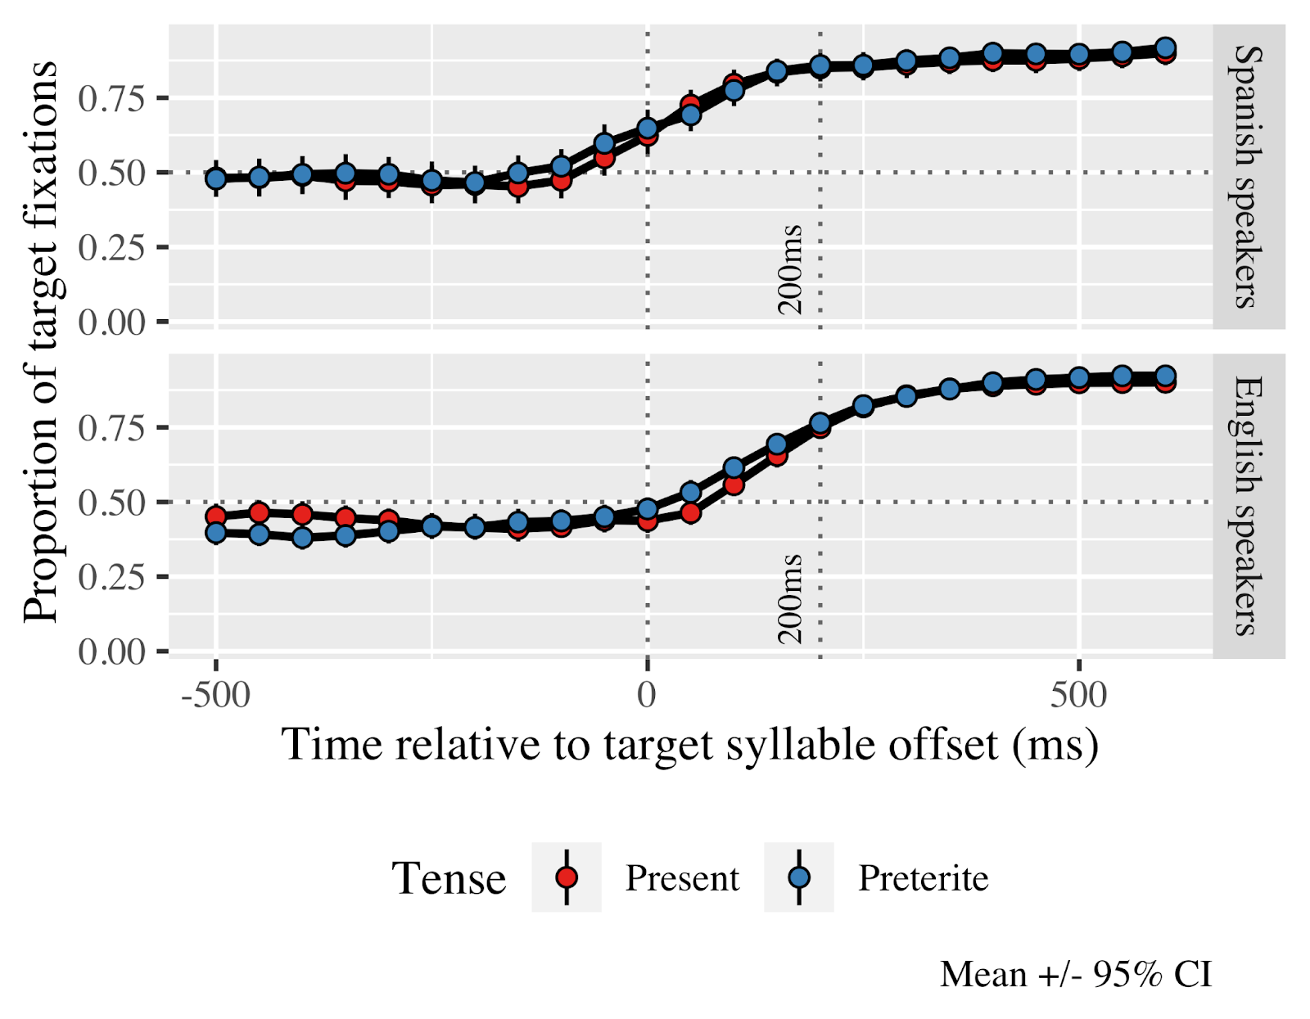
Results Timecourse
sal.ta
Salta
Saltó
7
Notes:
In this first graph, we can see the pattern of fixations before exploring relationships.
On the horizontal axis…

Slide 8
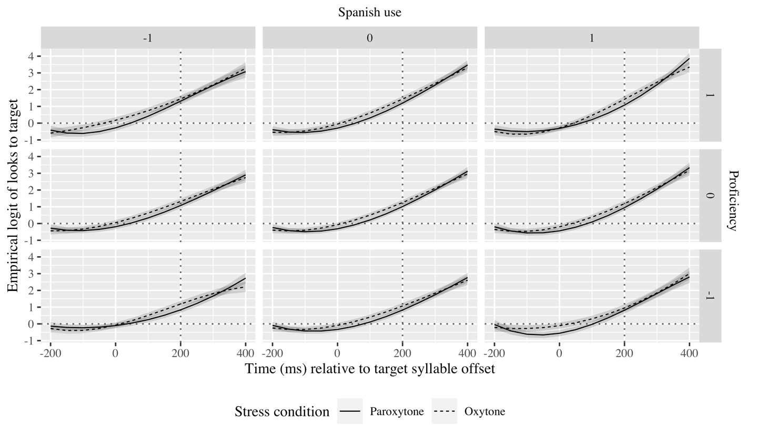
Results GCA English speakers
salta
saltó
8
Notes:
Results show that both groups generated predictions, although L2 learners did so later and generated less target-like predictions than monolinguals. The learners generated more target-like and faster predictions with higher than lower proficiency and predicted later with higher than lower L2 use, could be because they were considering more options they had got familiar with through more extensive daily life contact with the language. Finally, L2 proficiency and L2 use correlated moderately.
___________
Results show that both groups generated predictions, although L2 learners did so later and generated less target-like predictions than monolinguals. The learners predicted [earlier with oxytones than paroxytones,] generated more target-like and faster predictions with higher than lower proficiency and predicted later with higher than lower L2 use. Also, with extensive L2 use, higher proficiency learners predicted oxytones later but more and faster than lower proficiency learners. Finally, L2 proficiency and L2 use correlated moderately.

Slide 9
L1 transfer
Similarly sounding words cross-activated, but cross-activation decreases as proficiency increases (Berghoff et al., 2021)
Spanish-speakers more accurate at identifying stress patterns in L2 English than Korean-speakers (Lee et al., 2019)
In L2 nonce tone-number suffix associations, Swedes generate predictions, but Germans do not (Gosselke Berthelsen et al., 2020, 2021)
Do Spanish monolinguals, and intermediate and advanced Mandarin and English learners of Spanish with different levels of L2 use employ lexical stress to anticipate verbal suffixes in Spanish?
9
Notes:
After exploring the effects of L2 experience and determining L2 proficiency and L2 use effects are distinct, I wanted to see whether this difference would hold for different L2 populations and how they may interact with the first language or L1 background of the learners.
Previous research on L1 transfer…

Slide 10
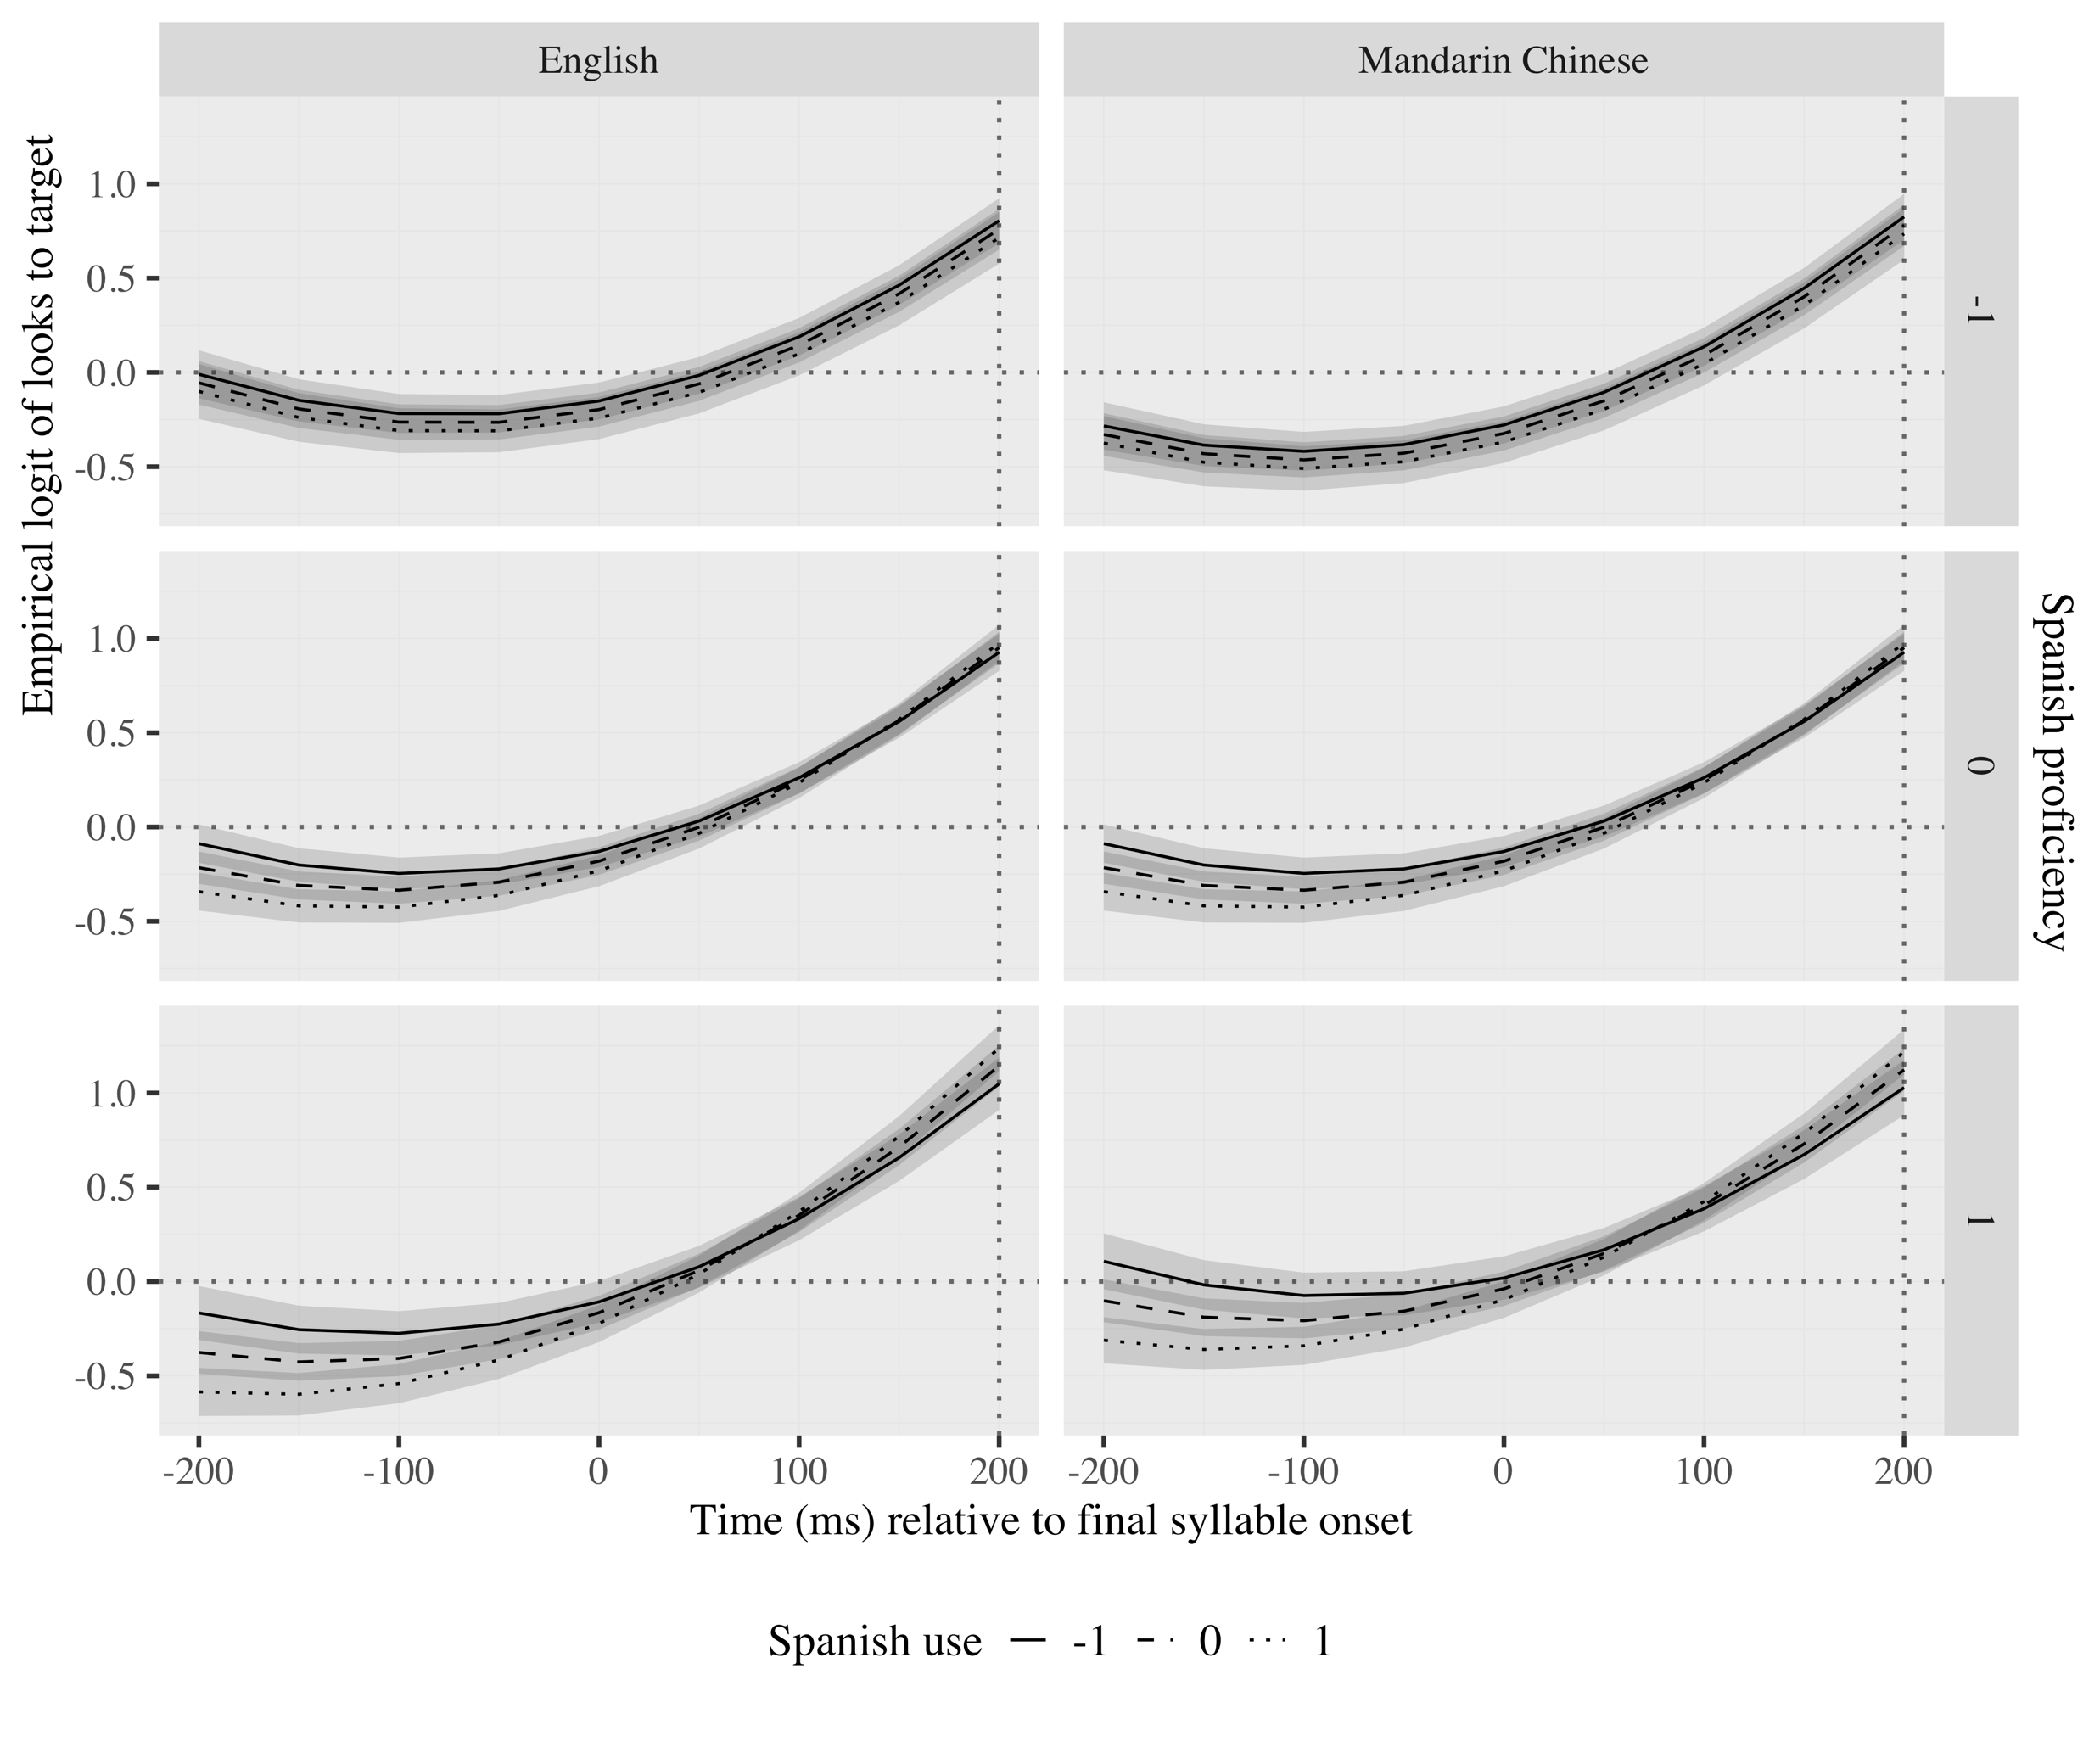
Results
10
Notes:
I collected data for an additional group of Mandarin Chinese native speakers and compared them to the English and the Spanish speakers.
All populations generated predictions. Stress patterns, L2 proficiency and L2 use were the primary mediators of prediction in L2 speakers. These factors interacted with each other as well as with L1 transfer. Proficiency interacted with L1, such that particularly Chinese speakers predicted more target-like and earlier as proficiency increased. L2 use interacted with L1, such that especially the English speakers predicted faster with more L2 use.
_______________
All populations generated predictions. Stress pattern, L2 proficiency and L2 use were the primary mediators of prediction in L2 speakers. [Oxytones were predicted earlier and more target-like than paroxytones, higher proficiency resulted in more target-like and earlier predictions, and more extensive L2 use contributed to faster predictions.] These factors interacted with each other as well as with L1 transfer. Proficiency interacted with [stress, such that proficiency resulted in more target-like predictions of oxytone, and with] L1, such that its positive effects were particularly relevant in Chinese speakers–more target-like and earlier. L2 use interacted [with stress, such that speed of prediction increased especially with L2 use especially in paroxytones, and] with L1, such that especially the English speakers benefited from more L2 use–faster. L2 proficiency and L2 use also interacted; at a high level of proficiency, prediction became faster as use was more frequent. L2 proficiency and L2 use were positively and moderately correlated.

Slide 11
Discussion of language experience studies
L2 proficiency and L2 use have distinct effects
Usage-based models (Bates & MacWhinney, 1982; Ellis, 2006)
Consequences in the brain models (Del Maschio et al., 2020)
L1 interacts with L2 experience
Cross-linguistic transfer models (Bates & MacWhinney, 1982; Schwartz & Sprouse, 1994)
Lexical models of spoken word recognition (Hopp, 2015; Patterson et al., 2017; Kaan, 2014)
Utility of prediction (Kaan & Grüter, 2021; Kuperberg & Jaeger, 2016 )
11
Notes:
The first two studies in my dissertation…

Slide 12
Prediction in cognition
Domain-specific models of learning (Ericsson & Charness, 1994; Gobet, 2015)
Domain-general models of learning (Anderson, 1990; Thorndike & Woodworth, 1901)
Predictions generated in other domains too:
Sports (e.g., Bishop et al., 2013; Wimshurst et al., 2016)
Driving (e.g., Morando et al., 2016; Yamani et al., 2018)
Music (e.g., Huron, 2016)
12
Notes:
With the third study we switch gears a little.
A lot of prediction research in language has examined prediction in language, however, recent neurocognitive research, for instance, indicates that predictive mechanisms may be shared across cognition. I therefore wanted to explore how language prediction relates to prediction in other non-language skills.
Domain-specific no transfer because skills too specific
Domain general transfer across domains is possible if the domains share common features (Thorndike & Woodworth, 1901) and cognitive elements (Anderson, 1990).
Most previous research on e.g., chess or playing videogames suggest no transfer bc skills too specific. However, prediction is a more general mechanism that is used in more than one cognitive domain/skill.

Slide 13
Prediction in cognition
Vision/space ~ Language:
Deixis as a cue to prediction in adults (Reuter et al., 2021)
Visuospatial expectations updated faster in children the larger their vocabulary (Reuter et al., 2018)
Is linguistic prediction of word morphology based on lexical stress associated with visuospatial prediction in Spanish monolinguals?
13
Notes:
To avoid possible confounding effects of modality, I decided to investigate prediction in spoken word recognition and (aural modality) and in visuospatial prediction (visual modality).
Previous research between these two fields has revealed that language and visuospatial processing may be associated in several ways…
______
Reading abilities (Helland & Morken, 2016; Estes & Barsalou, 2018)
Space organization and expressions to talk about it (Crawford et al., 2000)

Slide 14

14
Notes:
A group of 30 monolingual speakers of Spanish completed the same eye-tracking task as before to measure their ability in language prediction and a time/movement anticipation task to measure their ability to make trajectory predictions based on speed and distance information…

Slide 15
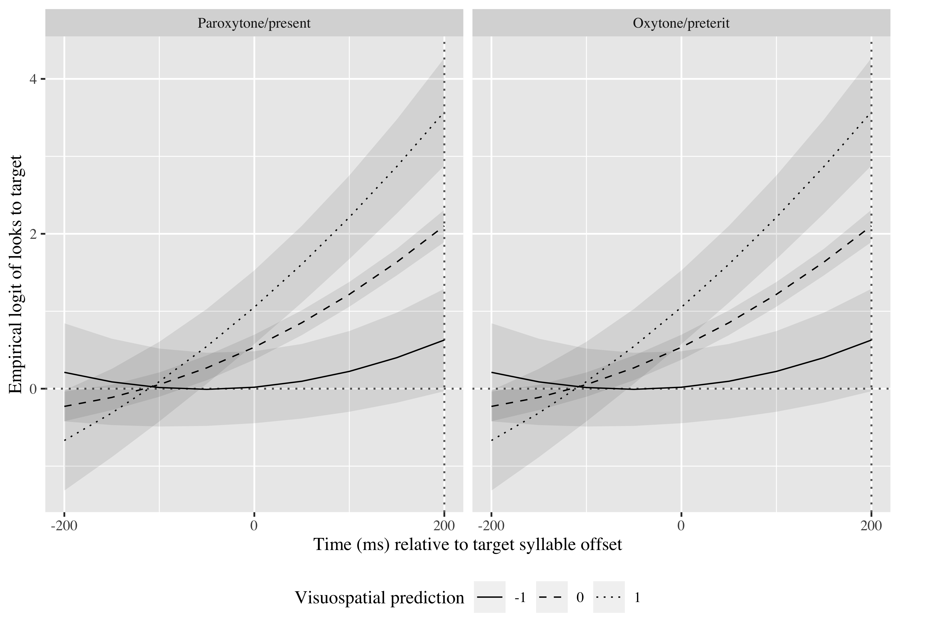
Results
Salta
Saltó
Salta
15
Notes:
The data revealed that verbal and visuospatial prediction were associated, such that a shorter deviation time in visuospatial prediction was associated with faster spoken word prediction.

Slide 16
Discussion
Domain-general models of learning (for more general mechanisms)
Neural reuse theories (Asano et al., 2021)
Neuroemergentist approach (Hernández et al., 2019)
16
Notes:
domain-general models for prediction, However, the finding does not completely support domain-general accounts arguing that the information shared needs to be both perceptual and conceptual (Singley & Anderson, 1989).

Slide 17
Future research
Association between language and non-language prediction in bilinguals
Association between language and music prediction
17

Slide 18
Pedagogical implications
Importance of teaching L2 prosody
Expanding real life situations in which L2 learners use the L2

Slide 19
Conclusion
Distinct language experiences shape language processing and prediction differently
Need to heed language use more closely
Prediction abilities may share common mechanisms across cognition
18

Slide 20
Thank you.
Notes:
Acknowledgments

