Slide 1


Slide 2
The ”staff”
Laura Haro, CEO
Noora Pohjalainen, Restaurant Manager
Mariel Malinen, Chef
Noora Salonen, Waitress

Slide 3
Idea for web pages
Web pages for an Indian reastaurant
Own experiences
Colorful culture
Tasty food
Easy to get good and visual pictures

Slide 4
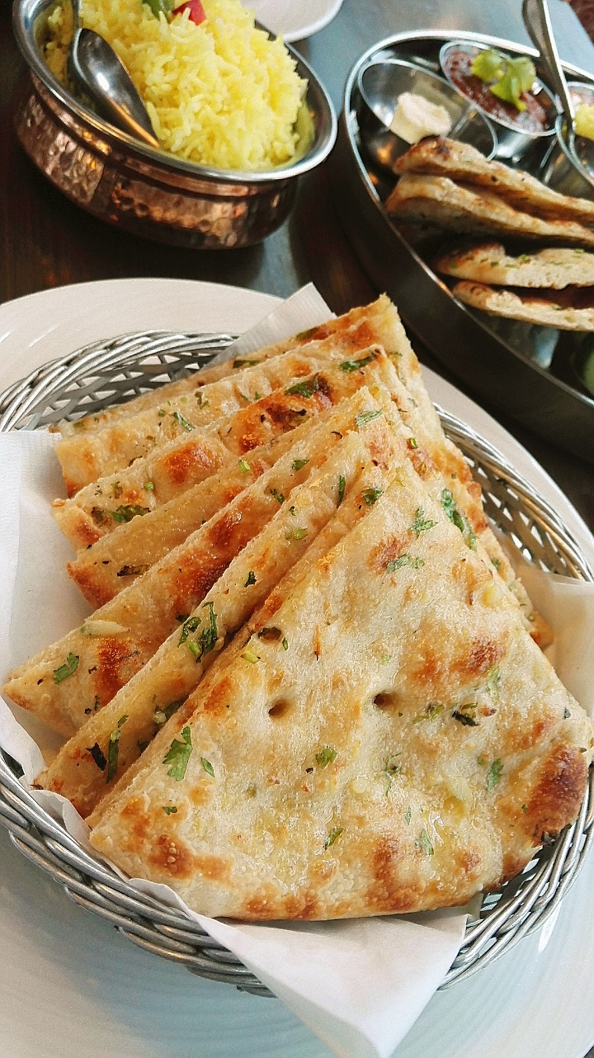
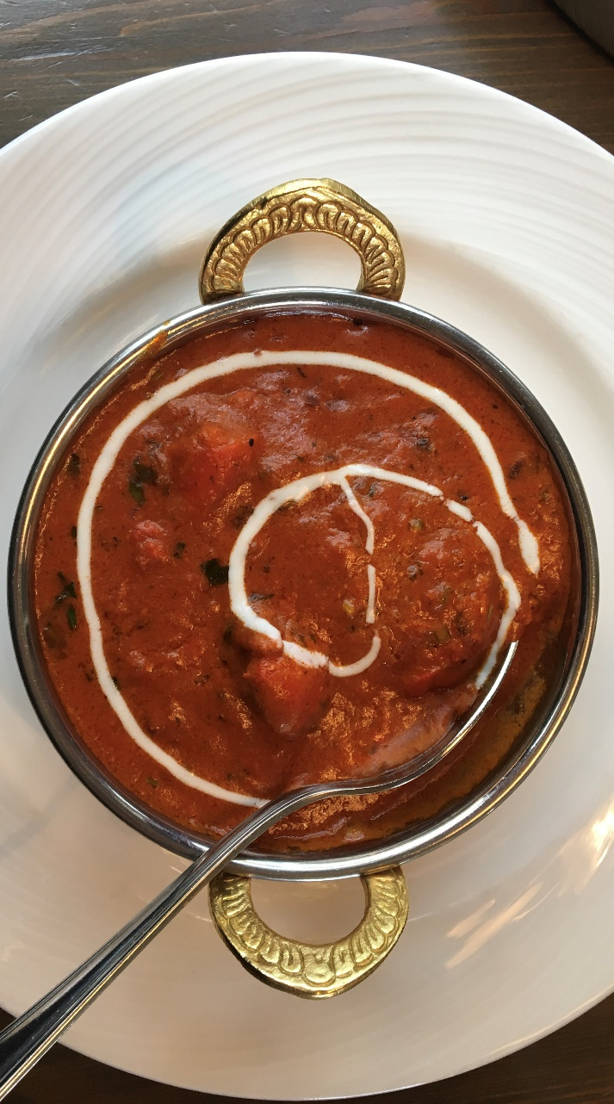
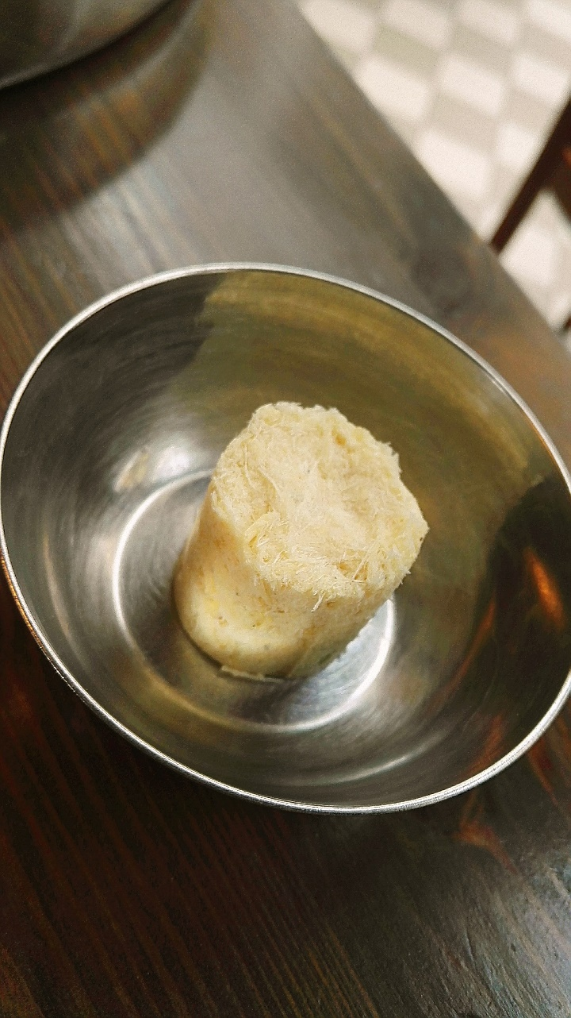
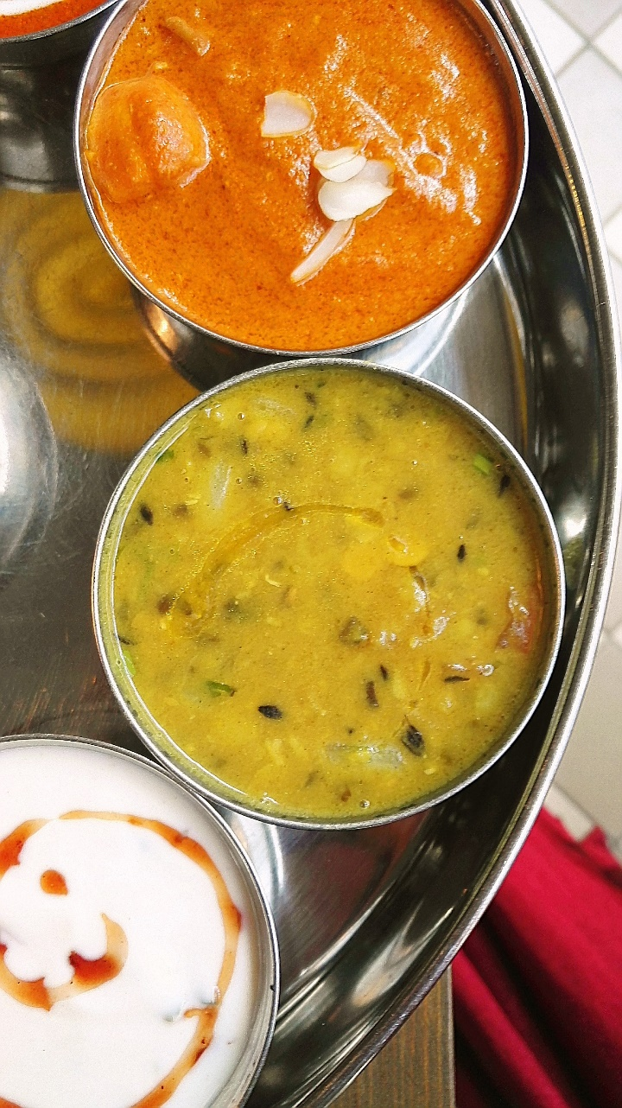
Dinner with the group
Pictures…

Slide 5
Idea for web pages
Web pages for an Indian reastaurant
Own experiences
Colorful culture
Tasty food
Easy to get good and visual pictures

