Slide 1

Playing it Smart: Marketing Insights and Recommendations
Laura Heffner, Junior Data Analyst
October 2024

Slide 2

Problem:
How should Bellabeat market their smart fitness products to female customers to improve sales among their smart devices and compete against larger fitness companies?
Solution:
Create a marketing campaign based on the unique versatility of Bellabeat’s Leaf.

Slide 3
Business Task:
Analyze data about how people are using their non-Bellabeat smart fitness devices
Identify the trends and insights from that data
Create recommendations for a marketing strategy

Slide 4
The Data:
Fitbit Fitness Tracker Data (CCO confirmed public dataset from Mobius)
3/12/2016-5/12/2016—short collection
30 Fitbit users –small sample, no demographic data provided
Data includes calories, intensities, steps, heartrate, and sleep by the day, hour, or minute
Data is cited and fairly reliable
Data is not original (3rd party source), current, or comprehensive

Slide 5
Key Findings:
Strong positive correlations between calories burned, intensity level, and number of steps.
The average number of calories burned per day increases as the level of intensity increases.
The total number of calories burned per intensity level was highest during sedentary activity.

Slide 6
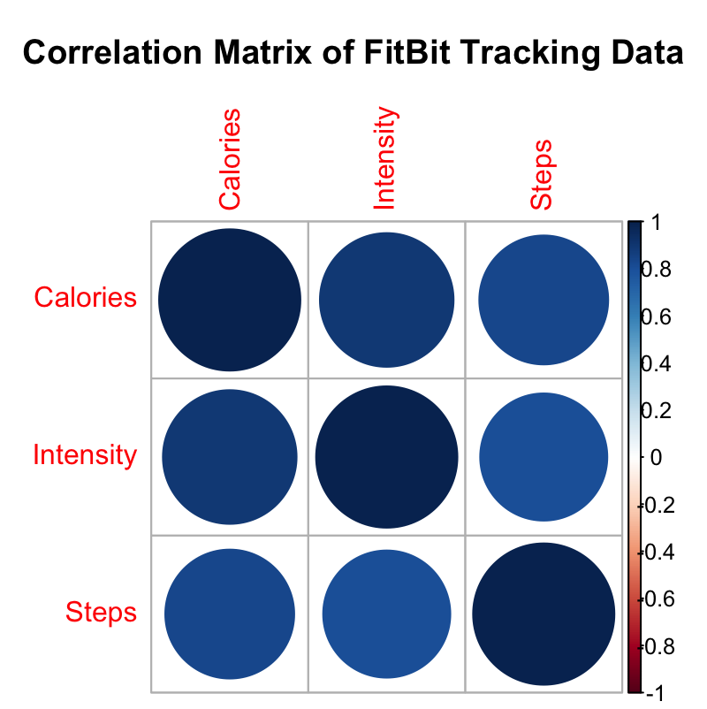
Data Source: Mobius. 2016 May. Fitbit Fitness Tracker Data. V2.
Strong Positive Correlations exist between Calories, Intensity, and Steps.
All variables increase as any one increases.
Great source of positive reinforcement for fitness tracker wearers.

Slide 7
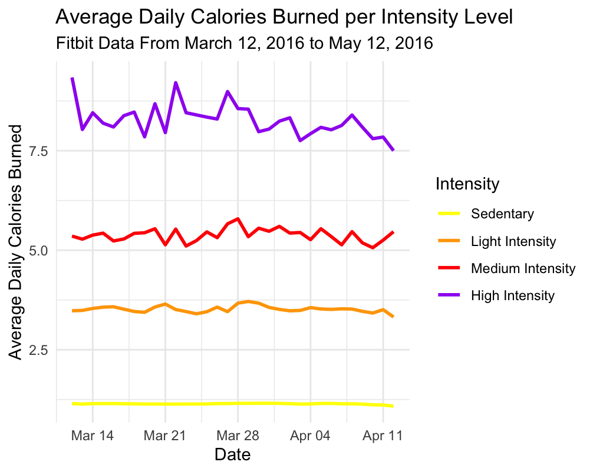
Data Source: Mobius. 2016 May. Fitbit Fitness Tracker Data. V2.
Average Daily Calories Burned increases as Intensity Level also increases.
High Intensity Activity burns the most calories.
Average calories burned per day varies more at higher intensity levels.
Exercise is important to track.
BUT… This isn’t the only important time to track health…

Slide 8
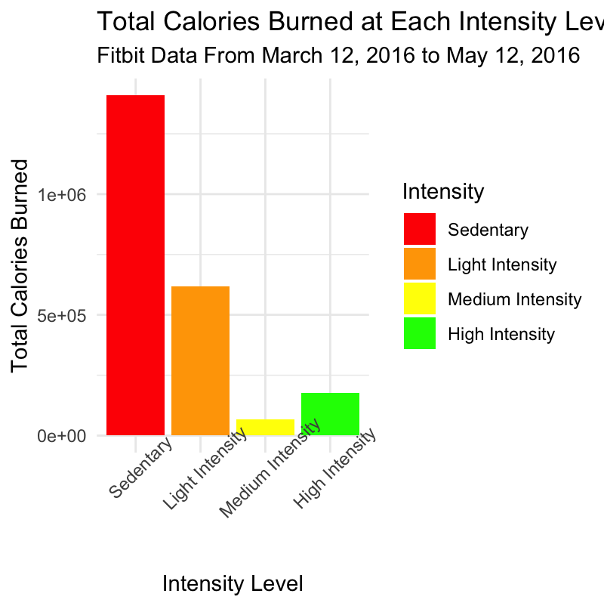
Total Calories Burned at Each Intensity Level Fitbit Data From March 12, 2016 to May 12, 2016
When participants were sedentary, the most calories were burned.
Data Source: Mobius. 2016 May. Fitbit Fitness Tracker Data. V2.

Slide 9
Why Do We Care?
Continuous fitness trackers are able to show us all kinds of important health information.
To get a complete picture of someone’s health, users need consistent wear of the product.
The Leaf offers women flexibility and versatility when wearing a fitness tracker.

Slide 10
Recommendation:
Create a marketing campaign that highlights:
The versatility of the Leaf
Importance of tracking health comprehensively
Show women wearing the Leaf jewelry in a variety of settings:
the gym
a wedding
work
a doctor’s appointment
Women need a complete picture of their health, and that only comes from something they can wear anytime, anywhere.
We don’t just track workouts. We track wellness.

Slide 11
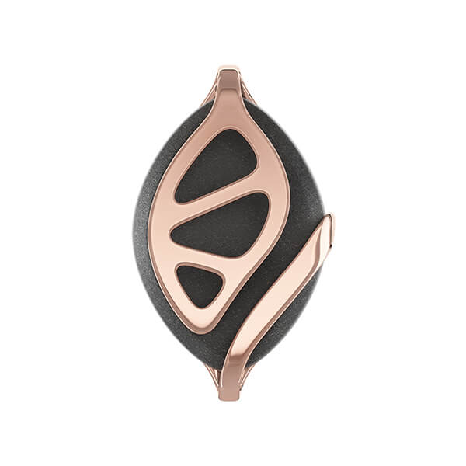
Future Implications
Research specifically about women’s fitness tracker wearing habits
Data from a larger sample population that includes demographic data
Data that is collected over a longer time frame

Slide 12
Summary
Calories, Intensity, and Steps all positively correlate
The daily average calorie burn is highest during the highest intensity
Sedentary activity is when the majority of calories are burned
Continuous tracker wear gives comprehensive health information
As jewelry, the Leaf allows women to wear it in all situations making it unique in the industry, and ideal for women who care about their health

Slide 13
Thank you

