Slide 1
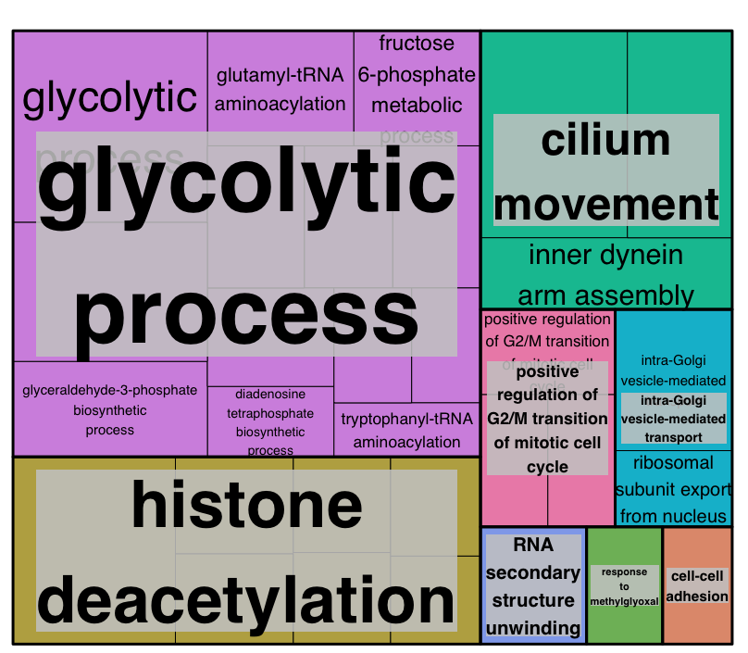
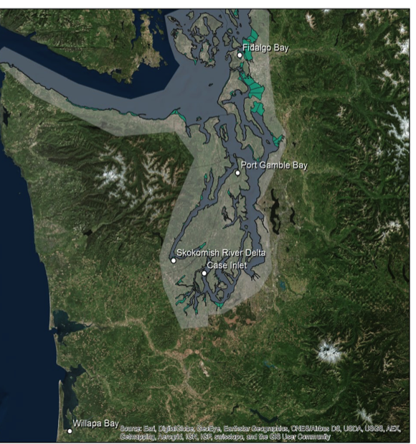
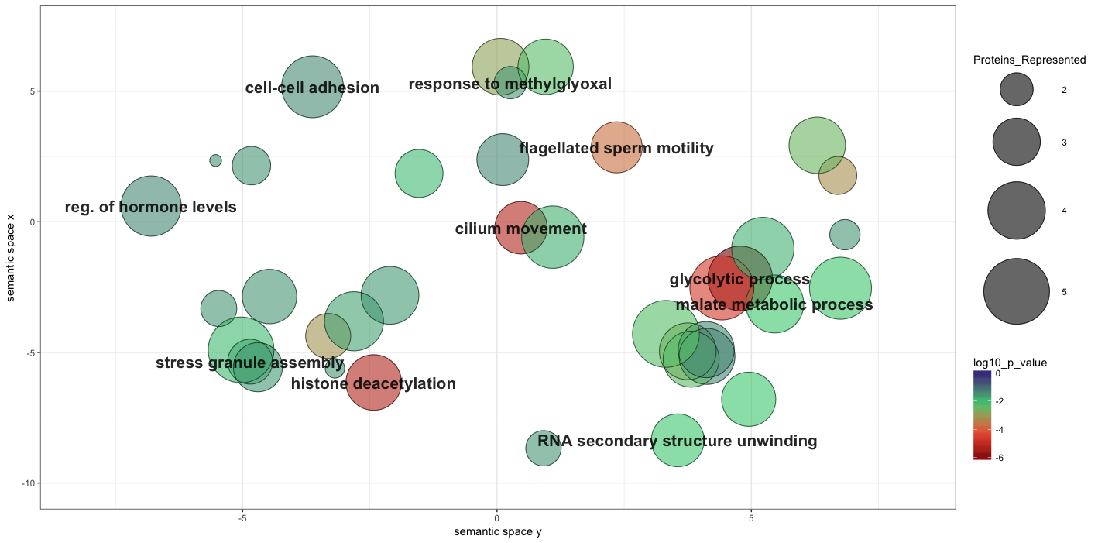
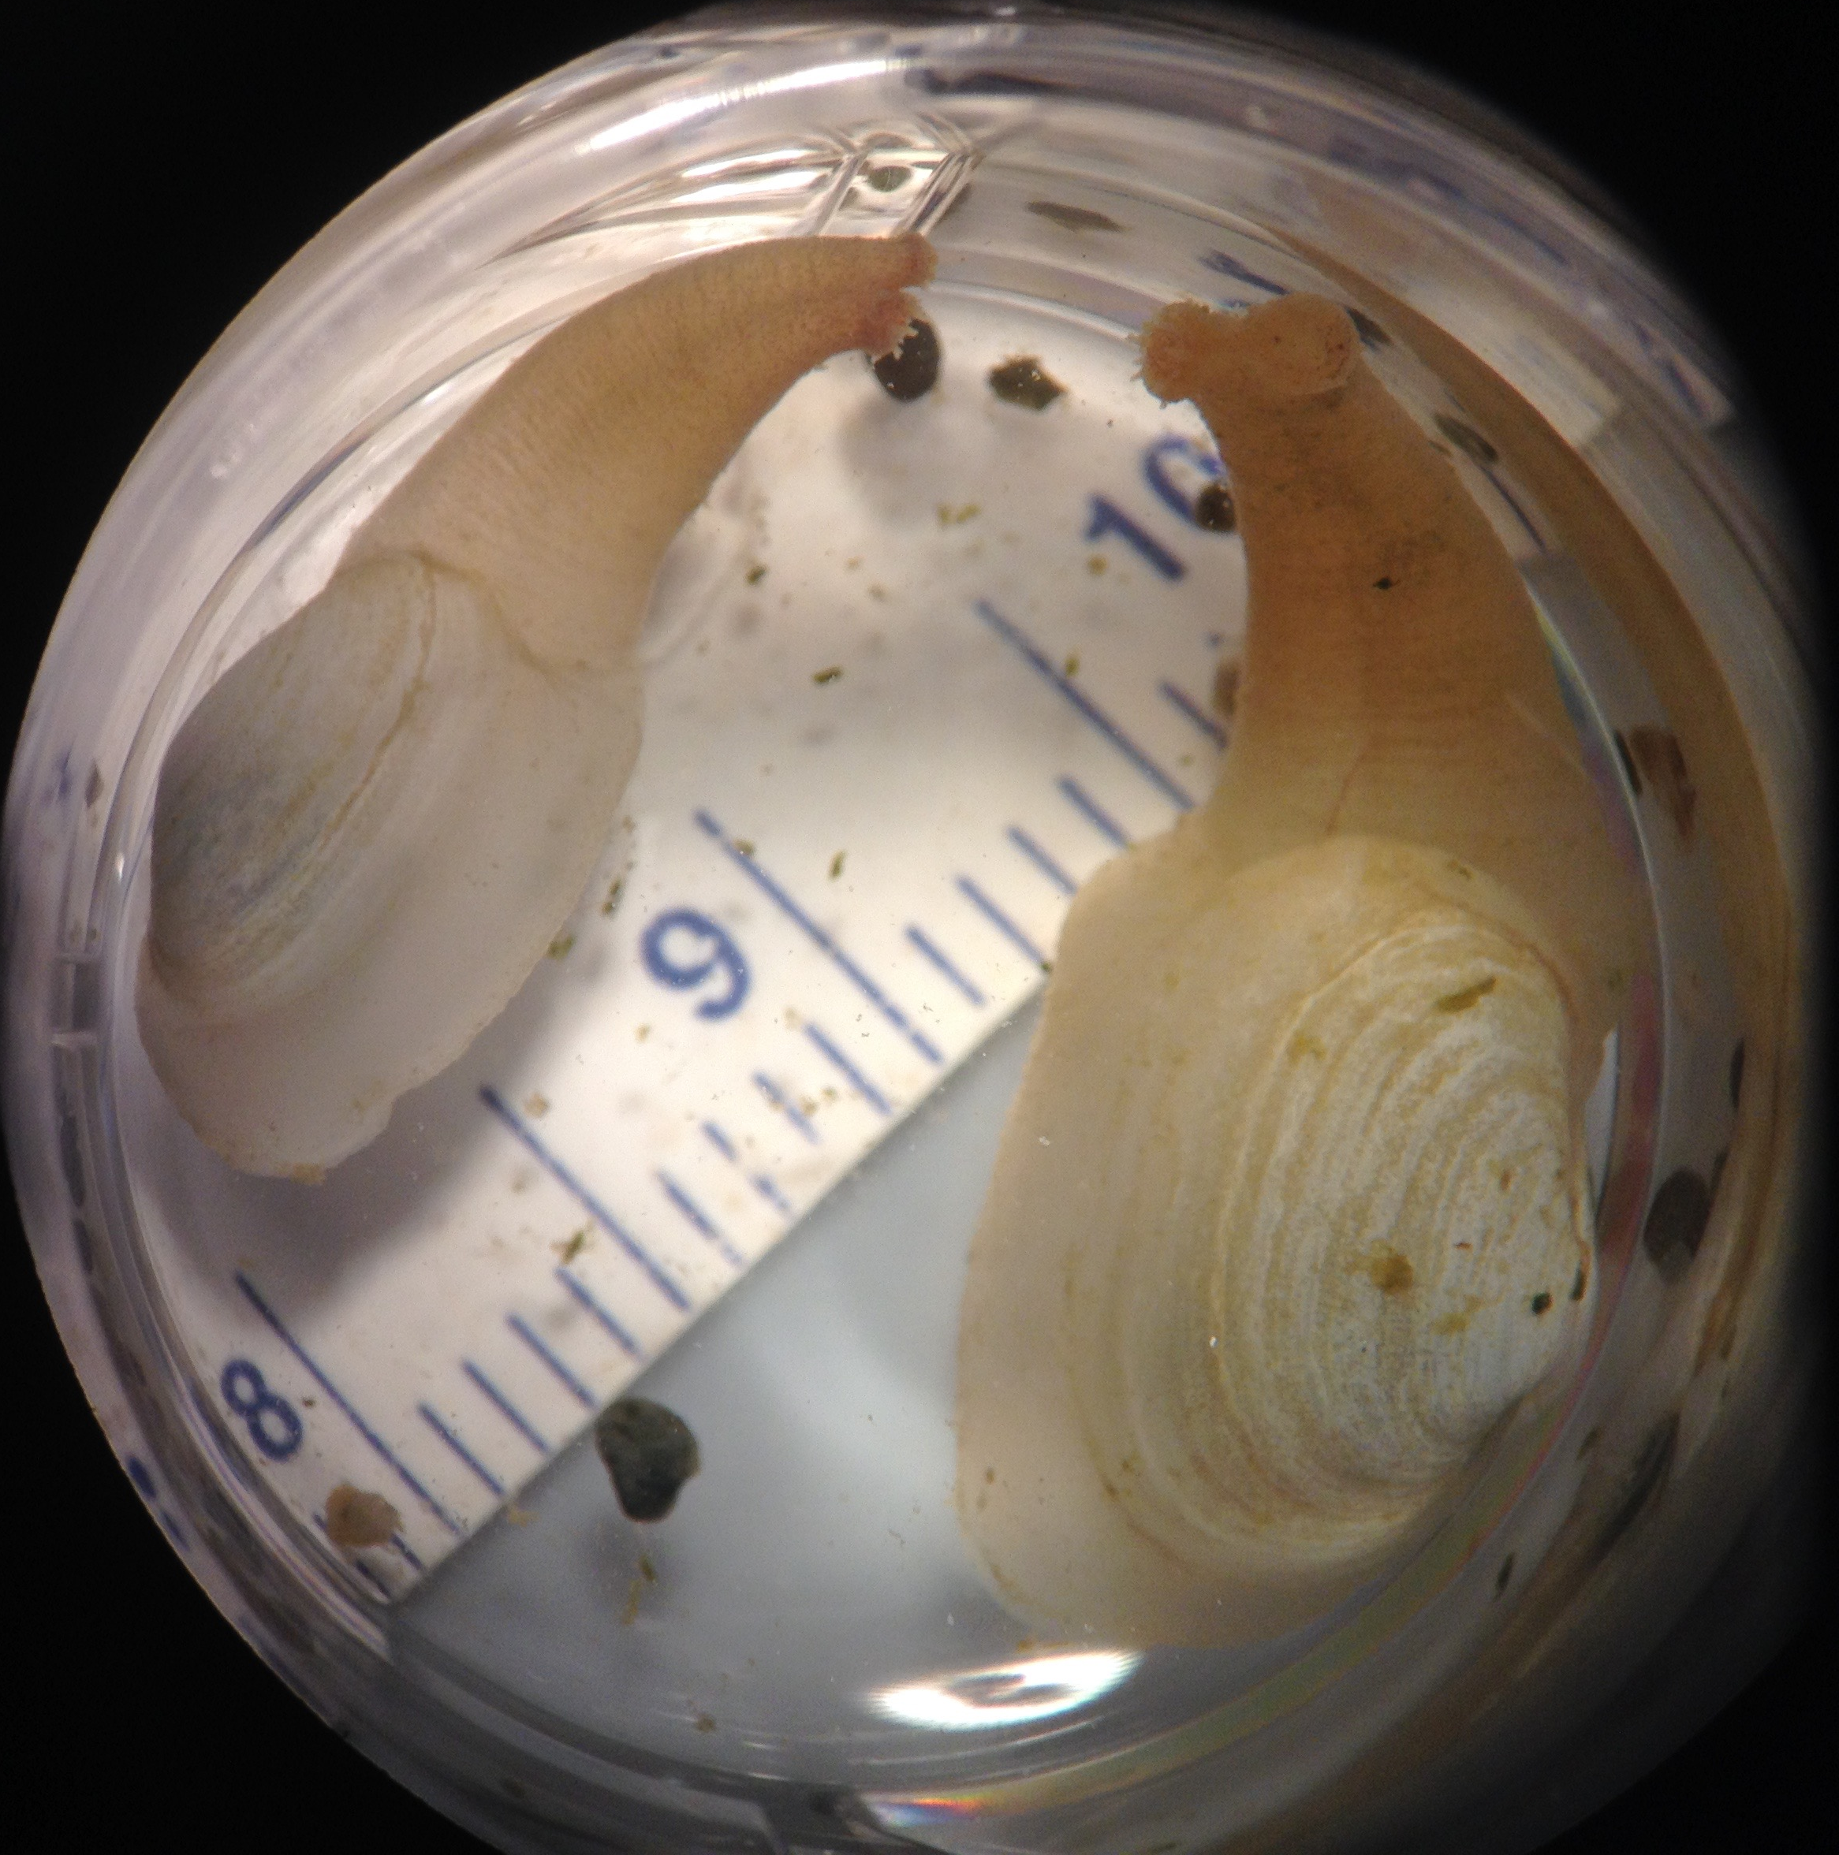
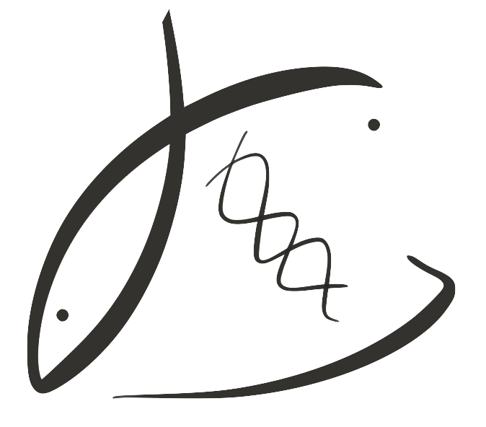


Geoduck as indicators of environmental change
Laura H. Spencer¹, Micah Horwith², Alex Lowe³, Emma Timmins-Schiffman⁴, Brook L Nunn⁴, Sean Bennett¹, Steven Roberts¹
University of Washington ¹School of Aquatic & Fishery Sciences, ³Department of Biology, ⁴Genome Sciences, ²Washington State Department of Natural Resources,
The animal
The questions
The methods
Pacific geoduck (Panopea generosa)
Largest clam native to the Pacific Northwest
Important commercial fishery (wild & farmed)
Sedentary, calcifying, sub-tidal
Likely to be impacted by rising ocean temperature and pCO₂
Can we detect an environmental signature via differences in protein expression?
Does treatment (eelgrass, no eelgrass) or geographical site correlate with expression of stress-related proteins?
What is the overall variability in gill tissue protein expression?
Shotgun proteomics for discovery analysis
Mass Spec Sample Prep
Sonication and cell lyses
Protein quantification
Mini-Trypsin digestion
Desalting and peptide isolation
Add standards
Extract proteins & fragment
The preliminary results
The trials
Shotgun proteomics reveals protein groups
differentially expressed in eelgrass beds
Right: Gene Ontology (GO) Tree
generated using REVIGO showing
differentially expressed biological process
categories.
Below: Scatterplot of GO terms;
clusters represent closely related
categories, size indicates number of proteins
represented, color represents p-value from
protein enrichment analysis via DAVID
5 sites throughout western Washington
2 treatments per site: eelgrass bed, bare sediment
4 replicates per treatment
2 month-long trials in June and August 2016
Continuous water quality measurements: pH, temperature, salinity, depth, chlorophyll
Gill tissue sampled for protein extraction
Data-Independent Tandem Mass Spectrometry
Orbitrap Fusion Lumos machine
Does not require pre-selected precursor ions
Captures all peptides within designated mass/charge ratio
Identify and quantify peptides
PECAN
Survey peptides against annotated background proteome
Generate summary file for direct use in Skyline
Fidalgo Bay
Identify proteins in samples
Figure 2: Map of western Washington State showing 4 experimental sites in Puget Sound and 1 in the coastal Willapa Bay; each site selected contained suitable shellfish habitat and patches of eelgrass and bare sediment.
Port Gamble Bay
Skokomish River Delta
Quantify relative protein abundance
Skyline
View summary statistics for peptide abundance
Export statistics for processing and visualization
Case Inlet
Willapa Bay
Contact
Thank you.
Laura H Spencer
School of Aquatic and Fishery Sciences, University of Washington
lhs3@uw.edu
laurahspencer.github.io/LabNotebook
This material is based upon work supported by the National Science Foundation Graduate Research Fellowship Program.
Special thanks to the teams at the Roberts Lab, the MacCoss lab of Biological Mass Spectrometry at the University of Washington Department of Genome Sciences, and University of Washington Proteomics Resource.

